Slide 1




InvertNet: Year 2 Progress & Plans
Chris Dietrich, David Raila and Omar Sobh
University of Illinois
iDigBio HUB Summit II , Gainesville FL

Slide 2
InvertNet Rationale
Vast majority of specimens in U.S. collections are invertebrates
  primarily insects and related arthropods
  less than 5% available online
  only label data usually provided
Most invertebrate biodiversity research is specimen-based
  all knowledge of many species is embodied in collections
Existing digitization methods are inadequate
  slow and expensive ($1+ per specimen)
  risk of damage to specimens from handling

Slide 3
InvertNet Goals
Digitize all holdings of 22 midwestern arthropod collections (50 million + specimens)
  Specimen images and metadata (label info)
  Drawers, vials, slides
  Advanced imaging (including 3D)
  Best quality at reasonable cost (~$0.10/specimen)
Provide access to images and other data via online virtual museum
  browsable/searchable/zoomable web interface
  link to other data providers (GBIF, national ADBC HUB, etc.)
Provide platform for research and development of additional tools and resources
  Data mining and analysis
  Community building, collaboration, and support
  Education, outreach, and reference

Slide 4

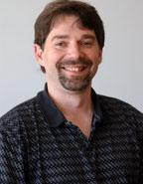
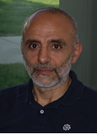
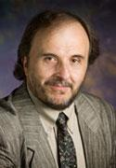
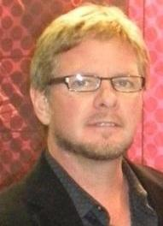
InvertNet UIUC Team
Chris Dietrich – Director
  Systematic Entomologist
John Hart – CoPI
  Computer Science - Graphics
Nahil Sobh – CoPI
  Computational Multiscale Nanosystems
Umberto Ravaioli – CoPI
  Computational Multiscale Nanosystems
David Raila – Senior Collaborator
  Computer Science – Sr. Research Programmer
Others
  Programmers, research assistants, hourlies

Slide 5
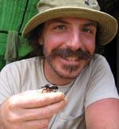
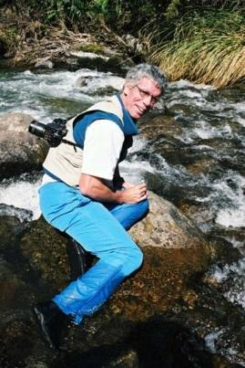
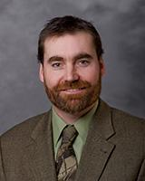
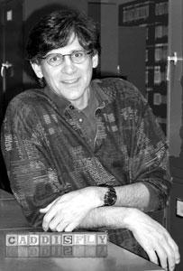

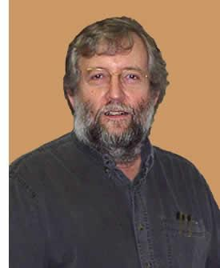
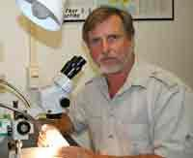
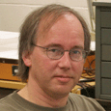
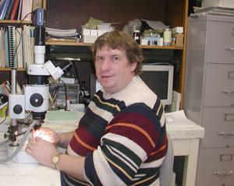
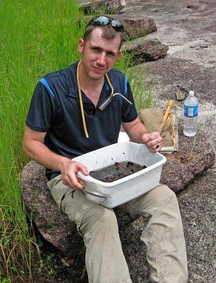
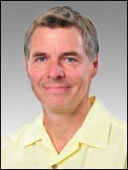
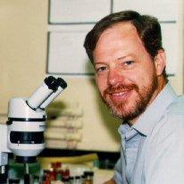

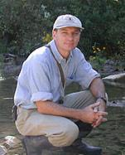
InvertNet Collaborating Curators
Collaborator | Institution
A. Cognato | MSU
G. Courtney, J. VanDyk | ISU
J. Holland | Purdue
R. Holzenthal, P. Tinerella | Minnesota
P. Johnson | SDSU
H. Klompen, M. Daly | OSU
J. Rawlins, R. Davidson, J. Fetzner | Carnegie Museum
D. Rider, G. Fauske | NDSU
A. Short | Kansas
R. Sites | Missouri
D. Young | Wisconsin-Madison
J. Zaspel | Wisconsin-Oshkosh
G. Zolnerowich | KSU

Slide 6
Additional Collections
Eastern Illinois University
Western Illinois University
Southern Illinois University
Illinois State University
Milwaukee Public Museum
Northern Michigan University
U North Dakota
Valley City State University
U Hawaii (added this year)

Slide 7
Year 1 Accomplishments: Digitization Workflows
Implemented digitization workflows for slide-mounted specimensand specimens stored in vials
Tested drawer digitization hardware
Established web portal at UIUC using HUBzero platform
- Community development for collaborators
- Digitization workflow
- Searchable/browsable web interface for images and label data
Staging pinned collections for digitization
- basic housekeeping (drawer and unit tray labels, updating nomenclature, organizing identified material)
- curator exchanges to upgrade curatorial status of focal taxa
Develop training materials for participants
InvertNet Digitization Workshop – Spring 2012

Slide 8
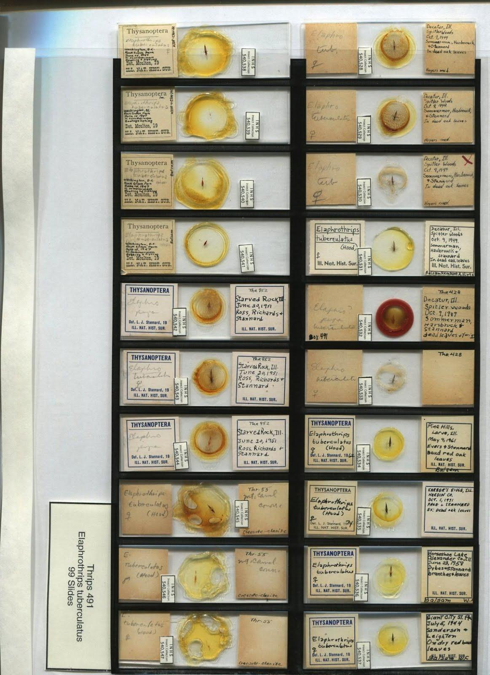
Digitization Workflows: Slides
  Designed new, less expensive template for arranging sets of 20 slides on flatbed scanner
  Published workflow description on InvertNet.org (http://invertnet.org/resources/98)
  Published training video demonstration of entire procedure (https://invertnet.org/resources/1997)

Slide 9
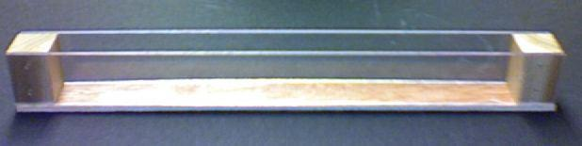
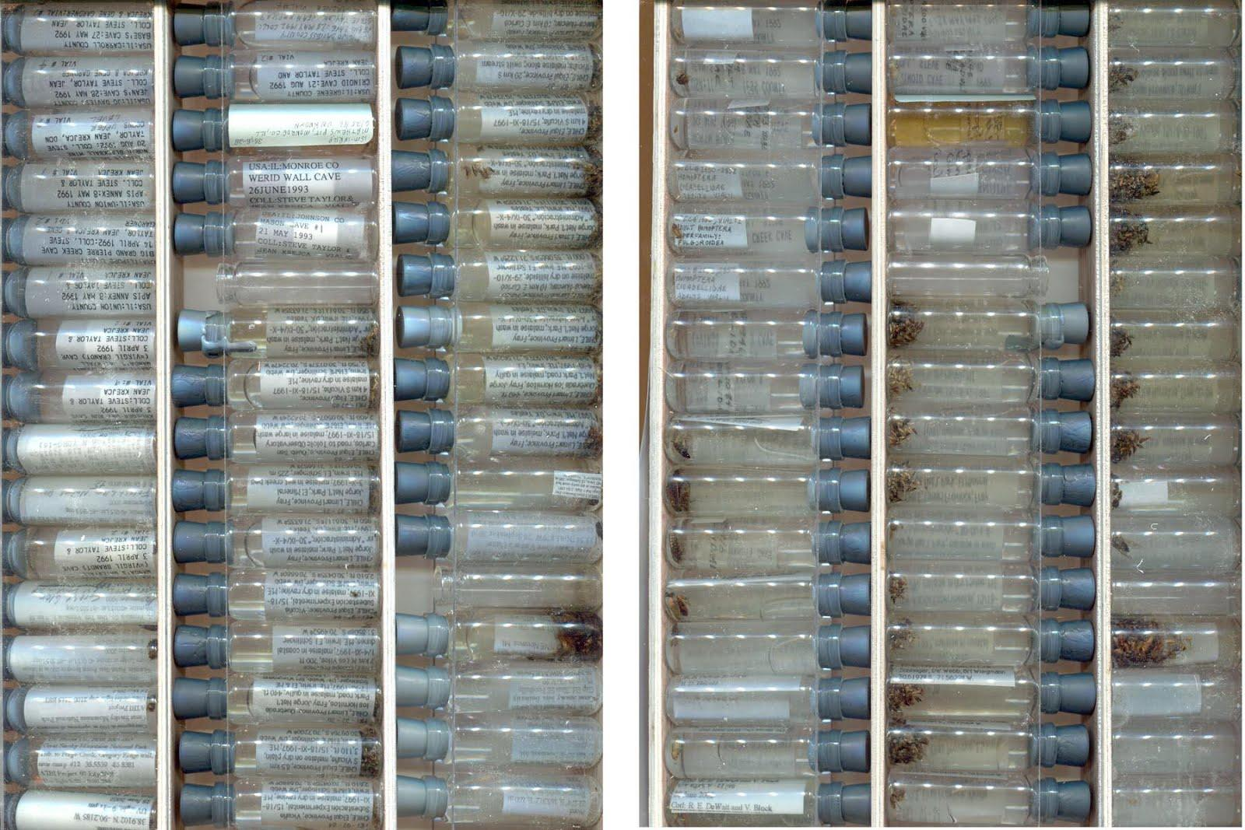
Digitization Workflows: Vials
  Developed new workflow that does not require removing labels from vials and allows multiple vials to be scanned simultaneously
  Published workflow description on InvertNet.org (http://invertnet.org/resources/93)
  Published training video demonstration of entire procedure (https://invertnet.org/resources/1957)

Slide 10
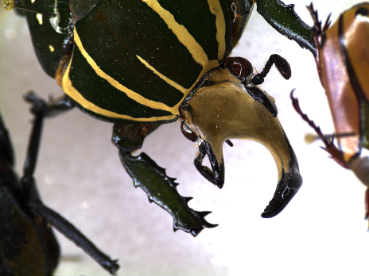
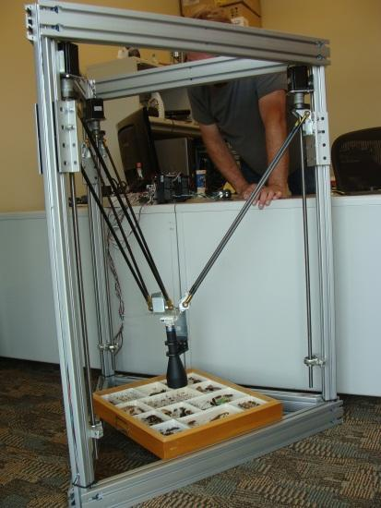
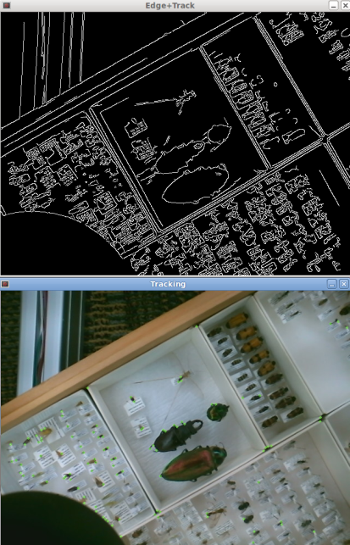
Drawer Digitization
    Custom designed precision robotics system
      Precision machine hardware and machine control software
      High-res industrial camera with low-distortion telecentric lens
      State of the art computer vision system (OpenCV)
        Feature detection+image processing
      Integrated and customized for InvertNet
        Easy to use – automated
Delta robot

Slide 11
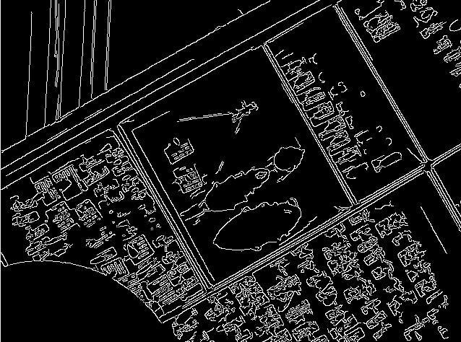
OpenCV – Computer Vision Library
High performance vision library
  Feature/object detection, image processing, image registration/metrics …
  Maintained and growing
InvertNet Uses
  Autofocus
  Stitching
  Auto-calibration - drawers
  Real-time quality
  monitoring/adjustment
  during capture
  Key specimen
  additional processing

Slide 12
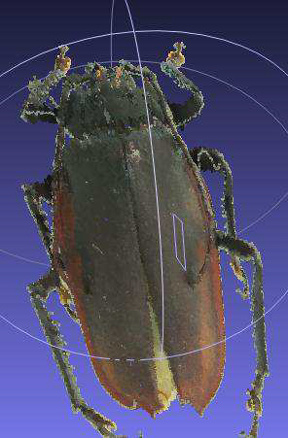
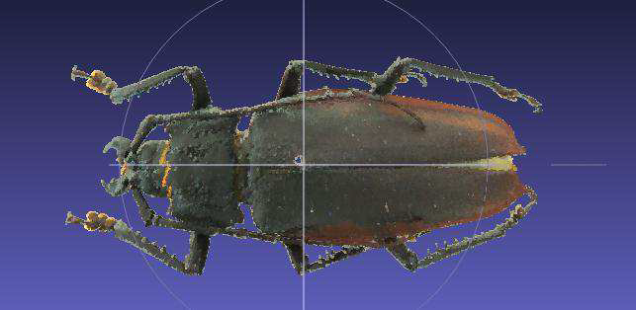
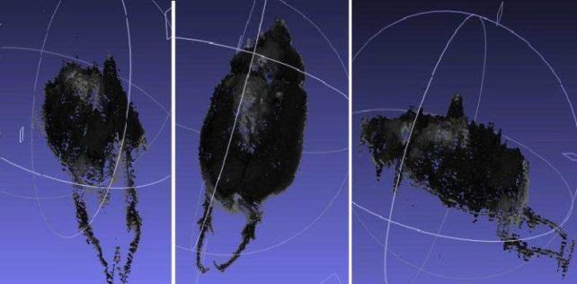
Digitization Workflow Testbed:
3D Reconstruction
Disney research SIGGRAPH 2010
  Computes 3D model from multiple
  images at known positions
    Testing of capture positions needed
  UIUC I2PC reference algorithm in place
    Working on parallelization for performance, optimization for small-scale specimens
  Good initial results

Slide 13
Digitization Workflow:
Advantages
Meets cost target of 10 cents/specimen
Provides rapid access to entire digitized collection
Multiple images from different perspectives stitched together for 2D and 3D reconstruction and zoom capability
2D images of multiple units acquired simultaneously then segmented into individual database containers

Slide 14
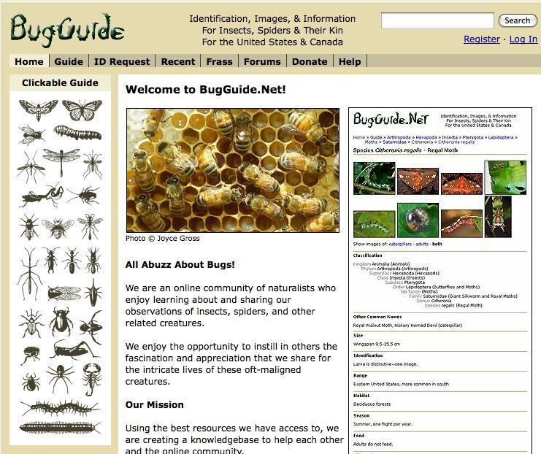
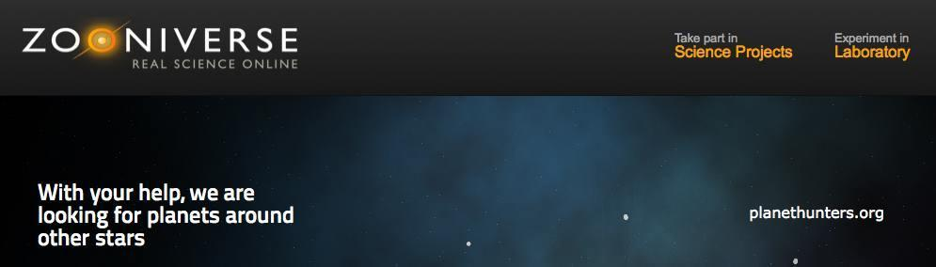
Outreach
  Crowd-sourcing label data capture (Zooniverse)
Link to BugGuide: users compare photos of live bugs to images of identified specimens

Slide 15

InvertNet IT Infrastructure
Year One

Slide 16
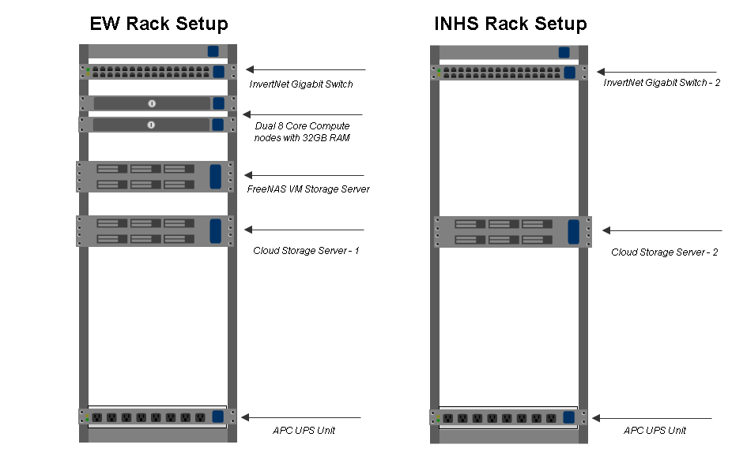
InvertNet Infrastructure
InvertNet Infrastructure Physical Rack Setup
Notes:
The slide feature a physical look at how the rack is setup for the initial stages of building InvertNet

Slide 17
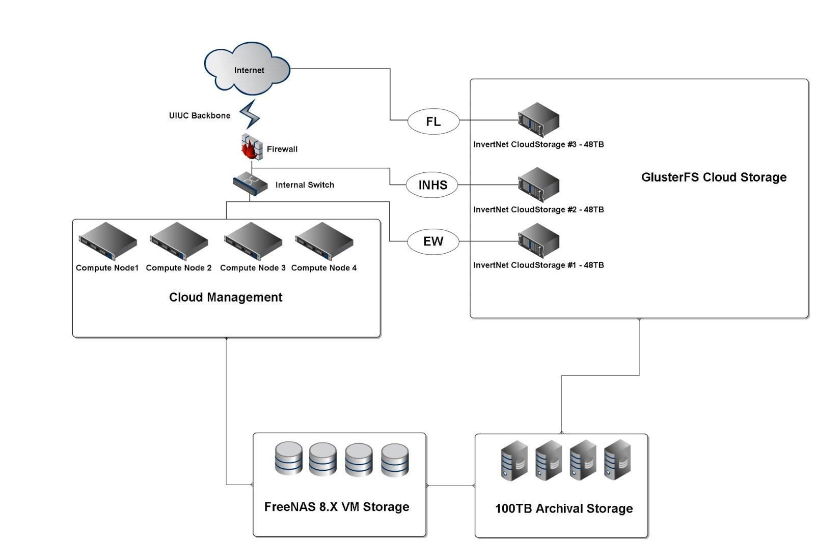
Notes:
This is a quick overview to the topology of the system that we have in place, showing the cloud storage and backup system

Slide 18
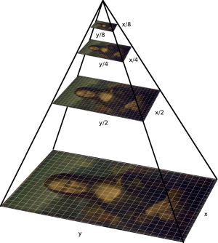
Added Features in Year One
Ingest Pages for Slides and Vials:
Drag and Drop Chunked Uploading
Tagging, Profiling, Batch Submission
InvertNet Taxonomic Tree and Site Search:
CoL Taxonomic Base
Search terms autocompletion
Search by site as well as the Digital Image Repository
Zoomable Viewer:
Tiled Pyramidal TIFF format
This is a standard TIFF extension and is supported by most image processing applications including Photoshop, GIMP, VIPS and ImageMagick. The libtiff codec library is also perfectly capable of reading and writing such images.
Notes:
There are the features that we have implemented in year one

Slide 19


Upcoming Features
InvertNet 2.0 -
Infrastructure Upgrade of base system to Hubzero1.1
Geo-located Storage for added redundancy - IdigBio
Storage Burst CDN (Amazon API, GigenetCloud)
Website:
Ingest Pages for Drawers
Responsive Design
Segment, Annotation and Specimen Capture Tools
Bug-Guide and Google Images tool for resources
Taxonomic Collaboration:
Method to have a taxonomic base that can be added onto with citing and reasons for addition or change extended by API for authorized others to interact with.

Slide 20
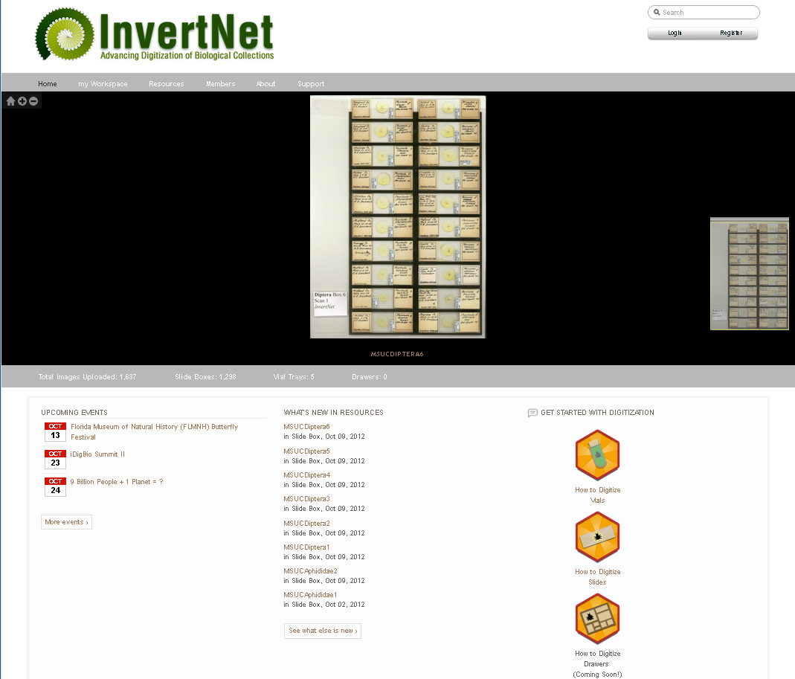
Join Us
Registration is open to all and available now!

Slide 21
Acknowledgements
Collaborators: J. Hart, N. Sobh, U. Ravaioli, C. Taylor, A. Cognato, G. Courtney, J. Holland, R. Holzenthal, P. Tinerella, P. Johnson, H. Klompen, M. Daly, J. Rawlins, R. Davidson, J. Fetzner, D. Rider, G. Fauske, A. Short, R. Sites, D. Young, J. Zaspel, G. Zolnerowich
Funding: NSF ADBC program

