Slide 1
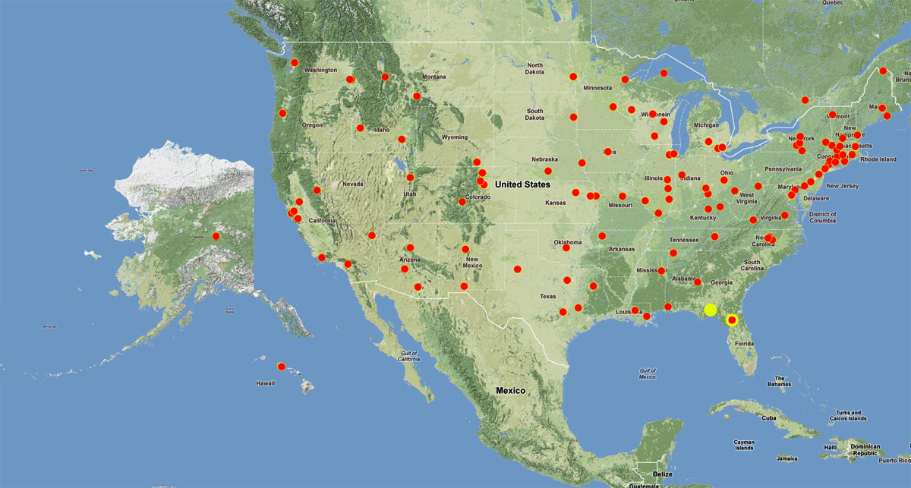
Advancing Digitization of Biodiversity Collections (ADBC NSF Program)
Currently 7 Thematic Collection Networks with 130 participating institutions

Slide 2
Project Goals
Digitize & Georeference one million occurrence records for southwestern ground-dwelling arthropods
2. Produce 16,000 species images (promote identifications)
3. Online interactive database & taxonomic workflows
Broader Impact Goals
Promote Biodiversity-Informatics workforce
Use Data Now: SDM & Biodiversity Modeling (Climate Change)

Slide 3
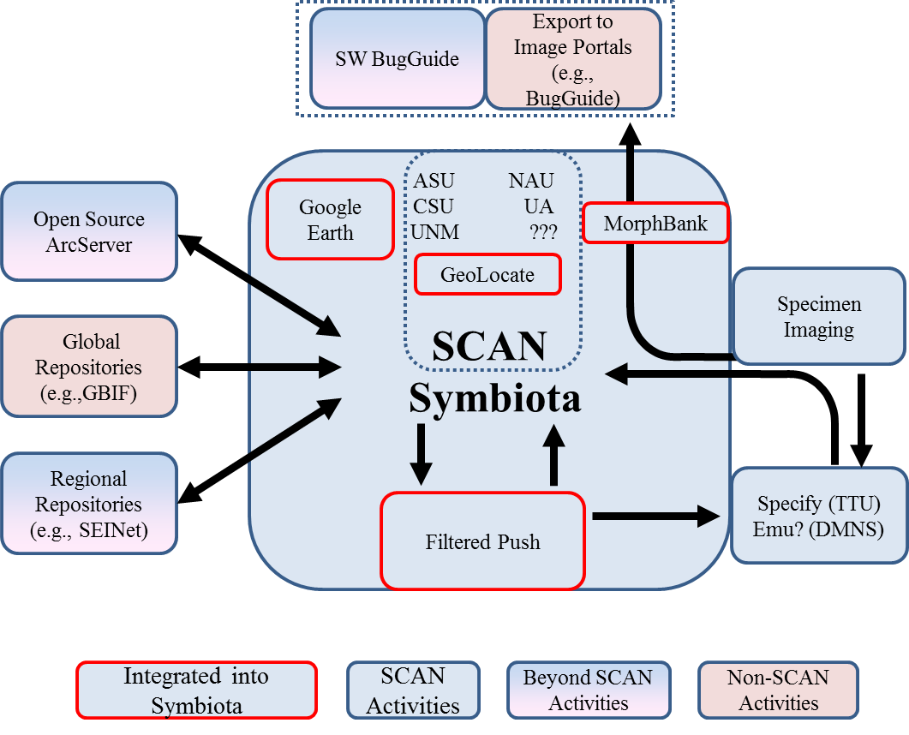
Workflow - Symbiota
Eight SCAN
Museums

Slide 4
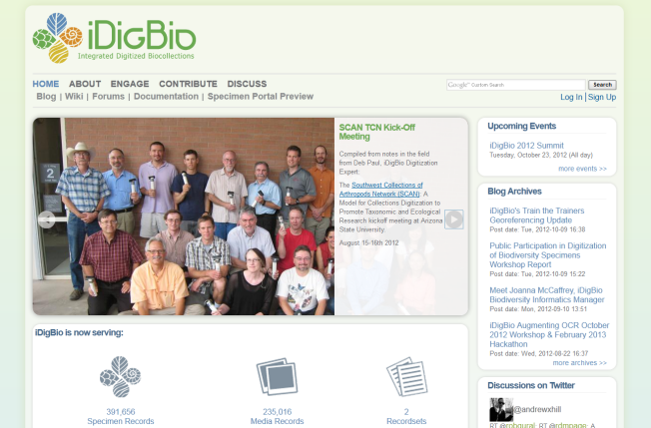
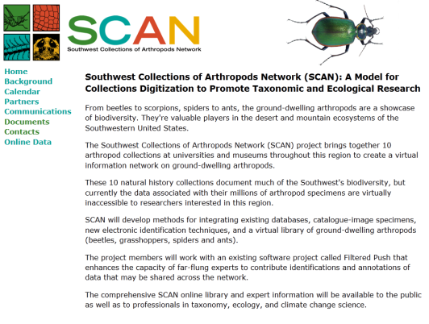
SCAN Interactivity
iDigBio
SCAN Background Website
SCAN Symbiota Data Portal
Hosted at iDigBio
Transitioning to
Drupal Site hosted
by iDigBio
Museum-specific
Catalog Management Tools
Symbiota
Specify
Arctos
Filtered Push
Updates Catalog
Records
Filtered Push and Portal
Power Annotation Updates
Filtered Push
EMu

Slide 5
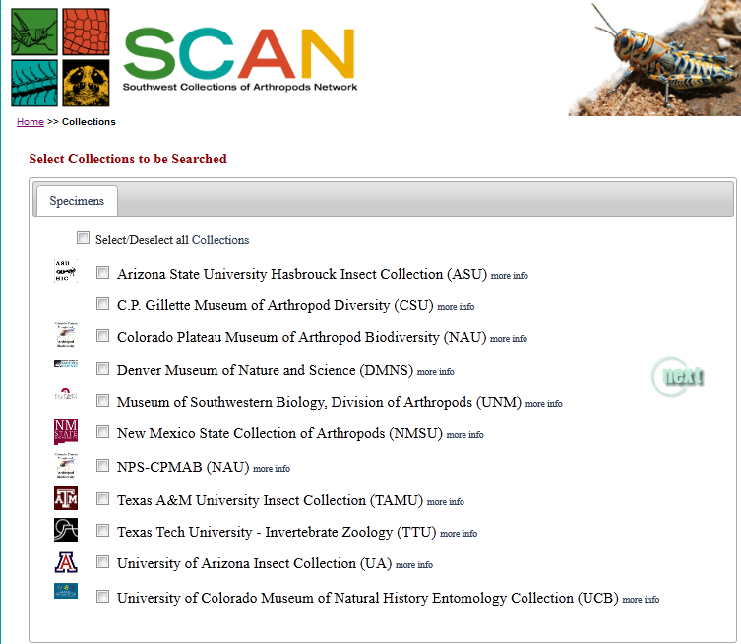
(100,000 Records)

Slide 6
SCAN Interactivity
iDigBio
SCAN Background Website
SCAN Symbiota Data Portal
Hosted at iDigBio
Transitioning to
Drupal Site hosted
by iDigBio
Museum-specific
Catalog Management Tools
Symbiota
Specify
Arctos
Filtered Push
Updates Catalog
Records
Filtered Push and Portal
Power Annotation Updates
Filtered Push
EMu

Slide 7
Workflow - Imaging
Eight Museums
w/ High End
Imaging Systems
Eight SCAN
Museums

Slide 8
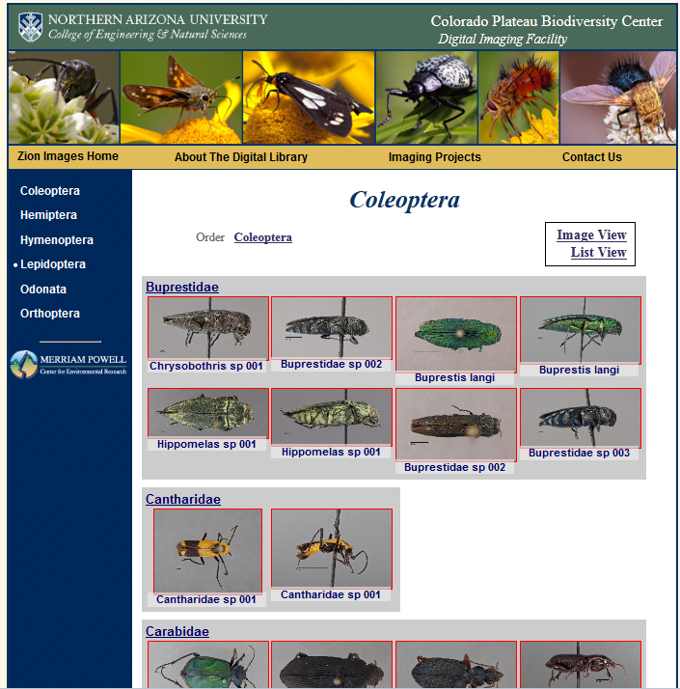
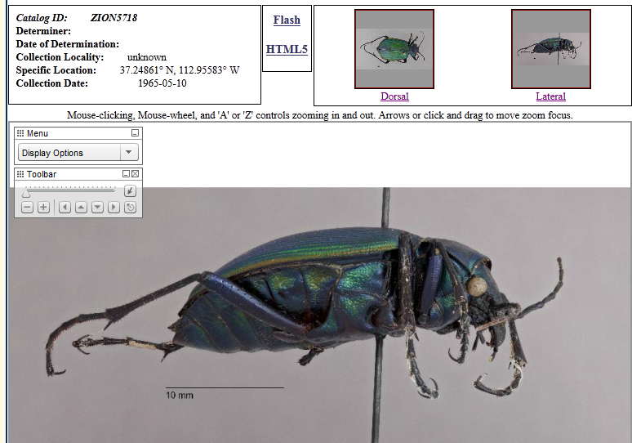
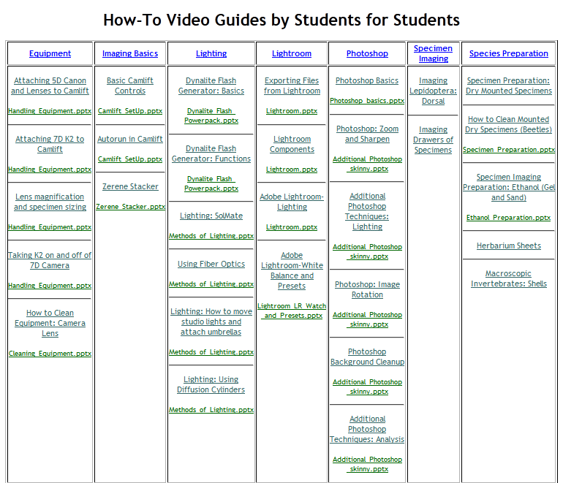
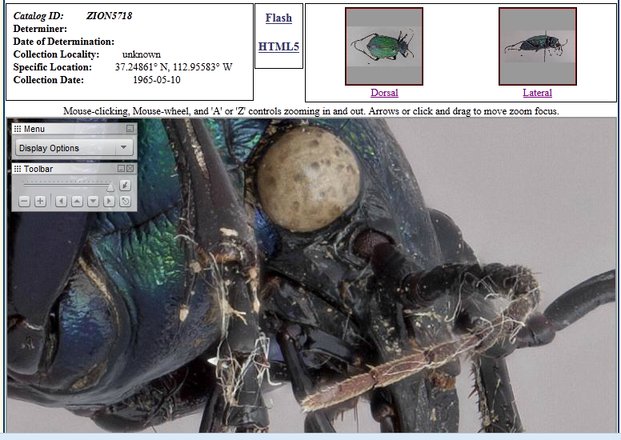
SCAN Imaging
Online image library
Zoomify
3. How-to resources

Slide 9
SCAN Challenges & Opportunities
Develop a virtual workforce
Basic Virtualization (Skype & Adobe Connect)
Host virtual workshops & meetings with wikis, blogs etc….
Create a digitization culture
A. Expand to Non-Scan taxa
B. Other collections (within existing institutions, smaller museums, and private)
3. Increase Identification Capabilities
Faster reliable identifications to genus or species
1. Taxon-specific imaging (most taxa),
DNA barcoding (Carabidae), genitalia (Eleodes)
4. Navigate the Dynamic Road of Technologies
A. Adopting & Cross-walking Available Technologies
B. Planning for the future

