Slide 1

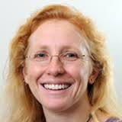
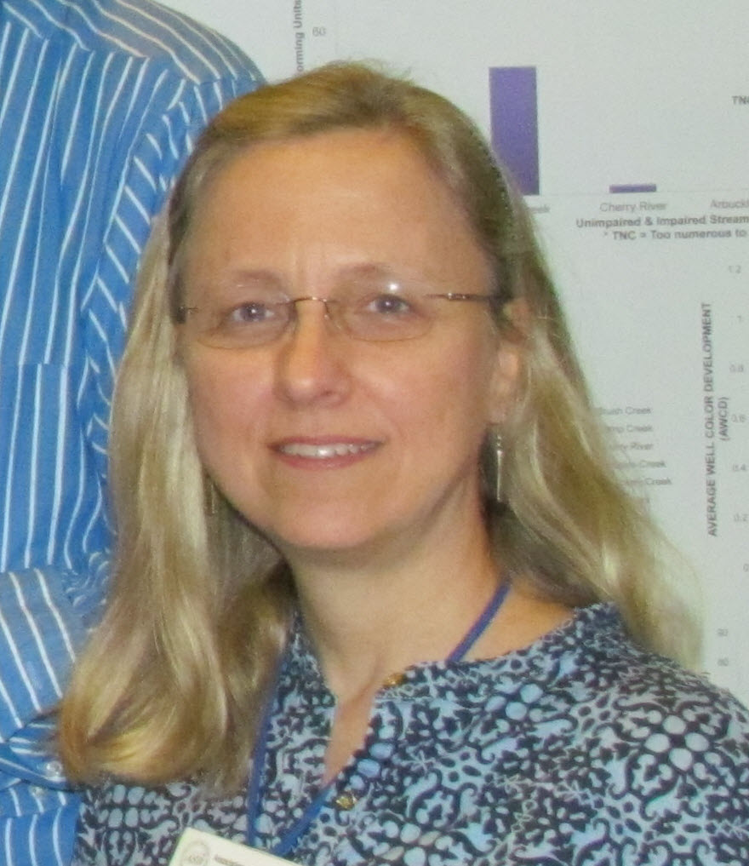

Innovative Uses of Collections Data (by & for collections!)
Shelley James & Deb Paul
Notes:
Typically the focus of digitization and funding is based on the downstream research use – how the availability of data can further science. However, collections themselves need to justify the continued digitization activities – to administrators, to funding agencies, to the broader internal and external community. How can digitization and understanding of biodiversity informatics help the collections themselves?
Along with the standard convenience:
Database queries to locate specimens – for loans, curation etc
Inventory
Research and data cleaning without leaving desk or handling specimen
Reducing costs due to shipping and handling

Slide 2
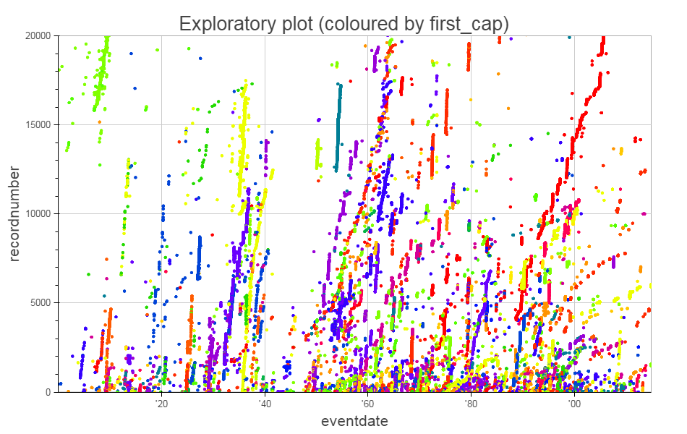
Curation & data cleaning
Duplicate resolution – georeferencing, determinations, missing data, outlier detection
Clustering of data
Patterns
Nicky Nicholson (Kew), TDWG2016

Slide 3
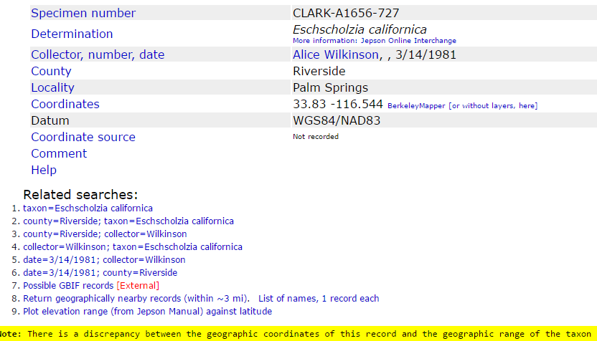
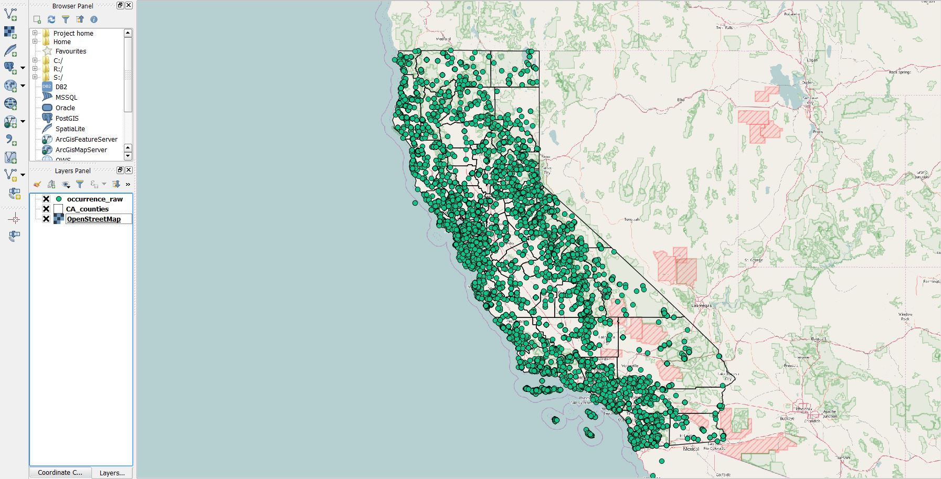
Spatial & temporal analysis
Flagging cultivated specimens
Potential georeferencing errors
Spatial analysis to flag outliers
Potential new records
E.g. CCH portal, NSW Flora Online

Slide 4
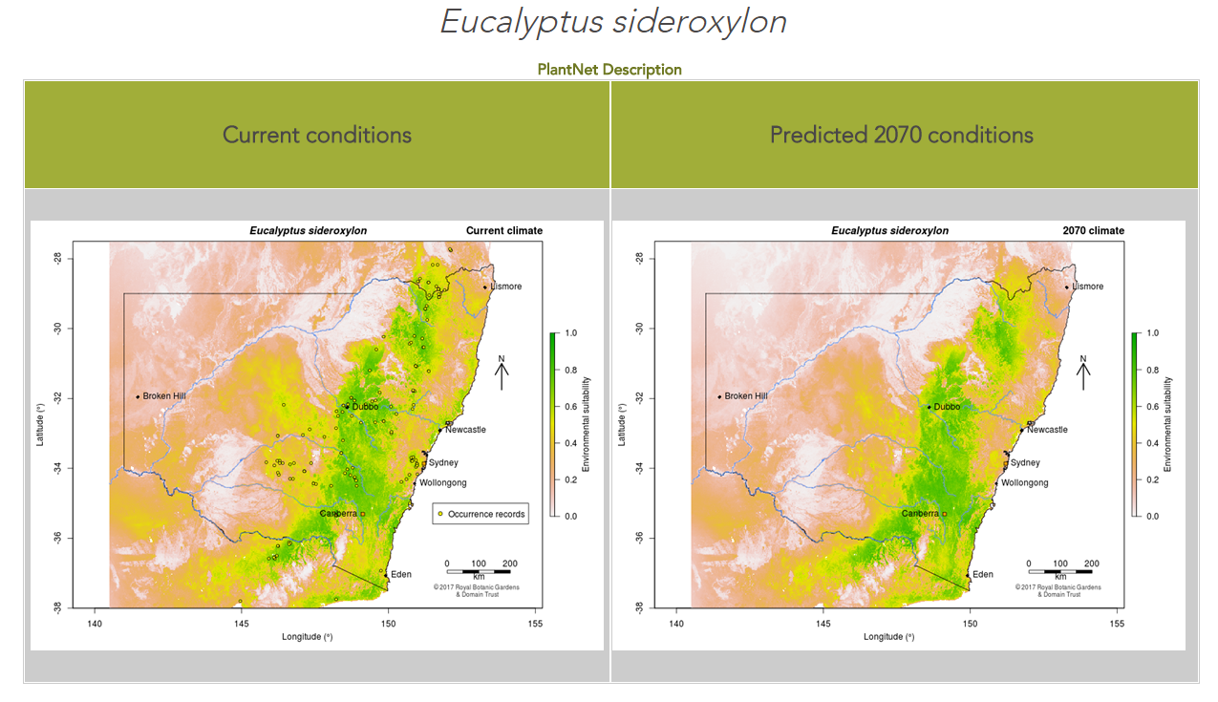
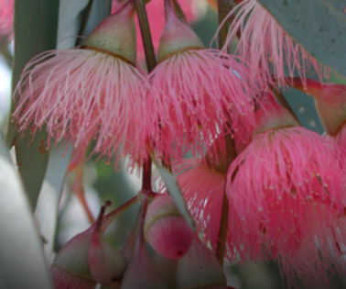
Expeditions and collecting
Gap analysis in collections
Taxon, spatial
Matching data from different collections for “ecosystem” analysis
Restore & Renew
Notes:
Also my PNG work
Restore and Renew- collection to molecular & evolutionary genetic to future restoration

Slide 5
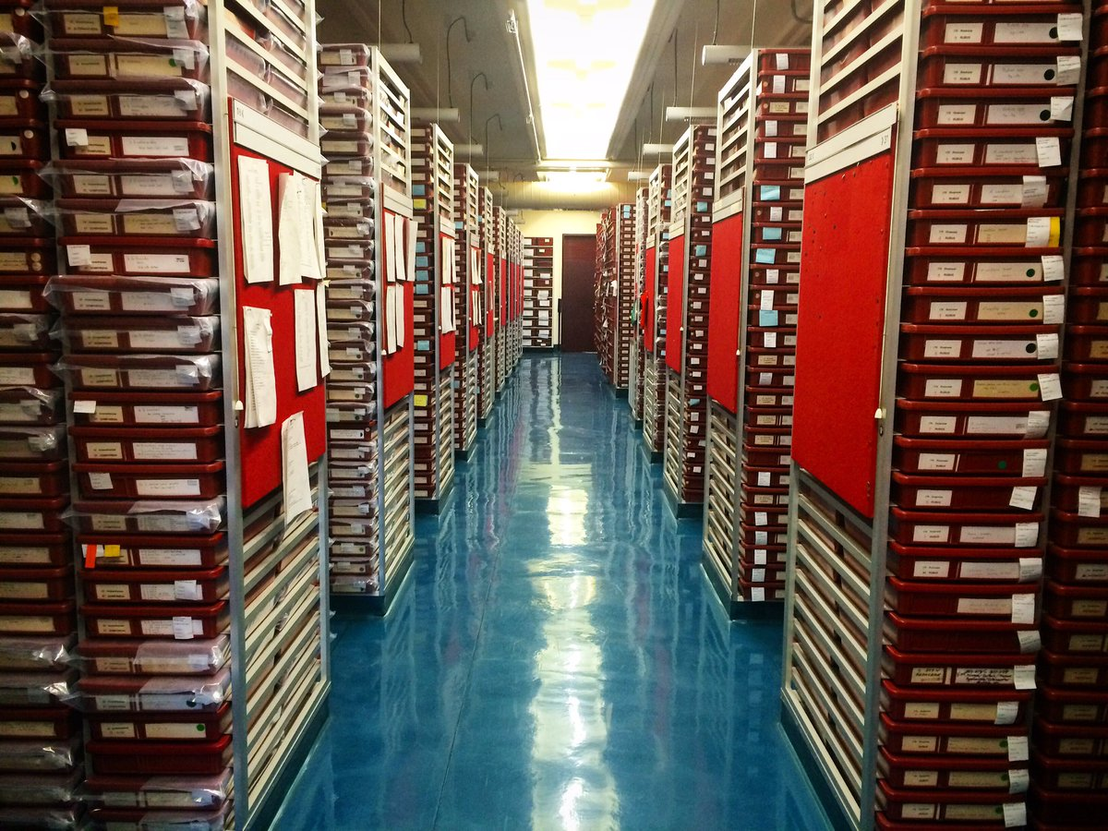
Cataloguing and estimating
Utilizing databased portions of the collections to help validate collection size estimates – asset valuation

Slide 6
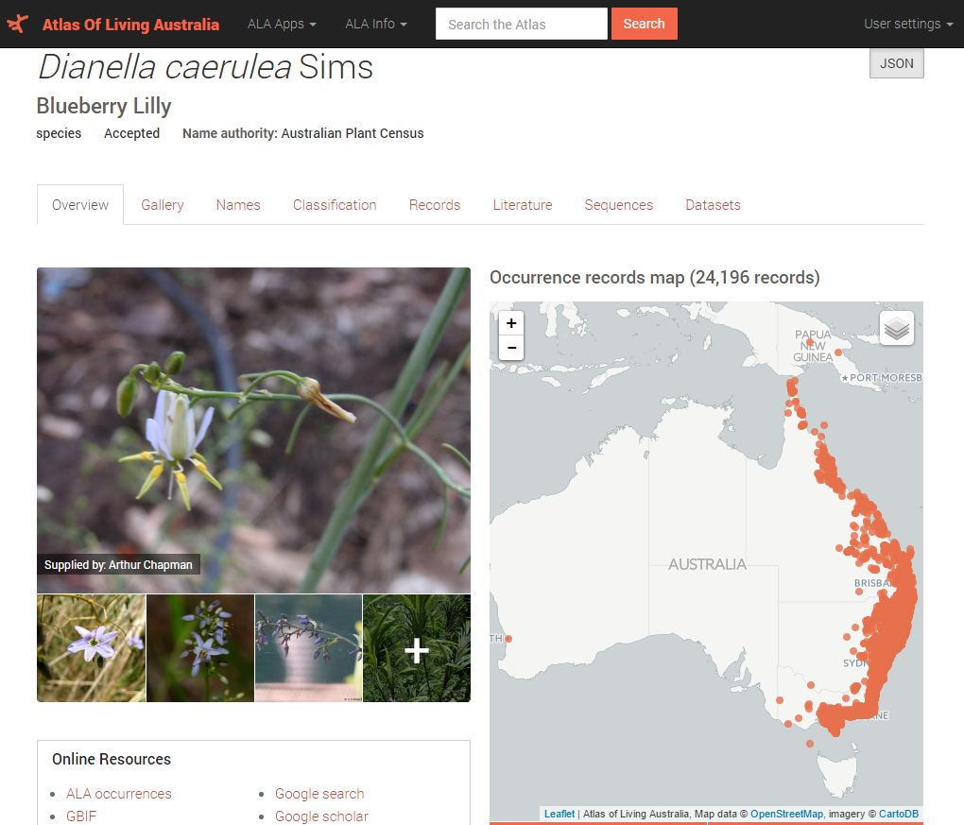
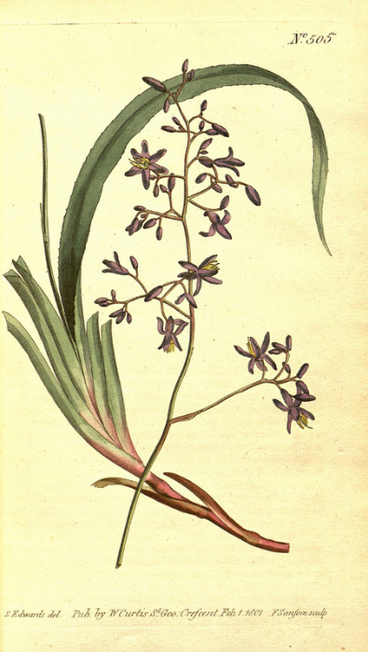







Linking specimen data
Curtis’s Botanical Magazine
Linking BHL images on flickr to literature, and specimens in ALA
Notes:
Other projects linking field notes to specimens

Slide 7
Join us!
Innovative Uses of Collections Data Symposium
Wednesday, 21st June
11:20-16:00
Curtis Hotel, Four Square

Slide 8
Innovation abounds!
Innovative Inventory: Shedding light on dark data and creating new collection tools (Kathryn Estes-Smargiassi)
Starting from scratch: Digitization of an entire collection ecosystem (Gary Motz)
Analyzing the University of Colorado Herbarium (COLO) digital collection (J Ryan Allan)
A digitized collection: Where next? (Anne Molineux)
From the scrub to the web: Digitizing the collection at the Archbold Biological Station (Stephanie Leon)
Deep Learning with Botanical Specimen Images (Sylvia Orli)
Fantastic Fishes and Where to Find Them: A Dynamic Inventory of United States Fish Collections (Randy Singer)
Georeferencing for Research Use (GRU): Innovative geospatial training using natural history collections (Shelley James)
Poster: Update on the Fishes of Texas Project (Adam Cohen)

Slide 9
Your turn!
What are you doing in your collection that is innovative?
What are other possible uses of collections data?
Using available data to improve management efficiency
Risk management
Limitations (e.g. downgrading data)
Learning opportunities

Slide 10
