Slide 1
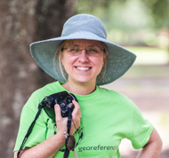
Seeking NHC Biodiversity Informatics data skills and literacy: seek, find, create, repeat
Deborah Paul, @idbdeb @iDigBio, Florida State University
@SPNHC2017 Denver Museum of Nature and Science
18 June 2017

Slide 2

where does one get these data and computational literacy skills and knowledge?
Biological Informatics
Informatics
Bioinformatics
Biodiversity Informatics
For Biodiversity Informatics: What human skills and software tools are needed to collect, manage, and do research with this specimen and related data? What infrastructure is needed (hardware and software)? What data standards are needed? What data and computational literacy skills and knowledge are required through the data pipeline from data collection to digitization to data use / re-use?
molecular to gene
organism to ecosystem
Notes:
From NIBA
3.1. Implement new training opportunities in biodiversity informatics.
* Develop new opportunities and expand existing training programs for collections professionals so that they can more fully engage in biodiversity informatics activities. These efforts should include exposure to informatics tools, their application both in biodiversity science and in informatics more broadly, and proper curation protocols for electronic data.
* Promote new undergraduate curricula and graduate programs in biodiversity informatics, particularly those that are cross-disciplinary (e.g., engineering, computer science, geography, library science). Develop opportunities for US students to gain international experience through biodiversity informatics training experiences using specimens and data that originated in other countries.
* Expand museum studies programs or biology degrees to include biodiversity informatics as applied to biocollections and exposure to topics such as informatics programming museum, visualization engineering, education and outreach visuals, natural language processing, and Web ontologies.
3.2. Establish career paths and professional retention incentives for data and specimen management and curation.
* Develop evaluation mechanisms that recognize and reward the products of successful careers in biodiversity informatics.
* Develop a standardized nomenclature and hierarchy for careers in biodiversity informatics that can inform position descriptions, hiring, and criteria for promotion.
3.3. Provide opportunities that encourage more people to become biodiversity software developers and that encourage the development of more biodiversity informatics software.
* Develop workshop training and software developer courses in biodiversity informatics.
* Develop schema that are accessible and establish service standards.
* Train experts and students in the various aspects of tool development and programming (e.g., MySQL).
* Collaborate with commercial firms to provide employment opportunities for biodiversity software developers who graduate from academic tracks. Your project?

Slide 3
NIBA Implementation Plan - Goal 3
Goal 3: Enhance the training of existing collections staff and create the next generation of
biodiversity information managers
3.1. Implement new training opportunities in biodiversity informatics.
3.2. Establish career paths and professional retention incentives for data and specimen management and curation.
3.3 Provide opportunities that encourage more people to become biodiversity software developers and that encourage the development of more biodiversity informatics software.
Notes:
3.1. Implement new training opportunities in biodiversity informatics.
* Develop new opportunities and expand existing training programs for collections professionals so that they can more fully engage in biodiversity informatics activities. These efforts should include exposure to informatics tools, their application both in biodiversity science and in informatics more broadly, and proper curation protocols for electronic data.
* Promote new undergraduate curricula and graduate programs in biodiversity informatics, particularly those that are cross-disciplinary (e.g., engineering, computer science, geography, library science). Develop opportunities for US students to gain international experience through biodiversity informatics training experiences using specimens and data that originated in other countries.
* Expand museum studies programs or biology degrees to include biodiversity informatics as applied to biocollections and exposure to topics such as informatics programming museum, visualization engineering, education and outreach visuals, natural language processing, and Web ontologies.
3.2. Establish career paths and professional retention incentives for data and specimen management and curation.
* Develop evaluation mechanisms that recognize and reward the products of successful careers in biodiversity informatics.
* Develop a standardized nomenclature and hierarchy for careers in biodiversity informatics that can inform position descriptions, hiring, and criteria for promotion.
3.3. Provide opportunities that encourage more people to become biodiversity software developers and that encourage the development of more biodiversity informatics software.
* Develop workshop training and software developer courses in biodiversity informatics.
* Develop schema that are accessible and establish service standards.
* Train experts and students in the various aspects of tool development and programming (e.g., MySQL).
* Collaborate with commercial firms to provide employment opportunities for biodiversity software developers who graduate from academic tracks. Your project?

Slide 4
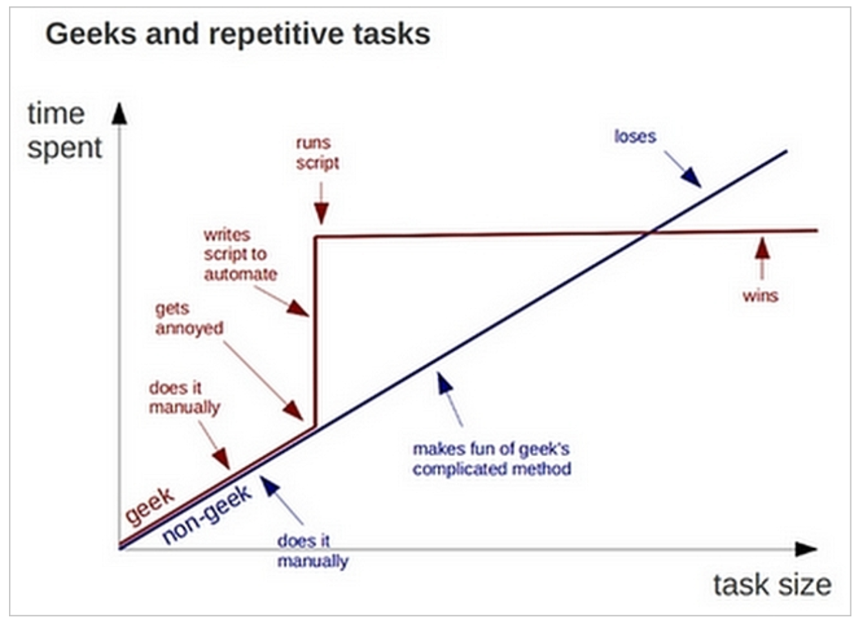
A very quick BI needs assessment
What’s the slow
step in your
Energy of Activation?
Repetitive tasks? Sticking points?
These offer insights to guide your needs assessment
Skills you know you’d like to have
Software/ tools you’d like to learn or learn more about
Notes:
Some biodiversity data skill / knowledge you’d like to acquire.
Some software you’d like to know how to use.
What’s a sticking point (slow software, repetitive tasks need automating, …) you have / you know about right now in your biodiversity data mobilization or data use?
What’s a biodiversity specimen data question you’d like to ask the imaginary expert?
http://www.datacarpentry.org/shell-genomics/slides.html#3

Slide 5
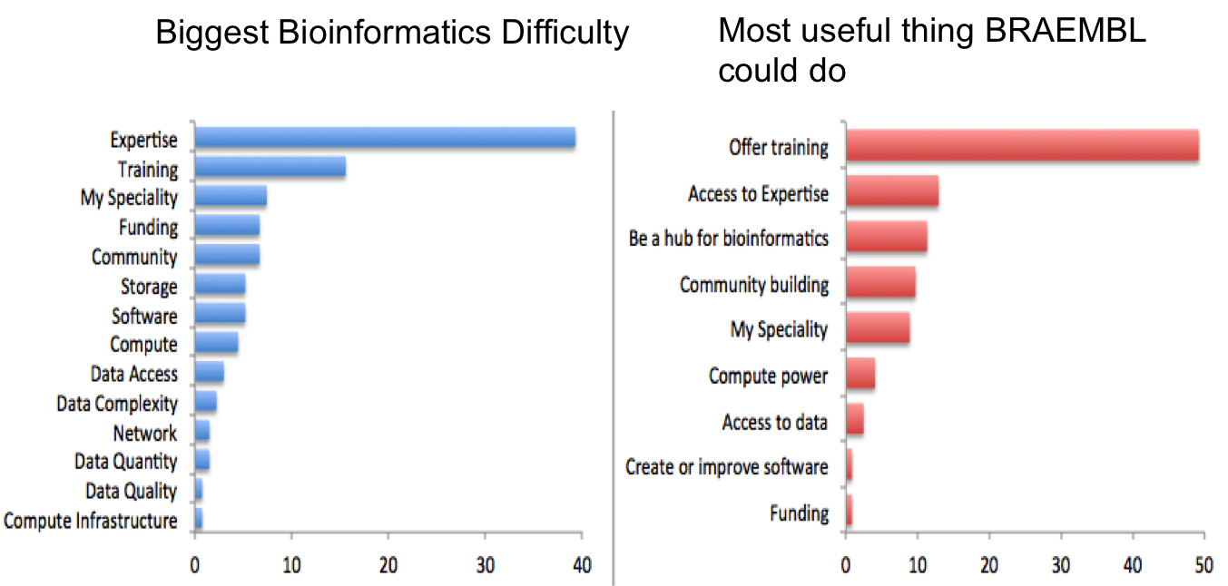
Survey of Researchers - EMBL (Australia)
Training more than money
Notes:
https://github.com/tracykteal/ICE2016-presentation/
https://github.com/tracykteal/ICE2016-presentation/raw/gh-pages/images/braembl.png

Slide 6
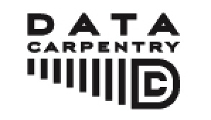

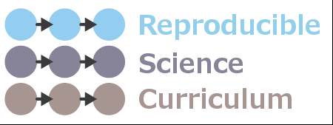
BIO Centers IT View
Participant point-of-view
I usually manage data in Excel and it's terrible and I want to do it better.
I'm organizing GIS data and it's becoming a nightmare.
My advisor insists that we store 50,000 barcodes in a spreadsheet, and something must be done about that.
I'm having a hard time analyzing microarray, SNP or multivariate data with Excel and Access.
I want to use public data.
I work with faculty at undergrad institutions and want to teach data practices, but I need to learn it myself first.
I'm interested in going in to industry and companies are asking for data analysis experience.
I'm trying to reboot my lab's workflow to manage data and analysis in a more sustainable way.
I'm re-entering data over and over again by hand and know there's a better way.
I have overwhelming amounts of data.
I'm tired of feeling out of my depth on computation and want to increase my confidence.
man pages
automated file-naming / renaming
OpenRefine
look at large text file(http://openrefine.org)s
concatenate files together
computer directory structure
write a text file not in Word
the idea that you can parse a file
the shell commands, piping, grepping
which tool do we need to use to do an analysis
introducing the idea of csv files (delimited) files
the idea that you can formulate questions for your data and have them answered by your computer
preparing data for analysis (such as formatting, trimming, masking, deduplication, mapping to a standard, etc)
awareness of data and metadata standards, and how to map data to them or make them compliant
Sentiments on data within the NSF BIO Centers
(BEACON, SESYNC, NESCent, iPlant, iDigBio)

Slide 7
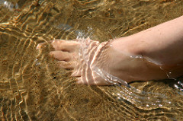
The Carpentries
Data Carpentry
Software Carpentry
Reproducible Science Curriculum
Novice+
Instructor training
Mentoring
Assessment
Joint materials development
Community
Code of Conduct
Two days+
Better spreadsheet skills
Open Refine
Introduction to SQL
Introduction to R
Introduction to the command line
Introduction to Versioning
(using GitHub)
Introduction to SQL, R / Python and Data Viz / Analysis
Managing Research Data
Notes:
https://www.flickr.com/photos/danzen/966894209/ Dan Zen

Slide 8

Who’s working on NHC BI skill / knowledge needs?
Darwin Core Hour (next talk!)
Biodiversity Information Standards (TDWG)
EUCollComp from the SYNTHESYS Project
Entomology Collections Network (ECN)
Society of Herbarium Curators
SPNHC
Emerging Professionals Group
Professional Development Committee
DEMO Camp
BLUE – Biodiversity Literacy in Undergraduate Education
University of Colorado, Boulder (Talia Karim)
University of Kansas (Andrew Short, Town Peterson)
University of Arizona (Bryan Heidorn)
Arizona State University (Nico Franz)
University of Florida (iDigBio – Pam Soltis, Robert Guralnick)
You?
Notes:
https://github.com/tracykteal/ICE2016-presentation/
https://github.com/tracykteal/ICE2016-presentation/raw/gh-pages/images/braembl.png

Slide 9
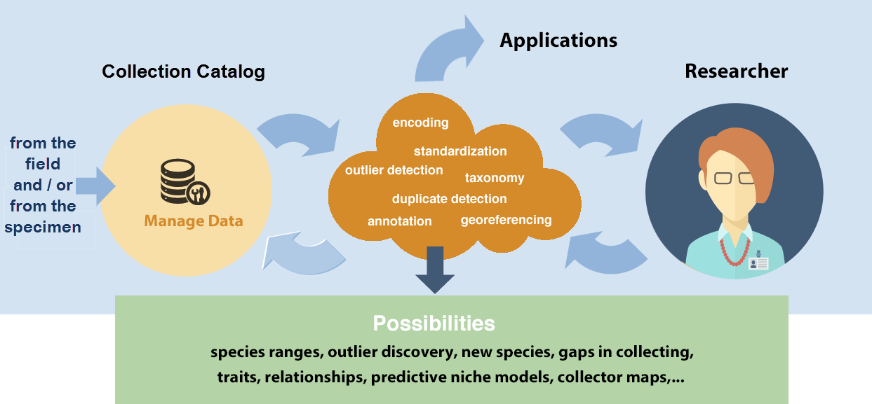
Are you T-shaped?
Breadth of skills / literacy to collaborate across disciplines in areas outside your expertise
Independent evolution (+/-)
Need translators in the nhc research data pipeline (+)
Depth of skills /
expertise
in a single field
Notes:
"T-shaped" skill (Wikipedia to the rescue: http://en.wikipedia.org/wiki/T-shaped_skills):
The vertical bar on the T represents the depth of related skills and expertise in a single field, whereas the horizontal bar is the ability to collaborate across disciplines with experts in other areas and to apply knowledge in areas of expertise other than one's own.
We need folks in our broader community who can translate scientists' needs to technology experts, and who can then take these tools to researchers to show the research community how to use them. The T-shaped person fits this concept very well. Right now, these folks in our community essentially evolve independently over-and-over again. They are self-made and thank goodness for them, but we really need more of them if our data skills and knowledge, standards, software, hardware and collaboration efforts are to be sustainable.

Slide 10
Your thoughts?

