Slide 1




Biodiversity Informatics 101
Theme 2 : Who's who in Australia’s natural history biodiversity informatics?
Nicole Fisher & Shelley James

Slide 2
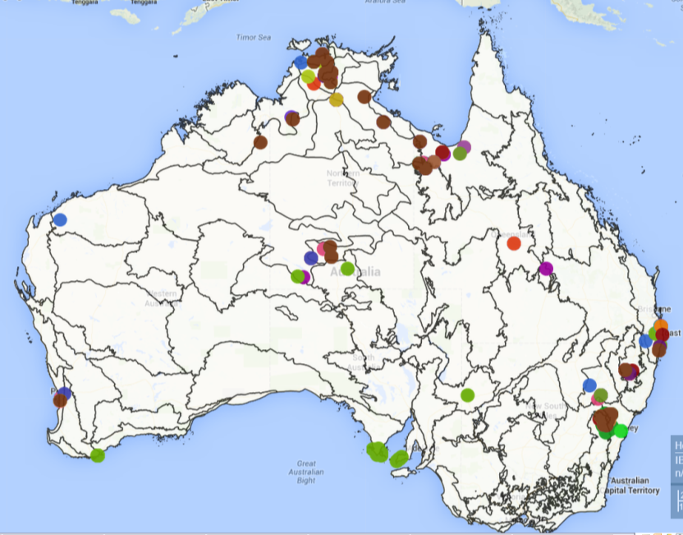
Australia
240 yr time-series (1770-today) of biological specimens
globally unique : ~ 8% of the world’s plant & animal species
only about 25% of Australia’s species have been described
>200 NH collections
3 largest herbaria >1.2 million specimens ea.
  38 herbaria, >8 million specimens,
  250 staff (IH estimates)
    > 34M biological specimens
    ~ 20% is databased

Slide 3


























Sharing biodiversity knowledge
>$50 million investment
Leading the digital transformation in the sharing of
biodiversity knowledge
IT & engagement professionals
Partners – founding & beyond
>63 million records
>4500 data sets
>460 spatial layers
>8.5 billion records downloaded
Data
specimens ✓occurrence
images, sounds ✓literature
sequences ✓tissues
more coming…e.g. indigenous
National Research infrastructure
Australian Node
System
data capture & aggregation
data management
data discovery
data visualisation
data analysis & reporting
Open source, open access,
open infrastructure
globalisation, 10+ countries
public data policies

Slide 4
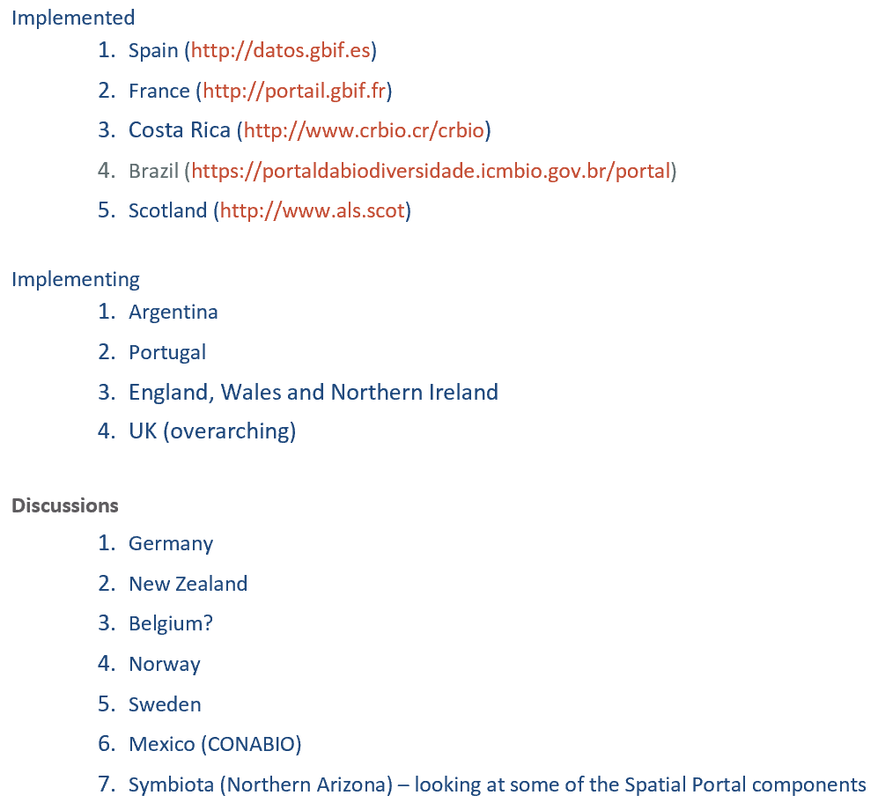
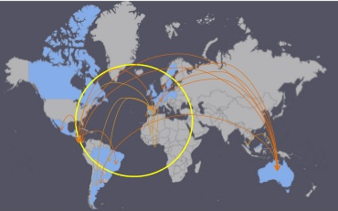
ALA platform for other countries …
ALA seen as a leader in biodiversity e-infrastructure as it was 1 of the first sites worldwide to aggregate existing biodiversity data into 1 place and provide tools to analyse and visualise data.
More info : http://www.gbif.org/living-atlases

Slide 5
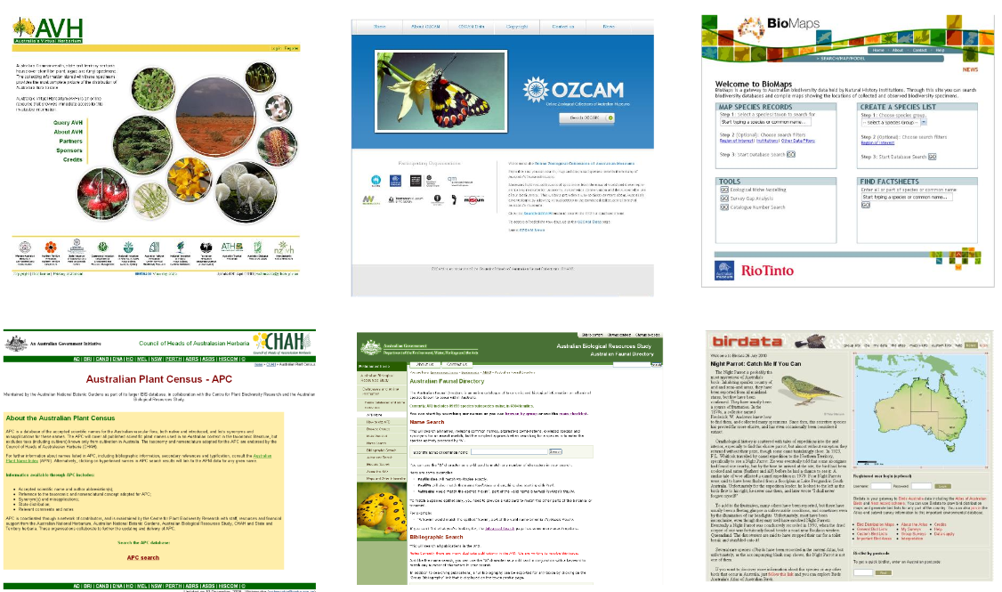
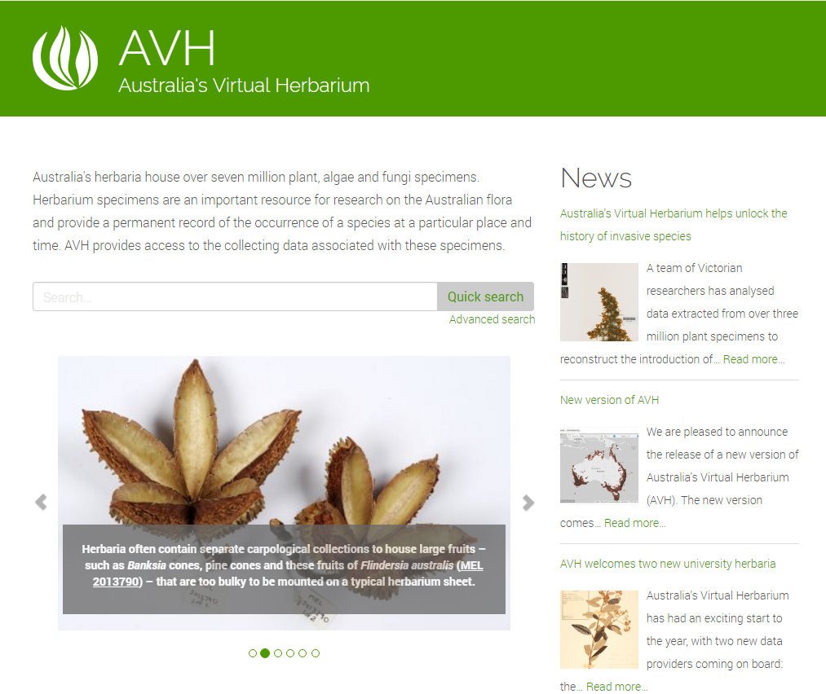
ALA builds on the work of the community
ALA fortunate to be able to build on existing tools & previous efforts of others bringing together biological data.

Slide 6
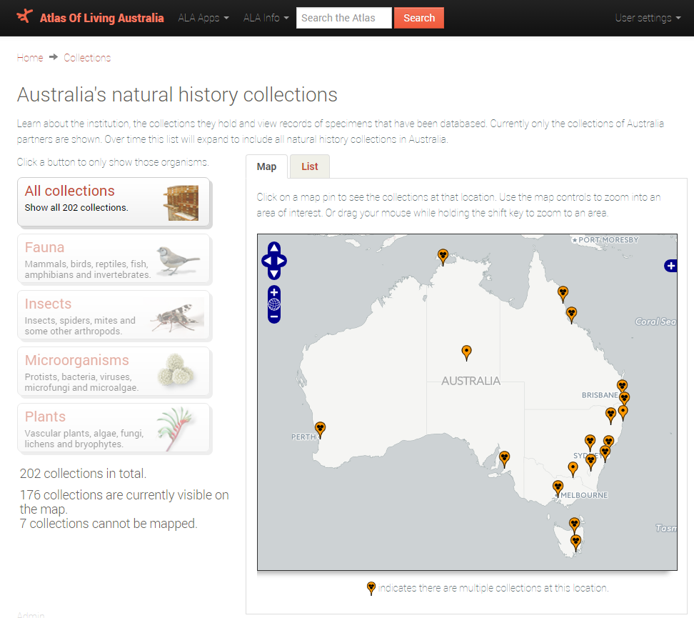
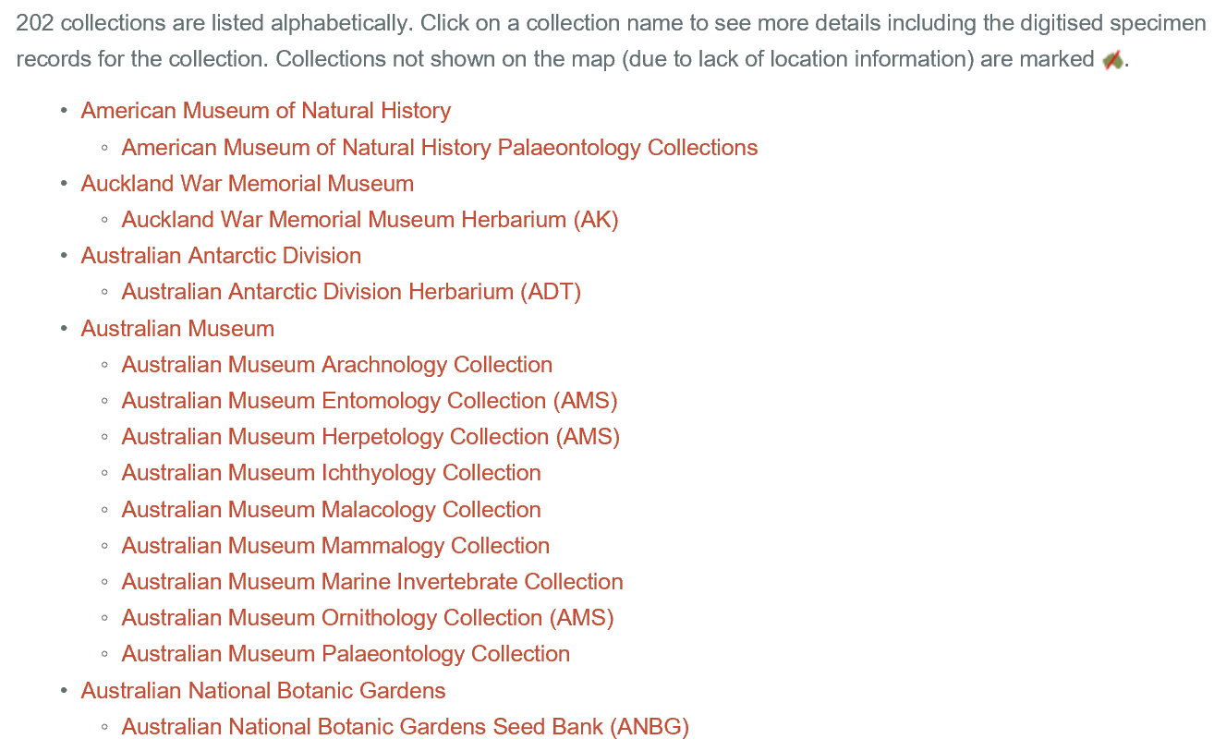
Where to for Australia’s collections information?
http://collections.ala.org.au/
Natural History Collections (NHC) register
designed to provide information about
the natural history collections held in Australian museums, herbaria,
universities, government departments,
CSIRO & to provide access to their
digitised records.

Slide 7


Collections communities
------councils/heads of collections------
Flora community :
CHAH (Council of Heads of Australasian Herbaria)
- responsible for major Australian and New Zealand Herbaria, Oceania representatives
HISCOM (Herbarium Information Systems Committee)
subcommittee of CHAH
computing & information technology programs, deals with the application of new technologies in herbarium management, botanical research & information delivery.
Faunal community :
CHAFC (Council of Heads of Australian Faunal Collections)
- peak body representing Australia’s zoological & palaeontological collections
FCIG (Faunal Collections Informatics Group)
subcommittee of CHAFC
discuss the technical aspects of sharing biological data, and manage the OZCAM, Australia's Fauna website.
------subcommittees------

Slide 8
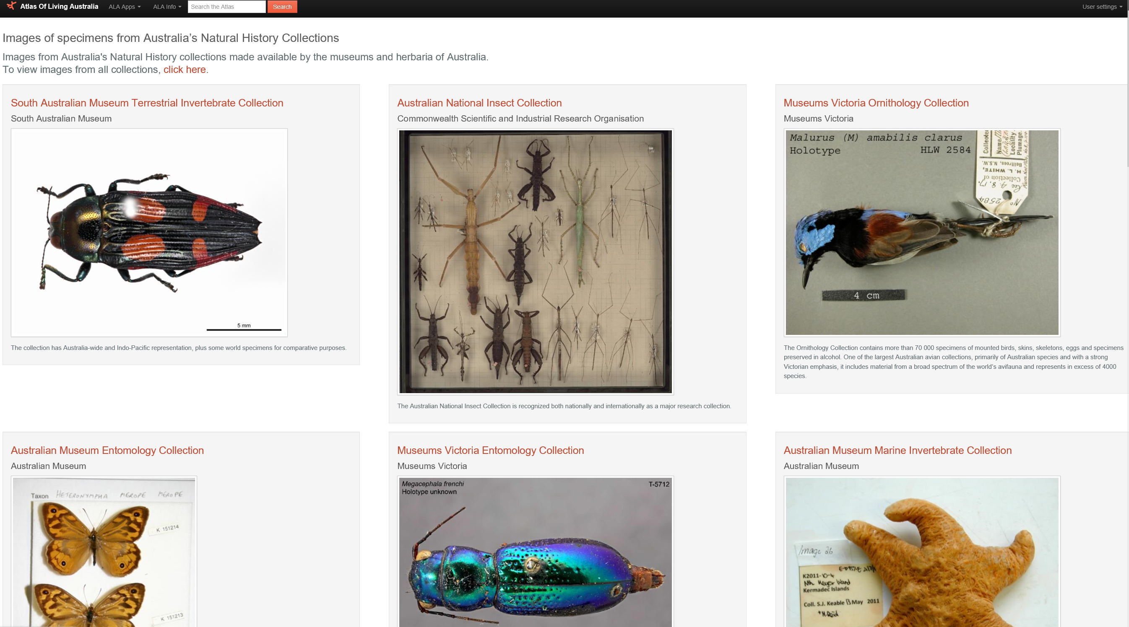
ALA Specimen collection browser
http://specimens.ala.org.au/

Slide 9
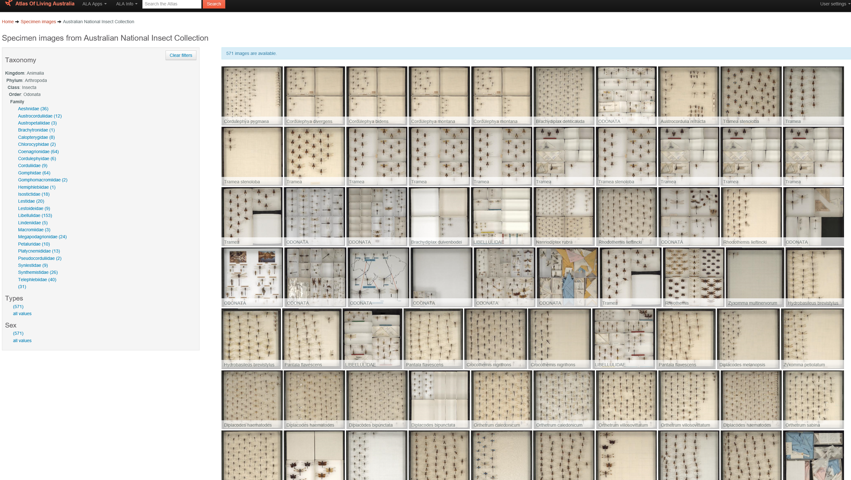
ALA Specimen collection browser
http://specimens.ala.org.au/

Slide 10
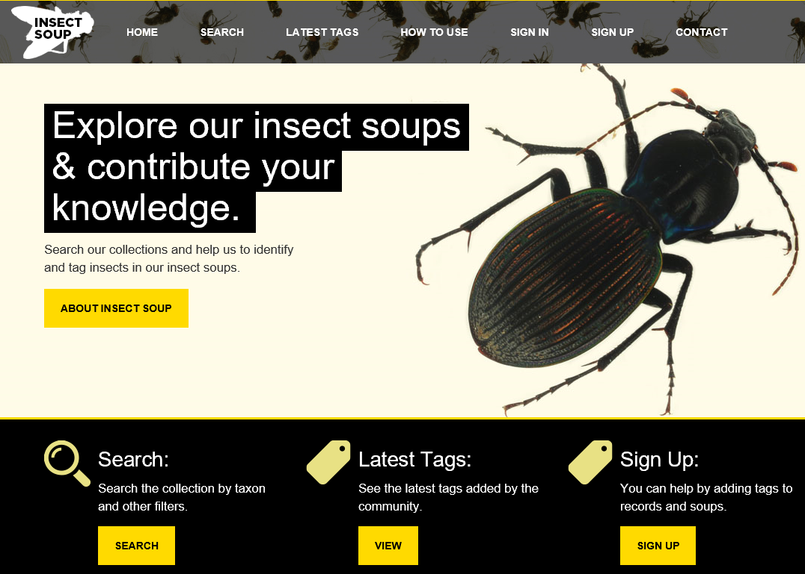
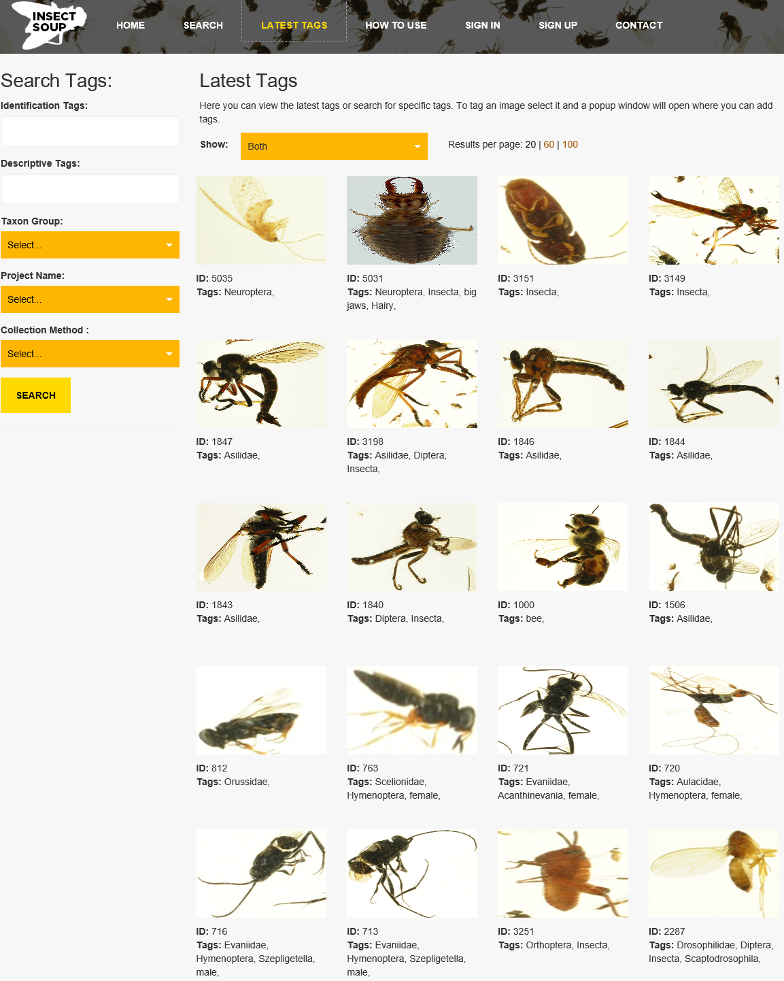
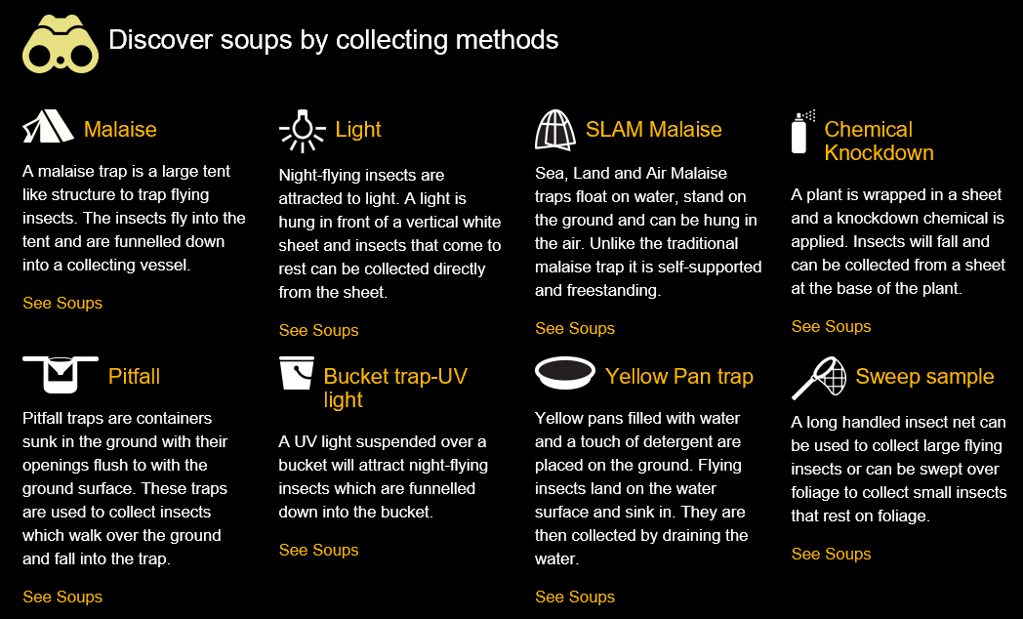
Bulk samples (soups)
http://insectsoup.australianmuseum.net.au/ Contact : Paul Flemons (Australia Museum)

Slide 11







More tools & resources
- Australia’s transcription centre (ALA & Aus. Mus.)
- enabling digital data collection (ALA)
- Australia’s Virtual Herbaria (driven by ALA)
- Online Zoological Collections of Australian Museums (ALA)
- linking literature to specimens (Mus. Vic.)
- social network, web-based, community, biodiversity workspace (Mus. Vic & ALA)
- Taxonomic backbone

Slide 12



Acknowledgements
iDigBio & sponsors
Jennifer Strotman, Holly Little, Deb Paul
Organisers of SPNHC 2017
Nicole Fisher
National Research Collections of Australia
e nicole.fisher@csiro.au
w www.csiro.au/en/Research/Collections/Digitisation
Shelley James
Manager Collections
National Herbarium of NSW
e shelley.james@rbgsyd.nsw.gov.au
w www.rbgsyd.nsw.gov.au/Science-Conservation/Herbarium

