Slide 1
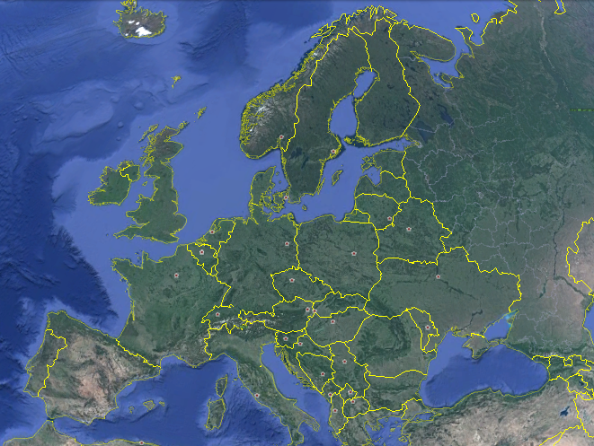
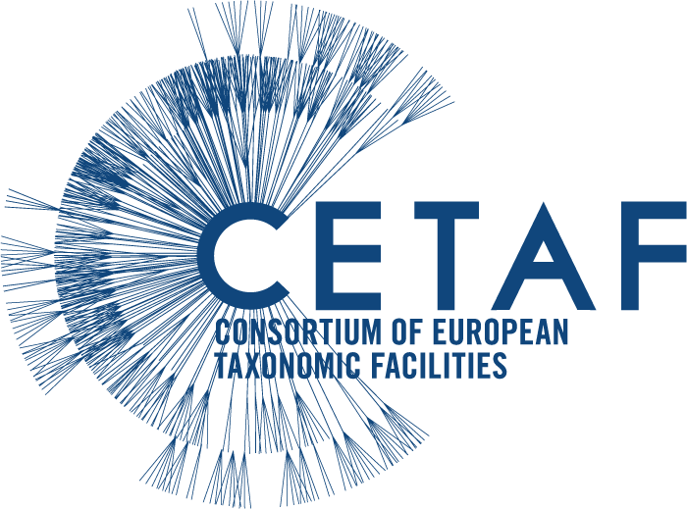



Who’s Who in Bioinformatics:
The European Landscape
Elspeth Haston & Laurence Livermore

Slide 2
From local to global
GLOBAL
Intercontinental co-operation and united facilities
INTERNATIONAL
Continental collaboration
INTERNATIONAL
Continental collaboration
NATIONAL
Governmental and NGO initiatives
NATIONAL
Governmental and NGO initiatives
NATIONAL
Governmental and NGO initiatives
Local
Institutional strategies
and solutions
Local
Institutional strategies
and solutions
Local
Institutional strategies
and solutions
Local
Institutional strategies
and solutions
Who’s Who in Bioinformatics: The European Landscape SPNHC 2017, Denver

Slide 3
From local to global
GBIF
Intercontinental co-operation and united facilities
CETAF
Continental collaboration
European Open Science Cloud
Continental collaboration
GFBIO
Governmental and NGO initiatives
Digitarium
Governmental and NGO initiatives
eReColnat
Governmental and NGO initiatives
BGBM
Institutional strategies
and solutions
MfN
Institutional strategies
and solutions
H
Institutional strategies
and solutions
MNHN
Institutional strategies
and solutions
Who’s Who in Bioinformatics: The European Landscape SPNHC 2017, Denver

Slide 4
The UK landscape
NatSCA
Natural Sciences Collections Association
https://nbnatlas.org/
NBN
National Biodiversity Network
https://nbn.org.uk/
ALS
NBN Atlas of Living Scotland
https://scotland.nbnatlas.org/
GCG
Geological Curators Group
http://geocurator.org/
SEWEB
Scotland’s Environment Website
http://www.environment.scotland.gov.uk/
Herbaria United
http://herbariaunited.org/
BSBI
Botanical Society of Britain & Ireland http://bsbi.org/
Who’s Who in Bioinformatics: The European Landscape SPNHC 2017, Denver

Slide 5
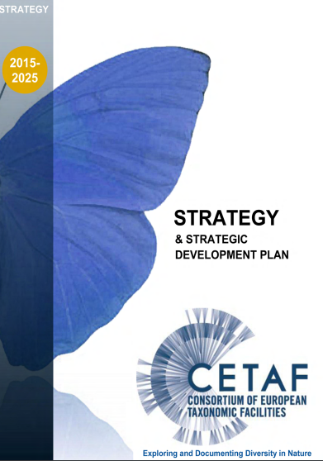
60 Institutes
21 Countries
1.5 Billion specimens
Over 5,000 researchers
http://cetaf.org/
Who’s Who in Bioinformatics: The European Landscape SPNHC 2017, Denver

Slide 6
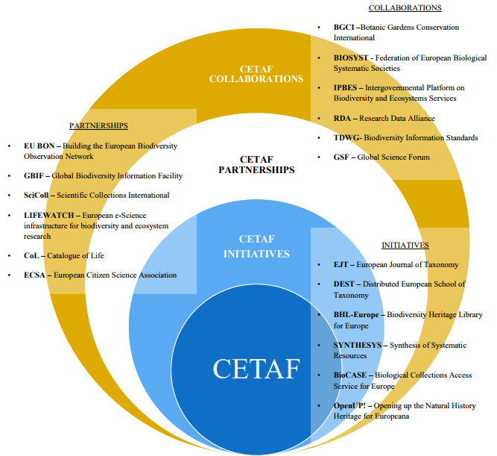
Who’s Who in Bioinformatics: The European Landscape SPNHC 2017, Denver

Slide 7
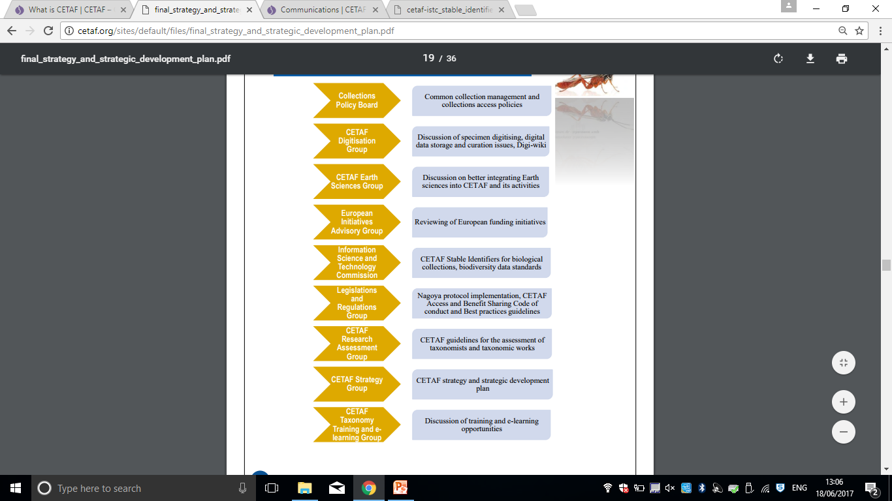
CETAF Bodies
and their current focus areas
Who’s Who in Bioinformatics: The European Landscape SPNHC 2017, Denver

Slide 8
Digitisation Working Group
http://cetafdigitization.biowikifarm.net/cdig
Who’s Who in Bioinformatics: The European Landscape SPNHC 2017, Denver

Slide 9
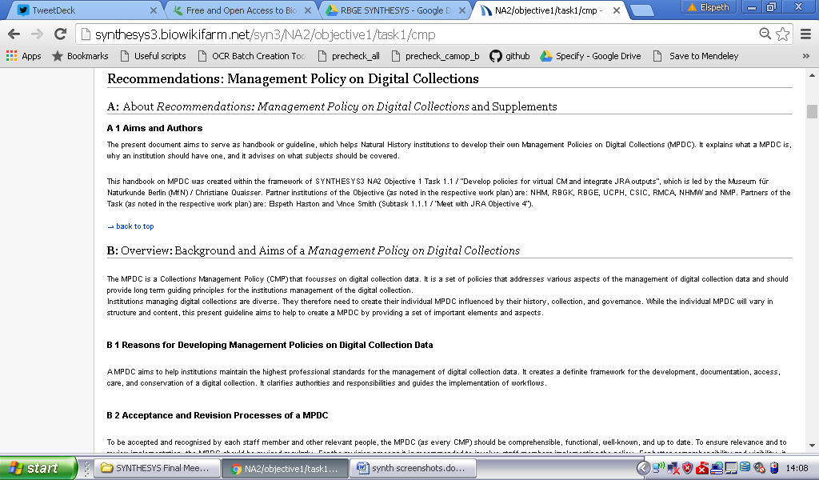


Slide 10
Who’s Who in Bioinformatics: The European Landscape SPNHC 2017, Denver

Slide 11
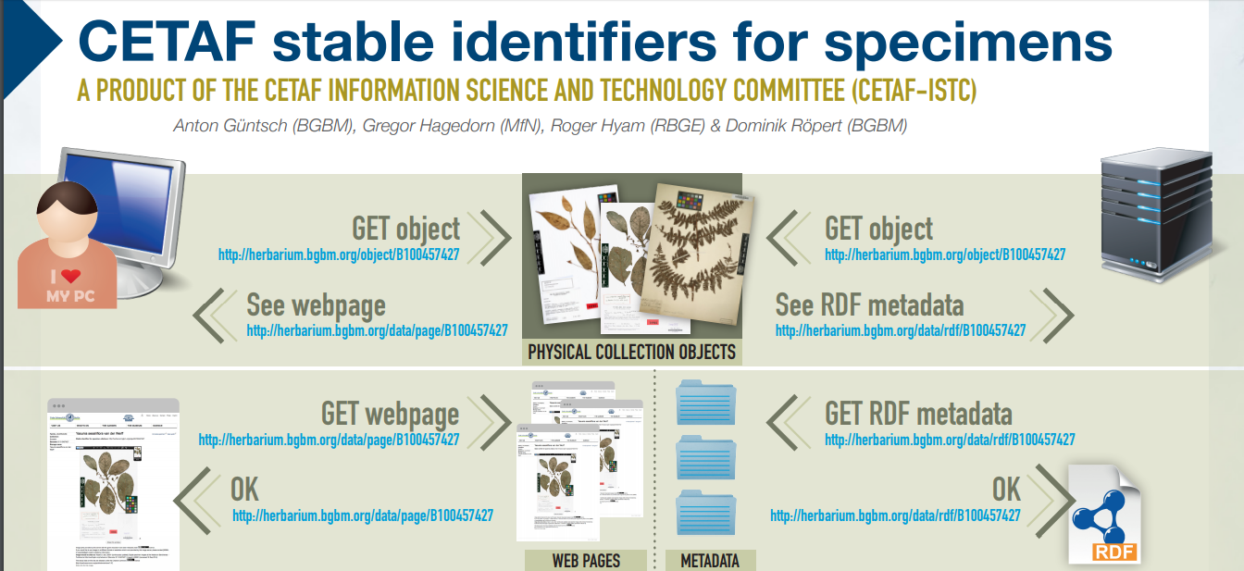
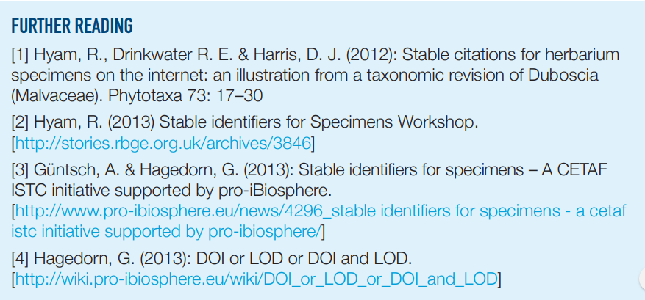
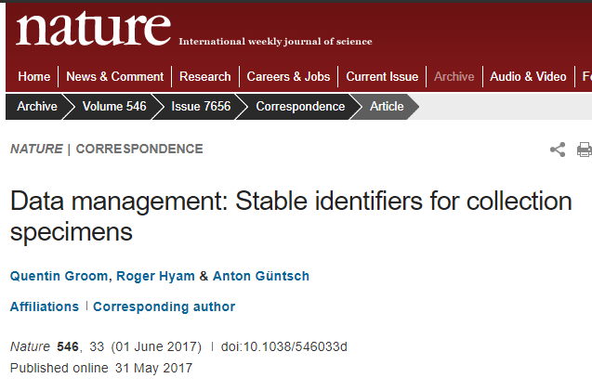
Stable Identifiers
Gap analysis
MPDC
CETAF Strategy
Who’s Who in Bioinformatics: The European Landscape SPNHC 2017, Denver

Slide 12
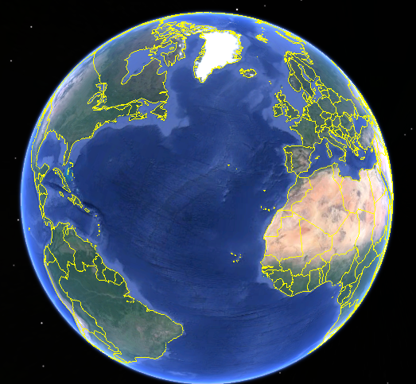
Who’s Who in Bioinformatics:
The European Landscape and beyond …
Elspeth Haston & Laurence Livermore

Slide 13
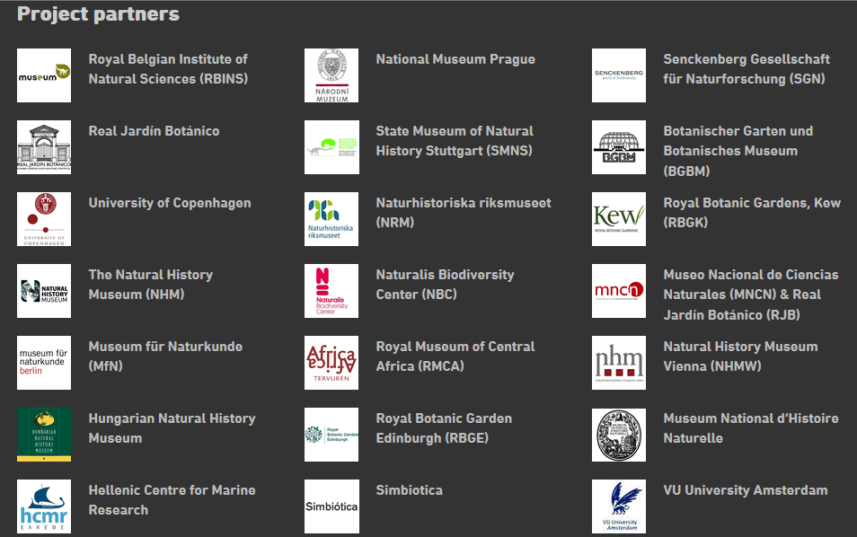
What is SYNTHESYS?
Overall aim:
  “to create an integrated European infrastructure for researchers in the natural sciences”
3 projects (2004 – 2017 >33M€)
21 Partners (18 with NH collections)
3 core strands of work:
Transnational Access improves accessibility of natural history collections through funded physical access to collections / expertise and facilities (chemical analysis, molecular and imaging).
Joint Research Activities
improve access to data stored digitally within NH collections by extracting and enhancing data from digitised collections
Network Activities
deliver collection management policies, best practice models, unified standards and protocols for new and emerging collections.
Notes:
Creating an integrated European infrastructure for researchers in the natural sciences. There are 11 Taxonomic Access Facilities (essentially countries with NH collections, some countries have more than one NH collection e.g. in UK RBG Edinburgh, RBG Kew and NHM, London) – with an estimated total of 385 million specimens.
Main site / access applications: http://www.synthesys.info/
Current SYNTHESYS3 Project site: http://synthesys3.myspecies.info
The predecessor to SYNTHESYS, ENHSIN (Jan 2000 - Mar 2003) had the stated aim:
“To enable the development of a shared, interoperable infrastructure of natural history specimen databases in European institutions. Although exciting developments have been made in producing frameworks for connecting global species databases (Species 2000) and for providing access to the wider content of European natural history collections (BioCISE), there is, at present, no corresponding approach to facilitate access to specimen data.”
A few years on and we still have some way to go!

Slide 14
Recent SYNTHESYS Highlights
50,000 funded visitor days, >3,800 researchers (42%♀ 58%♂) resulting in >4,500 scientific outputs/publications
Instructional best practice videos: “Collecting plant material in silica gel: The teabag method” https://vimeo.com/195812974
Innovative open source digitisation software: https://naturalhistorymuseum.github.io/inselect/
3D imaging handbook: http://biowikifarm.net/v-mfn/3d-handbook/3d_Imaging_Handbook:Main_Page
Notes:
More links within talks from a recent final meeting conference: http://synthesys3.myspecies.info/node/669
Gender balance of accepted applications consistently exceeds industry average. She Figures 2012 Gender in Research and Innovation’ indicating that females account for 33% of scientific researchers in the EU.

Slide 15
SYNTHESYS+
Successor project to SYNTHESYS3, still in development (proposal submission in March 2017)
Some likely components:
Extend reciprocal transnational Access to a (single?) non-EU NH collection
Develop “collections on demand” services (digitisation, molecular, analytical)
Build larger coordinated network of molecular data sharing between partners
Prototype and apply computer vision and machine learning
Will prepare the community for the DiSSCo Project…
Notes:
Creating an integrated European infrastructure for researchers in the natural sciences
(11 Taxonomic Access Facilities) – with an estimated 385 million specimens
Crowdsourcing research falls into JRA

Slide 16

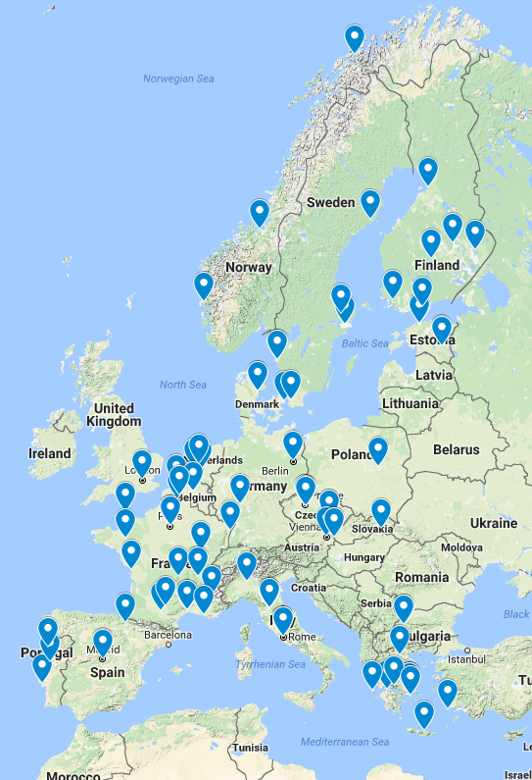
What is DISSCO?
Next step for building large Research Infrastructures in EU (ESFRI Project)
Larger in scope (90 museums in 19 countries), ambition and timescales (13 year programme)
Addresses three main challenges:
Access to collections and data
Integration and interoperability
Digital skills and competencies
Notes:
Access to collections and data -Less than 10% widely available, fragmented services
Integration and interoperability - Standards, protocols, workflows
Digital skills and competencies -Training, awareness

Slide 17
Promotional Video
https://youtu.be/OeOGbQ4WrwM

Slide 18
Contact DiSSCo Coordination Team
Dimitris Koureas (NHM)
Ana Casino (CETAF)
Wouter Addink (Naturalis)
Contact your
DiSSCo National Task Force
(currently in 19 countries)
http://dissco.eu/content/partners
Contact us online
http://dissco.eu
@DiSSCoEU
and our printed material

