Slide 1
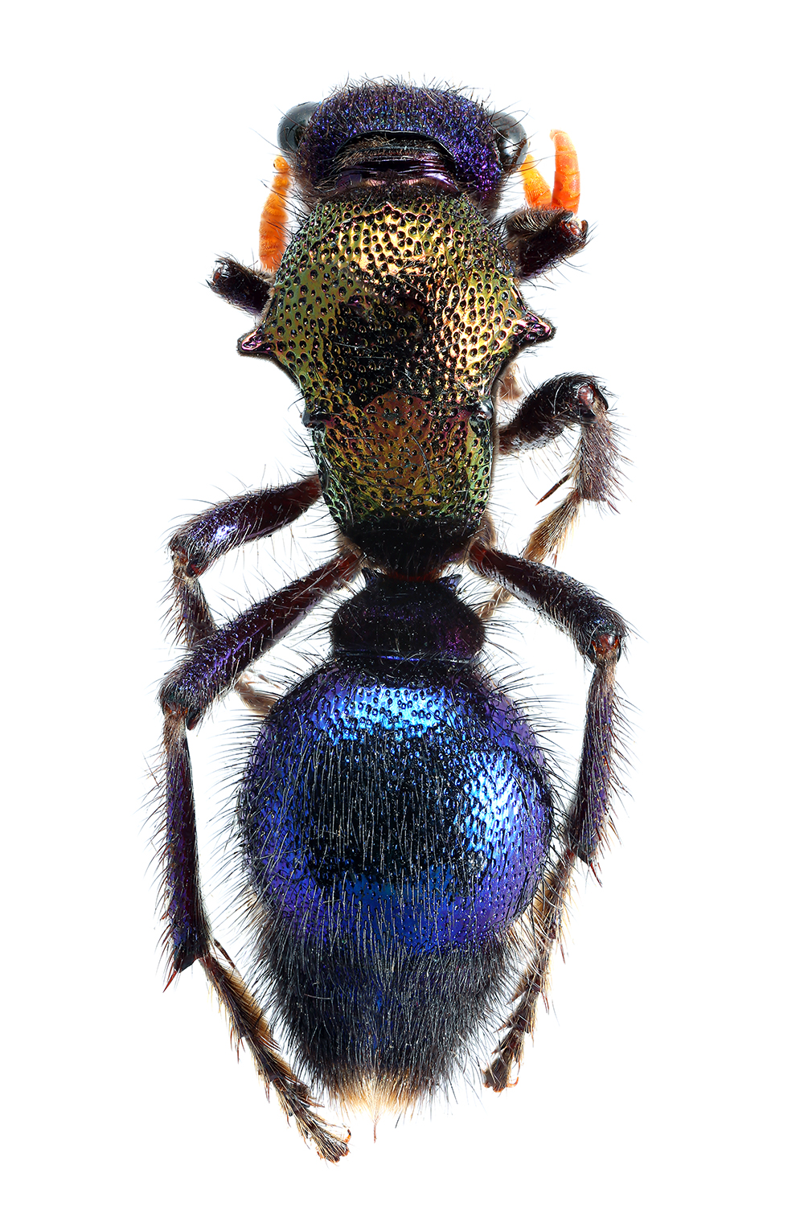
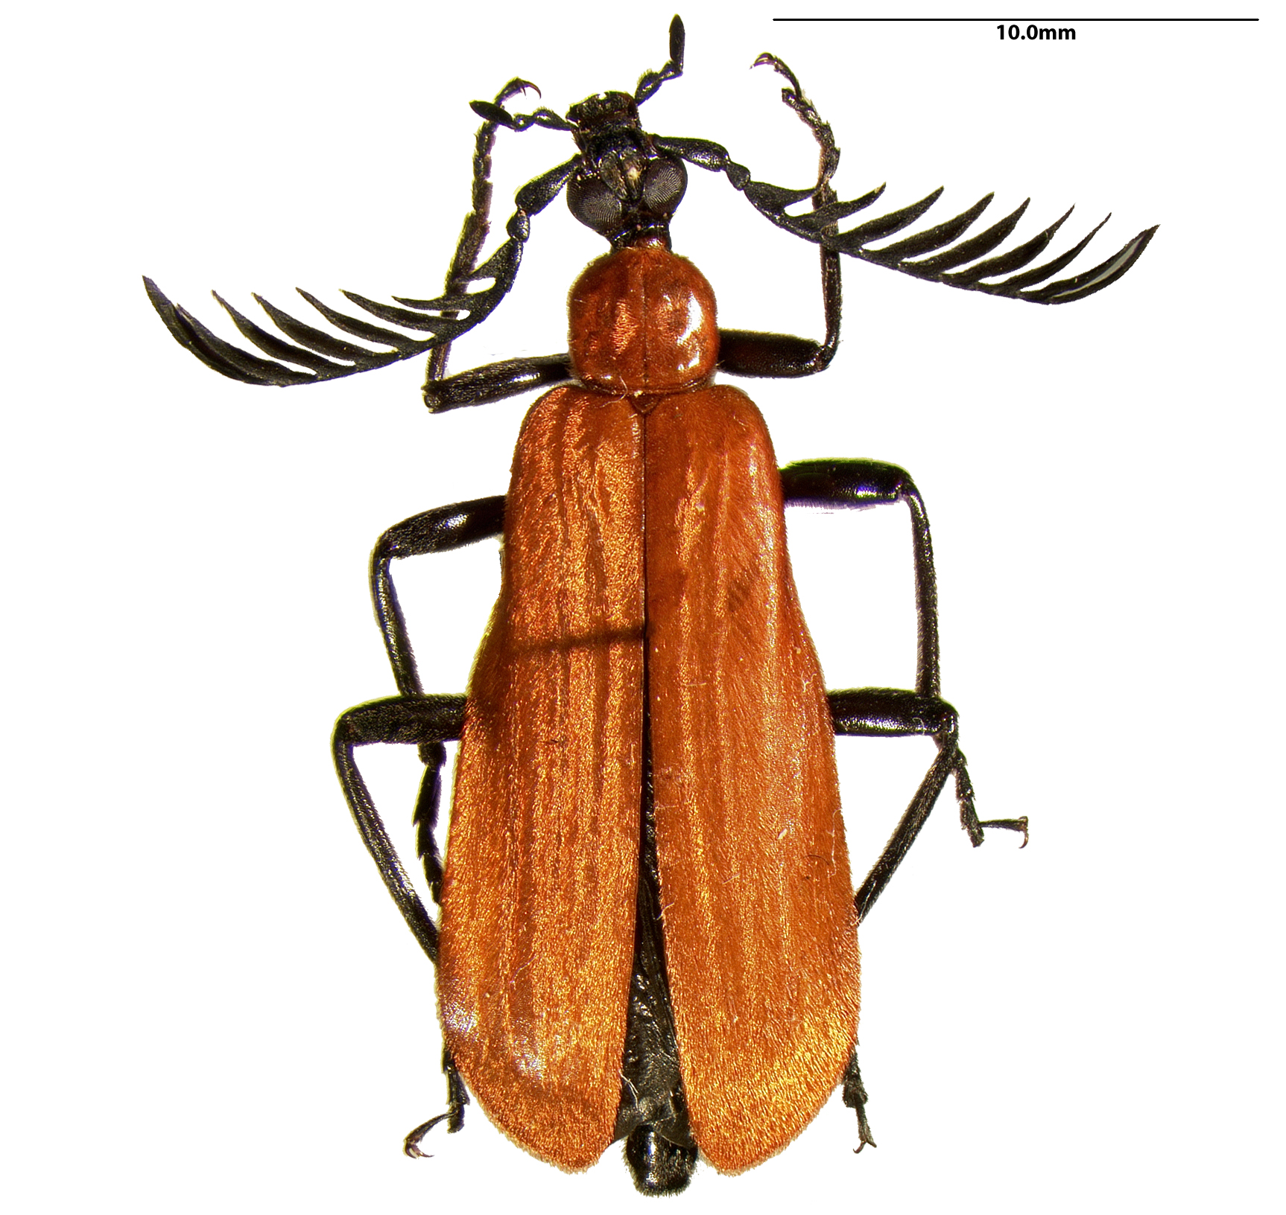
I. ESA, ECN, InvertNet, ECN-SPNHC liaison II. Entomological biodiversity data and collections
I. ESA, ECN, InvertNet, ECN-SPNHC liaison
Daniel K. Young & Craig M. Brabant
University of Wisconsin-Madison
young@entomology.wisc.edu

Slide 2


Entomological Society of America
American Entomological Society

Slide 3

Entomological Society of America (ESA)
American Association of Economic Entomology
founded in 1889
“Entomological Society of America”
founded in 1906
The two societies merged as “modern” ESA
founded in 1953

Slide 4
Entomological Society of America (ESA)
largest entomological organization in the world serving the professional and scientific needs of entomologists & related disciplines
over 6,000 members affiliated with educational institutions, health agencies, private industry, and government
members are researchers, teachers, extension service personnel, administrators, marketing representatives, research technicians, consultants, students, pest management professionals, and hobbyists

Slide 5
ESA Sections
Medical, Urban, and Veterinary Entomology
Physiology, Biochemistry, and Toxicology
Plant–Insect Ecosystems
Systematics, Evolution, and Biodiversity

Slide 6
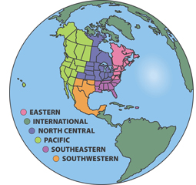
ESA Branches (6)

Slide 7
ESA Publications
American Entomologist (including Bulletin of the ESA archives)
Annals of the Entomological Society of America
Arthropod Management Tests
Journal of Integrated Pest Management
Environmental Entomology
Journal of Economic Entomology
Journal of Medical Entomology
Journal of Insect Science
Insect Systematics and Diversity

Slide 8
I. ESA, ECN, InvertNet, ECN-SPNHC liaison

Slide 9
Entomological Collections Network (ECN)
Workshop held at Penn State University
17–19 August 1989
Systematics Resources Management in Entomology

Slide 10
ECN Mission Statement (1989)
A professional forum for entomological collections and related issues with the following objectives:
foster communication between institutions that maintain arthropod collections
provide a forum for education on techniques appropriate for management of arthropod collections
develop standards for data collection and representation
facilitate sharing of data, programs, expertise and experience among arthropod collection staff and interested members of the systematics community

Slide 11
Entomological Collections Network (ECN)
11, 13 December 1989
steering committee meetings
11 December 1989
ESA Informal Conference
32 participants

Slide 12
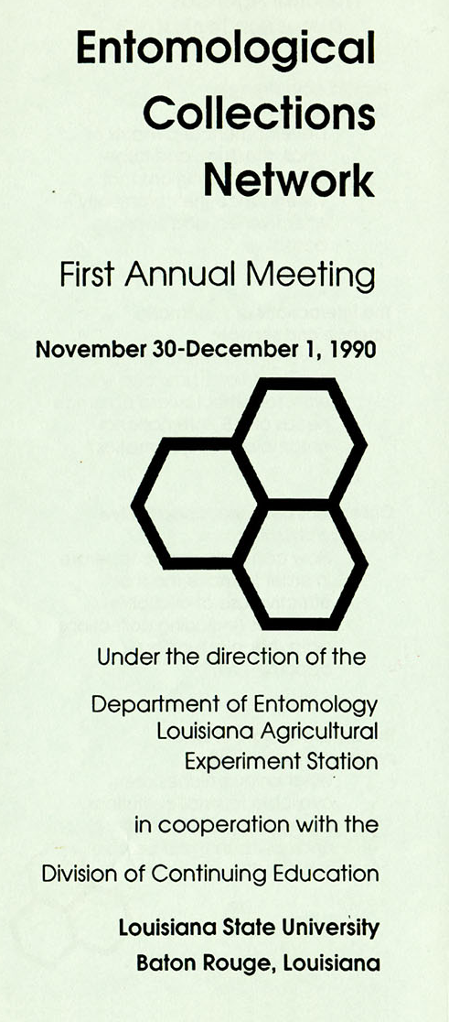
Entomological Collections Network (ECN)
30 November – 01 December 1990
1st formal program
LSU Agricultural Experiment Station

Slide 13

Entomological Collections Network (ECN)
2016 annual meeting
23–24 September
Orlando, FL
in conjunction with annual
meeting of ESA & XXV ICE

Slide 14

Entomological Collections Network (ECN)
2017 annual meeting
04–05 November
Denver, CO
in conjunction with ESA annual meetings

Slide 15
I. ESA, ECN, InvertNet, ECN-SPNHC liaison

Slide 16























Collaborative Research: Digitization TCN: InvertNet – An Integrative Platform for Research on Environmental Change, Species Discovery and Identification

Slide 17
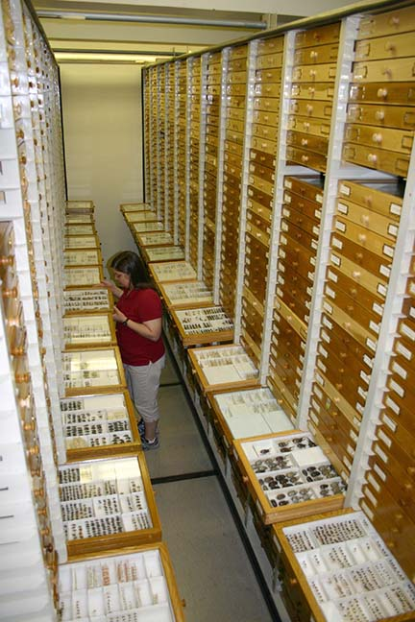
InvertNet Rationale
vast majority of specimens in U.S. collections are invertebrates
primarily insects and related arthropods
< 5% available online
usually only label data provided
invertebrate biodiversity research largely specimen-based
all knowledge of many species is embodied in collections
existing digitization methods inadequate
slow and expensive ($1+ per specimen)
risk of damage to specimens from handling

Slide 18
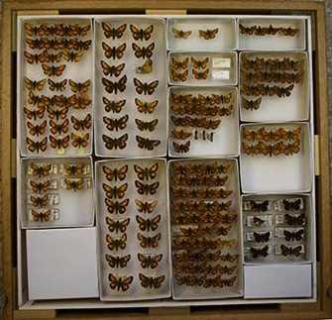
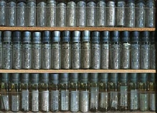
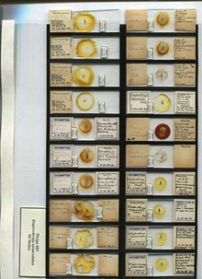
InvertNet Goals
Digitize holdings of 22 Midwestern arthropod collections (~50 million specimens)
Specimen images and metadata (label info)
Drawers, vials, slides
Advanced imaging (including 3D)
Best quality at reasonable cost (~$0.10/specimen)
Provide access to images and other data via online virtual museum
browsable/searchable/zoomable web interface
link to other data providers (GBIF, iDigBio, etc.)
Provide platform for research and development of additional tools and resources
Data mining and analysis
Community building, collaboration, and support
Education, outreach, and reference

Slide 19
I. ESA, ECN, InvertNet, ECN-SPNHC liaison

Slide 20
II. Entomological biodiversity data and collections

Slide 21
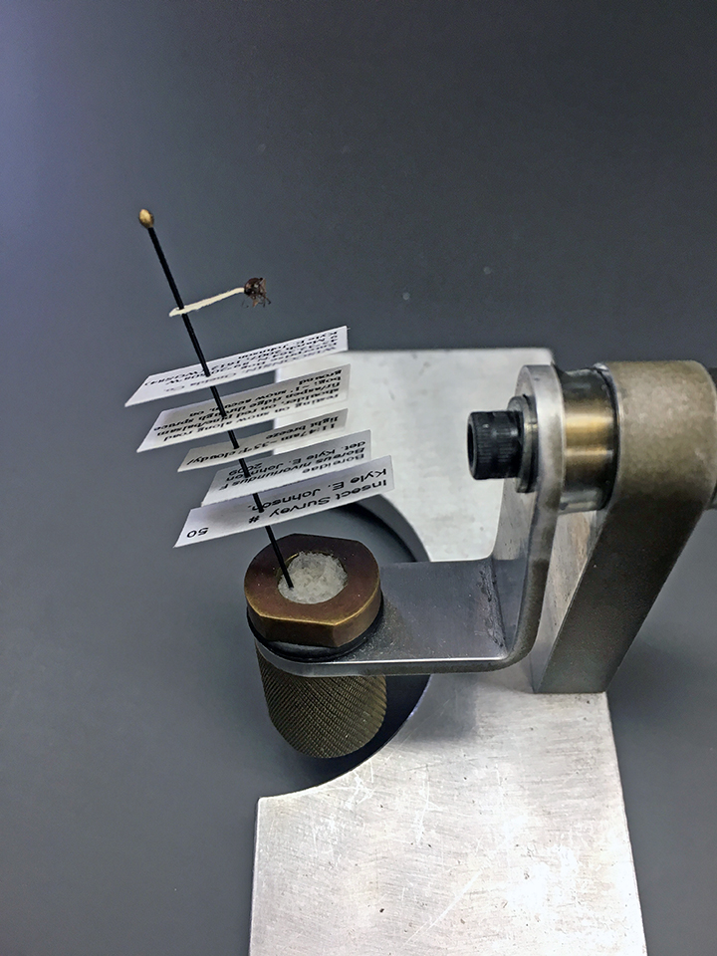
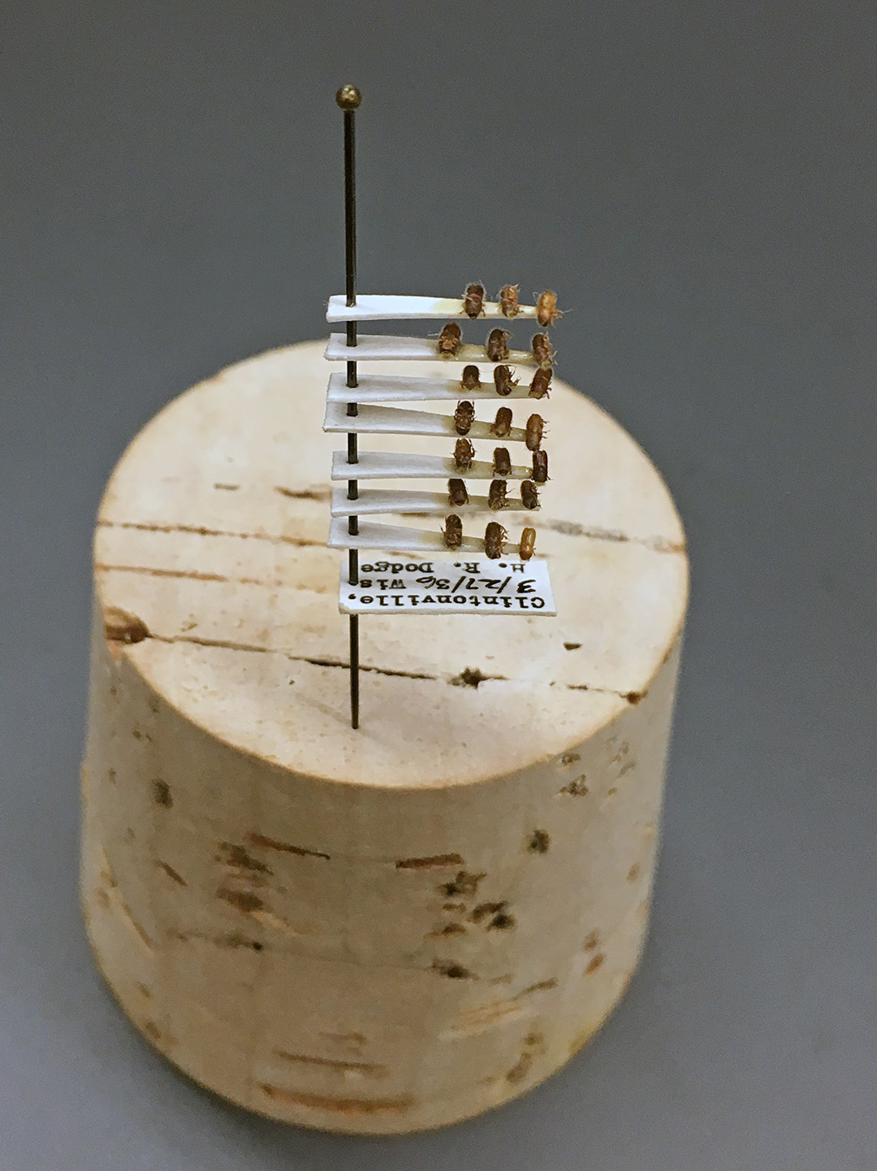
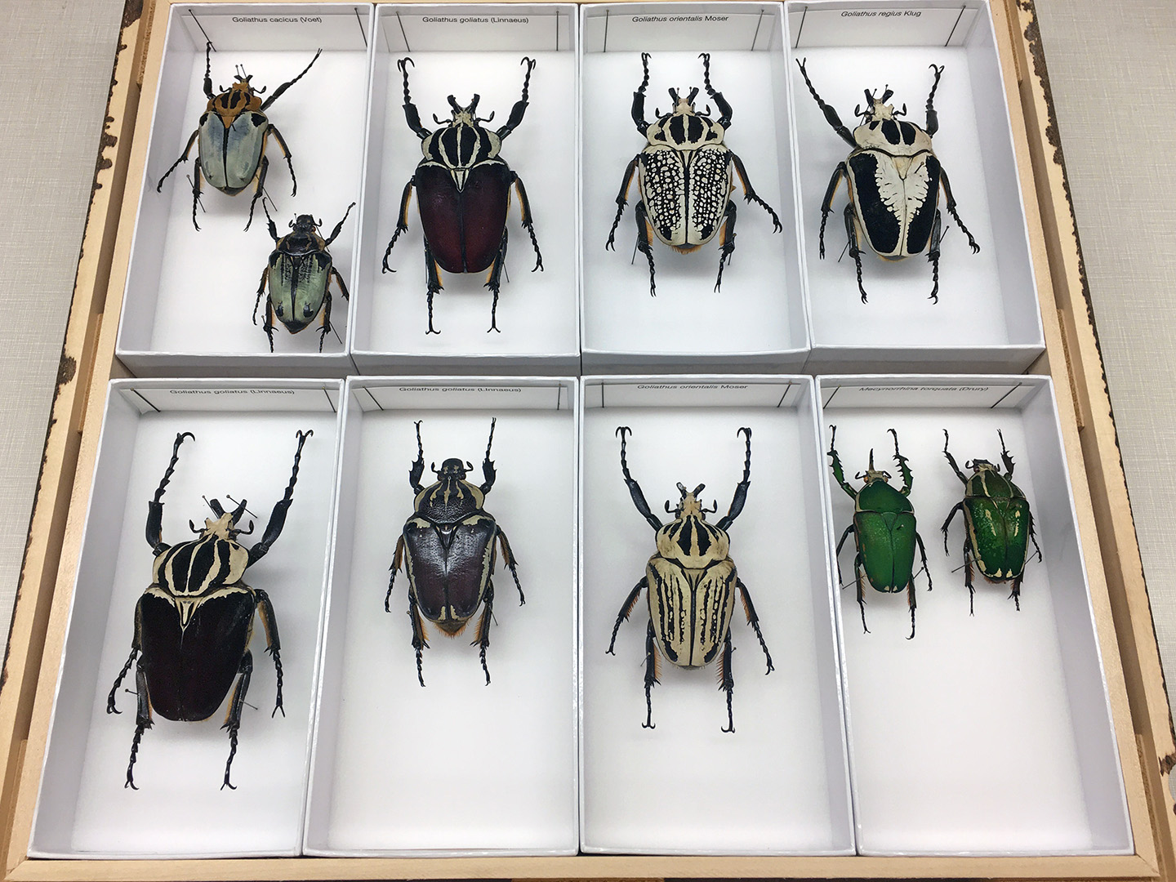
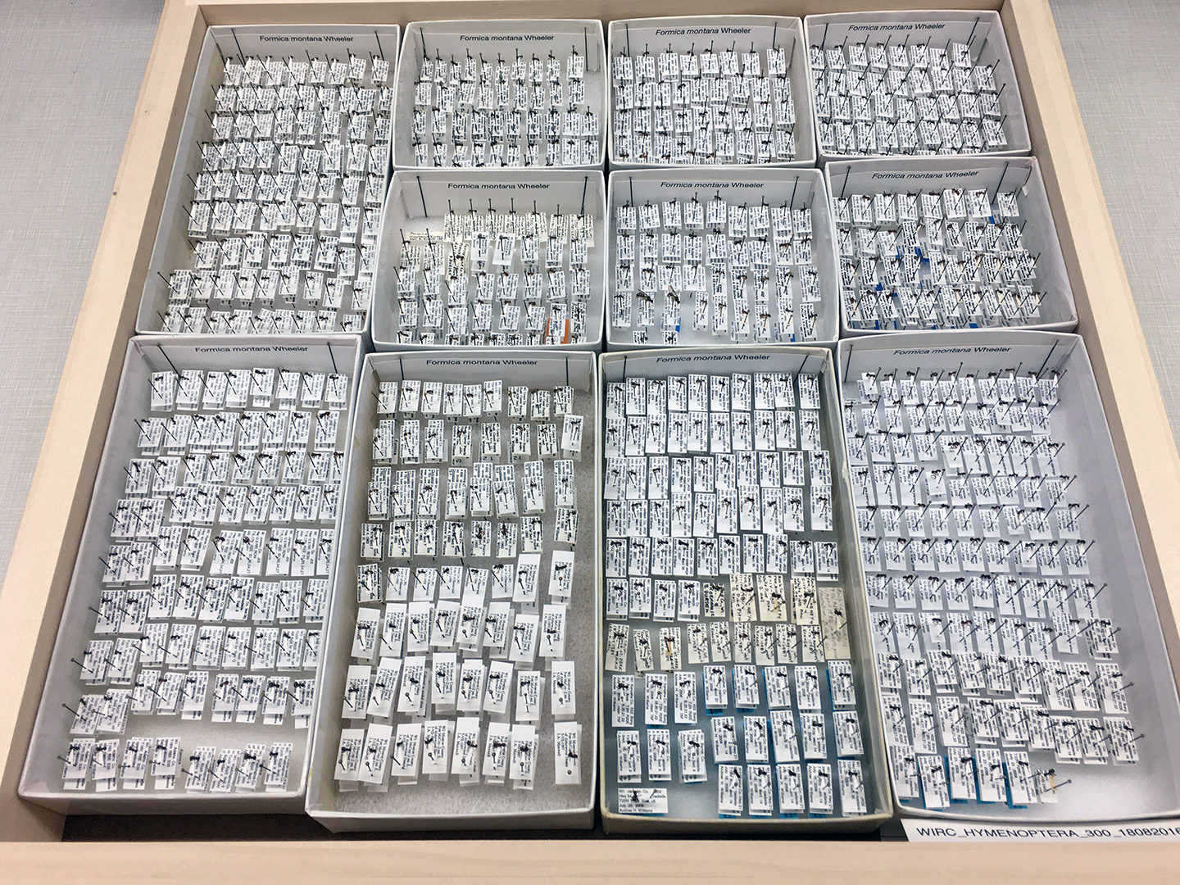
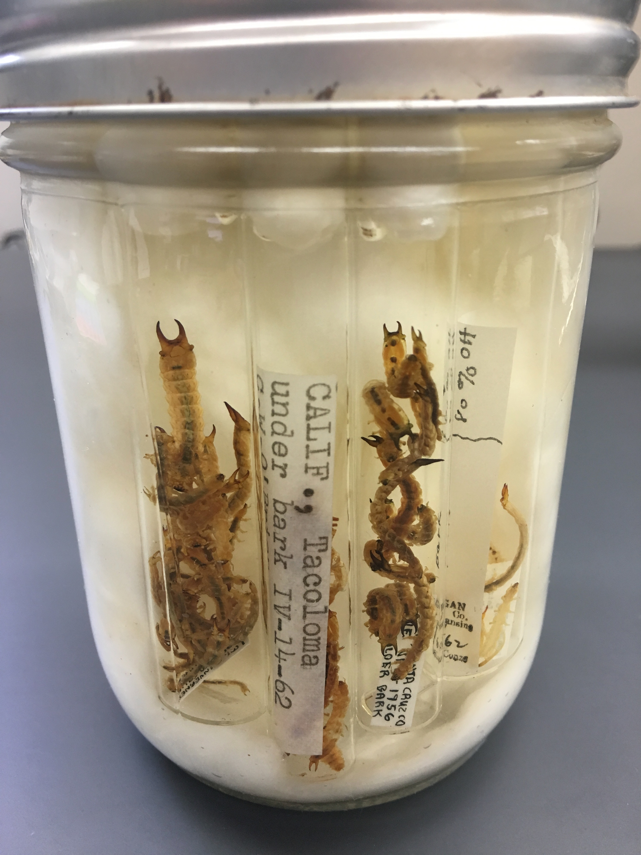
Retroactive occurrence data capture
Sheer number of specimens: est. 3,000,000+ curated, additional 5,000,000+ in bulk
Multiple, stacked labels
Multiple, stacked specimens
Transcription errors
Alcohol (i.e., “wet” collection) – additional suite of challenges

Slide 22
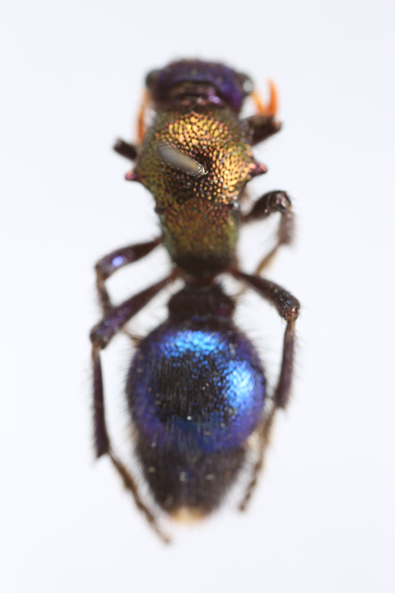
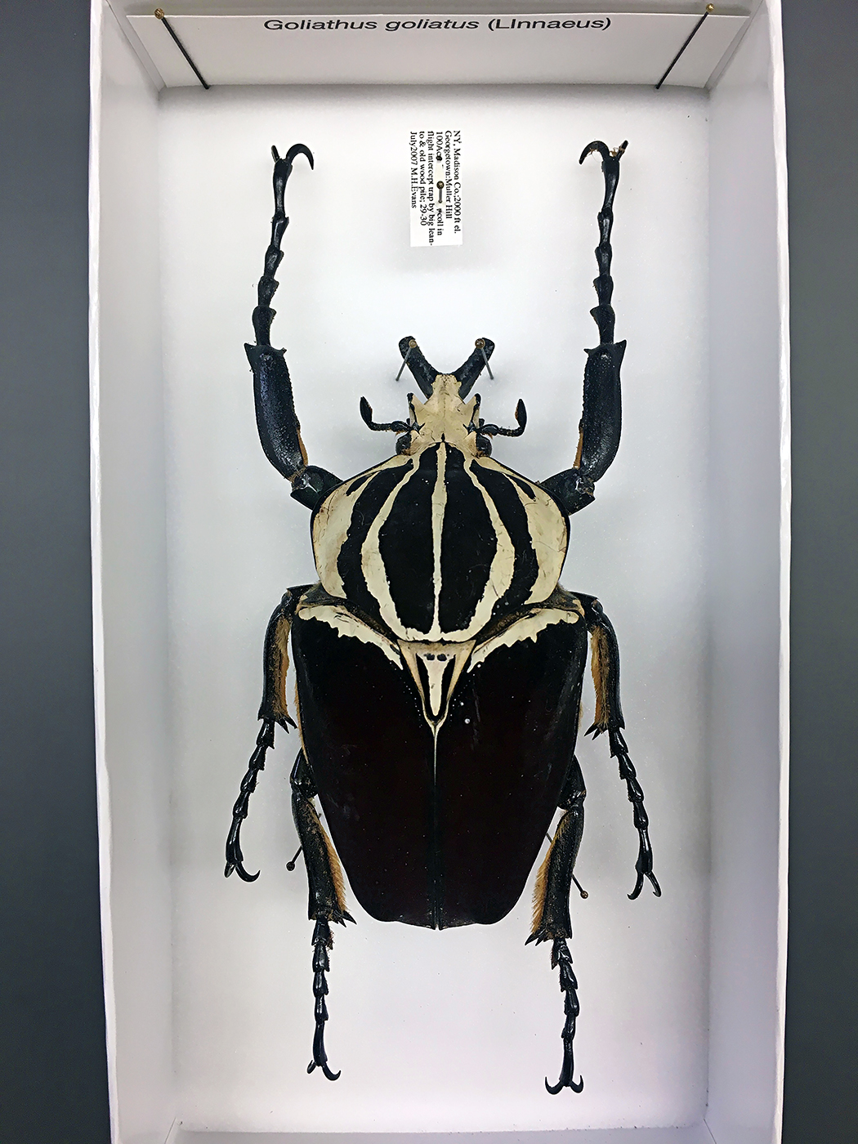
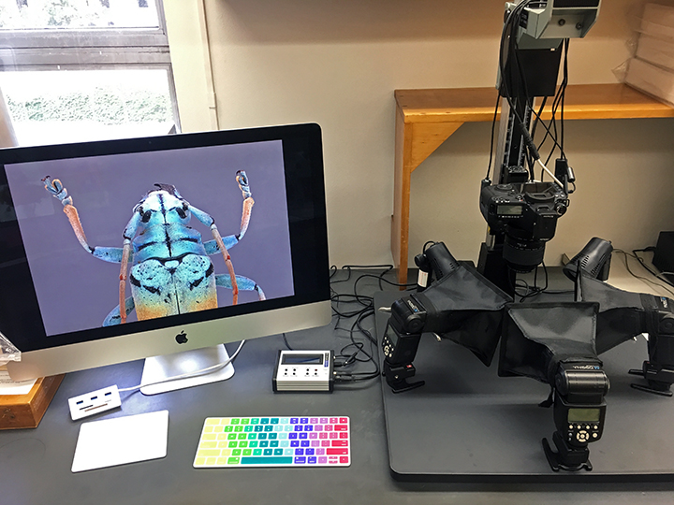

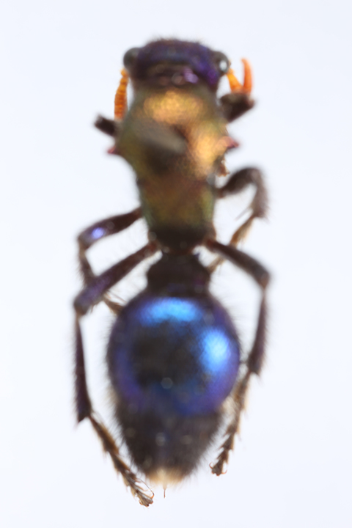
Image Capture
Sheer number of specimens – handling time
Size, fragility of specimens
Shallow depth of field

