Slide 1
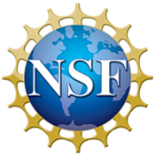
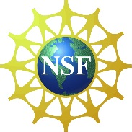
Encouraging the Proliferation of Digital Data
SPNHC 2017
18 June 2017
Denver
iDigBio/Institute for Digital Information and Scientific Communication
Florida State University

Slide 2
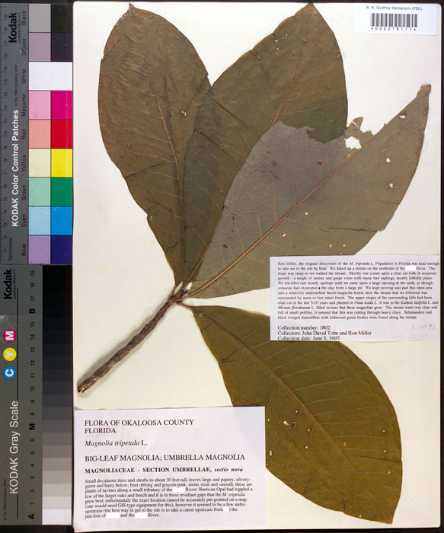
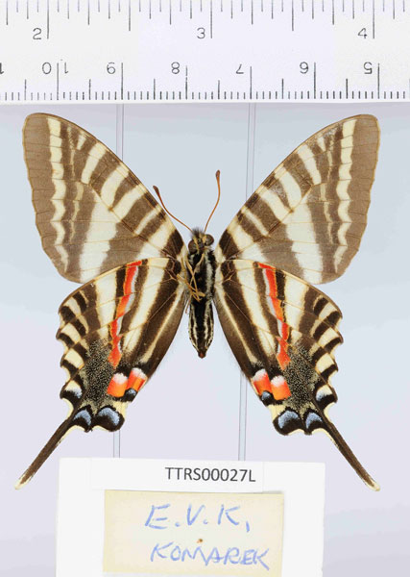
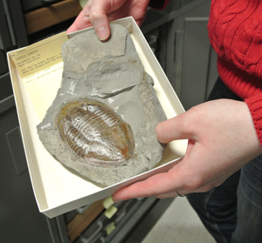
Estimates suggest that there are between 500 million and one billion neobiological and paleobiological specimens in United States’ collections, perhaps 3+ billion worldwide. No one really knows for sure!

Slide 3
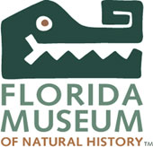
In an effort to make these collections universally accessible to taxonomists, ecologists, researchers, and the general public, in 2011 the U.S. National Science Foundation launched a $100+ million, 10-year Advancing Digitization of Biodiversity Collections (ADBC) program and named the University of Florida and Florida State University jointly as the coordinating center and national resource for digitization.
The scope of our work is limited to public, non-federal, U.S. collections, though NSF has encouraged us to develop international collaborations and we work closely with the Smithsonian.
The goal is to digitize and make available via the Web digital records for all biological and paleontological collection objects in N. America over the 10-year life of the project and to facilitate the discovery and use of these data for important biodiversity research.

Slide 4
Definition of Digitization
Converting analog specimen data to digital format, to include transcription of text data (labels, catalogs, field notes, etc.), recording specimen images (2D, 3D, CT), converting audio/video to digital, etc.

Slide 5
The Alphabet – A Few Acronyms
Acronym | Meaning
iDigBio | Integrated Digitized Biocollections
NSF | National Science Foundation
ADBC | Advancing Digitization of Biodiversity Collections
TCN | Thematic Collections Network
PEN | Partner to Existing Network
CSBR | Collections in Support of Biological Research
IMLS | Institute for Museum and Library Services
GBIF | Global Biodiversity Information Facility
BCoN | Biodiversity Collections Network
GRBio | Global Registry of Biodiversity Repositories
DwC | Darwin Core
IPT | Integrated Publishing Toolkit
API | Application Programming Interface
VertNet | Vertebrate data portal, Data mobilization and cleaning services
EOL | Encyclopedia of Life

Slide 6
InvertNet: An Integrative Platform for Research on Environmental Change, Species Discovery and Identification (Illinois Natural History Survey, University of Illinois) http://invertnet.org
Plants, Herbivores, and Parasitoids: A Model System for the Study of Tri-Trophic Associations (American Museum of Natural History) http://tcn.amnh.org
North American Lichens and Bryophytes: Sensitive Indicators of Environmental Quality and Change (University of Wisconsin – Madison) http://symbiota.org/nalichens/index.php http://symbiota.org/bryophytes/index.php (plus 2 PENs)
Digitizing Fossils to Enable New Syntheses in Biogeography - Creating a PALEONICHES-TCN (University of Kansas)
The Macrofungi Collection Consortium: Unlocking a Biodiversity Resource for Understanding Biotic Interactions, Nutrient Cycling and Human Affairs (New York Botanical Garden)
Mobilizing New England Vascular Plant Specimen Data to Track Environmental Change (Yale University)
Southwest Collections of Anthropods Network (SCAN): A Model for Collections Digitization to Promote Taxonomic and Ecological Research (Northern Arizona University) http://hasbrouck.asu.edu/symbiota/portal/index.php
iDigPaleo: Fossil Insect Collaborative: A Deep-Time Approach to Studying Diversification and Response to Environmental Change (U. Colorado, Boulder)
Developing a Centralized Digital Archive of Vouchered Animal Communication Signals (Cornell University, Laboratory of Orthithology)
The Macroalgal Herbarium Consortium: Accessing 150 Years of Specimen Data to Understand Changes in the Marine/Aquatic Environment
Collaborative: Documenting the Occurrence through Space & Time of Aquatic Non-indigenous Fish, Mollusks, Algae, & Plants Threatening North America's Great Lakes
Collaborative Research: The Key to the Cabinets: Building and Sustaining a Research Database for a Global Biodiversity Hotspot
InvertEBase: reaching back to see the future: species-rich invertebrate faunas document causes and consequences of biodiversity shifts
The Microfungi Collections Consortium: A Networked Approach to Digitizing Small Fungi with Large Impacts on the Function and Health of Ecosystems​ (MiCC)
Documenting Fossil Marine Invertebrate Communities of the Eastern Pacific - Faunal Responses to Environmental Change over the last 66 million years​ (PCMIF) (EPICC) (U. California, Berkeley)
The Cretaceous World: Digitizing Fossils to Reconstruct Evolving Ecosystems in the Western Interior Seaway (KU)
Lepidoptera of North America Network: Documenting Diversity in the Largest Clade of Herbivores (NAU)
The Mid-Atlantic Megalopolis: Achieving a greater scientific understanding of our urban world (Morris Arboretum, U. Pennsylvania

Slide 7
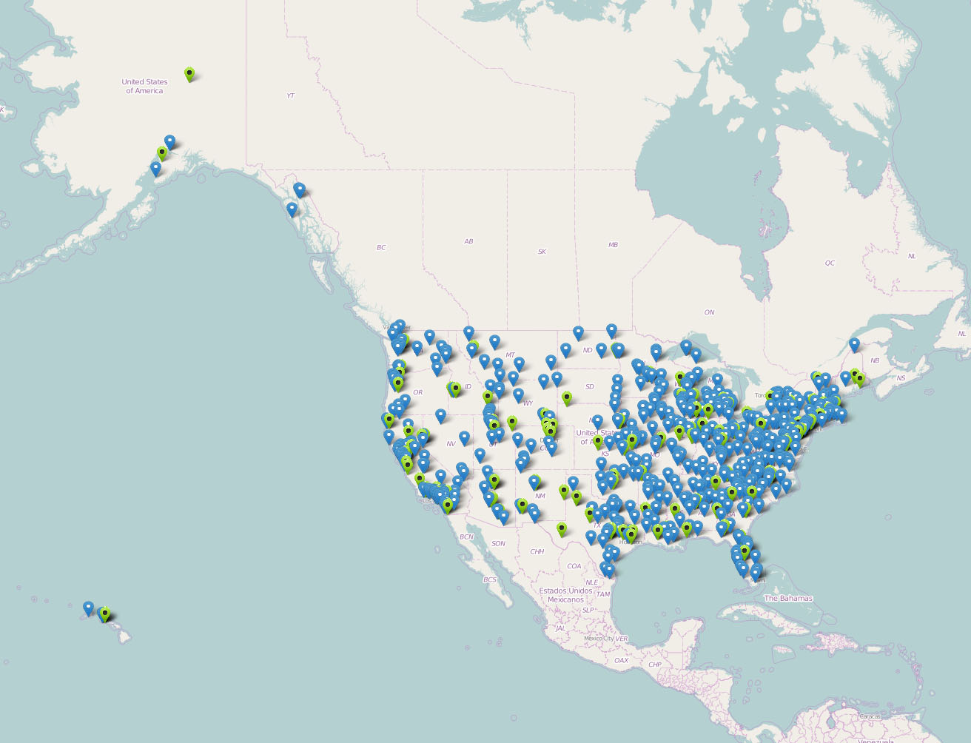
Advancing Digitization of Biodiversity Collections (ADBC)
To date: 18 TCNs,17 PENs, ~319 unique institutions, 600 collaborators, 50 states

Slide 8
Assessing Digitization Practices in Biological and Paleontological Collections
28 Collections
10 Museums
Spanning biological and paleontological collections
Insects and other invertebrates, plants, birds, mammals, herps
Wet, dry

Slide 9
Personnel
Task Clusters
(modules)
Geo-referencing
Image Capture
Image Processing
Pre-digitization Curation
or “Staging”
Data Capture
Image/Data
Storage
Written
Protocols
Biodiversity informatics Manager

Slide 10
Personnel
Task Clusters
(modules)
Geo-referencing
Image Capture
Image Processing
Pre-digitization Curation
or “Staging”
Geo-referencing
Data Capture
Image/Data
Storage
Written
Protocols
Biodiversity Informatics
Biodiversity informatics Manager

Slide 11
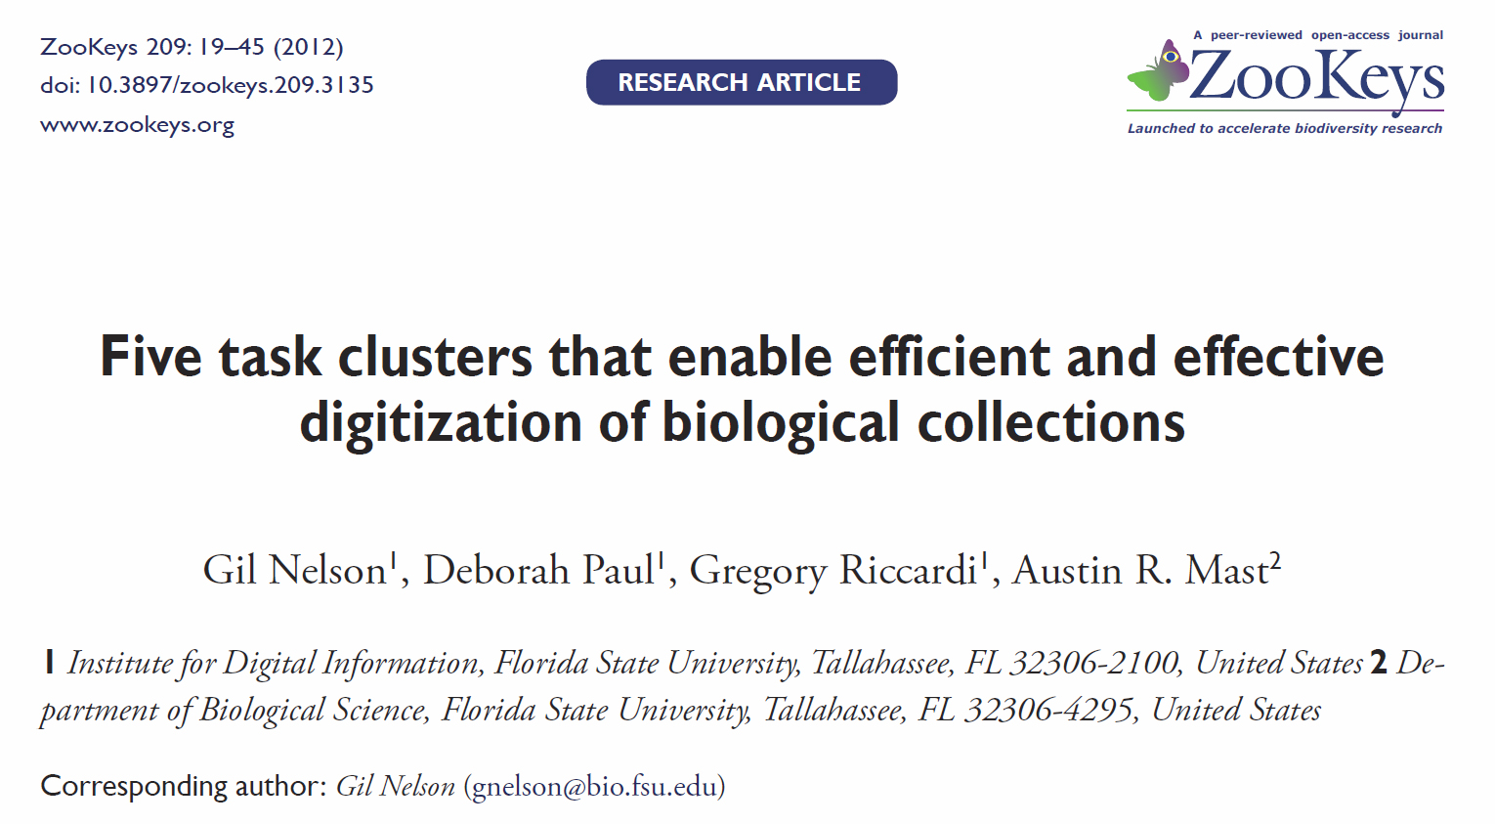

Slide 12
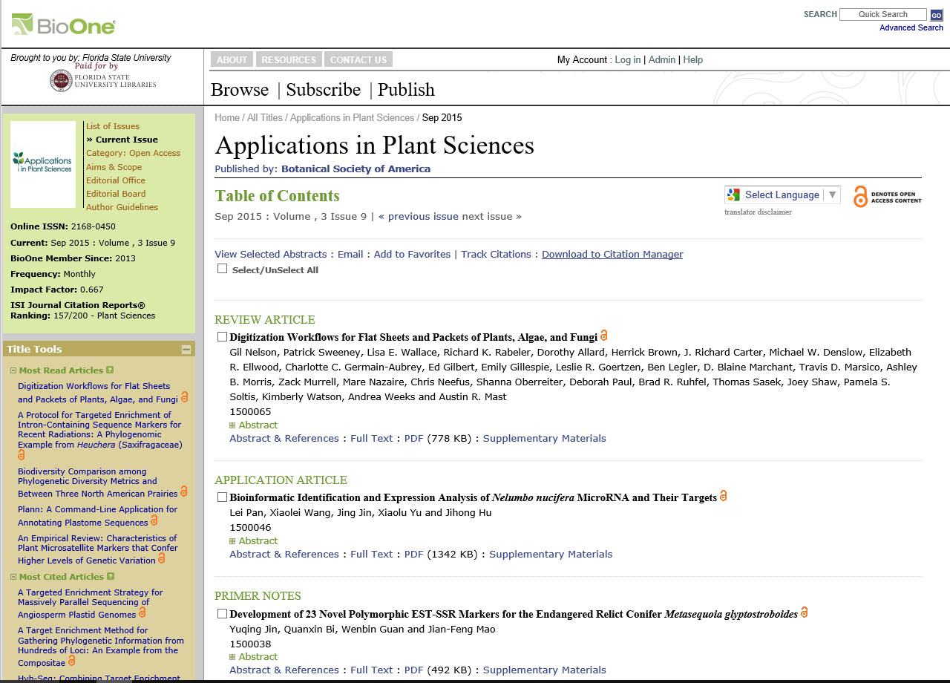

Slide 13
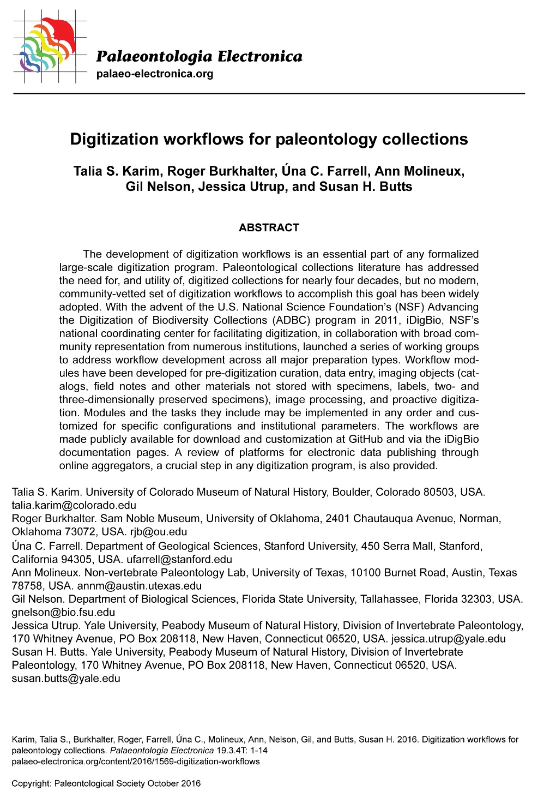
https://github.com/iDigBioWorkflows/PaleontologyDigitizationWorkflows
19 October 2016

Slide 14
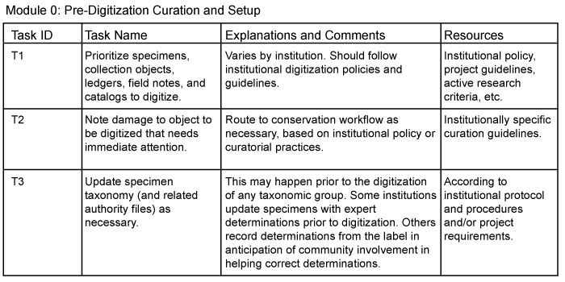

Slide 15
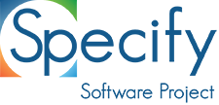

Slide 16
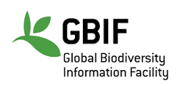

Slide 17
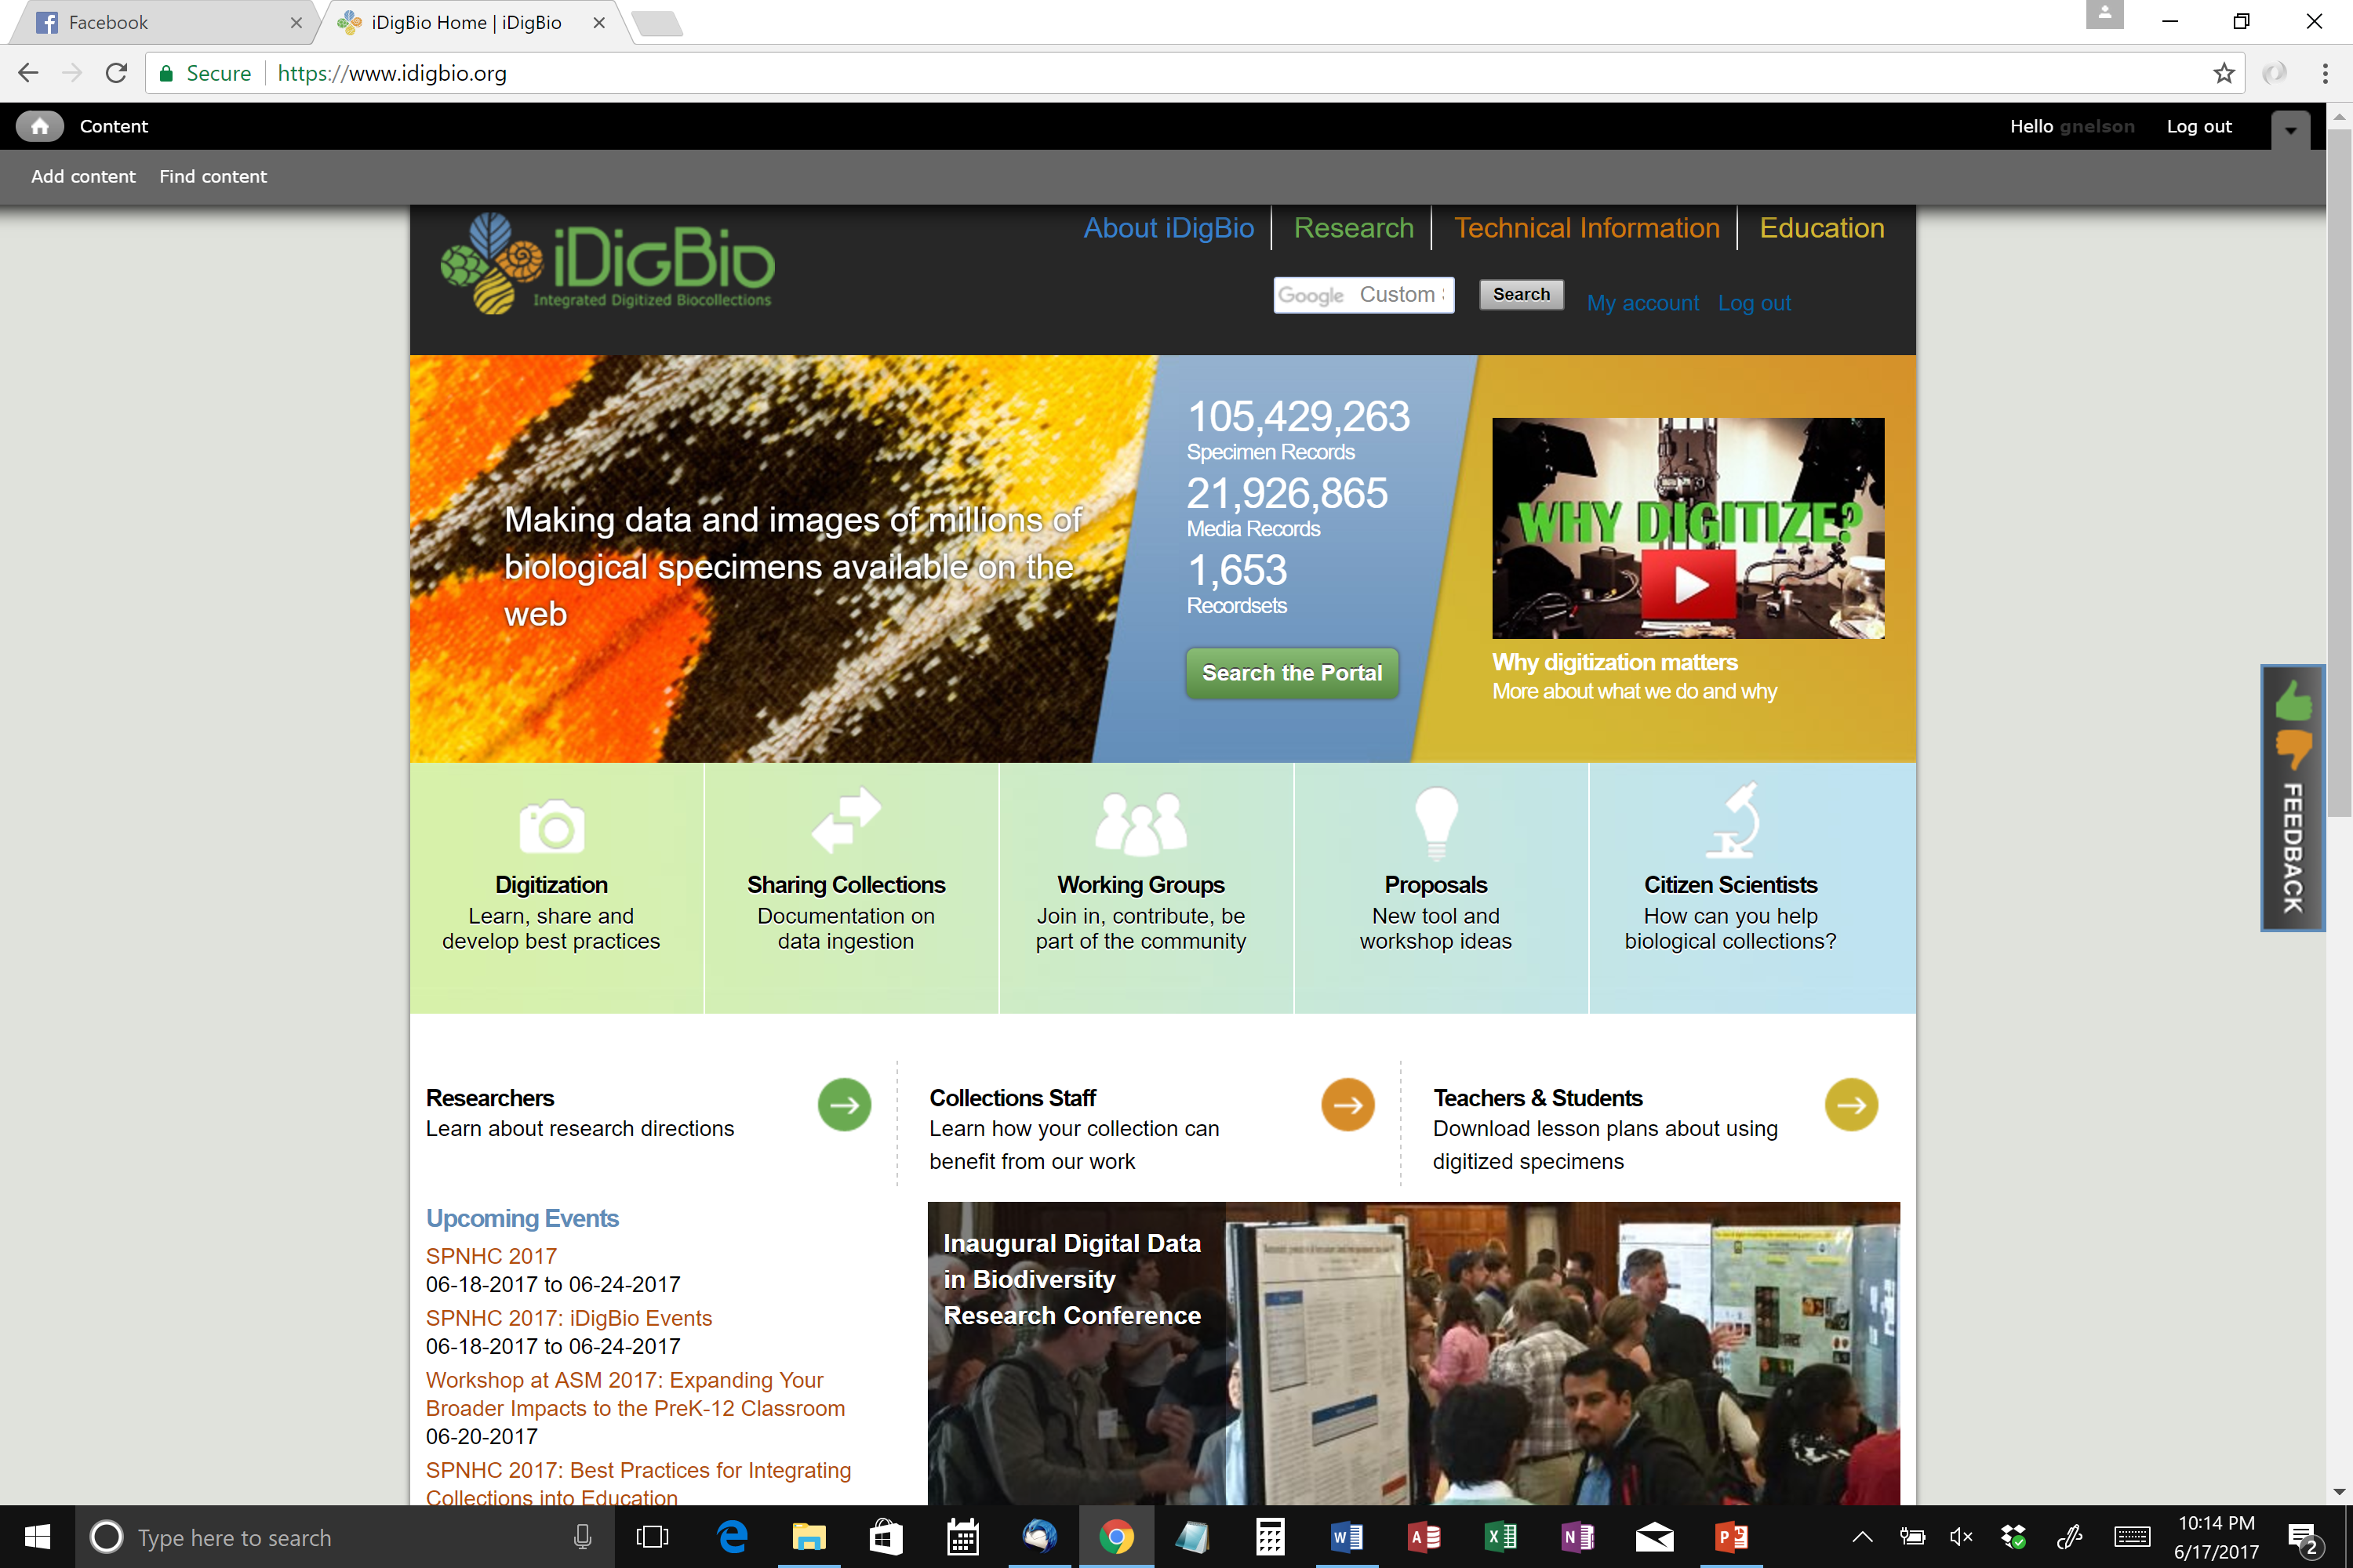

Slide 18
