Slide 1
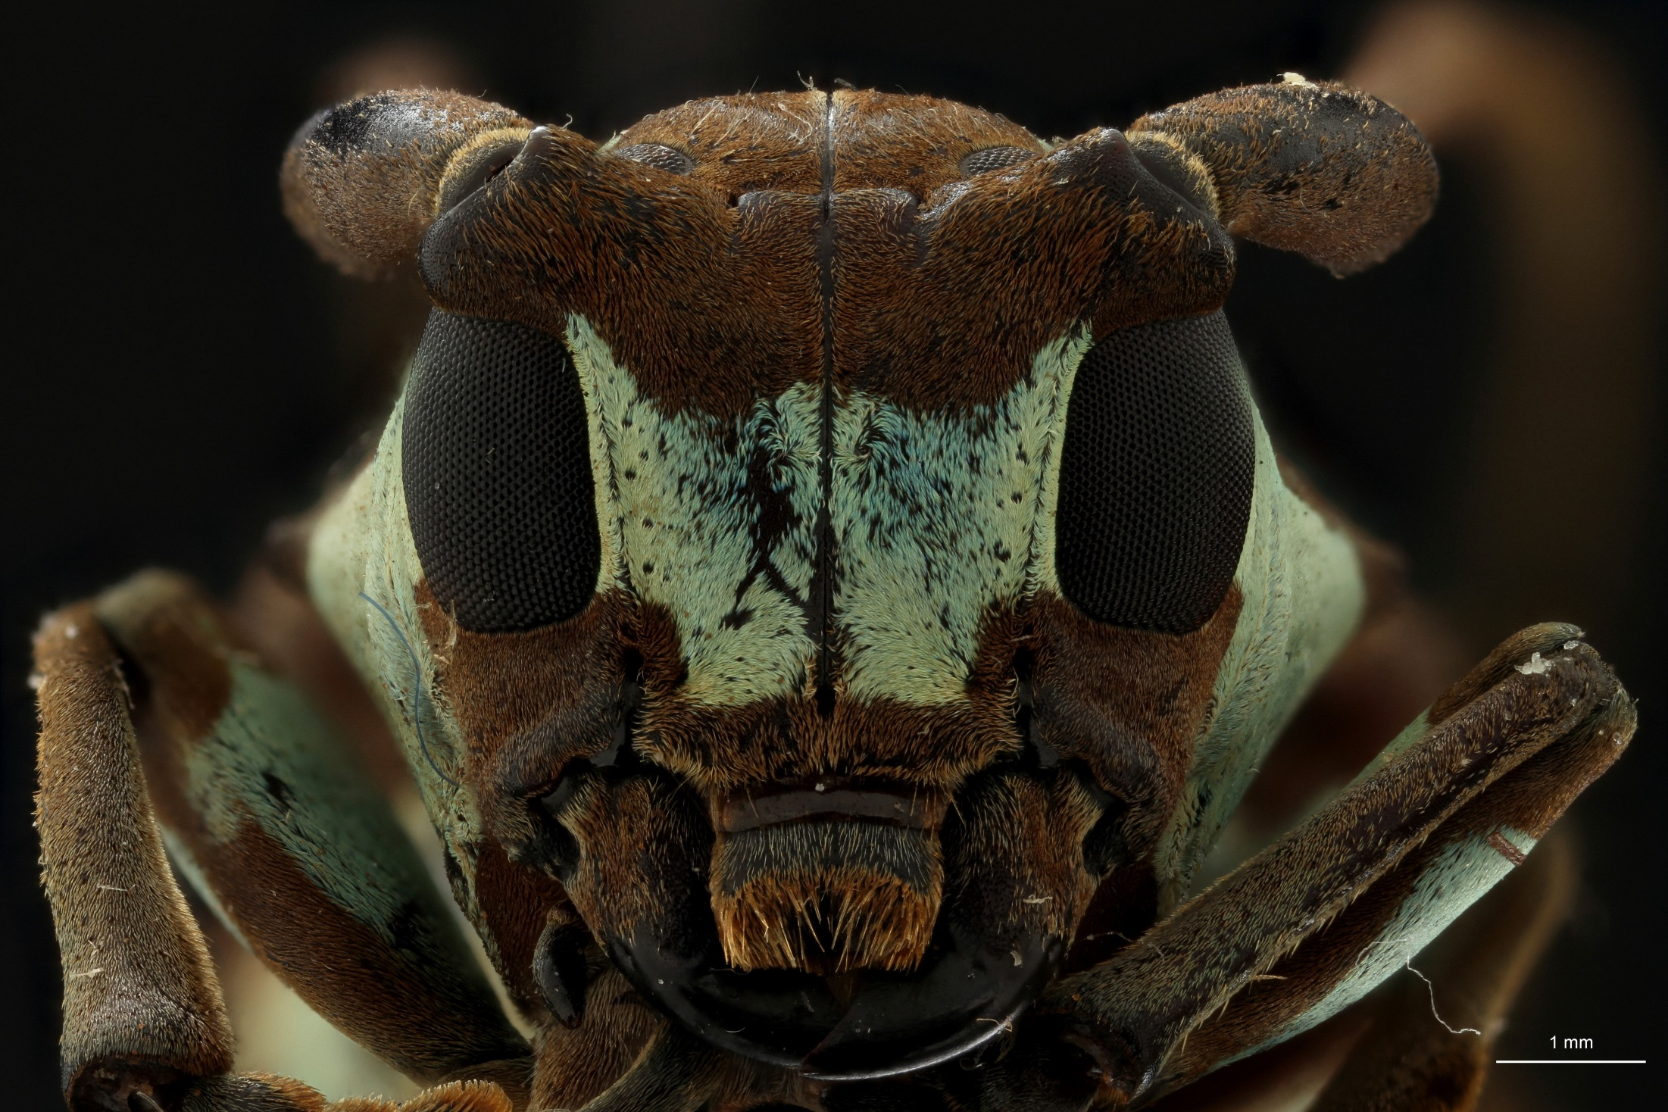
Wiki-Handbook of best practices and standards for 3D imaging Natural History specimens.

Slide 2
Overview
How?
Research and Techniques
Partnerships
Framework
What?
Wiki platform
Printed Handbooks of Best Practice

Slide 3
How?

Slide 4
How?

Slide 5
Which techniques are considered?
2D (basis for 3D)
3D
Surface only
Volumes (Surface + Interior)

Slide 6
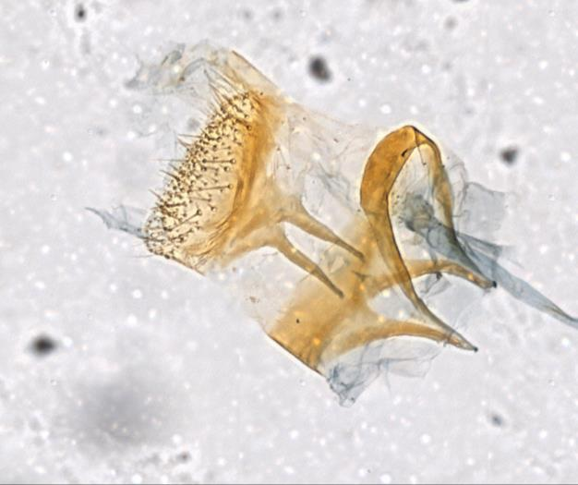
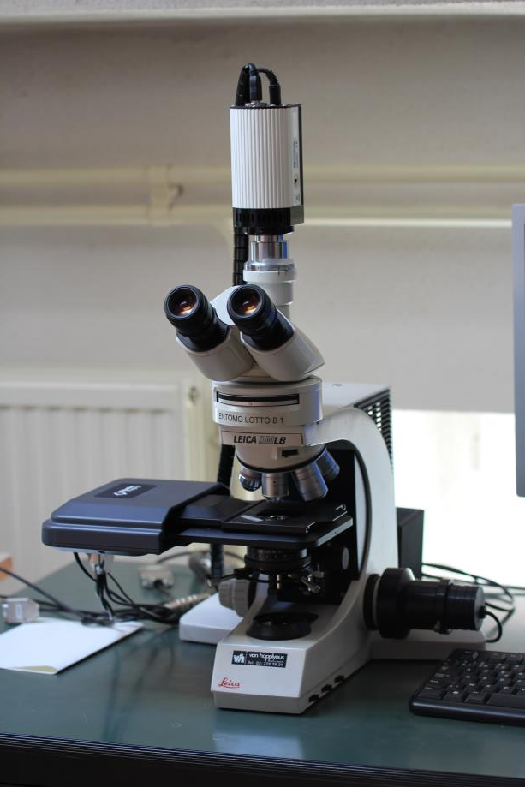
2D: Gigapan - Focus Stacking Microscope
Caloptitia galacotra (Pt) RBINS 2017
Microscope Focus Stacking 2D+

Slide 7
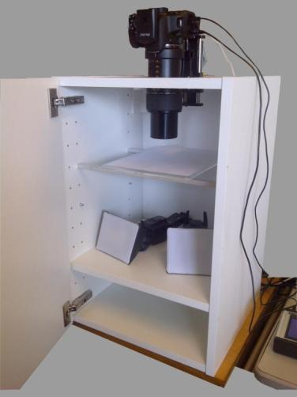
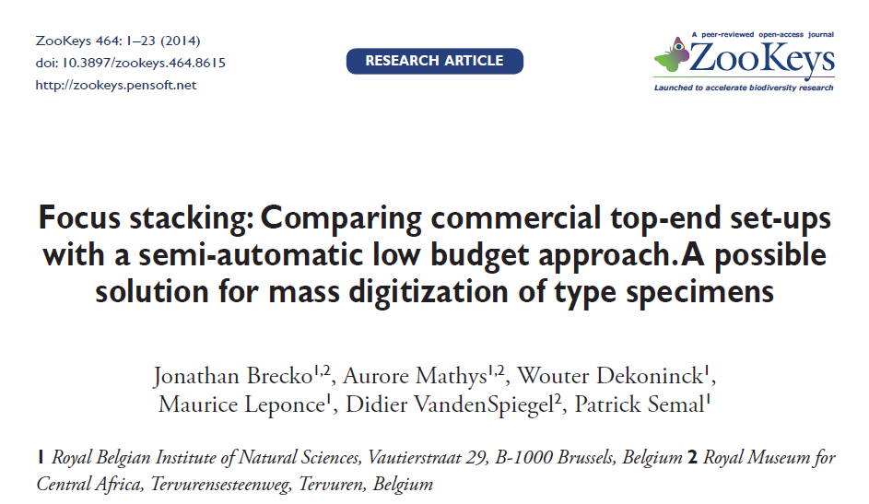
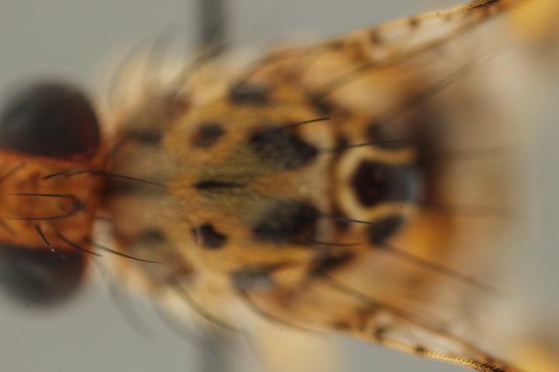
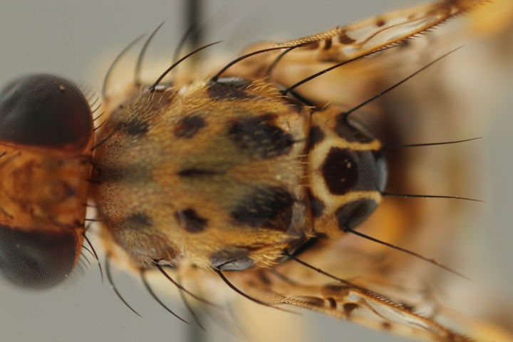
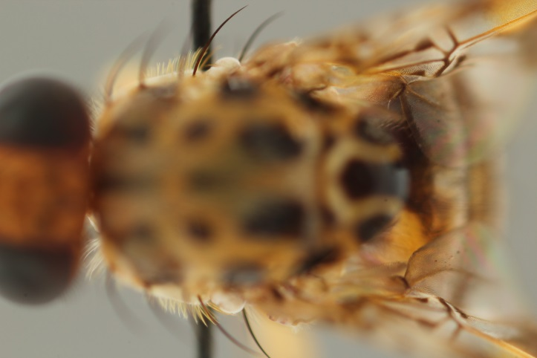
2D+ (Focus Stacking)
http://zookeys.pensoft.net/articles.php?id=4346
Focus Stacking 2D+

Slide 8
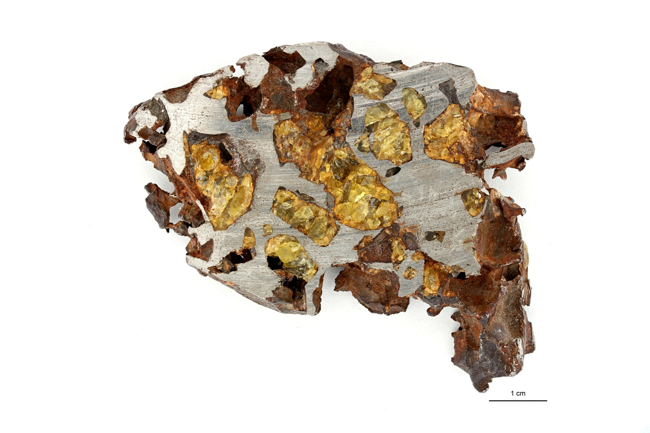
2D+ (Focus Stacking)

Slide 9
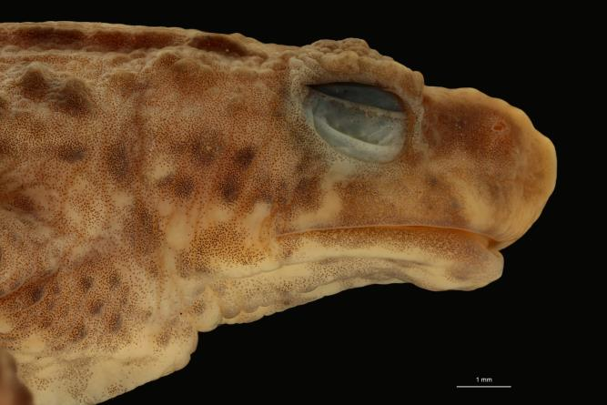
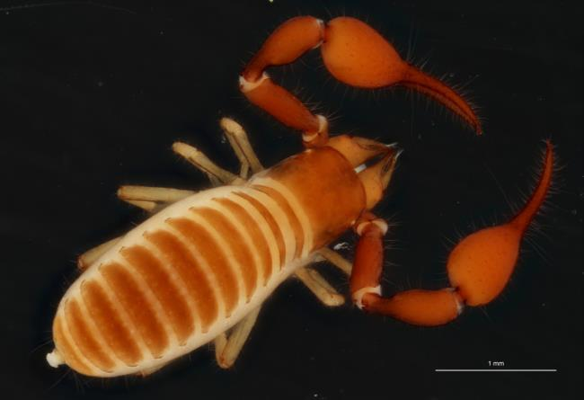
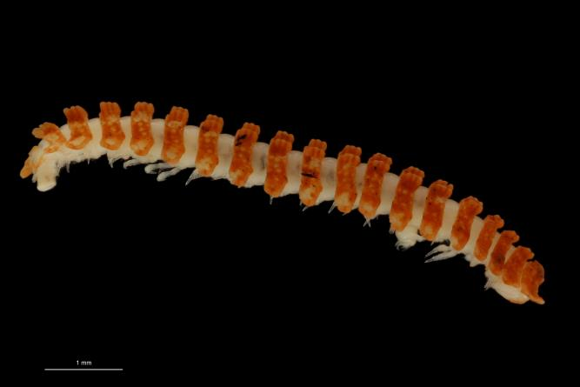
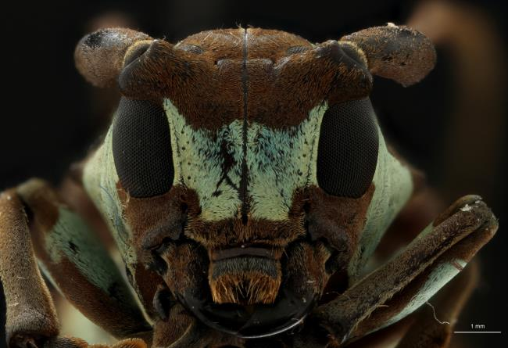
2D+ (Focus Stacking)

Slide 10
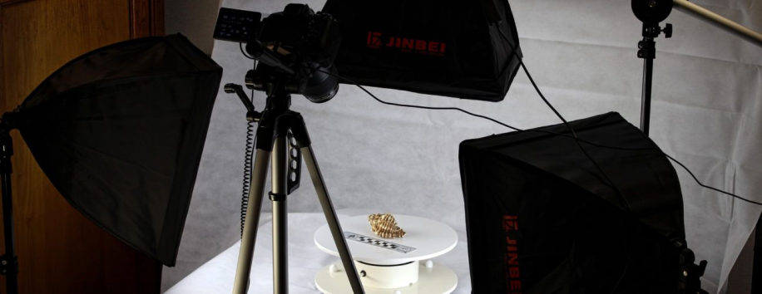
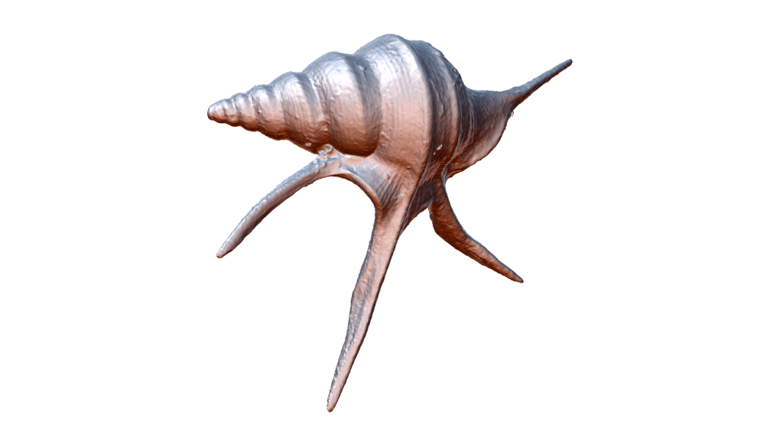
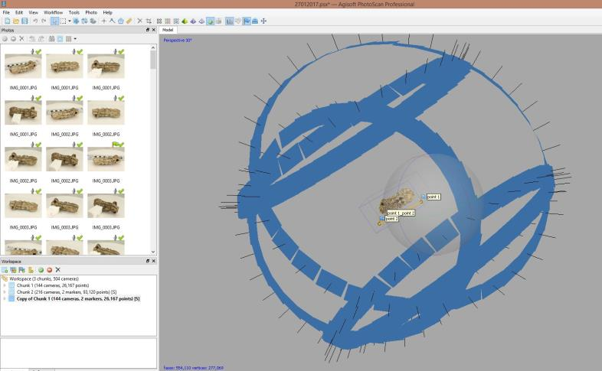
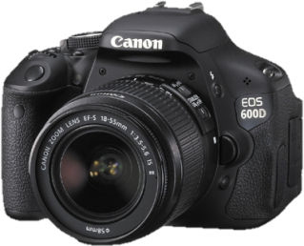
3D Scanning: Photogrammetry
Agisoft Photoscan
Photogrammetry

Slide 11
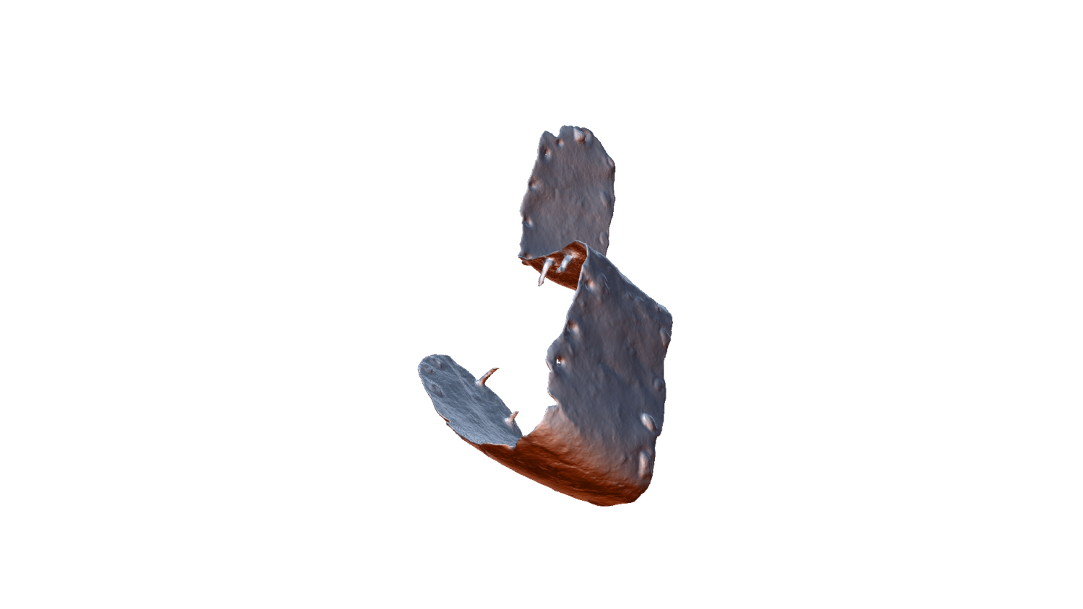
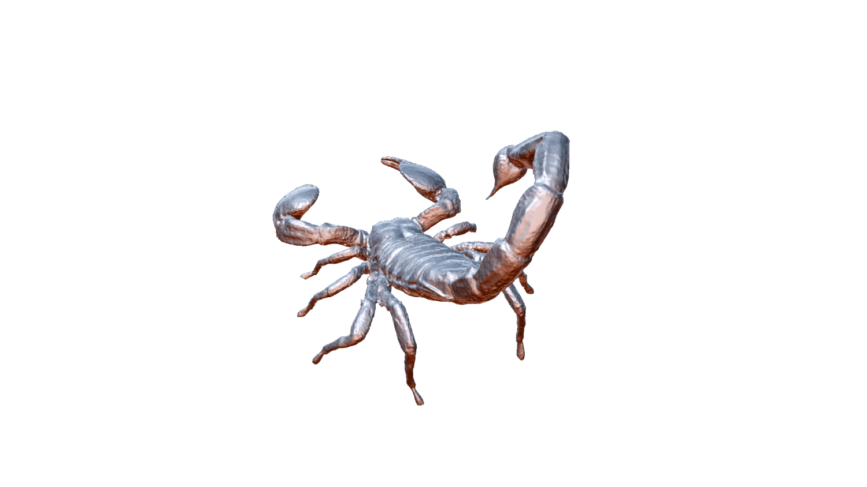
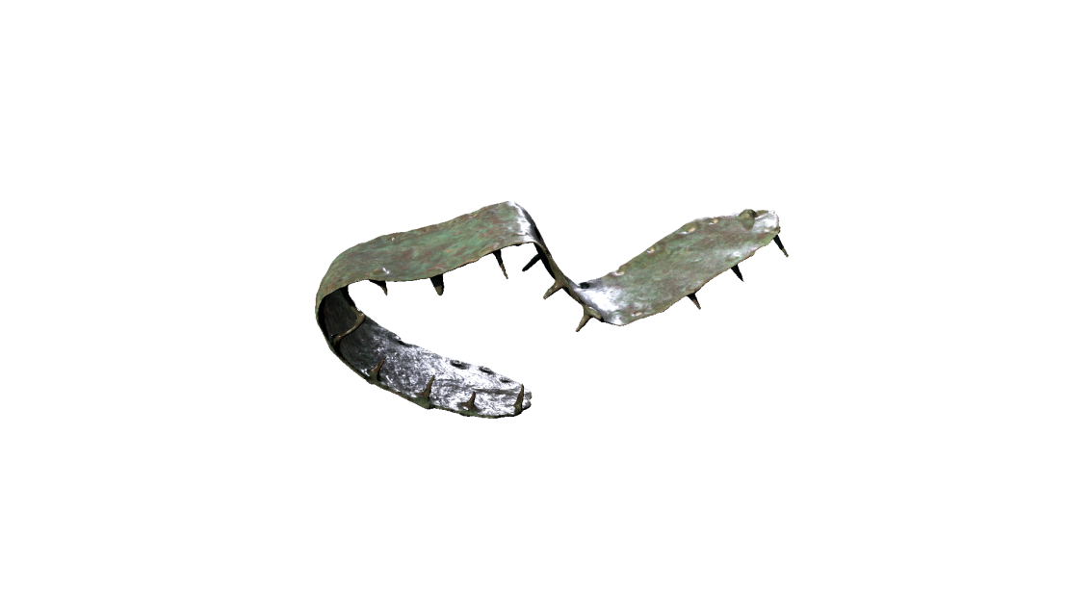
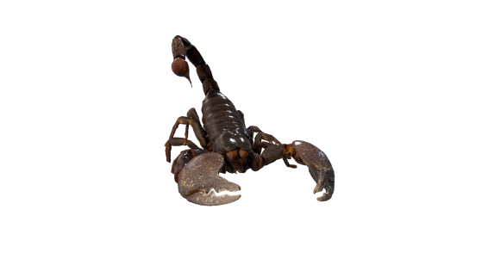
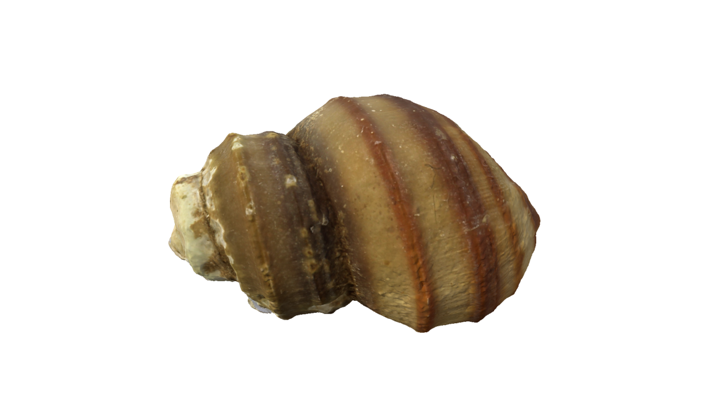
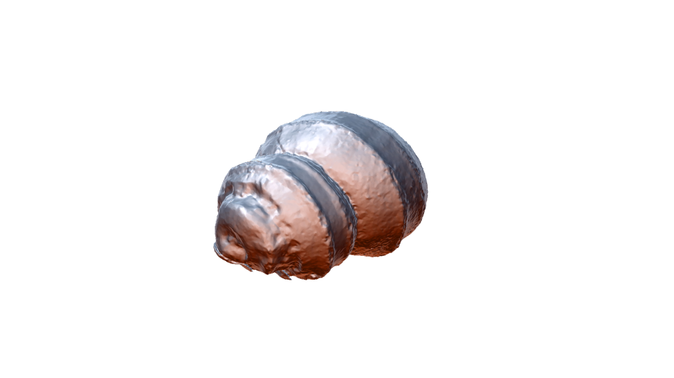
3D scanning: Photogrammetry
Photogrammetry

Slide 12
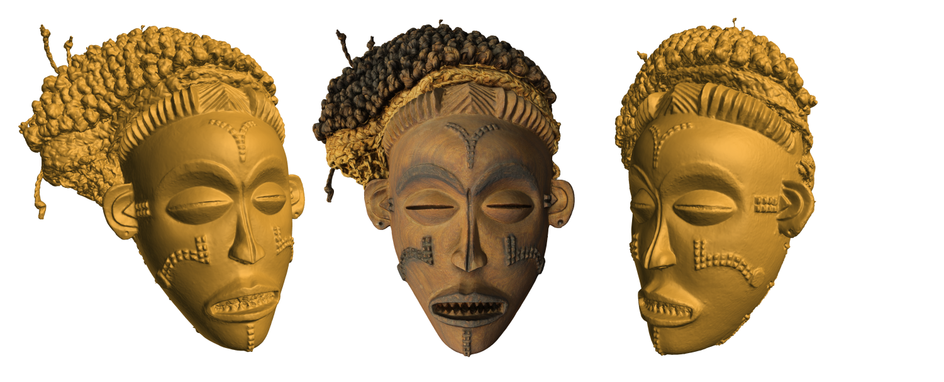
3D scanning: Photogrammetry
Photogrammetry

Slide 13
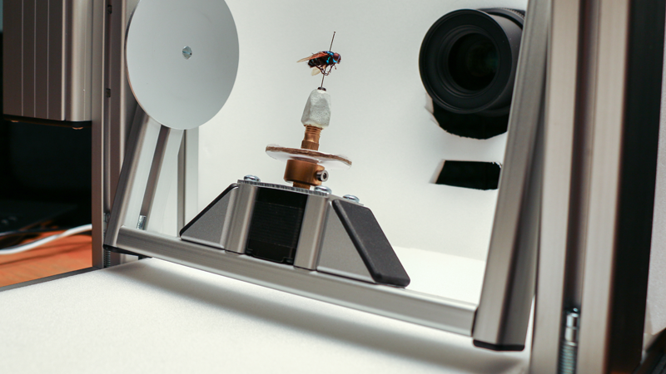
2D+ ZooSphere
http://Zoosphere.net

Slide 14
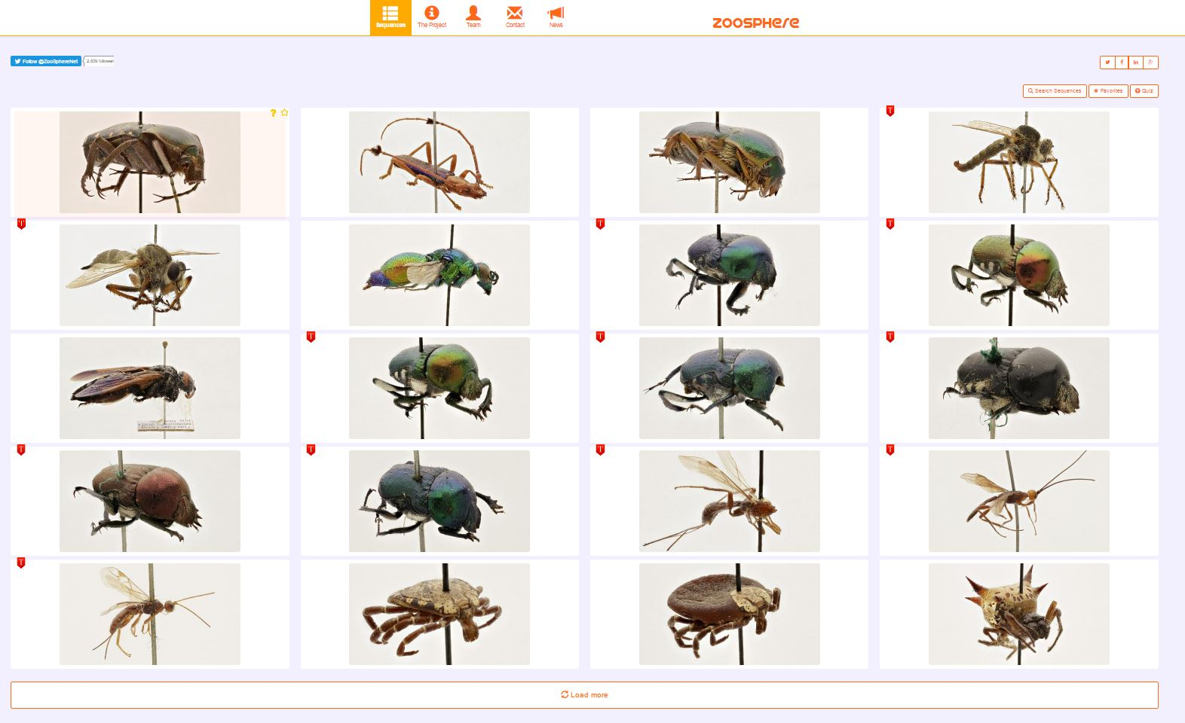
2D+ ZooSphere
http://Zoosphere.net

Slide 15
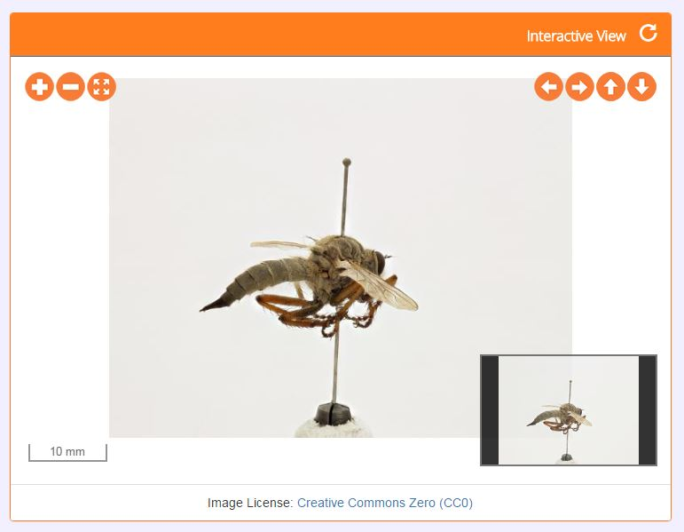
2D+ ZooSphere
http://Zoosphere.net

Slide 16
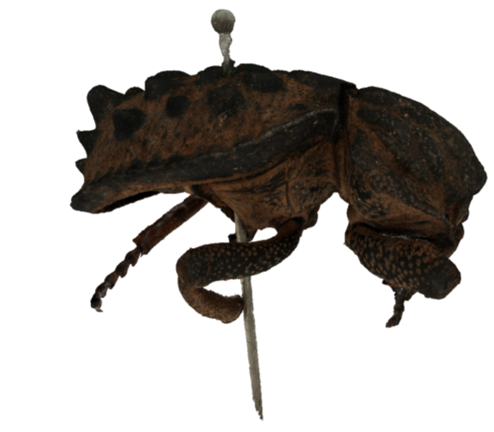
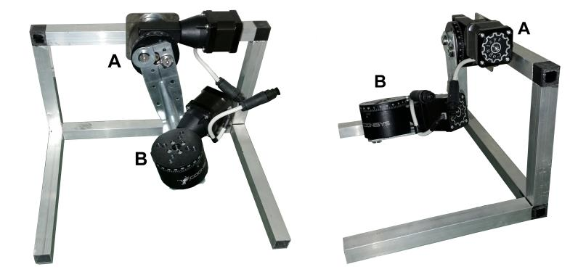
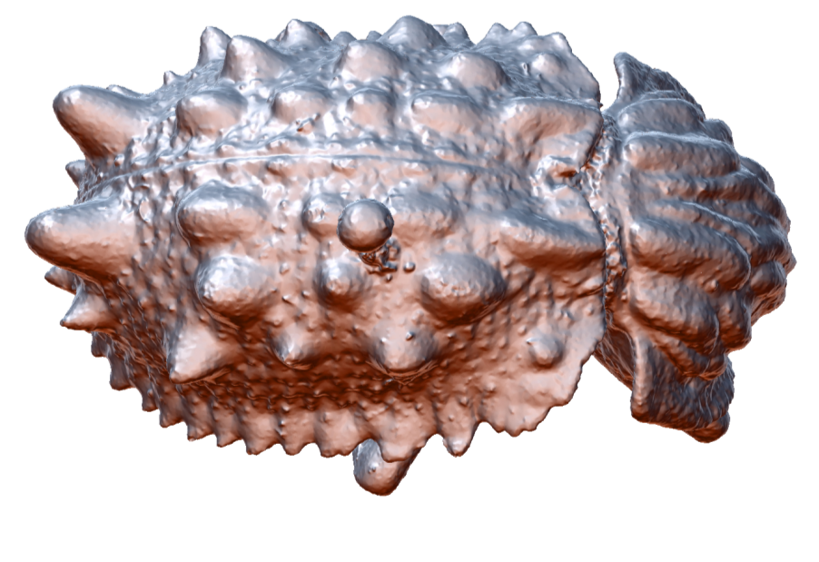
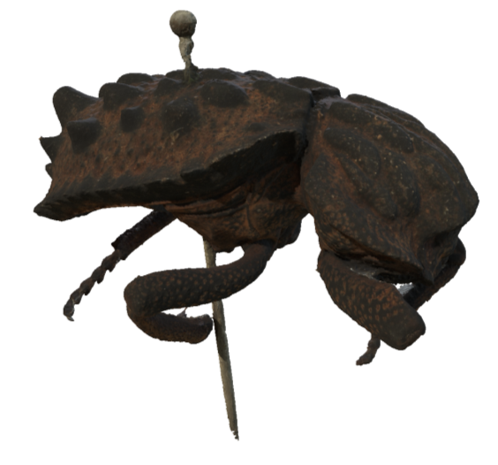
3D scanning: Focus Stacking +Photogrammetry

Slide 17
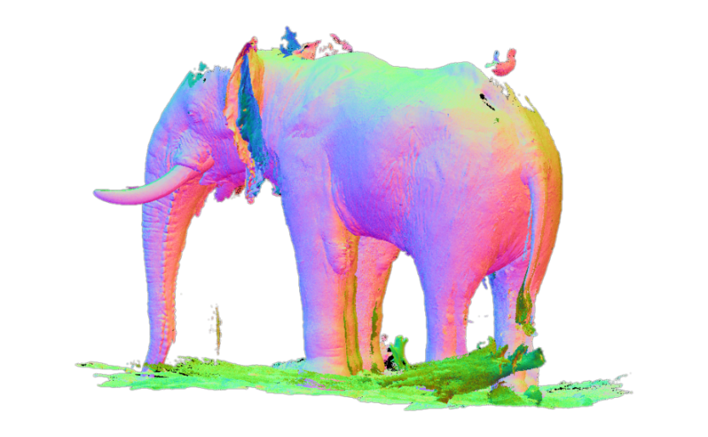
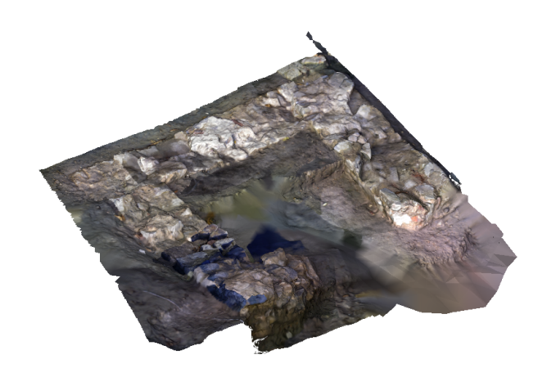
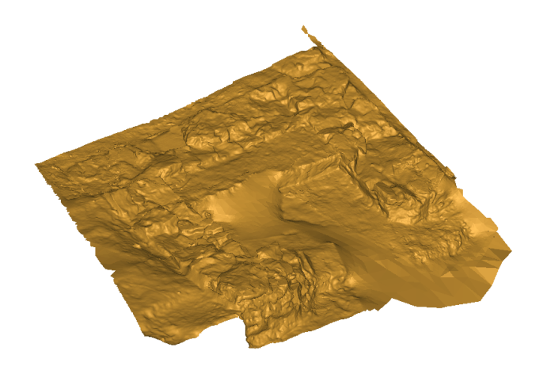
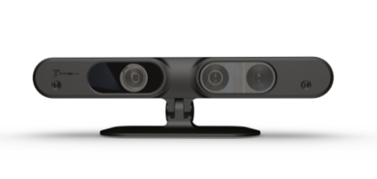
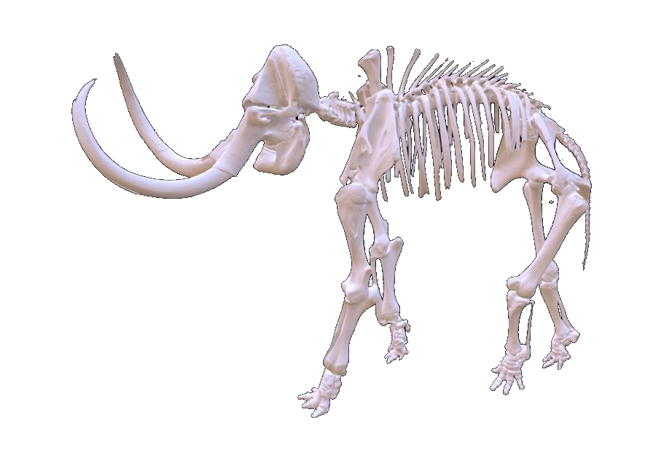
3D scanning: Infrared
Infrared technology

Slide 18
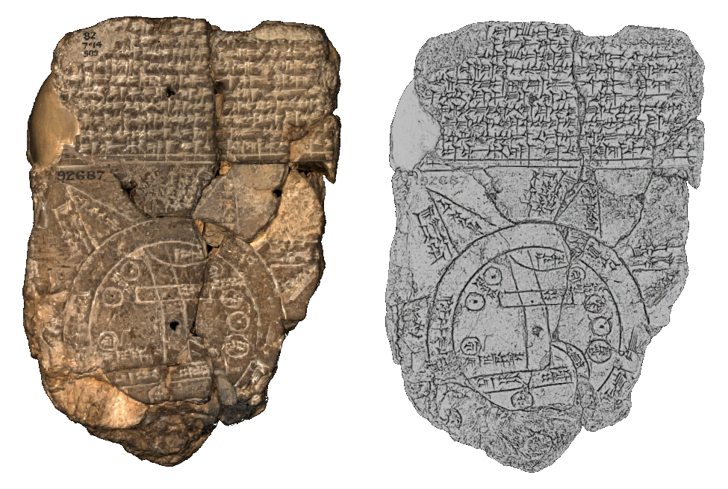
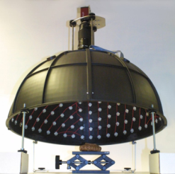
3D scanning: RTI/Minidome
Mini Dome KULeuven

Slide 19
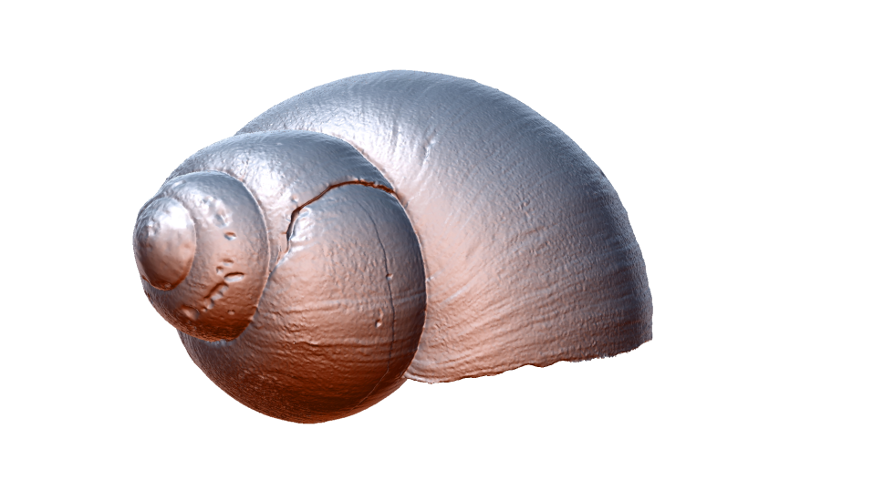
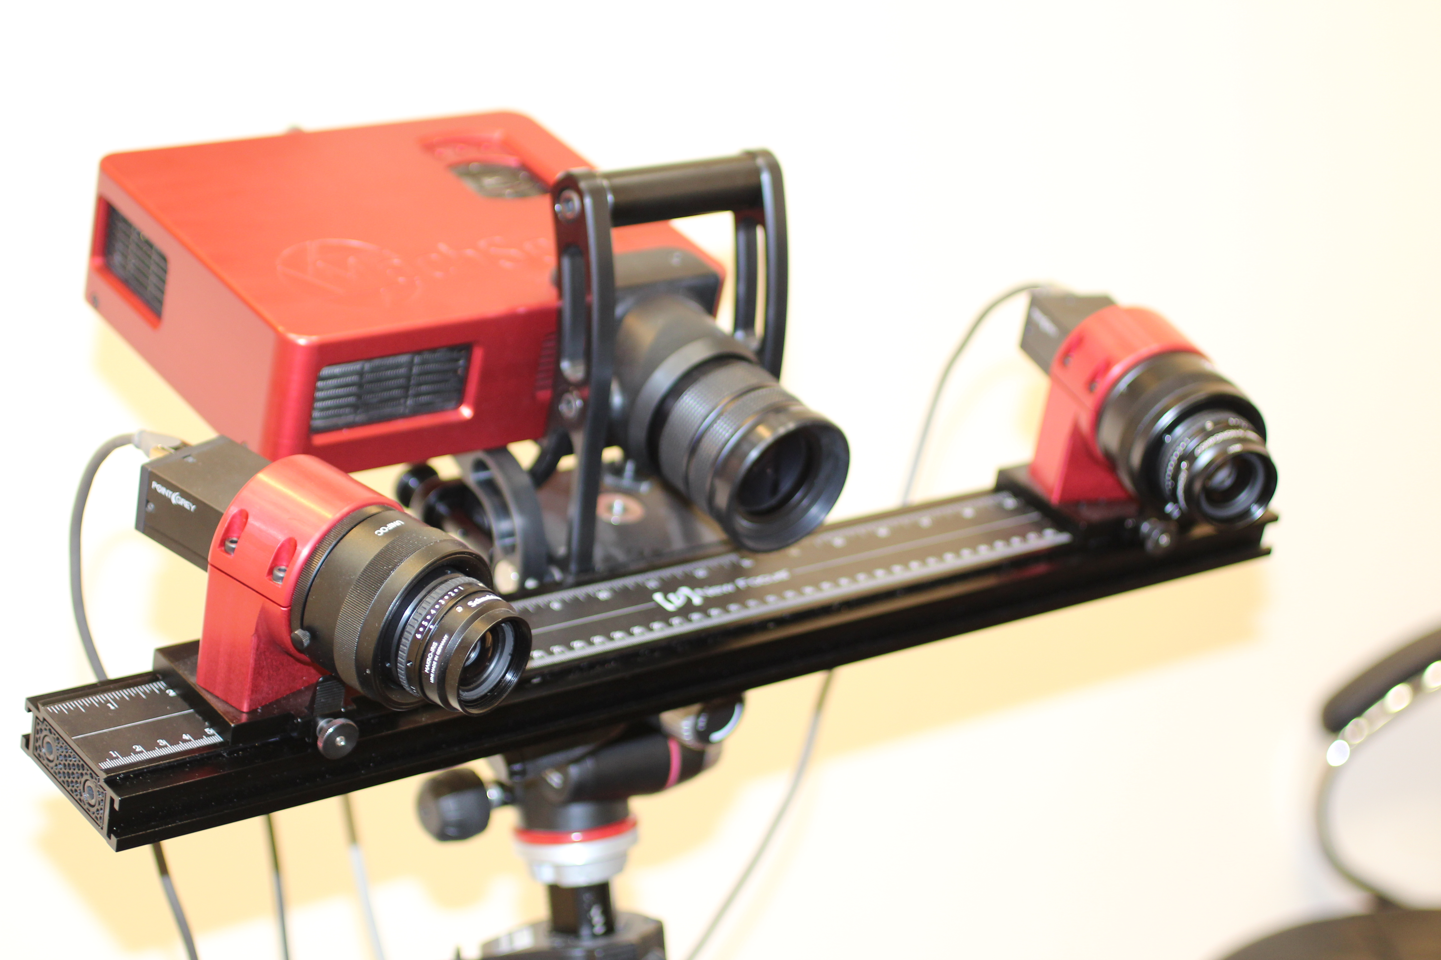
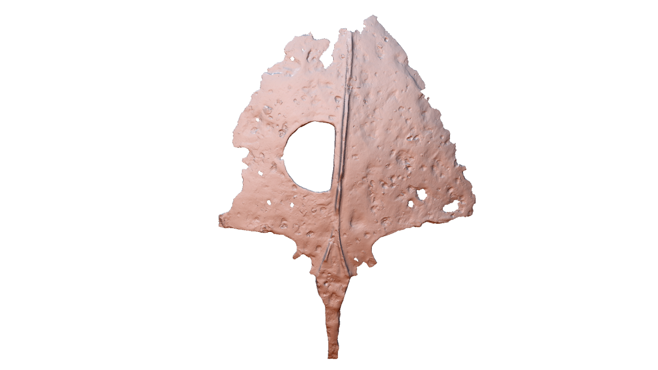
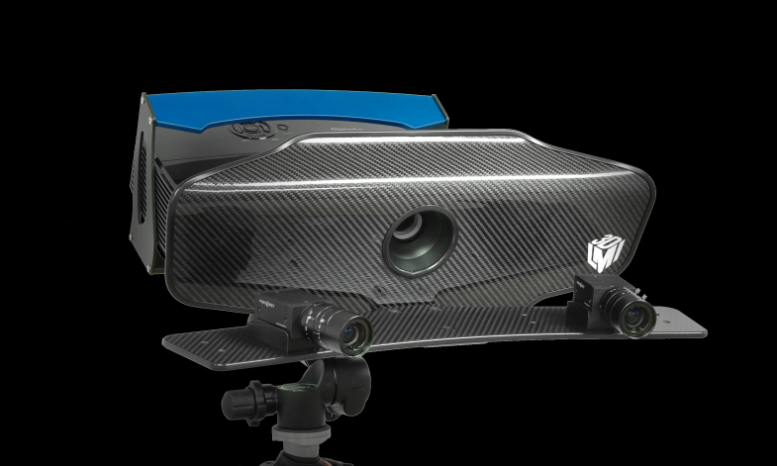
3D scanning:
Structured Light

Slide 20
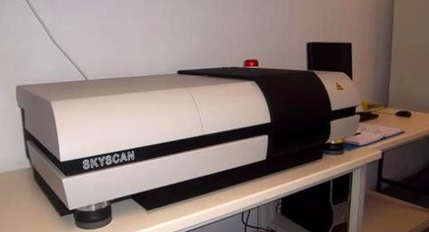
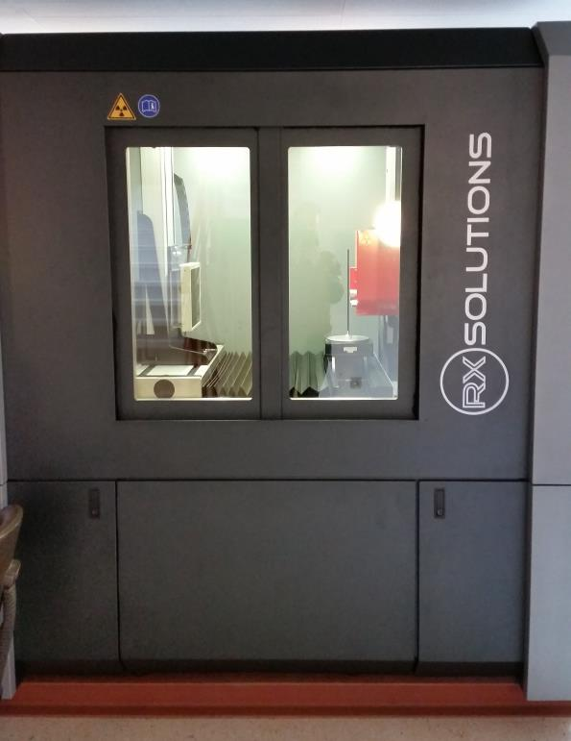
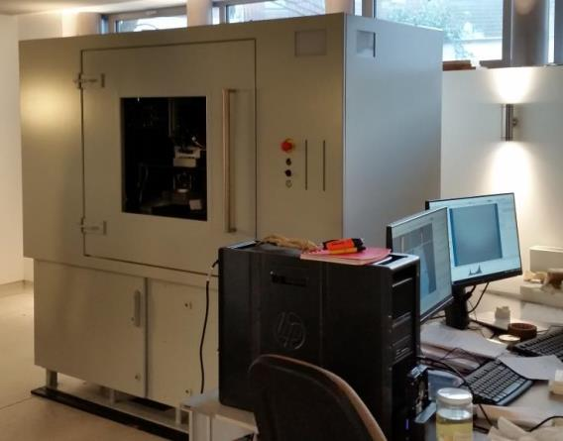
3D scanning: µCT

Slide 21
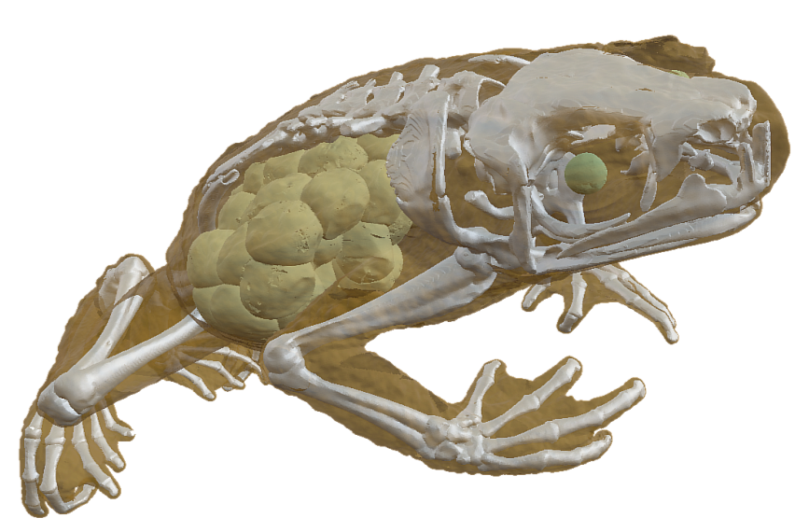
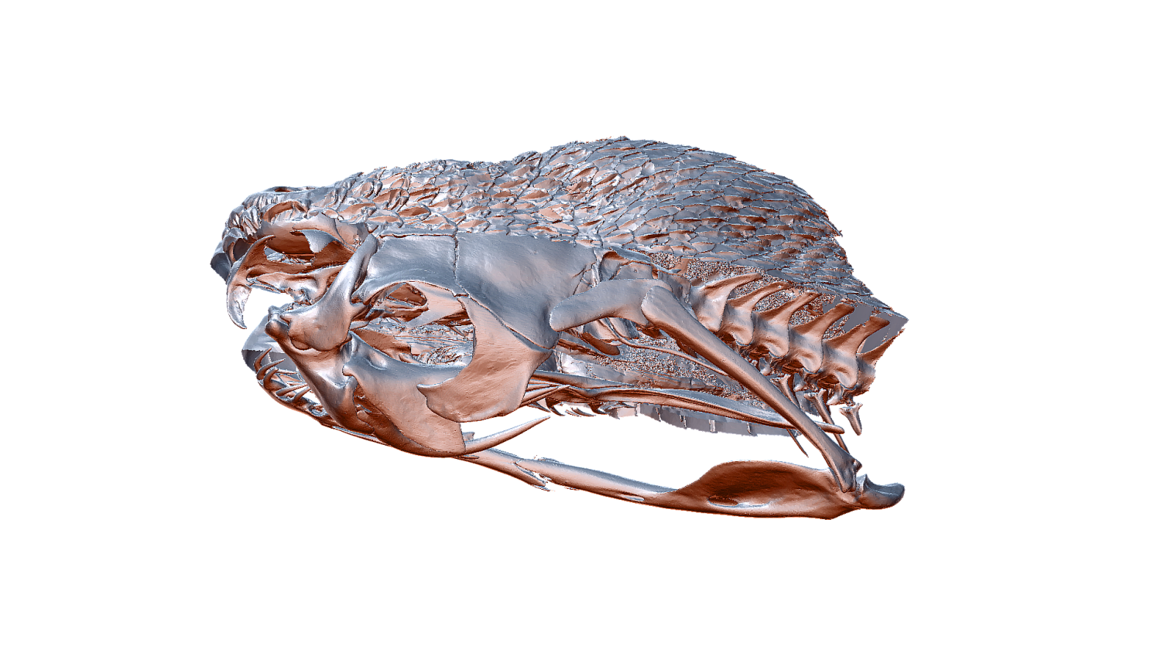
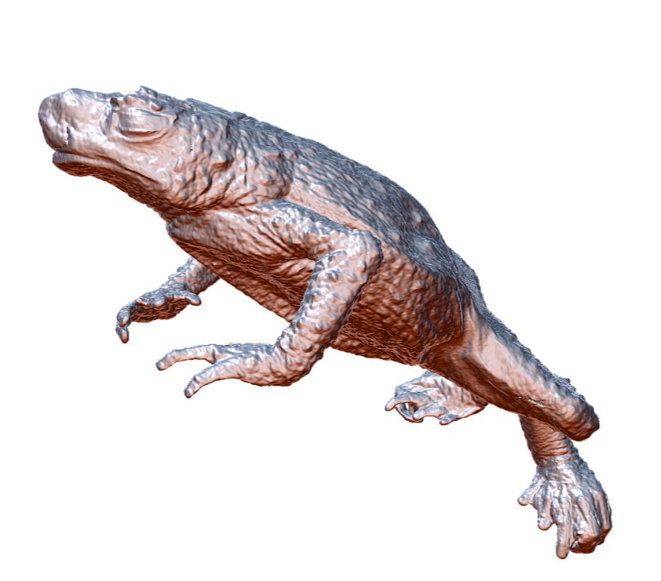
3D scanning: µCT

Slide 22
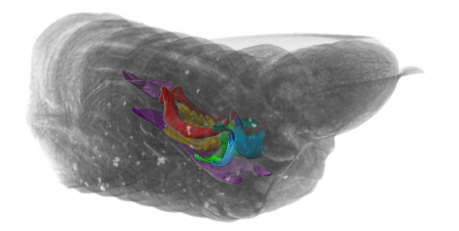
3D scanning: µCT

Slide 23
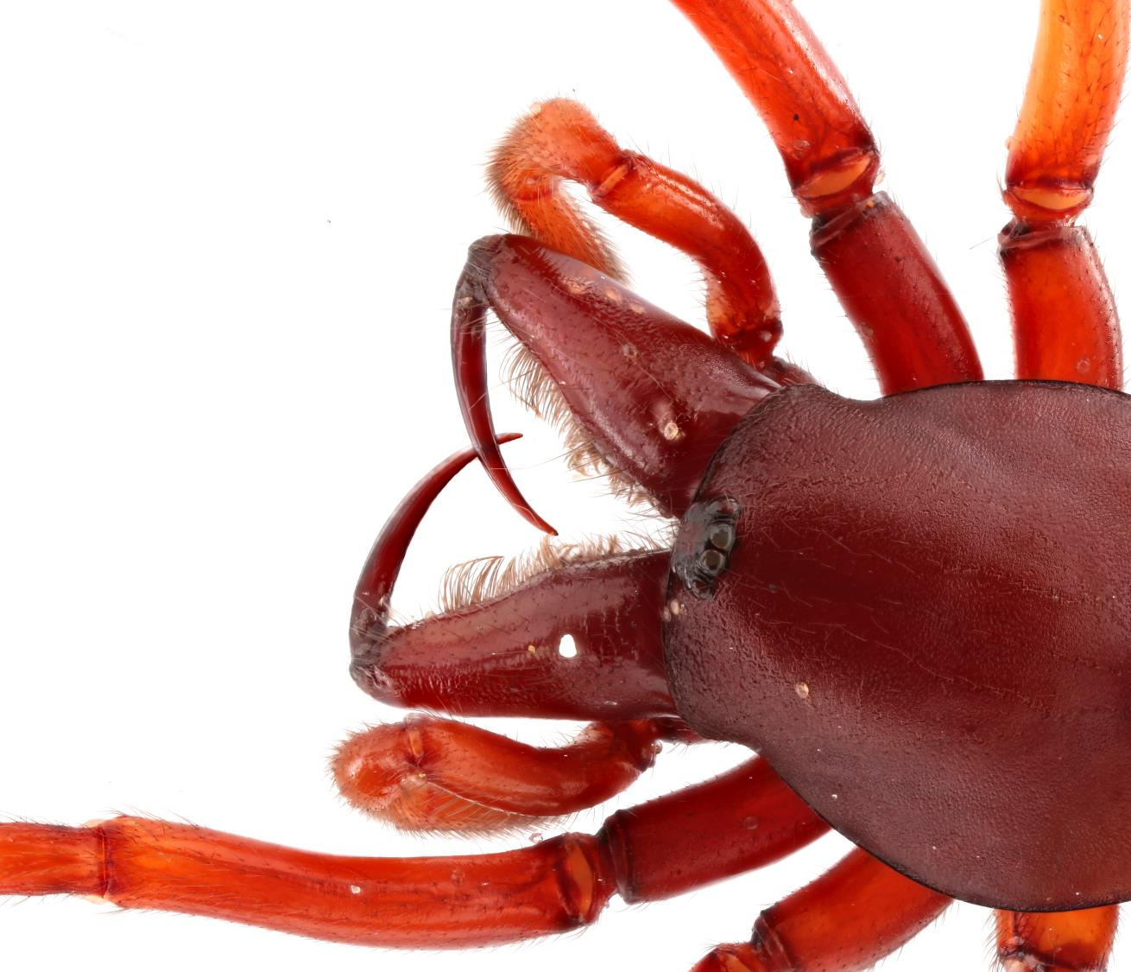
3D Handbooks
&
WIKI

Slide 24
Handbook of best practice and standards for 3D imaging of Museum collections
Authors
Jonathan Brecko
Aurore Mathys
Didier VandenSpiegel
Patrick Semal
…

Slide 26
WIKI page 3D imaging handbook
http://biowikifarm.net/v-mfn/3d-handbook/3d_Imaging_Handbook:Main_Page

Slide 36
Aurore Mathys (RBINS & RMCA)
Niki Keklikoglou (HCMR)
Sarah Faulwetter (HCMR)
Alexander Kroupa (MfN)
Bernhard Schurian (MFN)
Stefanie Krausse (MfN)
Saskia Jancke (MfN)
Thomas von Rintelen (MfN)
Didier VandenSpiegel (RMCA)
Patrick Semal (RBINS)
….

Slide 37
Jonathan.Brecko@naturalsciences.be
or
Jonathan.Brecko@africamuseum.be
http://virtualcollections.naturalsciences.be/
https://sketchfab.com/naturalsciences
http://digit03.africamuseum.be/allspecimens
https://sketchfab.com/africamuseum
https://microct.portal.lifewatchgreece.eu/
http://www.zoosphere.net/

