Slide 1
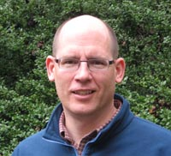
Data Librarianship and Small (& Large) Collections Support
SPNHC 2016
Brian Westra Science Data Services Librarian
University of Oregon

Slide 2
Survey question
Go to www.menti.com and use the code 56 57 16
https://www.menti.com/77e300
Results

Slide 3
Why libraries are involved in Research Data Services
Expertise and philosophy similar to other services for scholarly communications/research products:
Organize
Describe
Preserve
Provide access
Notes:
Not all libraries are on board with this.
Some follow a more limited scope of activity, others explore collaborations beyond these options

Slide 4
Image from UCSC Data Management guide, at http://guides.library.ucsc.edu/datamanagement/ accessed June 21, 2016
Notes:
Where should libraries provide services? Some follow a more limited scope of activity, others explore collaborations beyond archiving and preservation.
Such as:
Data management plan
Description, storage, analysis (during project)
Some even get into Data Science (analysis, data munging, computational science, visualization)

Slide 5
Data services and libraries
Data Management Plan (DMP) consultations
Data information literacy
Infrastructure for organizing, preserving and sharing data
Metadata support
‘Curation-friendly’ tools and practices that facilitate data sharing and preservation
Notes:
Data services in libraries were a response to the growing volume of data produced and used in the sciences.
Good list here: http://guides.lib.umich.edu/c.php?g=283036

Slide 6
NSF Data Management Plan requirement - 2011
Some of the challenges for proposal writers:
Data and metadata formats and standards
Where and how to share data
Backup and storage ≠ Preservation

Slide 7
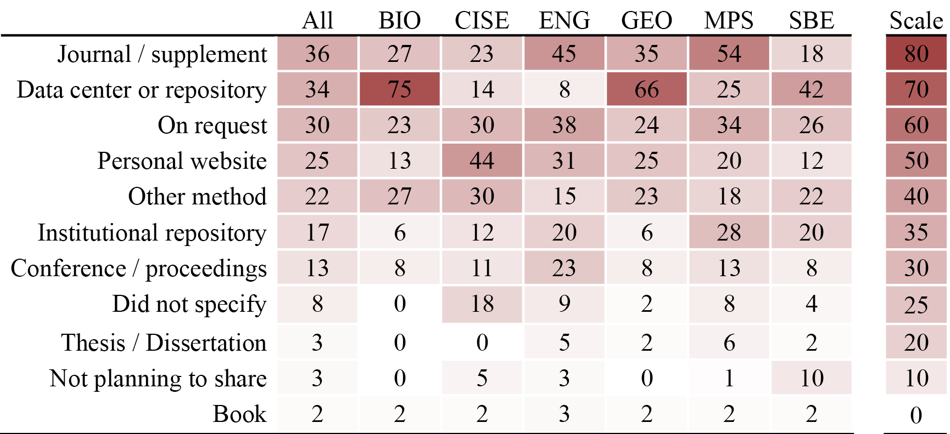
How authors propose to share their data
DMPs as a Research Tool (DART): https://osf.io/kh2y6/files/
Notes:
Note that a high percentage of BIO proposals note the use of a data center or repository.
500 plans evaluated, 465 were for proposals purported to produce data. 53 of the 500 plans were BIO, or 12% which is comparable to NSF numbers (10% of NSF funded proposals were BIO).

Slide 8
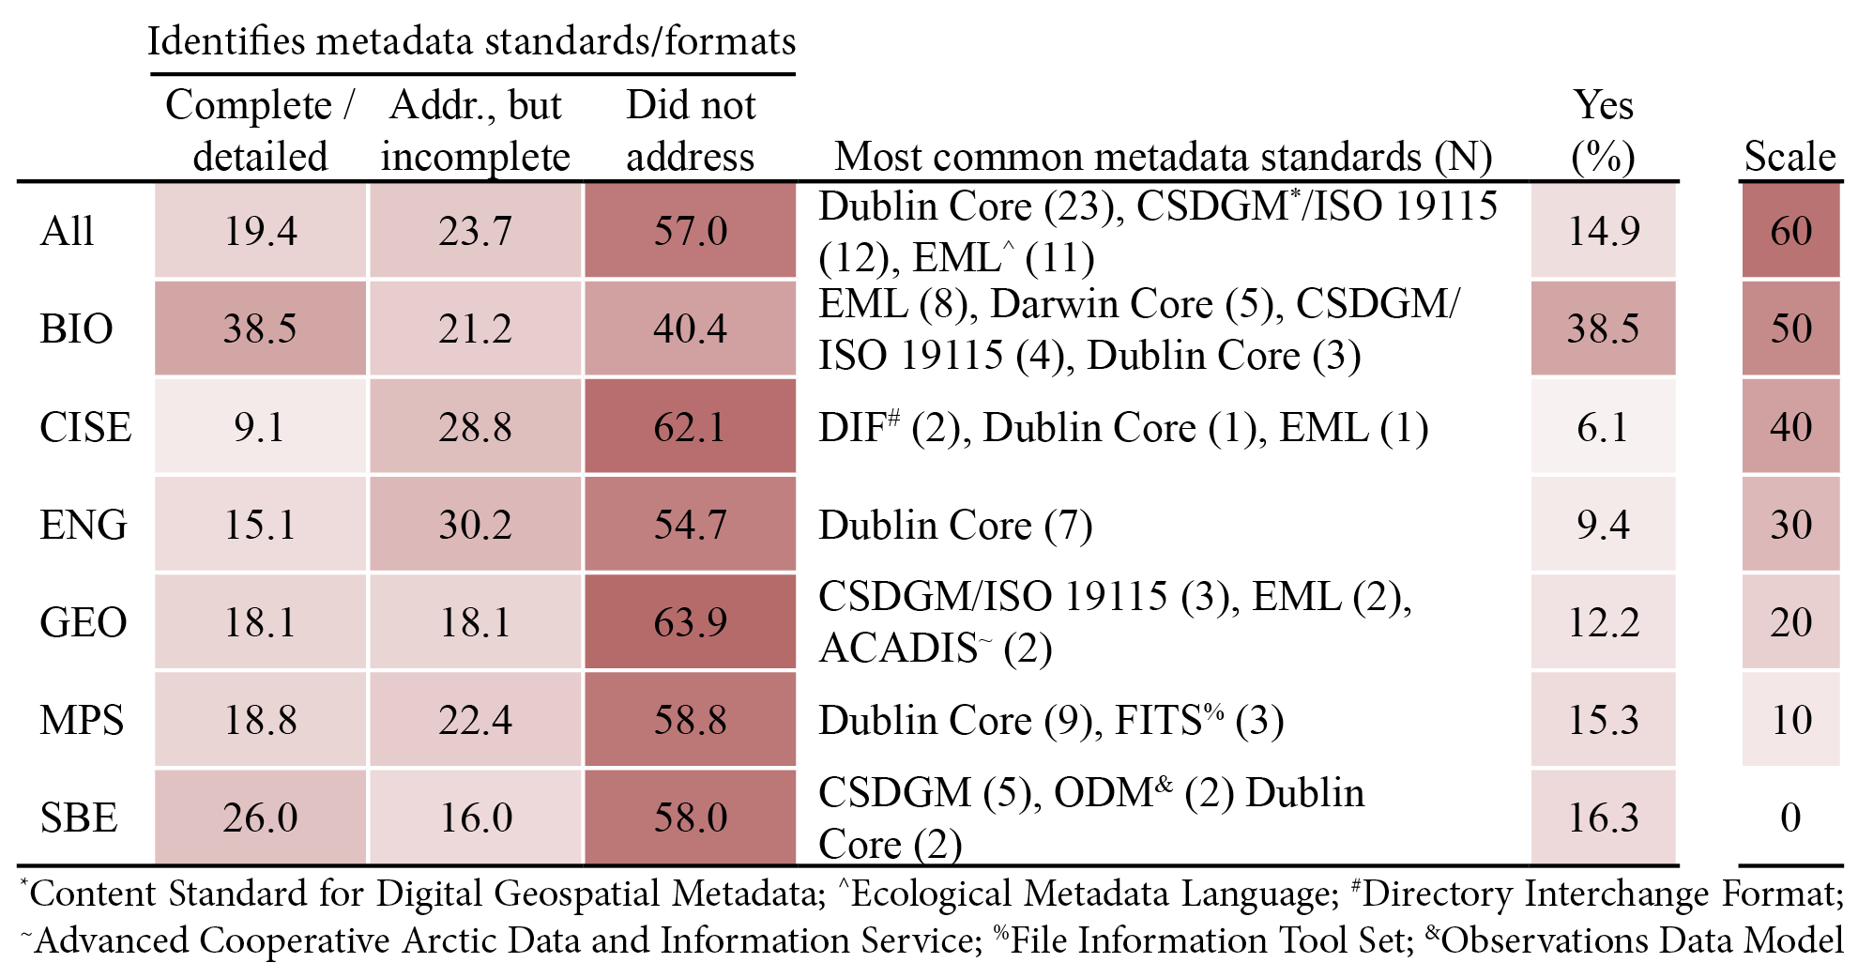
What kinds of metadata do the plans propose?
DMPs as a Research Tool (DART): https://osf.io/kh2y6/files/
Notes:
BIO DMPs provided complete/detailed descriptions of metadata standards, and described specific standardsto a higher degree than other directorates.

Slide 9
Bridging communities
DMP consultations | Other conversations
Collaboration | Instruction/training
Notes:
How do I make the connections for services?
One way is by intentional conversations,
Another is via DMP consultations follow-up.

Slide 10
Managing Images in an Evo Bio team
Stickleback fish
Wanted workflow-friendly tool to improve:
Organizing, describing, sharing, and analyzing images
UO + partners at UAlaska Anchorage
Notes:
Began exploring OMERO in late 2010; Solari Incentive award for $5000, ran from 2010-2012

Slide 11
OMERO – Open Microscopy Environment
Server + Desktop Client
Virtual folder and file structure to organize images
Tags and other descriptive information
ImageJ integration
BioFormats integration
Notes:
ImageJ: enables measurements on the image
Bioformats: conversion from a large number of proprietary formats into the OME-Tiff format (open format)

Slide 12
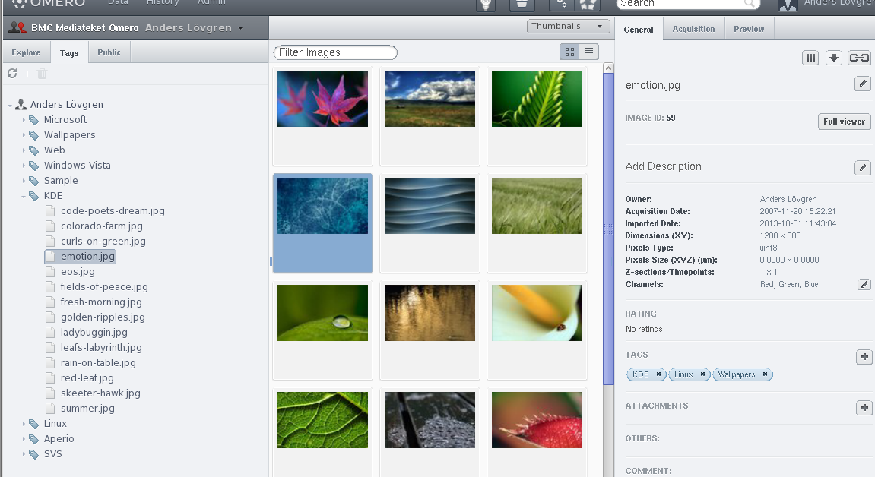
From: http://it.bmc.uu.se/andlov/proj/edu/omero/screenshot.php
Notes:
Browsing by Tags (left side tab; right side list of different tags applied to this image)

Slide 13
OMERO – Outcomes
~1000 images in the system
Less time spent looking for an image
Share images and views of images across multi-institutional team
Add tags and other descriptive information
BioFormats integration – handles proprietary formats
Notes:
ImageJ: enables measurements on the image
Bioformats: conversion from a large number of proprietary formats into the OME-Tiff format (open format)

Slide 14
OMERO – Lessons learned
Decentralization
Independence comes with a cost
Champions act within trusted relationships
Unstructured metadata – ease of use but costs later on
Notes:
Research teams rely on their own members for technical support. Those without are at a disadvantage.
A balance between research practices and the systems that support them, and the needs for rich/deep description to support discovery and reuse. Tag-based metadata would be difficult to translate to standardized metadata, ie. Species = _____; contributor = _____;

Slide 15
Managing collections data
Biodiversity research collection
Insect - fungi - substrate interactions
Needs:
Data sharing
Image preservation

Slide 16
Managing collections data
Using to:
Organize collection objects
Manage structured metadata
To publish data to iDigBio
Notes:
iDigBio-sponsored training on Specify helped tremendously with this project. iDigBio also provided support for me to attend this meeting
Process: Data cleanup > Mapping to Schema > import > image mapping to specimen records > connecting image files > export to repository

Slide 17
Next steps?
Images
Metadata
Repository
Archive images in repository
Notes:
iDigBio-sponsored training on Specify helped tremendously with this project. iDigBio also provided support for me to attend this meeting
Process: Data cleanup > Mapping to Schema > import > image mapping to specimen records > connecting image files > export to repository

Slide 18
Managing collections data – Lessons
Transition to a new system takes time
Leverage external support
iDigBio sponsored Specify training
Specify team for schema/mapping, Specify Cloud (hosting)
Notes:
iDigBio-sponsored training on Specify helped tremendously with this project. iDigBio also provided support for me to attend this meeting
Process: Data cleanup > Mapping to Schema > import > image mapping to specimen records > connecting image files > export to repository

Slide 19
Many other opportunities
Curriculum-integrated data information literacy
Follow-up on DMPs: intention > practice
Build/share infrastructure/suite of tools and services:
Active data processes;
Storage and backup;
Post-project data preservation and sharing

Slide 20
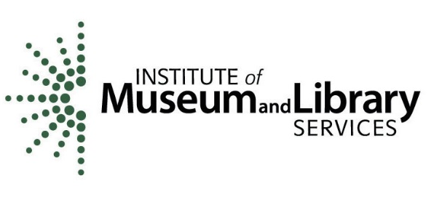
Thank you!
Brian Westra | bwestra@uoregon.edu
http://library.uoregon.edu/datamanagement
This presentation at SPNHC thanks to support from a University of Oregon Foundation/Solari Incentive award and iDigBio
DART project funded by Institute of Museum & Library Services grant number LG-07-13-0328

