Slide 1
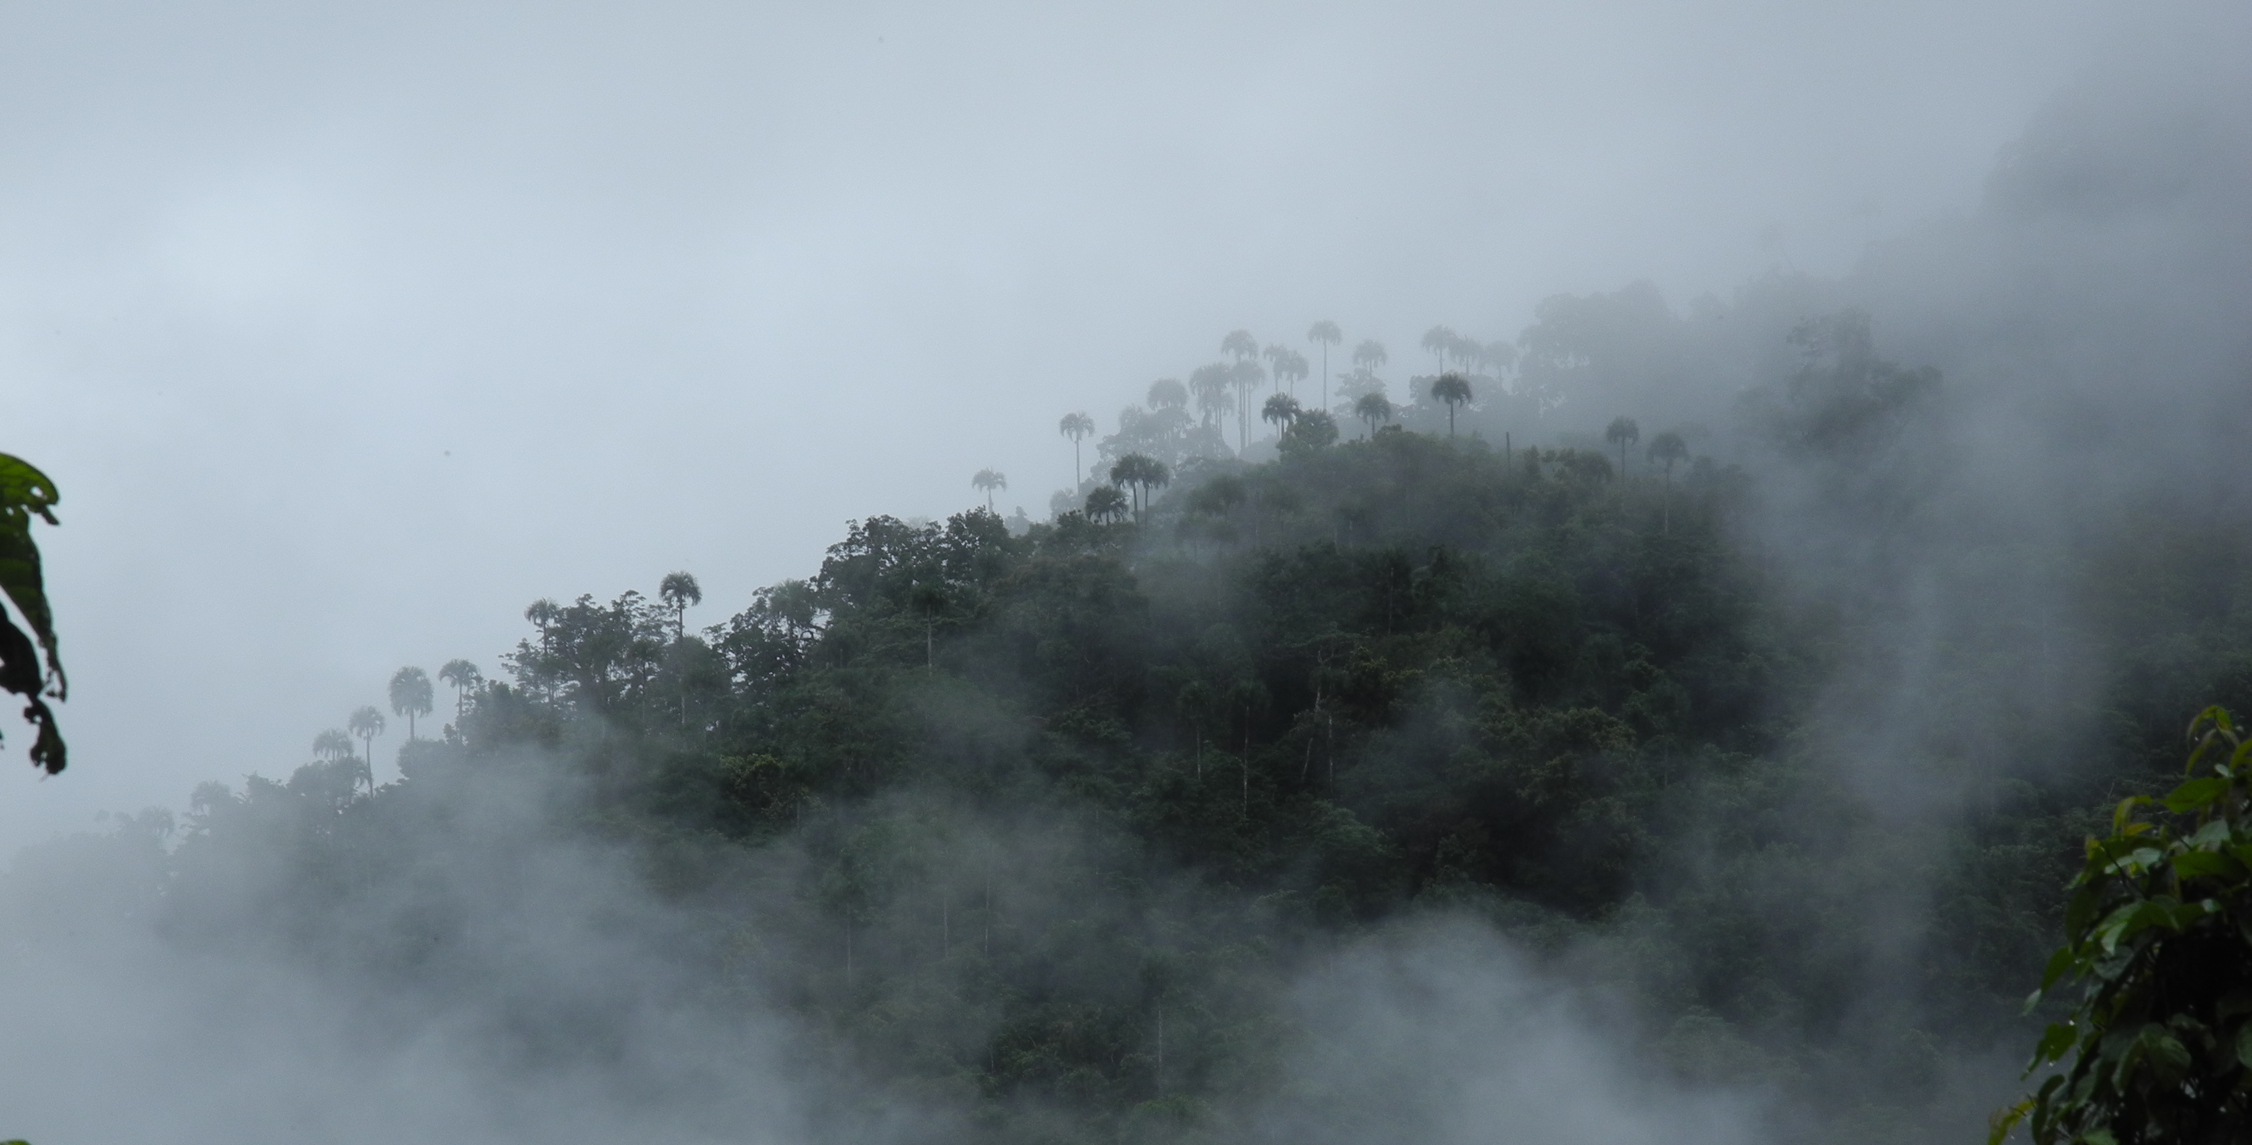
Field to database to aggregator and beyond: documenting the flora of Melanesia
Shelley A. James
iDigBio, Florida Museum of Natural History
This work was also
supported by NSF grants DEB-0950207 and DBI-1057453, and CEPF.
SPNHC, Berlin, 2016

Slide 2
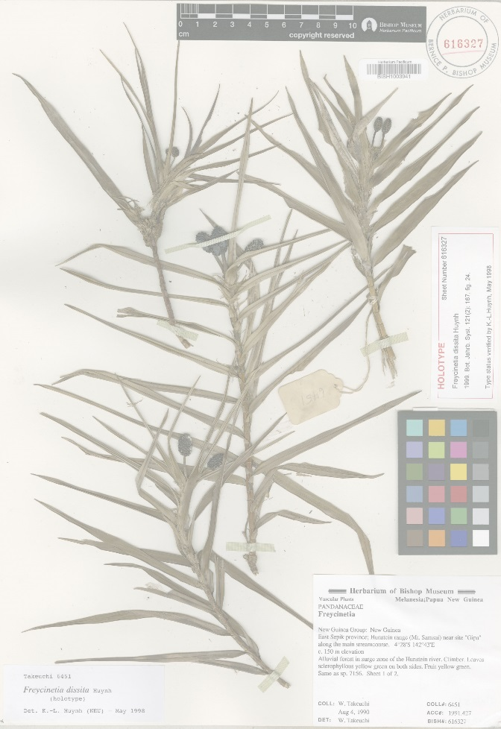
Field to database born digital – important?
Making data accessible, discoverable, useable sooner
Improve collections management efficiency
Sustainability
Expedition and collection tracking
Publishing and citation

Slide 3
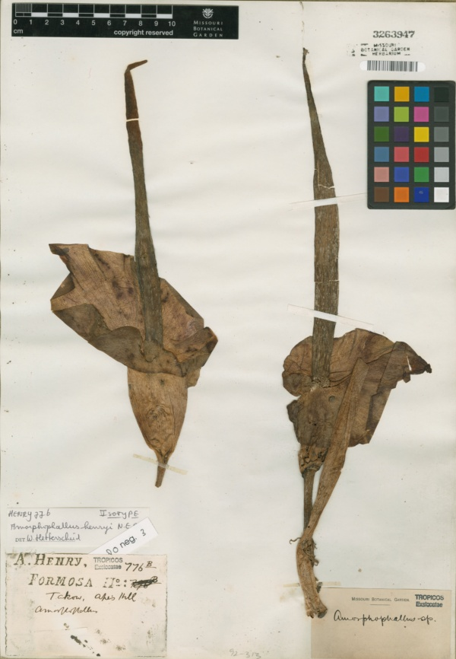
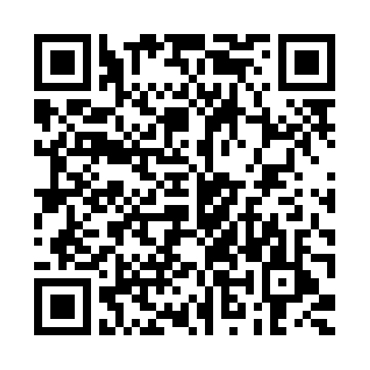
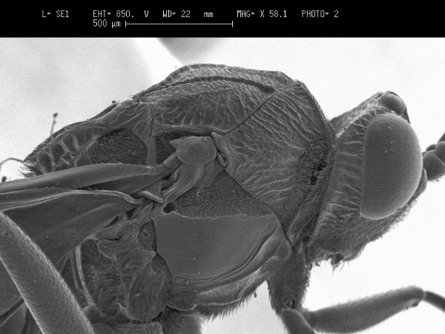
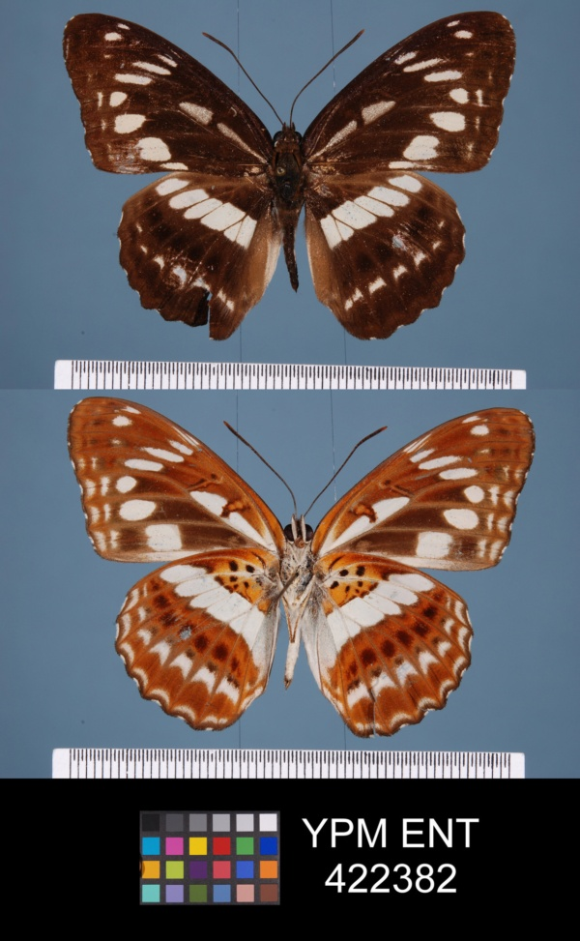
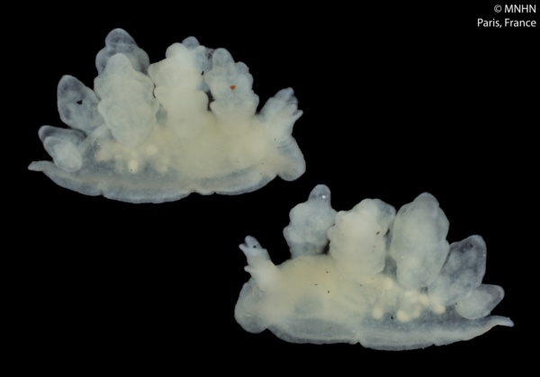
Minimum data fields needed for biodiversity aggregators?
Darwin Core
recordID
occurrenceID (unique!)
scientificName
eventDate
recordedBy (ORCID!)
Locality information
catalogNumber
institutionID
collectionID
Geological Context
Audubon Core
recordID
occurrenceID of specimen
URL
Camera EXIF
photographer
Metadata
Institution
Collection
Contact & info
Description
URL
Collect data with a particular level of reuse in mind!

Slide 4
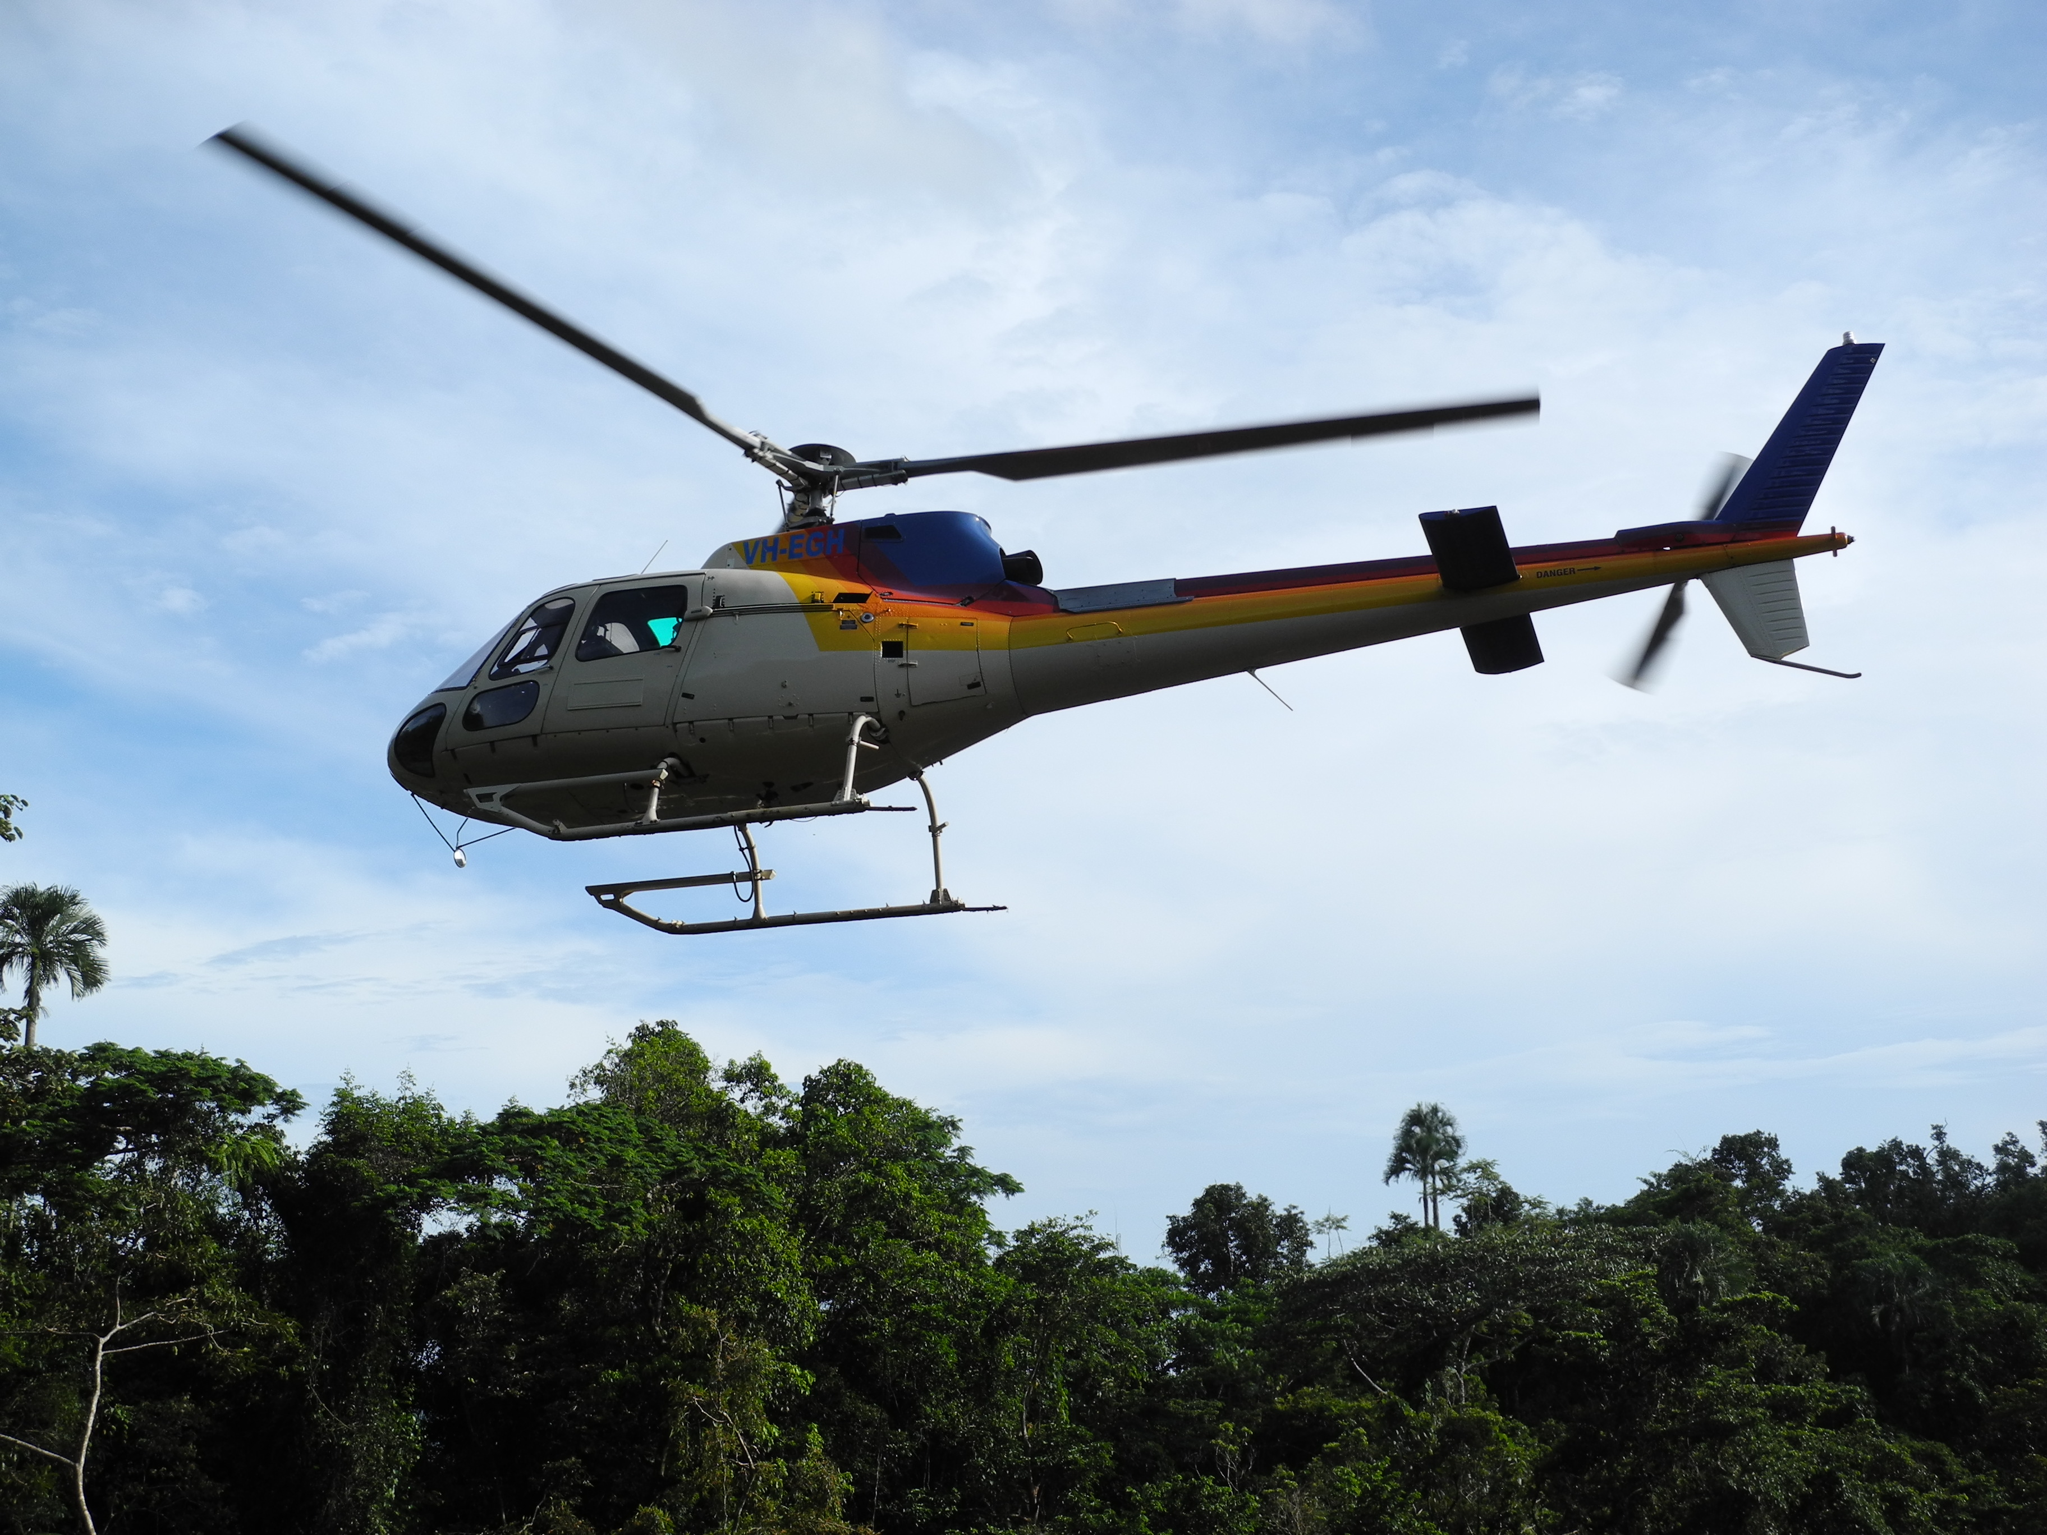
Valevahalo (base) camp, Guadalcanal

Slide 5
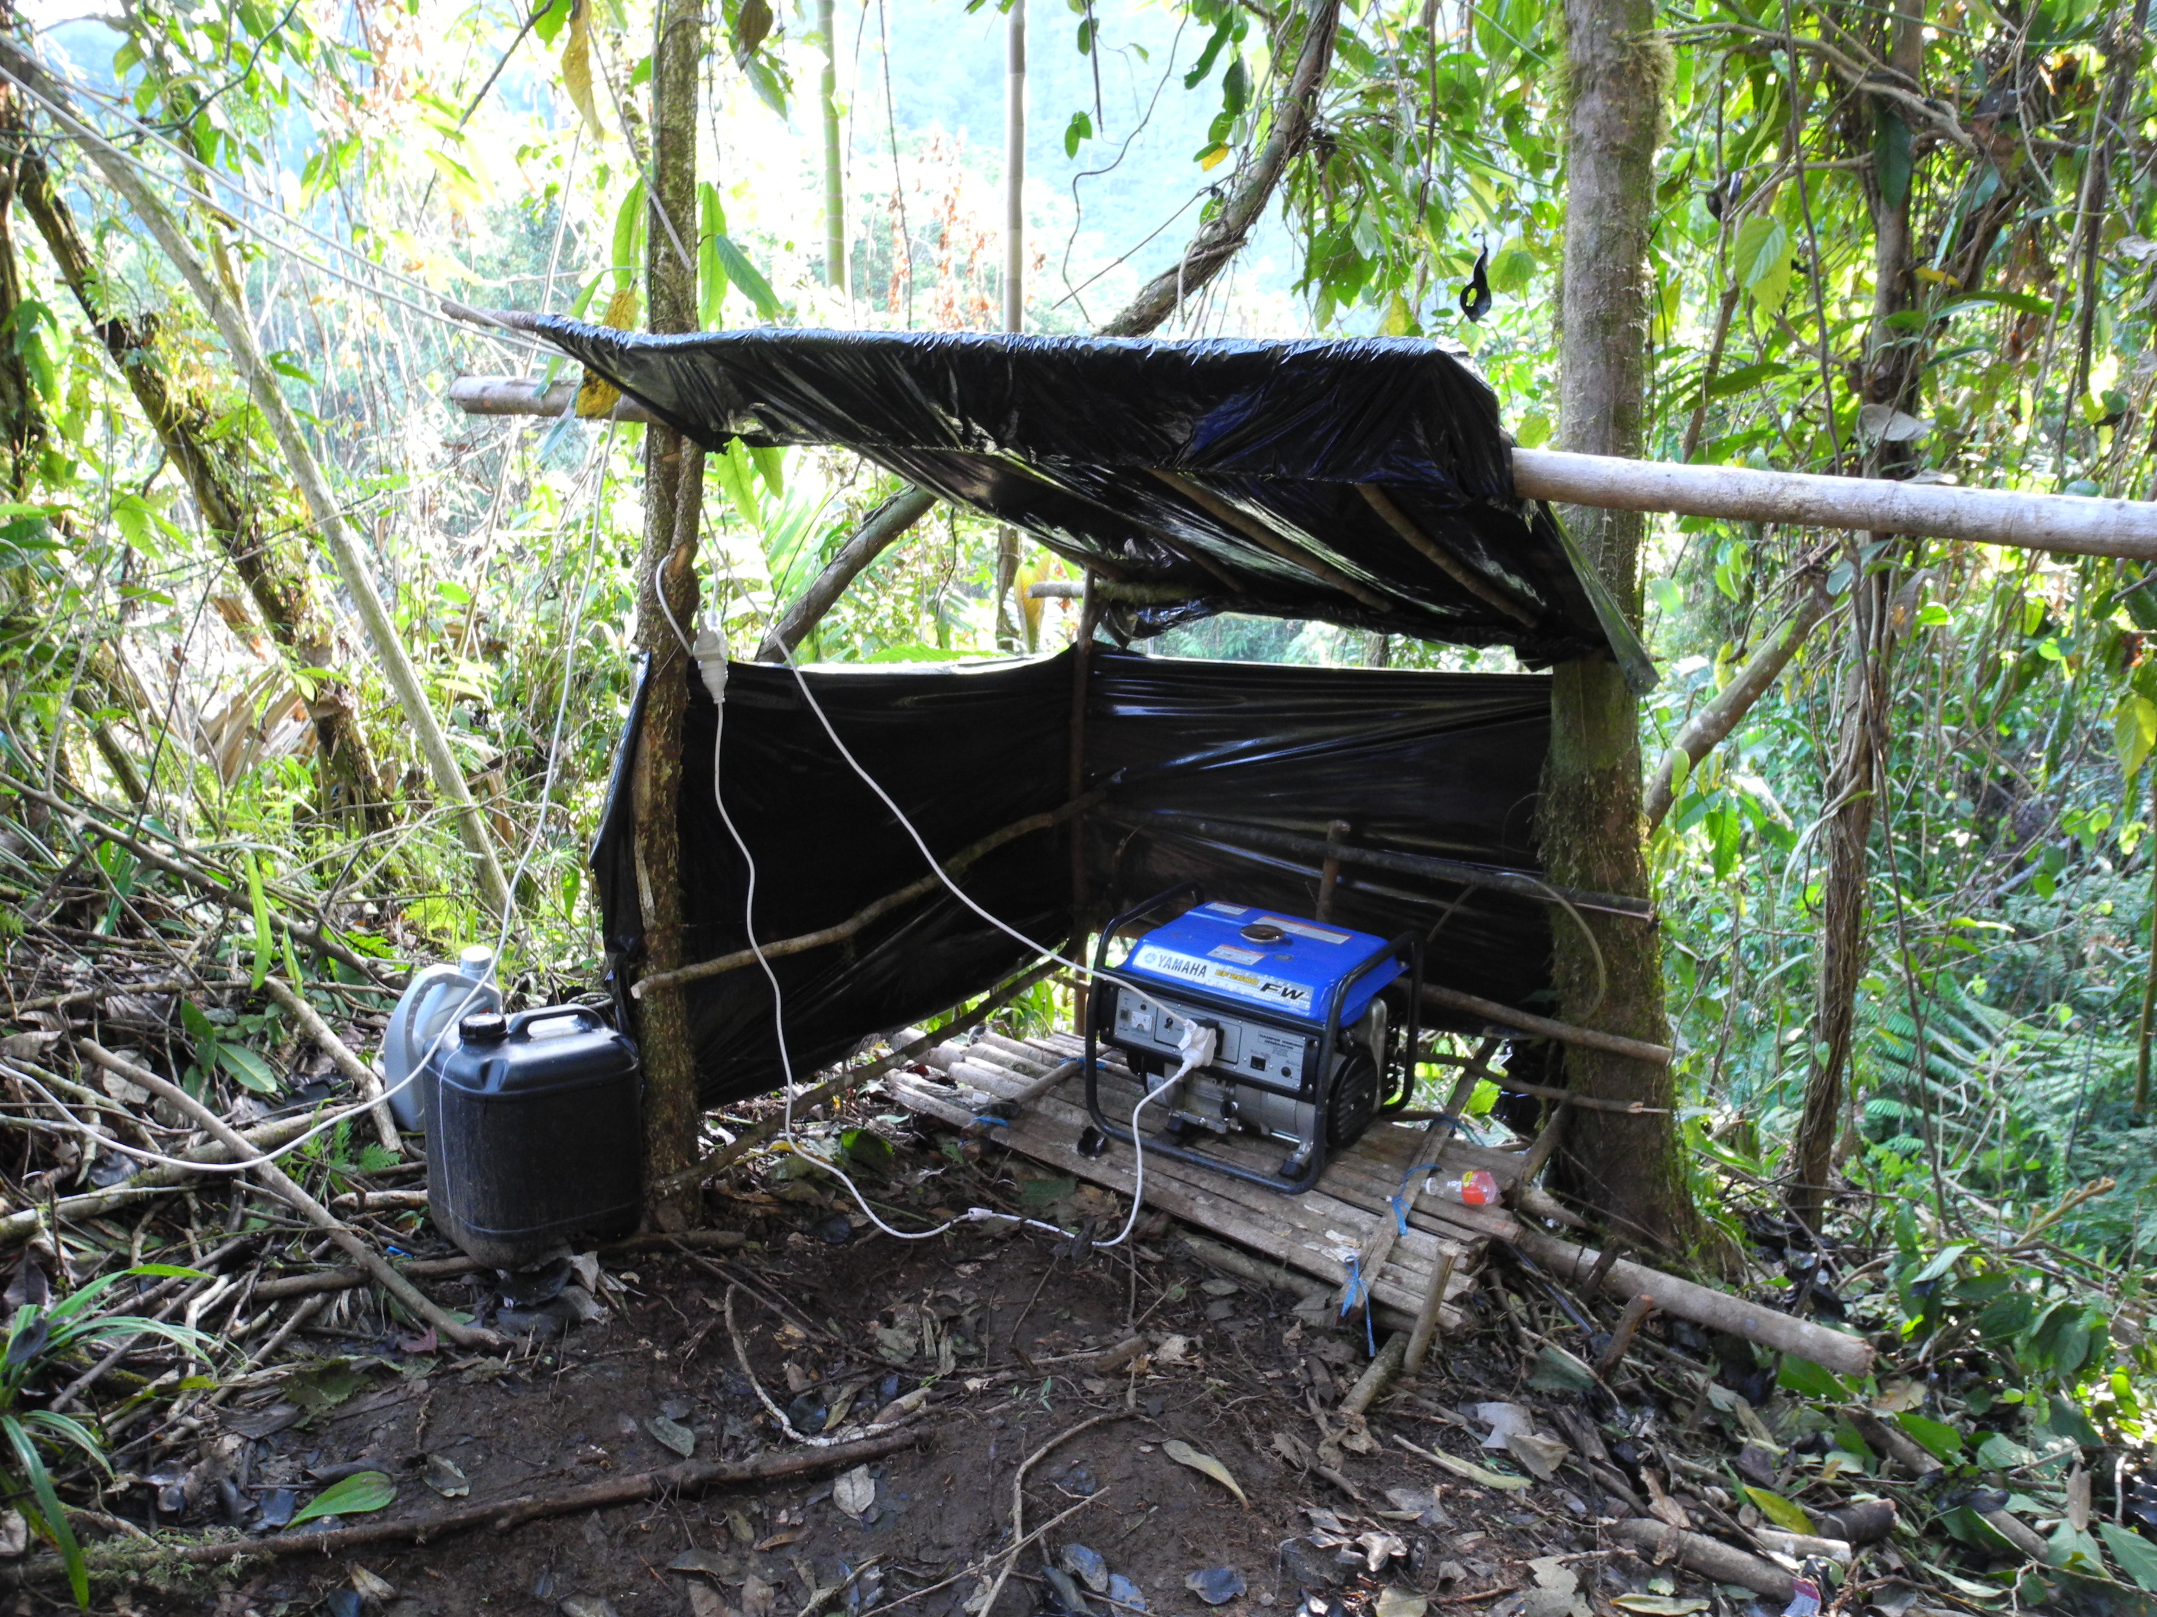
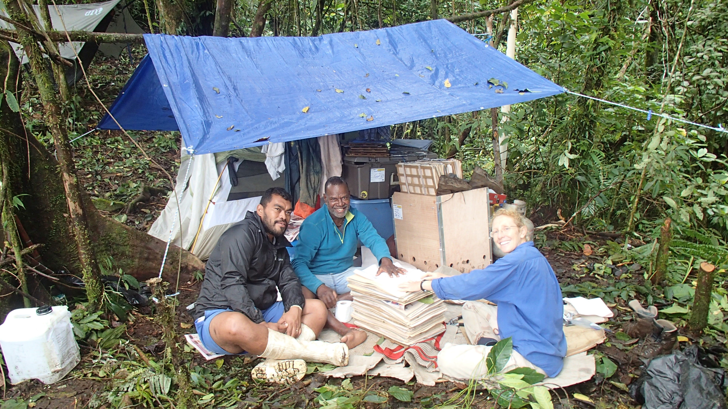
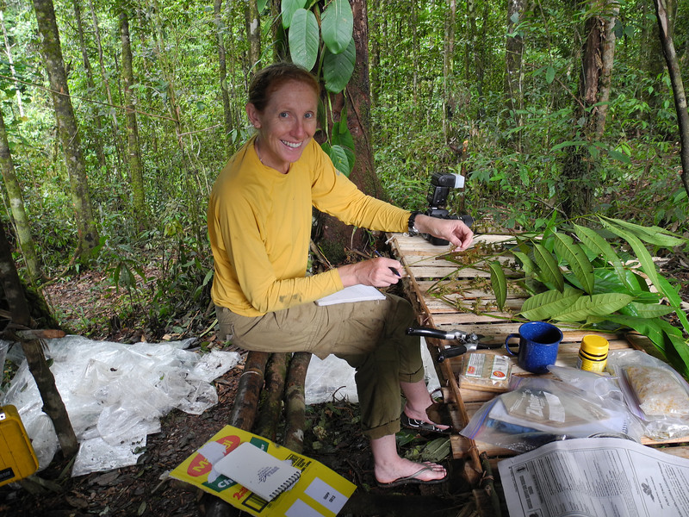
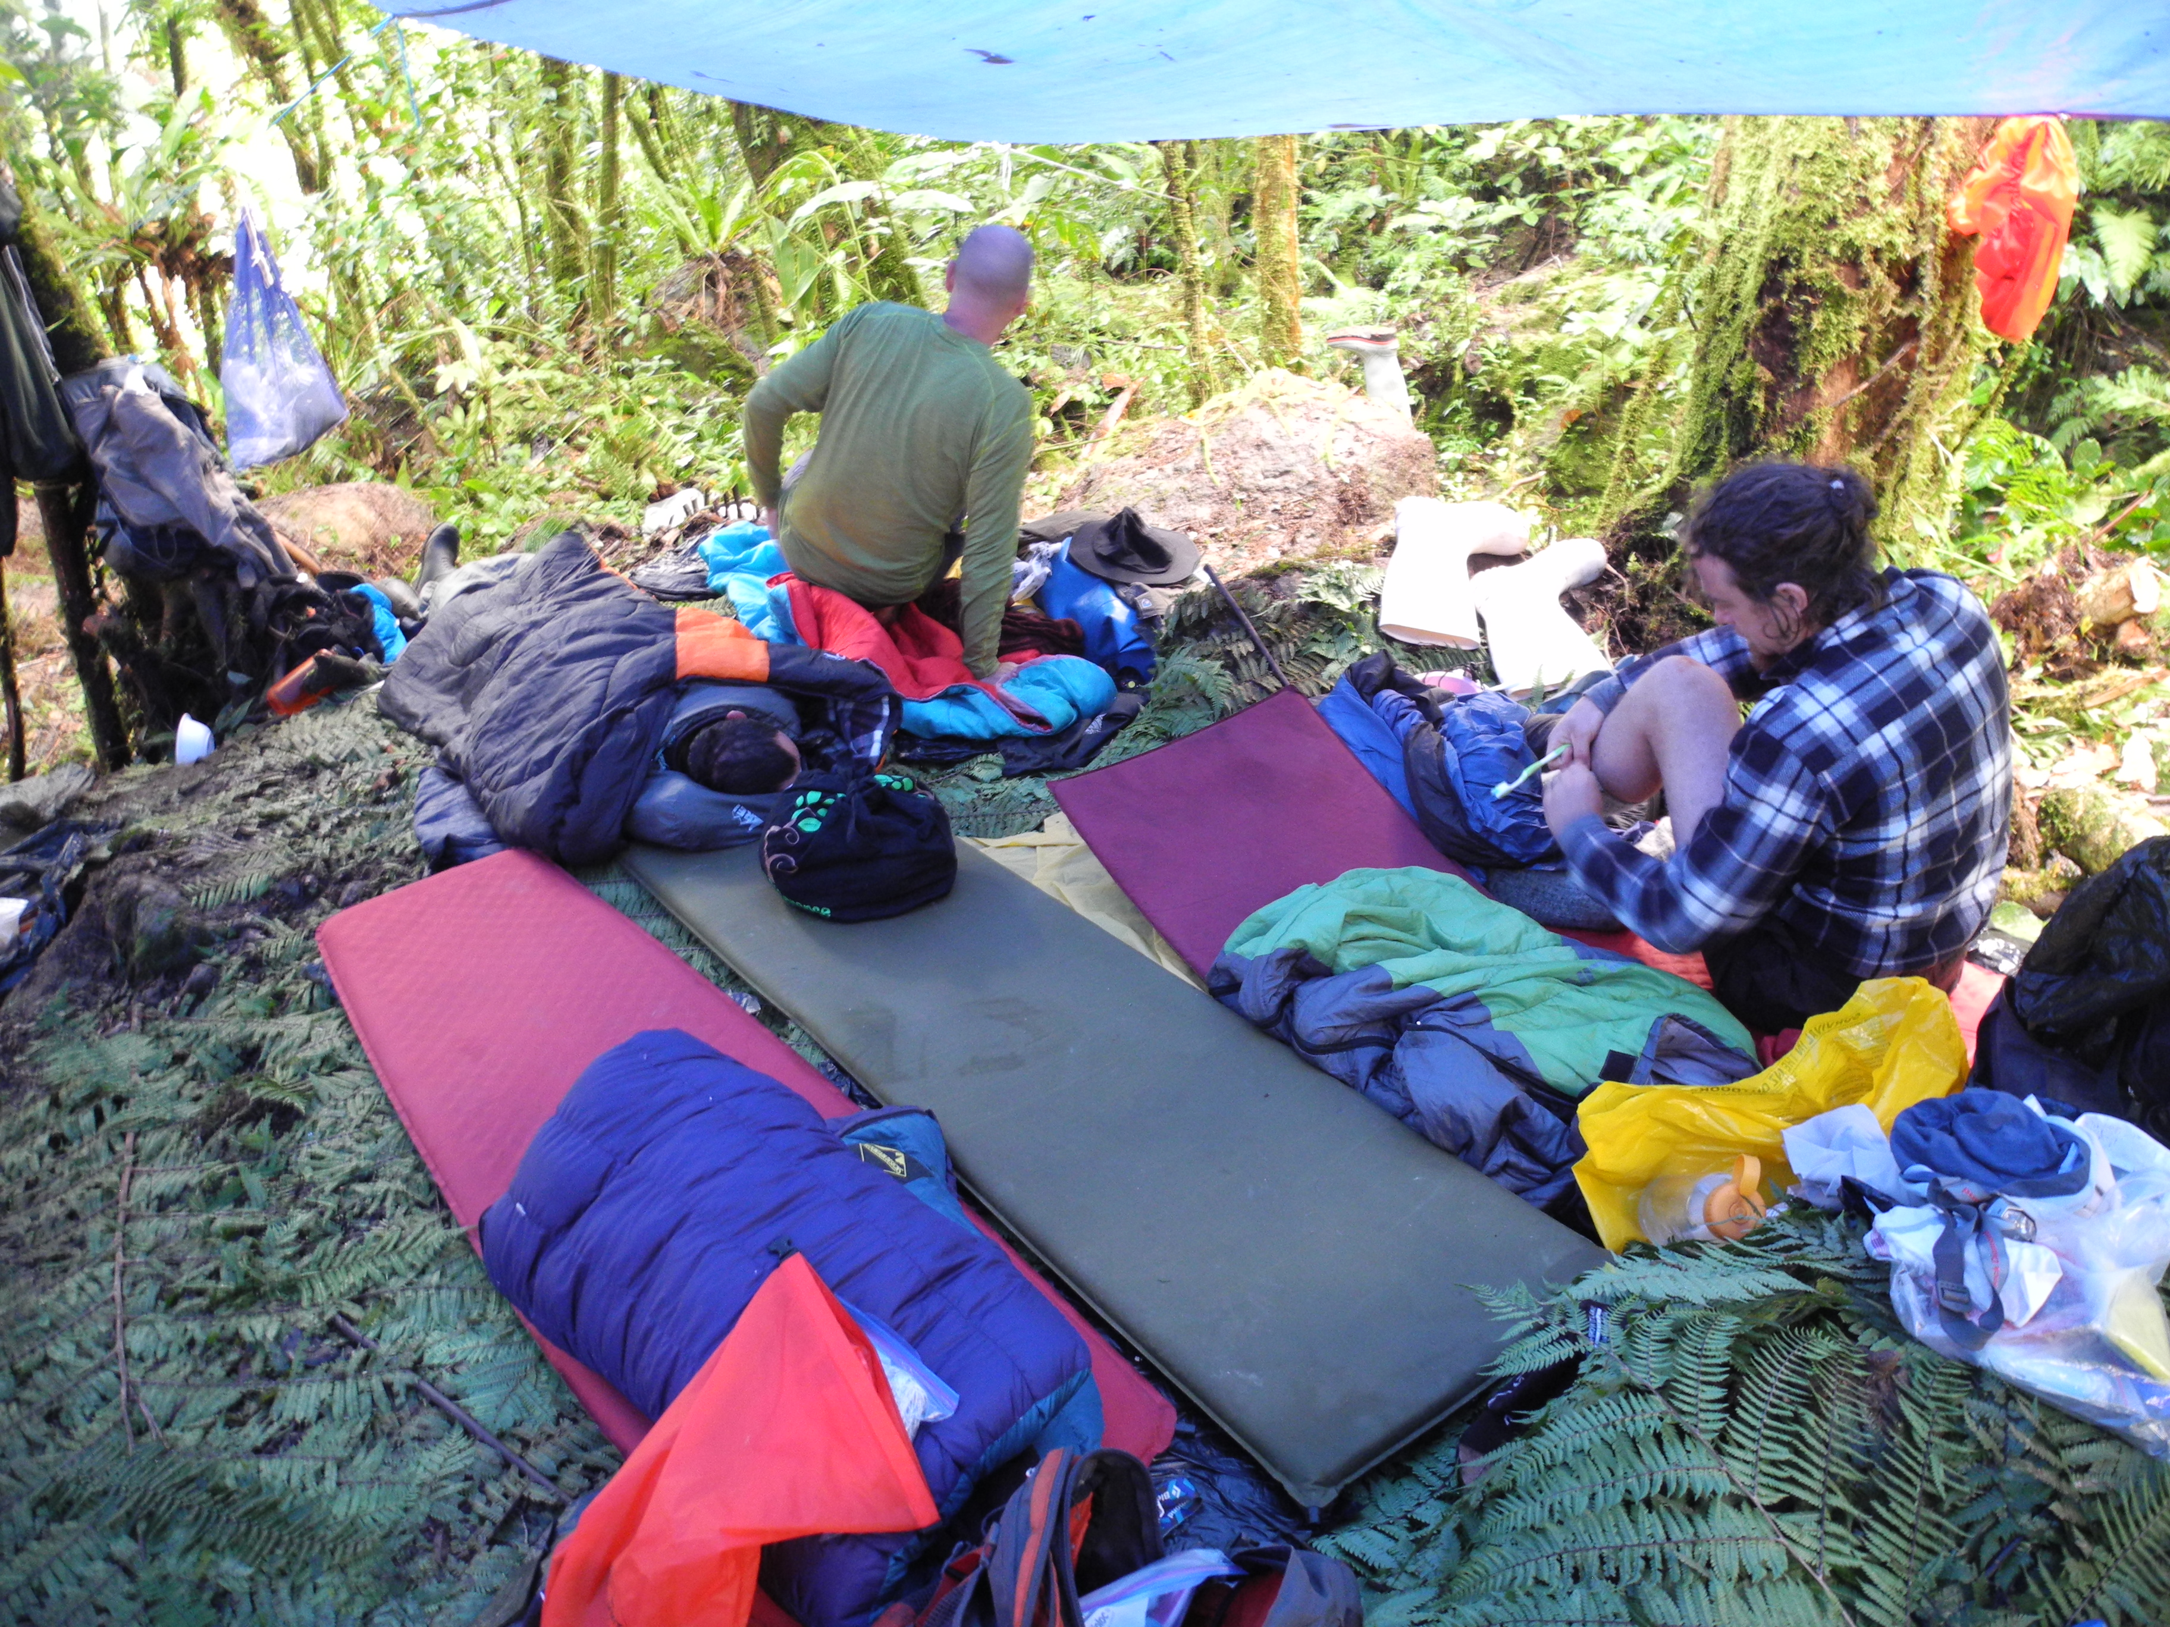
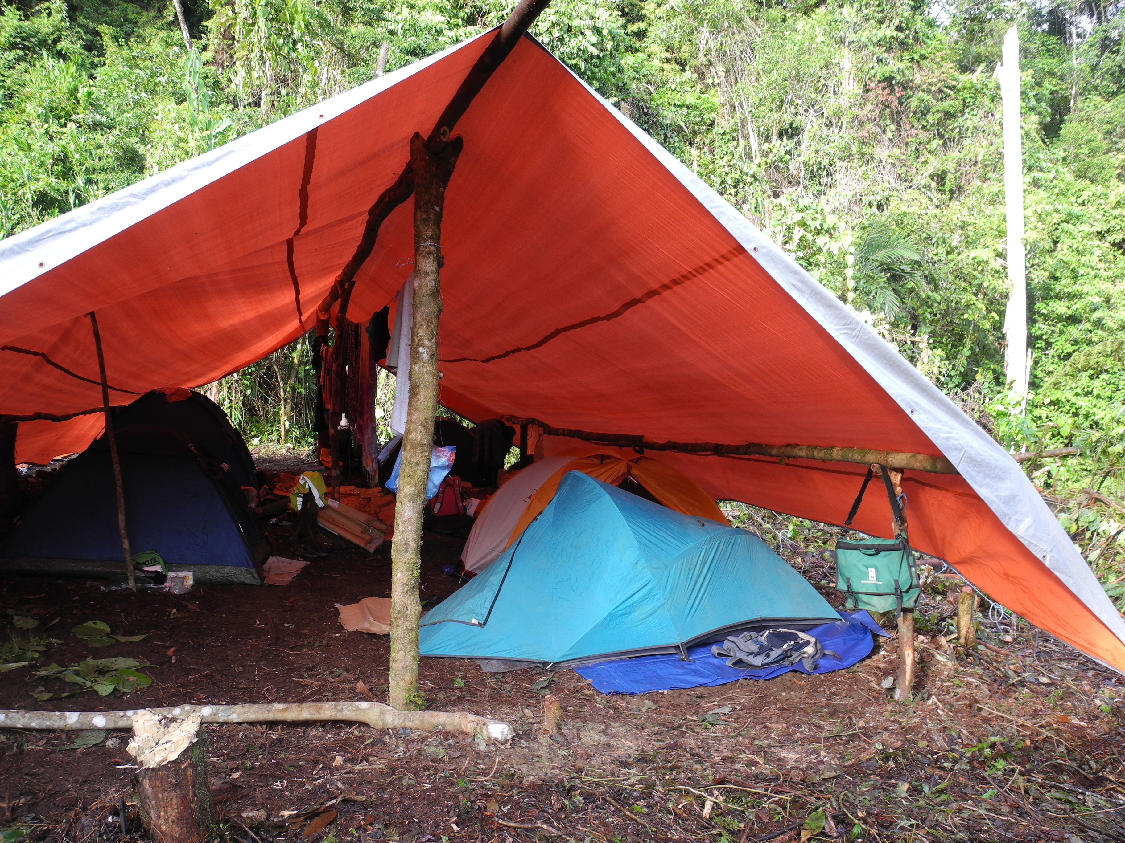
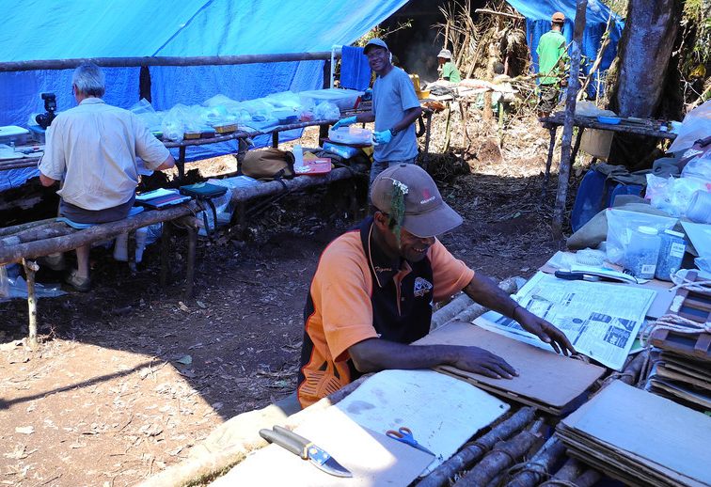

Slide 6
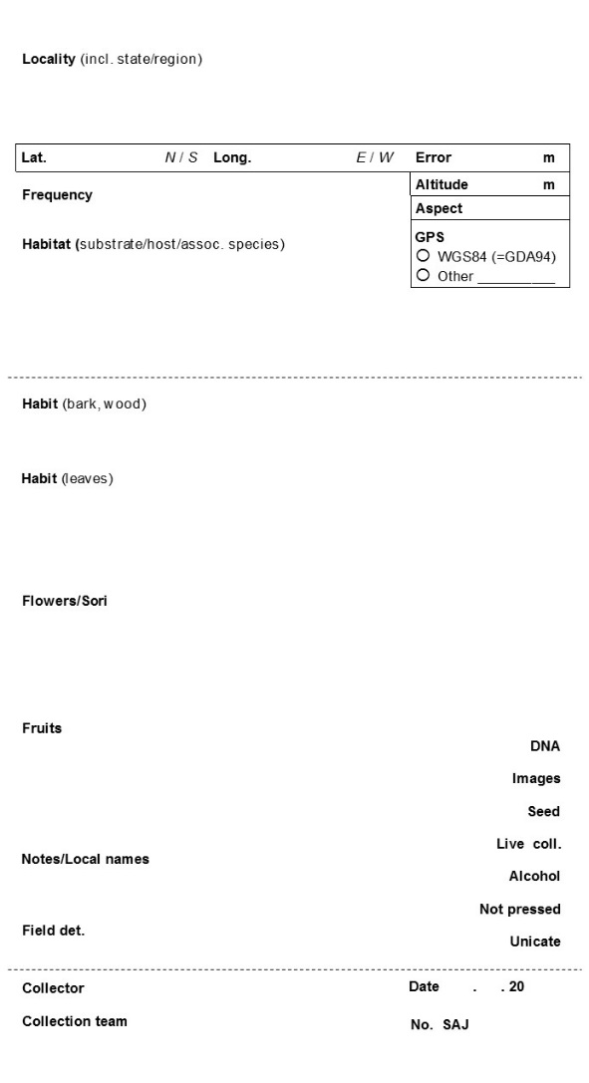
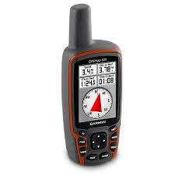
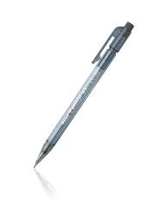
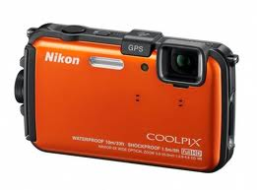
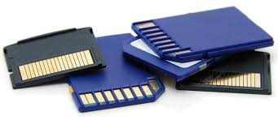

Slide 7
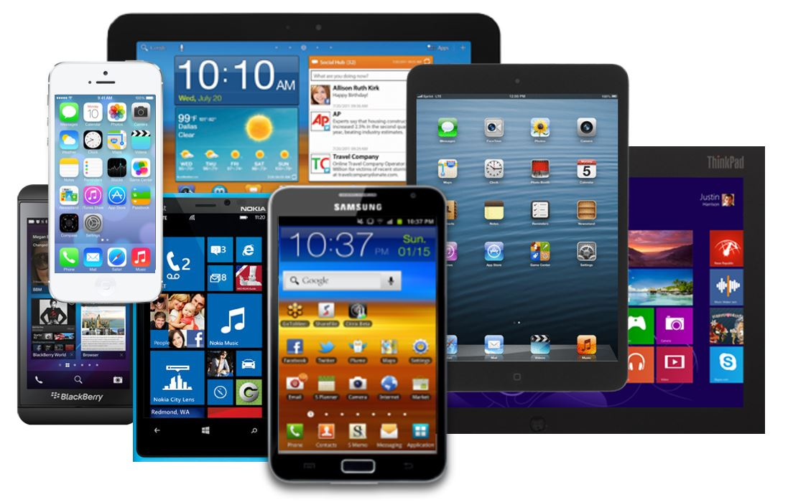

Slide 8
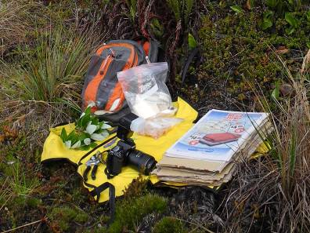
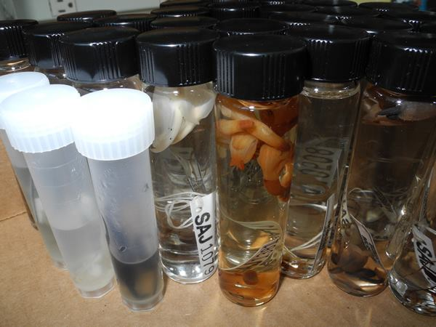
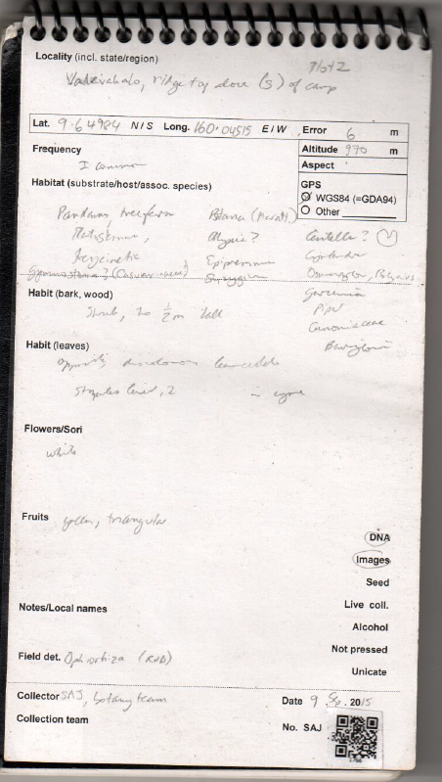
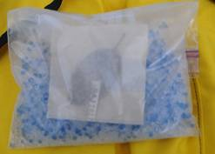
The Scenario
Botanical collecting expeditions
> 250 flowering and fruiting taxa/specimens
3+ voucher specimens
1 tissue sample → products
Alcohol collection fruits, flowers
10+ images per collection (RAW + JPG)
Living collection
Notebook entry

Slide 9
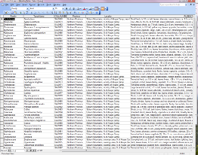
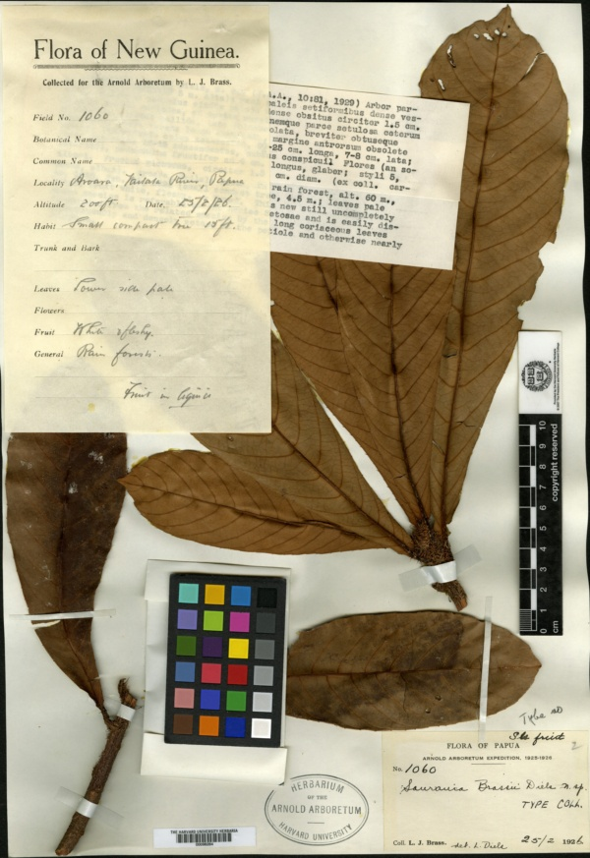
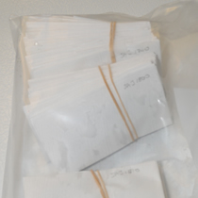
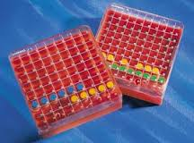
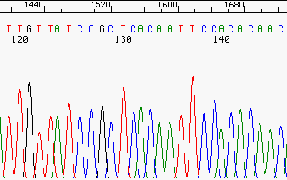
Collection Tracking!
Field number
Expedition metadata
Collection specimen numbers
Tissue specimen number
Field images, digitized herbarium voucher
Genbank and other downstream identifiers
Other duplicate specimen numbering systems
etc.

Slide 10
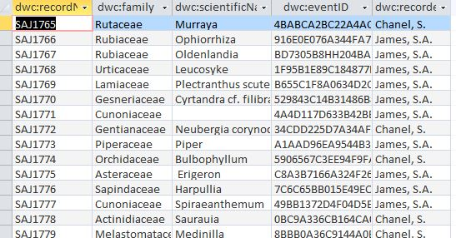
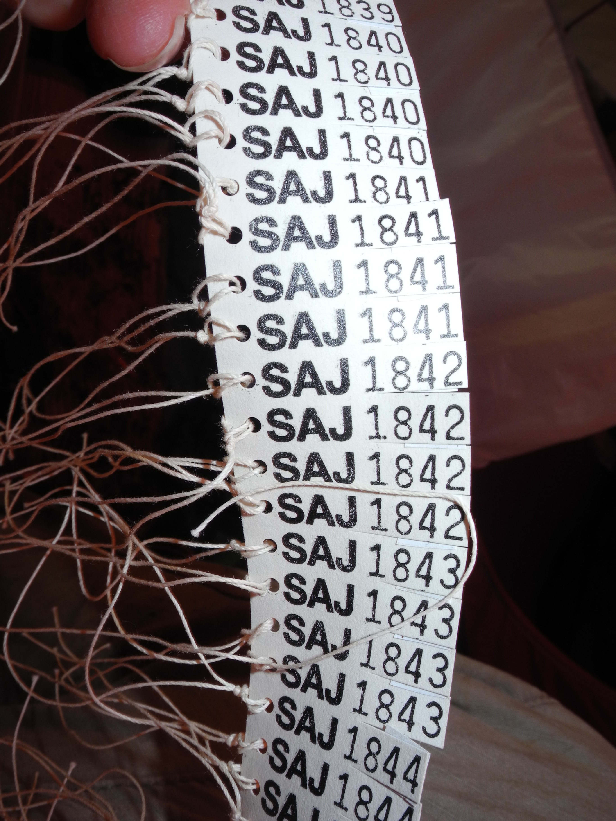
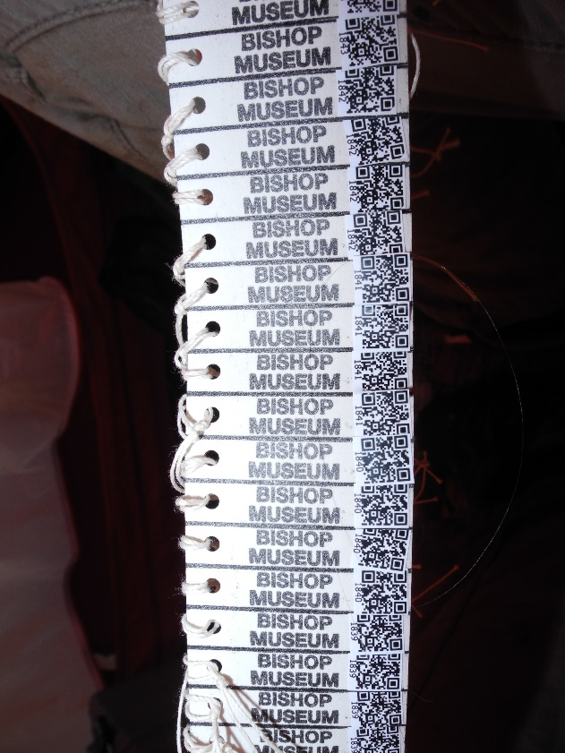
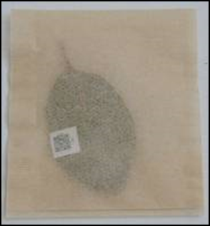
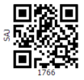
QR codes and collections data
916E0E076A344FA7BEC4084443F3CC66
dwc:eventID

Slide 11
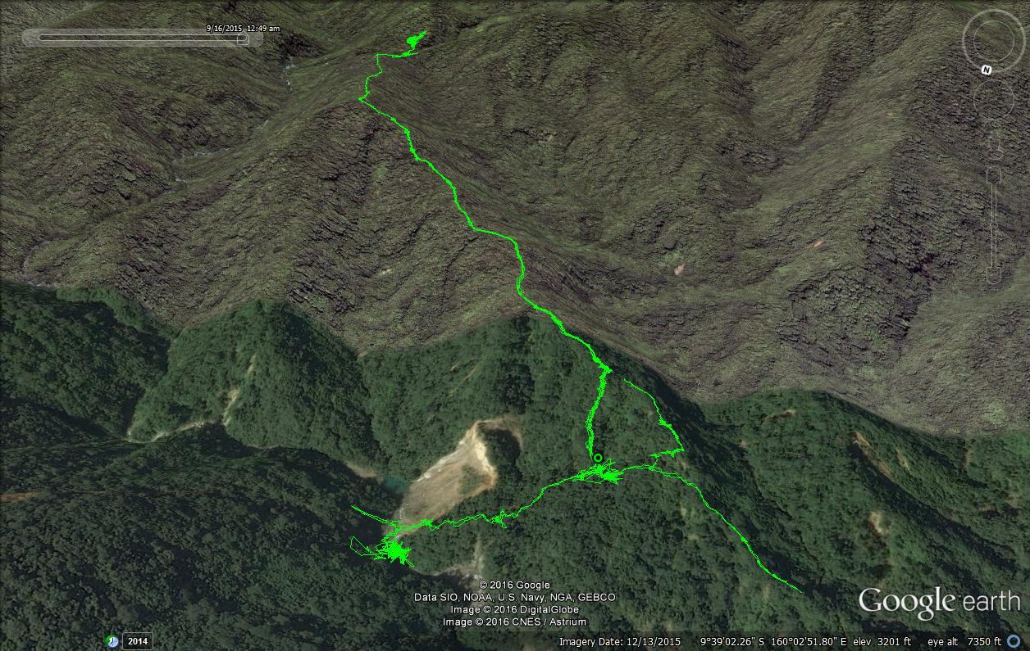
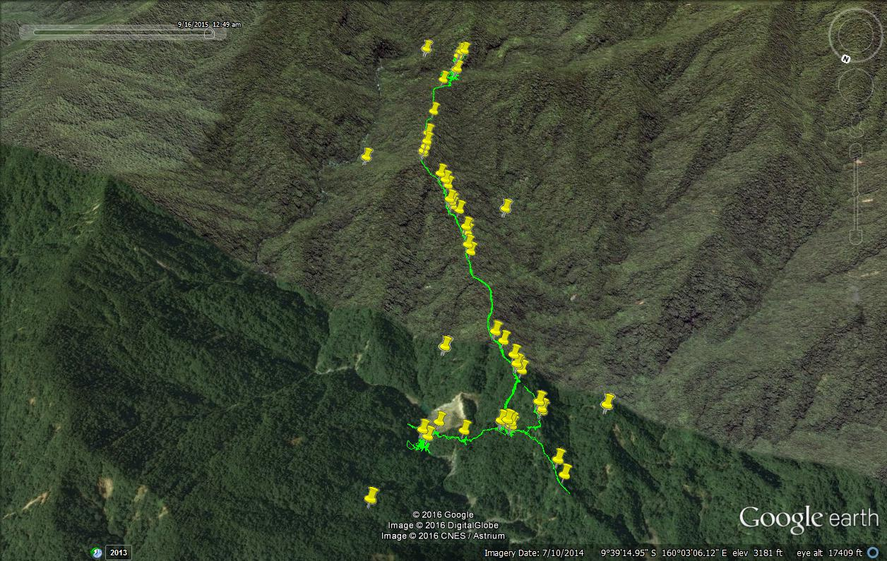
Other useful tips
Keep GPS track; Geotag images
Photograph tag number before each specimen
Don’t delay on transcribing/cleaning/integrating data!
1300 m
800 m
1000 m

Slide 12
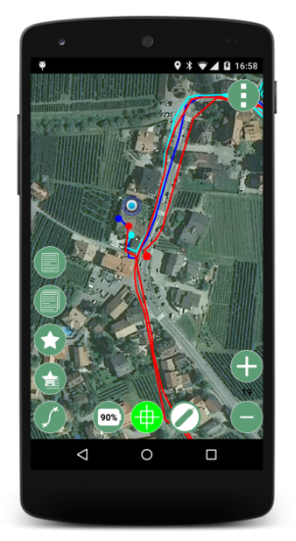
More tricks and tips!
Mobile technology and apps
Tools for cleaning and standardizing data
Data collection apps
Georeferencing tools
Photo geotagging
Measurement tools (height, direction, distance)
Audio collection tools
OpenRefine
Google Earth, other visualization software
Taxonomic name etc. validation services

Slide 13
More tricks and tips!
Mobile technology and apps
Tools for cleaning and standardizing data
Field information management system
Develop a sustainable workflow
Publish using identifiers!
Reach out to iDigBio for information:
Field to Database Wiki
Glossary of Terms

Slide 14
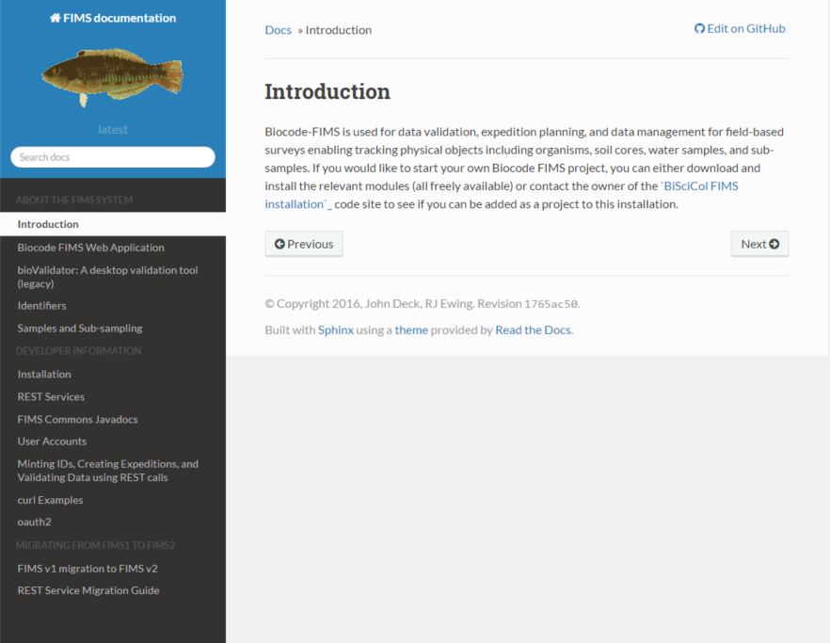
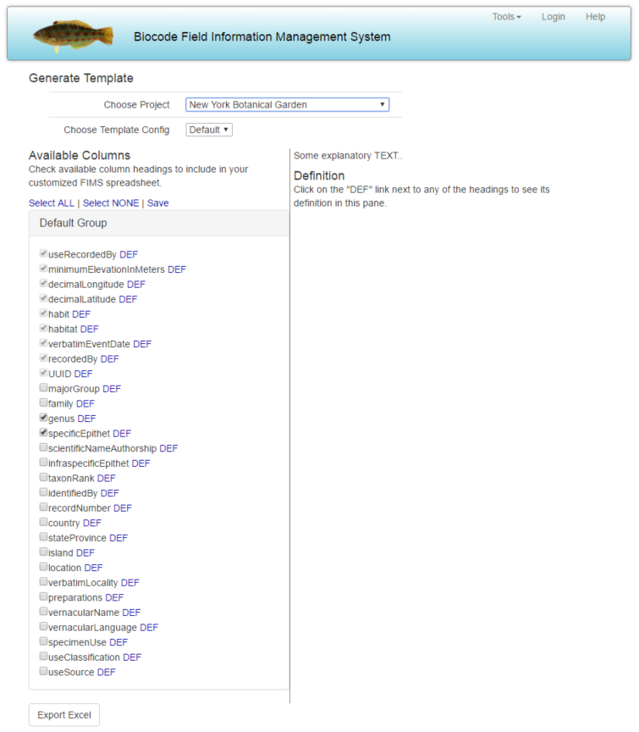
http://www.biscicol.org/
Expedition identifiers & metadata
Excel spreadsheet generation
Controlled vocabulary
GUID generation
Data validation
DwC

Slide 15
More tricks and tips!
Mobile technology and apps
Tools for cleaning and standardizing data
Field information management system
Develop a sustainable workflow
Publish & archive data using appropriate identifiers!

Slide 16
More tricks and tips!
Mobile technology and apps
Tools for cleaning and standardizing data
Field information management system
Develop a sustainable workflow
Publish & archive data using identifiers!
Reach out to iDigBio for information:
Field to Database Wiki
Glossary of Terms
www.iDigBio.org

Slide 17
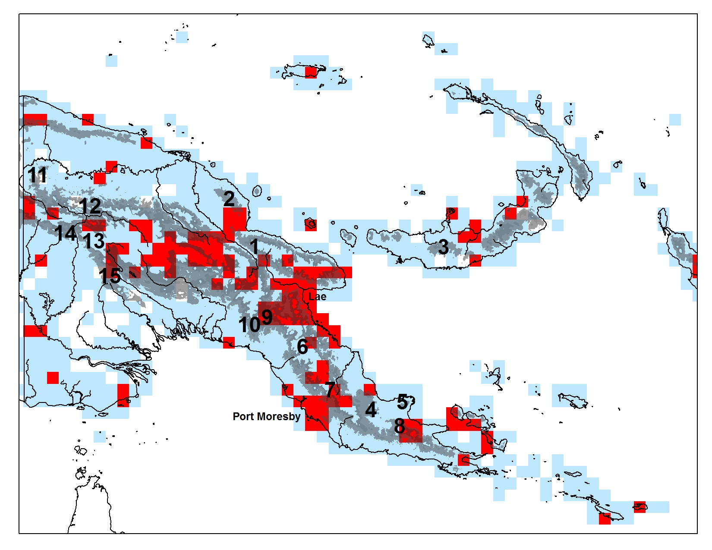
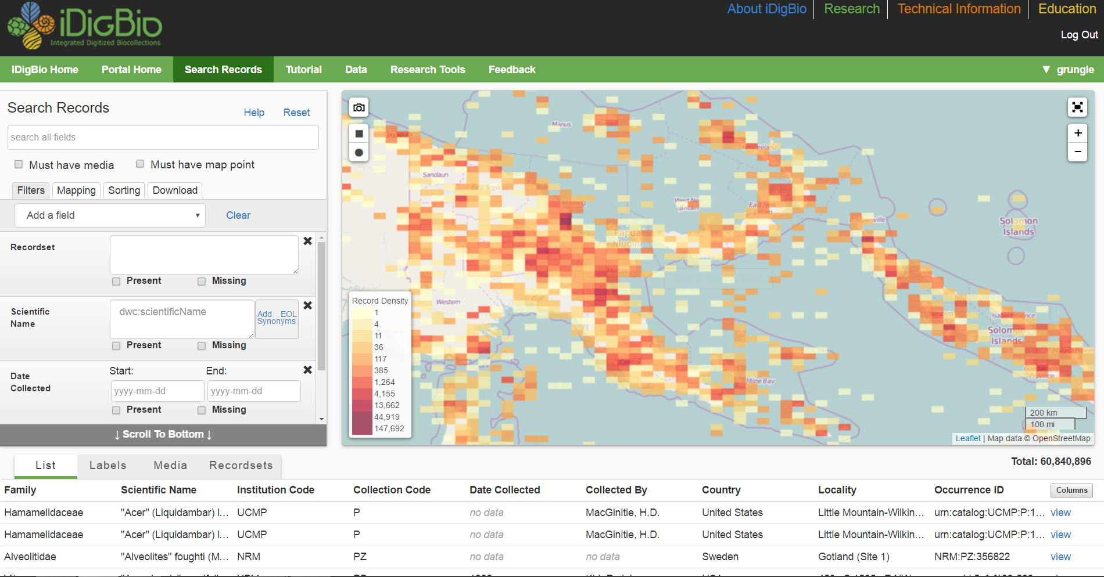
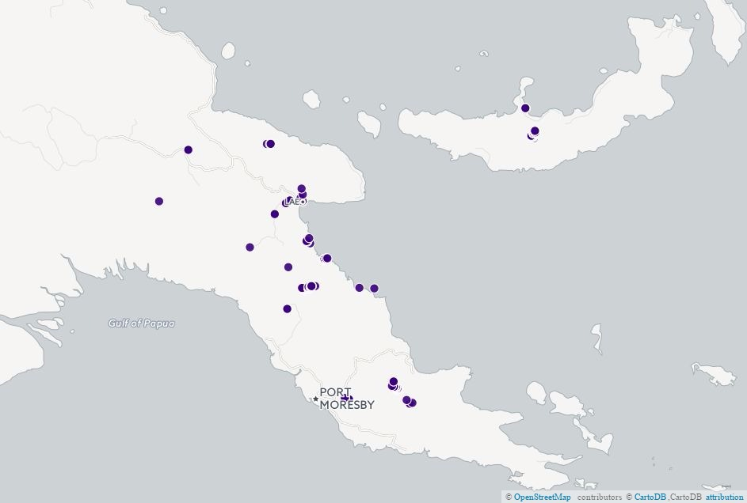
Using biodiversity data to plan expeditions
iDigBio
GBIF
Other biodiversity data sources
Physical specimens
Previous survey documentation
Literature
Notes:
Proposed NSF-funded botanical collecting sites in relation to collection density and elevation in the east Papuan region. Grid cells with an adequate collection density for floristic inventories are in red; the gray indicates the region within the elevation 500-1500 m, hypothesized to be the most species rich but under-collected zone.
380 specimens per grid cell (equivalent to 50 specimens per 100 km2) is considered adequately collected.

Slide 18
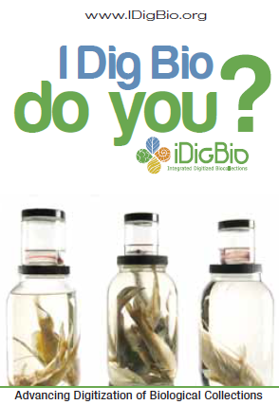
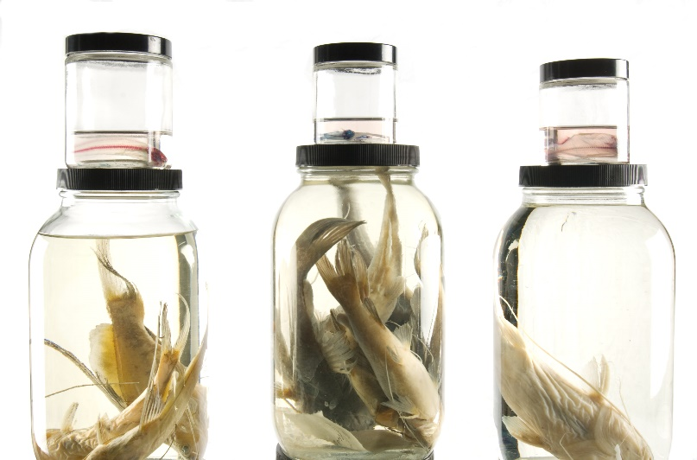
www.iDigBio.org
Shelley James, sjames@flmnh.ufl.edu

