Slide 1

iDigPaleo & ePANDDA Digital infrastructure and tools for collection discovery and use
Susan Butts¹, Talia Karim², Chris Norris¹ & Dena Smith^{2,3}
(1) Yale University, (2) University of Colorado, (3) Geological Society of America
Notes:
As researchers, or as people than manage collections – a research facility – we tend naturally to think in terms of improving research access to collections data
But if we’re to realize the truly transformative societal effects of mass digitization of collections data, we need to develop tools for the use of data outside traditional research settings
Today, I’m going to talk about two inter-related projects called iDigPaleo and ePANDDA that collectively address this need

Slide 2
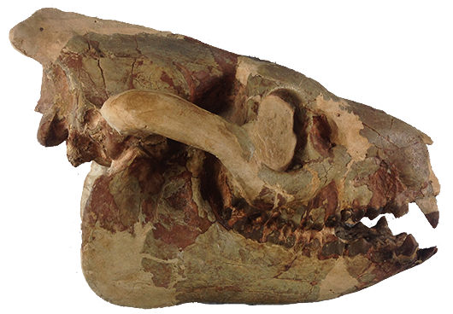
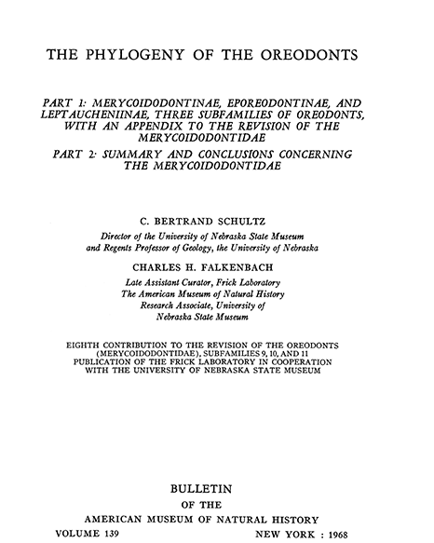
.
.
.
.
.
Notes:
Within paleontology, we have two fantastic community resource
One of these, you’re already aware well aware of – the worldwide network of fossil collections that are such a rich resource for research and education
The second is the fruits of those collections – the paleontological research carried out by thousands of people worldwide
Of course, the research comes from more sources than just collections
And because of this, the relationship between collections and research is a mutually enriching one

Slide 3
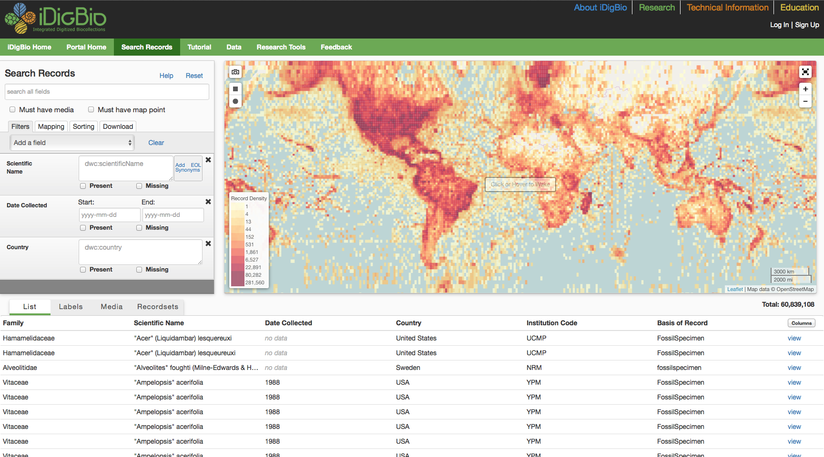
Notes:
Of course, this mutually enriching relationship has been going on for a very long time
What’s changed in recent years is our ability to capture and share data digitally
We’re obviously all very familiar with specimen-based resources – our own web accessible collections database, and aggregated portals such as VertNet or iDigBio

Slide 4
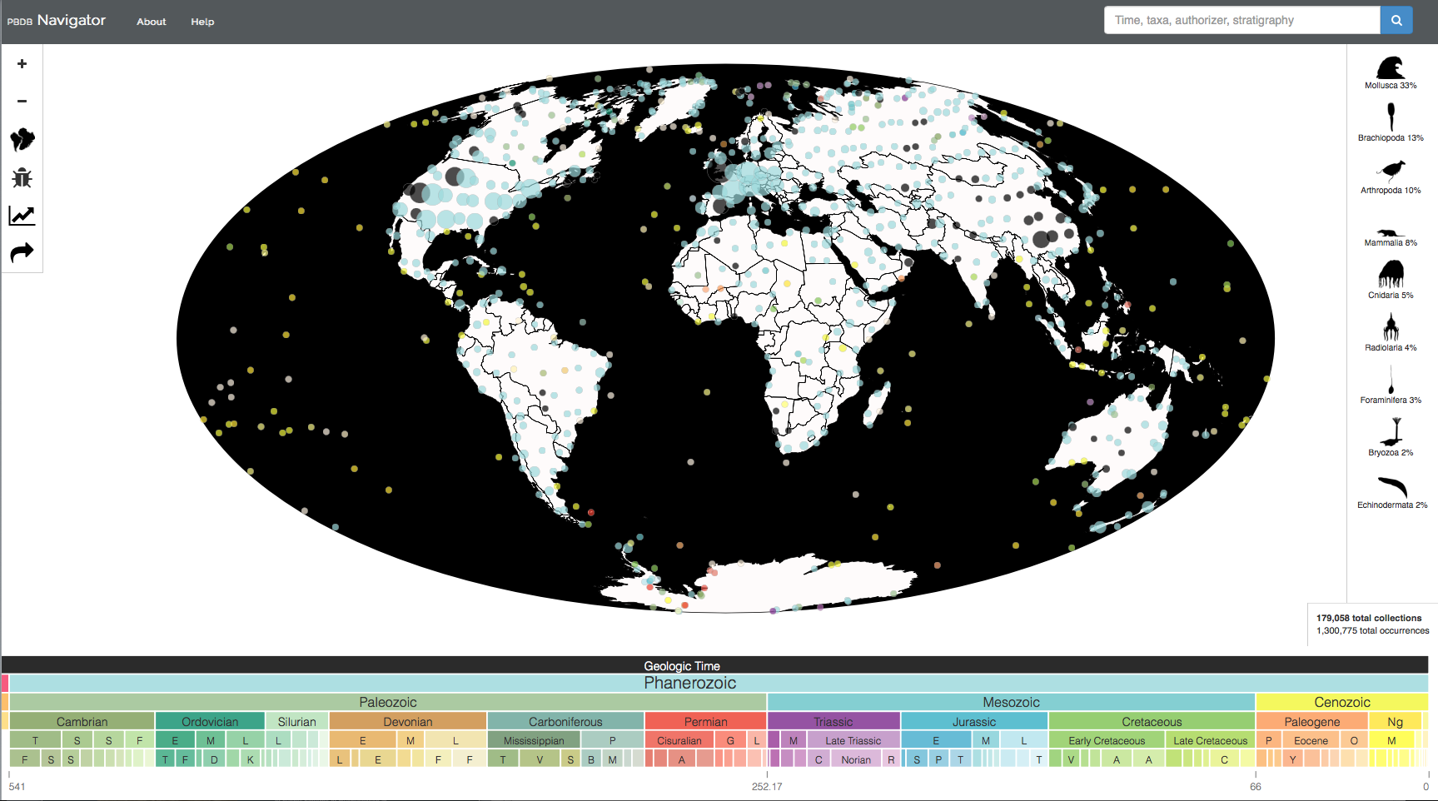
Notes:
If you don’t work in paleontology, however, you may be less familiar with this one
This is the Paleobiology Database and if you haven’t used it, it’s an awesome product
It is a crowdsourced, literature-based (including unpublished dissertations and theses) database.
PaleoDB currently contains over 1.2 million records, and includes authority files for taxonomic hierarchies and synonymies, multiple classification schemes, and multiple time scales
It is an extraordinarily rich resource, which was cited as a data source by nearly 3,000 academic papers in 2014
But…
Taxa are tied to publications, not specimen records, even though the records in the publications are often derived from collections

Slide 5
.
.
.
.
.
.
.
.
.
.
.
.
.
.
.
Notes:
In theory, you ought to be able to move data around between these different resources, and everyone would benefit
In practice, the architecture of PaleoDB and iDigBio is quite different, so linking them is not straightforward

Slide 6

.
.
.
.
.
www.edutopia.org
Notes:
And even if you could link them together, what about using that combined dataset outside traditional research settings?
PaleoDB and iDigBio have made great strides towards increasing the ability to search and access data
But what about a toolset to access that combined dataset in, say, a classroom context?

Slide 7
ePANDDA: seamless linkage of paleontological data from multiple sources
iDigPaleo: tools for discovering, saving, and sharing paleontological data
Notes:
And that is what our two interlinked projects do

Slide 8
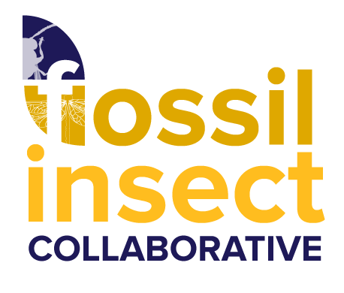

TCN: Fossil Insect Collaborative: A Deep-Time Approach to Studying Diversification and Response to Environmental Change
Lead PIs: University of Colorado Museum of Natural History – Dena Smith (also now STEPPE GSA) and Talia Karim
YPM PIs: Susan Butts and Chris Norris
Notes:
Let’s start with iDigPaleo
The pilot version of iDigPaleo is one of the products of this project
$2.3M – digitization grant from NSF
4 year project 2013-2017
TCN Thematic Collections Network – ADBC advancing digitization of biological collections
Some of these slides are from the PIs

Slide 9
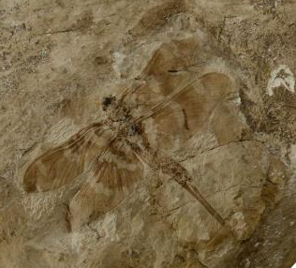
Digitize and make available all the major collections of fossil insect specimens in the United States
Research Goals
understand responses to environmental change and patterns of biodiversity through time
phylogenetic reconstruction, evolution of morphological characteristics, and studies of overall patterns of diversification in deep time
YPM-IP.1002 Dunbaria fasciipennis Holotype
Notes:
The project goal is to make available all the major collections of fossil insect specimens in the United States by creating electronic specimen records consisting of digital images and associated collection data
From a research perspective --- understand response to environmental change and patterns of biodiversity through time
---phylogenetic reconstruction, evolution of morphological characteristics, and studies of overall patterns of diversification in deep time.

Slide 10
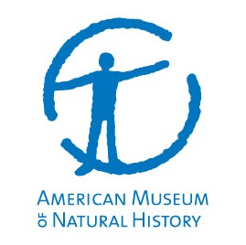


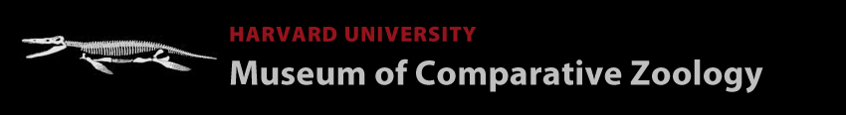

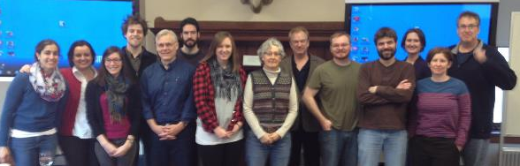
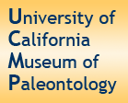





PEN
PEN
Notes:
Like all of these TCN grants, it’s a multi-institutional collaboration, including 11 institutional partners
Collectively they will contribute over 500K+ digitized fossil insect records to the project, including images and georeferenced locality data

Slide 11
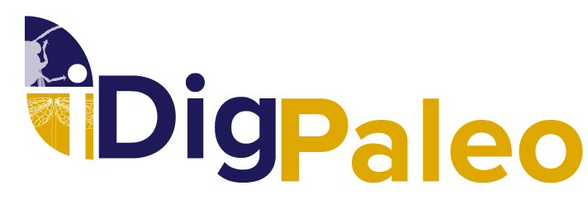
Aggregate data from fossil insect project
Provide tools for educational access to these data
Notes:
Yale is has digitized its fossil insect collections as part of the grant, but perhaps more important is the development of iDigPaleo
As already mentioned iDigPaleo addresses the critical question of access – once you’ve digitized the data, what do you do with it?
The pilot version developed through the TCN grant deals with one potential application – bringing collections data into the classroom

Slide 12

Your Data
iDigPaleo
iDigBio
Notes:
So what does iDigPaleo do?
Let’s assume that you have some paleontological collections data
You can expose those data to the world via your own search interface
And you can send your data to iDigPaleo, who will expose in in the context of data from other institutions - this is a good thing; context is good
At its simplest, iDigPaleo is just another way of getting your paleontology data to iDigBio

Slide 13
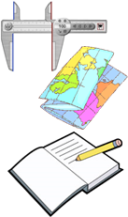

Your Data
TCN
iDigPaleo
iDigBio
Notes:
If you’re getting funding from ADBC, your collection is likely to be part of a network of data providers – a TCN, like our fossil insect project
You can serve up the data institution by institution
iDigBio can aggregate all of the data and serve it up via the national portal
Or iDigPaleo can aggregate all of the data and serve it as a single feed to iDigBio
Understandably, iDigBio might prefer to get a single feed from iDigPaleo.
But what’s in it for you?
As I said, aggregation is the simplest thing we do.
If you have an institutional IPT (Integrated Publishing Toolkit) provider we can pull your content into iDigPaleo, and we can push it to iDigBio
But the real strength of iDigPaleo is its associated toolkit
This lets your collection users search the aggregated paleo data via the web and do a bunch of things that make it highly suitable for education and outreach purposes.

Slide 14
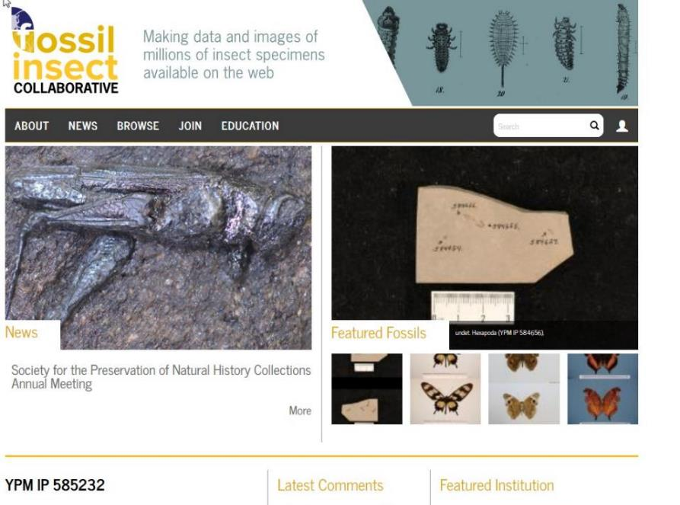
Notes:
The front end of iDig Paleo is a search portal
Currently posting records from – YPM, CUBoulder, Harvard MCZ, National Museum of Natural History – Illinois Natural History Survey will be up any day
You can see that we are posting both fossil and extant insect data, because these will be used for comparative studies, for example contrasting past and present distributions of insects based on their fossil record

Slide 15
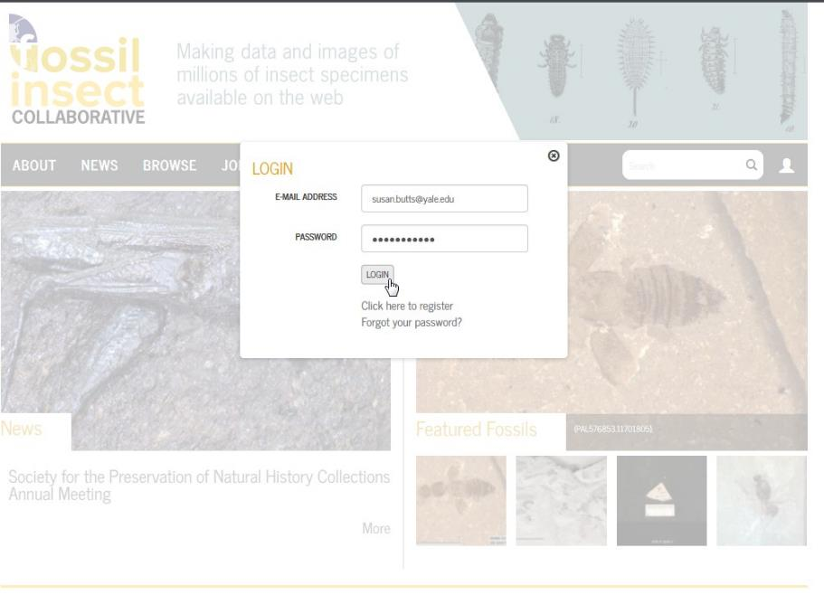
LOGIN
Notes:
Basic functionality can be accessed as a guest, but to get the full benefit of the site you need to register as a user

Slide 16
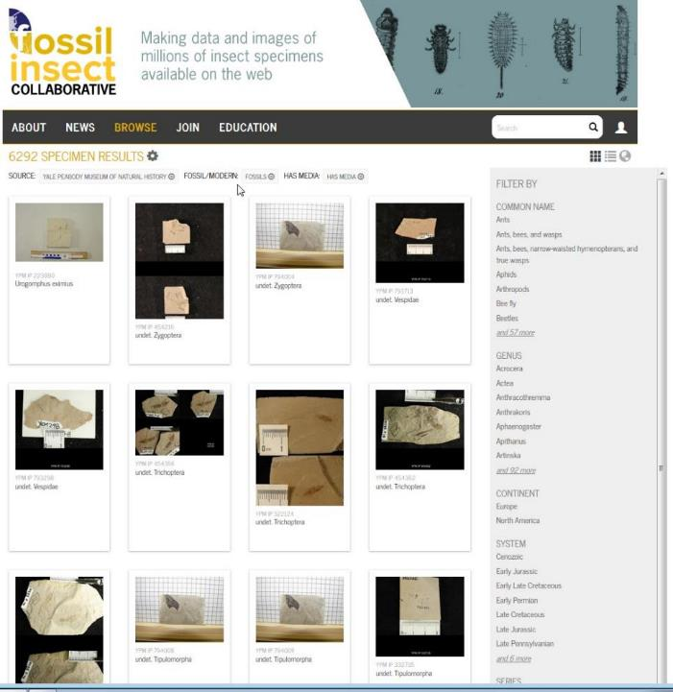
BROWSE
Notes:
The simplest way to use iDigPaleo is to browse specimen records. You can enter your own search terms, or use a one of more preset filters

Slide 17
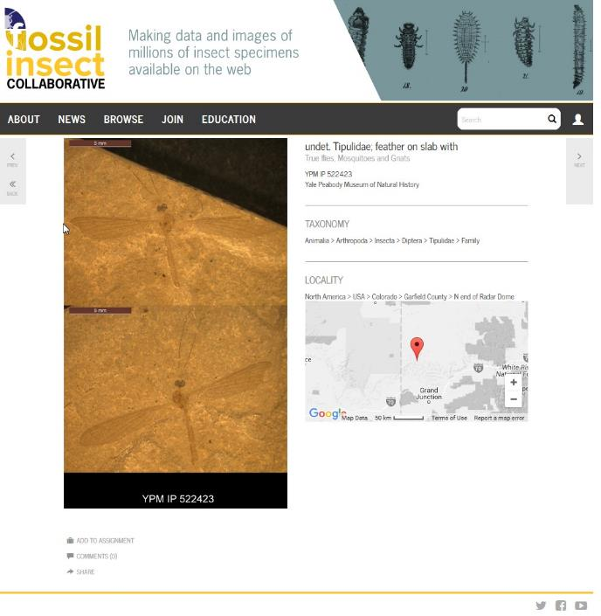
MAP
Notes:
The portal lets you map where the fossils were found. This is the location for a single specimen record, but you can also produce maps for multiple specimens
Being able to map the records is important, because it lets you ask and answer questions about how the distribution of particular insects has changed over time, in response to environmental change
e.g. TseTse fly

Slide 18
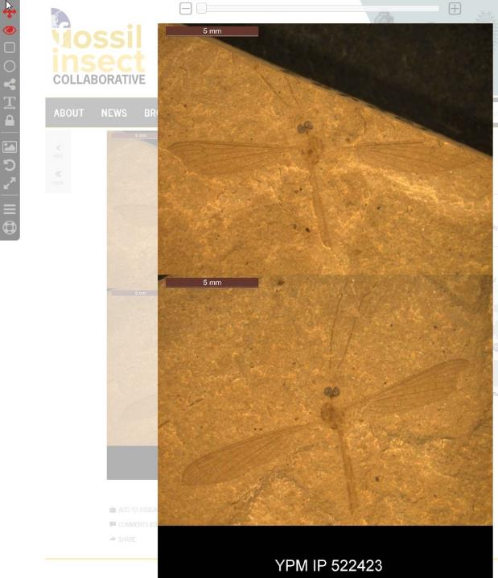
MEASURE
Notes:
You can also do quantitative work, scaling the image and then taking and recording measurements on-screen
Sample classroom activity – measure fossil dragonfly wing; measure wings of recent dragonfly; reconstruct other dimensions based on proportions

Slide 19
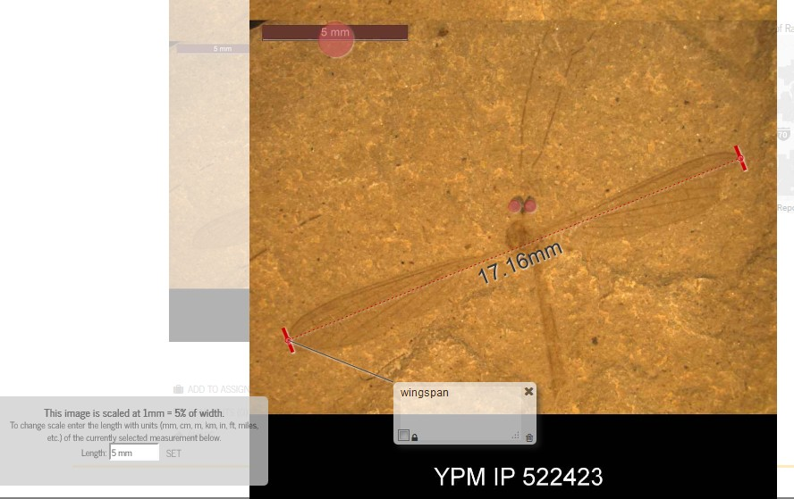
NOTE
Notes:
iDigPaleo also lets you record qualitative observations by annotating the image
e.g. “find the eyes,” or “mark and label 3 distinctive features that make this a crane fly (tipulid)”

Slide 20
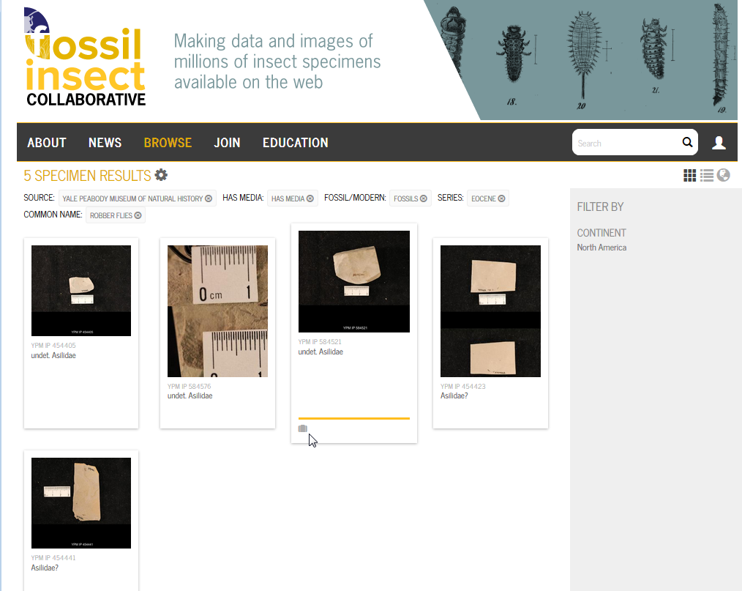
GROUP
Notes:
A teacher who wants to use this in the classroom has a number of options
– Create and save their own set of records to share with the class
Have the class create and work with their own set of records as part of the assignment
Work from a preset record site provided by us

Slide 21
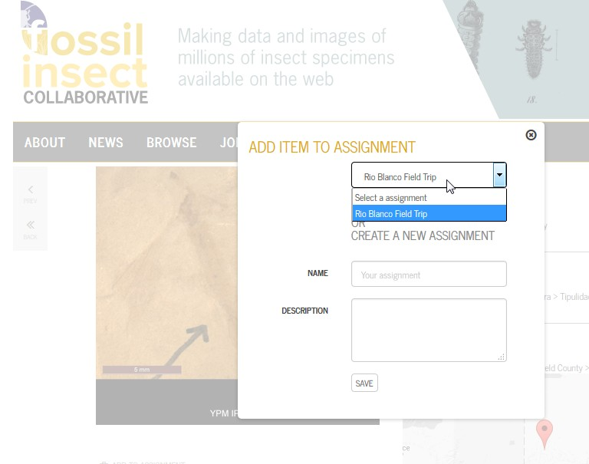
SAVE
Notes:
Assignments can be saved and stored

Slide 22
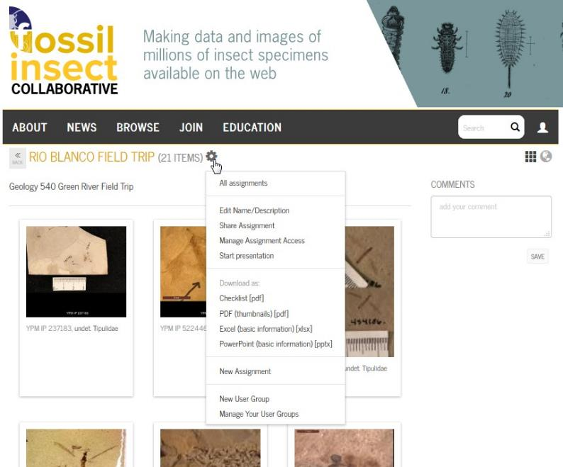
SHARE
Notes:
Once the teacher has created an assignment, it can be shared with the class in several ways:
Make a powerpoint presentation
Make a PDF handout or checklist
Share the assignment with your class (as a URL – that allows them to register and view interact with the assignment
They might:
answer questions or share observations by adding comments at the assignment, or item level.
annotate images or measure objects
students can respond to assignments by creating their own collection of items complete with name, description, image annotations and comments

Slide 23
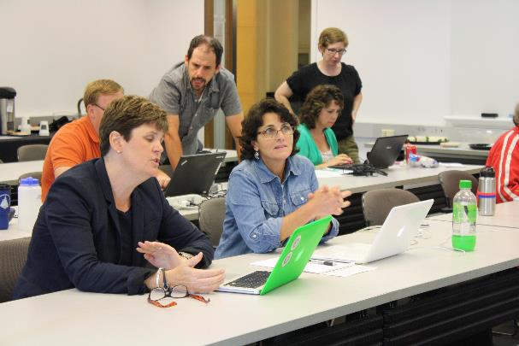
iDigPaleo Teacher Workshop, Yale Peabody Museum July 20-21, 2015
Pilot version of iDigPaleo is being developed for K-12 classroom usage
Could just as easily be used for undergraduate or postgraduate education
Could also be a tool for research
Notes:
As we mentioned, for this project we’ve been focusing on K-12 classroom usage
The toolset that’s been developed has much wider applications
To realize these, we need to address those challenges of data enrichment from multiple sources – which is where ePANDDA comes in

Slide 24

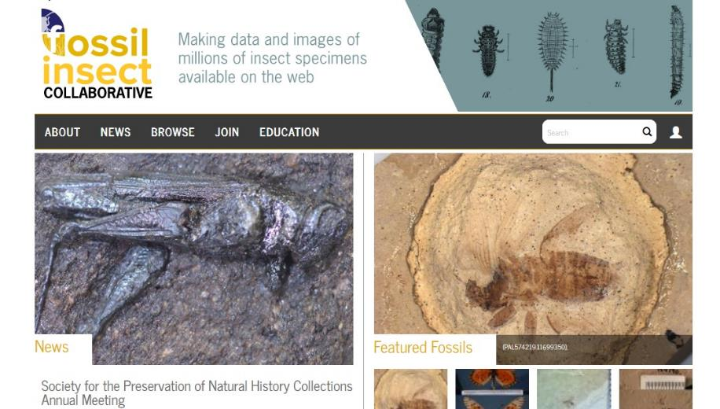
iDigPaleo
Notes:
So, let’s recap from the beginning
iDigPaleo – data pre-aggregator, configured for K-12 education use
Currently fossil insects, but can be all paleo
Each record has metadata for a thousands of museum specimens, including coordinates, stratigraphic information and images

Slide 25

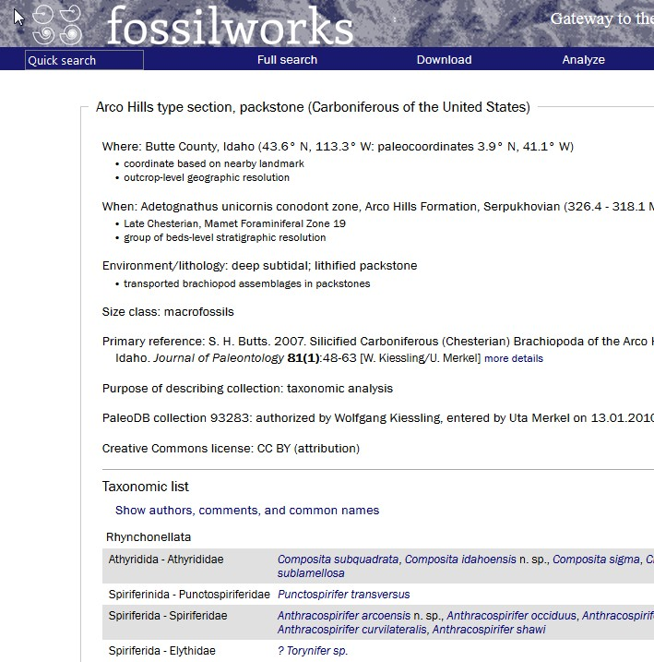
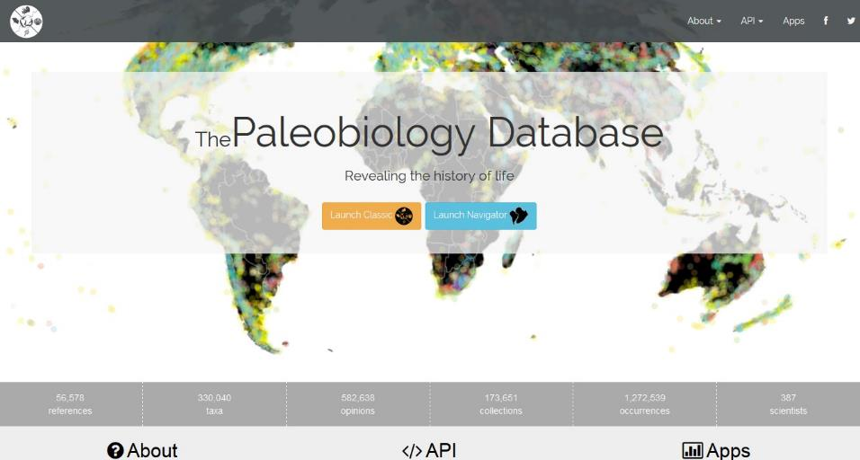
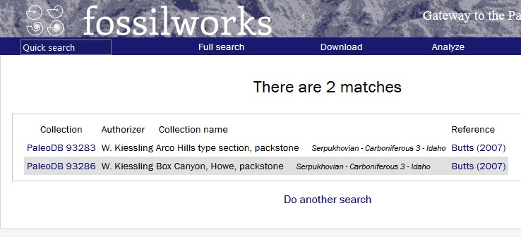
PBDB
Notes:
Then we have PBDB
Crowdsourced, Literature-based (incl. unpub dissertations and theses) – so taxa are tied to a publication
1.2+M records – very different architecture from the idigs
Authority files for taxonomic hierarchies and synonomies, multiple classification schemes, multiple time scales
Nearly 3000 academic papers referenced PBDB as a data source in 2014
Two APIs – Classic”fossilworks” (access/download PBDB) and Navigator (education, classroom allows users to visualize data with silhouttes of taxa, plotting on maps with)
But, it has two big issues:
No links to specimens
No neontological data

Slide 26

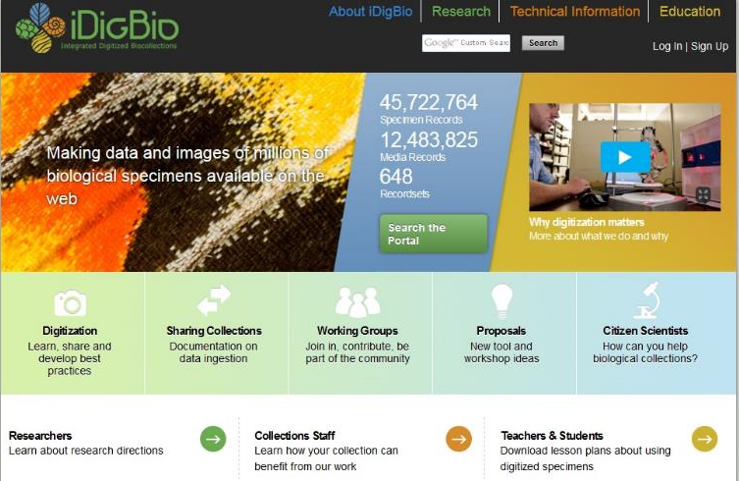
iDigBio
Notes:
Aggregated database serves as HUB -e national resource for digitized information about vouchered natural history collections within the context established by the NIBA community strategic plan and is supported through funds from the NSF ADBC program
Model is pretty similar to iDigPaleo – museum objects in aggregated database for data analysis – also developed for education, avocational uses
=iDigBio –NoSQL- 45M specimen records (1.1M paleo, .5M from YPM) - Neontological comparative material –
idigs are IPT harvested - GBIF Integrated Publishing Toolkit (IPT) mapped data in a standard format known as a Darwin Core Archive (DwC-A),

Slide 27

ePANDDA
External authority files: taxonomy, stratigraphy, locality, bibliography
Taxonomy
Notes:
Common thread – taxonomy (identification of animal) – compare against external authorities to automatically align taxonomy, stratigraphy, locality and bibliographic data against external authorities databases and providers’ data (option to manually override) --- Seamlesslessy map, translate, and distribute data
What you need to take advantage of this is an API harmonizer – pulls in paleo data, neontological, data, literature data AND literature –

Slide 28

ePANDDA
ePANDDA:
enhancing PAleontological and Neontological Data Discovery API
iDigPaleo
Susan Butts, Yale
Talia Karim, Colorado
Chris Norris, Yale
Dena Smith, GSA
PaleoDB
Jocelyn Sessa, AMNH
Mark Uhen, George Mason
iDigBio
Shelley James, Florida
Gil Nelson, Florida State
Not our final logo
Notes:
We and a group of collaborators from GSA, iDigBio, and the Paleobiology Database are working on this a API project, which we call ePANDDA, funded through NSF’s EarthCube program.
ePANDDA: enhancing paleontological and neontological data discovery API
Plain English explanation:
Portal sites combine the same fields from different databases as part of the query process
ePANDDA will use data commonalities to run queries across databases that don’t completely overlap
Etymology of ePANDDA – as is often the case the acronym fitted to the name of some charismatic megafauna
You would think that would be a no brainer for a logo
We’re still working on the logo

Slide 29



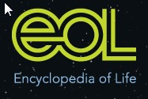
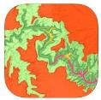

Research User Custom Interface
iDigBio
iDigPaleo
iDigBio API
iDigPaleo API
ePANDDA API
Map, Translate, and Distribute Data
Fossil Club API
Fossil Club Web Portal
PBDB API
PBDB
Notes:
We’re also looking at developing APIs and plug-ins (AKA widgets) that let us share data with other groups and provide resources for researchers and amateur collectors.
Mapping – Gplates
Geologic info – Mancos - geological formation and the regional stratigraphic column, all supplied by the servers at earth-base.org
Analysis – diversity
EOL – common names – Phylopics – organism silhouettes
Earthchem - major geochemical databases from the U.S. Geological Service and other international providers
Genetic data --
Widgets – pieces of code you can insert in your web page – dynamically display datafeeds

Slide 30
ePANDDA
Matching services
Occurrence – specimen
Publication – specimen
Taxon – specimen
Locality – specimen
Stratigraphic – specimen
Utility services
Lookup and validation – taxon, DOI, stratigraphy
Inexact text matching algorithms & machine learning
Establish potential links between data entities
User customizable
Control methods employed
Set how aggressive (or not) matching will be
Notes:
Held an end-user workshop in March of this year; identified a wish list of functionality
Winnowed this down to the following basic outline of what e-PANDDA will provide

Slide 31
Possible Pathways to implementation
ePANDDA
Interactive API based on replicated dataset
PROS: requires only minimal dataset to perform matching; more customizable; much faster
CONS: requires more infrastructure – storage, bandwidth, processing
Non-interactive API, working on a per-request basis
PROS: less infrastructure management
CONS: less functionality – fewer matching options, fewer services: slower; less scalable as usage grows
Notes:
Biggest challenge – speed
We set out not to build another database
Is likely that we will end up building another database, but only a minimal one and for indexing only
The alternative is less functionality and less scalability
Projected implementation date – Fall 2017

Slide 32



Thank you
iDigPaleo: Christina Byrd, Michael Engel, Brian Farrell, David Grimaldi, Alex Hastings, Sam Heads, Kathy Hollis, Holly Little, Ricardo Perez-de la Fuente
ePANDDA: Larry Gall, Shelley James, John Lauters, Gil Nelson, Jocelyn Sessa, Danielle Serratos, Harry Shyket, Mark Uhen
Programming for iDigPaleo and ePANDDA is coordinated by Seth Kaufman, Whirl-i-Gig
Development of iDigPaleo is supported through NSF EF 1305027: Digitization TCN: Collaborative Research: Fossil Insect Collaborative: A deep-time approach to studying diversification and response to environmental change
ePANDDA is supported through NSF ICER 1540984: EarthCube IA. Collaborative Proposal: ePANDDA: Enhancing Paleontological and Neontological Data Discovery API

