Slide 1

The Art of Georeferencing: A case study at the North Carolina Museum of Natural Sciences (NCSM)
Gabriela M. Hogue

Slide 2




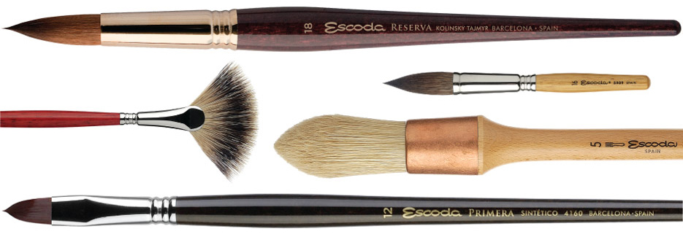
Notes:
Why call it an “Art”?
Just as artists can create completely different paintings using the same materials, we, as museum professionals can present different coordinate data, specifically its uncertainty, leading to its accuracy and precision or lack thereof.

Slide 3
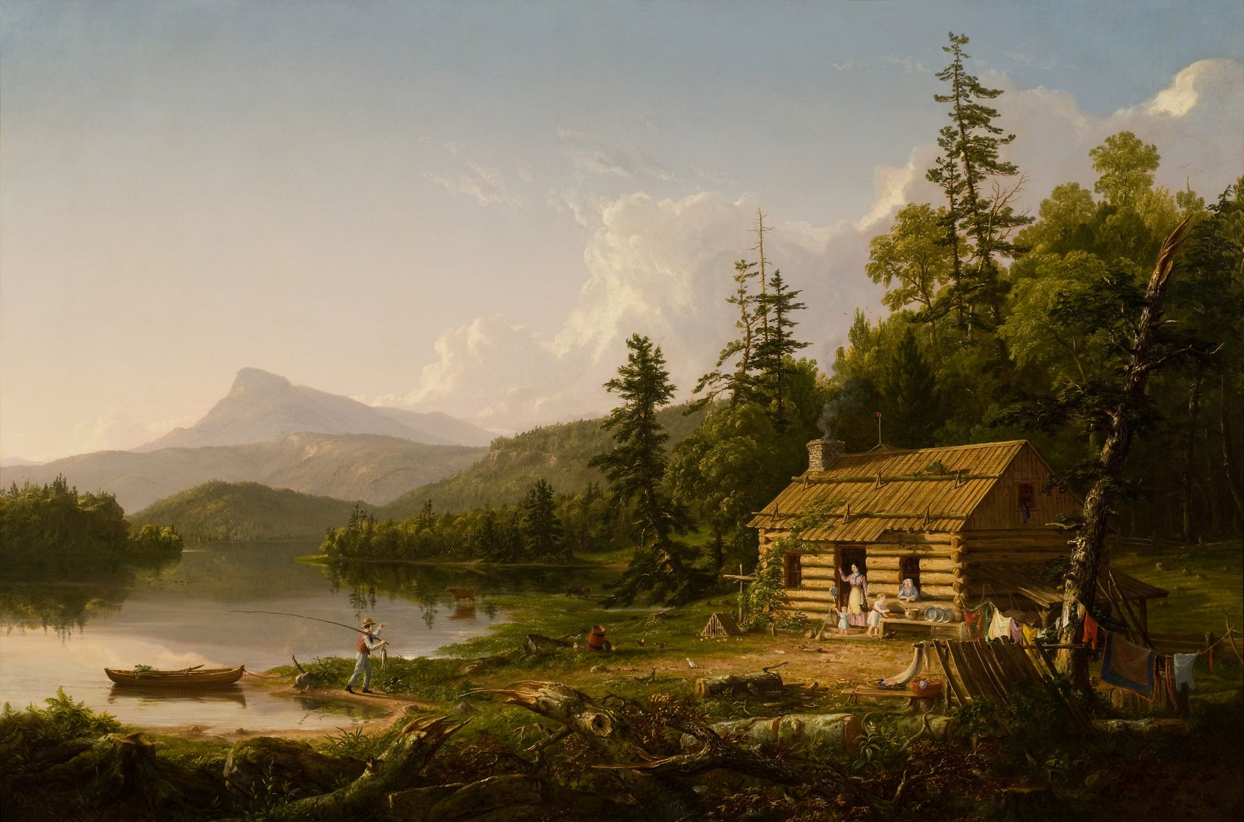
Thomas Cole
Home in the Woods (1847)
Notes:
Realistic Landscape with influence of romanticism
Thomas Cole – American artist known for landscape and history paintings – founder of American Art Movement

Slide 4
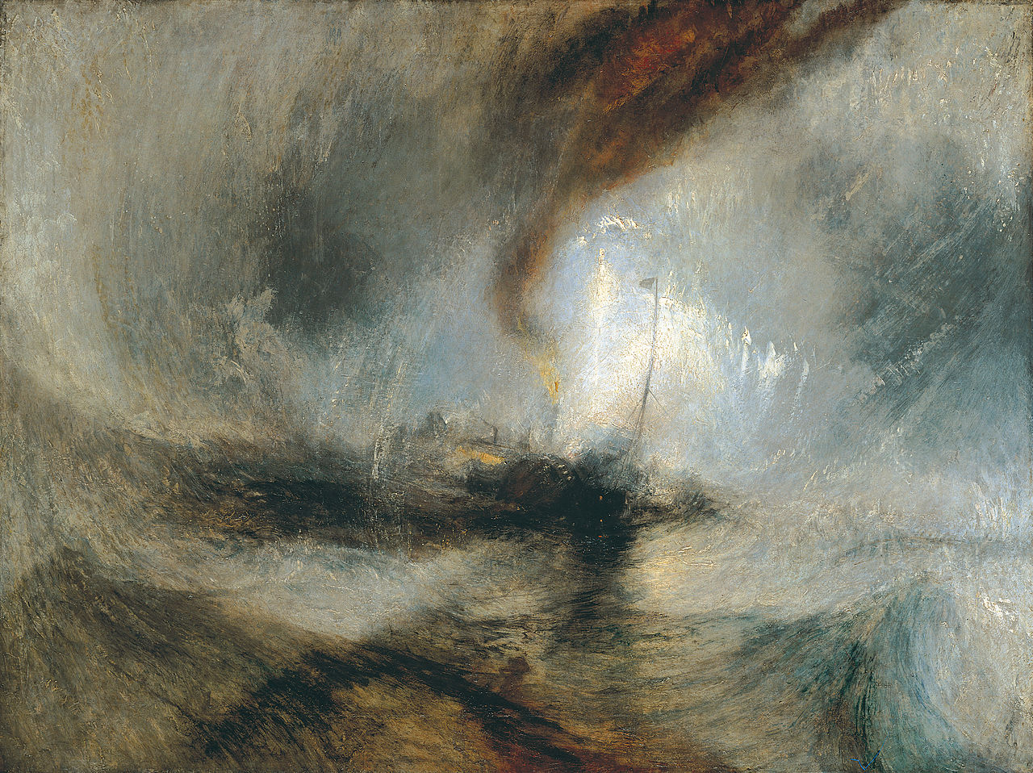
Joseph William Turner
Snow Storm – Steam–Boat off a Harbour’s Mouth
Notes:
Joseph Turner – originally a realistic landscape painter; later paintings appear to be impressionistic – it’s said he was striving for the expression of spirituality in the world
It is famously said that Turner conceived this image while lashed to the mast of a ship during an actual storm at sea.

Slide 5
Notes:
Vastly different styles - we move from the tranquility of nature in Cole’s painting to the fierce brutality of nature in Turner’s - yet both provide us with so much information about what was happening in each of the scenes depicted
Cole – illusion is scene is exactly as it was depicted – precision and accuracy
Turner – clear it was a storm but not clear where? What? – accurately depicting the storm with little precision and detail
This balance is what we face in georeferencing

Slide 6
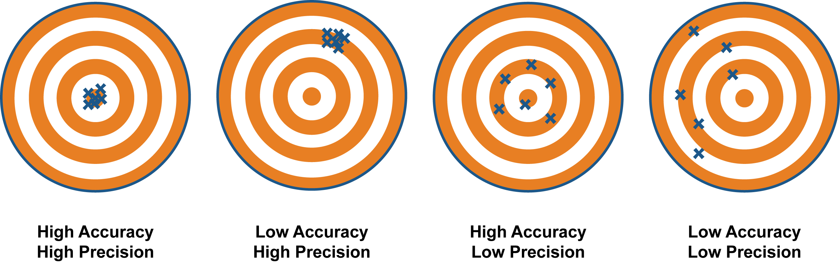
Accuracy versus Precision
Notes:
Low A, High P – clustered together but missed the bullseye
High A, Low P – not clustered but the ‘average’ position hits the bullseye
Low A, Low P – random
What are we striving for? Obviously, High A and High P – not always possible because it’s very dependent on the locality data that we receive

Slide 7
Locality Data
Research Vessel Name
Salinity
R/V Station Number
Waterway
Dissolved Oxygen
Locality Description
R/V Cruise Number
Temperature
Date Collected
Gear
Latitude
Longitude
Continent
Time
Depth of Capture
Collectors
Country
County
Geodetic Datum
State
Locality Remarks
Permits
Notes:
People often ask me “how do you spend your days?” I would love to say “working with specimens” but the honest answer is curating the data that accompanies those specimens.
Goal – take a specimen to its full state of utility – online data access
Fine line – data augmentation (such as georeferencing); are we adding accuracy and precision and creating a false sense of the actual accuracy and precision of the data because we know that there is so much power in distributional records, especially georeferenced ones

Slide 8
The biggest change in the coming years will be the recognition that georeferencing is a key element of description, retrieval, evaluation, visualization, and use in information systems of all types – not just in geographic information systems and not just associated with maps and geospatial datasets. It will be the realization that when informal georeferencing with place names is linked to formal georeferencing with coordinates or other spatial referencing systems, the result is new and powerful capabilities for information retrieval and analysis. – Linda L. Hill, Georeferencing: The Geographic Associations of Information, 2006.
Notes:
Linda Hill in her book in 2006 spoke of the power of georeferencing very well

Slide 9
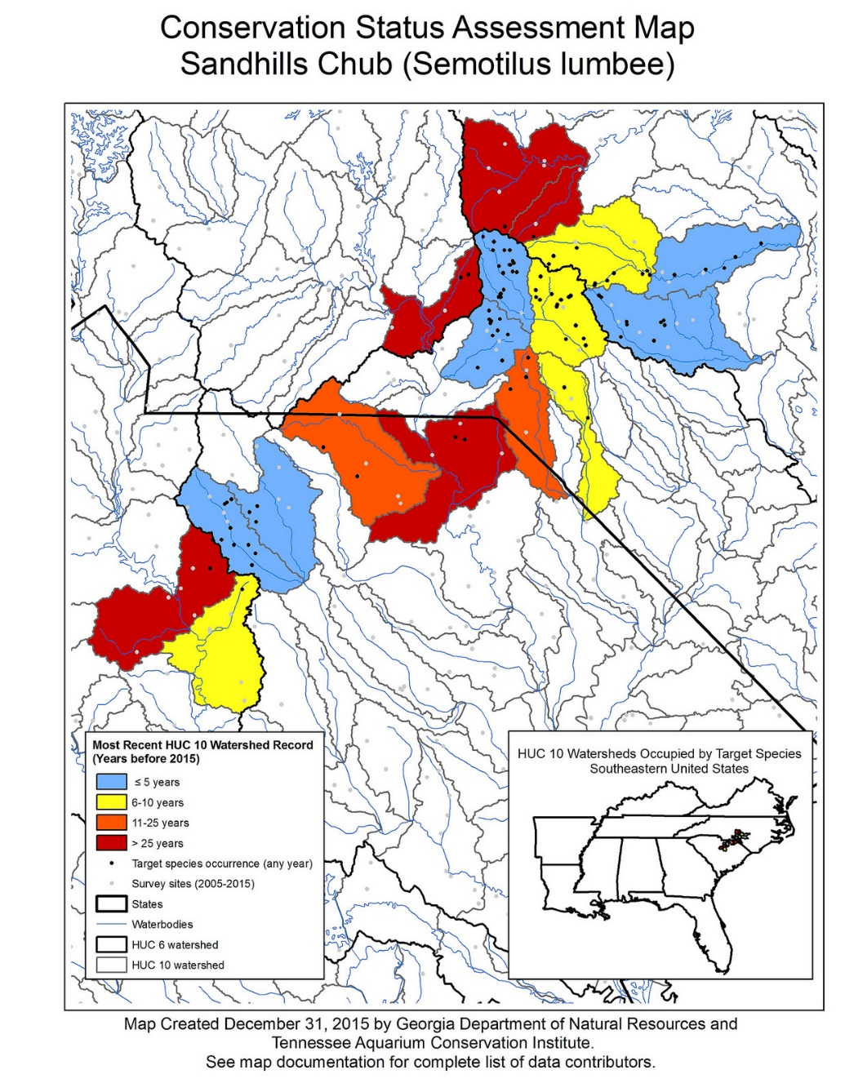
Power of Distributional Records
FIGURE 1. Distribution of Labidesthes sicculus (blue dots) and L. vanhyningi (red squares) examined in this study. Stars indicate type localities.
Taken from: Werneke, D. C. and J. W. Armbruster. 2015. Silversides of the genus Labidesthes (Atheriniformes: Atherinopsidae). Zootaxa 4032 (5): 535-550
Notes:
Assessing biodiversity
Health of waterways
Species discovery
Illuminating changes over time
Guiding Conservation
Guiding Management
Showing changes in distribution
Conservation project – by GADNR – Conservation Status Assessment maps for imperiled minnows and suckers – used georeferenced distributional records, sent maps to experts on each of the species, received feedback and created final maps – web accessible
Discovery of new species - L. sicculus – Northern Brook Silverside
L. vanhyningi – Southern Brook Silverside

Slide 10
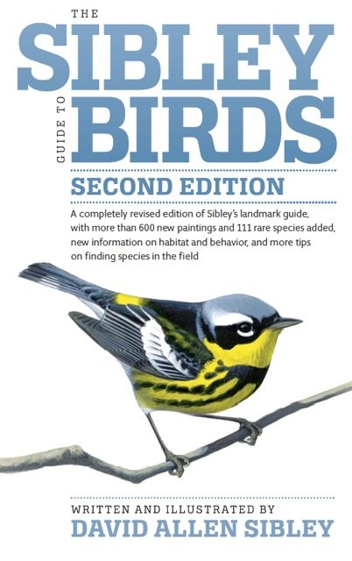
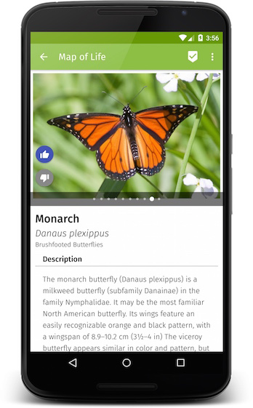

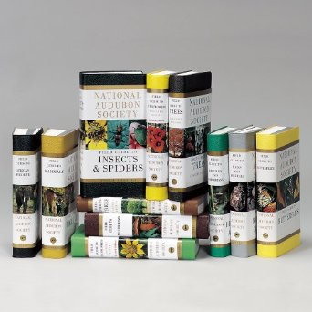
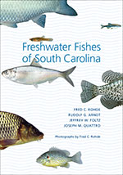


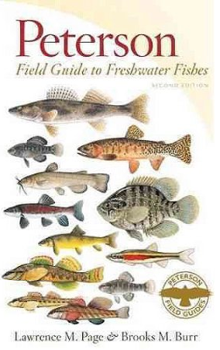

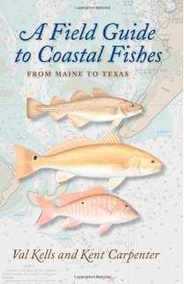

Power of Distributional Records
Notes:
And so many more….not possible without georeferenced distributional records
Let’s look at Evolutional of georeferencing at NCSM

Slide 11
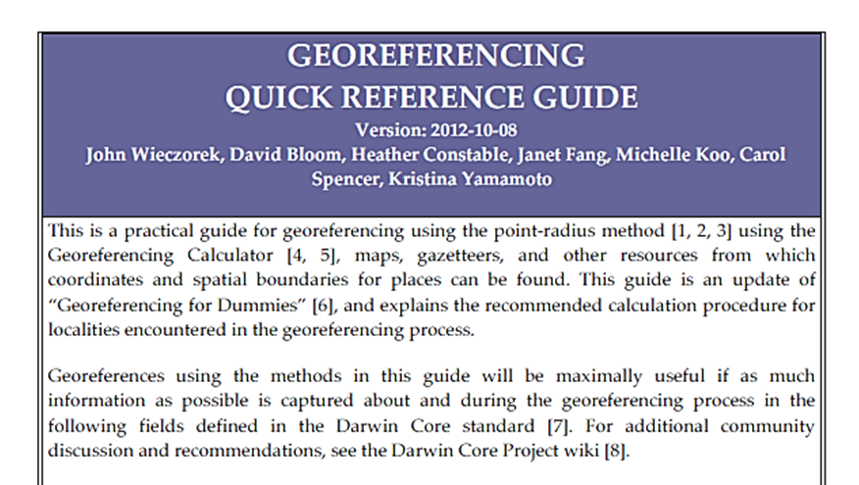
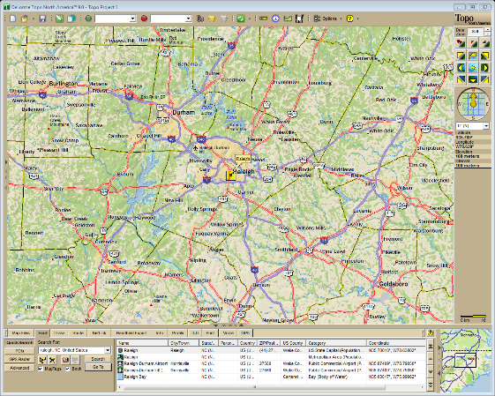
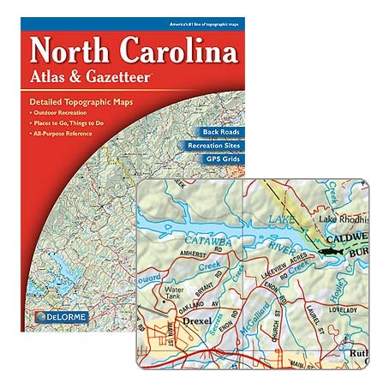
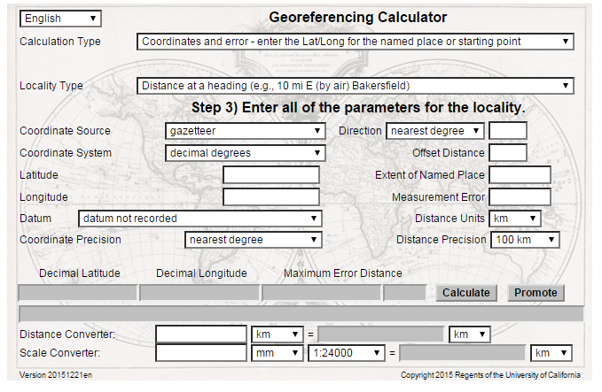
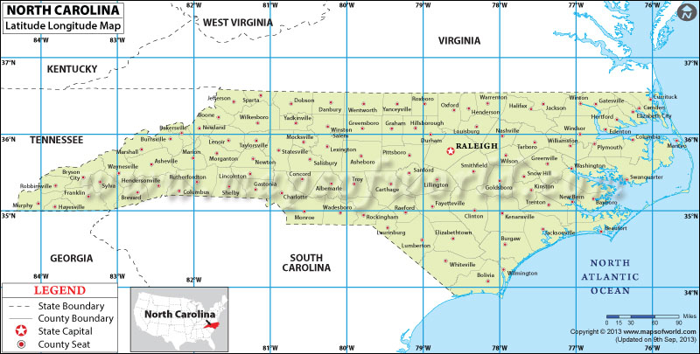
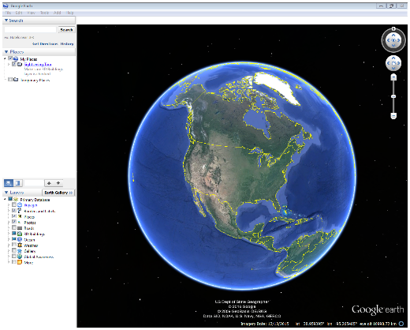
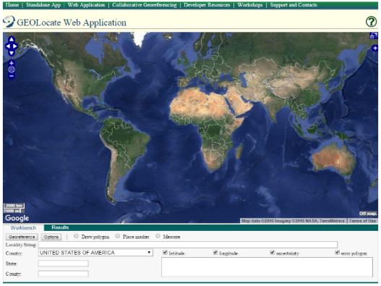
Evolution of Georeferencing at NCSM
Using paper maps
Using paper maps + mapping software
Using mapping software + established georeferencing standards
Notes:
Not straight arrows – issues in changing – funding to purchase mapping software when it wasn’t free; training and learning to use the various programs; change, change, horrible change
Getting to the last step was a really big change and required more buy in because of the need to change the database, train staff, add time into the whole databasing process, etc.

Slide 12
Confidence Levels
Confidence | Description
L0 | Precise location known
L1 | The linear site is known to be no more than .5 mi. long.
L2 | The linear site is known to be no more than 1 mi. long.
L3 | The linear site is known to be no more than 2 mi. long.
L4 | The linear site is known to be no more than 6 mi. long.
L5 | The linear site is known to be no more than 25 mi. long.
L6 | The linear site does not exceed a distance equal to 1/2 the state.
L7 | The linear site does not exceed a distance equal to diameter of the state.
S0 | Precise location known, plus/minus 200'.
S1 | Location known to be within a circle 1/4 mi. in diameter.
S2 | Location known to be within a circle 1/2 mi. in diameter.
S3 | Location known to be within a circle 1 mi. in diameter.
S4 | Location known to be within a circle 2 mi. in diameter.
S5 | Location known to be within a circle 5 mi. in diameter.
S6 | Location known to be within a circle 15 mi. in diameter.
S7 | Location known to be within a county.
S8 | Location known to be within 1/2 of the state.
S9 | Location known to be within the state.
S10 | Location unknown.
The Confidence Levels were taken from the Scale of Relative Certainty (with slight modifications) which was written by Dr. Eric H. Metzler and published in the Association of Systematics Collections October 1994/ vol. 22 no. 5 newsletter.
Notes:
Units using different databases – Dbase, excel, or no db just handwritten
Confidence levels where being used by those that were using Dbase – pick your battles

Slide 13
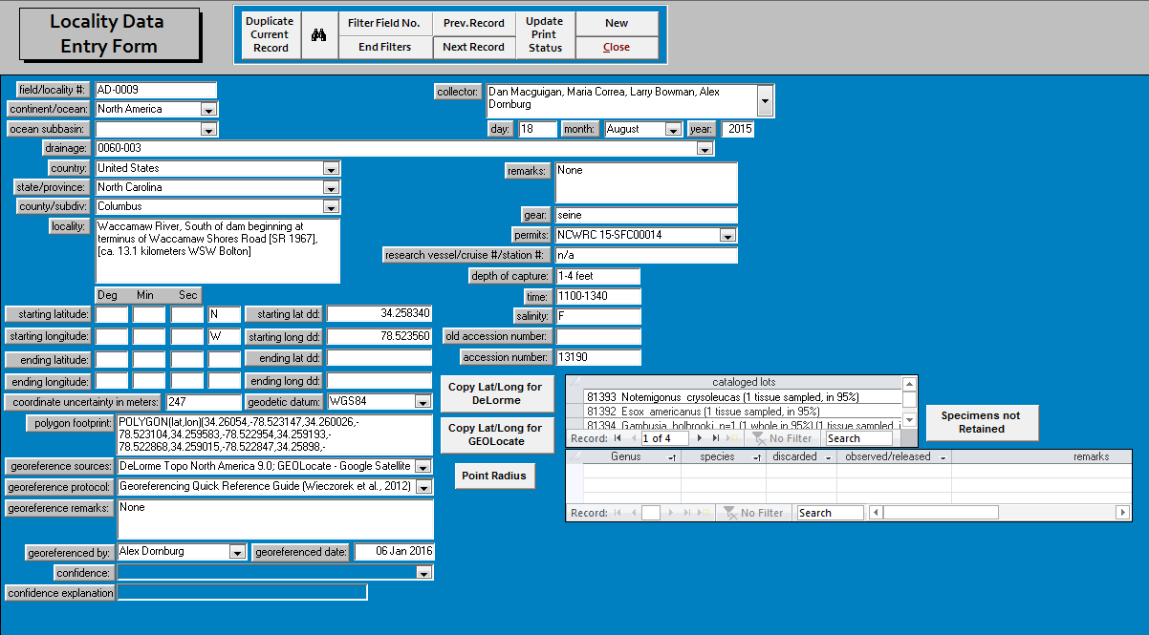
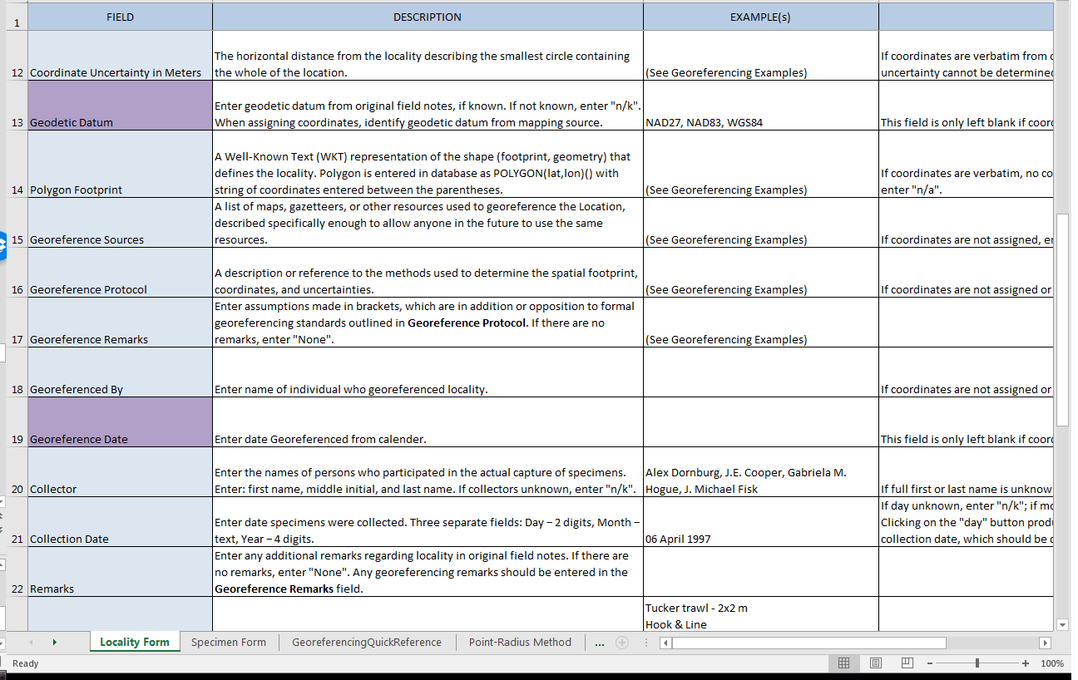
Revitalizing our Georeferencing Standards
Notes:
Read up on the georeferencing methods/standards that had already been established
Revisited every related locality field in our database and decided as to whether the data standards for each field needed to change
Added georeferencing fields to the db that were not already there
coordinate uncertainty in meters
Polygon footprint
Georeference protocol
Georeference remarks
Georeferenced by
Georeferenced date
We ended up creating a new databasing standards document – locked excel file – every field contains a definition of what should be entered. Did that for all of the Locality and Specimen fields
Also contains: georeferencing quick guide, point radius method, georeferencing examples, and the world wide list of institutional codes

Slide 14

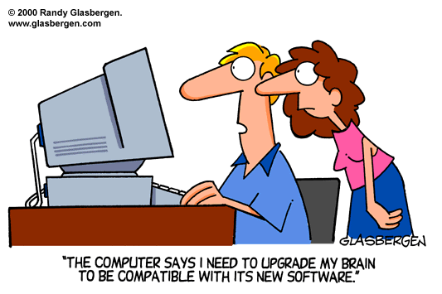

Incorporation of New Georeferencing Methods
Training & testing
Additions/Changes
Questions/Issues
New Revitalized Standards in Use!
Notes:
Meetings & discussions
Testing allowed us to see the need for some additions and changes to the standards – ex. Research vessel that does a trawl – start and end lat/long - Point Radius (linear transect)
Even though we have these standards, there will always be some issues with locality data

Slide 15
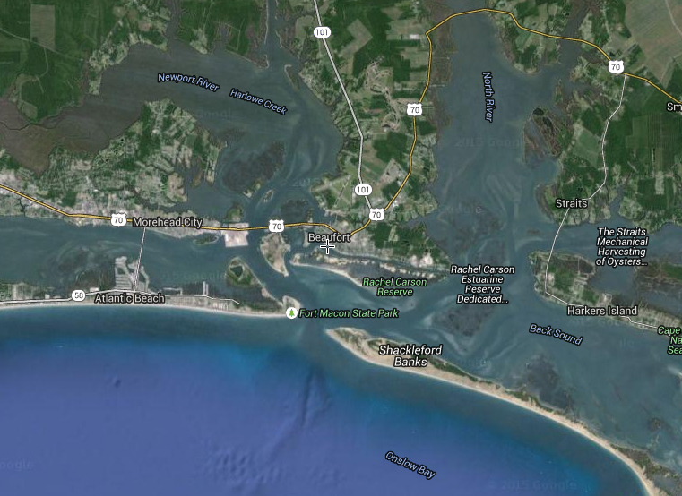
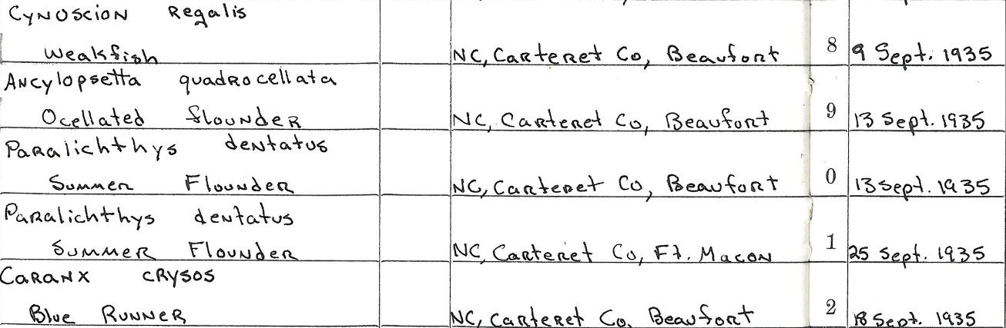
Issues with Georeferencing
Vague Locality Information

Slide 16
Issues with Georeferencing
Vague Locality Information
Little River, North Carolina
Notes:
8 Little Rivers in NC – all in different major drainage basins
Once we began using our new standards, we decided to do some time trials

Slide 17
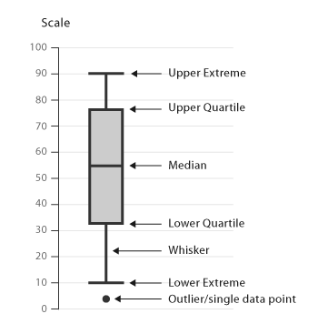
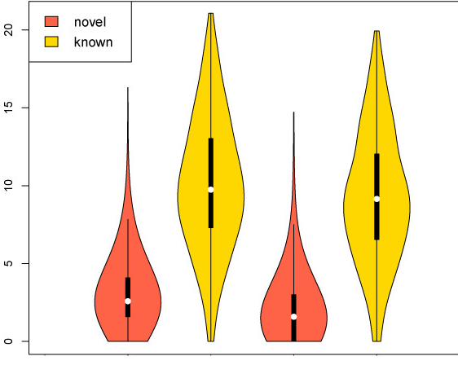
Violin plot = Box plot + rotated kernel density plot on each side
Box plot
Notes:
Box plot is a convenient way of graphically depicting groups of numerical data through their quartiles – or percentiles – 25, 50 (median), 75, going to 95. A box plot does not show you how the data is distributed – violin plots incorporate rotated Kernel Density distribution models and therefore we can see the probability density of the data via the width of the violin.

Slide 18
Time Trials
Notes:
These are locality types, Np standing for Names Place and taken from the Georeferencing quick reference guide
JIC – junction, intersection, crossing
UA – undefined area
BA – bound area
RSRP – river, stream, road, path
PR - point radius
Verbatim – verbatim coordinates
Can take anywhere from a few minutes to over 30 but, no matter how long it can take, this is extremely valuable data. So the questions is, if it’s so valuable why don’t all museums have all specimen records already georeferenced? Funding and staff

Slide 19

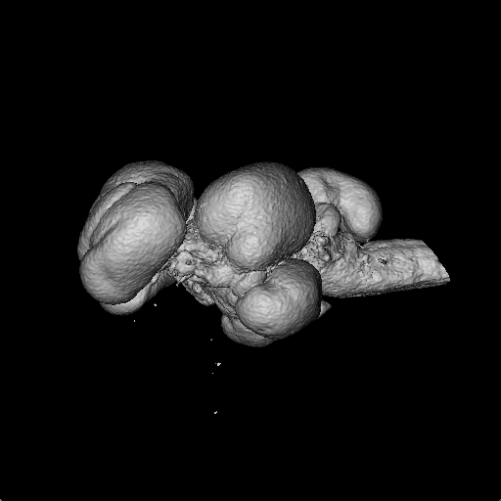
The Funding Problem
Notes:
Funding agencies are looking to fund something new and novel, like this ct brain scan of a damselfish. We are asking for this (click) but we really need this (click) in order to just get our specimen records entered into a digital format, let alone expending extra time and effort in order to georeference those records and make them research ready.

Slide 20


The Funding Problem
High Throughput versus Research Ready
High throughput and research ready…why? Staff!
Not high throughput but research ready…why? Staff!
Notes:
There have been some digitization projects that have proven the power of funding and staff = high throughput and research ready data.
It all goes back to the power of funding.

Slide 21
Verbatim Coordinates = ca. 5 minutes
1 person/6 hours per day = 72 localities/day
1 month (20 days) = 1440 localities/month
5 people/6 hours per day = 360 localities/day
1 month (20 days) = 7200 localities/month
Other localities = ca. 9.5 minutes
1 person/6 hours per day = 38 localities/day
1 month (20 days) = 758 localities/month
5 people/6 hours per day = 189 localities/day
1 month (20 days) = 3789 localities/month
Notes:
Looking again at the violin plots of our time trials we can see that: text above
This is if the staff are only working on locality data 6 hours a day which we all know is never the case because there are so many other aspects of curation.
And then after we do this work

Slide 22
How do we ensure that Uncertainty Data is used by anyone that uses our data?
Notes:
No answer to this question other than it begins with a dialogue – move to next slide for example

Slide 23
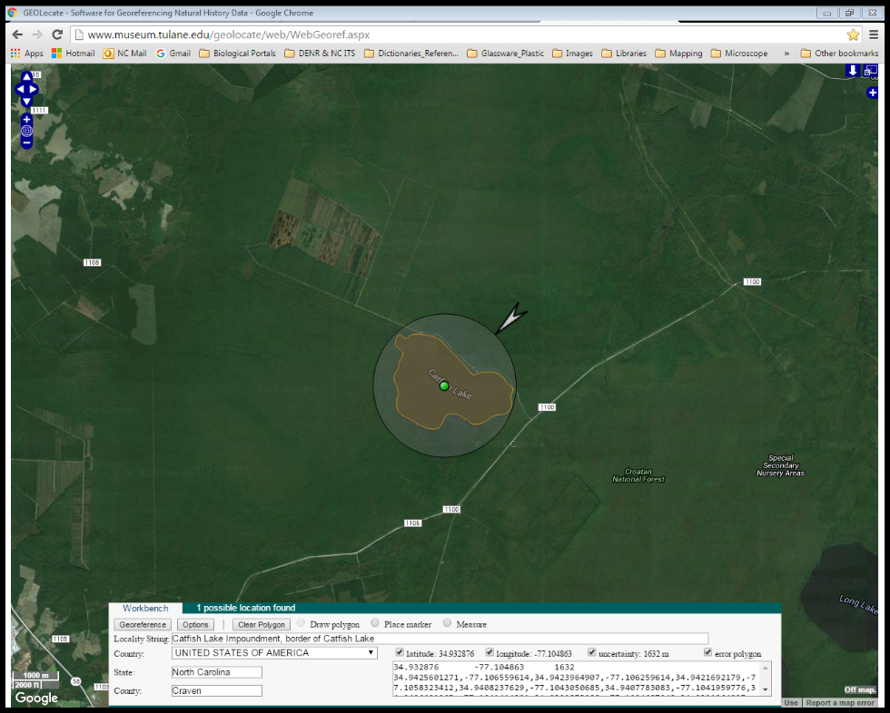
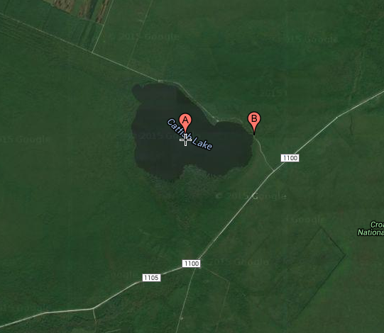
Use of Data
Notes:
NCWRC example – chatting about something else, then “oh, btw, I moved this point in your layer for our GIS project”
She just decided that the specimen was probably collected at point B, without including any uncertainty. This led me to ask: How many other points have been moved? How is that noted?
Opened the door to allow me to explain that coordinate data and uncertainty are bound together and need to be used as one, not as 2 separate things.

Slide 24
How can we best communicate to funding agencies the need to use these methods/standards?
Notes:
Even if we cannot provide high throughput but are providing research ready data.

Slide 25
Are the protocols and standards that we have right now flexible enough for every situation?
Notes:
Example of the trawl data that I spoke of earlier; If they are not flexible enough what should we do?

Slide 26
What can we do to further help museums in their implementation?

Slide 27
Notes:
I began this talk with these beautiful, yet very different paintings because we seem to be facing the same challenge as artists have faced in the past – the acceptance of impressionism as art when realism was considered to be the only art form (as far as painting was concerned).

Slide 28
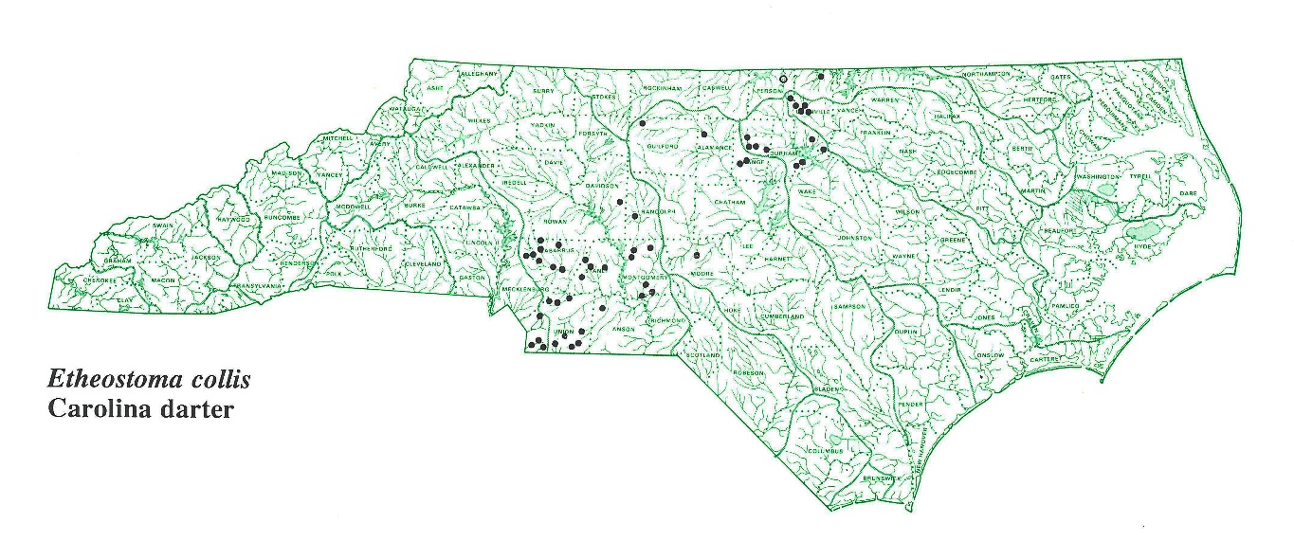

Notes:
Our point data can be a very precise painting

Slide 29
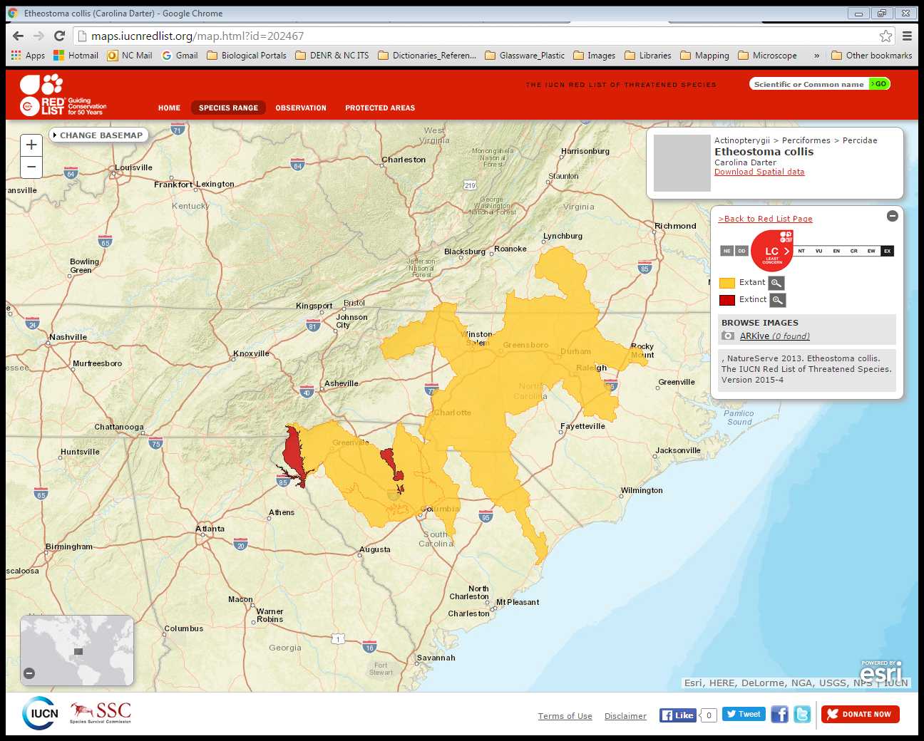
Notes:
but when we include uncertainty it becomes more impressionistic – but this needs to be what is accepted as the true data. Once our end users accept this more impressionistic view, that is when our coordinate data and its uncertainty will be used as one.
What do we do when the locality is North America, or Atlantic Ocean, or North Carolina? There seem to be very different approaches right now as to when a locality is too vague to georeference and we really need solidify those standards

Slide 30
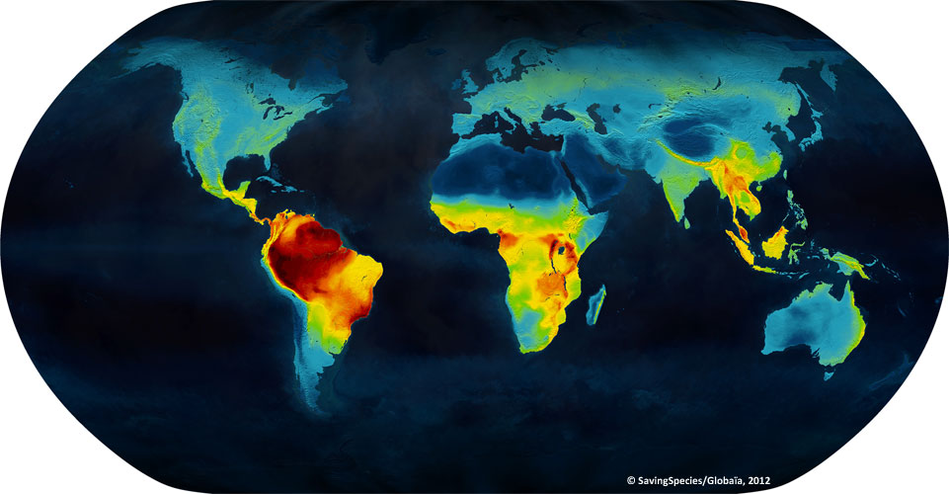
The Art of Georeferencing
Questions?
Notes:
My hope was that this talk would open up a dialogue specifically about how we can better express to our end users the need to use uncertainty data and also how we can better express to funding agencies the need for this research ready data even if it is not high throughput.

