Slide 1
eMesozoic: an alternative approach to digitising palaeontological collections
Philippa Brewer, Liadan Stevens, Emma L Bernard, Sandra Chapman, Lorna Steel, Anna Taylor, Lyndsey Douglas, David Godfrey, Francesca Taylor, Vladimir Blagoderov, Lawrence N. Hudson, David Smith & Molly Clery
Notes:
As you can see I am not Pip, unfortunately she was not able to come, we leaned it only yesterday. So, please forgive me if I say something she didn’t intend to say.
We will be talking about a pilot project on digitisation of British Mesozoic vertebrate fossils in NHM

Slide 2
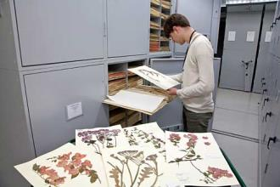
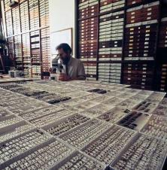
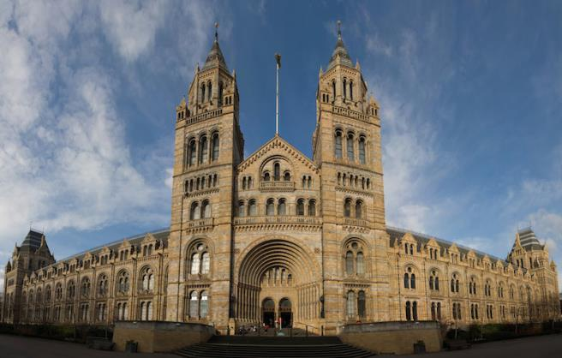
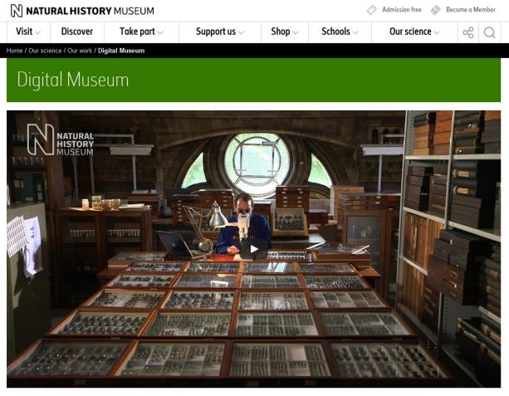
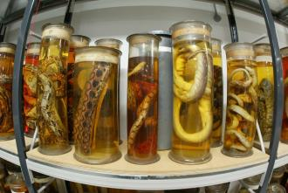
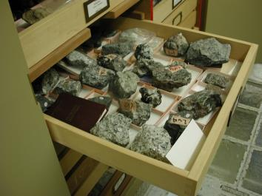
Digitisation @ the NHM
80 million specimens!
http://www.nhm.ac.uk/our-science/our-work/digital-museum.html
Notes:
I shall not dwell on this slide, we all know by now what digitisation means. In last three years we were conducting Digital Collection Programme, which included not only development of standards and protocols and aligning our collection management system, but also several pilot digitisation projects.
eMesozoic was one of those projects.

Slide 3
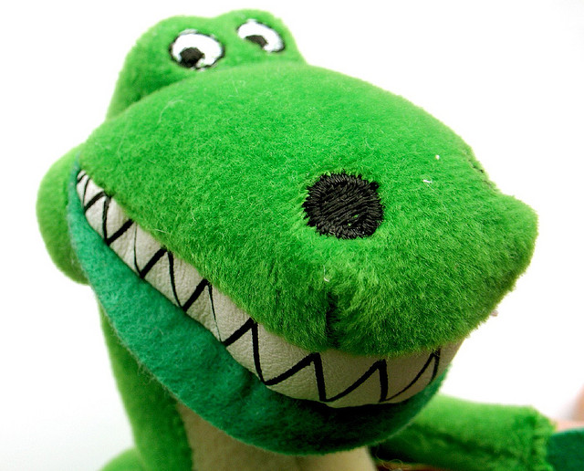
eMesozoic
Suggest a project which looks at the worse case scenario for digitisation, but use dinosaurs to make everything seem better….
Notes:
What we wanted to do was digitise collections which features a wide range of challenges to mass digitisation of palaeontological material and see if we can develop efficient workflows and then present realistic figures for digitisation.
And, of course, to make it more attractive we had to include dinosaurs!

Slide 4
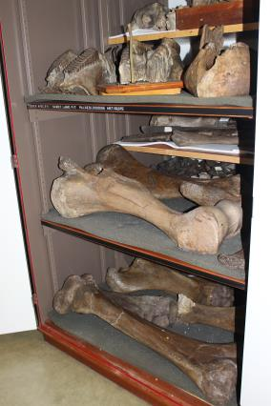
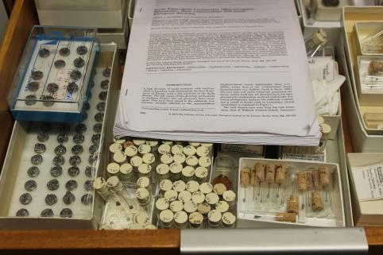
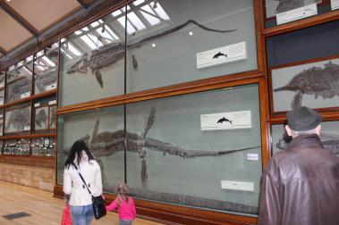
CHALLENGES: Digitising historical palaeontological collections with complex histories
Wide range of specimen sizes and types, from delicate sub-millimetre teeth to heavy sauropod bones which extend across several collection locations
Storage areas which are difficult to work in
Availability and quality of specimen documentation varies widely, with information held in various media
Differing, complex and inconsistent registration practices
Notes:
But apart from dinosaurs, eMesozoic represents typical challenges you may find in palaeontological collections
Widest range of specimens
Locations spread across the collection, sometimes very difficult to work in
And, most challenging of all – inconsistent legacy documentation. Most of the specimens already registered and databased, but records in need of update. Multiple numbers, non-unique numbers, - you name it
Availability and quality of documentation associated with specimens varies widely, as does the source of that information. For example, in the fossil mammal collection at the NHM, not all specimen have labels. The original source of the specimen data is the accession registers, with information then updated in our collection management system. In the NHM fossil fish section, the labels are probably the most reliable and up-to-date information associated wit the specimens. In reptiles, however, it was the card catalogue.

Slide 5
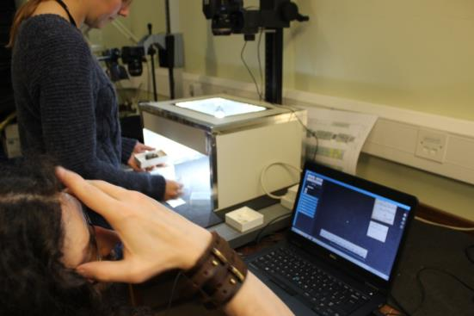
eMesozoic: The Brief
British Mesozoic vertebrate specimens
18,000 specimens
1 year
£100,000
Develop workflows
Estimate the cost of digitisation for palaeontological specimens at the NHM
Notes:
This is, in short, what we wanted to do

Slide 6
THE PROCESS: Preparation
Produce stub catalogue records for those not already on our Collections Management System
Attach images of register pages to catalogue records
Identify British Mesozoic specimens
Barcode collections locations
Prepare collections for digitisation
Notes:
There were various projects aimed at preparing the collections for digitisation before imaging even commenced

Slide 7
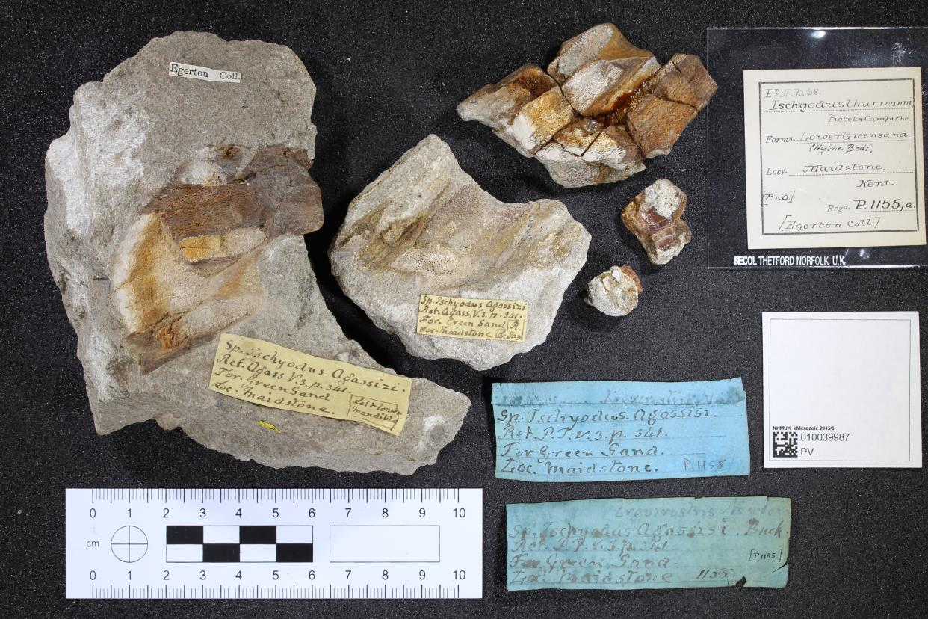
THE PROCESS: Imaging
Notes:
We opted for image-based transcription of specimens, labels and accession register images.
Palaeo specimens rarely can be moved far, so instead people should get to the specimens, not the other way around. The imaging part of the work flow involved moving from collection area to collection area and setting up equipment, getting specimens to digitisation workspace, arranging specimens and labels to be imaged, adding barcode and scale and taking the image.

Slide 8
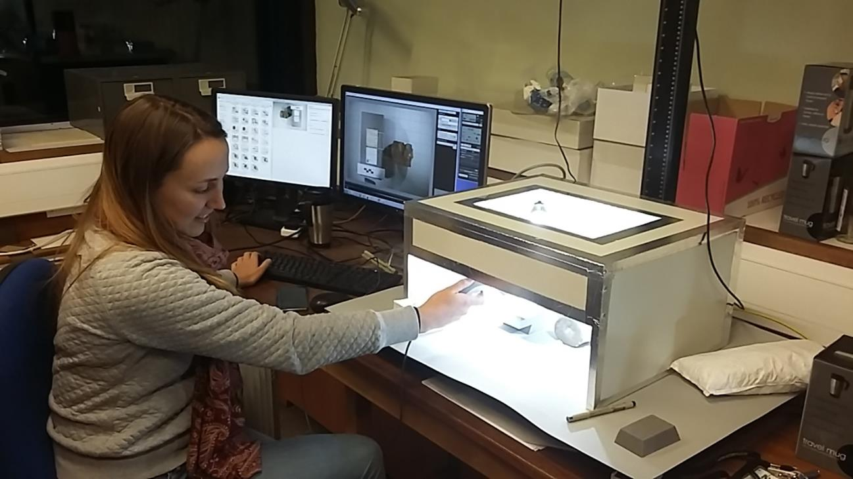
THE PROCESS: Imaging
Notes:
As there were a wide range of specimen sizes in our selected collections, we had 3 main imaging workflows.
For small specimens, imaging is straightforward. We used the same method as for iCollections – digitising British moths and butterflies: photographing ndividual specimens, sometimes in several projections, together with labels.

Slide 9
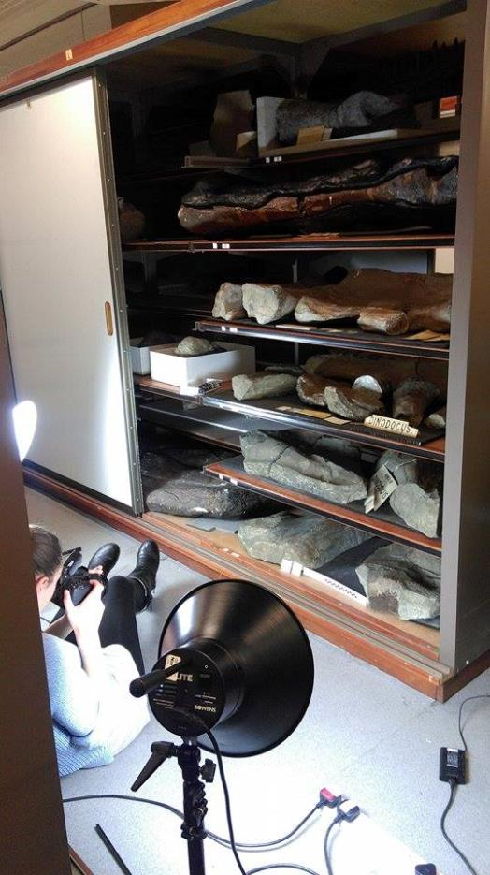
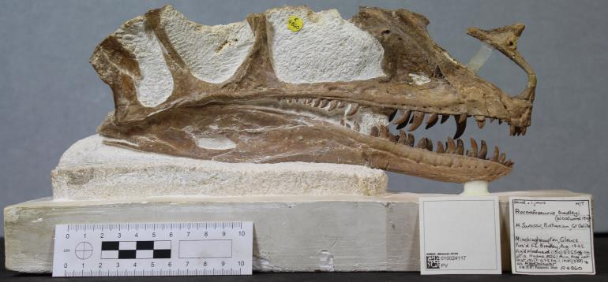
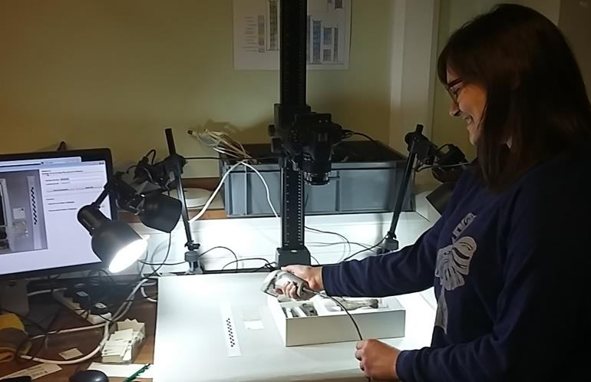
THE PROCESS: Imaging
Notes:
For medium / large specimens – imaging was more fiddly as it takes more time to set up each image, lots of fiddling with lights and camera height. Often involves more than one digitiser at any one time to do this workflow (e.g., need to handle awkward and heavy specimens).
For some specimens it was also necessary to take pictures of them in situ in the cabinet, because labels may be attached to the shelf or drawer or specimens are to heavy to handle.
We went through collections multiple lines concentrating on different workflow, doing all smaller specimens first, for example, then returning for larger ones.

Slide 10
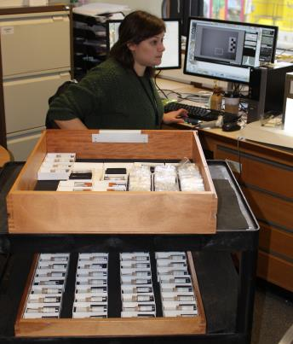
THE PROCESS: Imaging
Average imaging rates (specimens
per person per day):
Across all workflows: 76
Small workflow only: 95
Medium workflow only: 35
Large workflow only: 23
Varies considerably depending on specimen / collection type
Dinosaurs: Between 26 and 160 small specimens imaged per person per day (average of 80)
Mammals: Between 84 and 267 small specimens imaged per person per day (average of 169)
Notes:
Across all workflows, we managed about 76 specimens per day. However, this was an average estimate across the full year. As expertise developed, towards the end of the project efficiency increased.
It is clear from these figures that the number of specimens we can digitise per day is highly dependent on the size of the specimen.
For large specimens, we often only manage around 23 specimens per day per person.
For small specimens, however, the average rate is 95 specimens per day which can range between 25 and 260 specimens, depending on the type of specimen.
This really highlights the effect of different types of specimens, in different storage conditions, at different stages of curation.
The overall figure is also much lower than many other digitisation projects, as we really are looking at the difficult to digitise specimens.
Unlike all other digitisation pilots, in eMesozoic timings and costs were very dependant on imaging, while in all others – preparation was the limiting factor.

Slide 11
THE PROCESS: Imaging
Notes:
As we imaged, we renamed the images with the specimen barcode and location barcode, using custom-designed software.
Images were rotated and then ingested into our collection management system in batches.

Slide 12
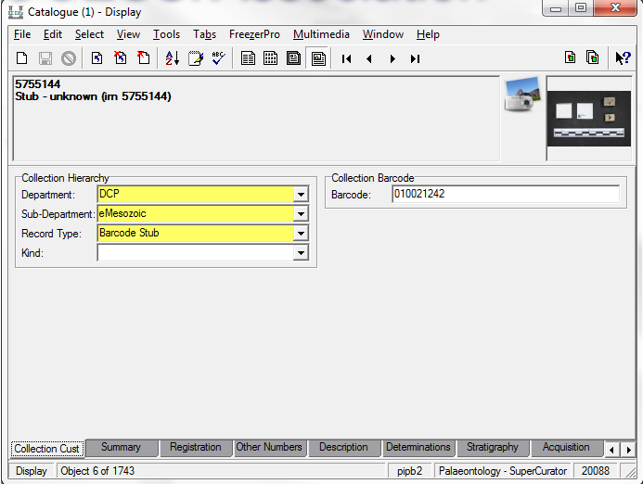
THE PROCESS: Association
Creation of Barcode Stub records to aid ingestion and association
Notes:
Our workflow required that we manually associate images with catalogue records. This was because there were:
Handwritten registration numbers in a variety of places
Specimens multiple catalogue records
Unregistered specimens
A complex system of prefixes and suffixes appended to our registration numbers
Hence, we needed a way to create empty records in our collection management system (barcode stubs) which contain only the association between the images we took as part of this project, the specimen barcode and the collections location.
Once these holder records / barcode stubs had been created through the ingest process, we could then evaluate each holder record / barcode stub and decide whether to merge it was an existing catalogue record or to create a new one.
The evaluation and merging of records was achieved in our Association App

Slide 13
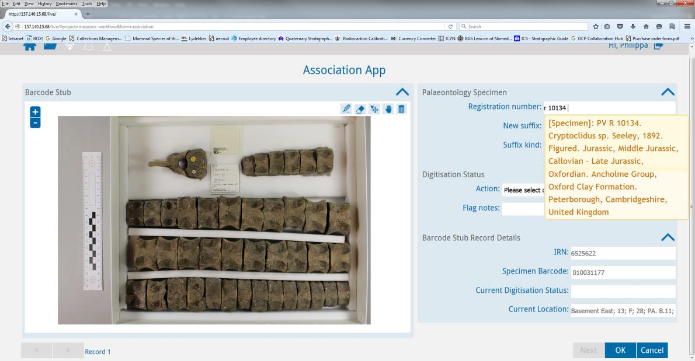
THE PROCESS: Association
Web-based form to associate images taken with catalogue records (or create new records)
Notes:
In this App, we can see the image and label with registration number. When digitiser types in the registration number into the App, it communicates with our collection management system and gives some options. In most cases, we could select the correct catalogue record and merge the two. Merging then associated the specimen image, the specimen barcode and collection location with the correct catalogue record. The barcode stub could then be deleted.
In this example, the number R 10134 has been found in our collection management system and we could proceed to merge the barcode stub with this catalogue record. However, if the specimen number actually had a suffix on the end, or wasn’t registered, we can then create a new catalogue record using this App.
The Association App is a simple and necessary step in the process for our collections. Digitisers can get through on average about 450 associations per day per person.

Slide 14
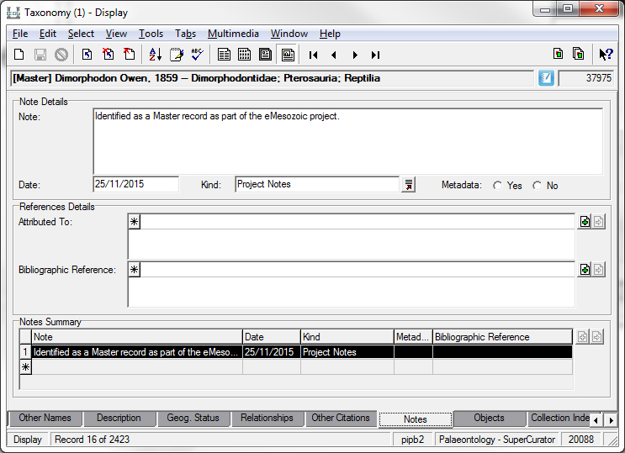
THE PROCESS: Transcription
Notes:
The nest step would be transcription or updating existing catalogue records.
Entering information directly into our collection management system was not efficient. Not only it is relatively slow, but also we had issues with the fact that many of the associated metadata in our CMS was duplicated and messy. For example, when searching for a site on our collection management system, i.e., where the specimen was collected from, we might come up with 200 site records matching those search terms – much of which was duplication due to bad imports in the past. Obviously selecting the correct record from these for each specimen record was not an efficient use of time.
We decided to push through only high quality metadata through to the App, to be associated with the catalogue records. To do this, we identified such records as “Master records” for this project. We changed the status of the records in our collection management system to “Master” and added a project tag to the notes field. These two tags pushed those records, and those records only, through to the Transcription App, developed based on iEMu.

Slide 15
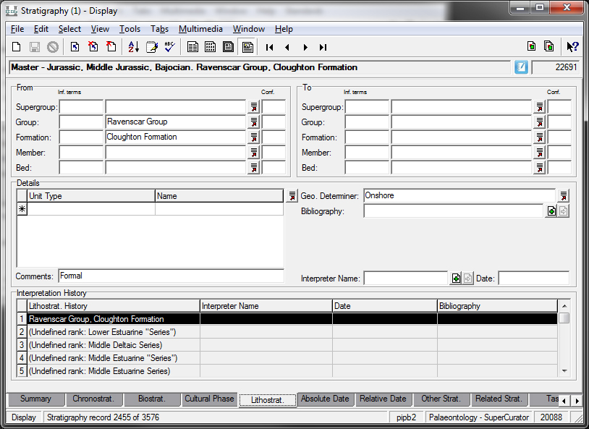
THE PROCESS: Transcription
Notes:
As this was a pilot project, we were only testing this Master List methodology using Sites, Stratigraphy and Taxonomy as our metadata field types. We put in some initial work to create an initial set of Master records prior to starting transcription. We did those by compiling existing information from our collection management system, from Excel spreadsheets and card catalogues and publications. We then asked experts to validate those records before adding them into our collection management system. For stratigraphy we used the British Geological Survey Rock lexicon as a starting point, and added old names and synonyms into the master record (and followed a similar procedure with sites and taxonomy).
This also meant that if accession register or labels had an old name for a site or unit on them, the digitisers could put that in and it would link to the most up-to-date name as well.

Slide 16
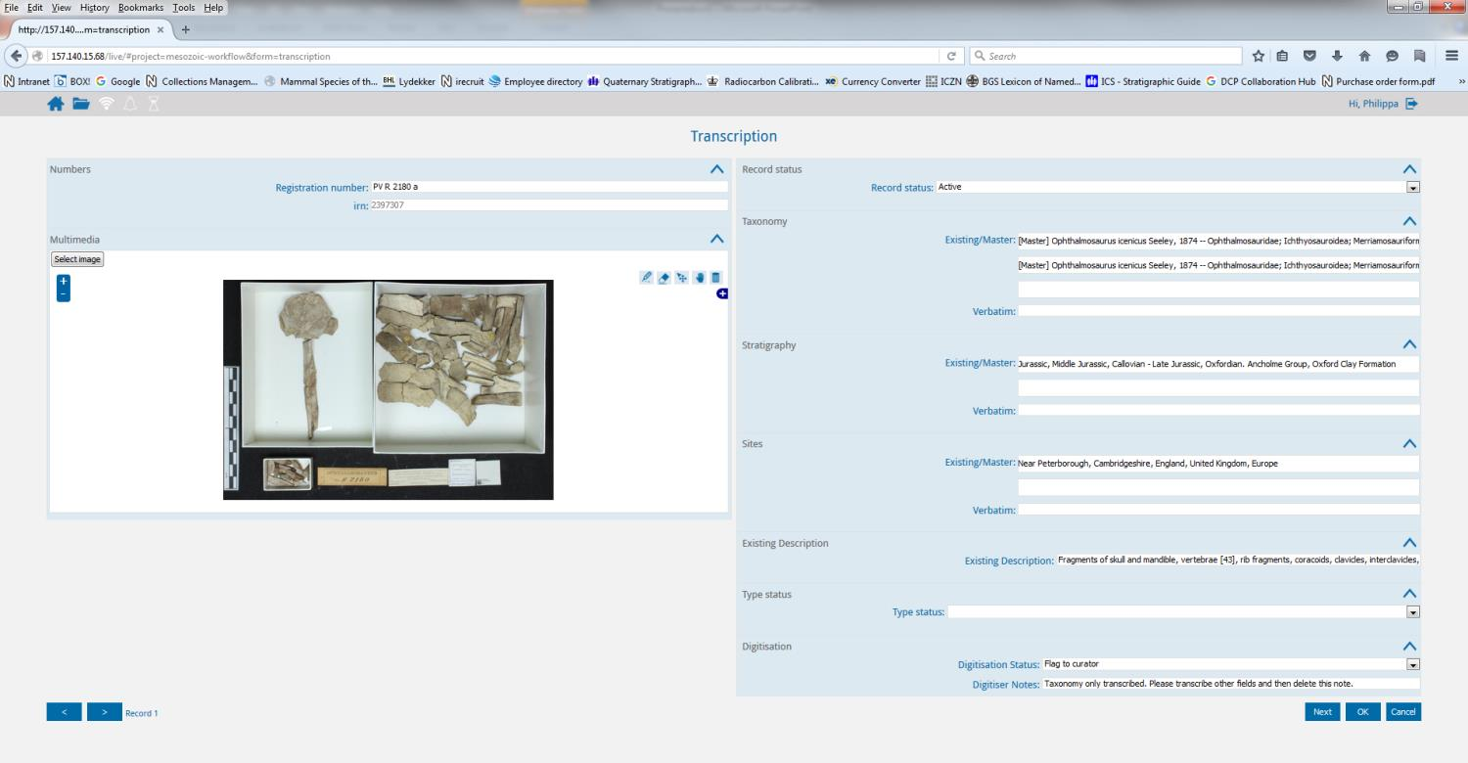
THE PROCESS: Transcription
Notes:
The Transcription App is shown here. The visible fields can be changed very quickly and easily. As this was a pilot we were not doing a complete transcription of records, but selected the fields we felt were most important for researchers and to help deal with the majority of collection-based queries we get asked.
Like the Association App, this App communicates directly with our collection management system. If data is already in the collection management system attached to the catalogue record (whether as metadata or additional images), that data is visible in the App. We can then add to it as appropriate.

Slide 17
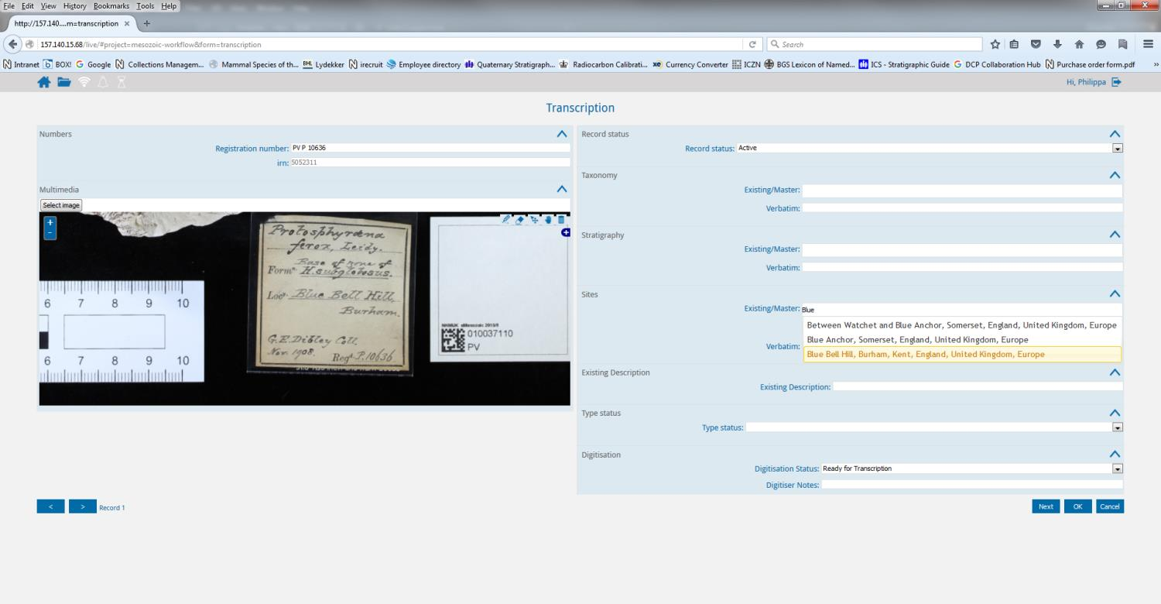
THE PROCESS: Transcription
Notes:
It is possible to Zoom in on the image to see the label clearly.
In this case, the site has not already been entered and so we start to type the site name, it searches our collection management system and brings back a list of possible sites, we select the correct one and it associates it with the record.
If no suitable master record comes up, digitisers typed the information in verbatim. We then ran a weekly search and created new master lists based on the verbatim information, so that next time they entered the information, there would be a master list available to attach. In this way, we have generated a clean set of metadata records.

Slide 18
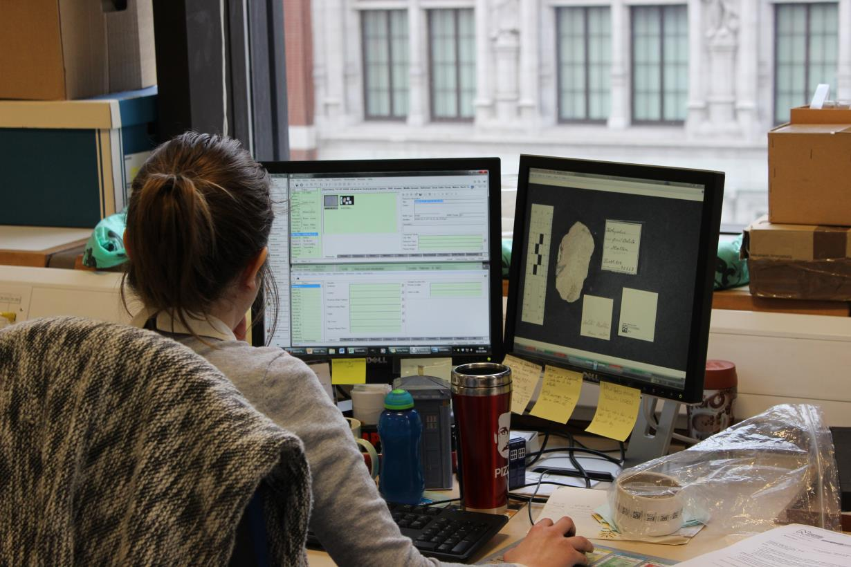
THE PROCESS: Administration
Notes:
The workflow requires a lot of administration in the back end, such as dealing with metadata which is not in as a master list, problematic records, duplicated registration numbers, labels with specimen number ranges on them. This is a full time job in itself, and is significant job for a collection such as this.

Slide 19
WHAT HAVE WE ACHIEVED?
High quality metadata to use on other projects, to assist with cleansing database, to publish, and to share
Data to form the basis of research projects, such as those examining first and last occurrences of taxa over time
Awareness of the issues and limitations of digitising palaeontology collections
Workflows and Apps which can be further refined and developed
Notes:
This project ended on the 31st March 2016, with all targets met or exceeded.

Slide 20
LESSONS LEARNED
As we suspected, the cost of digitising vertebrate palaeontology specimens is high, ~£6/specimen
The issues associated with digitising old, complex, historical collections are many
Image-based transcription = useful
Master lists?
Talk to curators!
Talk extensively to data managers and test the Apps
Spending time preparing the collections for digitising is very important!
Notes:
So, what have we learned?
A LOT!!
As we suspected, the cost of digitising vertebrate palaeontology specimens is high – up to £6 per specimen if commit to digitising all specimens (even the difficult to digitise ones). This is, however, a direct cost – what has been paid in salaries to digitisers and other expenses. It does not include all the time curators and researchers spent supporting the project. It is quite difficult to calculate and quantify.
The issues associated with digitising old, complex, historical collections are many; such digitisation projects require almost full-time support of collection and researcher support.
We opted for image-based transcription and found that the images were very useful, allowing us to compartmentalise digitisation into different work flows, and we also found the images particularly useful for dealing with issues arising during digitisation which then fall to the curator to resolve – such as specimen in the wrong, place, specimen with the wrong number attached to it etc. Researchers also appear to be very keen on specimen images being available. Downside, is if a collection is desperately in need of conservation of curation, images of specimens in poor condition are going to be released. As an institution you need to consider reputation issues.
Should we use Master Lists? They definitely speed up transcription and reduces error. However, the cost of producing them is enormous. Perhaps, they may be really efficient instrument if large collections or institutions were to work together to make a pool of master lists available for everyone, with different institutions accepting ownership of different master lists.
Another lesson learned is to always talk to the curator – we know the issues, we can help you develop the workflow.
Administration of the project is huge. It is important to take curators or the project team off of all other projects and day-to-day work. We tried to balance our day-to-day activities and this project. We have now gone mad.
Overall, however, I think the major take home message that we have gotten from this project is that collections preparation ready for digitisation is absolutely essential. You need to go through the collections, re-store them to isolate specimens for digitisation, check labels, re-register specimens etc. I would strongly suggest doubling the amount of time on a digitisation project, with half of that time being for collections preparation. Otherwise you are going to have a legacy of issues from the project, which will cost more to resolve in the long-run.
Lots of testing and discussion with data managers is also essential. We suggest using the time devoted to collections preparation before digitisation commences to sort out data issues in parallel.

Slide 21
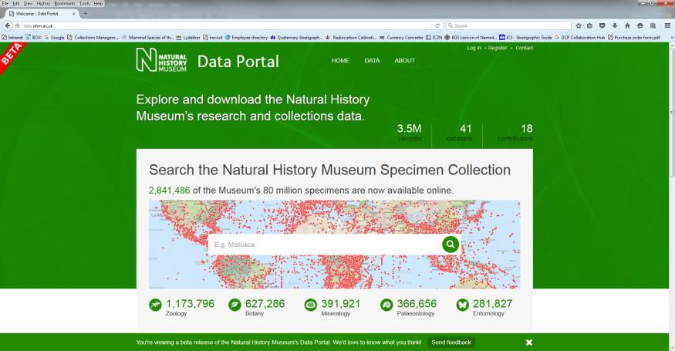
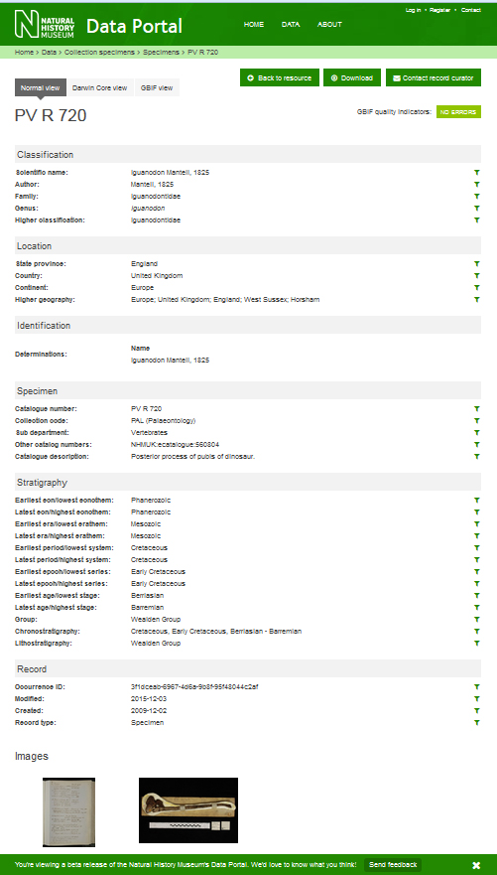
LINKS
http://data.nhm.ac.uk/
http://www.nhm.ac.uk/our-science/our-work/digital-museum.html
Notes:
Fortunately it is over now and data is available through NHM data portal

Slide 22
ACKNOWLEDGEMENTS
Everyone who has been involved in this project and/or provided advice of assistance – there are many of you! Includes, but not limited to Adrian Hine, Aileen Bevan, Alan Hart, Alfie Gleeson, Alison Longbottom, Andy Gale, Angela Milner, Axiell, Becky Smith, Ben Atkinson, Camilla Foster, Charlie Underwood, Chie Heath, Chris Hughes, Consuelo Sendino, Darrell Siebert, David Ward, Geoffrey Warrington, Giles Miller, Helena Toman, Javier Parraga, Jerry Hooker, Jill Darrell, Ken Johnson, Laurence Livermore, Lawrence Hudson, Lu Allington-Jones, Martha Richter, Martin Munt, Matt Woodburne, Michael Benton, Mike Howarth, Mike Sadka, Mike Smith, Nichola Nicholson, Pawel Szulga, Peta Hayes, Rachel Ives, Rebekah Smith, Richard Twitchett, Robin Hansen, Roula Pappa, Simon Wills, Stephen Hesselbo, Susan Evans, Susannah Maidment, Tim Ewin, Vladimir Blagoderov, Zerina Johanson and Zoë Hughes
BGS Lithostratigraphy Lexicon
Our AMAZING digitisers: Lyndsey Douglas, David Godfrey, Frankie Taylor and Anna Taylor
Notes:
We want to acknowledge and thank everybody who participated in the project, particularly our digitsers

