Slide 1

Lessons learnt from a herbarium specimen mass digitisation pilot
A Pilot between RBG Kew and Natural History Museum London
Sarah Phillips, Alan Paton, Sandy Knapp, Laura Green
Notes:
Thanks - today I am going to talk about a collaborative herbarium specimen digitisiation pilot project between Kew and the Natural history museum ( or NHM). Together we have around 12 million herbarium specimens. Both institutions only have a proportion of the specimen information available. Kew has only 13% databased (8% imaged) so we have some way to go. How are we going to increase the rate we make this information available to researchers.

Slide 2
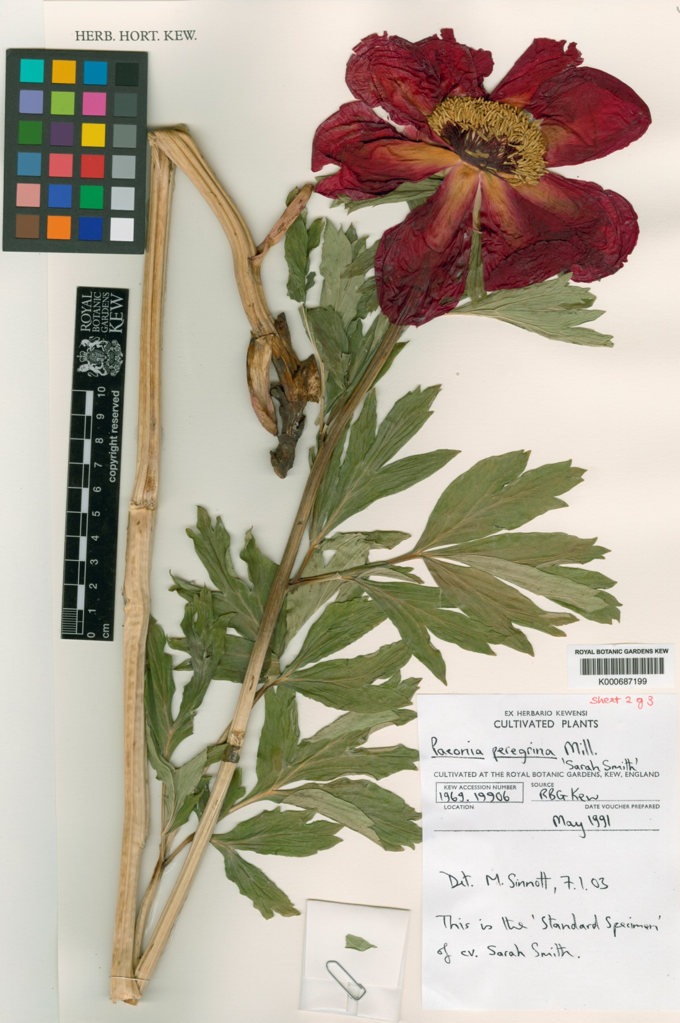
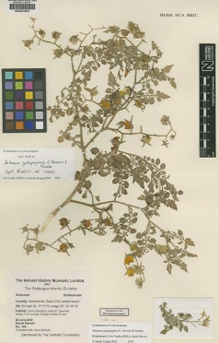
Overview
Background to collaboration
Mass digitisation pilot: What we did
Lessons learned
Next steps and challenges

Slide 3


  New science strategies emphasise, and have targets
  for, digitisation
  Establish proof of concept to stimulate new funding
  Large scale digitisation now possible
Notes:
collaboration focussing on core research areas in each institution
Political – both institutions have science strategies which emphasis digitisation. Kew target of digitising 80% of its collection by 2020.
- We know that for herbarium specimens large scale digitisation is now possible (with Paris and Naturalis having digitised all their collections and other institutions starting to look at this.

Slide 4
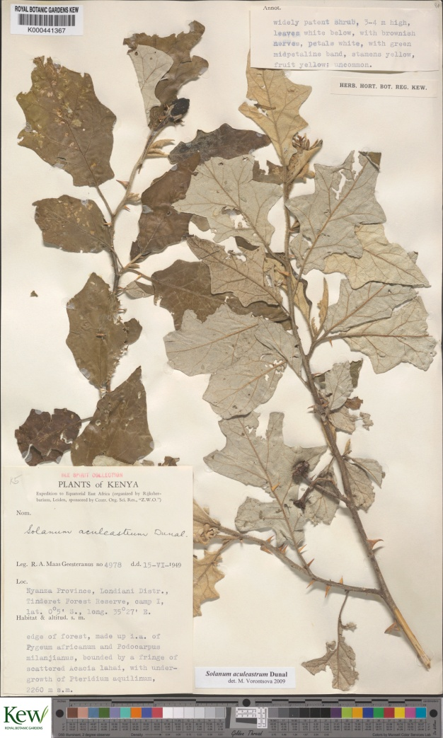
K/NHM Mass digitisation pilot
Image all
Solanum, Dioscoreaceae, Hypericum (NHM only)
67,500 specimens
420 ppi images
3000 - 4000 per day
Transcribe specimen data - Team in Suriname
Evaluate different workflows
Derive robust costings
Notes:
Picked groups of research interest and NHM and Kew pool information from both institutes for research
. Just under 70,000 specimens. For the pilot we worked with Picturae same company that digitised Naturalis specimens Picturae. Could image at 420 ppi and 3000-4000 specimens per day per system.. Although informed rates have increased. Specimen label data transcribed from images

Slide 5
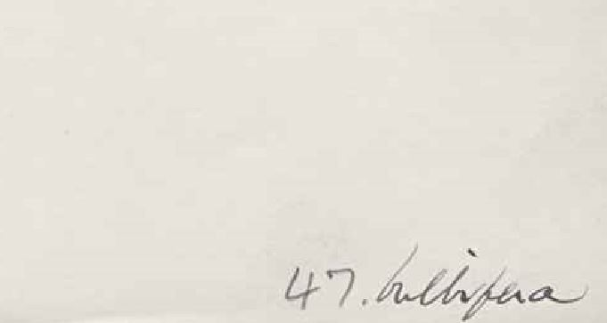
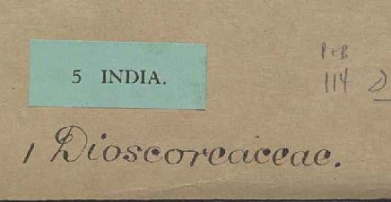
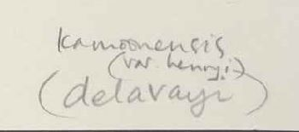
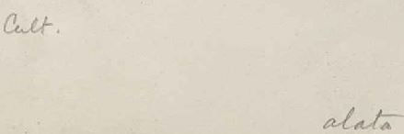
Differing workflows to test
Creation of stub record (barcoded in herbarium – ‘filed as’ name recorded)
V
No pre curation: barcoded at Picturae, names from imaged covers
Notes:
Working together allowed us to test different approaches for different collections
e.g. Solanum, Dioscoraceae in the NHM those not already barcoded were barcoded in house and the filed under name captured – what we termed as a stub record. In our case this name is not always on the specimen itself.
Compared to kew where we did no pre curation. Picturae staff barcoded the specimens and the names were captured by transcribing the information from the folders.
Hypericum – spent some time on folder preparation – checking names clearly legible on folder.

Slide 6
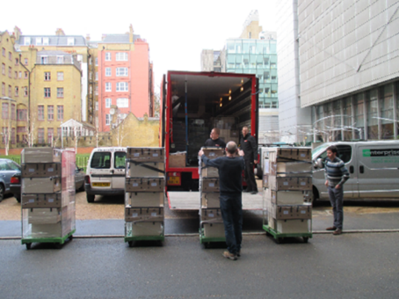
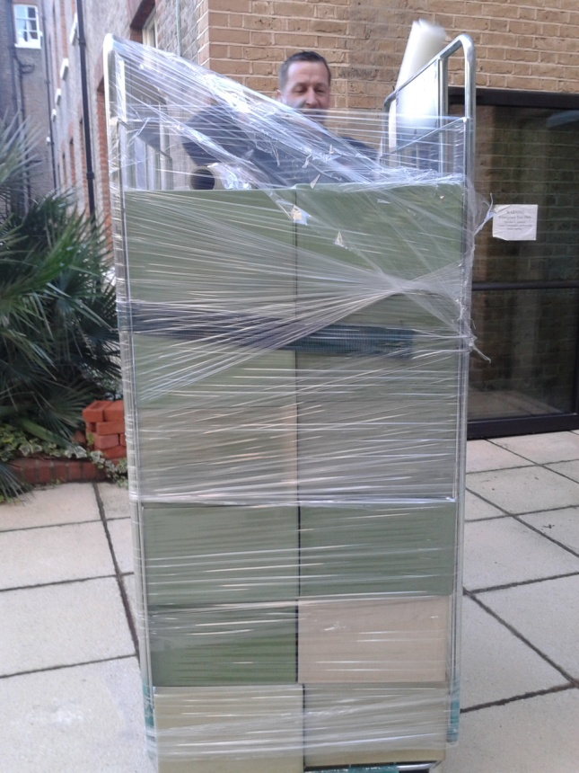
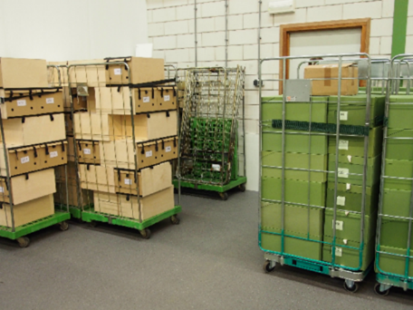
Transport
Notes:
For the pilot we transferred specimens to Amsterdam through the channel tunnel, Used Crown (who move expensive art works around). Picturae also hired there facility to set up the digitisation system.

Slide 7
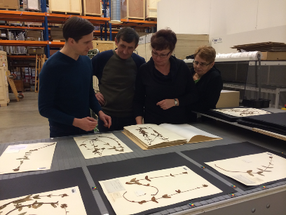
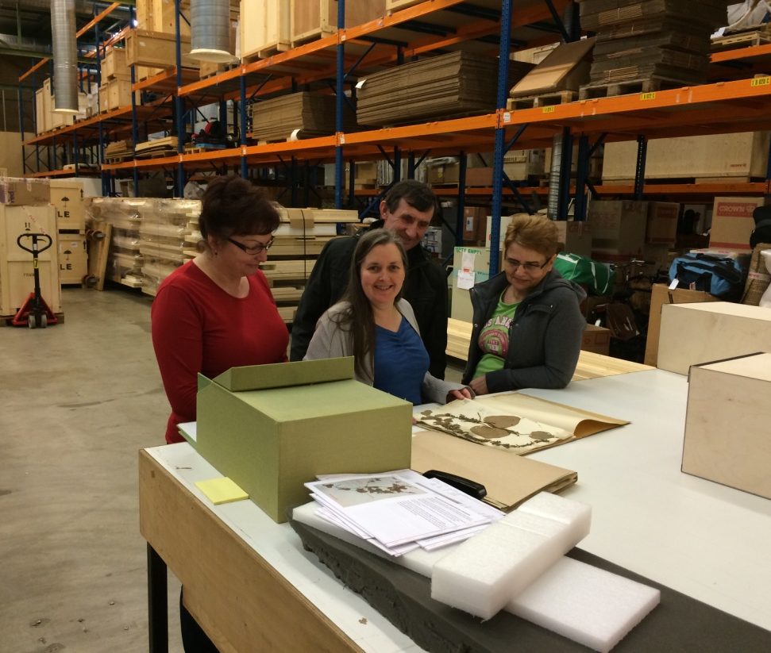
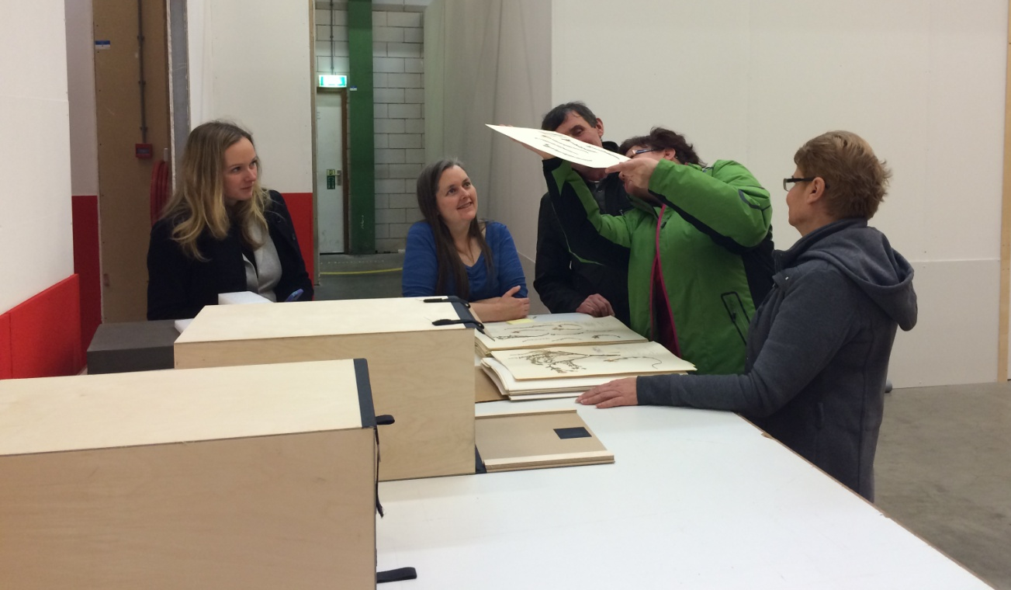
Training
Notes:
Before we begun – we gave training on specimen handling to the operators imaging the specimens. We were on site for the first two weeks of the imaging process.

Slide 8
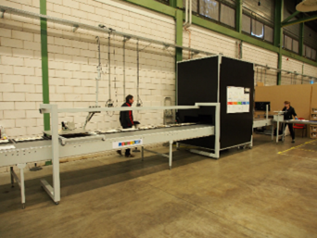
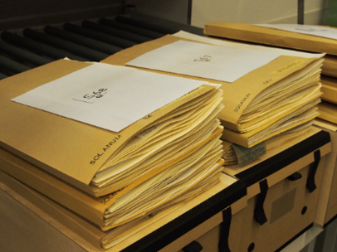
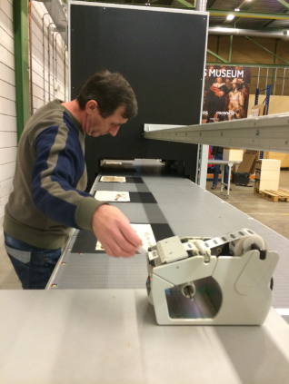
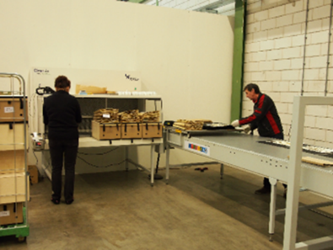
Picturae digistreet
Notes:
Then the digitisation started. Conveyor belt system call a digistreet. The first person removes the specimens from the boxes, barocdes the folders and puts the specimens on the conveyor belt. The second person then barcodes the herbarium specimen sheets.

Slide 9
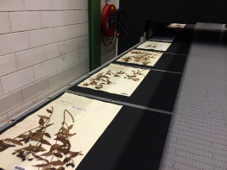
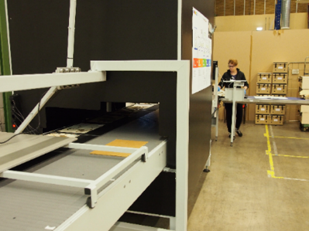
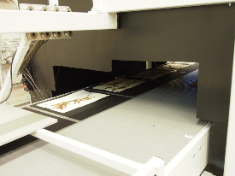
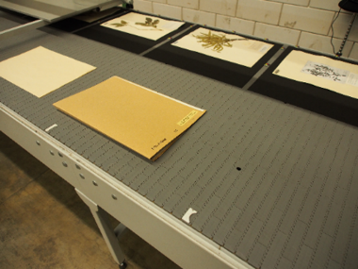
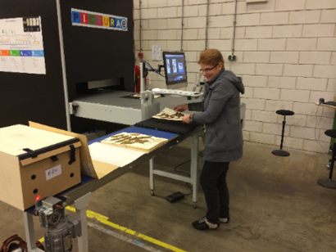
Sheet and cover order preserved
Notes:
The specimens then move along the conveyor belt under the big black box where the camera is. The file is automatically named by reading the barcode on the image and cropped. The final person then places the specimens back in the convers and boxes in the correct order. In this image the specimen have already been barcoded and filled under name captured so there is no need to image then – they are placed on the opposite side of the conveyor belt – where they are not imaged but the correct order is retained.

Slide 10
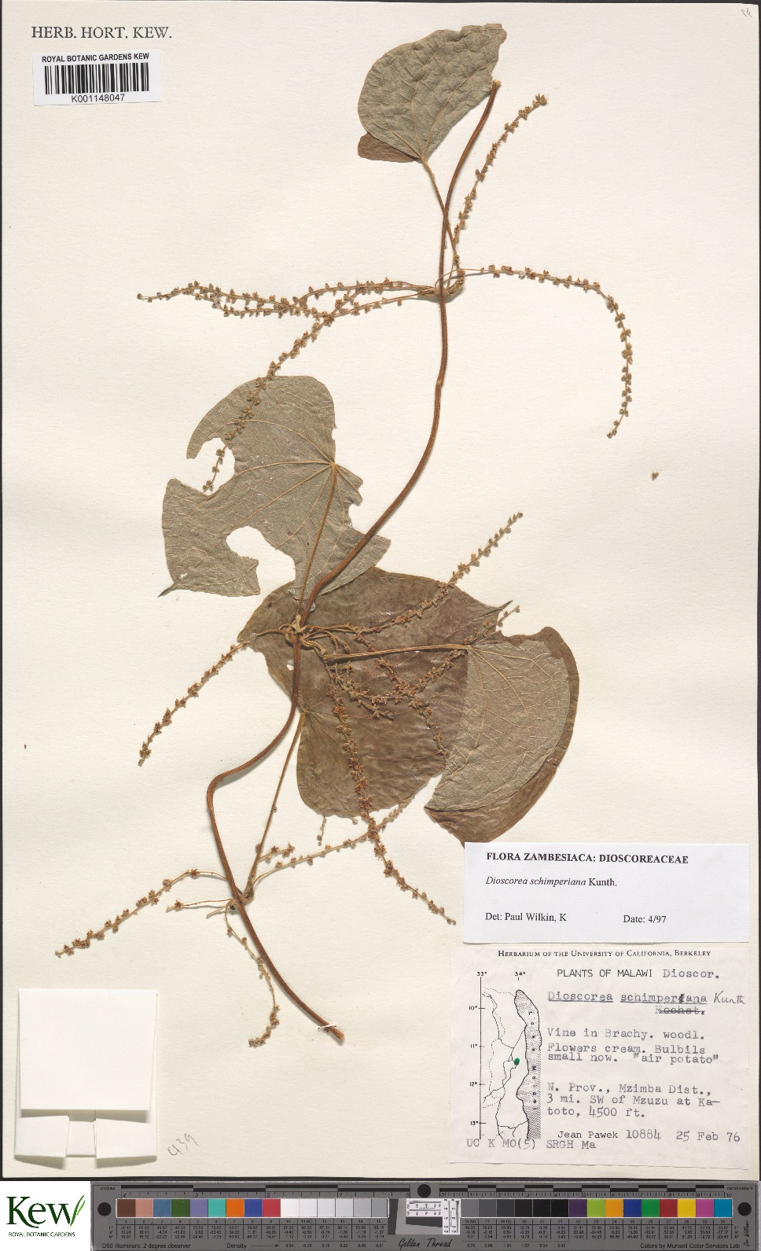
Image Quality Control
Notes:
Quality control – all thumbnails were checked to make sure they were cropped – looking at the thunbnails and then 1% of images checked. Once satisfactory they were passed to the team in suriname for transcription
Image satisfactory for the pilot –discussed some improvements contrast and sharpening to get a more visually useful image.. Some pixel noise.

Slide 11
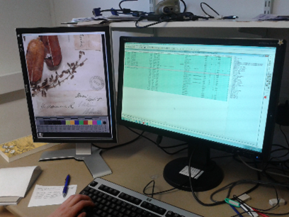
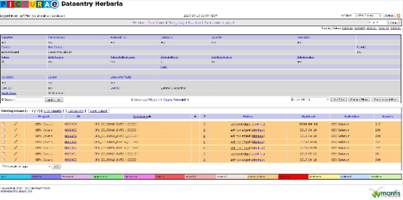
Data Quality Control
Notes:
Brahms was used to transcribe and check the data. Approx 10% of the data was checked. Data was captured using Brahms – system familiar by all to a certain extent. Specimen were checked in batches and each batch was passed or rejected
A bug tracker system was used called Mantis to track the acceptance or rejection of batches.

Slide 12
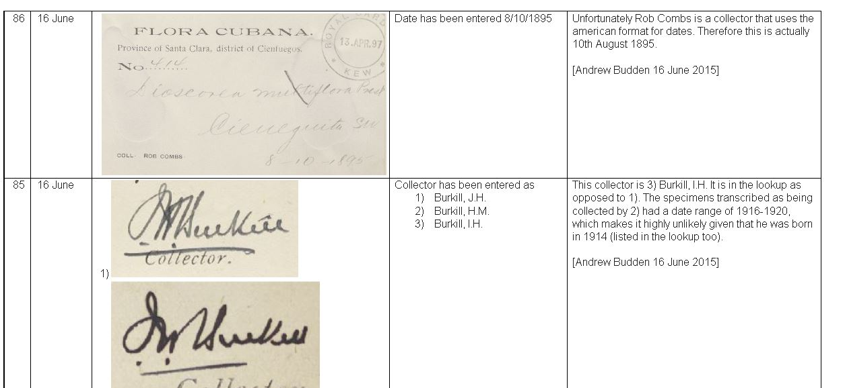
Transcription QC
Weekly conference call to discuss issues
Feedback written in individual Brahms records
Shared Google Doc for question on labels and examples
Increase level of QC at start of project
Important to have a clear tested transcription protocol
Notes:
Transcribers in Surinam could see the examples. How they enter the data
Transcription protocol could have been improved (need to decide on much interpretation we would allow) .

Slide 13
Error Values Table
Field | Transcription error | Identification error
 |  | Incorrect data / column | Data not entered
Collector | 0.5 | 0.5 | 0.5
Addcoll | 0.5 | 0.5 | 0.5
Number | 0.5 | 0.3 | 0.5
CollDD1/2 | 0.3 | 0.3 | 0.3
CollMM1/2 | 0.3 | 0.3 | 0.3
CollYY1/2 | 0.5 | 0.5 | 0.5
Datetext | 0.3 | 0.3 | 0.3
Notes:
So each batch was scored for errors to try and quantify them so are less subjective about why they were rejected. Fields were weighted depending on priority of the field. For example if a collector name was transcribed incorrectly, in the record then the record would get a score of 0.5. (Although the maximum score for any record is 1)

Slide 14
Amount of records/ Batch size | ≤150 | ≤ 280 | ≤ 500 | ≤ 1200 | ≤ 3100
Sample size | 20 | 32 | 50 | 80 | 125
Accepted if amount of errors | < 1 | < 1.5 | < 2 | < 3 | < 4
e.g. For a batch of 440 records, 50 records are sampled. If error count more then 2 batch is rejected
Notes:
Allowed transcribers to enter information in square brackets if they were unsure – so this was not rejected.. However we could add a score if we felt that there was overuse of these brackets.
All scores were added up and then this value would would indicate if file could be rejected or not. An improvement of the number of batches rejected over time can be seen.
Each individual record can not have a score more than 1.
Iso - 2859

Slide 15
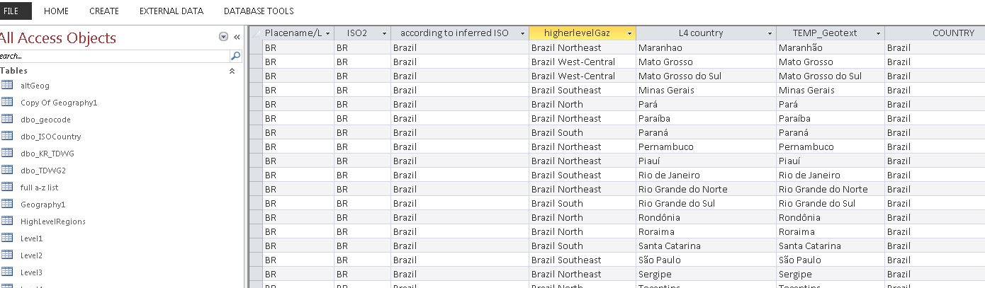
Data Cleaning
Concentrated on high priority fields e.g. Country
Cleaned in batches using queries in MS Access
e.g. Missing country information added by looking in locality text field for matching entries in a geography table
16.8% of Dioscoreaceae records had missing country information – reduced to 8.6%
Notes:
On a mass digitisation effort a pragmatic approach is required. Can not clean it all . We have to prioritise what makes the record most useful and searchable. – concentrated on fields like country.
For example because the transcribers were doing little intrepretation and only entering the country if it was on the label then there were lots of records with missing country names.

Slide 16
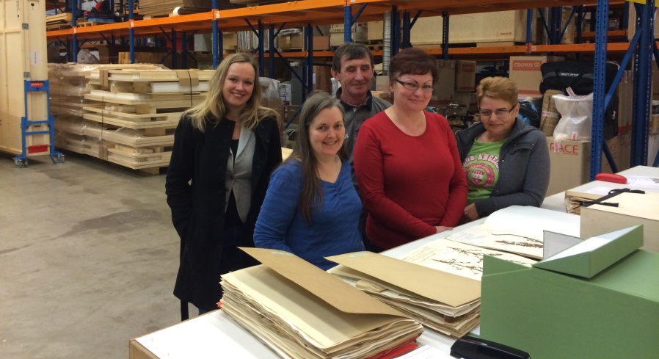
Main Successes
NHM and Kew worked effectively together
Communication generally good, but details of scheduling and implementation would benefit from more face to face meetings
Good specimen care during digitisation
High imaging throughput
Collaboration allowed more testing of variables and workflows
Notes:
Single project manager for both sites was effective
More time upfront to plan.

Slide 17

Challenges Identified
Logistics for imaging off-site resource heavy
Picturae struggled with multi-specimen sheets
A more effective protocol regarding guidelines for quality standards needed
Time needed for uploading images and data into Institutional Systems
Notes:
The transcription protocol was a challenge – deciding on what the rules were and how much interpretation was appropriate.
Images rate of ingestion an issue. – better Infrastructure needed.

Slide 18
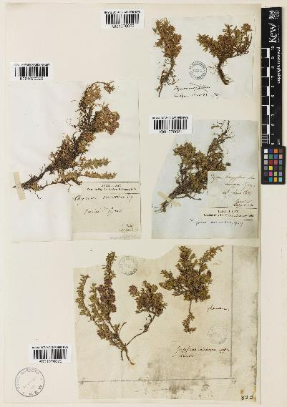
Costs
Costs of stub record creation in house c 50% outsourcing of imaging and capture of filed as names
Total Cost per Sheet - £2 or €2.5
Notes:
the real cost differential between the two models is the cost of dealing with all the multiple specimen sheets post digitisation , indentifying them, reimaging them, checking the data records.
apart from that the two models were more or less equitable – outsourcing slightly cheaper.
Euros.

Slide 19
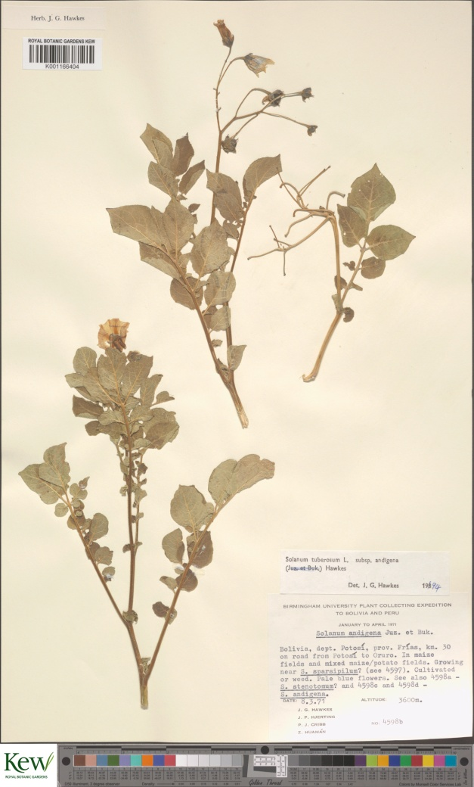
Post Mass Digitisation Challenges
Digitisation of new accessions
Kew C.30,000 a year
Keeping the digital records up to date and aligned with physical collection
Need to define resources needed for these activities
Improve collection management system for more streamlined updating of specimen records
Notes:
So if we manage to get the funding to digitise these intuitional catalogues then the work is not done.
Currently Solanum and Dioscoraceae is a small proportion of new accession so we can digitise these. However we have 30,000 new accessions that need to be digitised before they can be laid away amongst digitised material.
Estimates that one digitisation office could barcode, capture minimal data and image before laying away – records can be enhanced at a later point. By specific projects, researchers or crowdsourcing. However should Kew ask that all incoming material should be accompanying by electronic records. Collection information is captured electronically to create the herbarium label so electronic records should be sent along with the duplicates.
Currently started to look at a workflow for the digitisation of new specimens.
Another challenge is keeping the digital records up to dat. . Everytime a specimen is physically moved to a different place within the herbarium the “filed under name “ needs to be updated to allow quick retrieval of the specimen.
Currently have not defined how much curator resource is needed for this task.

Slide 20

THANK YOU
Alan Paton, Laura Green, Andrew Budden, Sandy Knapp, Steve Cafferty, Jonathon Gregson, Jacek Wajer, Lawrence Brooks, Ben Atkinson, Charlotte Couch, Marie-Helene Weech, Anna Haigh, Joanne Osborne, Keith Lyons, Elizabeth Woodgyer, Xander Van der Burgt, Lee Davies, Lauren Phelan, Frances Crawford, Nina Davies, Sarah Blyth, Ken Bailey, Jeroen Bloothoofd, Noortje Wijkamp, Chrissie Hendricks, everyone at Picturae and Alembo.

Slide 21
Field | Transcription error | Identification error
 |  | Incorrect data / column | Data not entered
Collector | 0.5 | 0.5 | 0.5
Addcoll | 0.5 | 0.5 | 0.5
Number | 0.5 | 0.3 | 0.5
CollDD1/2 | 0.3 | 0.3 | 0.3
CollMM1/2 | 0.3 | 0.3 | 0.3
CollYY1/2 | 0.5 | 0.5 | 0.5
Datetext | 0.3 | 0.3 | 0.3
Country | 0.5 | 0.5 | 0.5
Locality* | 0.1/0.3 | 0.3 | 0.1/0.3
Flags | 0.3 | 0.3 | 0.3
Llunit | 0.3 | 0.3 | 0.3
Lat/Long | 0.3 | 0.3 | 0.3
NS/EW | 0.3 | 0.3 | 0.3
Notes:
So each batch was scored for errors to try and quantify them so are less subjective about why they were rejected. Fields were weighted depending on priority of the field. For example if a collector name was transcribed incorrectly, in the record then the record would get a score of 0.5. (Although the maximum score for any record is 1)

Slide 22
Field | Unjustified use of interpretation marks
All fields | 0.3
Amount of records/ Batch size | ≤150 | ≤ 280 | ≤ 500 | ≤ 1200 | ≤ 3100
Sample size | 20 | 32 | 50 | 80 | 125
Accepted if amount of errors | < 1 | < 1.5 | < 2 | < 3 | < 4
Notes:
Allowed transcribers to enter information in square brackets if they were unsure – so this was not rejected.. However we could add a score if we felt that there was overuse of these brackets.
All scores were added up and then this value would would indicate if file could be rejected or not. An improvement of the number of batches rejected over time can be seen.
Each individual record can not have a score more than 1.

Slide 23
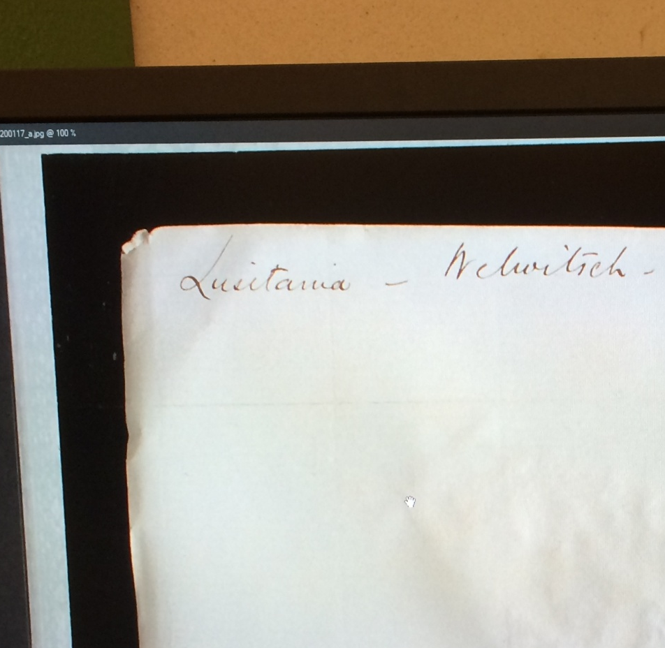
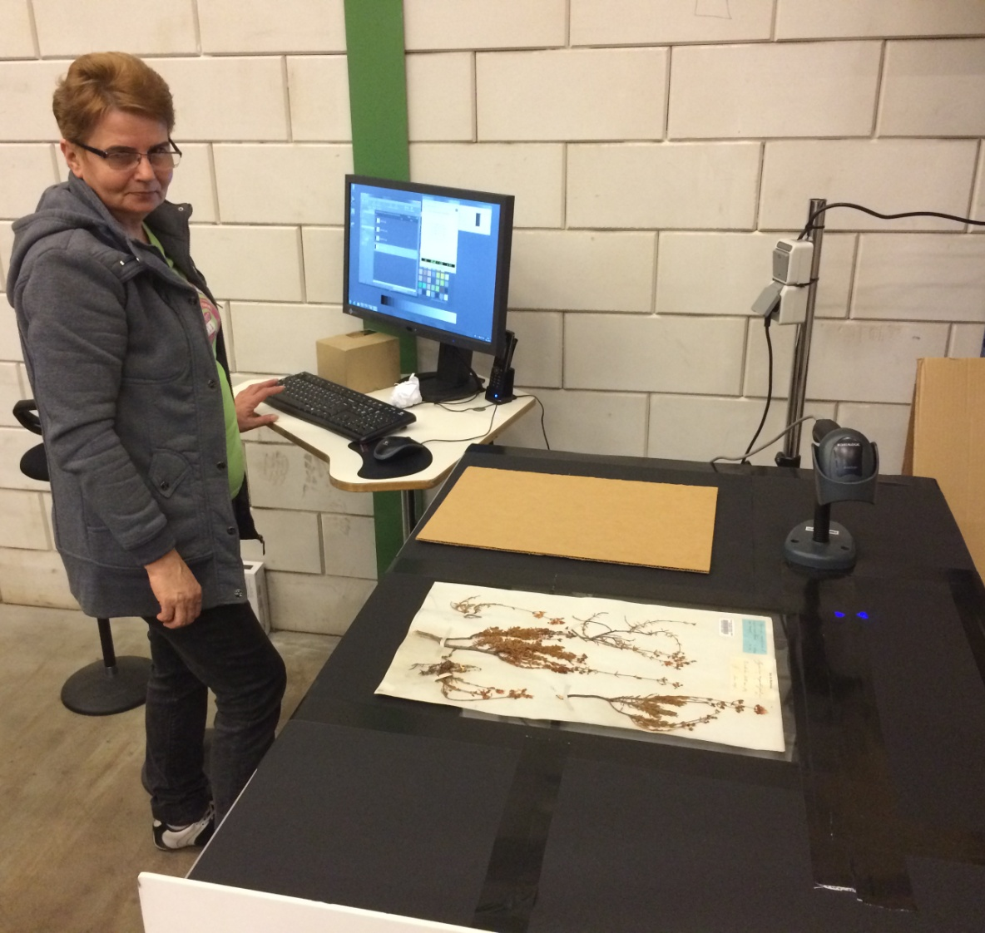
Verso Imaging
Notes:
Last person for the NHM images the sheet – they had training to recognise the types of sheets which could have writing on the back – then they checked them and used another station where the backs were imaged from underneath.

Slide 24
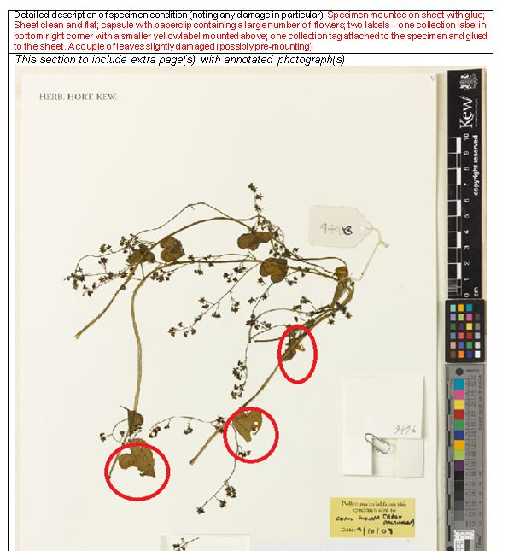
Condition
Reporting
At Kew/NHM
On arrival
After digitisation
Back at Kew/NHM
Notes:
Lot of concern (1 in 1000 specimens). Obviously risk of damage to specimens while transporting offsite is a concern.. So we assessed for damage at four recording state of specimens before they left, comparing on arrival, after digitisation prior to return and on return. Image on site and when they come back. process. No significant damage seen.

