Slide 1

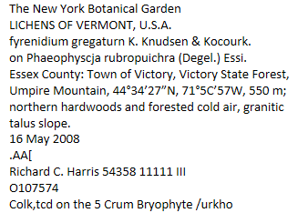
Using optical character recognition (OCR) output in digitization:
#spnhc2014
#digitization
#collections
See your data before it's in the database and after
SPNHC, June 26, 2014
Symposium: Progress in Natural History Collections Digitisation
Canolfan Mileniwm Cymru \ Wales Millennium Centre, Cardiff Bay
Deborah Paul, Andrea Matsunaga, Miao Chen, Jason Best, Sylvia Orli, Elpseth Haston,
find Deb on Twitter @idbdeb @iDigBio
Notes:
Data Discovery and Doer Happiness!
Slide to introduce iDigBio & aOCR WG
Parsing
Data discovery
Visualization
Validation
Grouping
RBGE (more from Elspeth next!)
Citscribe Hackathon
OCR Track Team
Using OCR output to reveal data, create datasets, increase transcriber / validator happiness
Use entered data to create a more efficient validation strategy
Collaboration – JRA Synthesys 3
BHL Error correction - Crowdsourcing
Working Group Invite

Slide 2
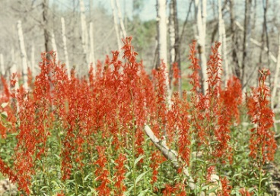
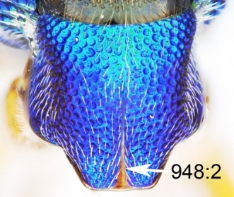
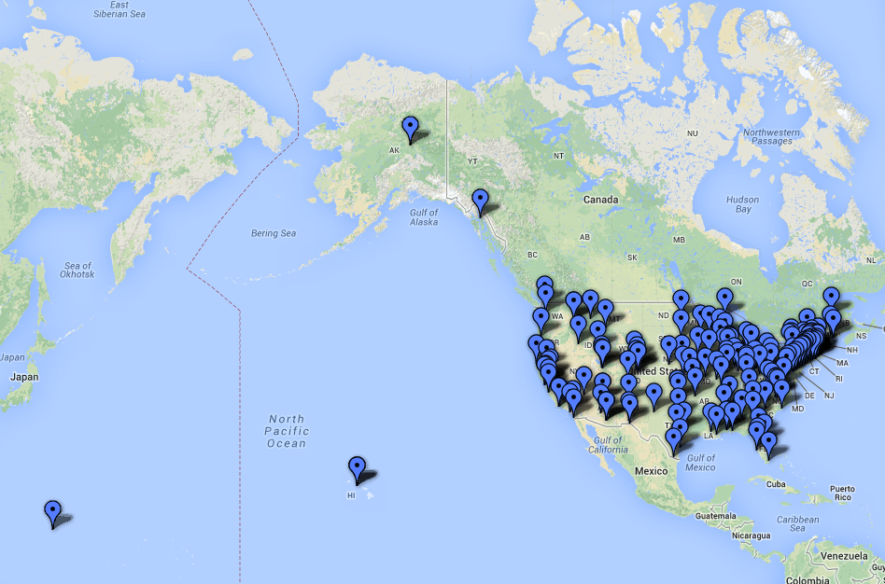
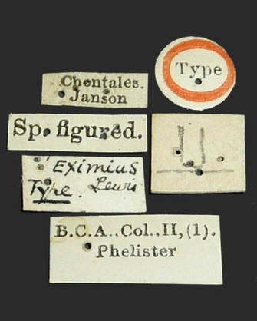
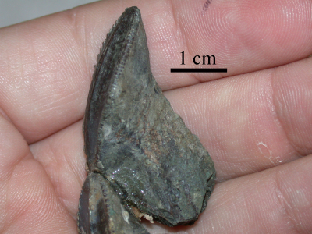
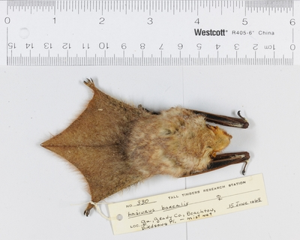
What is iDigBio?
NIBA - NSF - ADBC - iDigBio - TCN - PEN
facilitate use of biodiversity data
enable digitisation
portal access
sustainability – community collaboration
Notes:
Goals
expand the USA digital resource of vouchered biological and paleontological collections
advance scientific knowledge: improve access to data and media
a billion-in-ten
10 TCNs, more soon

Slide 3
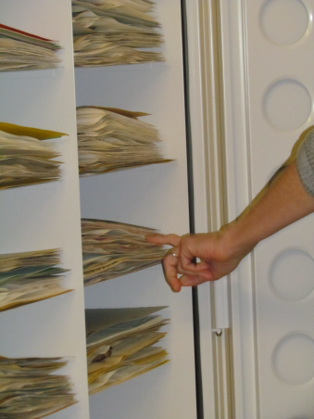
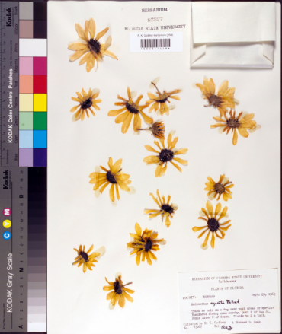
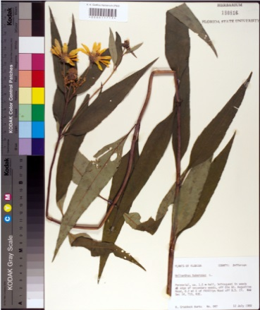
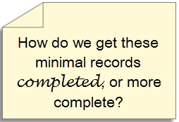

Minimal Data Capture
Trend
“filed as” name
higher geography
barcode
image
all sheets in folder get the same initial data
only the barcode differs
filed as name
Biological collection data capture: a rapid approach using curatorial data
Notes:
Biological collection data capture: a rapid approach using curatorial data
Read this to get an idea of the current trend in digitizing minimal records to start.

Slide 4
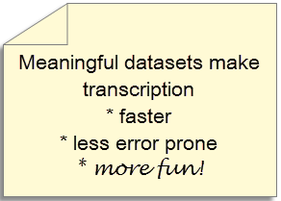
Would you like to…?
enter records faster?
use the ditto feature often?
find duplicates quickly?
find the labels
find the labels with lots of handwriting?
create your own record sets to transcribe?
by collector
by country or county
by your Great Aunt Penelope
by taxon
by language
create cogent sets to speed up validation and database updates?
make transcribers / validators jobs easier (paid and volunteer)?
Notes:
Use Machine Learning and
Natural Language Processing on OCR output
find sheets with !handwriting
find the labels in the images
find labels from a given collector, a given place
group sheets / labels by language
group sheets for data entry
group sheets for crowd-sourced transcription
group sheets for researchers

Slide 5
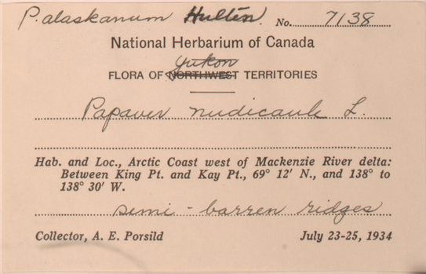
Got Text?
Got Handwriting?
Notes:
Notice what OCR will and will not do.
What is the percentage of handwriting?
What will the OCR pick up clearly?
Note the paper color, the shadow on the lower left, different fonts, a scratched out word, …
If we’re talking authority files for names, why not sample labels of their handwriting too as attribute?

Slide 6
Label
OCR
No. ....2L31.
National Herbarium of Canada
FLORA OF’T TERRITORIES
.
Hab. and Loc., Arctic Coast west of Mackenzie River delta:
Between King Pt. and Kay Pt., 69° 12’ N., and 138° to
138° 30’ W.
. .
Collector, A. E. Porsild July 23-25, 1934
Next imagine output from 1000s of labels or notebooks or text files!
Notes:
see if the audience expectations match the results shown.
transition to the next slide --- it’s important to note the comment about 1000s of labels.

Slide 7
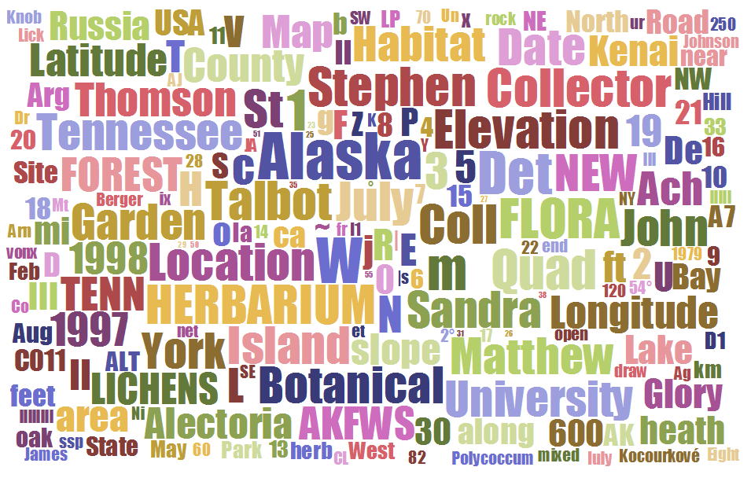

Slide 8
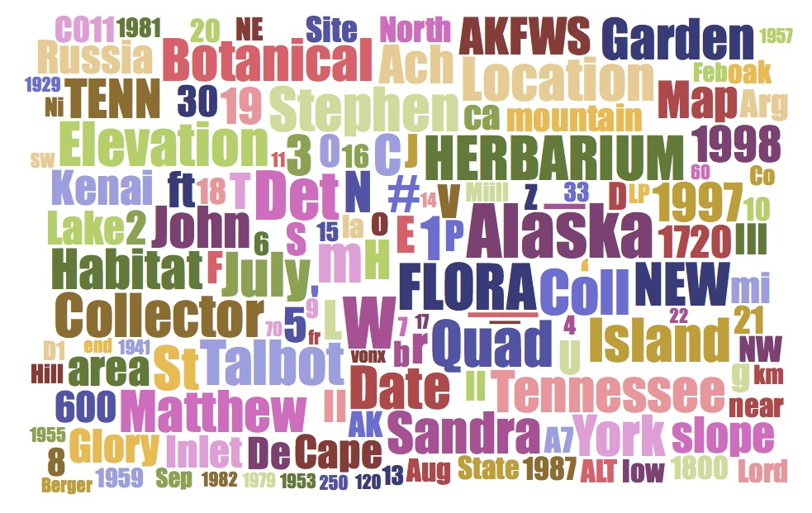
Web Service-Based Word Cloud http://aocr1.acis.ufl.edu/datasets/lichens/silver/ocr/WebrootDatasetsLichensSilverOcr.txt
Müll
Created by sending a text file to this cloud generator
http://www.jasondavies.com/wordcloud/#http%3A%2F%2Faocr1.acis.ufl.edu%2Fdatasets%2Flichens%2Fsilver%2Focr%2FWebrootDatasetsLichensSilverOcr.txt
Notes:
8 Mull (umlauted u)

Slide 9
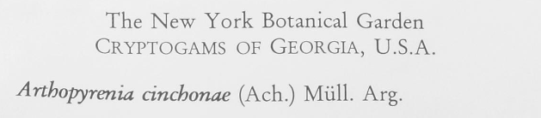
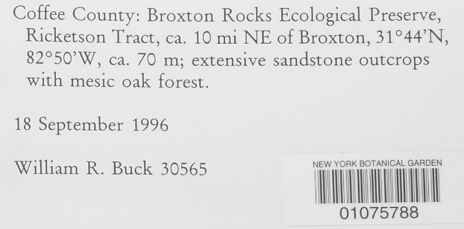
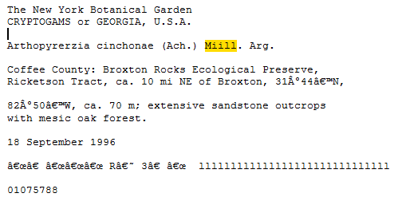
OCR text

Slide 10
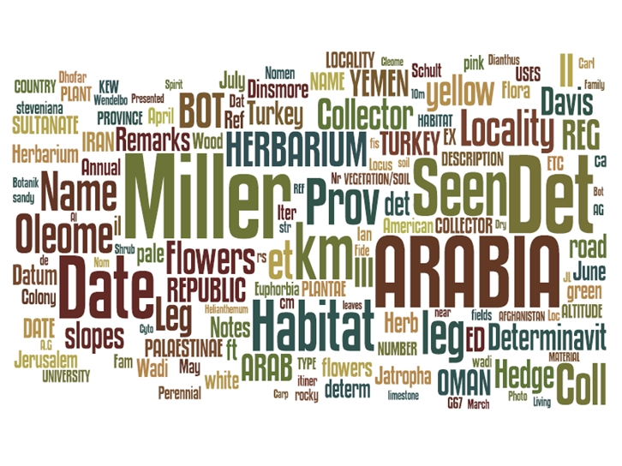

Seeing the dark data…
Robyn E Drinkwater, Robert Cubey, Elspeth Haston at TDWG 2013.
Notes:
The use of optical character recognition (OCR) in the digitisation of herbarium specimens October 2013 Biodiversity Information Standards (TDWG) 2013 Conference. Florence, Italy. Robyn E Drinkwater, Robert Cubey, Elspeth Haston
Having a European member of in our aOCR working group has been key to two-way communication, expertise sharing, knowledge transfer, and collaborative efforts to move the community forward on uses for OCR output.

Slide 11
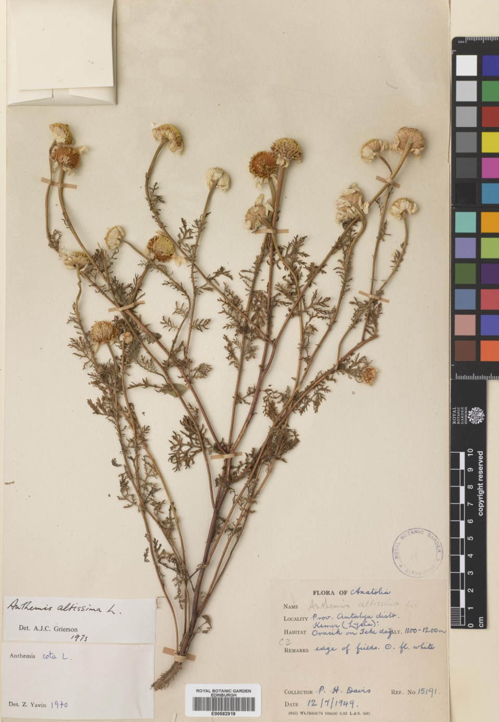
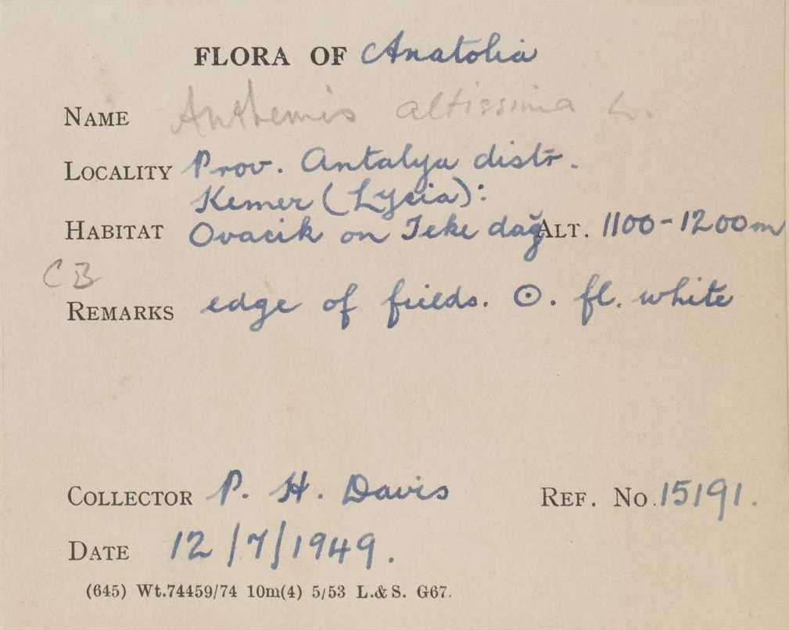
It’s surprising what can be used to help filter specimens – the black art of search terms!

Slide 12
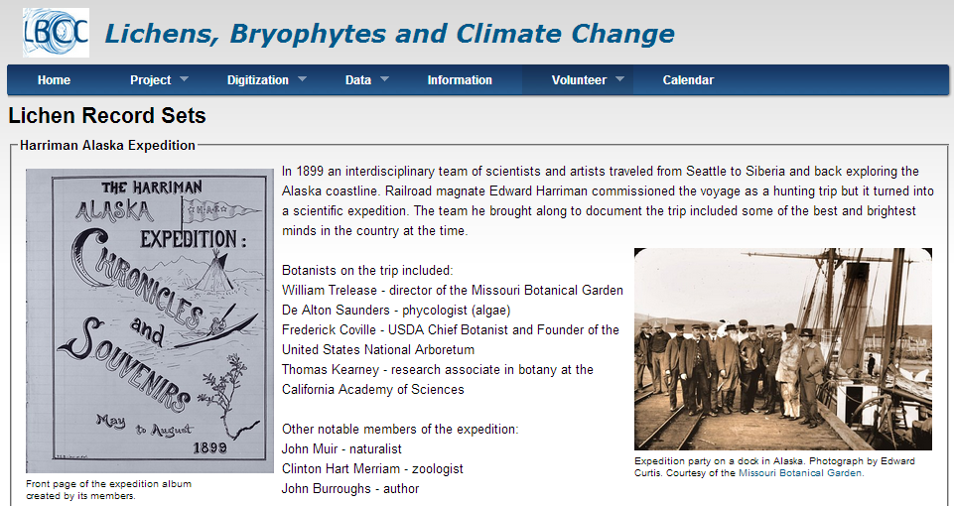
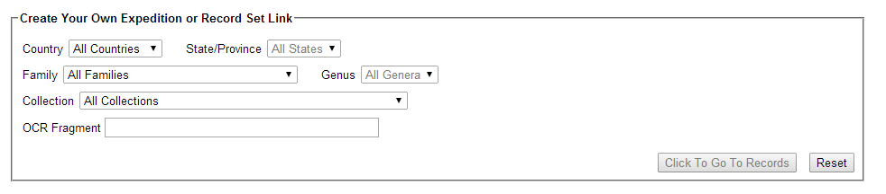
http://tinyurl.com/LichenRecords

Slide 13
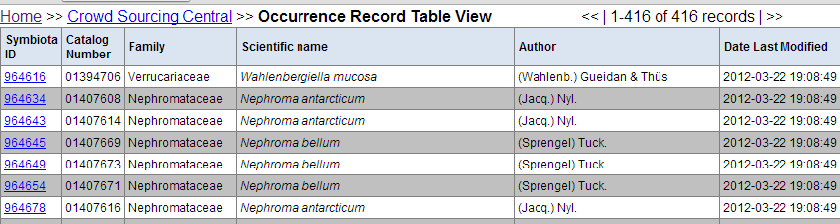
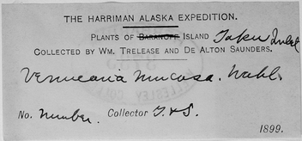
Inside the 1899 Harriman Expedition

Slide 14
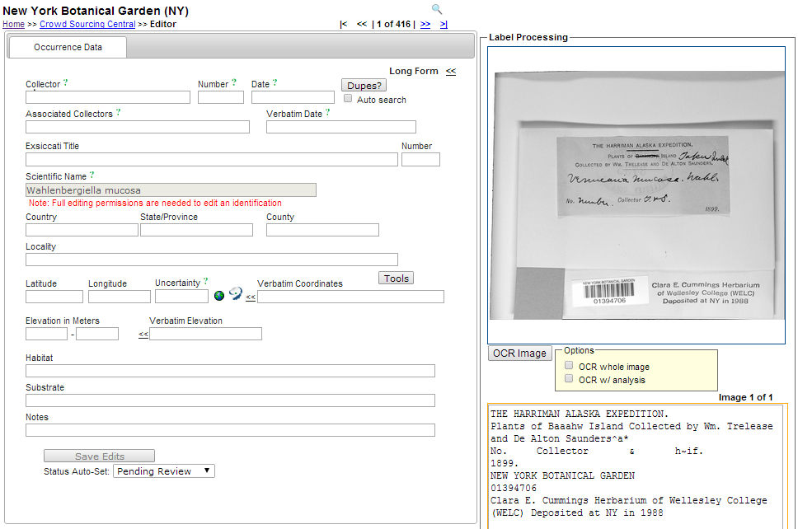
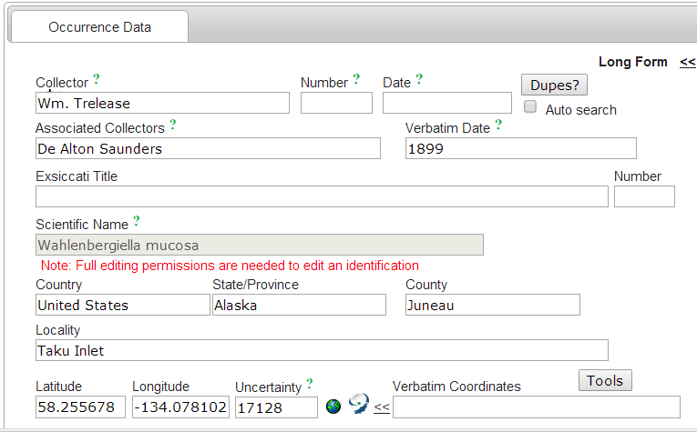
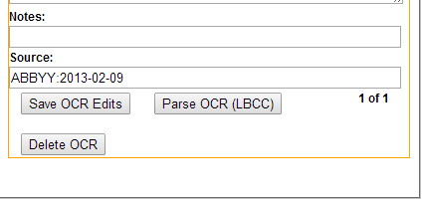

Slide 15
Overall Word Cloud Workflow
Some work from the recent iDigBio CITSCribe Hackathon
Web Service
(Jason Davies)
OCR
Engine
OCR
Output
OCR
Engine
OCR
Output
OCR
Engine
OCR
Output
Index (Solr)
Histogram
(Google Charts, Facet Explorer)
Word
Cloud
Images
Crowd
sourcing
(BVP)
DwC
Parsed
Output
OCR confidence
(n-gram)
Cluster
(carrot²)
Google Charts: http://developers.google.com/chart/interactive/docs/gallery
N-gram: http://github.com/idigbio-citsci-hackathon/OCR-Error-Estimation
Facet explorer: http://github.com/idigbio-citsci-hackathon/facet-explorer
Jason Davies WC: http://www.jasondavies.com/wordcloud/
Apache Solr: http://lucene.apache.org/solr/
carrot²: http://project.carrot2.org/
Notes:
4 tracks at the recent iDigBio and Notes from Nature Hackathon
Interoperability Track
OCR Integration Track
QA/QC and Reconciliation of Replicates Track
User Engagement Track

Slide 16
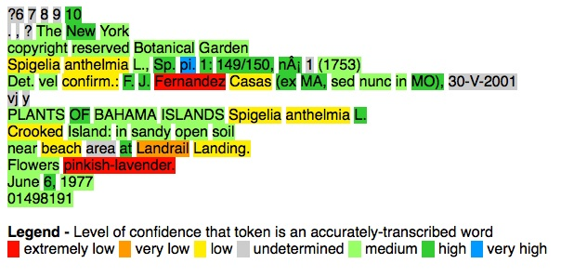
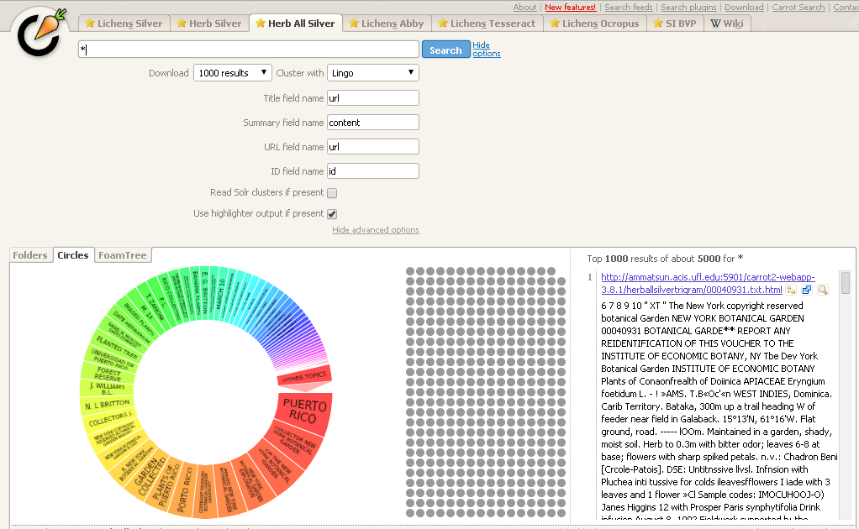
Word Clouds using N-gram Scoring, Faceting, Solr + Carrot²
Notes:
For more on this work, there’s a video online at iDigBio as well as a written report (blog post).
Contact the working group for more information and help.

Slide 17

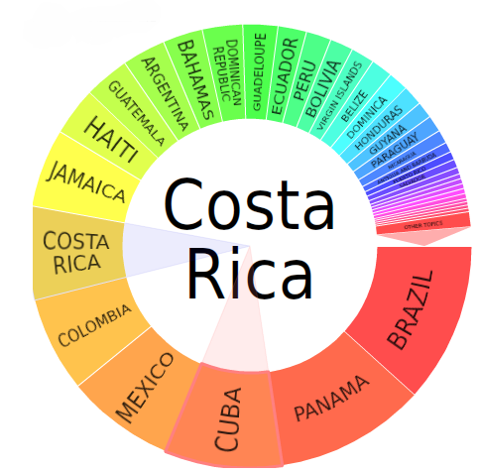

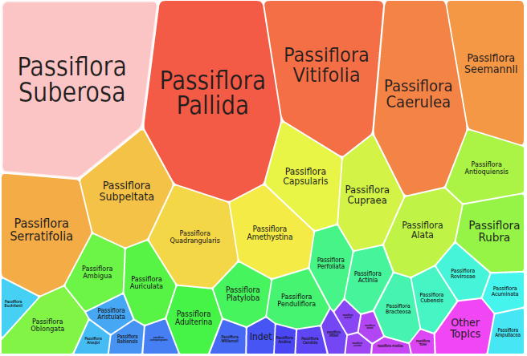
Imagine Integration with current software
Use for initial sort or validation

Slide 18
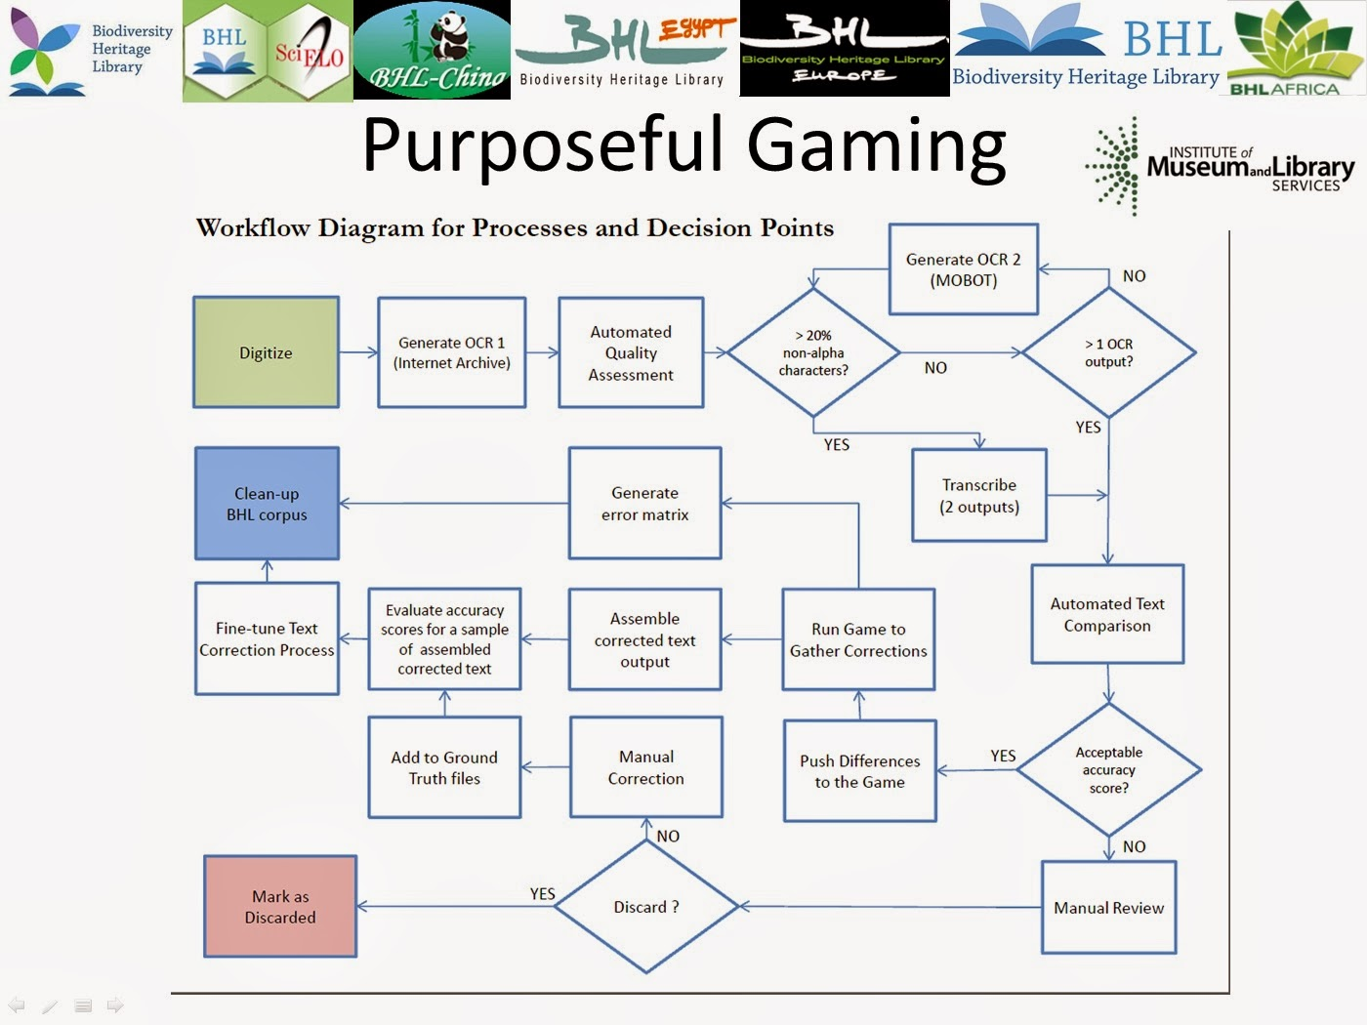

Slide 19
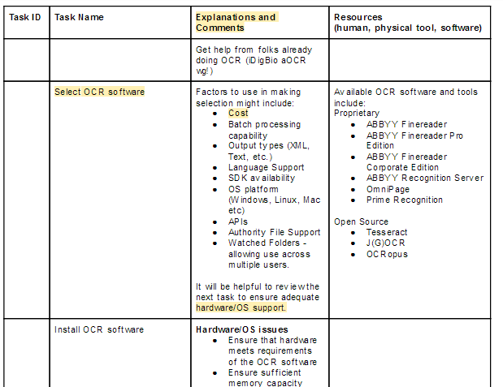
Working Group Collaboration - Workflows
Setting up OCR
Running OCR
Machine Learning
Natural Language Processing
Notes:
Two working groups at iDigBio put their expertise together to create a detailed step-by-step list of tasks in a workflow that describes setting up OCR in a digitization workflow from choosing the OCR to getting output.
Working Groups:
Augmenting Optical Character Recognition
Developing Robust Object to Image to Data (DROID) workflows working group.

Slide 20
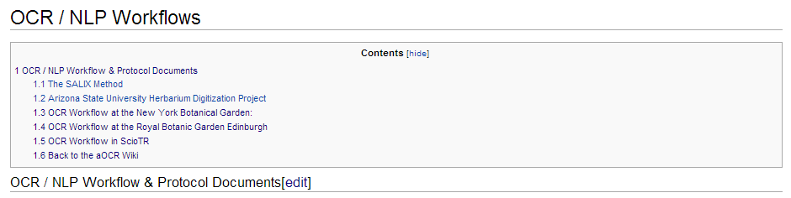
Sample Workflows with OCR integrated
New workflow sample OCR protocols
Got one?
Got a resource for these?
Got new ideas for how to use the text data to improve the data?
Let’s share!

Slide 21
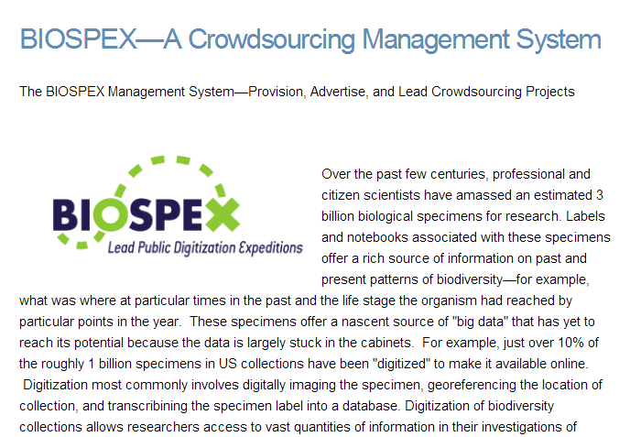

Managing your crowdsourcing data behind the scenes
OCR too!

Slide 22
OCR use, a bit more…
Got Text?
Got Handwriting?
aOCR WG, JRA Synthesys3, …
user-interface interest group
exemplar ML and NLP workflows
combining with Voice recognition software (Macroalgal TCN)
Notes:
aOCR WG
Who’s using OCR?
What for?
NYBG Field Notebook Project
Stephen Gottschalk
Lichen BCC TCN
Workflows
BHL
N-gramming (word confidence) with gaming
(Rod Page (see Hackathon going on now) March 2014

Slide 23













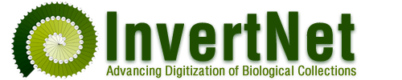



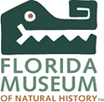
Diolch yn fawr!
Work presented here made possible by many and especially…
MaCC TCN
Andrea Matsunaga, Researcher, iDigBio
Miao Chen, Indiana University, Data to Insight Center
Jason Best, Botanical Research Institute of Texas
Sylvia Orli, IT Head, Smithsonian Botany Department
William Ulate, Technical Director, BHL
Reed Beaman, Informatics Specialist, iDigBio
Elspeth Haston, et al Royal Botanic Garden Edinburgh (RBGE)
iDigBio Augmenting Optical Character Recognition WG
SALIX

