Slide 1
The Fairmont State Experience
By Dr. Donald E. Trisel

Slide 2
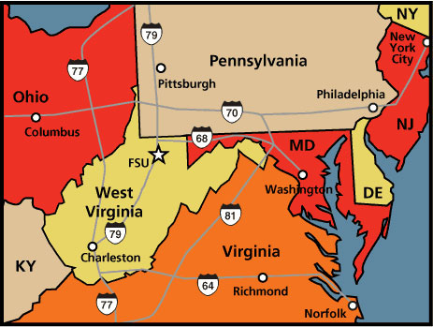
(The Other) FSU in Fairmont, WV

Slide 3
Don’s Bio
Professor of Biology at FSU
Ph.D. in Botany from Miami University.
Ecological impact of Lonicera maackii
100% teaching contract, research on side.

Slide 4
Current story on FSU web pages

Slide 5
Quick Stats about FWVA
Estimated 10,000 specimens
Mostly WV vascular.
1,000 added in past 2 yrs
Oldest specimen (so far) from “1 89 8”
1800 specimens w/ label data in Excel
2200 specimens imaged
Specify on Network soon?!

Slide 6
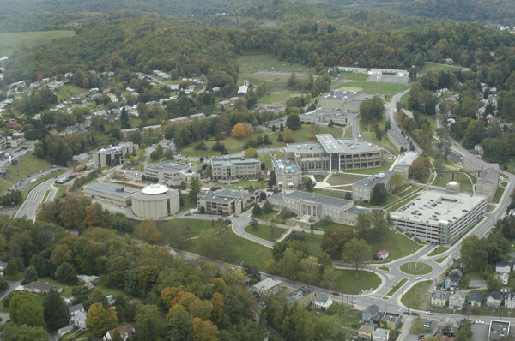
FSU Main Campus
FWVA Herbarium in 402 Hunt-Haught Hall, Botany Lab

Slide 7
Digitization
Most efforts framed around undergraduate research experiences

Slide 8
Courses that utilize FWVA
Bio 2202 Principles of Botany
Bio 3312 Advanced Botany
Collection assignment
[Bio 3370 Plant Physiology]
Research
Bio 4485 Senior Seminar
Bio 4495 Independent Studies
Bio 4998 Honors

Slide 9
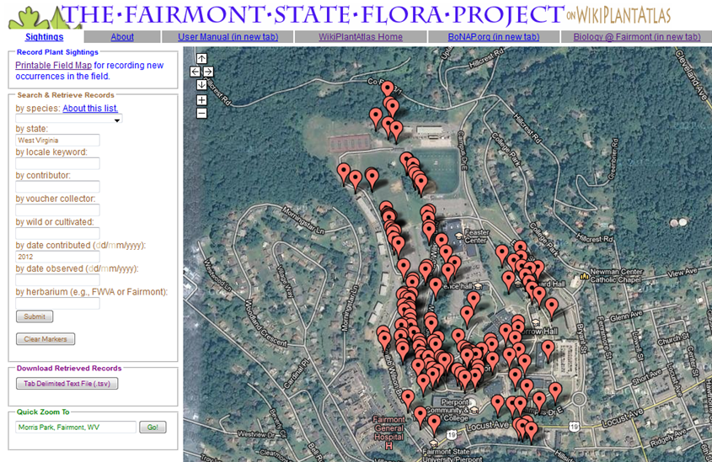
http://www.wikiplantatlas.org/
Chris Hardy at Millersville University

Slide 10
Student experience = all aspects of herbarium curation:
ID
Collecting, pressing, drying, mounting, freezing, labeling
Digitizing labels, photography
Repair
Reorganizing
Science!

Slide 11
Recent Presentations
WVAS
ASB (Charleston, WV in 2013)
Celebration of Student Scholarship at FSU

Slide 12
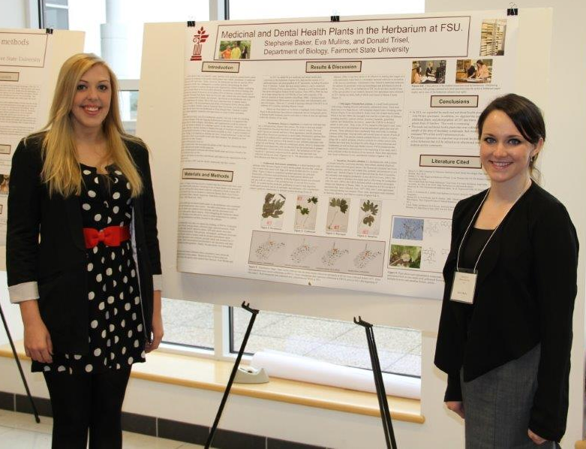
Recent Presentations
Stephanie Baker and Eva Mullins
Topic: Medical and Dental Health

Slide 13
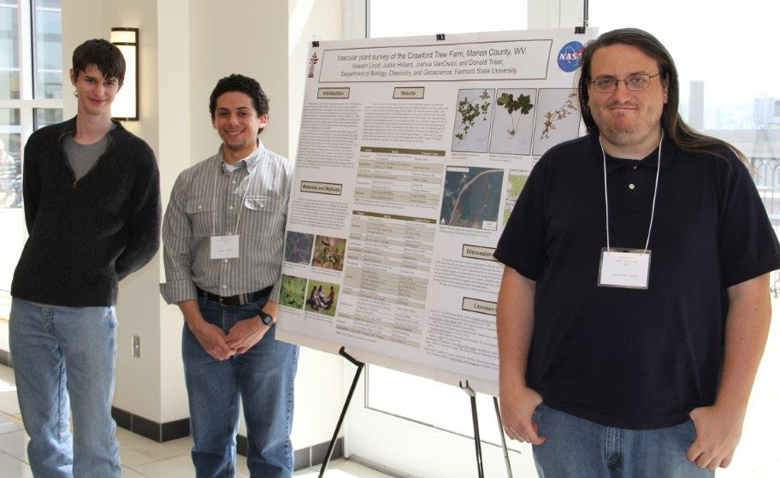
Recent Presentations
Joshua VanOsdol, Justin Hilliard, Kass Lloyd
Topic: Crawford Tree Farm Survey

Slide 14
Recent Presentations
Lauren Siburt and Jade Bennett
Topic: Arthritis and Joint Health

Slide 15
Funding
No annual budget
No staff
Grants (all internal)
President/Provost
Undergraduate Research Advisory Council
College of Science and Technology
NASA
Indirects

Slide 16
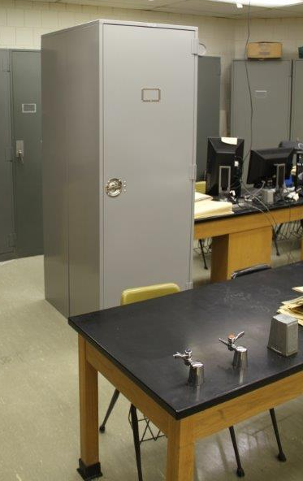
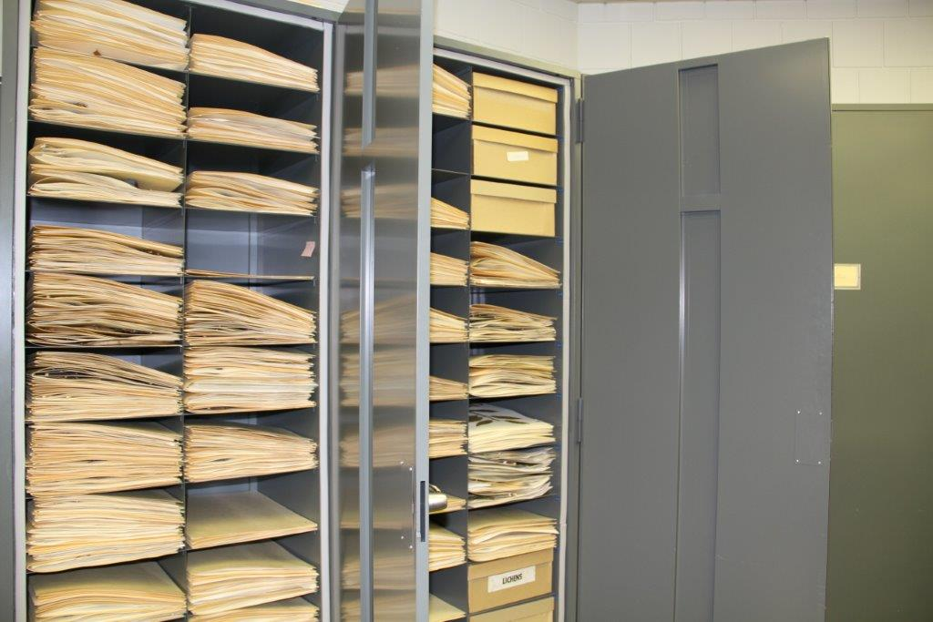
2 Drying Cabinets
10 Storage

Slide 17
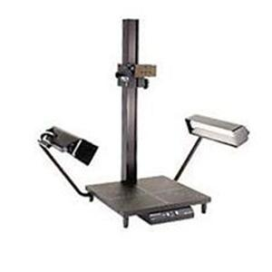
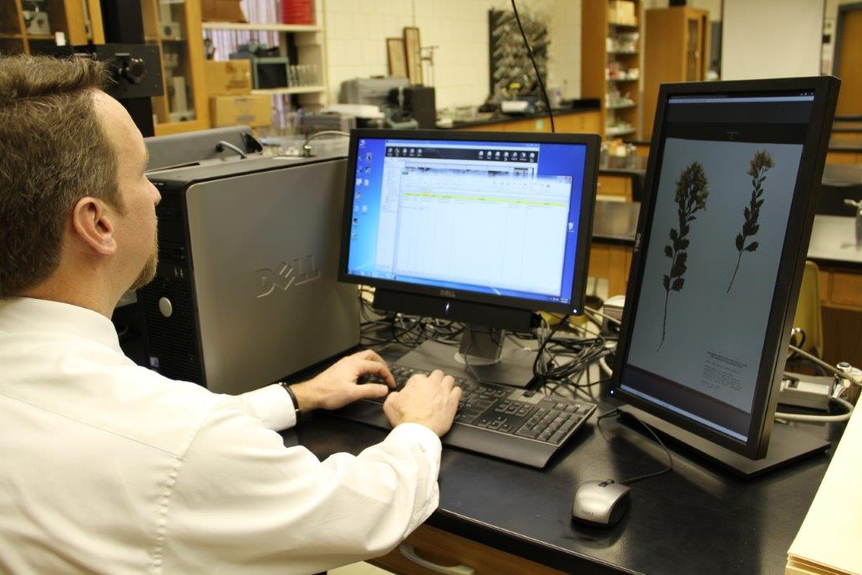
Imaging equipment
2010. Spring 2013.

Slide 19
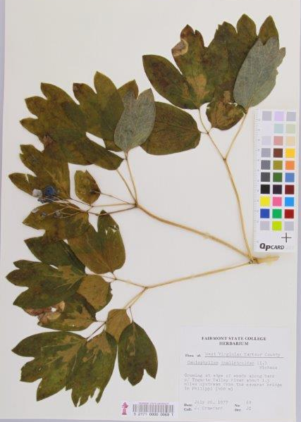
Future Plans
Databasing from images
Citizen Scientists?
Mobile Imaging?
WV Chapter of the SHC?

Slide 20
Tips?
Recruit good students.
Justify existence, become visible.
Ask for funding.
Research projects.
Plan and Start.
Refine the process.

Slide 21
Questions? Comments?
Quote from Stephanie Rae Baker @ WVSOM:
“When I interviewed for acceptance into medical school, my medicinal plant research was a very strong conversation piece, about which they were very interested in hearing. I cannot stress enough to students planning to go on to professional school how important it is to get involved in undergraduate research!”

