Slide 1
Optical Character Recognition (OCR)
It’s not just for parsing anymore! – Think Sort
Another tool in the digitization toolbox
iDigBio Mobilizing Small Herbaria Digitization Workshop
December 9 – 11, 2013 Tallahassee, Florida
Deborah Paul, iDigInfo, iDigBio
Twitter @idigbio #smallherb

Slide 2
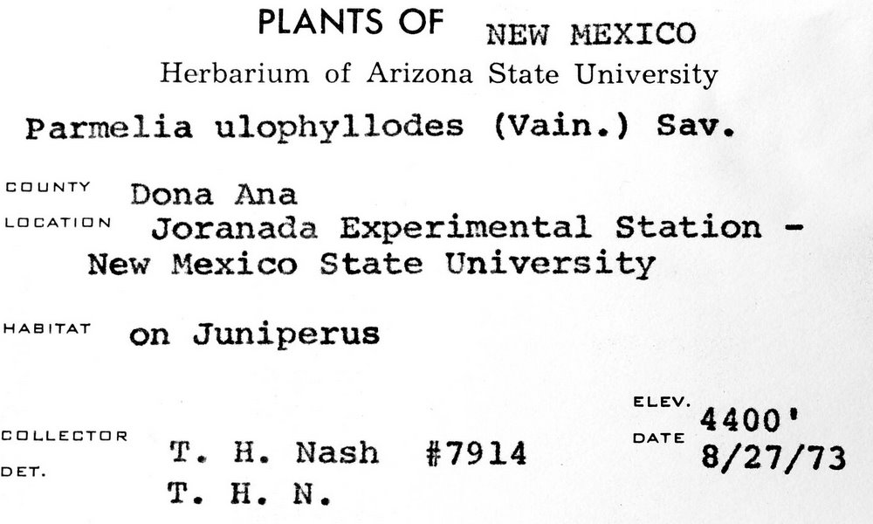
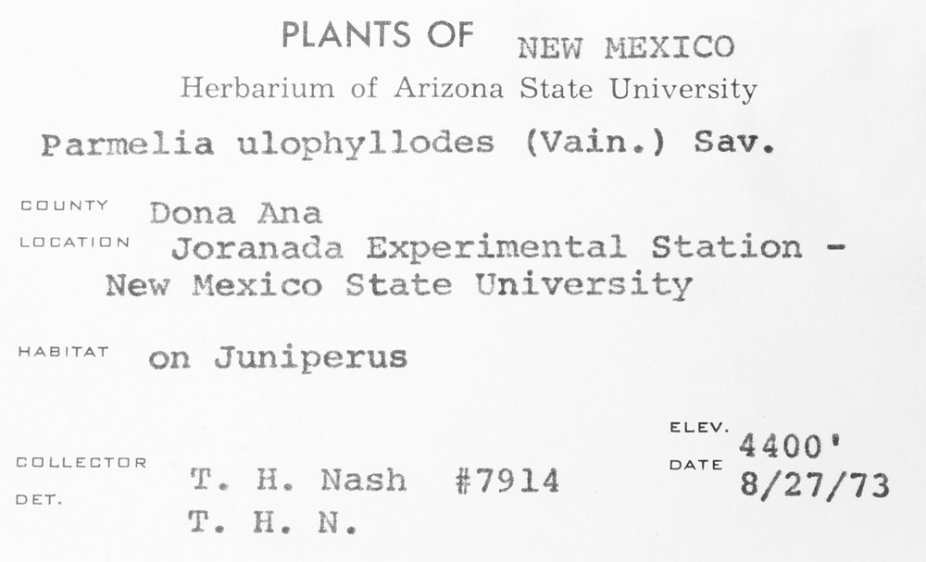
Optical Character Recognition
Tesseract V3
Dual cycle
Automatic
Manual review
Expected hurdles
Handwritten labels
Old fonts
Faded labels
Form labels
Adjustable image variables
Â¢_].L.|Â»â€˜Â¢ .'Â».f.'._..â€˜~,(.J
fin-xâ€˜*\'a:"511z:1 wf .~\:'i/.onli State University
P.â€™~.r"~2= ,_. gg J:.2 " J*J*" â€ (=:\â€˜-â€œax "Â»..'\-12
â€˜ â€œ "â€˜ ;T~;â€˜~7i?Â»-1_1_\f;>sf`;,' ESX
ZÂ»ie+â€˜-Â». â€œ~'.Â»te;~:i_.t<Â» ff`t;~f3":.f.â€œ
Â» Â»4 xx, ,
"""â€˜â€œâ€T"â€™ <1;-.rs f3'a,1.z>.t;;aÂ¢f~rus â€™
V4 J 'if . rÂ°'Â° M '1?nies ivain.) Sav.
neutal Station - " '1 ~Â»r';;4-\P ` 1.
T11 ./P.. ,J ..-.
ELEV. ' `.fJL_\ LATL Q _â€˜ 1 _ Yâ€™ DATE
_ ,. W5. (> f- , -:â€˜; i f>i_T ~~ . A 1:
Â». v\ .-v Â»~. 4. a xvala 8/27/73
PLANTS OF NEW r~1ExIco
Herbarium of Arizona State University
Parmelia ulophyllodes (Vain.) Sav.
COUNTY â€œÂ°â€â€œâ€œ
Joranada Experimental Station -
New Mexico State University
"â€œâ€œâ€œ' on Juniperus
ELEV. ‘ 4400
EEILLEETUR DATE
DU T. H. Nash #7914 8/27/73
T. H. N.
from: Edward Gilbert, Symbiota Developer
Notes:
Slide from Edward Gilbert, Symbiota Developer

Slide 3
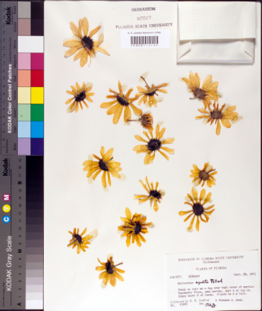
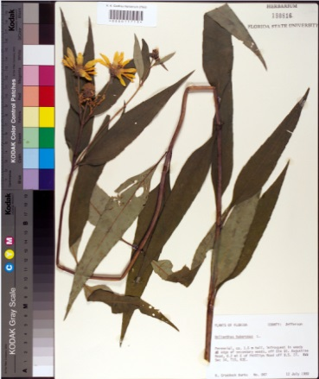
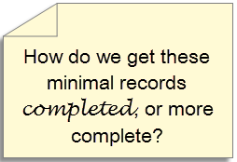
Minimal Data Capture
Trend
“filed as” name
higher geography
barcode
image
all sheets in folder get the same initial data
only the barcode differs
filed as name
Biological collection data capture: a rapid approach using curatorial data
Notes:
Biological collection data capture: a rapid approach using curatorial data
Read this to get an idea of the current trend in digitizing minimal records to start.

Slide 5
The herbaria at the Royal Botanic Garden Edinburgh (RBGE) and The New York Botanical Garden (NY) use a similar recently developed workflow:
Capture minimal data for each specimen
(e.g. barcode, geographic region, and the taxon name on the specimen folder).
Capture high quality digital images of each specimen
Process images with ABBYY® OCR software
Develop and/or use software tools to search OCR text output and sort the images/data based on principal data elements (e.g. by collector and country)
Sort image/data to enable faster data capture & higher accuracy by data transcriptionists, including duplicate record matching.
Notes:
Who is using OCR (not for parsing)?
NYBG
RBGE
RBGK
LBCC
Smithsonian (SALIX)

Slide 6
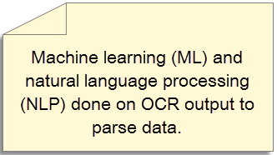
Optical Character Recognition Output in a digitization workflow - Parsing
Photograph herbarium sheets
Run OCR on the images
PARSE the results directly into database fields
hard to do (well)
works best on ocr from typed / printed labels
improving (75%+)
algorithms shareable
Evidence* supports use
SALIX, 30% faster than typing.

Slide 7
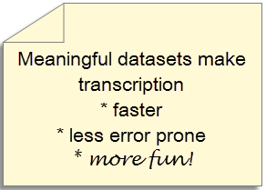
Optical Character Recognition Output in a digitization workflow - Sorting
SORT images
Use Machine Learning and
Natural Language Processing on OCR output
find sheets with !handwriting
find the labels in the images
find labels from a given collector, a given place
group sheets / labels by language
group sheets for data entry
group sheets for crowd-sourced transcription
group sheets for researchers

Slide 8
Exploring the data…
Robyn E Drinkwater, Robert Cubey, Elspeth Haston at TDWG 2013.
Notes:
The use of optical character recognition (OCR) in the digitisation of herbarium specimens October 2013 Biodiversity Information Standards (TDWG) 2013 Conference. Florence, Italy. Robyn E Drinkwater, Robert Cubey, Elspeth Haston

Slide 9
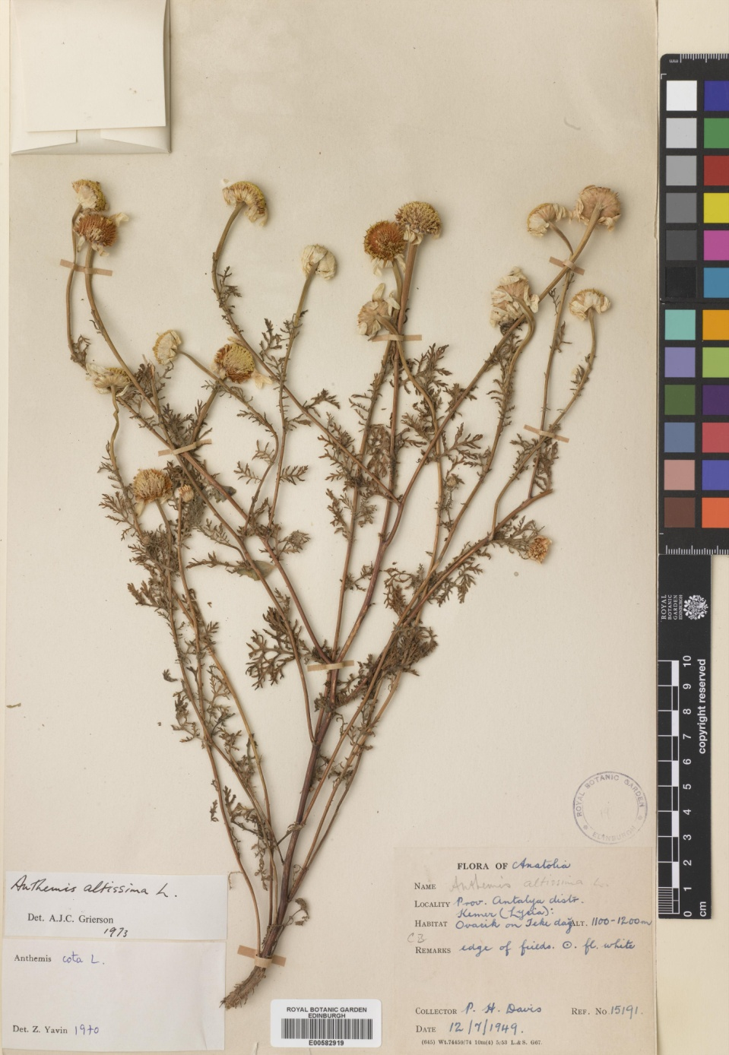
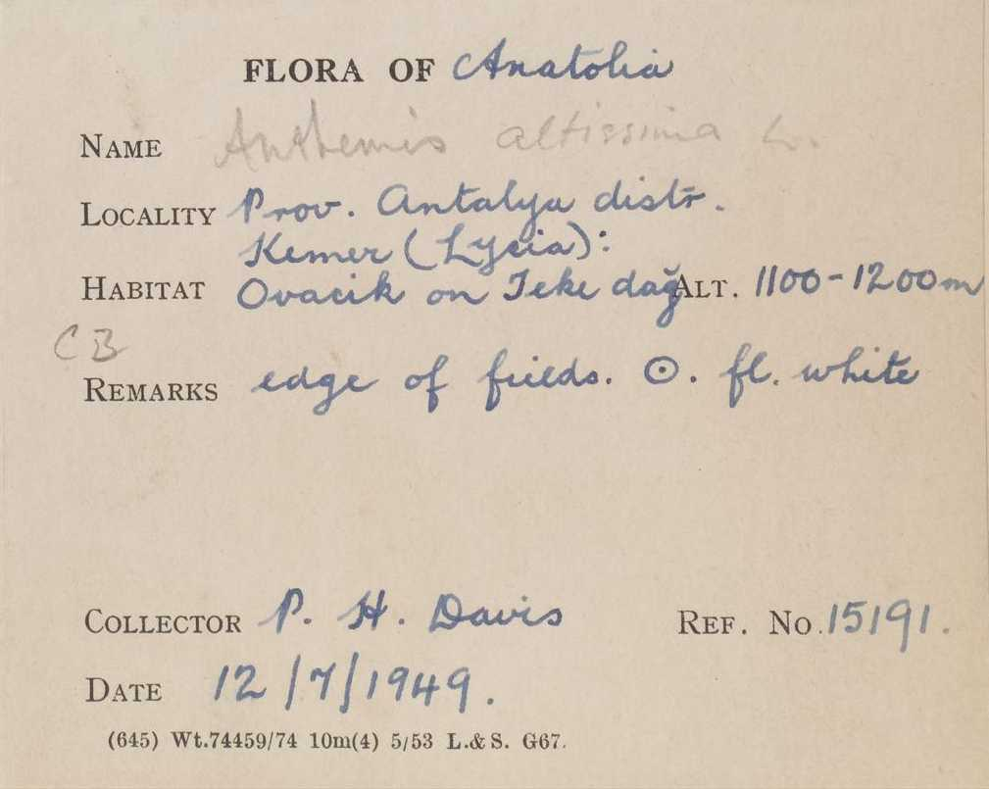
It’s surprising what can be used to help filter specimens – the black art of search terms!

Slide 10
Humans are in-the-digitization-loop
recent trials at RBGE (Drinkwater, et al. TDWG 2013)
faster transcription with ordered datasets
humans report liking the ordered datasets
compared to randomly presented sheets
transcription 30 % faster than typing alone (SALIX)
set creation takes advantage of
human learning (mastery)
geography
handwriting
morphology
human preferences (autonomy, purpose)

Slide 11
OCR Workflows: What’s new and What’s not-quite-here-yet?
The use of optical character recognition (OCR) in the digitisation of herbarium specimens October 2013 Biodiversity Information Standards (TDWG) 2013 Conference. Florence, Italy. Robyn E Drinkwater, Robert Cubey, Elspeth Haston.
Abstract, Powerpoint
The SALIX Method: A semi-automated workflow for herbarium specimen digitization. June 2013 Taxon 62(3):581-590 A Barber, D Lafferty, L Landrum.
iDigBio aOCR Hackathon results
OCR as a Service
Images hosted on a server at iDigBio
OCR software runs on the iDigBio server
Returns OCR text output
Use for Sorting
Use for Parsing!

Slide 12
iDigBio Augmenting OCR (aOCR) WG current events
iDigBio Public Participation Working Group
Citizen Science Hackathon Dec 16 – 20th with Notes from Nature, +
Twitter #citscribe
DROID1 working Group – Flat things, packets, entomology labels
OCR nearly finished
ML / NLP workflows in progress
Meeting with the Community
Smithsonian (SALIX), and Cal Academy of Sciences
finishing a paper reporting on our 1st aOCR hackathon
Scoring Parsed OCR from a standard dataset
comparing methods and ocr software
ABBYY compared to Tesseract, …
Parsing algorithm enhancement / optimization
OCR web services, label-finding, finding handwritten labels

Slide 13
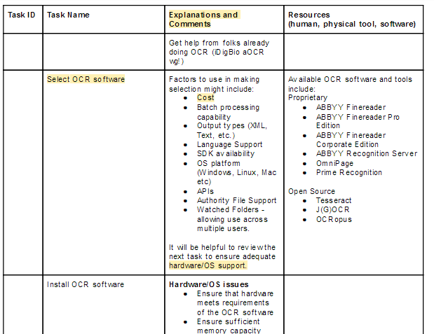
aOCR + DROID1 OCR workflow, …
Setting up OCR
Running OCR
Machine Learning
Natural Language Processing

Slide 14
aOCR Working Group
MaCC TCN
Bryan Heidorn, Director, School of Information Resources and Library Science, University of Arizona
Robert Anglin, LBCC TCN Developer
Reed Beaman, iDigBio Senior Personnel, FLMNH
Jason Best, Director Bioinformatics, Botanical Research Institute of Texas
Renato Figueiredo, iDigBio IT
Edward Gilbert, Symbiota Developer, LBCC and SCAN TCNs
Nathan Gnanasambandam, Xerox
Stephen Gottschalk, Curatorial Assistant, NYBG
Peter Lang, Pre Sales Engineer, ABBYY
Deborah Paul, iDigBio User Services
Elspeth Haston, Royal Botanic Garden, Edinburgh
John Mignault, New York Botanical Garden
Anna Saltmarsh, Royal Botanic Gardens, KEW
Nahil Sobh, Developer, InvertNet
Alex Thompson, iDigBio Developer
William Ulate, Biodiversity Heritage Library (BHL), MOBOT
Kimberly Watson, Curatorial Assistant, NYBG
Qianjin Zhang, Graduate Student, University of Arizona
SALIX
Notes:
Representing visually, the organizations and affiliated groups for each of the working group members as well as the groups we have been collaborating with to date…

Slide 15
Season’s Greetings and Happy Digitizing…

