Slide 1
Got (messy) data? Clean it, enhance it, have fun with it
Get Open Refine
openrefine.org
iDigBio Mobilizing Small Herbaria Digitization Workshop
December 9 – 11, 2013 Tallahassee, Florida
Deborah Paul, iDigInfo, iDigBio
Twitter @idigbio #smallherb
Notes:
This powerpoint is just a quick introduction for a time when only 10 minutes were allotted.
Please try out the software. Watch videos at
http://www.openrefine.org for an introduction.

Slide 2
“You just saved me a month!”
“I feel like I just came out of the dark ages.”
“Our data ready now in 3 years, instead of 7.”
Notes:
Quotes from prior workshop participants.

Slide 3
OpenRefine
An open-source power tool for working with messy data.
Got Data in a Spreadsheet,…?
TSV, CSV, *SV, Excel (.xls and .xlsx),
JSON,
XML,
RDF as XML,
Wiki markup, and
Google Data documents are all supported.
the software tool formerly known as GoogleRefine

Slide 4
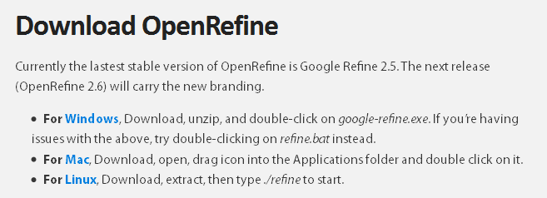
http://openrefine.org/
works on your own computer (Mac* or PC)
small to medium-sized data sets (not millions)
Notes:
10 minutes on open refine
who: anyone, mac or pc, good for small to medium datasets (not millions of records)
what: open source software for cleaning, analyzing, enhancing data
where: on your own computer
when: now?
why: makes data inspection easy, fast, playful even
how: go to www.openrefine.org to download

Slide 5
What data issues can you find / fix?
some data issues
use open refine because
the unknown
non-standard data
dates
people
places
languages
countries
typos
filename issues
taxonomic errors
identifier / guid error
mapping to standard terms
formatting
missing data
missing metadata
inspect dataset to find / fix errors
inspect to reveal patterns
easy to repeat steps
easy to undo changes
easy to enhance data

Slide 6
What to expect?
clustering algorithms
fingerprint, soundex, levenshtein, …
scatter plots
excel, csv, xml, …
scripts (for repetitive cleaning)
created automatically
save to re-use
regex (you can do this!)
enhance data
call a service (what?)
call GEOLocate (just like Georeference Me!)
reconcile names again a taxonomic name service

Slide 7
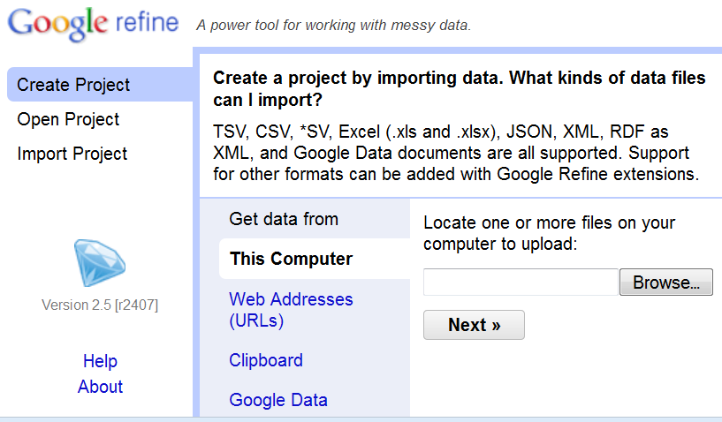
Notes:
Upload any CSV file and try it out!
A sample CSV file is posted with this power point on the Wet Collections Workshop Wiki if you want to try it now.

Slide 8
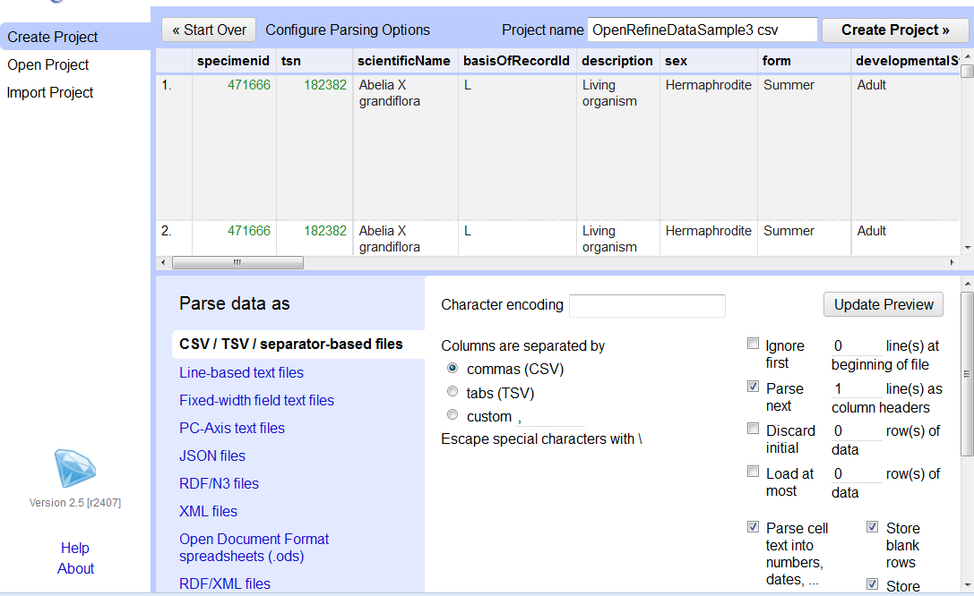
Notes:
Note here you can specify the “encoding” (do you have special characters like umlauted letters in your dataset? like ä or ü – choose “UTF-8” encoding
Simple to do, just click in the UTF-8 box, select UTF-8, done.
If your file is tab-delimited, or has a delimiter different than comma, specify the delimiter using the “custom” radio button under Columns are separated by
Next, note that you can discard rows, ignore rows, parse data, in this initial step to create a project.
Click Create Project in the top right-hand corner.

Slide 9
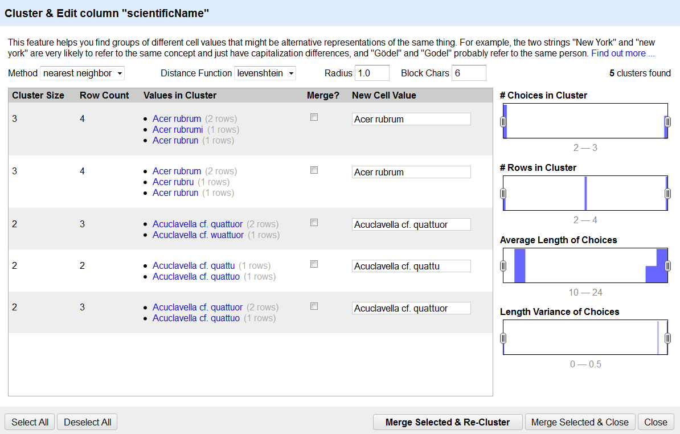
Notes:
After clicking on Cluster you may or may not get a result with the default algorithms.
Play with them to see what happens.
Here, nearest neighbor > levenshtein found 5 clusters.
Note the algorithms guess which value you might want. Just select “Merge” if the guess is correct.
If not, fix the value displayed in New Cell Value and then choose
Merge Selected and Close (or Merge Selected and Re-Cluster) – whichever is appropriate.
All these issues are now fixed.
You can do this with any column in the spreadsheet.

Slide 10
Ready?, Demo anyone?...
Tutorial Cleaning, Validating, and Enhancing Data with Open Refine
and sample CSV dataset for above tutorial
OpenRefine videos and tutorials
www.openrefine.org
Join Google+ Open Refine Community
Check out Google Fusion Tables too!
Teach others about these power tools
Pay-it-forward!
Data that is “fit-for-research-use”
& fun

Slide 11
Happy Holidays 2013!
Happy Parsing,
Sorting,
Faceting,
Enhancing, …
an easy gift idea too!

