Slide 1
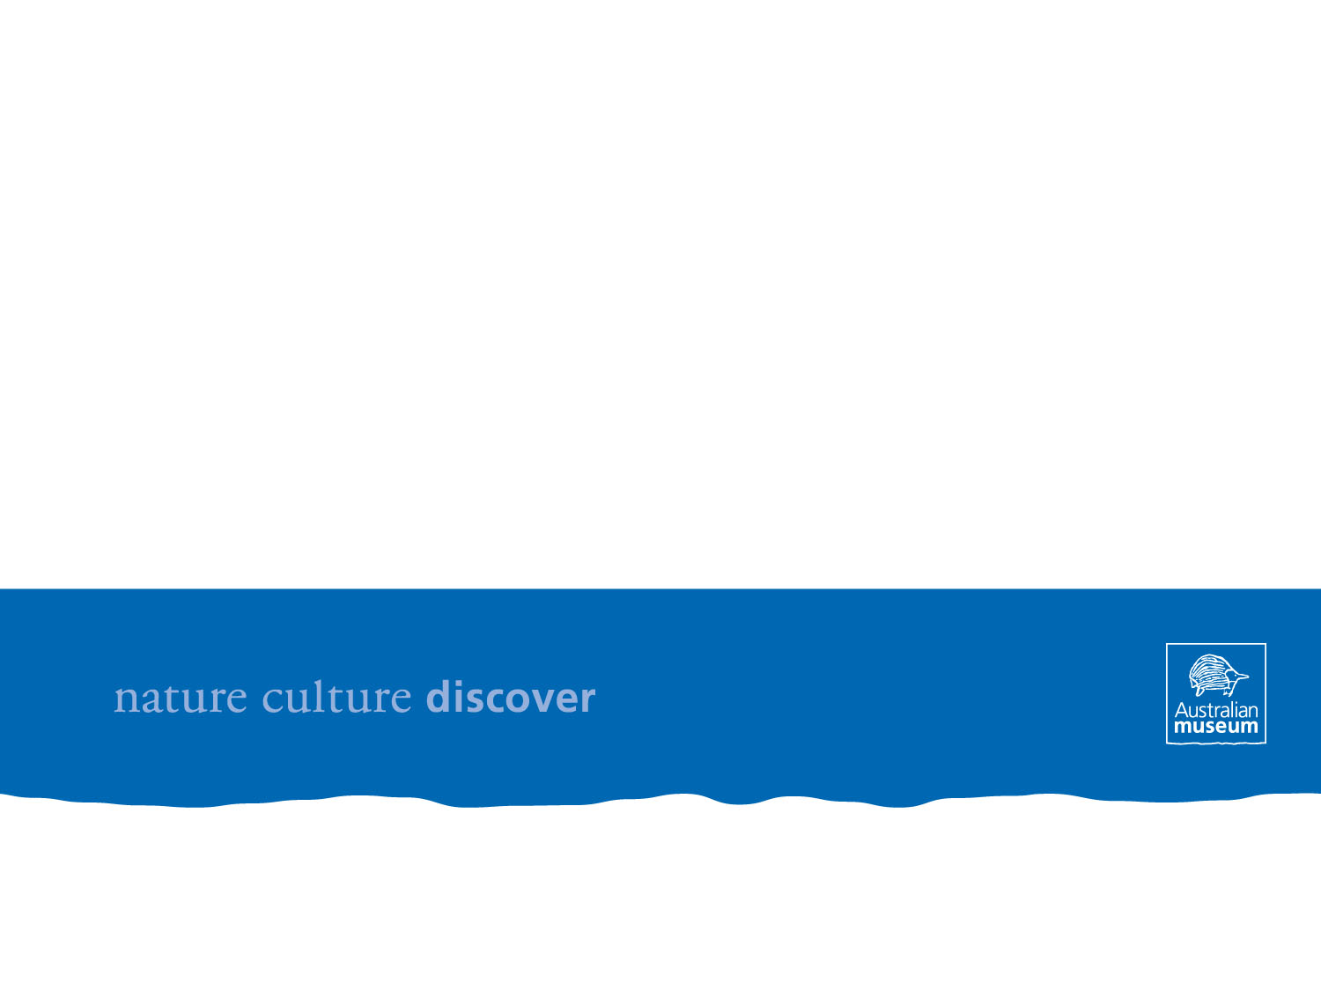

EMu’s in the Cloud - ruminations on interesting interfaces, efficient workflows and building an infrastructure for crowdsourced digitising that is open and integrated
Paul Flemons
September2012

Slide 2

A volunteer based approach to digitisingcollections
A two stage approach that involves the use of onsite volunteers to image specimen labels and online volunteers to trancribe the information on those labels

Slide 3

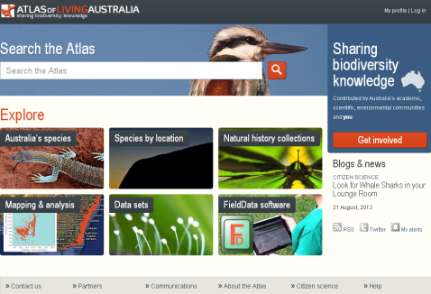
Public Participation in Digitising at the Australian Museum
Stage 1
Image,
species name,
catalogue number
Image,
species name,
catalogue number
Stage 2
Complete record and georeference
Notes:
Stage 1 - onsite capture of images – enables decoupling of transcription from the collections providing greater flexibility in data capture, data validation, collection management – see list of benefits from zootaxa paper
Stage 2 - online transcription of label data into standards compliant Darwin Core fields using customised browser based data entry templates

Slide 4
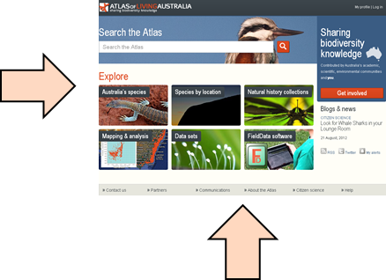
Public Participation in Digitising at the Australian Museum
Stage 1
Image,
species name,
catalogue number
Image,
species name,
catalogue number
Public
Participation
Stage 2
Complete record and georeference

Slide 5
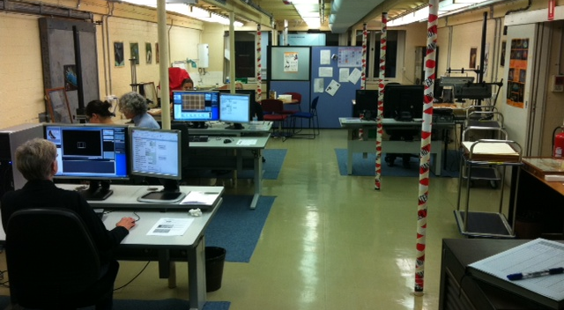
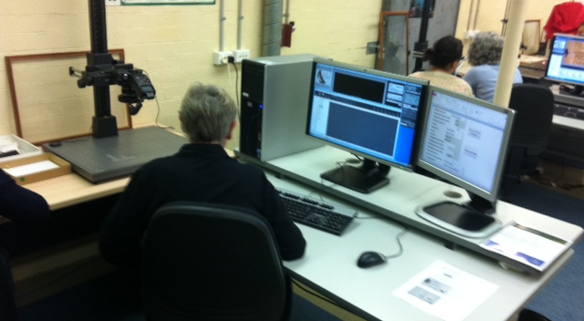

Stage 1 - Image and partial record capture
Notes:
The Australian Museum has been involved with numerous cases of wildlife forensics for almost 10 years now. These cases have predominantly wildlife trafficking cases requiring species identification using DNA.
Australian quarantine laws are extremely strict so it is pertinent that all incoming and outgoing animals be identified to species as accurately as possible. In addition there are severe penalties that can be imposed if perpetrators are found with animal parts prohibited to be traded under Australian legislation (including that involved in enforcing the CITES treaty). For seized animals unable to be identified using traditional taxonomy, such as exotic bird embryos and shark fins, DNA is critical for species identification.
The Australian Museum is extremely fortunate to have millions of natural history specimens along with an extensive frozen tissue collection providing unrivalled reference material. This presentation will describe some case studies of the wildlife trafficking cases that the Australian Museum has been involved in with using DNA-based identification.
The cost of wildlife trafficking cannot be understated. When considering the impact of wildlife trafficking one must consider the cruelty and risk to the individual animals, the risk to the survival of that species, the cost of policing and enforcing border security measures as well as the risk to the unique biodiversity of Australia through potential introduction of exotic species.

Slide 6
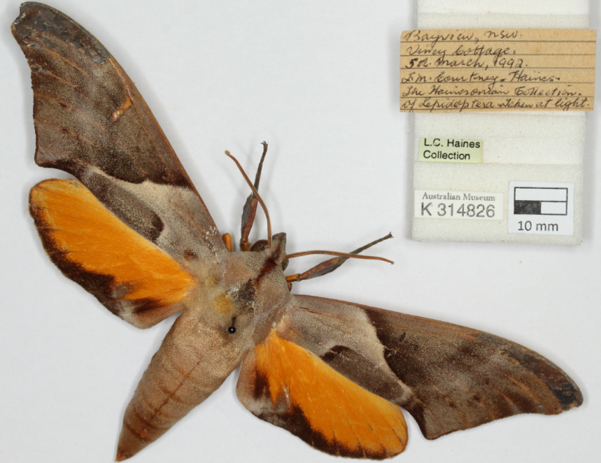
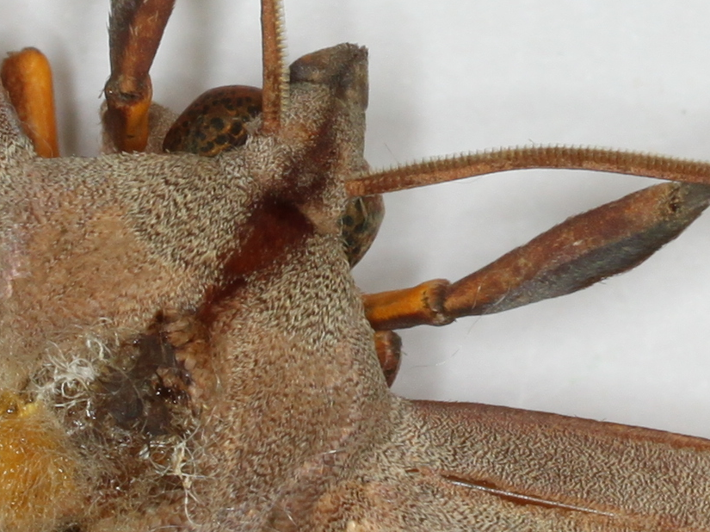

Stage 1 - Image and partial record capture
Notes:
The Australian Museum has been involved with numerous cases of wildlife forensics for almost 10 years now. These cases have predominantly wildlife trafficking cases requiring species identification using DNA.
Australian quarantine laws are extremely strict so it is pertinent that all incoming and outgoing animals be identified to species as accurately as possible. In addition there are severe penalties that can be imposed if perpetrators are found with animal parts prohibited to be traded under Australian legislation (including that involved in enforcing the CITES treaty). For seized animals unable to be identified using traditional taxonomy, such as exotic bird embryos and shark fins, DNA is critical for species identification.
The Australian Museum is extremely fortunate to have millions of natural history specimens along with an extensive frozen tissue collection providing unrivalled reference material. This presentation will describe some case studies of the wildlife trafficking cases that the Australian Museum has been involved in with using DNA-based identification.
The cost of wildlife trafficking cannot be understated. When considering the impact of wildlife trafficking one must consider the cruelty and risk to the individual animals, the risk to the survival of that species, the cost of policing and enforcing border security measures as well as the risk to the unique biodiversity of Australia through potential introduction of exotic species.

Slide 7
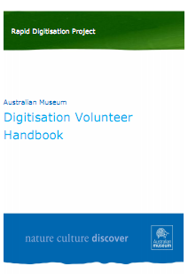
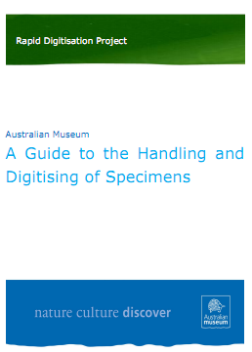
Stage 1 - Image and partial record capture
Documentation
  Website - http://www.australianmuseum.net.au/Rapid-Digitisation-Project
  Manuals
  Videos
  http://www.australianmuseum.net.au/Video-Guide-Handling-Specimens
  http://www.australianmuseum.net.au/Video-Introduction-to-Handling-of-Specimens

Slide 8
Stage 1 - Image and partial record capture
Recruitment
  Through traditional Museum networks
    Members of the Museum society
    Existing Museum volunteers
    website
Training
  Custom designed training course
    Induction
    Training Videos and Manuals
    Hands on training
Coordination and Supervision
  Two part time staff share the tasks of recruiting, training, coordinating and supervising
    Equivalent of 1.2 full time staff
    4 volunteer contact days
    1 non-contact day – specimen preparation, data management and documentation
Notes:
The Australian Museum has been involved with numerous cases of wildlife forensics for almost 10 years now. These cases have predominantly wildlife trafficking cases requiring species identification using DNA.
Australian quarantine laws are extremely strict so it is pertinent that all incoming and outgoing animals be identified to species as accurately as possible. In addition there are severe penalties that can be imposed if perpetrators are found with animal parts prohibited to be traded under Australian legislation (including that involved in enforcing the CITES treaty). For seized animals unable to be identified using traditional taxonomy, such as exotic bird embryos and shark fins, DNA is critical for species identification.
The Australian Museum is extremely fortunate to have millions of natural history specimens along with an extensive frozen tissue collection providing unrivalled reference material. This presentation will describe some case studies of the wildlife trafficking cases that the Australian Museum has been involved in with using DNA-based identification.
The cost of wildlife trafficking cannot be understated. When considering the impact of wildlife trafficking one must consider the cruelty and risk to the individual animals, the risk to the survival of that species, the cost of policing and enforcing border security measures as well as the risk to the unique biodiversity of Australia through potential introduction of exotic species.

Slide 9
Stage 1 - Image and partial record capture
Current Volunteer Team:
  60 – 70 volunteers
  volunteer drop out rate has been minimal with most volunteers committing weekly, some fortnightly
  a 2:1 ratio of female/male volunteers
  age range: a third under 30; a third between 30-49 and a third over 50 yrs.
  university students (10); full time workers (Saturday’s); part time workers and retirees
Input: 1.2 EFT staff
Output: equivalent to around 3 EFT staff
Notes:
The Australian Museum has been involved with numerous cases of wildlife forensics for almost 10 years now. These cases have predominantly wildlife trafficking cases requiring species identification using DNA.
Australian quarantine laws are extremely strict so it is pertinent that all incoming and outgoing animals be identified to species as accurately as possible. In addition there are severe penalties that can be imposed if perpetrators are found with animal parts prohibited to be traded under Australian legislation (including that involved in enforcing the CITES treaty). For seized animals unable to be identified using traditional taxonomy, such as exotic bird embryos and shark fins, DNA is critical for species identification.
The Australian Museum is extremely fortunate to have millions of natural history specimens along with an extensive frozen tissue collection providing unrivalled reference material. This presentation will describe some case studies of the wildlife trafficking cases that the Australian Museum has been involved in with using DNA-based identification.
The cost of wildlife trafficking cannot be understated. When considering the impact of wildlife trafficking one must consider the cruelty and risk to the individual animals, the risk to the survival of that species, the cost of policing and enforcing border security measures as well as the risk to the unique biodiversity of Australia through potential introduction of exotic species.

Slide 10
Stage 2 – Crowdsourced transcription and georeferencing
I have already covered this yesterday
– you know how it works
Notes:
The Australian Museum has been involved with numerous cases of wildlife forensics for almost 10 years now. These cases have predominantly wildlife trafficking cases requiring species identification using DNA.
Australian quarantine laws are extremely strict so it is pertinent that all incoming and outgoing animals be identified to species as accurately as possible. In addition there are severe penalties that can be imposed if perpetrators are found with animal parts prohibited to be traded under Australian legislation (including that involved in enforcing the CITES treaty). For seized animals unable to be identified using traditional taxonomy, such as exotic bird embryos and shark fins, DNA is critical for species identification.
The Australian Museum is extremely fortunate to have millions of natural history specimens along with an extensive frozen tissue collection providing unrivalled reference material. This presentation will describe some case studies of the wildlife trafficking cases that the Australian Museum has been involved in with using DNA-based identification.
The cost of wildlife trafficking cannot be understated. When considering the impact of wildlife trafficking one must consider the cruelty and risk to the individual animals, the risk to the survival of that species, the cost of policing and enforcing border security measures as well as the risk to the unique biodiversity of Australia through potential introduction of exotic species.

Slide 11
So - why this approach
Why not just have a lab full of volunteers enter data from the labels directly into the collection database.?
Practical reasons
  Database permissions for data entry
  Union issues around volunteers doing the work of paid staff – so needed to be something new not already done by staff
Benefits of having images of labels and specimens

Slide 12
Benefits of having images of specimens and their labels
  images are a readily accessible digital voucher of specimen and labels for verifying data
  reduced need for specimen handling
  having a virtual specimen in the event of collection loss or damage (eg fire, flood, earthquake), or when the specimen is on loan
  enabling remote access to original label data for review by researchers
  some limited potential for species identification from an image
  image may be only accessible image of a species
  decouples data entry from the collections enabling options for full data entry by “non-experts” :
    at time of image capture
    through crowdsourcing mechanisms
digitising of collections where specimens are imaged and their associated label data entered as complementary data. Digitising is the new databasing. The advent of this approach has come from the realisation that having an image of the specimen and its associated labels has strong collection data management benefits including:
An readily accessible digital voucher of specimen and labels for verifying data
A reduced need for specimen handling
A virtual specimen in the event of collection loss or damage (eg fire, flood, earthquake), or when the specimen is on loan
Remote access to original label data for review by researchers
Capacity for using handwriting to help identify collector in absence of collector name
Some limited potential for species identification from an image
Enabling the use of “non-experts” in data entry with the benefit of knowing data quality and dubious data can be checked without having to physically visit the specimen in the collection.
Notes:
The advent of this approach has come from the realisation that having an image of the specimen and its associated labels has strong collection data management benefits including:
An readily accessible digital voucher of specimen and labels for verifying data
A reduced need for specimen handling
A virtual specimen in the event of collection loss or damage (eg fire, flood, earthquake), or when the specimen is on loan
Remote access to original label data for review by researchers
Capacity for using handwriting to help identify collector in absence of collector name
Some limited potential for species identification from an image
Enabling the use of “non-experts” in data entry with the benefit of knowing data quality and dubious data can be checked without having to physically visit the specimen in the collection.

Slide 13
Why this approach?
Why not use the 1.2 EFT for digitising directly whether through direct data entry or through imaging then data entry?
Productivity is increased by using the paid staff to supervise volunteers.
By engaging the public in digitisiing our collections we are
    increasing the scientific literacy of the public
    providing increased access to our collections
    building an advocacy network for our collections and our institutions

Slide 14
Lessons learned – DigiVol
Management and Collection staff may be uncomfortable, unsupportive and even hostile initially.
Ideally have the process managed and incorporated into the management structure of the collection being digitised.
Change management process –
  take small steps and address all concerns consistently,
  communicate regularly through face to face meetings,
  be inclusive, particularly in developing training materials and in the training process
Start with those activities that are least controversial (easily handled groups)
  as the relationship grows and staff become more comfortable then begin moving into the more controversial activities eg more fragile groups

Slide 15
Lessons learned : DigiVol
Volunteers can be very dedicated and passionate so it is important to get the balance right between giving the volunteers ownership, a sense of community and that they are involved in something worthwhile and important and maintaining control over the process.
Volunteer engagement and contribution can be improved by building the community sense of the group by:
increasing understanding and appreciation of collections and the associated science through tours of collections and talks by collection staff and scientists.
rewards and tokens of membership – eg tshirts, birthday cards etc (still to be tried)

Slide 16
Lessons learned :
Biodiversity Volunteer Portal
At face value the idea of crowdsourcing the transcription and georeferencing of collections seems fanciful if not downright insane, particularly when considering the mismatch of task and resource:
Task – transcribe and georeference the diversely structured, relatively unstandardised and often unreadable handwritten jargonistic notes of obsessively focused fanatics spanning writing styles and languages of a century or more across geographic entities that undergo regular name changes.
Resource: online volunteers who are not only generally untrained (in matters of collections and taxonomy) and unpaid, but are also anonymous and unaccountable.

Slide 17
Lessons learned :
Biodiversity Volunteer Portal
The key is balance between:
What institutions want:
  accurately digitised records, quickly and efficiently
    access
    auditing
    collection management
  Increased scientific literacy around collections
  Increased general appreciation and support of collections
What volunteers want:
  to be part of a community
  to feel they are contributing, making a difference
  have a project, something to occupy their spare time
  an interesting idea and interface/experience
Notes:
But to build a successful crowdsourcing digitising project we need to get our heads into the crowdsourcers headspace – what is the motivation of those who we want to transcribe our field notes and labels. That needs to be our primary focus in everything we do, because if no one wants to or is able to use our site then no matter how great we think it is or how cool we think our images are it simply wont work. The motivations ive been able to glean from our onsite volunteers, combined with papers and articles on the web has been the basis from which I approached understanding why people will volunteer and how to attract and maintain their involvement.
Having said that whilst striving to meet the needs of our users we also need to ensure the process and outcomes are meeting our goal of efficiently digitising our collections.

Slide 18
Lessons learned :
Biodiversity Volunteer Portal
To achieve this balance :
Engagement through :
Low level gamification aspects such as
    Expedition theme
    Contribution based team roles
    Leader board
  Facebook group
  Regular emails
What we still need:
  FORUM
  Rewards
    Virtual – Badges
    Real – real badges, tshirts, mugs, etc
Notes:
Lots of competition so need to make it interesting , attractive

Slide 19
Lessons learned :
Biodiversity Volunteer Portal
To achieve this balance :
An effective infrastructure and workflow
Ability to :
create and manage own expeditions
incorporate institutional picklists
validate tasks
  grant transcribers validation permissions
manage transcribers through permissions and direct email contact
Notes:
Lots of competition so need to make it interesting , attractive

Slide 20
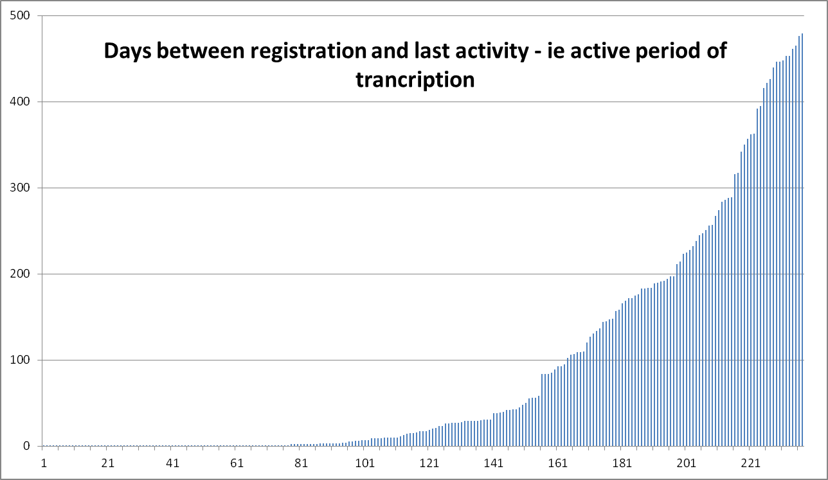
Lessons learned: BVP
How long volunteers hang around
Lessons learned
Motivations
Recruiting and maintaining volunteers
Task surges
Concept development
Rewards
Data management – before/after
Key components – help, tutorials, forum

Slide 21
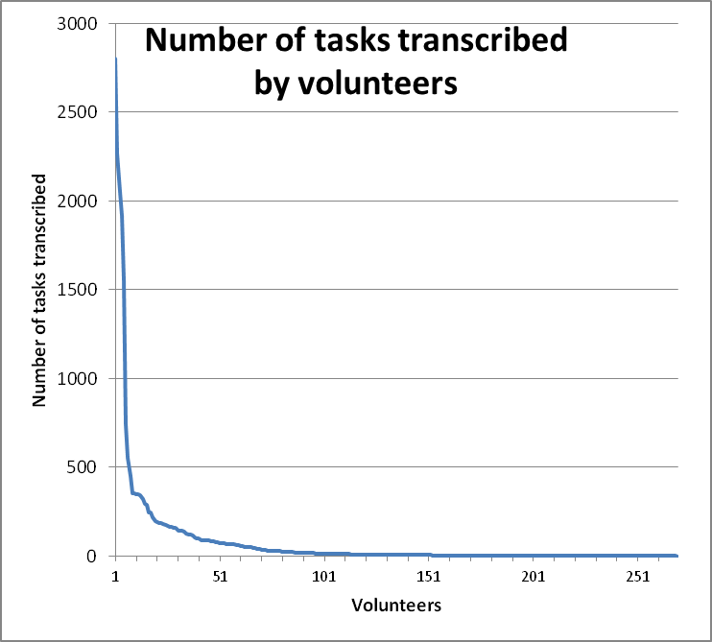
Lessons learned:
Biodiversity Volunteer Portal
No. Volunteers | No. Tasks Completed | Total
57 | 1 | 57
85 | 1-10 | 371
87 | 10-100 | 2994
36 | 100-1000 | 8405
2 | 1000-2000 | 3465
3 | 2000+ | 7116
Small number of volunteers get very involved and become very productive.
Just over half the volunteers who register for transcribing do less than 10 tasks and cease involvement in the first week or so.
The middle group of volunteers contributing between 10 and 1000 tasks is equally as productive overall as the really dedicated ones.

Slide 22
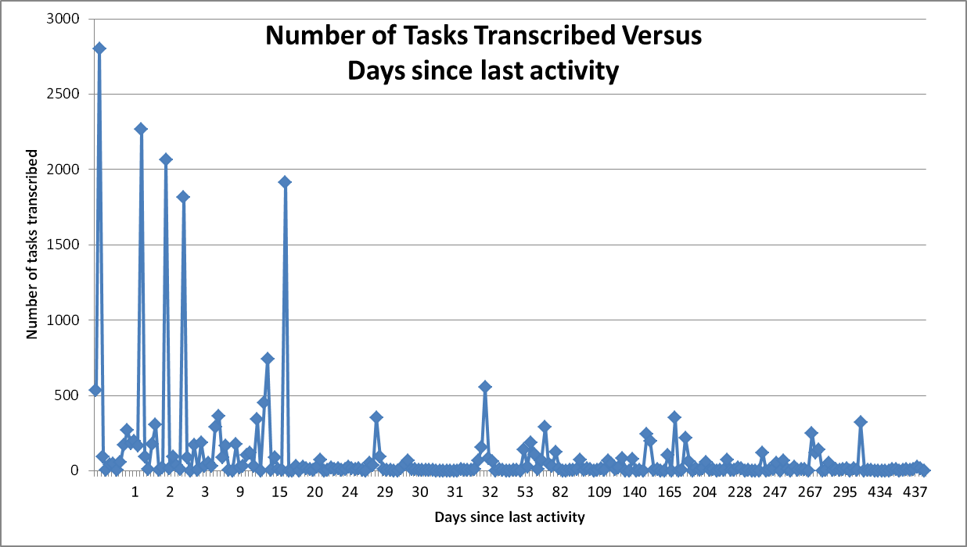
Lessons to be learned:
Biodiversity Volunteer Portal

Slide 23
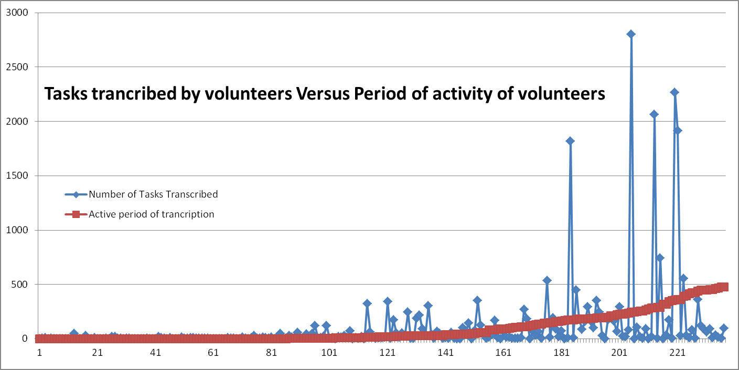
Lessons learned:
BVP – Volunteers activity

Slide 24
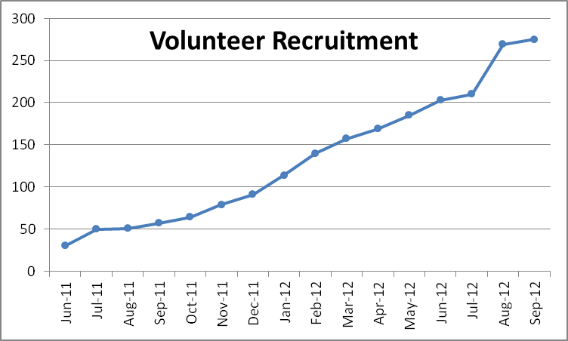
Lessons learned:
Biodiversity Volunteer Portal
Importance of Publicity
Startup and ongoing
AM Members and volunteers
ALA Blog post
Email mailing lists – entomological society
Special events
Scott Sisters exhibition at Museum plus field notes expedition
Media release corresponding with WhaleShark expeditions

Slide 25
Lessons learned:
Biodiversity Volunteer Portal
Productivity enhancement
The power of a challenge
Four WhaleShark expeditions – total of 2658 tasks
Exp 1 550 records 55 vol
Exp 2 572 records 19 vol
Exp 3 750 records 25 vol
Exp 4 786 records 25 vol
27 days 2058 records done – average of 76 a day
Challenge issued : to finish within 10 days
All remaining 600 tasks completed within 2 days – average 300 per day
Acceleration of 400%

Slide 26
Lessons learned :
BVP - Volunteers
Lesson learned:
The importance of interaction and sense of community cannot be underestimated:
As the project has progressed a small number of volunteers have become very active, with regular email contact
  helping with design of new templates and GUI improvements
  helping with testing new functionality
  validating
Some volunteers crossover between onsite and online volunteers – originally thought they would be totally separate.Eg Jim Richardson starting out as an onsite volunteer , becoming very involved now comes in as an onsite volunteer and provides a lot of feedback , and also validates.
We need to do more to encourage this sense of community – a forum is essential and long overdue.
Notes:
Tho they are online they still want, probably more than ever, to feel they are making a difference, that they are involved in something a little bit special and are part of a community. They want to have some idea of what the benefit of what they are doing is.

Slide 27
Lessons learned :
BVP - Volunteers
Lessons learned:
Volunteers don’t tolerate errors or bugs for very long particularly if their hard work is lost because of them – eg the field notes simultaneous task transcription where two people were transcribing the same task and one lost all of their text. Also time out bug that saw people lose all their field note text.
Solution: very important to respond to emails and fix bugs as a matter of urgency to ensure volunteers do not become disenchanted.
Notes:
Tho they are online they still want, probably more than ever, to feel they are making a difference, that they are involved in something a little bit special and are part of a community. They want to have some idea of what the benefit of what they are doing is.

Slide 28
Number of Transcribers per Expedition

Slide 29
Lessons learned: BVP
Infrastructure
Lesson learned: The aim of the site is to make it possible for any institution to create their own expeditions on the site. However every collection we have encountered so far, including specimens, field notes, and field logs has required a different set of data capture fields. This means we have had to develop a new template GUI when creating an expedition for a new collection.
Using the Darwin Core fields means we have a standard data schema to map all expeditions to however the configuration of the template GUI for each expedition requires the involvement of a programmer. This is a significant limiting factor in creation of new expeditions.
Solution: no easy solution as having a flexible completely configurable template creation tool is not trivial. We have avoided creating one due to the complexities of the various data entry fields required and the need for dynamic GUI creation.
For now the only viable solution is to create GUI templates as we go and for new expeditions try to use an existing template.

Slide 30
Lessons learned: BVP
Data quality
Lesson learned: transcribers are very good at simple transcribing as long as the words they are transcribing are recognisable to them. They struggle with scientific names, some collectors names and localities that they are not familiar with.
Solution: where possible provide picklists of scientific names, collectors and localities they are likely to encounter. The best way of doing this is by exporting such lists from your collection management database and using that as a picklist in the template for those fields that suit. So far two institutions have used picklists for collectors and localities in templates – the Australian Museum and the Australian National Insect Collection.

Slide 31
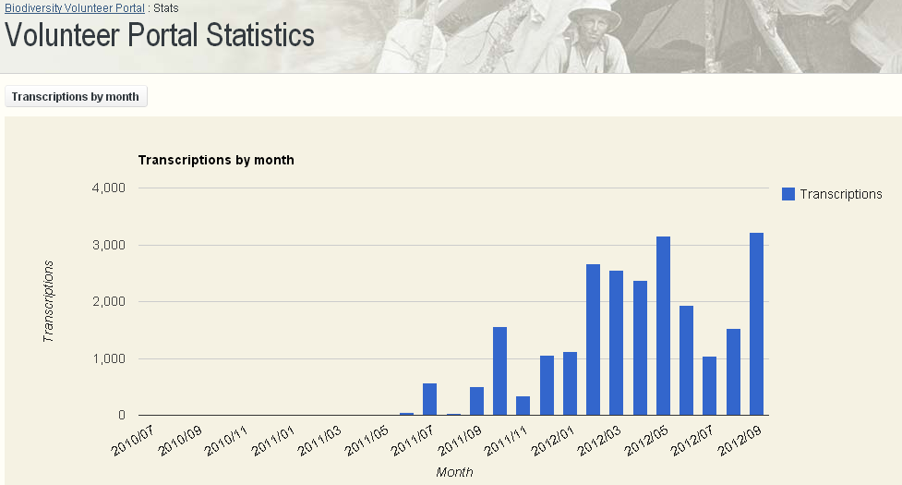
Atlas of Living Australia Biodiversity Volunteer Portal
Notes:
This graph illustrates the number of tasks completed per month.
The variability in tasks completed is likely to be a combination of a number of factors the most dominant one being the introduction of field notes in May 2012. Field note tasks taking considerably longer than the label tasks.
Other influential factors might include the number of volunteers, the number of hours they were spending transcribing, the variety and size of available expeditions and even the arrival of specific highly productive volunteers.

Slide 32
Lessons learned: Data quality
Lesson learned: georeferencing is a far greater challenge than simple transcription.
Volunteers vary in their understanding of the concept of georeferencing and therefore in their ability to georeference consistently accurately. Regardless of how good a volunteer (or anyone for that matter) is at georeferencing when the same place name is georeferenced by different people it is highly likely that the result will be different (except in the simplest cases).

Slide 33
Lessons learned: Data quality
Possible Solutions: there are at least three possible solutions to this problem :
don’t let volunteers georeference
provide a basic georeference tool – as we did with our first labels transcription template and accept that you will get a bit of noise in terms of your lat longs which can be cleaned up fairly efficiently using tools such as Google Refine
build more complex tools for users to select an existing collection event (combination of collector, date and locality) or locality where one exists that matches those on the label

Slide 34
Lessons learned: Data quality
Possible Solutions (Contd):
separate out the georeferencing from the transcriptions
  Build a separate workflow
    Extract transcribed locality text
    Merge duplicates and different versions of same location
    Provide an online tool that
      Users georeference locations one by one
      Users validate batch referenced locations
Bottom line: we cant make a silk purse out of a sows ear – ie label information, particularly historic labels are often very limited in the information they hold and how it was arrived at – extra effort may not result in better outcomes.

Slide 35
Concluding thoughts
Success has been remarkable given the limited marketing and the lack of tangible rewards
The commitment of a few can achieve a lot
Sense of meaning, achievement and community is crucial to ongoing success of crowdsourcing
Crowdsourcing takes time – it doesn’t happen overnight
Crowdsourcing will have ceilings which we will need to be creative and energetic if we hope to break through them

Slide 36
Thank you
www.australianmuseum.net.au

