Slide 1
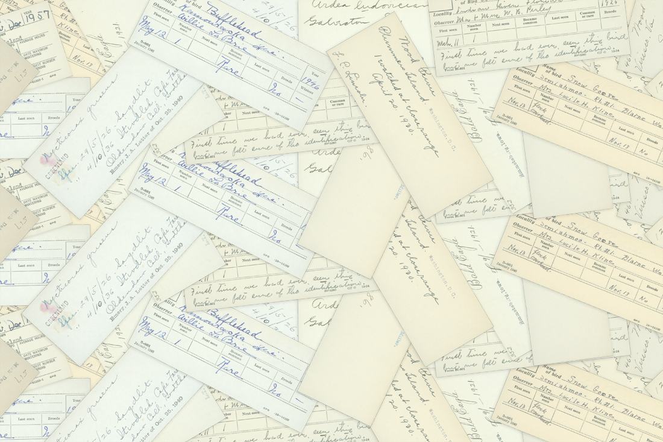
North American Bird Phenology Program (BPP):
Reviving a Historic Program in the Digital Era
www.pwrc.usgs.gov/bpp/
Presentation by Jessica Zelt, Kevin Laurent, and Sam Droege

Slide 2
Presentation Summary
Program History
Coordinators and Observers
Revival of Program
Transcription Screen and Process
Matching aka “Validate-o-Rama”
Who volunteers with us and why?
Future goals and applications

Slide 3
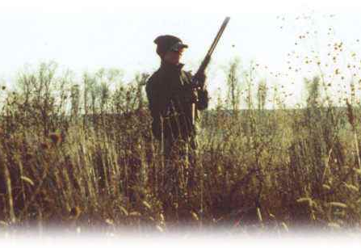
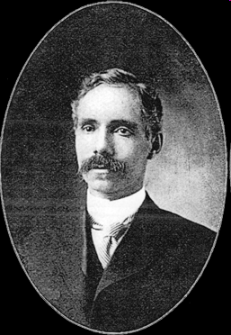
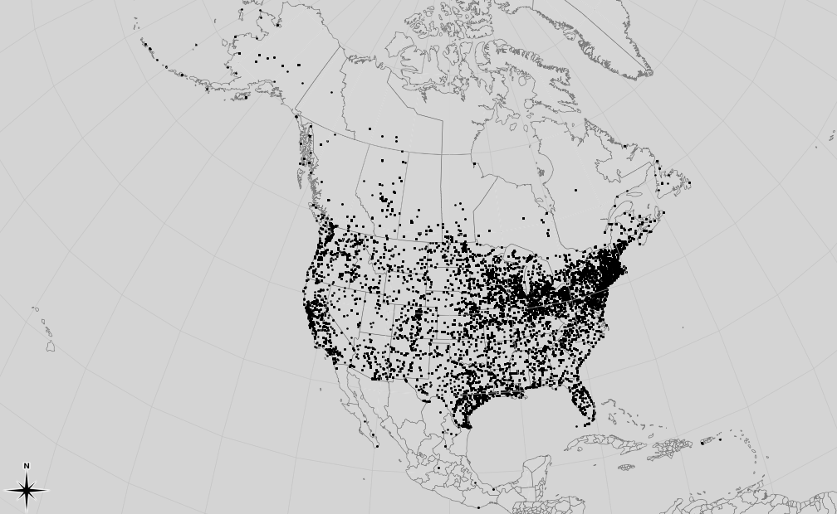
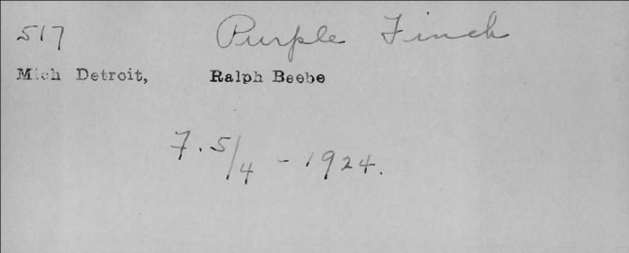
Wells W. Cooke and the start of the program
Wells W. Cooke, teacher in Indian Schools in the Mississippi Valley, took interest in studying bird migration
1881: First two years of his study he was receiving correspondence from about 20 observers
1883: The American Ornithologist Union (AOU) was founded, took interest in Cooke’s research
1884: The task of collecting and cataloging the amount of information had outgrown the capabilities and funding of the AOU.
Merriam drafted a memo to Congress asking for the appropriation of funds and the creation of The Division of Economic Ornithology.
As Chief of the Division of Economic Ornithology Merriam increased number of participation to ~3,000 observers.
Wells Woodbridge Cooke (1858-1916)
Notes:
Wells W. Cooke was an ordinary citizen interested in bird migration.
His interest started like many young boys of his time with the purchase of his first gun. With this tool he was able to start collecting specimens from his community and was fascinated by the different species he saw.
In 1881 he asked some of his friends and colleagues to start observing and documenting bird migration arrival and departure dates of birds seen around their homes.
That expanded in 1883 with the growth of the AOU who took interest in his program, sponsoring it and increasing the number of participants tremendously.
After the Division of Economic Ornithology was created by Congress, the program was moved and again expanded to over 3,000 participants.

Slide 4
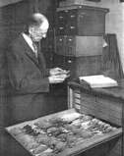
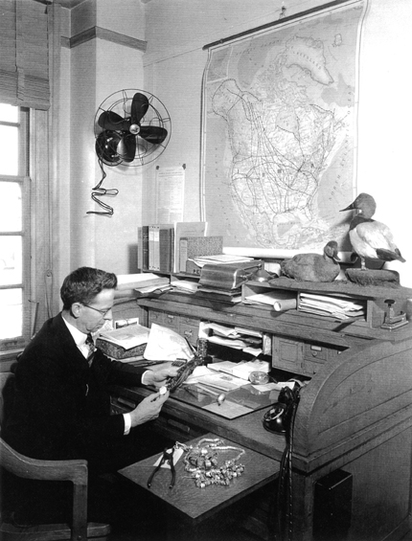
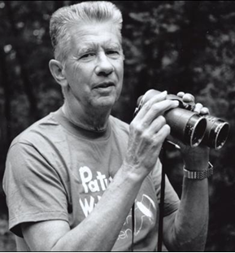
Program Coordinators
Wells W. Cooke started the project while a teacher at an Indian School in the Mississippi Valley
After Cooke’s death the program was supervised by the likes of Edward A. Goldman, Edward W. Nelson, Harry C. Oberholser, and May Thatcher Cooke (Wells’ daughter).
Fred Lincoln contributed greatly to running the project while simultaneously running the North American Bird Banding Lab.
Chandler Robbins closed the program in 1970, in part, to focus on the North American Breeding Bird Survey.
Wells W. Cooke H.C. Oberholser Fred Lincoln Chandler Robbins

Slide 5
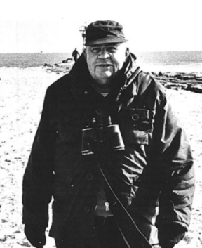
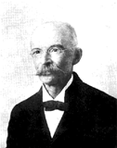
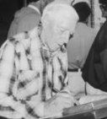
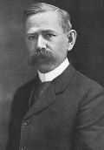
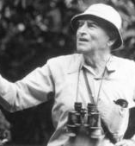
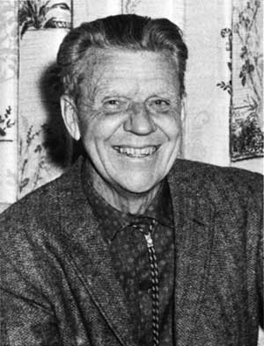
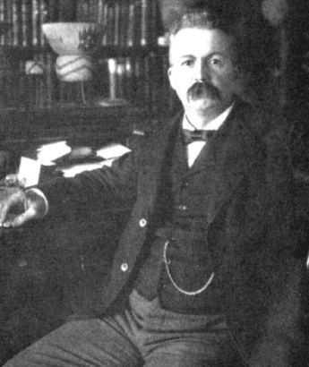
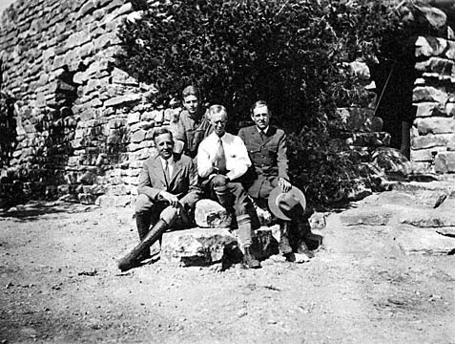
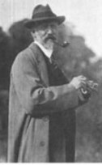
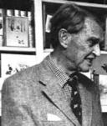
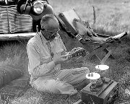
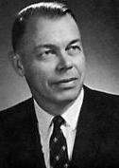
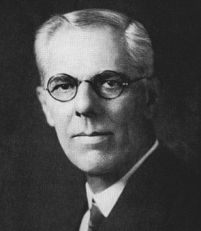
Bird Phenology Program Observers
Over the 90 year span in which records were actively collected, the collectors and original observers who recorded the bird migration cards comprised of notable naturalists, researchers and high ranking biologists within Fish and Wildlife Service and the Bureau of Biological Survey.
Ira N. Gabrielson
John Walter Hoxie
Winton Wedemeyer
Edgar Mearns
Alexander Skutch
Olaus J. Murie
C. Hart Merriam
Vernon Bailey
P. A. Taverner
James Bond
Aldo Leopold
Lawrence Walkinshaw
H.C. Oberholser
A.H. Howell
Notes:
Ira N. Gabrielson
Founder and president of the World Wildlife Fund
Founded the International Union for the Conservation
of Nature and Natural Resources
Established Patuxent Wildlife Research Center
Olaus J. Murie
Wildlife Biologist for the Bureau of Biological Survey
President of the Wilderness Society (1945)
Helped establish ANWR
Vernon Bailey
Founder and president of the American Society of Mammalogists
C. Hart Merriam
First Chief of the Division of Economic Ornithology and Mammology (1886)
One of the original founders of the National Geographic Society (1888)
Aldo Leopold
Wrote Sand County Almanac
Changed the way we view the world through helping to develop environmental ethics.
Founded the science of wildlife management with emphasis on biodiversity and ecology
A.H. Howell
Senior biologist for US Fish
and Wildlife
Fellow of the A.O.U.

Slide 6
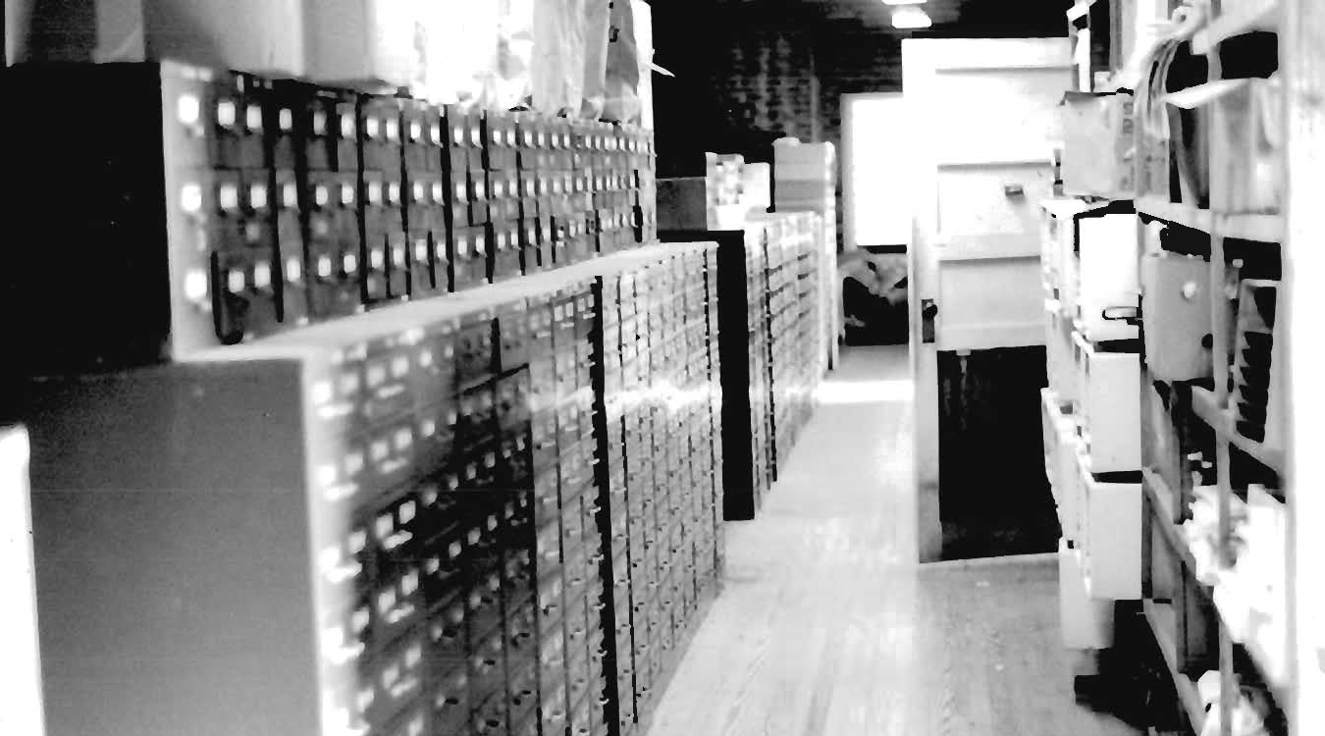
The 52 filing cabinets were put into attics, basements, and
off-site storage facilities for 40 years

Slide 7
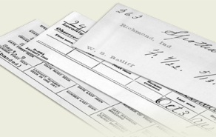
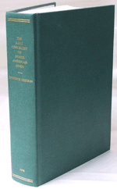
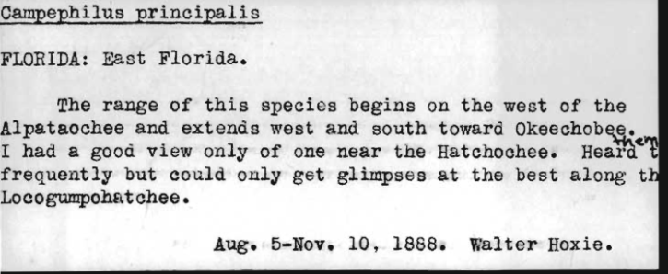
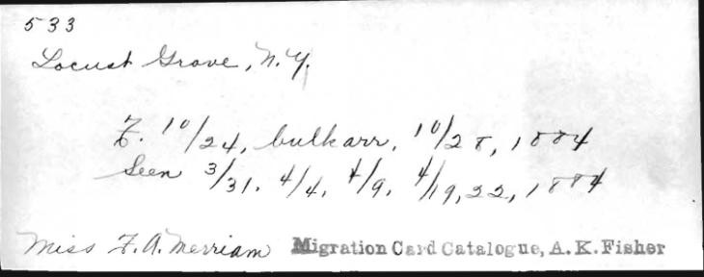
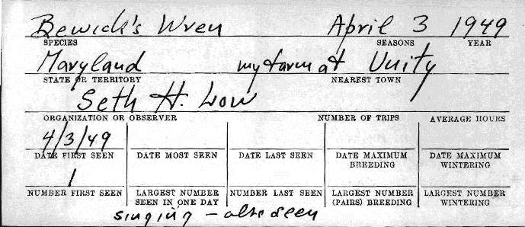
The program came to a close in 1970
Over the 90 year span 6 million records were collected
Database of the time- all of what was known about bird migration
Contained original records, publications, breeding and nest records, field reports….etc.
Contained records of extinct species, exotic species, and rare records.
Used to create the AOU Checklist of North American Birds and first field guides
House Sparrows introduced to U.S. in 1851
Ivory billed Woodpecker critically endangered or extinct
Bewick’s Wren now extirpated breeder from MD
Notes:
Since the original observers have passed away we do not need to worry about PII.

Slide 8
In 2009, Sam Droege and John Sauer received funding to
hire a coordinator and a few scanners to revive the program
Notes:
(2009) Year 1– Scanning, establishing office volunteer network to come into the office 6 days/week
(2010) Year 2- Launched website, developed online volunteer network to transcribe records
(2011) Year 3- Redid website and transcription screen with feedback
(2012) Year 4- Created the Matching system which will soon run automatically
Where did funding come from?
NOAA- Climate Data Modernization Program
USFWS
GIO Data Rescue Program
NE REX flex funds
Various USGS, BRD programs (Status and Trends, Office of Chief Scientist, NPN)

Slide 9
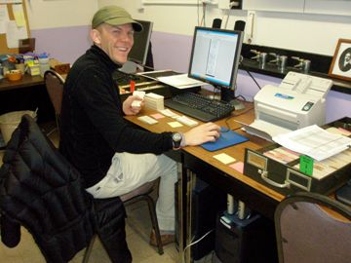
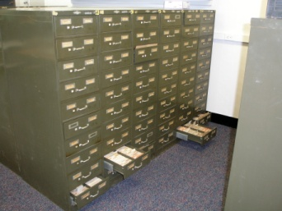
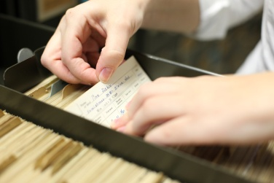
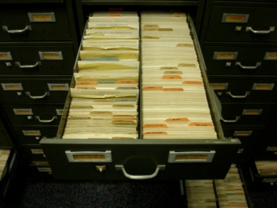
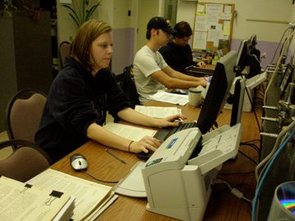
Program Goals
Curate, organize and prioritize 6 million data records for N. America, 1880-1970
Scan and key standard cards with quality assurance
Create a digital format for a dataset
Grow and manage a network of volunteers worldwide to transcribe historical biological data online.
Create automated system for transcription verification
Make data easily accessible for policy makers, the public and researchers.
Create template for digitizing legacy data that can be replicated and applied to other data sets
.
Notes:
How did USGS approve the program?
Had a permissive management who supported for expansion and new ideas

Slide 10
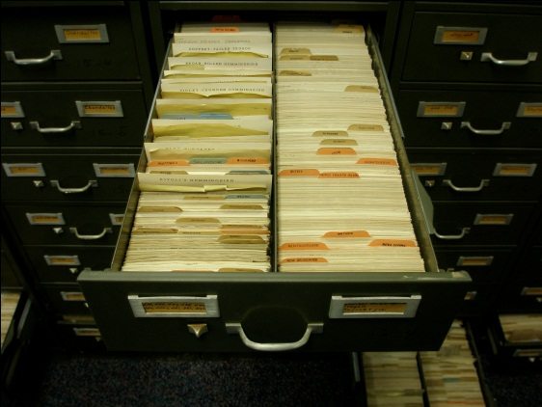
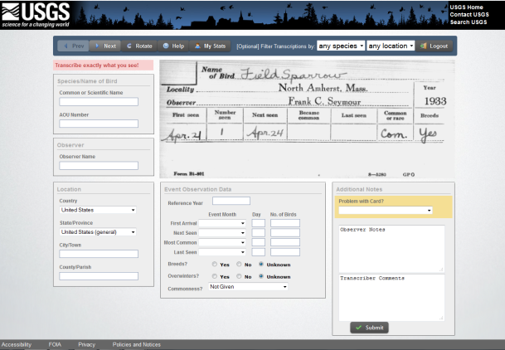
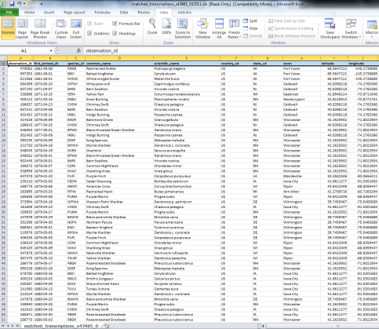
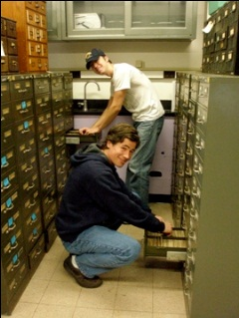
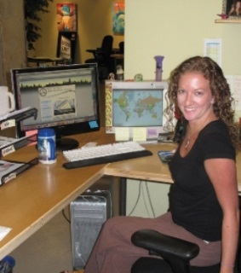
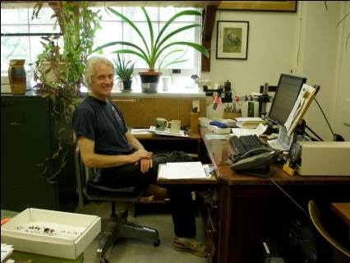
www.pwrc.usgs.gov/bpp/
Notes:
Scanning Cards, Uploading Cards and Adding to Database---
Cards scanned as PDF using Adobe Acrobat Pro.
Cards converted from PDF to png and split into separate files using custom scripts using Ghostscript.
Using Visual Basic, tab delimited files for the cards were built (Using folders created for png files, file names were created using tab delimited text file with different columns we want in database, ie., pathname, date, species, location- country and state).
Images uploaded to development server.
Run sql script using generated metadata from the tab delimited file and special format file written in xml. Goes through 3 scripts (species, country codes, state codes) to validate them. This is so that before it gets to users it has correct info in database. so its checking the 3 fields against database to “validate it” Once validated its inserted to observation table.

Slide 11
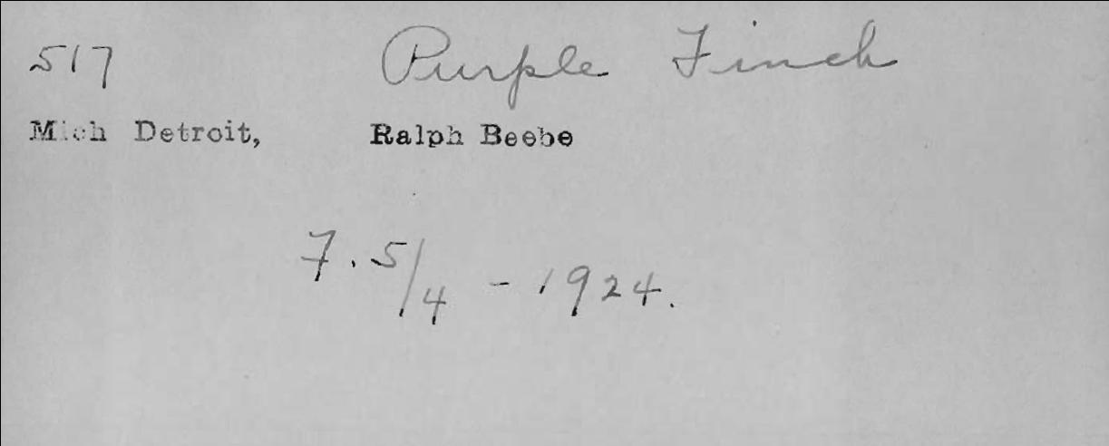
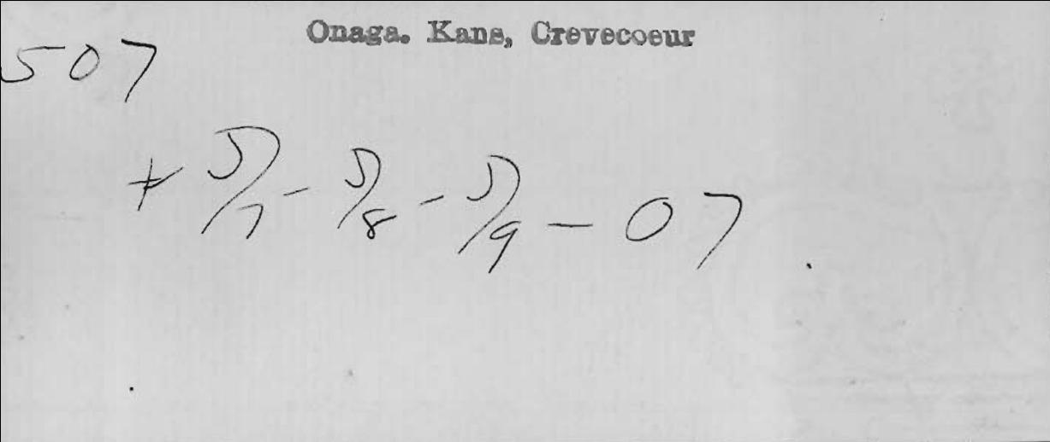
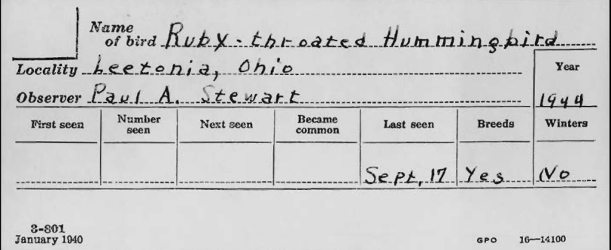
Typical Cards
Location where the observation was made
Species Name
Observer Name
Year
Does it winter in the area?
On which dates was it observed? (First, Next, Became Common, Last)
Does it breed in the area?

Slide 12
BPP Transcription Screen for Data Entry
https://www.pwrc.usgs.gov/BPP/v4/
Notes:
Security–
Password is encrypted and sent over channel that is encrypted from when its generated to when its sent into database All secure pages in https PHP used on transcription screen which is a server side scripting language to generate a page and control the user doing the transcription.
User asks for a page, php page (contains information from database which gets reformulated) what comes out is html page which goes to user. 1. acts as middleman between database and user. also aids in security barrier for users who might try to get to data in database for nefarious purposes.
2. not only to take data, but to input data.
3. creates a session id as security so third party cant disrupt connection or access data

Slide 13
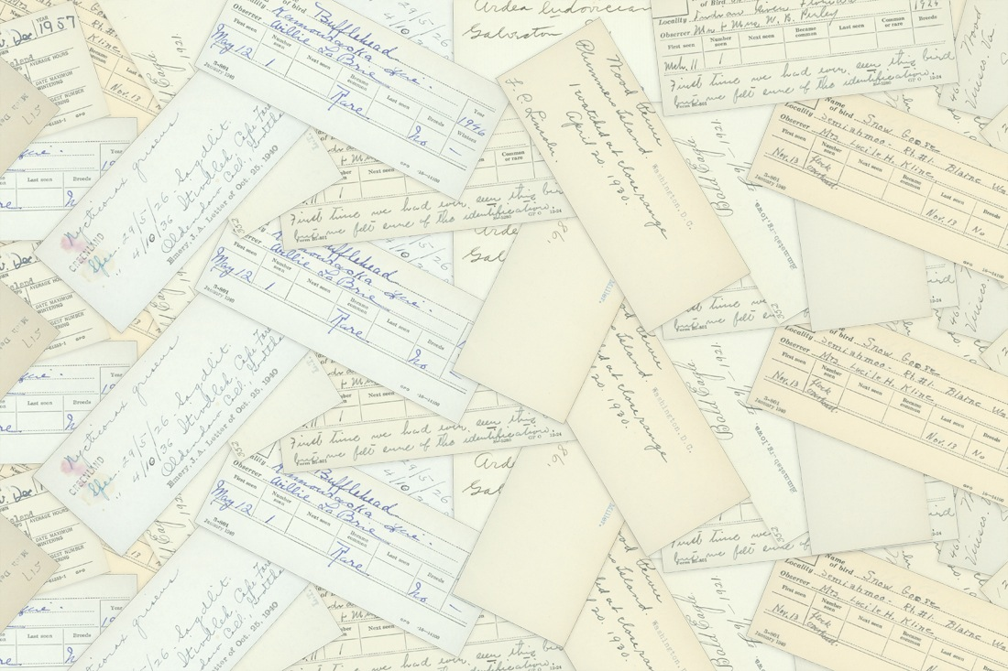
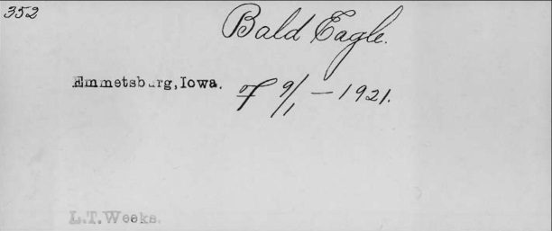
Transcription 1: Transcriber A
Transcription 2: Transcriber B
Match
No Match
Data from one transcription
goes into observation table
Transcription 3: Transcriber C
Match
No Match
Data from one transcription
goes into observation table
Record sent to
“rectification system”
Data from one transcription
goes into observation table
Notes:
VALIDATE-O-RAMA!!
All created in php to connect to the database

Slide 14
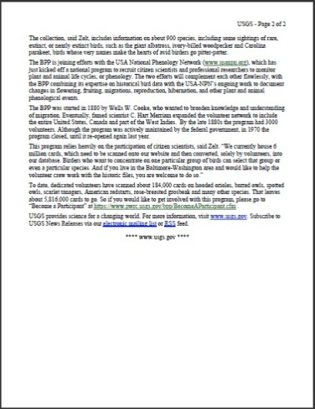
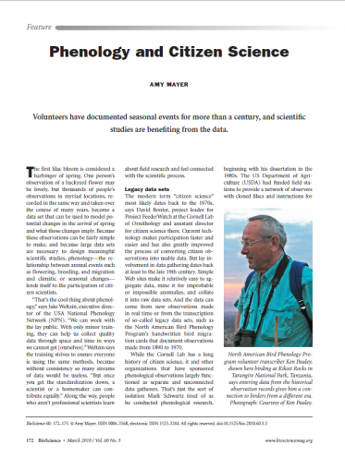
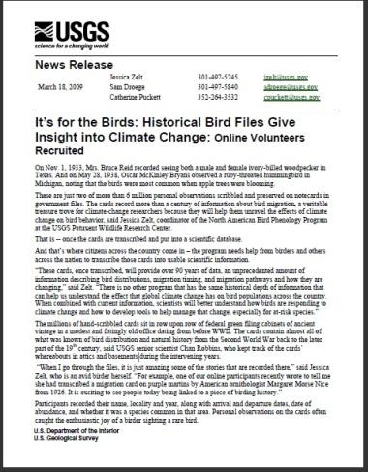
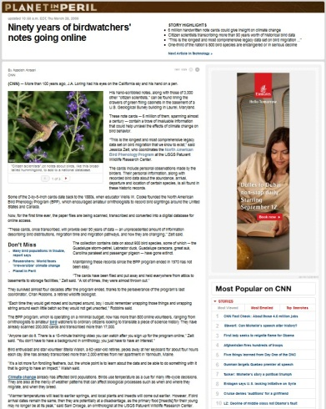
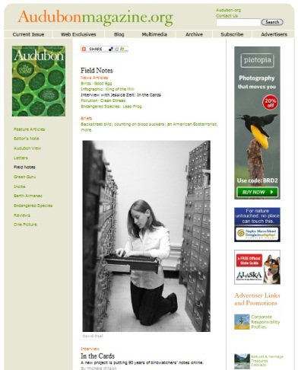
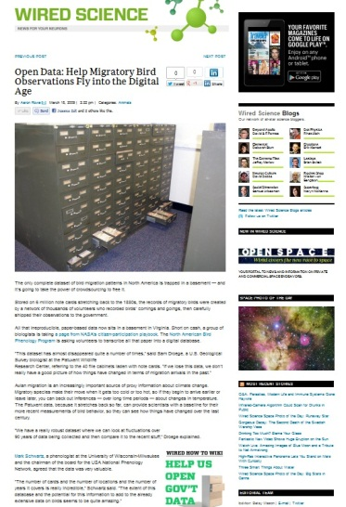
Volunteer Recruitment
On March 18, 2009, the BPP put out a press release to announce the program
ClimateWatch Magazine
Watching Birds, Tracking Climate
Audubon Naturalist News
Measuring Springtime
BioScience
Phenology and Citizen Science
Audubon Magazine
In the Cards
TC Palm
Bird records may provide insight into global warming
South Coast Today
Flight plans: Historic records to shed light on global warming, migration
Wildbirds Broadcasting
Online Entry to Improve Input of Historic Bird Phenology Details
CNN.com
Ninety years of birdwatchers' notes going online
Wired.com
Open Data: Help Migratory Bird Observations Fly into the Digital Age
ABC 7 News: San Francisco
Bird-watching helps fight global warming
ABC 7 News: Washington DC
What can old bird sightings reveal about climate change?
The Take Away
Saving history: The biologist who protected six million bird-watching notecards
The Take Away
Birding gets a digital upgrade

Slide 15
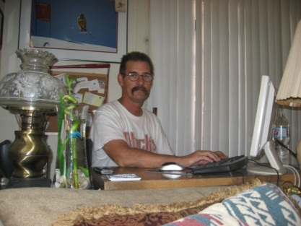
BPP records transcribed online by a worldwide network of
over 2,700 volunteers from…
United States
Canada
Turkey
Philippines
Nigeria
Japan
Ireland
Belgium
France
Germany
India
Romania
Iran
Australia
Notes:
Over 2,500 volunteers worldwide sign into the BPP data entry page and submit transcriptions of records.
Goals
Engage public in digitizing phenological dataset and through informal science program
Create an opportunity to involve citizens in a scientific research and educate the public about how the data is used
Enhance opportunities for the public to interact with research scientists.
Policy (PII, all historic observers so no worries, handles for current users)

Slide 16
Volunteer Retention
Let volunteers choose their own level of involvement
Establish a community by supporting interaction between volunteers
Give volunteers a reason to donate their time
Allow the volunteers to feel needed- without them we could not accomplish what we do!
Keep the lines of communication open with volunteers and identify any potential problems
Create a survey examining each volunteer's level of satisfaction within the project/program
Allow volunteers to contribute suggestions and improvements at anytime
Recognized each volunteer through for his/her work
Notes:
Key Points:
Let volunteers choose their own level of involvement (how much time they give, and what they transcribe/filters)
Create way for volunteers to communicate with each other– establish a community– Newsletters, My Stats, Volunteer competitions (charts, trivia), Social Media (Facebook), notable cards, and featured photos
Give volunteers a reason to donate their time (contributing to a greater good, connection to history or family, volunteer service hours, resume builder)
Allow the volunteers to feel needed– without them we could not accomplish what we do!
Keep the lines of communication open with volunteers and identify any potential problems and allow the volunteers to contribute ideas at any time – Newsletters, Contact Coordinator
Create a survey examining each volunteer's level of satisfaction within the organization.
Recognized each volunteer through for his/her work--prizes, thank you letters, certificates, newsletter recognition
Newsletters
Accessibility to program coordinator
Track volunteer transcription progress
Volunteer competitions
Tokens of appreciation for various achievements, Volunteer Certificates
Social Media- Facebook
Volunteer satisfaction surveys
Featured Photos, Notable Cards, Observer List

Slide 17
Current Count:
Cards
Total cards scanned: 1,042,494
Cards transcribed online: 669,070
Participants
Participants transcribing cards online: 2,700

Slide 18
160,000 Records Will Soon Be Available for Download
www.pwrc.usgs.gov/bpp/

Slide 19
Publications from BPP Data
Zelt, J., J. Courter, A. Arab, R. Johnson, and S. Droege, Accepted April 26, 2012. Reviving a Legacy Citizen Science Project to Illuminate Shifts in Bird Phenology. International Journal of Zoology.
Courter, J., R. Johnson, W. Bridges, K. Hubbard. Submitted March 30, 2012. Assessing Migration of Ruby-Throated Hummingbirds at Broad Spatial and Temporal Scales. The Auk.
Courter, J., R. Johnson, C. Stuyck, B. Lang, E. Kaiser. Submitted May 1,2012. Weekend Bias in Citizen Science Data Reporting: Implications for Phenological Studies. International Journal of Biometeorology
Droege, Sam. 2003. Spring Arrivals of Maryland and Washington D.C. Birds. Maryland Birdlife, Volume 59. No 1-2.

Slide 20
Future Applications
Create a front end for collecting migration records or merge with existing program
Make dataset accessible to scientists, managers, and other stakeholders interested in
exploring patterns and trends in phenology and climate across space and time
Make dataset available through other database repositories thereby integrating dataset with other physical and climatological datasets.
Repurposing crowdsourcing system for museum collections, citizen scientists, and other large datasets

Slide 21
For more information or to contribute or participate in this project, please contact:
Jessica Zelt
United States Geological Survey
Patuxent Wildlife Research Center
12100 Beech Forest Rd
Laurel, MD 20708-4083 USA
Phone: 301-497-5745
Email: jzelt@usgs.gov

