Slide 1
Public Participation in Digitization of Biodiversity Specimens Workshop
Digitization and Democracy
Bill Watson
September 29, 2012
Notes:
Thank you for the invitation to be here with you today. I’m sorry I missed what looked like and sounds like a fantastic first day.
I am Bill Watson, Chief of Learning Experiences and Evaluation at NMNH. I head up a team that imagines, develops, and delivers learning experiences – everything from lectures and demonstrations to intensive summer research internships for high school students to open collections exploration and theme-based hands-on, immersive explorations of scientists’ fieldwork and research.
In reflecting on what I might say here to add substantively to the conversation today, it occurred to me that:
Half of the people in the room today know far more about digitization than I do;
And the other half knows more about public participation in scientific endeavors than I do
So it’s my hope that I might offer some perspectives to help turn the conversation toward the word “public” and away a little from “digitization”.

Slide 2
We have a daunting number of specimens, data, and other assets – existing and not-yet-collected – to digitize. We need help.
Notes:
From what I can observe (not having been here…), this seems to be an important, driving question for this work and really for this group being here this weekend.

Slide 3
We have millions of people hungry for relevant, exciting, and meaningful experiences, and our main assets – our collections and data – mostly lie dormant for public engagement.
Notes:
I would like to propose that the flip side of that question is equally important and presents incredible opportunities for engaging people in digitizization and advancing science literacy and collections-based education at the same time.
Think about this statement for a moment. When was the last time you were in a natural history museum? While you were there, did you see any digitization work? For that matter, did you see much, if any, collections work? Most of us leave the collections and research behind the scenes, with public spaces mostly being about telling static stories with objects or some kind of “touching objects will make people love them” activities.
I say these things because I see them in my own museum every day.
But people want more.

Slide 4
What NMNH Visitors Want
Relevant
Authentic
Personalized
Immersive
One-of-a-Kind
“Awesome”
Notes:
People are looking for a new kind of experience.
At NMNH, we conducted a study of 125 groups visiting our museum and other museums in Washington, and this is what they told us they wanted.
Think about collections work and even especially collections digitization work. Does it meet these criteria? I think it does.

Slide 5
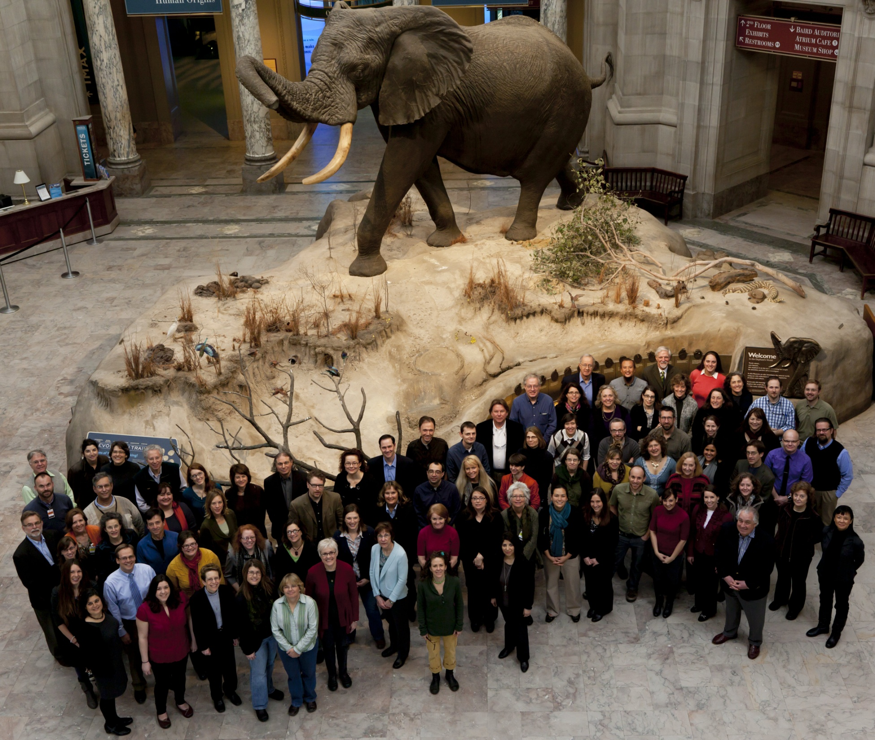
Notes:
At NMNH, we wanted to do something about this, in general, for the natural history museum field, and in fact for all learning in natural history settings, so this includes zoos, aquariums, nature centers, and I would even say universities with collections.
We were funded by NSF to hold a conference to explore these ideas in greater detail, so in February 2012 we convened 100 scientists, collections managers, educators, exhibits professionals, learning researchers, evaluators, and administrators to start to think through the biggest questions we have about how to link our publics with our assets in the 21st Century needs, and how we might go about designing programs to try to answer those questions.

Slide 6
21st Century Learning in NHM
NHM have unparalleled records of the natural world
We use them in very, very limited ways in our science education and literacy efforts
We can’t do our work without inviting the public to be a part of the action
Notes:
This was the thesis for our conference.
Focus on the last bullet:
“Our work” is documenting the world and doing research on that documentation. This is enabled by digital records.
“Our work” is also, in essence, changing the world. We have incredible platforms to get people excited about science, to understand it, and to take action in the world.

Slide 7
New Possibilities
Public use of digitized collections
Public participation in digitizing collections
Notes:
For our purposes today, I want to focus on what it means to be “part of the action”.
What I’m really talking about is part of the excitement, the passion, the urgency that most of the people in this room probably feel about documenting biodiversity, taking action to address biodiversity loss and climate change, and any number of topics that each lab is doing that are relevant, important, and need public support, understanding, and engagement.
Digitization of collections is in a lot of ways a lynchpin for inviting people to be a part of the action, and I think it’s worth exploring two aspects of what that means:
Public use of digitized collections
Public participation in digitizing collections

Slide 8
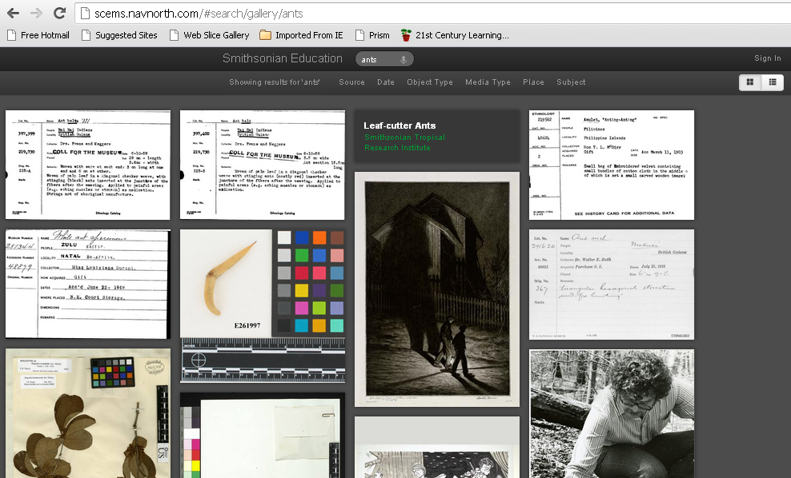
Notes:
Here is the first example of some of the work being conducted at the Smithsonian that starts to hint at public participation in digitization – the public use of collections side.
Created by teachers
A way to bring together pieces of the 137 million objects on a topic that you can use – in this case just to find them
Requires teachers to tell you what they need (curation?) and it requires extensive tagging of the assets you have.
Note here that this includes object records, exhibitions, articles, film, photos, exhibit descriptions, lesson plans – the gamut of digital resources.

Slide 9
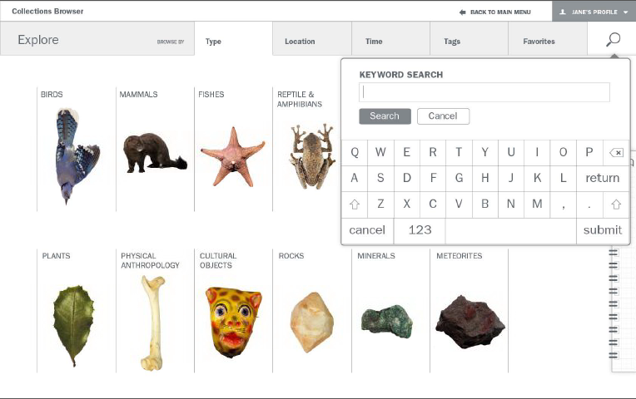
Notes:
Here’s another example from NMNH.
Here, we’re providing users with a user interface to find collections more easily (just objects here). We’re starting with our 20,000 education collection to see if we can find a way to make the records useful to the visitors.
Objects are searchable by name, tag, geographic region, and other ways.

Slide 10
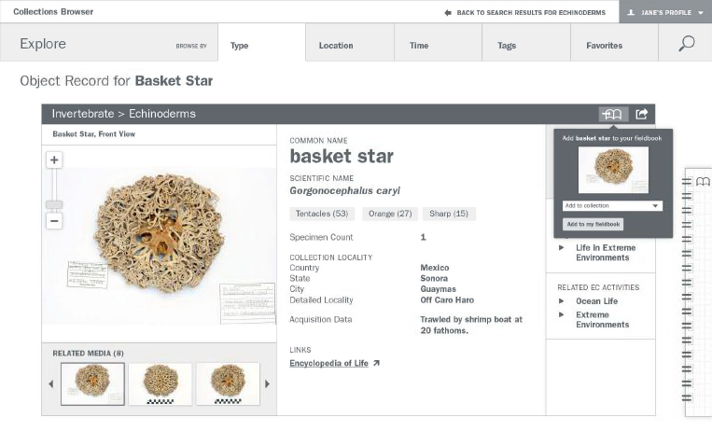
Notes:
Here’s an object record, but notice on the side that we’re providing some things to do with the object – embedded online activities to learn more about what we can learn from it.

Slide 11
Digital Support– Access and Use
Notes:
And finally, a set of digital tools with which you can start collecting your own resources for your own research projects.

Slide 12
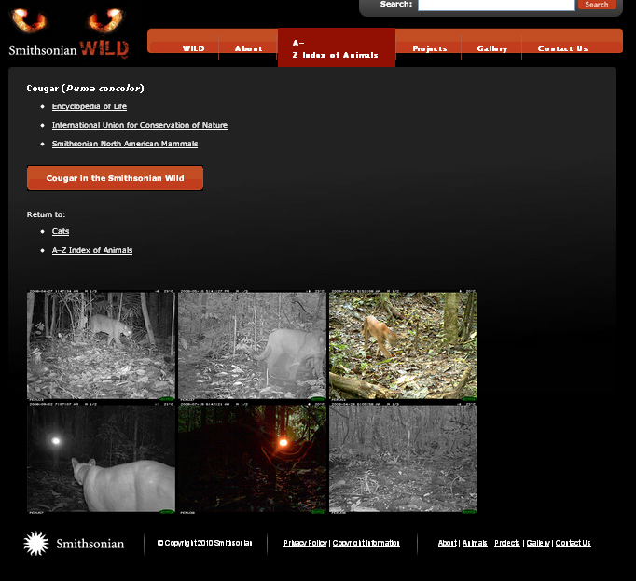
Notes:
And as a final example, this is a camera-trapping PPSR project called Smithsonian Wild.
These assets become a part of SI research, so here you have the public contributing directly to the collections – new objects that are immediately digital.

Slide 13
Check-point: Are these Public Participation in Digitizing Collections?
“Digitization…creates the potential for people the world over to add impressions, associations, and stories to the permanent record.”
- SI Digitization Strategic Plan
Notes:
I argue that they are. Any time you have people adding to the permanent record, it’s PPSR. And these are highly engaging projects, and people are very invested in them in two cases (and in the third, we hope they are).

Slide 14
A Conservative Model
Digitized Collections
Science Literacy
Notes:
So far, this is the road we’ve been on in the last few minutes. It’s a road in the same town as getting the public engaged in actual digitization, but it’s probably not what’s expected.
I do want to underscore the need to think broadly, here, though – what counts as digital data for public use. It’s often different than what counts for scholarship.
And remembering the impetus to do something for which the 21st Century public is hungry, doing things that allow them some level of contribution and control to use digitized objects and specimens for their own use is extremely important, and even groundbreaking, especially for natural history museums and other collections/specimen-based enterprises.
People want to do more than just see what we’ve done. They want to be a part of the action.

Slide 15
The Daring Model
Collections
Public Participation in Scientific Research
Digitization
Notes:
The road we want to go down, though, I think is the more exciting one, not only because it addresses a concern about getting things digitized, but also because it’s almost completely unprecedented.
Here we can see a model that has potential PPSR projects in collections. So think of things like identifying and accessioning objects, or pinning beetles.

Slide 16
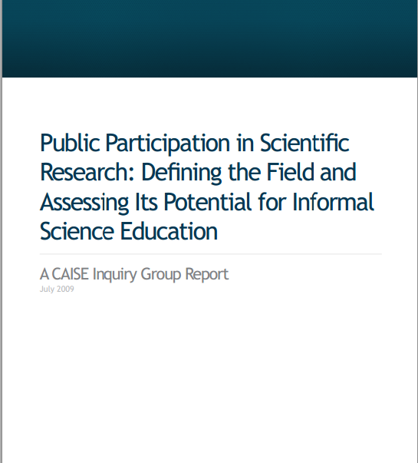
Impact of PPSR
Public Participation in Scientific Research
Meta-analysis of 10 PPSR projects
Summary of impact and recommendations
Notes:
These projects could have a huge impact.
In 2009, the Center for the Advancement of Informal Science Education published this guide.

Slide 17
PPSR Types
Contributory
Collaborative
Co-Created
Notes:
Contributory projects, which are generally designed by scientists and for which members of the public primarily contribute data
Collaborative projects, which are generally designed by scientists and for which members of the public contribute data but also may help to refine project design, analyze data, or disseminate findings
Co-created projects, which are designed by scientists and members of the public working together and for which at least some of the public participants are actively involved in most or all steps of the scientific process.

Slide 18
Impacts
Awareness, Knowledge, Understanding
All PPSR projects contribute
Knowledge of research design and data interpretation
Ask and answer their own questions

Slide 19
Impacts
Engagement and Interest
“…PPSR is one of the most expedient means for engaging people in science in a fun way”
Helps people see that their interests connect to science and science connects to their interest

Slide 20
Impacts
Skills
Identify organisms, use measurement instruments, collect data
Reading and interpreting graphs

Slide 21
Impacts
Behaviors
Improving habitats
Noticing invasives
Political action

Slide 22
Lessons
Best PPSR projects are those that are relevant to the participants
Not a single PPSR project reviewed was collections-based
Need for:
New models
New audiences

Slide 23
Collections-based projects are the perfect entry-level PPSR for NHM
Digitization projects are the perfect entry-level collections-based projects
Notes:
All of this boils down to our thesis for the presentation.

Slide 24
Audience – untapped resources and new audiences for the field
Tech geeks
Photographers
Statisticians
Who else?

Slide 25
Models – untapped potential for unique, fun, huge, meaningful work
Connect collections to real problems
Connect digitization to those problems
Digitization for democracy – creates the groundwork for participation

Slide 26
We have millions of people hungry for relevant, exciting, and meaningful experiences, and our main assets – our collections and data – mostly lie dormant for public engagement.
Notes:
So this morning, I hope to stimulate our day’s work by making three points:
1) Natural history museums have only scratched the surface of using their assets for the public good
2) Public Digitization projects are groundbreaking for public engagement in natural history museums’ work
3) The payoff of new models is not only faster digitization, but also a more engaged public

