Slide 1
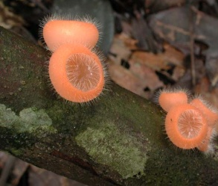
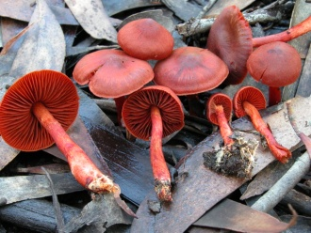
The Macrofungi Collections Consortium TCN and North American Mycophiles: Enhancing a Long-Standing Relationship
Notes:
For this project we have fomed an alliance of essentially all of the herbaria that document the history of research on macrofungi over the past 150 years to digitize these specimens and make the data available for scientific research and human benefit.

Slide 2
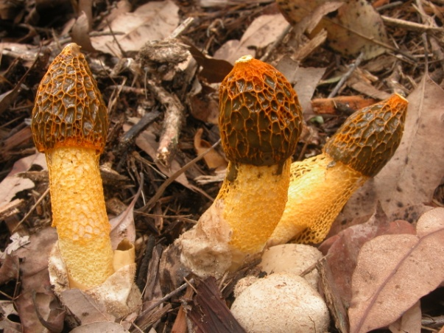
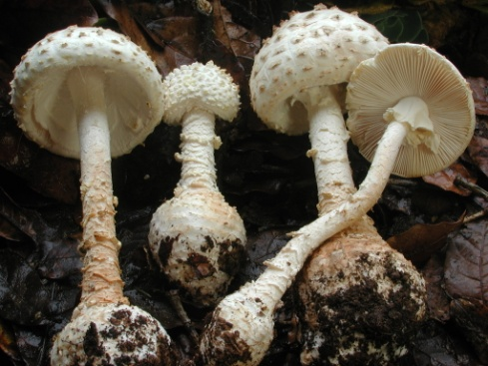
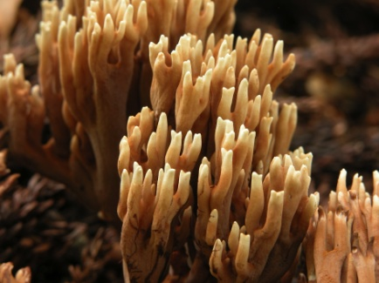
Goal of the Macrofungi Collections Consortium
To build an enduring alliance of the U.S. herbaria whose collections document the past 150 years of research on macrofungi that will digitize and share specimen data in support of a wide range of scientific and educational objectives

Slide 3
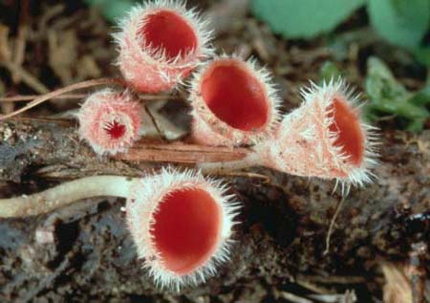
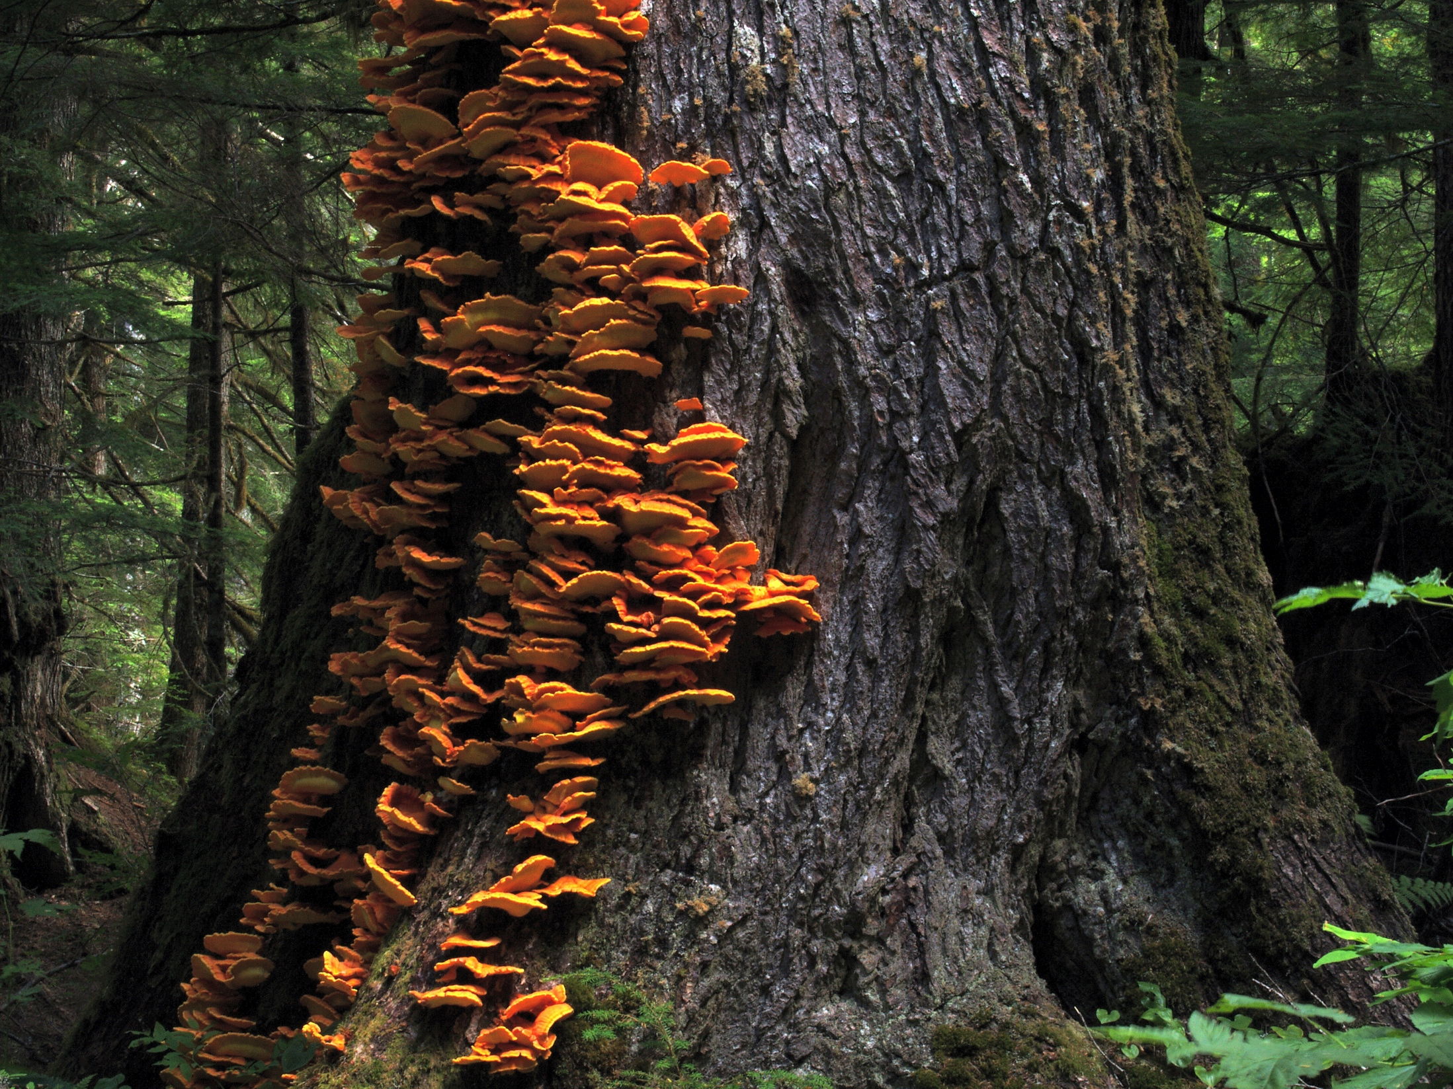
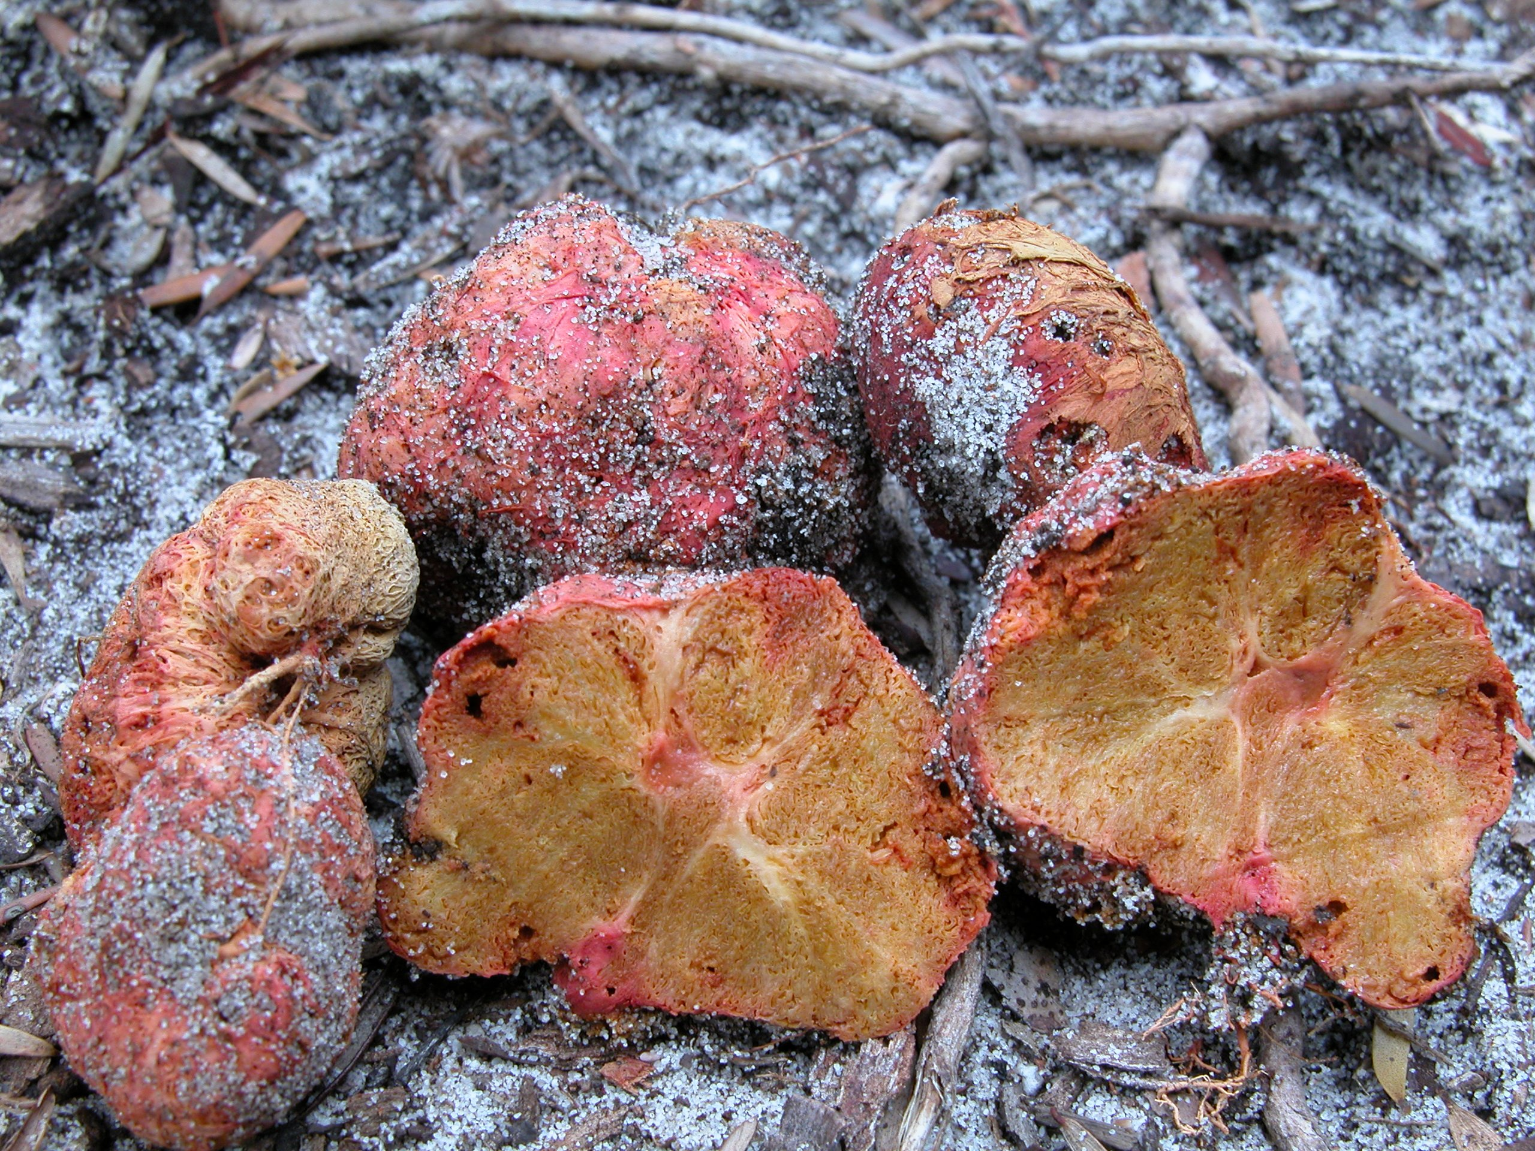
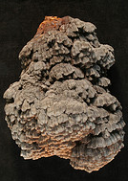
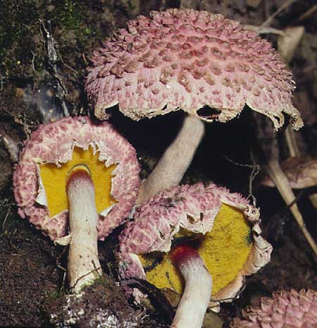
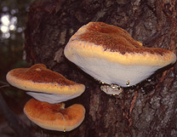
What are Macrofungi?
Notes:
Phylogenetically heterogeneous assemblage (includes both Agaricomycetes and Ascomycetes)
Produce a conspicuous spore-bearing body that is “fleshy” or “woody” in consistency
Play a key role in plant and animal life and the global carbon cycle. The group includes:
Ectomycorrhizal fungi
forest pathogens, wood-decay fungi
invertebrate predators such as nematode trapping fungi.
Food source for many animals, including humans
Incubation sites for many arthropod groups.

Slide 4
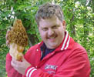
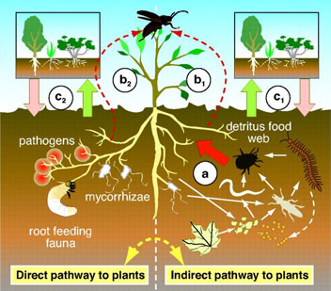
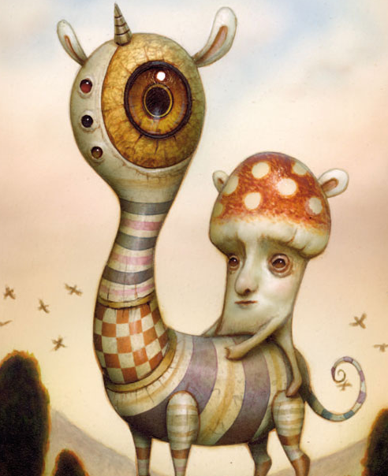
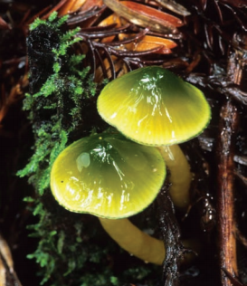
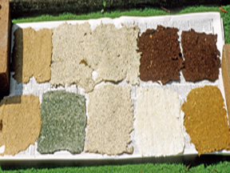
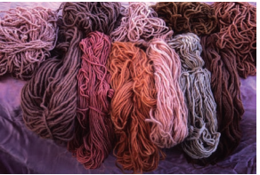
Why we care about Macrofungi
Food
Pharmaceuticals
Recreation
Forest health
Bioremediation
Crafts
Beauty

Slide 5
The Consortium of Collections Institutions: 35 institutions, including 3 botanical gardens, two natural history museums, and 31 universities from 24 states

Slide 6
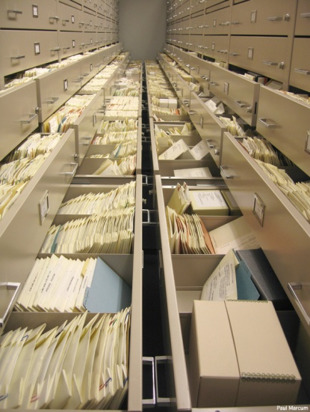
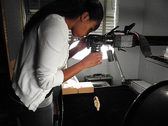
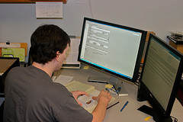
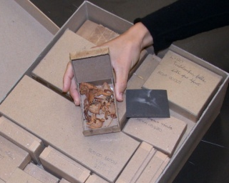
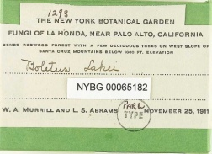
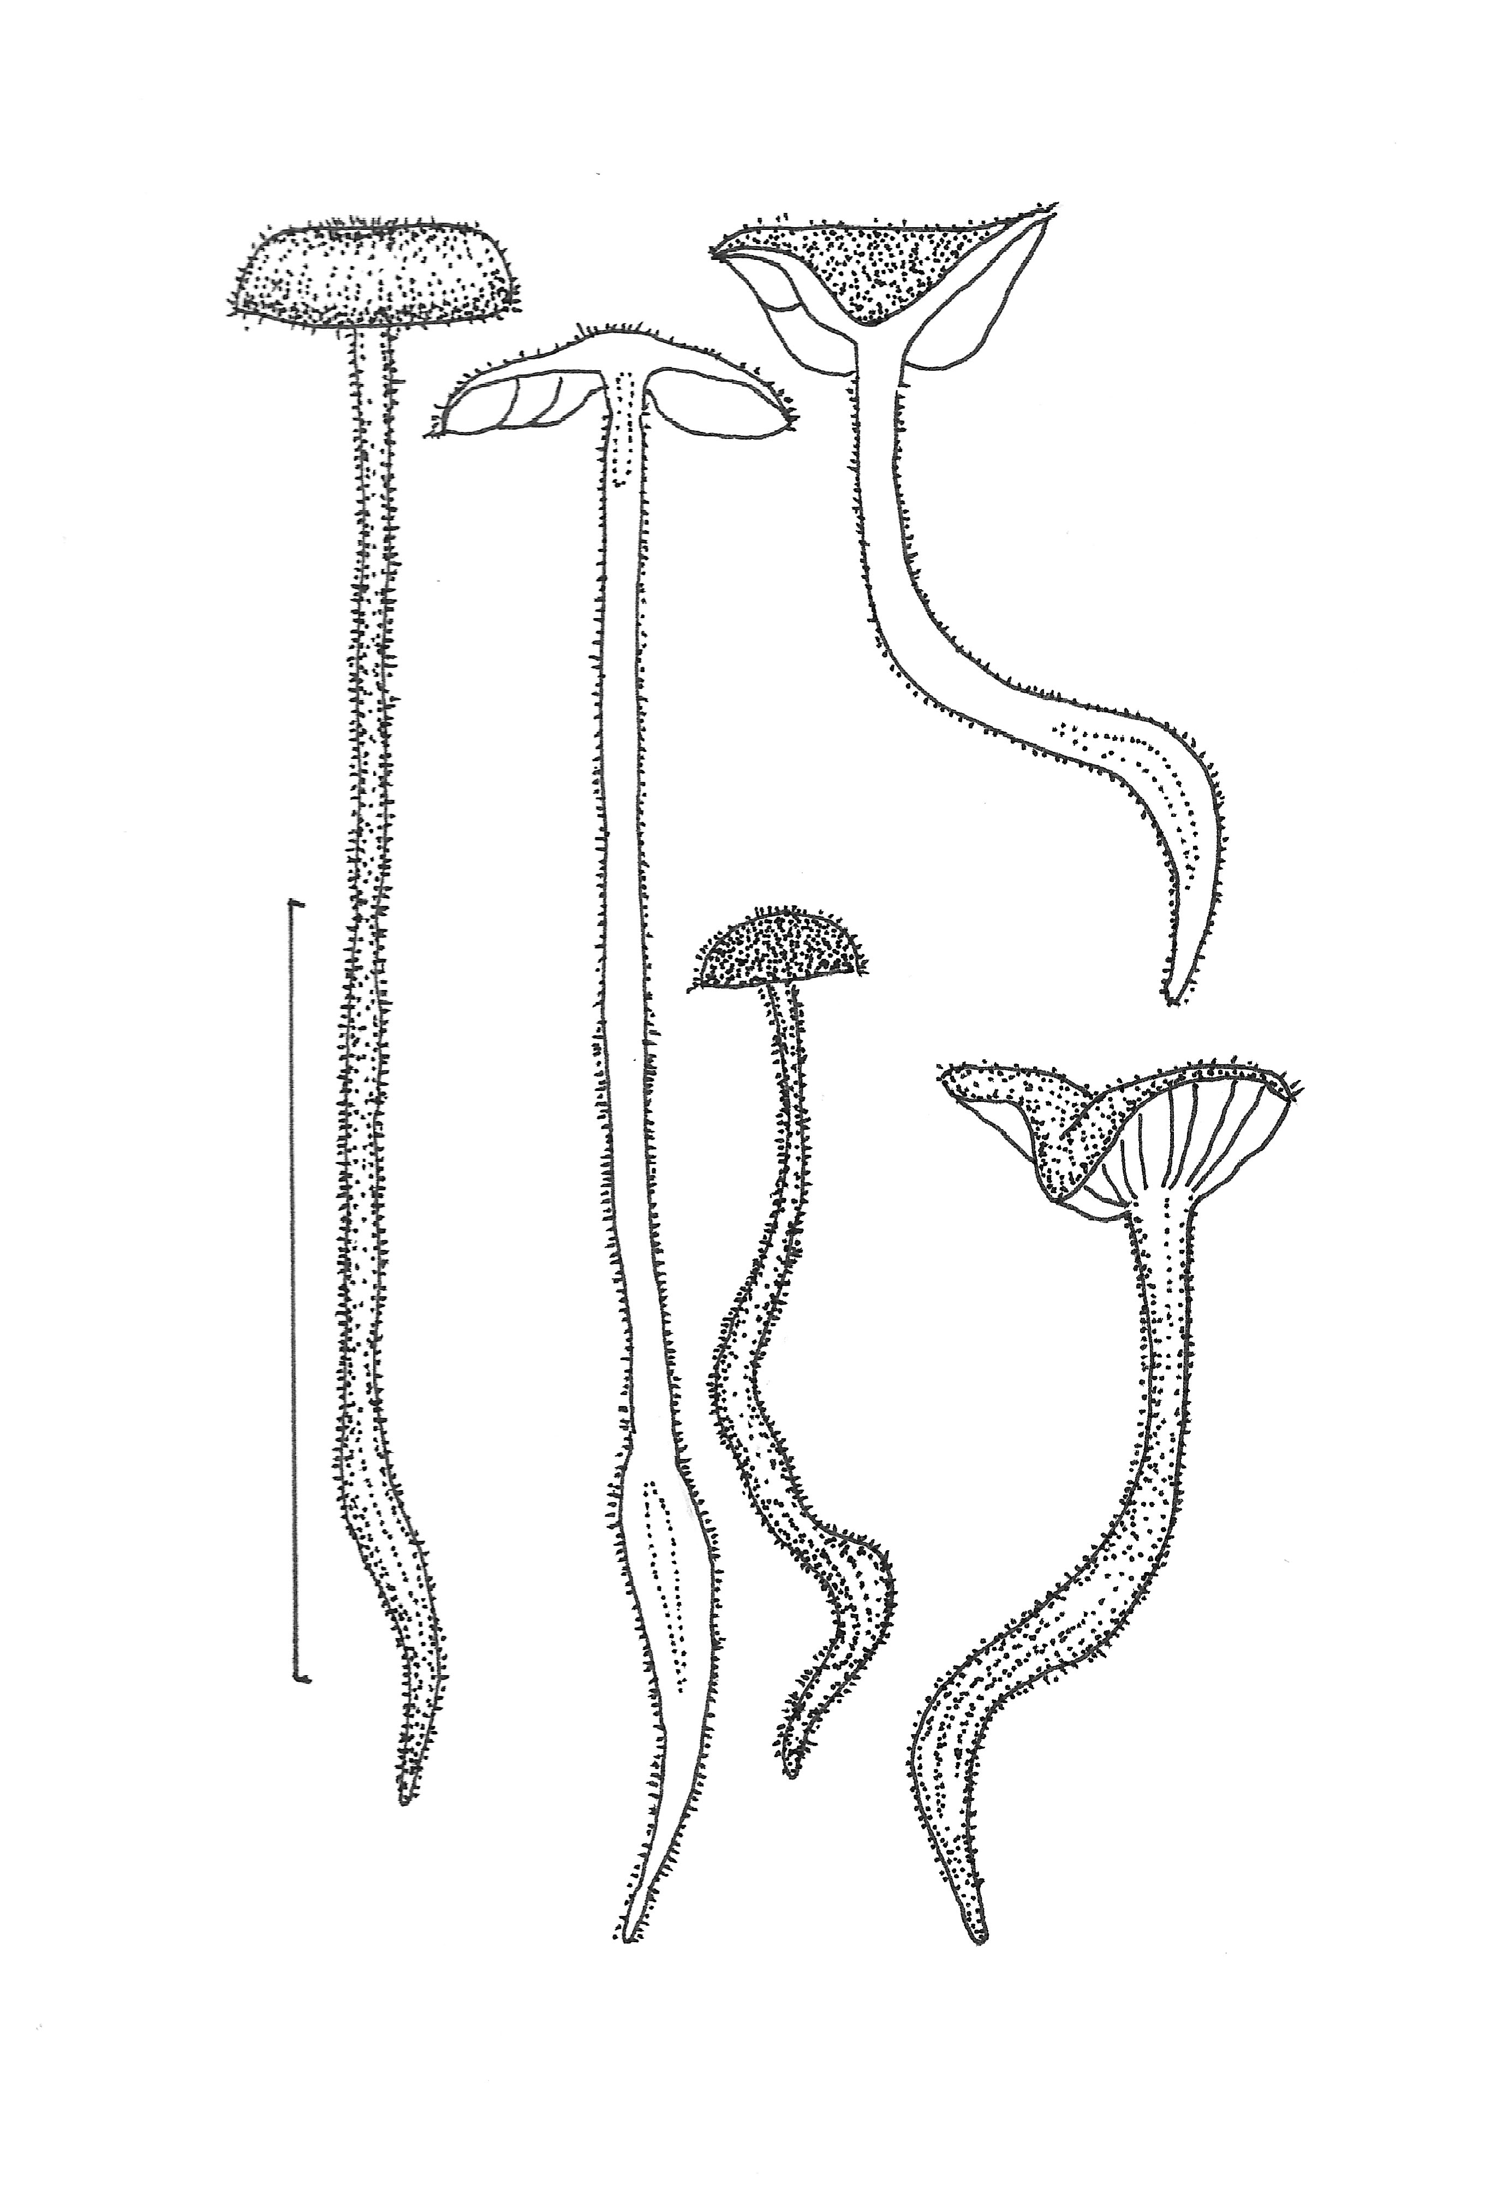
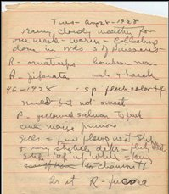
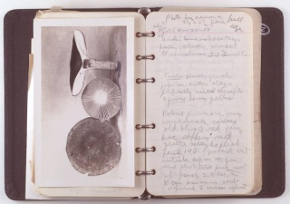
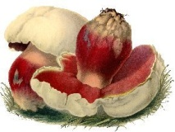
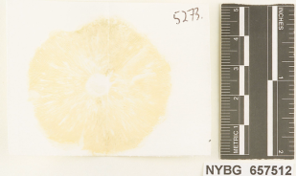
Digitize Specimen Data, Fieldnotes, Photographs
Data to be digitized:
700,000 specimen records (combined with 600,000 previously digitized specimens for a total of 1.3 million)
70,000 specimen images
144,260 photographs of living fungi (represented in specimen collections)
26,092 fieldbook pages
355,220 field notes, spore prints

Slide 7
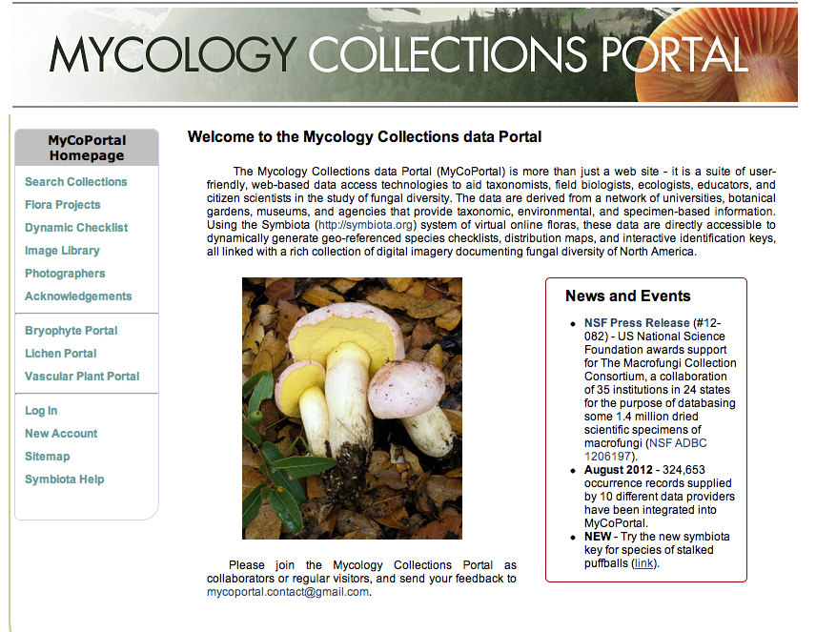
Disseminate Data through the Mycology Collections Portal
As of Sep 2012:
401,000 occurrence records supplied by 9 different data providers have been integrated into MyCoPortal.
http://mycoportal.org/portal/index.php

Slide 8
Public Participation in the MaCC
Amateur mycologists (=mycophiles) help with data editing, add content to the MycoPortal website and use data from the MycoPortal for their education and biodiversity documentation projects
Crowdsourcers help with transcription of specimen labels, and have the opportunity to learn more about fungi, natural history collections in general

Slide 9
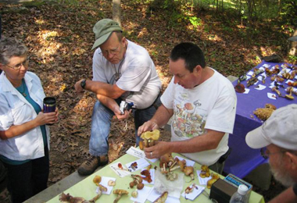
Objectives of the Public Partnership
Develop a corps of expert volunteers to help
edit and augment specimen records
Provide an outlet for the publication of information gathered by citizen scientists
Build a closer relationship between citizen scientists and MaCC herbaria for mutual benefit

Slide 10
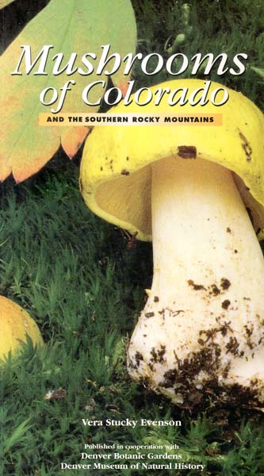
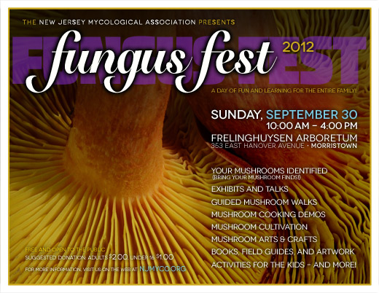
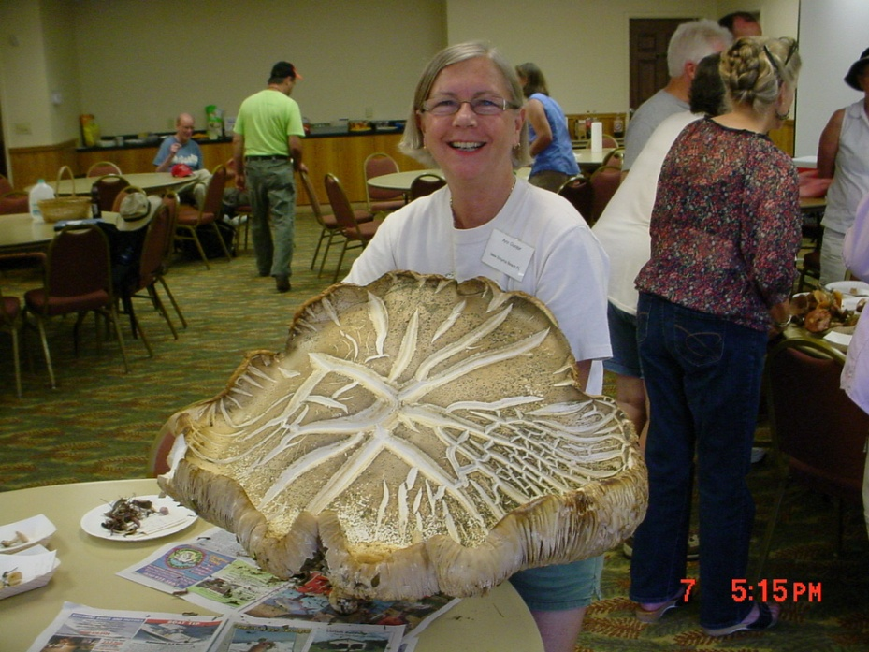
The Amateur Mycology Community
“To promote, pursue and advance the science of Mycology”
72 clubs nationwide affiliated with the North American Mycological Association
Conduct field outings – local, regional and nationwide
Document fungal biota through observations and collections
Educate the general public about
fungi
Communicate through meetings,
Mushroom Observer
Publish: McIlvainea, Mushroom, etc.

Slide 11
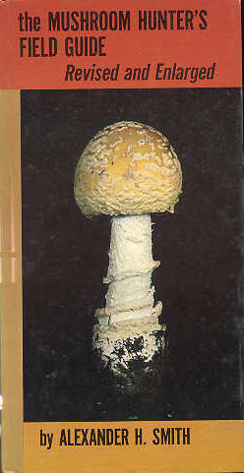
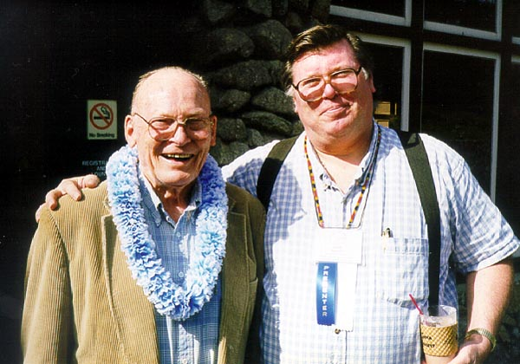
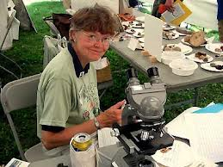
Amateur and Professional Mycology: An Enduring Partnership
Professional mycologists serve as lecturers, identifiers at club events; publish field guides designed for use by amateur community
Share information about fungi through Mushroom Observer
Amateurs make and maintain collections

Slide 12
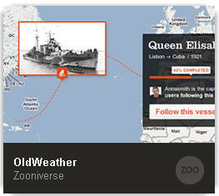
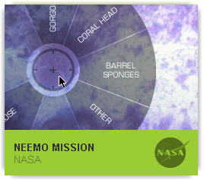
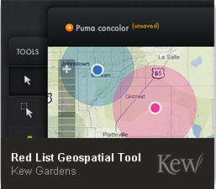
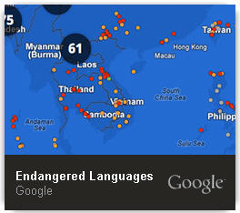
Objective of Crowd Sourcing Component
Create opportunity for participation in the project by citizen scientists beyond the amateur mycology community
Nuture an interest in fungi and collections in the crowdsourcing community and draw them into participation in amateur mycology community

Slide 13
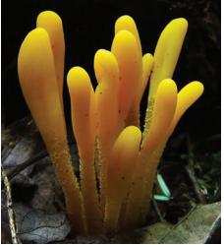
Opportunities and Challenges
Opportunities
Can help the MaCC project meet and maybe even exceed promised deliverables
Can help sustain regional herbaria
Can improve science literacy and appreciation of the value of collections
Challenges
Volunteers are not interested in participating
Volunteers participate but do not feel appreciated
Mission creep: Enthusiasm about the portal feeds ambition for a larger initiative that overshadows, or becomes confused with the primary MaCC objectives

Slide 14
MaCC Public Participation To-Do List
Activity | In Progress | Not Yet
Introduce the Amateur Mycology Community to the MaCC Project | ✔
Promote the MycoPortal as a tool for the Amateur Mycology Communty | ✔
Incorporate content generated by Amateur Mycologists into the MycoPortal | ✔
Implement the Crowdsourcing Component of the Project |  | ✔
Prepare guidelines and best practices for incorporation of crowdsourcer feedback into collections records |  | ✔

Slide 15
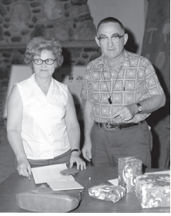
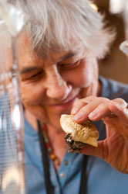
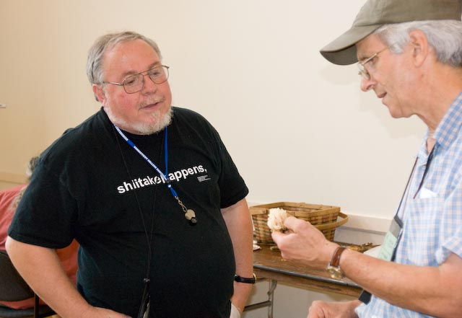
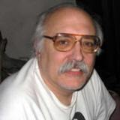
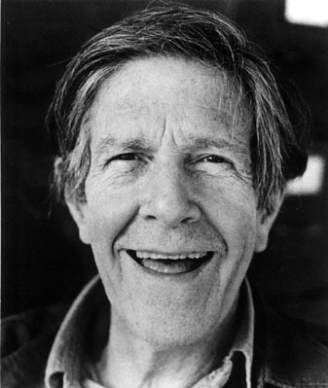
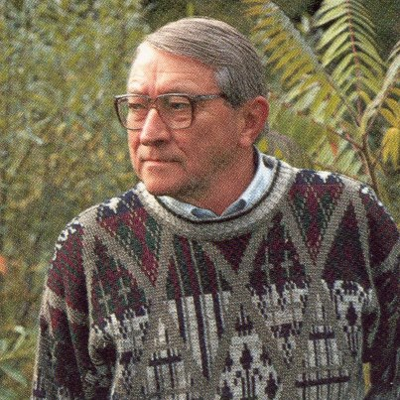
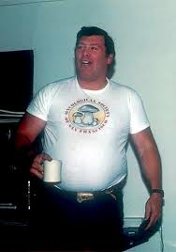
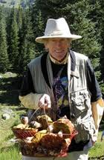
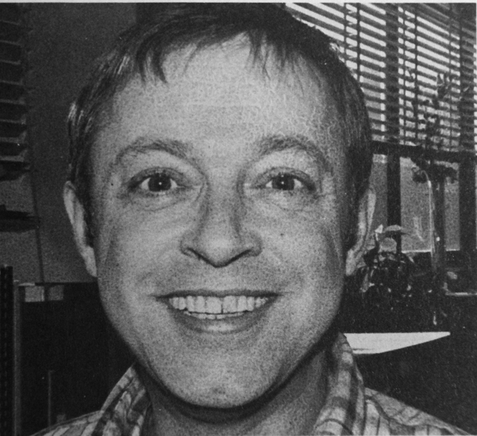
Amateur Mycologists I Have Known (or Known of)

Slide 16
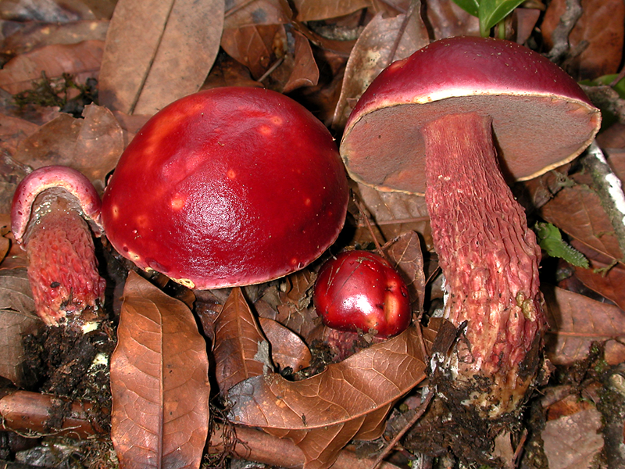
Charles Frost Shoemaker of Brattleboro
“Whatever I have acquired of science in my life came through search for health and mental entertaimnent; science is not my profession – shoemaking is.”
-Charles Frost
1801-1880

