Slide 1
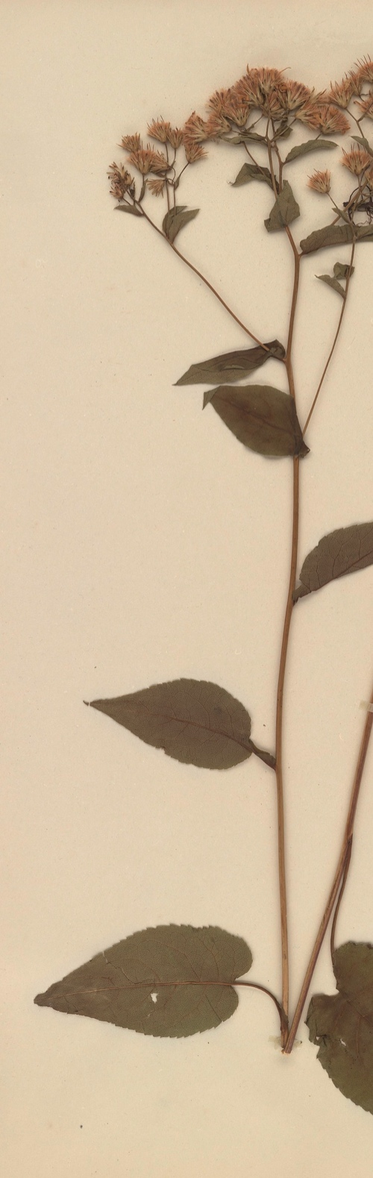


Mobilizing New England vascular plant data to track environmental change: an overview and preliminary thoughts on engaging the public.
P.W. Sweeney
Yale Peabody Museum of Natural History
Notes:
I’m here to speak about a TCN that was funded this last cycle and is just now getting started. I’m going to give an overview of our plans, and I’ll mention areas where , I think, the public could be involved in digitization work.

Slide 2
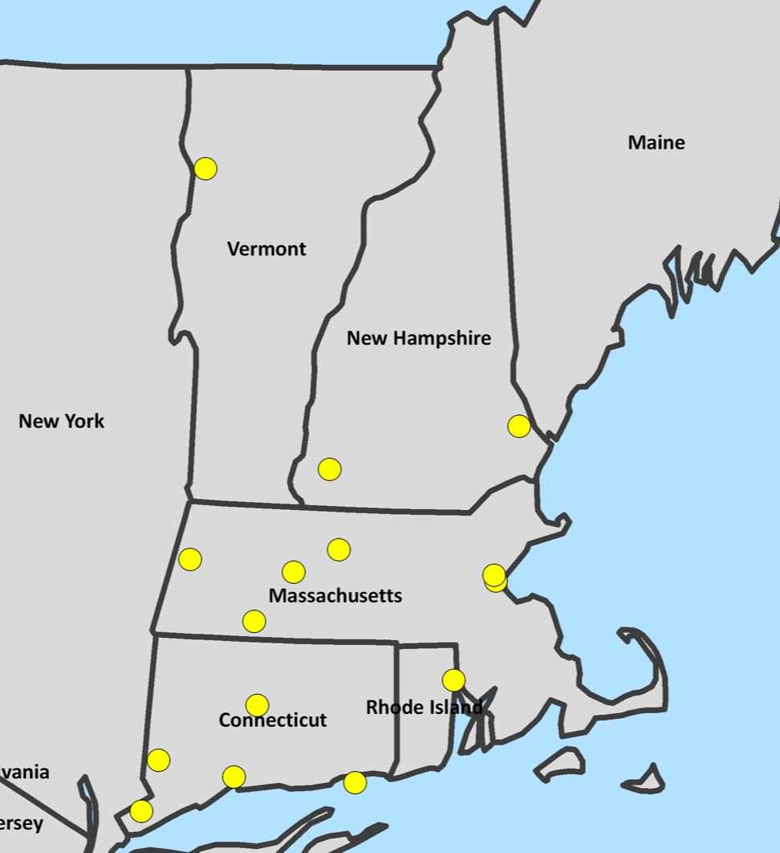
Objectives
Digitize 1.3 million N.E. vascular plant specimens from 15 regional herbaria
Notes:
The primary objective of the project is to digitize 1.3 million N.E. vascular plant specimens from 15 regional herbaria. By digitize we mean, capture an image, capture a subset of label data, some data about the specimen itself, and georeference.
This map shows the location of the participating institutions.

Slide 3

Public Participation
Notes:
At this stage we do not have a concrete plan for utilizing volunteer groups to help with the task of digitization; however, we think there is great potential for this in the New England region. I’m hoping that as a result of this workshop our project will come away with a good start on developing a plan to incorporate the public into our digitization work.
We have incorporated outreach in other ways. In our proposal/project, we have made explicit plans to include high school students, undergraduates and graduate students in the project, all of whom will be paid. We also will have a citizen science component, but it will not be focused on digitization of specimens. I’ll talk more about this later.

Slide 4
Public Participation: Volunteer Pool
Regional
  New England Wildflower Society
  New England Botanical Club
State Level
  Connecticut Botanical Society
  New Hampshire Botanical Club
  Rhode Island Wild Plant Society
  Vermont Botanical and Bird Club
Notes:
There are many groups in the region with whom we could seek collaborations.

Slide 5
Public Participation: Volunteer Pool
Within State (Connecticut)
  Avalonia Land Conservancy
  Bartlett Arboretum
  Berlin Land Trust
  Branford Land Trust
  Burlington Land Trust
  Chester Land Trust
  Connecticut Butterfly Association
  Connecticut College Arboretum
  Connecticut Entomological Society
  Connecticut/Westchester Mycological Association
  Darien Land Trust Essex Land Conservation Trust
  Granby Land Trust Highstead Arboretum
  Joshua's Tract Conservation and Historic Trust
  Killingworth Land Conservation Trust
  Madison Land Conservation Trust
  New Roxbury Land Trust
  Northern Connecticut Land Trust
  Old Lyme Conservation Trust
  Peabody Museum
  Shelton Land Conservation Trust Trumbull Land Trust

Slide 6

Digitization Plan: public Participation
NEVP
WANTS YOU!
Notes:
Now – on to the overview of our project, highlighting areas where the public could be involved.

Slide 7
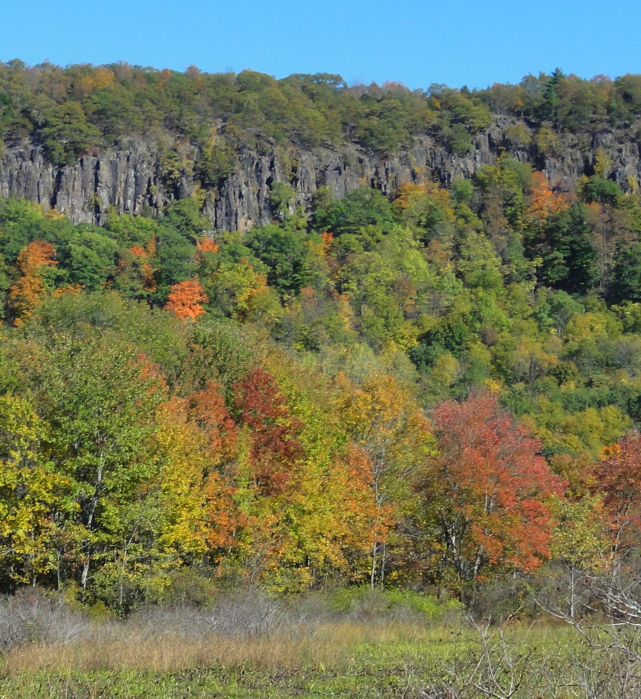
Rationale
The main goal of this TCN is to provide data to support the study of the consequences of climate change and land use history in the New England region over the last three centuries

Slide 8
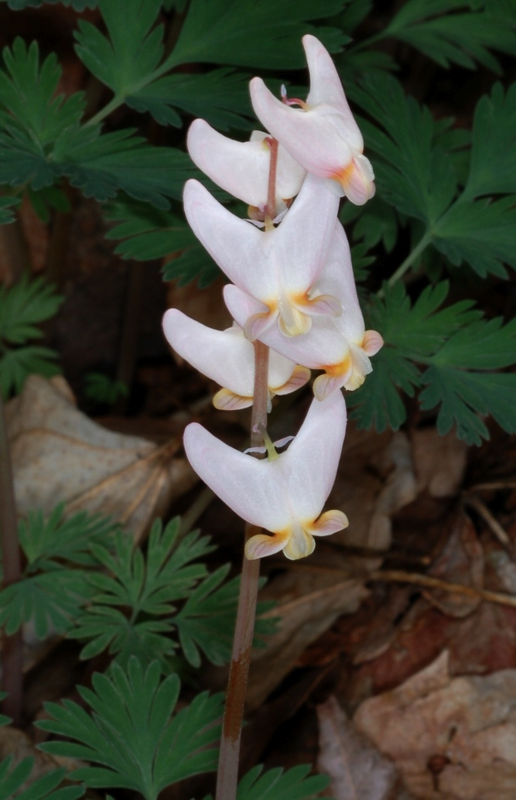
Rationale: Theme
Climate Change
Plant phenological observations play an important role in the effort to understand the effects of rising temperatures
Our project will cater to climate-change studies by capturing phenology (flowering and leafing-out stage) data
We will develop controlled vocabularies for flowering stage and leafing-out stage

Slide 9
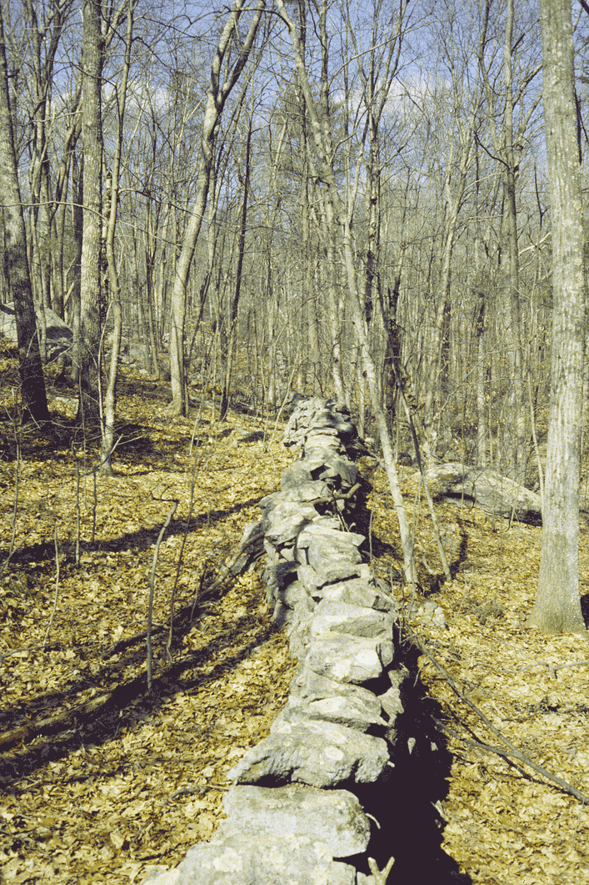
Rationale: Theme
Land-use history
Herbarium specimens, representing thousands of species with diverse ecological ranges and tolerances can add critical insights into the long-term consequences of past land-use
We will capture habitat data for a subset of taxa targeted for their particular importance to land-use studies, and we will develop a controlled vocabulary for habitat

Slide 10
Digitization Plan: Organization
Brown University (BRU)
Harvard University (HUH)
U. of New Hampshire (NHA)
U. of Massachusetts Amherst (MASS)
U. of Vermont (VT)
Yale University (YU)
Bartlett Arboretum (BART)
Berkshire Museum (BERK)
Boston University (BSN)
Central Connecticut State U. (CCSU)
Connecticut College (CCNL)
Harvard Forest (HF)
Keene State (KESC)
Western Connecticut State U. (WCSU)
Westfield State U. (WSCH)
University of Oklahoma
Notes:
So how are we going to do the digitization work?
15 collections will have their collections digitized.
University of Oklahoma is subcontracting with Yale to develop hardware and software for the project – I’ll talk more about their role later.

Slide 11
Digitization Plan: Organization
MASS
WSCH
HF
BRU
YU
BART
BSN
KESC
CCNL
WCSU
CCSU
BERK
HUH
NHA
VT
Notes:
The digitization effort will be organized as a hub and spokes, with a few of the larger institutions serving as digitization and organizing centers for the smaller collections.
In particular, six institutions will digitize their holdings – these are in grey.
The remaining nine institutions, shown in gold, will have their collections digitized either at Yale or U. Mass. HUH, VT, NHA, and BRU will be responsible for digitizing their collections alone.

Slide 12
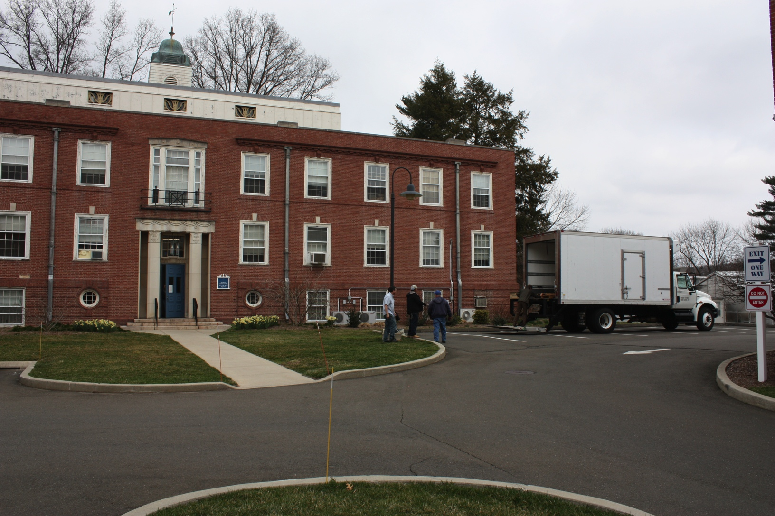
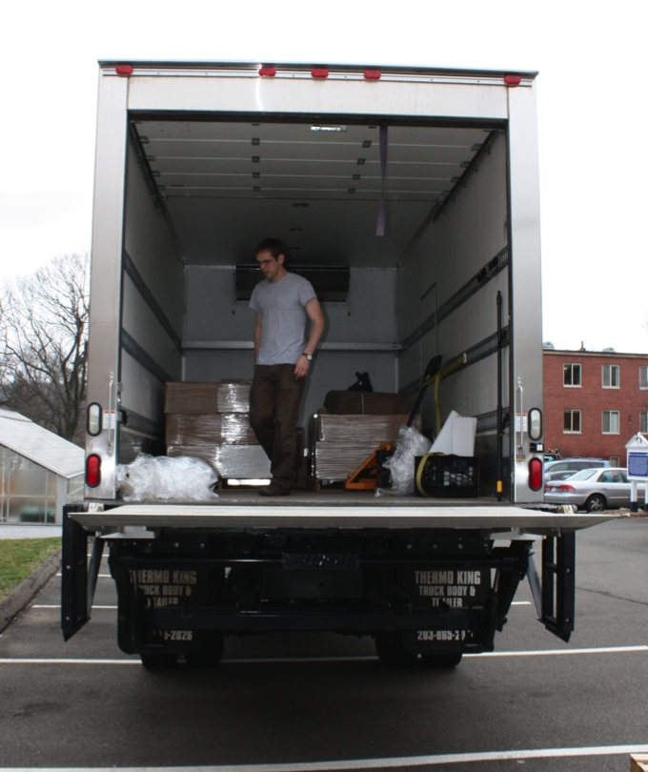
Digitization Plan: Organization
Notes:
The smaller collections will be packed up and moved to Yale or U. Mass where they will be digitized.
Pictured here is the Yale Peabody Museum’s box truck, which will be used to transport the specimens.

Slide 13
Digitization Plan: Organization
HUH & YU
BRU
MASS
NHA
VT
BART
BERK
BSN
KESC
CCNL
CCSU
WCSU
WSCU
HF
Notes:
Harvard and YU will act as key resource hubs that provide informatics assistance to all of the collections.

Slide 14
Digitization Plan: workflow
Collection Preparation (Pre-capture)
Primary digitization
Data Enhancement (Secondary Digitization)
Notes:
Now I’ll give you an overview of our workflow. We are thinking of the workflow as having three main components or stages.
A Collection Preparation or “Pre-capture” stage
A Primary Digitization stage
Data Enhancement or “Secondary” digitization stage
I’ll talk about each of these phases now.

Slide 15
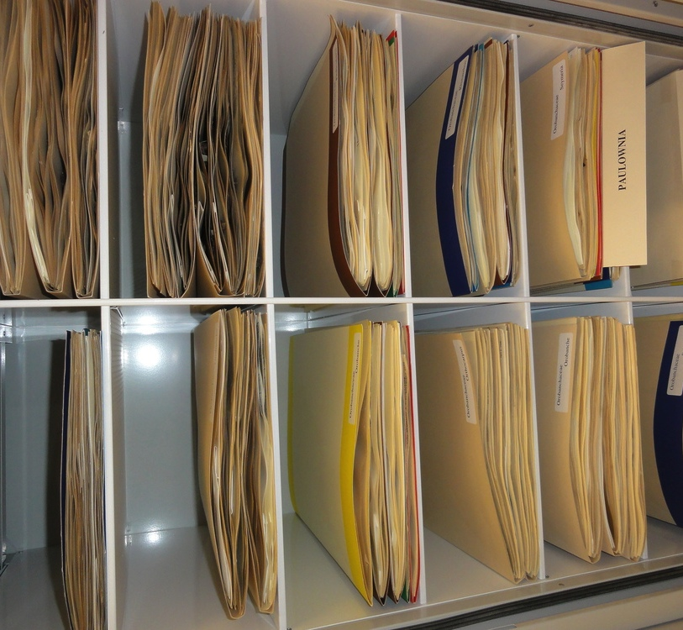
WORKFLOW: PRE-cAPTURE
In herbaria, sheets are often organized into folders by genus or species, with a single identification applying to all specimens in that folder. Often organized by geography, as well
Capture data that reflects the physical storage structure of the collection before imaging and data basing individual specimens
Associate this pre-captured data with specimen records at a later stage
Notes:
In herbaria, sheets are often organized into folders by genus or species, with a single identification applying to all specimens in that folder. In most herbaria, species within a genus are organized by geography, as well.
Capturing data that reflects the physical storage structure of the collection before imaging and databasing individual specimens, and then associating this pre-captured data with images can be a very efficient approach to capturing a subset of important specimen data.

Slide 16
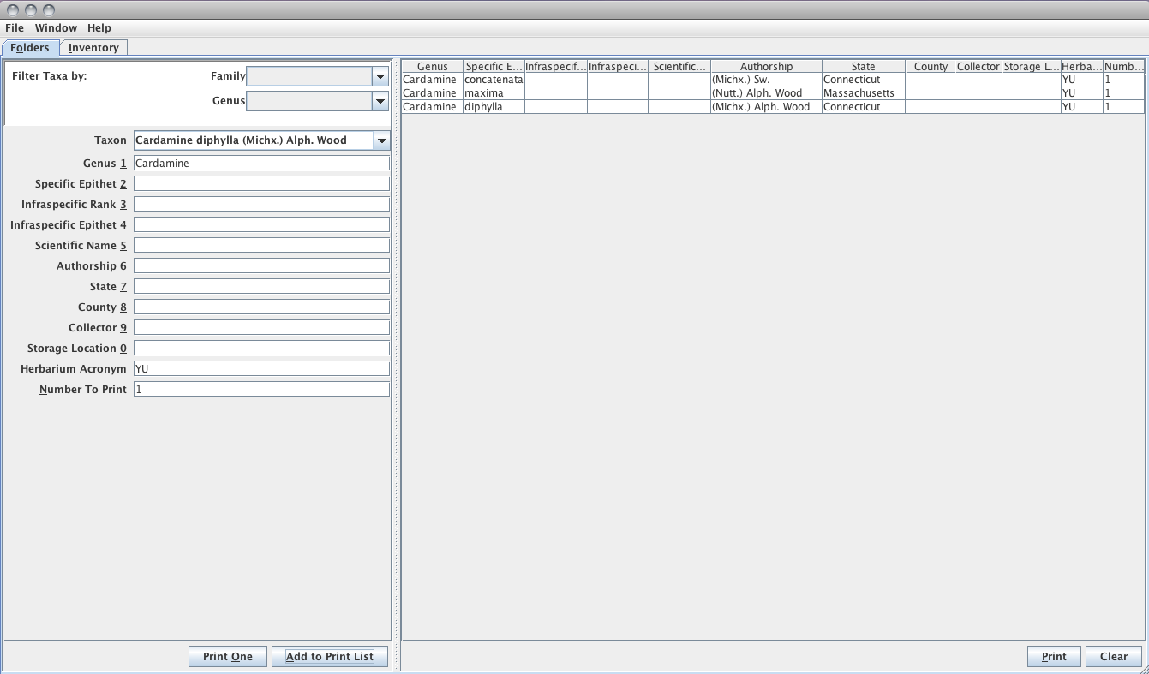
WORKFLOW: PRE-cAPTURE
Notes:
To do this we will use a very simple java application, which will be used to capture current identification (at family, generic, or specific rank) and state (when available).

Slide 17
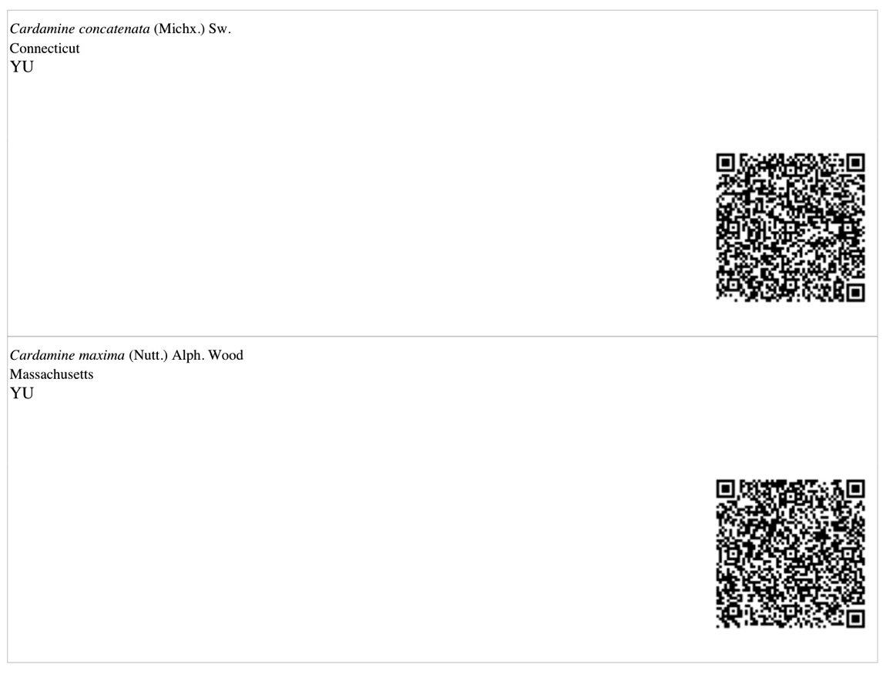
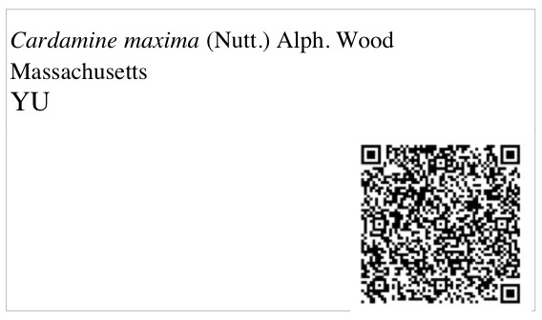
WORKFLOW: PRE-cAPTURE
Notes:
This information will be printed onto labels in human readable and barcode form and associated with the folder housing the specimens for later scanning at the primary digitization stage when this information will be associated with specimen- level records.

Slide 18
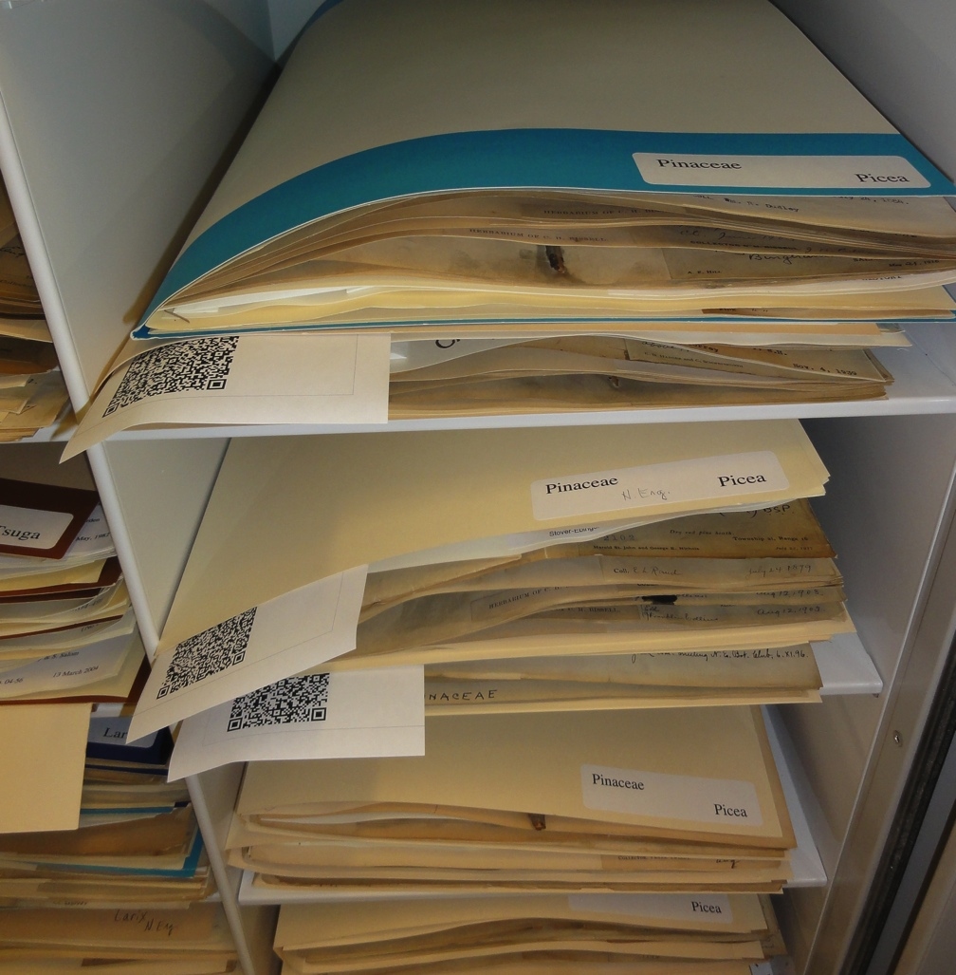
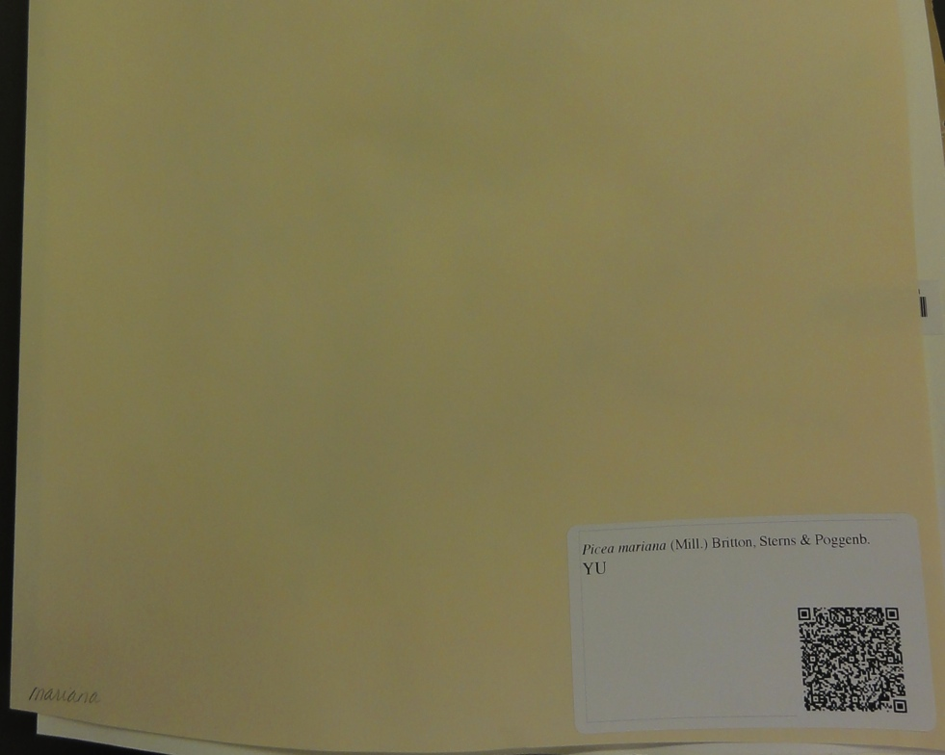
WORKFLOW: PRE-cAPTURE

Slide 19
WORKFLOW: PRE-cAPTURE
Notes:
To a limited extent, we could involve the public in the pre-capture stage. This would the public working directly in the collection with specimens, and would require a certain kind of volunteer and a through vetting process. Perhaps not an ideal place for the public to get involved at a large scale.
Use highly trained volunteers in YU herbarium. Volunteer office with somewhat thorough vetting process.

Slide 20
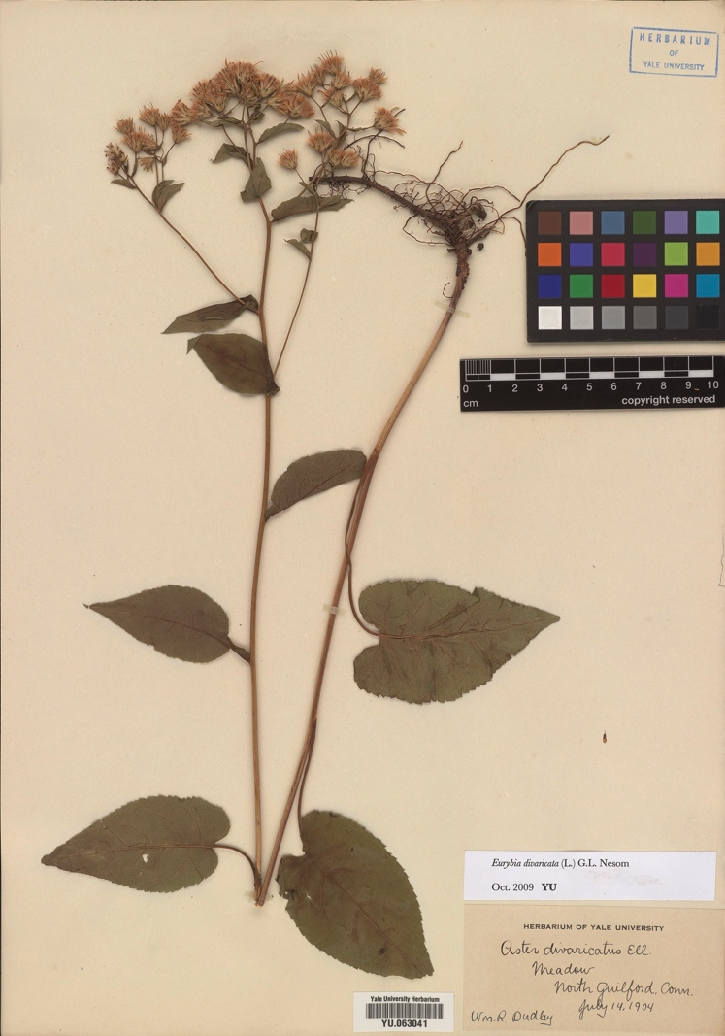
Workflow: primary digitization
Capture an image, a barcode number, a subset of label data & associate pre-capture data with specimen occurrence records
Notes:
In the primary digitization, we will capture: an image, a barcode number (catalog number), current identification and state where the specimen was collected barcodes generated during the pre-capture phase, collector, collection date, and town where the specimen was collected.

Slide 21
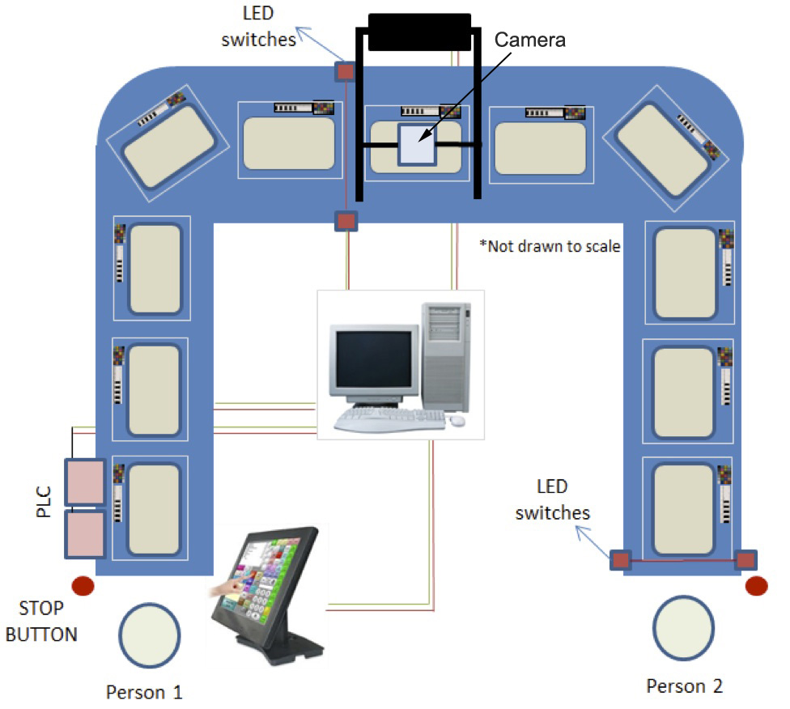
Workflow: primary digitization
To increase the efficiency of capturing an image and specimen-level data, we will develop and test an high throughput digitization apparatus
Notes:
To increase the efficiency of capturing an image and specimen-level data, we have teamed-up with Dr. Binil Starley, Assistant Professor in the School of Industrial Engineering, at the University of Oklahoma (subcontracting with Yale), to develop and test an industrial-scale, high throughput digitization apparatus, which will mediate the entire primary digitization process.
The basic idea to achieve the required throughput rate is to separate the imaging step from the manual loading and unloading of specimens. The separation of these steps will be made possible by an automated conveyor belt specimen handling system, which will allow image capture and specimen handling simultaneously.
The basic components of the digitization platform are: 1) a cleated low profile conveyor belt in either a straight line or ‘U’ shaped configuration of pre-defined lengths; 2) a high resolution digital camera with lighting system and a central computer system; 3) Light Emitting Diode (LED) switches to index the motion of the conveyor belt; 4) input devices such as touch screen monitors, bar-code scanners, and voice input hardware; and 5) Programmable Logic Controllers (PLC’s) that control and synchronize signals from the conveyor belt motion control, digital camera, and LED switches.
Apparatuses will be shared and moved around among the digitizing institutions.

Slide 22
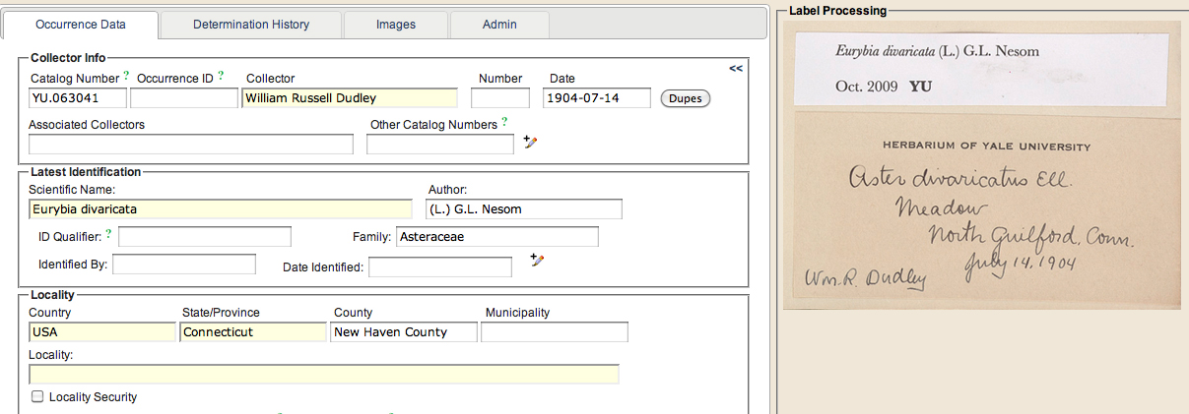
Workflow: primary digitization
Notes:
While the current plan is to capture label data off of the sheets, there could be an opportunity to capture data from images of labels. Volunteers could be used to help manually transcribe label data using a web interface. This could be managed through our Symbiota instance, which provides a form and an image of the specimen.

Slide 23
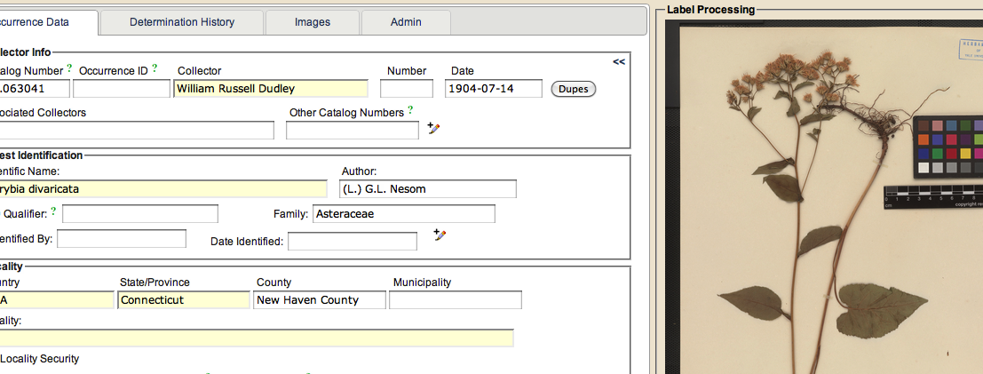
Workflow: secondary digitization
The secondary digitization stage will involve humans capturing (via keystroking) habitat and phenology data from images of specimens and labels.
Notes:
Controlled vocabularies for habitat and phenology

Slide 24
Workflow: secondary digitization
Notes:
Volunteers could be used here, too.

Slide 25
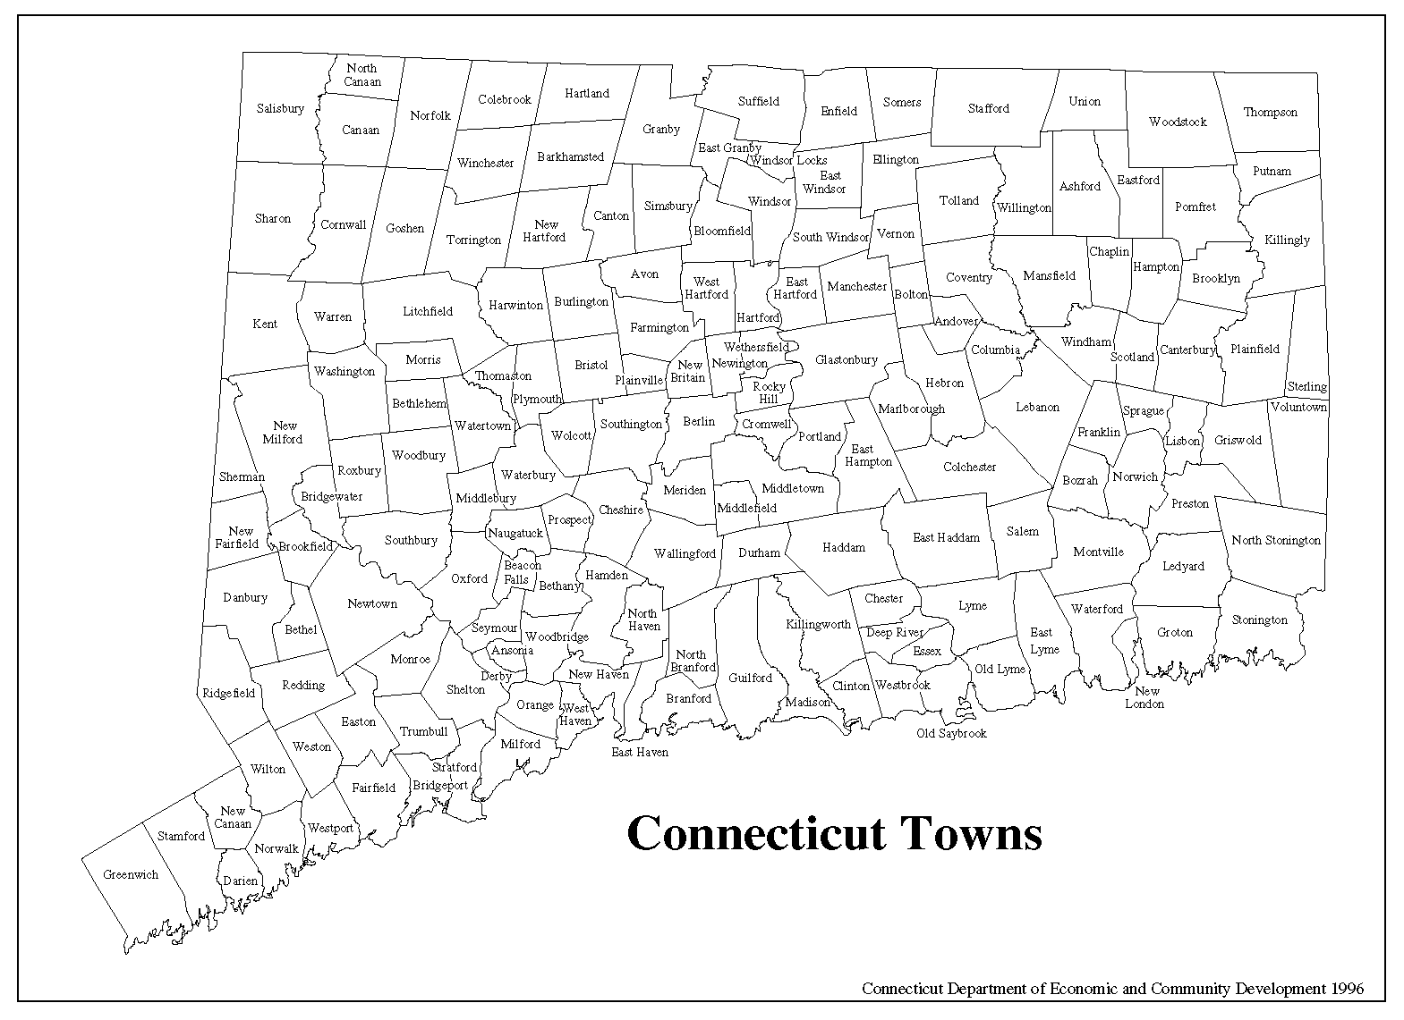
Workflow: secondary digitization
Georeference to at least town level
Notes:
States in New England are small and all areas of a state lie within a town. So we will used town centroids for latitude and longitude and for the uncertainty the radius of smallest circle enclosing the town polygon.
Since it is not a primary goal of our project to generate finer-level georeferences, this is probably not an area where we would seek help from the public.

Slide 26
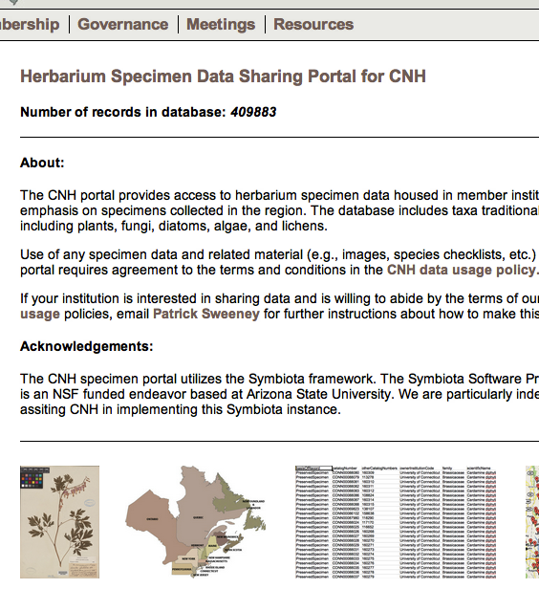
Mobilization
All of the data and images will be available to public through Consortium of Northeastern Herbaria (CNH) Symbiota portal(neherbaria.org/CNH)
Notes:
Within the CNH instance individual specimen records can be viewed with images, and the specimen occurrence data will be downloadable.

Slide 27
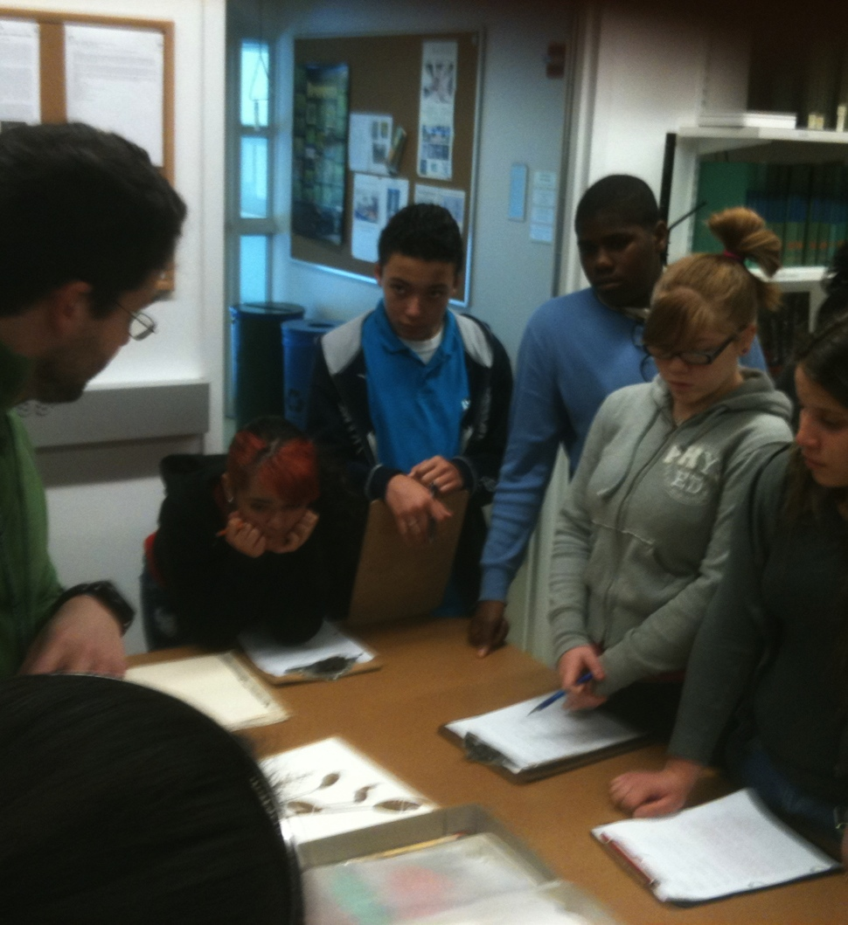
Training & outreach
Undergraduates and graduate students engaged in digitization & collections activities
Collection internships to teens
Notes:
In addition to the usual education and outreach activities that take place within our collections, training is integrated into the project in several ways.
At four institutions (BRU, HUH, YU, and VT) undergraduate and graduate students will be directly involved in digitization activities by conducting much of the actual work. These students will learn about collections management (e.g., handling and care of specimens, best practices) and biodiversity informatics.
Our project will collaborate with the Yale Peabody Museum's after school program for high school students, "Evolutions" ("EVOking Learning and Understanding Through Investigations Of the Natural Sciences") to offer internships to six students. This program engages a diverse group of teens from the New Haven Public School district in a rigorous 'for credit' academic program focused on science and science careers. New Haven schools and the Evolutions program are characterized by a large percentage of students from historically underserved populations.

Slide 28
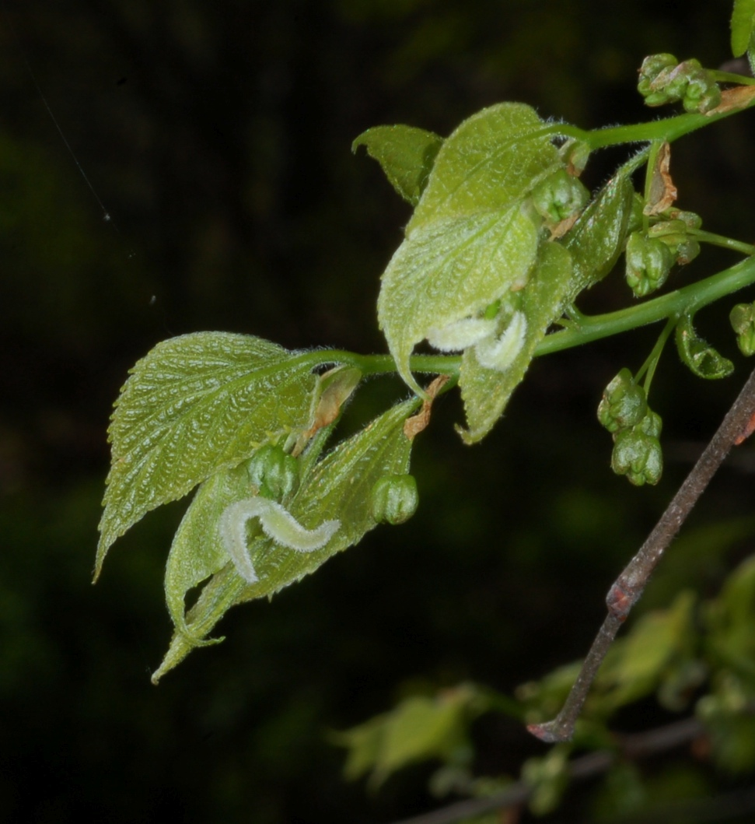
Training & outreach
We will establish a network of citizen science observers to provide information on flowering and leafing-out times across the New England region
Notes:
Using networks of citizen scientists has provided a way for scientists to develop a dense concentration of observations in a cost-effective manner.
Many of the herbaria in New England have strong representation of specimens from the late 19th century through the 1940s. Some herbaria have abundant collections through to the present time, but many have relatively few specimens collected over the past 50 years.
A baseline of information is needed on flowering times and leafing-out times across the New England region today.
To a large degree this can be provided by properly monitored citizen scientists who submit on-line their observations on particular phenological phases for a specified list of plant species for which we will also gather data from herbarium specimens.
A number of citizen science networks already exist in New England and Nationally.
We will build on these networks (see Collaboration Letters) to include more (or even all) of the species and stages that we will be evaluating, and to recruit more participants to these networks.
We will be encouraging people to make leafing out observations on a core group of 20 tree species across New England, within the Project Budburst and NPN framework, to complement our regional approach using herbarium specimens. Our herbarium approach will be giving us information on how climate variation over the past 130 years has affected leafing out time across the region, and this will integrate with the intensive observations made my the citizen science network and by remote sensing data.

Slide 29
Public Participation
Recruitment
Management
Training
Turn-over
Quality control

Slide 30
Acknowledgements
National Science Foundation
iDigBio
Symbiota Project
FilteredPush
The iPlant Collaborative & Texas Advanced Computing Center (TACC)

Slide 32
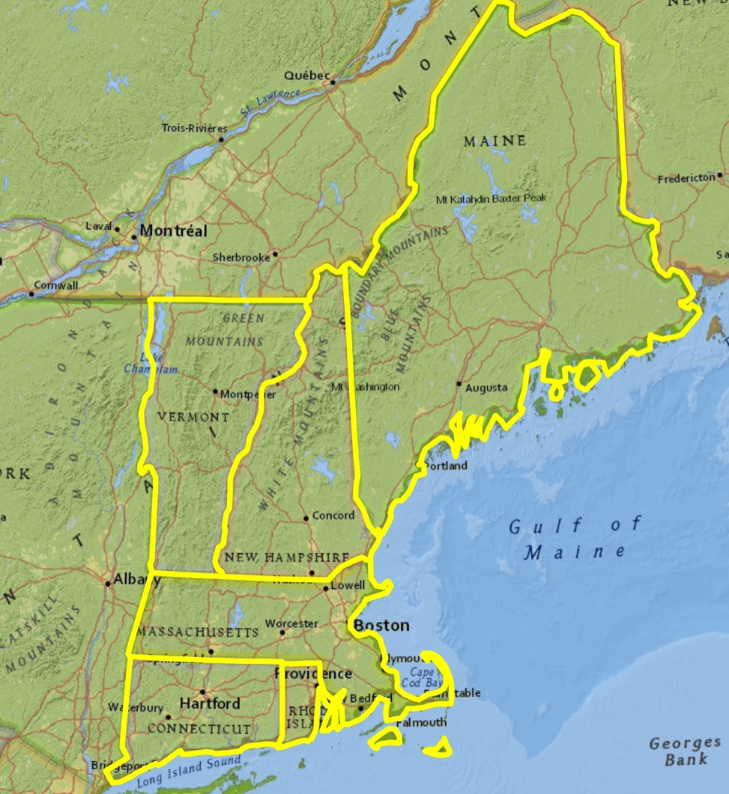
Rationale: NeW England
Why New England?
Herbaria
Landscape
History
Scientists
Notes:
***
Its herbaria include some of the world’s oldest and most comprehensive collections of varying size and scope. For example, the region includes Harvard University Herbaria with over 5 million specimens and which contains many historically important specimens (e.g., the Thoreau herbarium) versus smaller collections that comprised largely of specimens representing localized areas.
The New England landscape has a diversity of habitats from maritime islands and broad river valleys to sub-boreal forest and alpine tundra.
its coastal location and importance to colonial settlers have exposed it intense ecological pressure for hundreds years.
And its scientists have been at the forefront in applying historical plant collections to evaluating the impact of environmental changes.

Slide 33
Workflow: Primary Digitization
Digitization Stations
Symbiota
TACC
Specimen Data
Images
Notes:
***
Specimen data will be transported from the Digitization Stations to a Symbiota instance.
Batch builder -> transport -> batch unpacker (SPARQL queries on the packages to put records into Symbiota's relational database)
rdf/xml formatted batch file, batch unpacker in Symbiota
rdf/xml formatted batch file, batch unpacker -> Filtered Push -> AnnotationProcessor -> Specify
FilteredPush project is working on a rdf handler that would handle this
Images will be transported to TACC.
batches
tables with urls & catalog numbers/collection used for ‘batch’ linking of images to specimen records in Symbiota

Slide 34
Workflow: Enhancement
Filtered Push
Morphbank
Collection Databases
(Specify)
Symbiota
Notes:
***
In addition to enhancing records with phenology and coordinates, we have partnered with the FilteredPush project to connect Symbiota, Specify, and Morphbank to promote annotation of specimen records and their images by knowledgeable users.

