Slide 1
Community Assisted Digital Imaging of Insect Specimens
Public Participation in Digitization of Biodiversity Specimens Workshop
Julie Speelman
September 28, 2012

Slide 2
Overview
Introduction
Goals of InvertNet
InvertNet Workflows
Volunteer Demographics
Conclusion

Slide 3

Introduction
Julie Speelman
PI: Dr. Jeff Holland
Systematics:
Dr. Jennifer Zaspel

Slide 4


















InvertNet Institutions
Milwaukee Public Museum
Carnegie Museum
Notes:
Midwestern Institutions: Newest addition is Hawaii.

Slide 5
Goals of InvertNet
Digitize over 50 million specimens at 22 Midwestern collections
  Specimen images and metadata (label info)
  Drawers, vials, slides
  Advanced imaging (including 3D)
  Best quality at a reasonable cost (~$0.10/specimen)

Slide 6
Goals of InvertNet
Provide access to images and other data online in a virtual museum
  Ability to browse/search/zoom the web interface
  Link to other data providers ( ex. ADBC HUB,
  Bug Guide)

Slide 7
Goals of InvertNet
Development of additional tools and resources
  Data mining and analysis
  Community building, collaboration, and support
  Education, outreach, and reference

Slide 8
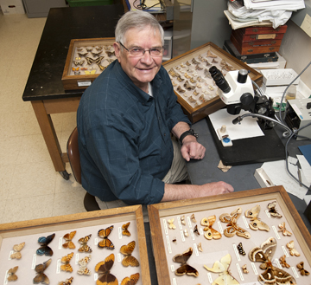
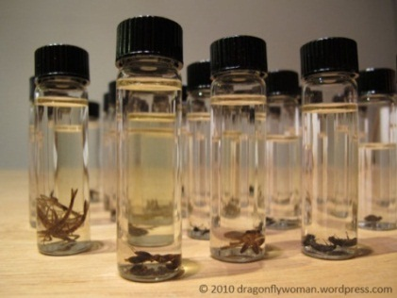
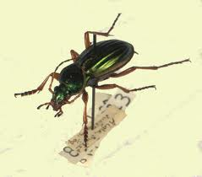

Purdue’s Goals
Digitize 2,250,000 specimens representing 150,000 species
Dry preserved: 1,300,000
Alcohol preserved:920,000
Slides: 30,000

Slide 9
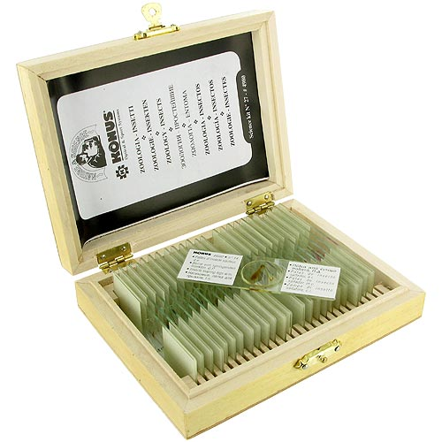
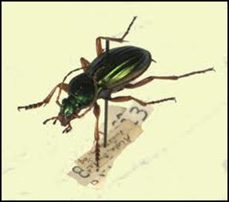

Invertnet Workflows
Slides
Vials
Pinned Specimens

Slide 10
Slide Workflow
Attach a label with a unique identification number to the slide
Label the slide tray with the label for the slides
Place 20 slides upside down on the tray

Slide 11
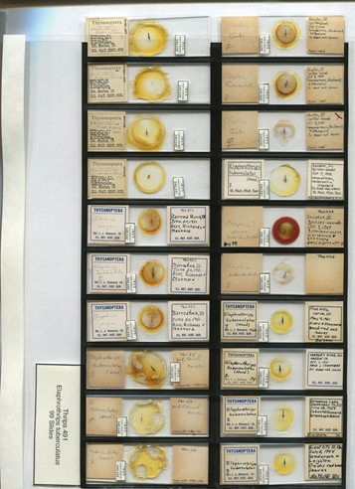
Slide Workflow
Place the tray on the flatbed scanner and obtain the image.
Save the scan
Upload to Invertnet.

Slide 12
Potential Volunteer Activities
Attach slide labels
Digitize images
Upload metadata

Slide 13
Vial Workflow
Curate specimens
Remove label from vial.
Replace alcohol and rubbers stopper if necessary.
Place vials on scanner tray.
Obtain image.
Save image
Upload image

Slide 14
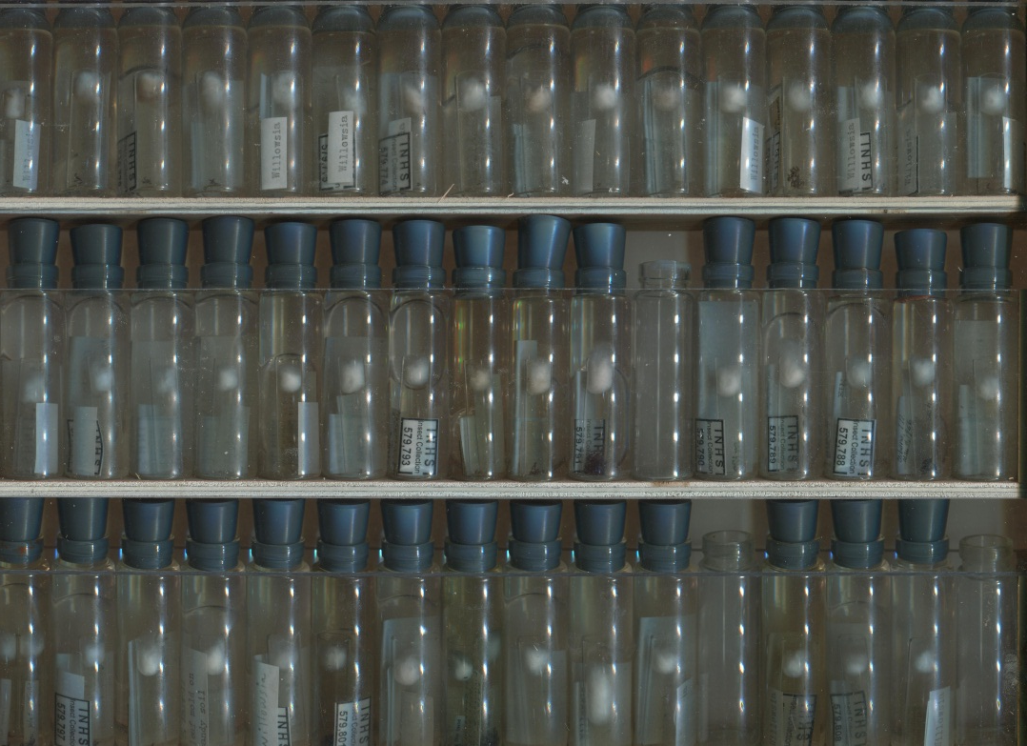
Potential Volunteer Activities
All steps of the workflow except curation

Slide 15
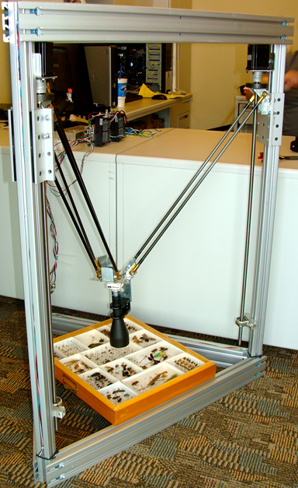
Drawer workflows
Curate the specimens
Digitize the image
Upload metadata

Slide 16
Potential Volunteer Activities
All steps of the workflow except curation

Slide 17
Who Volunteers?
Bureau of Labor Statistics (year 2000)
59 million people over age16 volunteered
27.6% of population 1 in 4 adults
Volunteered an average 24 hours a month

Slide 18
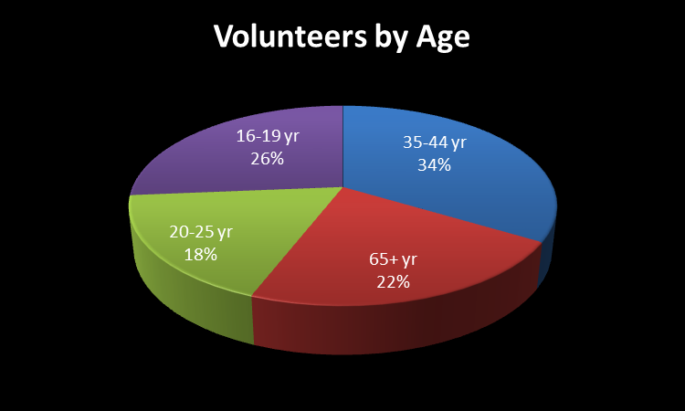
Volunteer Demographics
Women volunteer more than men
Bureau of Labor Statistics (year 2000)

Slide 19
Available communities at Purdue
High school students
Citizen science groups (Audubon Society, Master Naturalists)
Retirees
Undergraduates

Slide 20
Potential $$ Savings
Example from Purdue:
Currently have 2 undergraduate workers
Work on average 33 hr/week at $8.50/hr
Weekly total=$280.50, Monthly=$1122

Slide 21
Keys for Volunteer Program
Assess needs and determine objectives
Prepare a written proposal
Provide staff support-Volunteer Coordinator
Provide job descriptions
Recruit and select volunteers
Implement the program (train)
Reward the staff and volunteers
Source:Valente, C. and Manchester, L. (1989). “Volunteers,” Service delivery in the 90s: Alternative approaches for local governments.

Slide 22
Conclusion
Volunteers can be an integral component of a
large digitization project.
Potential to offer a huge cost savings.
A successful volunteer program requires organization and coordinator.

Slide 23

InvertNet

