Slide 1
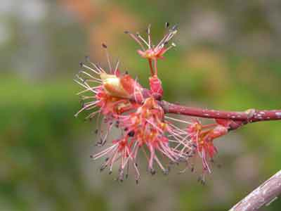
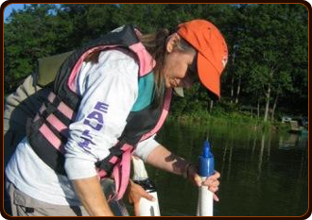
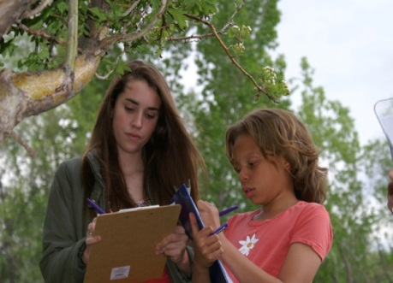
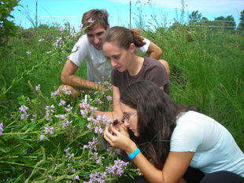
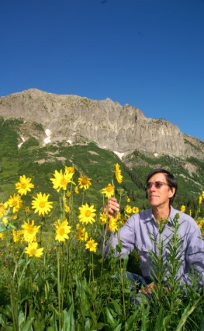
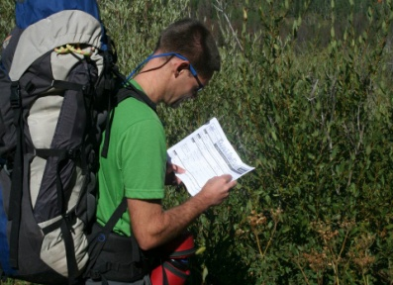
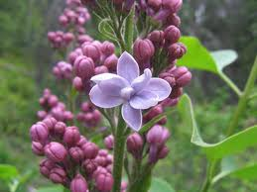
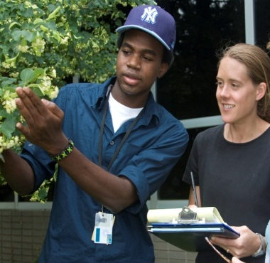
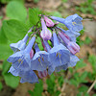
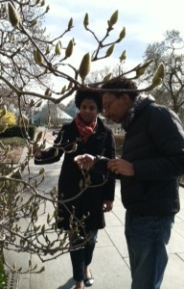

Lessons Learned from NEON’s Project BudBurst
Sarah Newman¹, Sandra Henderson, Dennis Ward, Leah Wasser, Liz Goehring
¹Citizen Science Coordinator, NEON, Inc.
IDigBio Workshop, 29 Sept 2012

Slide 2


Is a national citizen science field campaign focused on plant phenology
Engages the public in the collection of data about the timing of leafing, flowering, and fruiting of plants
Local focus through partnerships
Primary goal: Phenology education and outreach to a broad audience
Secondary goal: Useful scientific data
Entirely online
Data freely available to all
Contributory (data collection project)

Slide 3

Began at the University Center for Atmospheric Research (UCAR) in 2007
Moved to NEON, Inc. in 2010 to serve as the pilot citizen science program
Now past pilot stage and fully integrated into NEON Education and Outreach

Slide 4
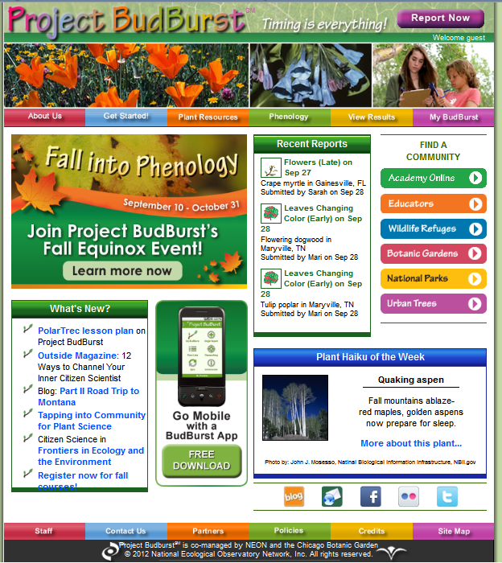

Slide 5
Now for lessons learned…

Slide 6
Know your Audience(s)
Notes:
General masses? Retires? K-12? Formal Ed? Informal Ed? Little kids? The needs are different for each of these groups and entry points to your program will differ with each group. Know up front which groups you want to reach as it can be easy to spread yourself thin. We’ve made clear in our mission statement that we are education focused, so our primary audiences are formal and informal educators, mainly 5th-Adult, with some activities for younger audiences.

Slide 7
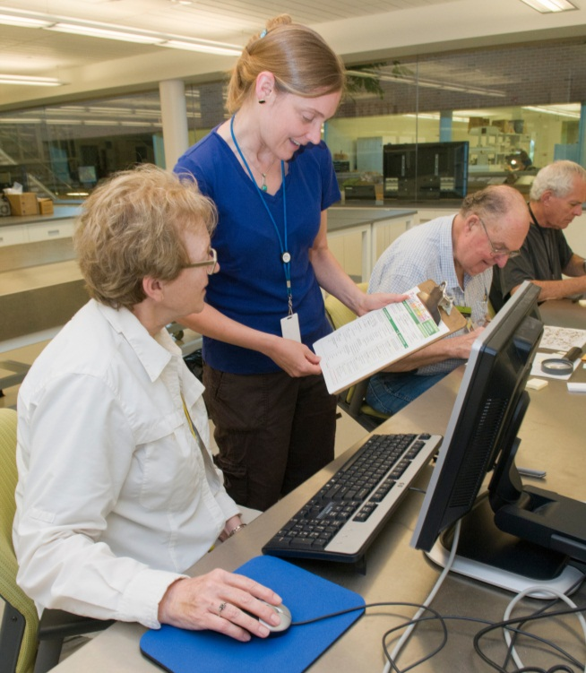
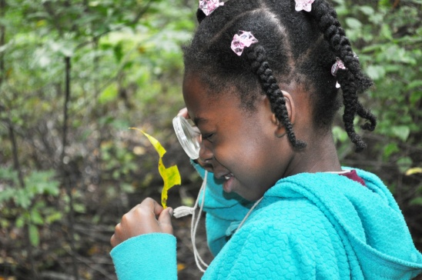
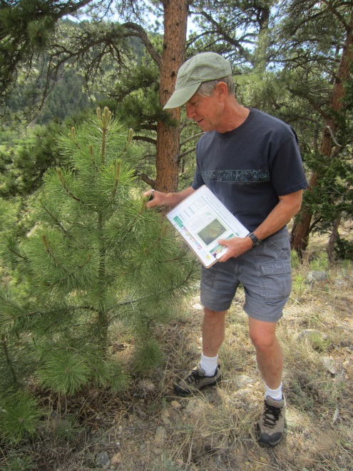
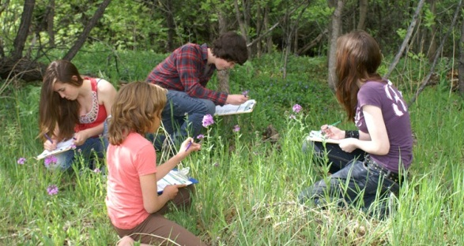
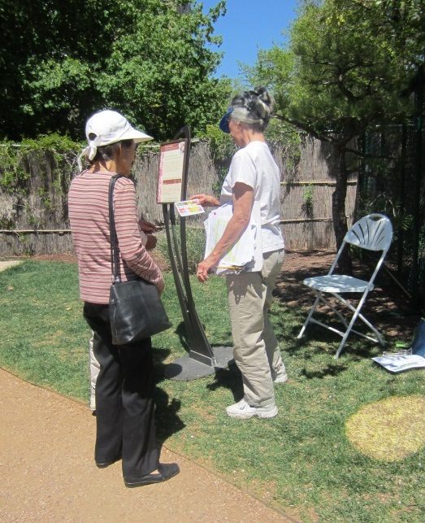
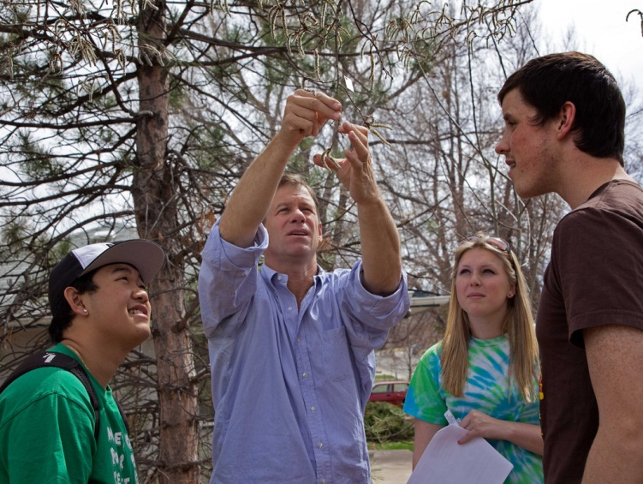
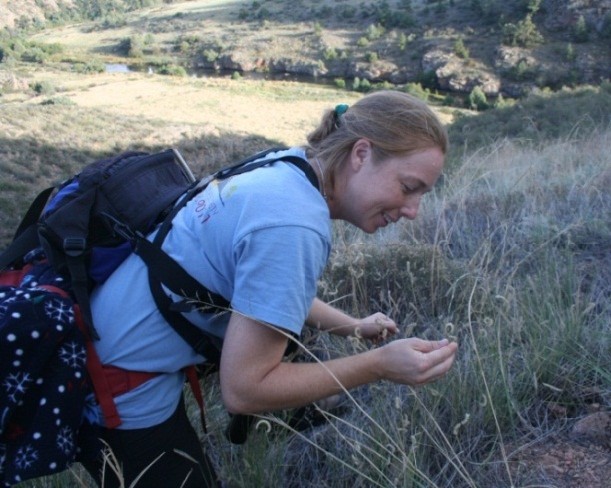
Notes:
Working with Onsite volunteers is not the same as working with offsite

Slide 8
Start small

Slide 9

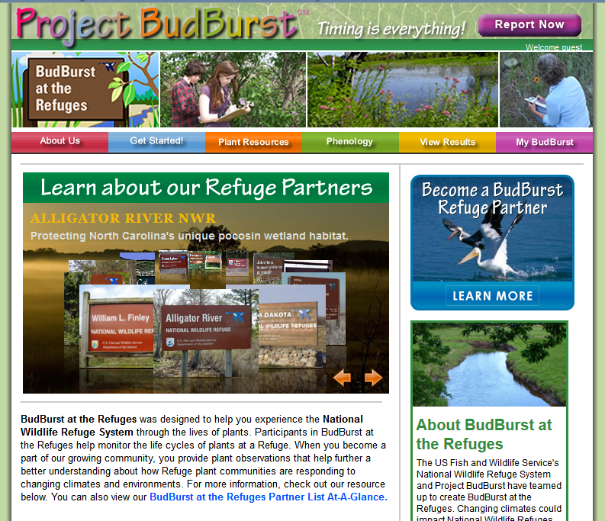

Notes:
More resources here!

Slide 10
Pilot your idea with your Audience(s)

Slide 11
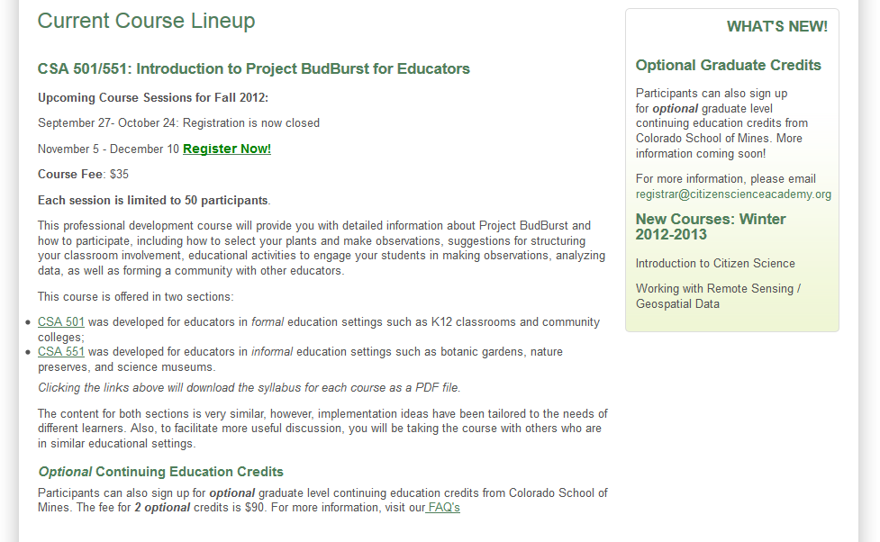
citizenscienceacademy.org
Notes:
Another good example of this is NASA’s Mapper program…The Pavillion Lake Research Program team makes use of DeepWorker subs to explore and document freshwater carbonate formations known as microbialites that thrive in Pavilion and Kelly Lake. Many scientists believe that a better understanding of how and where these rare microbialite formations develop will lead to deeper insights into where signs of life may be found on Mars and beyond.

Slide 12
Reduce Barriers to Participation

Slide 13
Language
Available Technology
Skills to using technology
Terminology
Website
Useability
Time commitment
Family Resources and Engagement
"Make the work transparent and simple“
-- Katja
Culture
Pandya, R.E. 2012. Frontiers in Ecology and the Environment 10 (6) 314-317.
Notes:
Hopefully you’ll be able to identify what those barriers are during the pilot phase…

Slide 14
Retention

Slide 15

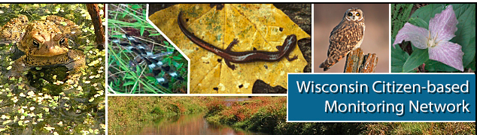



…Through shared community
Discussion Forum
Community Newsletters
Meetings/Conferences
Social Media (Facebook—Project BudBurst, Twitter #PBudBurst
Tiered Participation (Level up!)
Attach a research question to the specimens being transcribed

Slide 16
Recognition

Slide 17
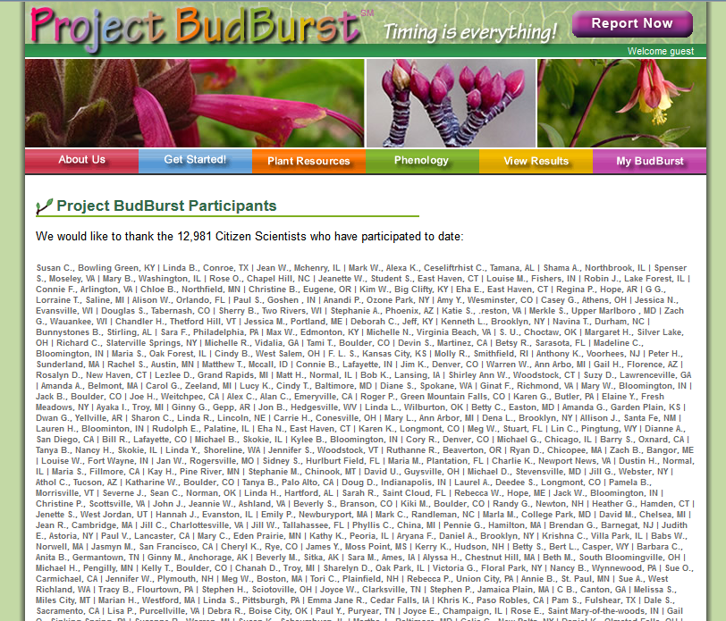

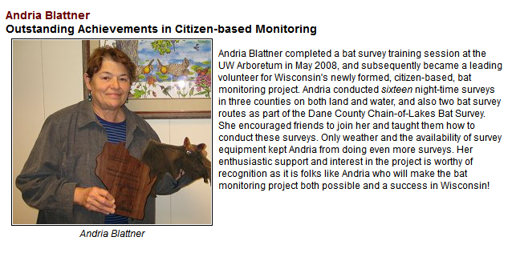
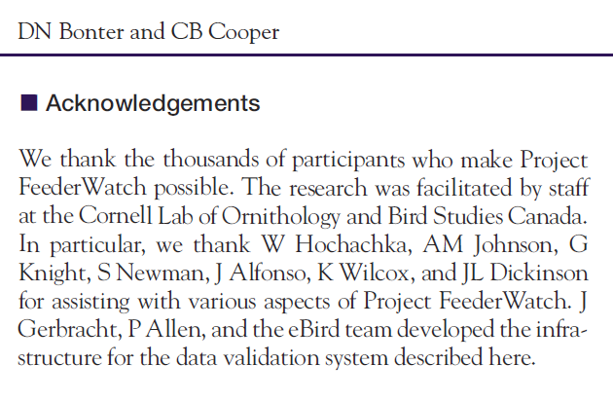
Notes:
Validate the work these folks are doing for you and fuel the flame for continued partnership (Rio Grande Nature Center Park example)….

Slide 18
Partnerships

Slide 19
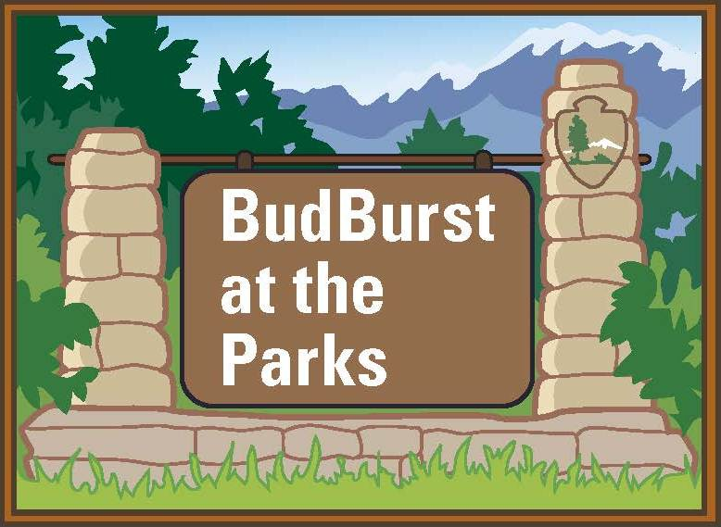
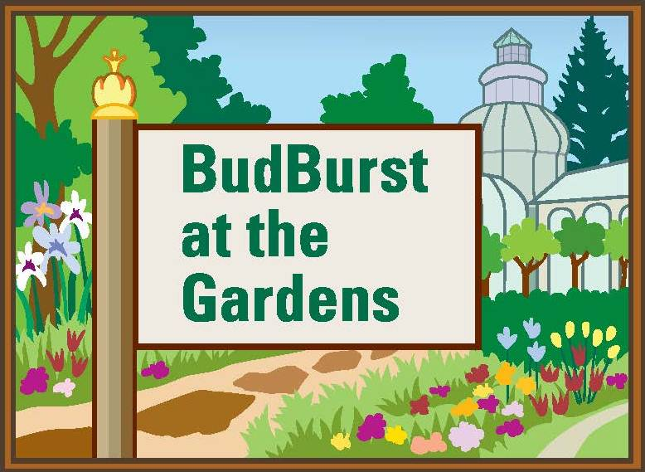



BudBurst at Museums?

Slide 20
Speak multiple languages

Slide 21
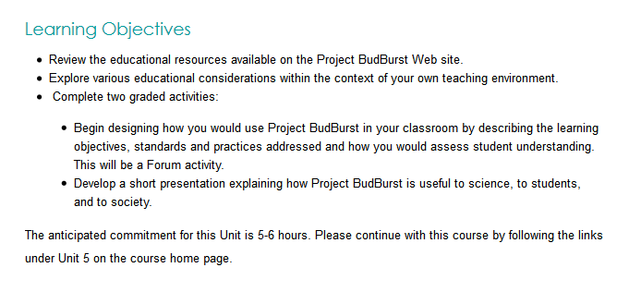
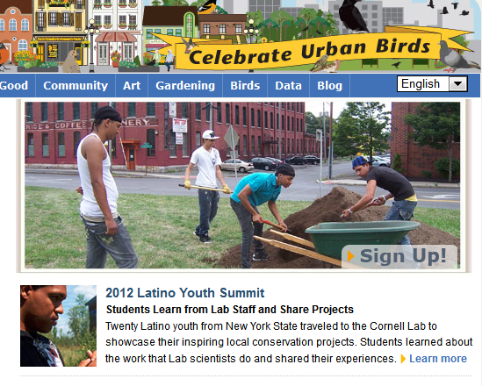
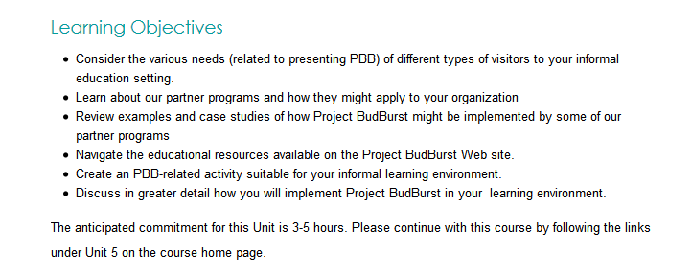
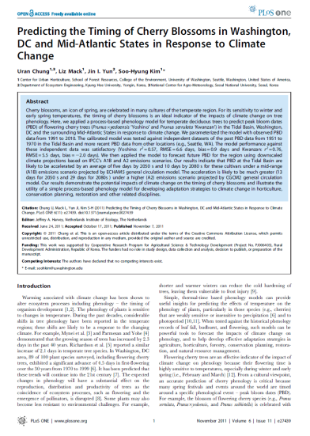
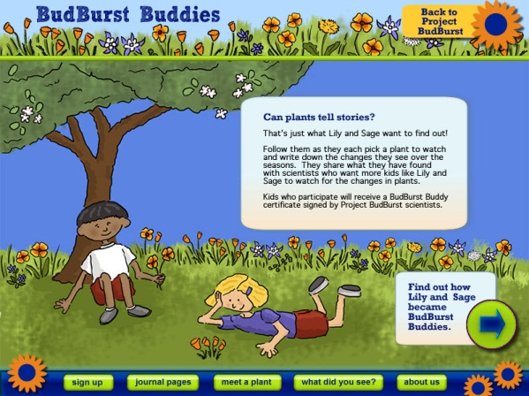
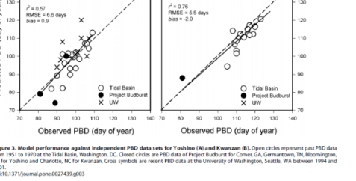
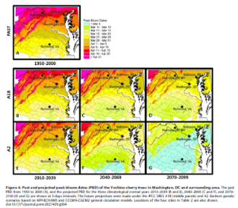
Formal Educators
Other languages or cultures
Informal Educators
Scientists
Twitter yesterday--more #iDigBio vocabulary: tri-trophic, systematics, mycophiles, macrofungi, anthropods, paleoniches. Need definitions or head might explode.
Youth
Notes:
PD Opportunities for formal vs informal audiences
Keep protocols as consistent as possible

Slide 22
Make it fun

Slide 23
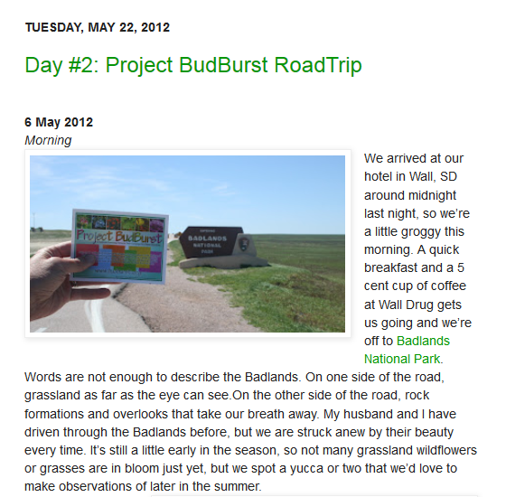
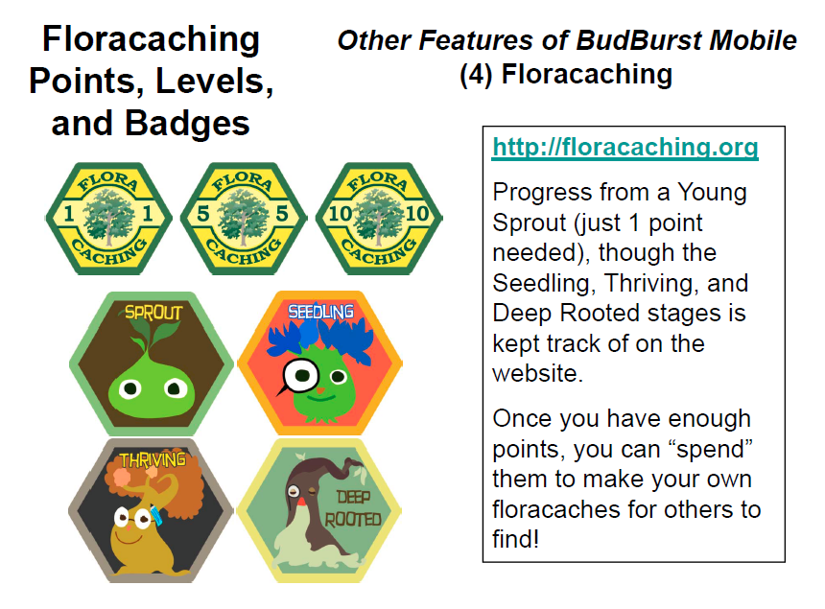


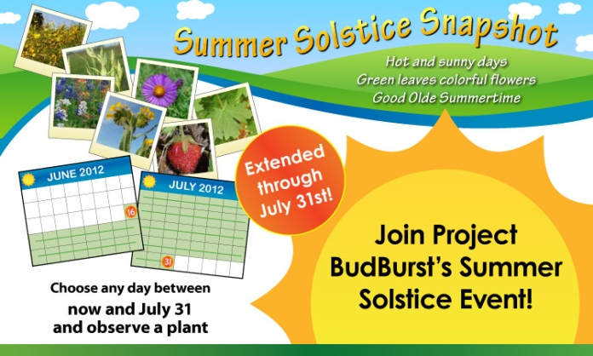
“Make the process "fun" for the citizens”—Melody’s survey
Transcription Trekker?
Notes:
Lake Monitors and coffee example

Slide 24
Be nimble

Slide 25

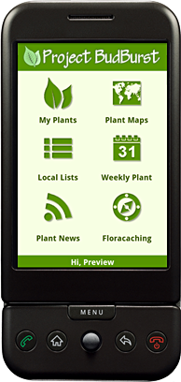

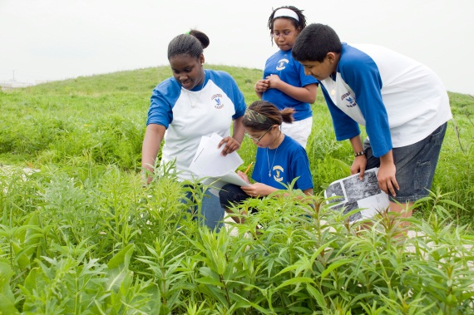
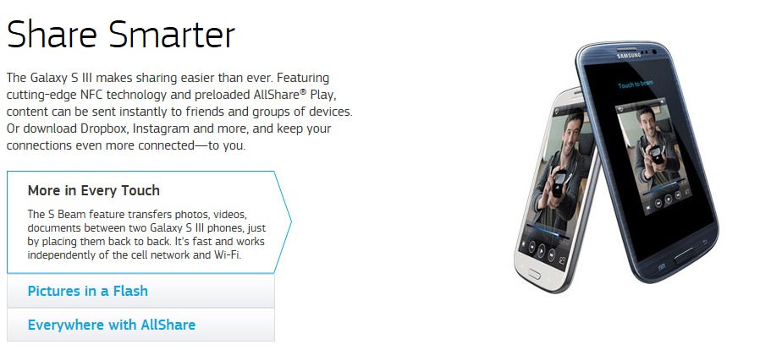
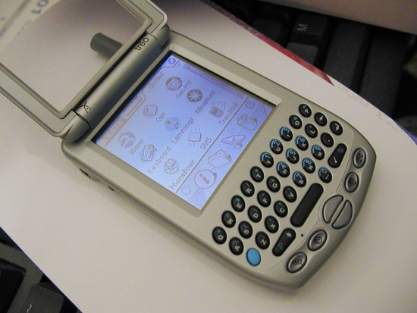

Slide 26
10 Lessons Learned
Know your audience(s)
Start small
Pilot with your audience(s)
Reduce barriers to participation
Retention through shared community
Recognition
Partnerships
Speak multiple languages
Make it fun
Be nimble

Slide 27
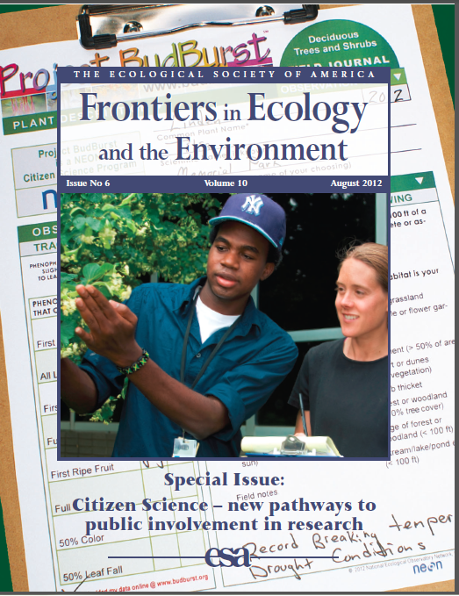
Frontiers in Ecology and the Environment
August 2012

Slide 28
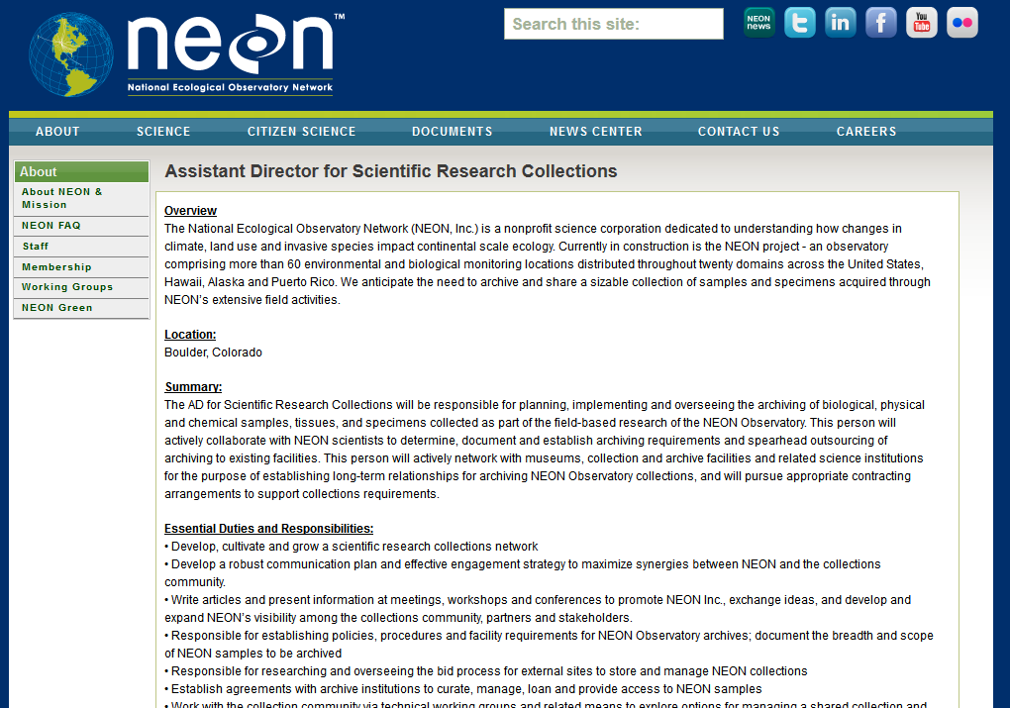
NEON Science Collections Job
neoninc.org

Slide 29
What might a workflow look like for citizen science data transcription for collection networks?
Generate Idea
Pilot with audiences
Refine based on feedback from Pilot
Test with a new audience
If good, Launch across TCNs
If not good, test with a third audience
Identify audiences

Slide 30




