Slide 1
Digitizing 'all' North American lichen and bryophyte specimens
2.3 million specimens,
65 institutions,
1 year later
Corinna Gries
Edward Gilbert
Thomas H. Nash III

Slide 2
Bryophytes and Lichens
Different evolutionarily but similar in size and habitats occupied (epiphytes, soil mats, and rocks)
Both dominate much of the arctic and northern boreal regions (lichens in upland areas and bryophytes in wet habitats.
Both also occur commonly in many other ecosystems (deserts to tropics)
Bryophytes, particularly in peat bogs store a major part of the worlds organic carbon

Slide 3
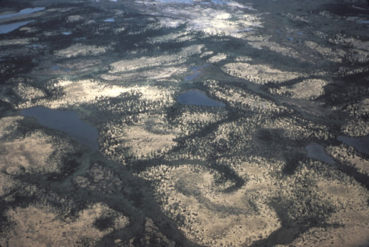
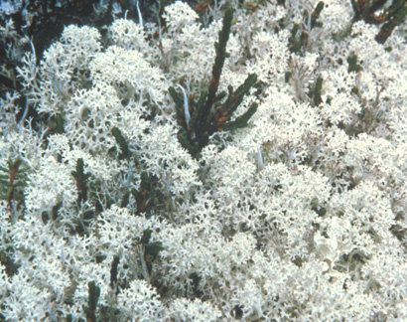
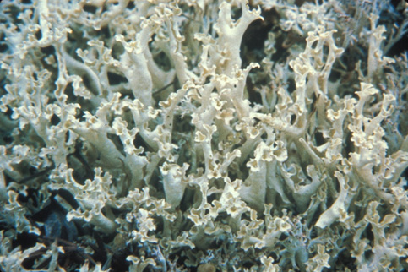
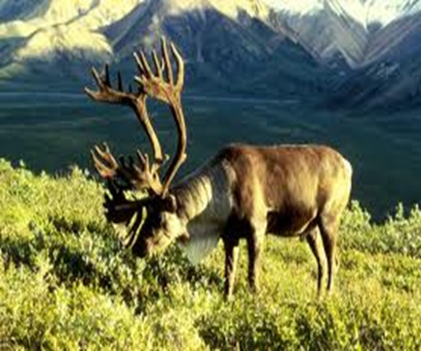

Slide 4
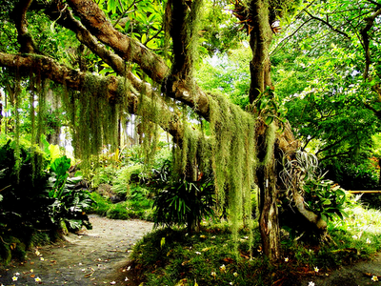
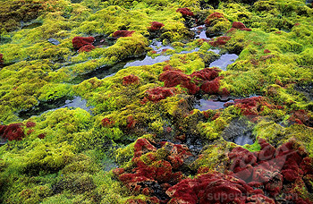
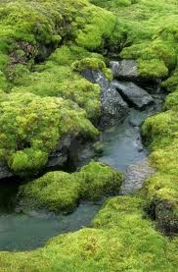
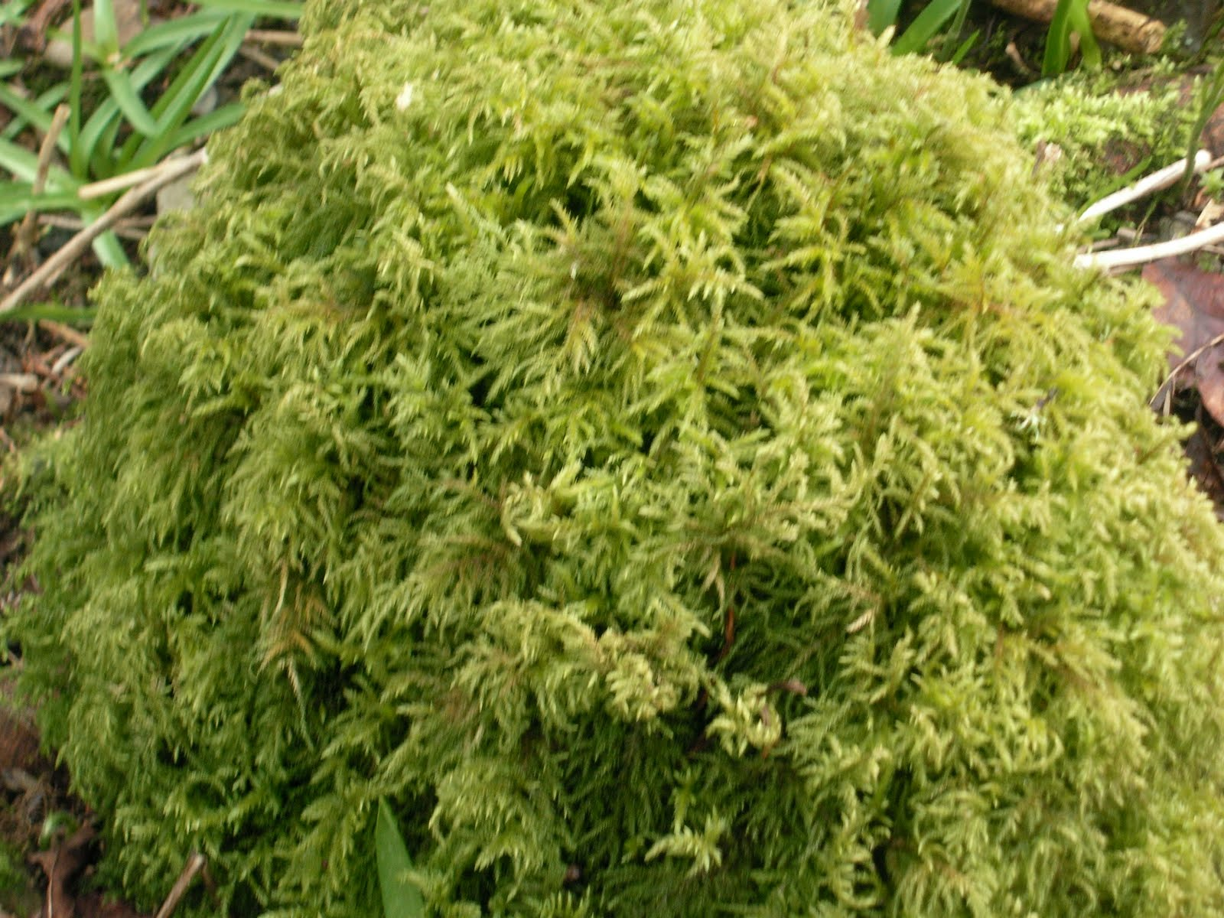

Slide 5
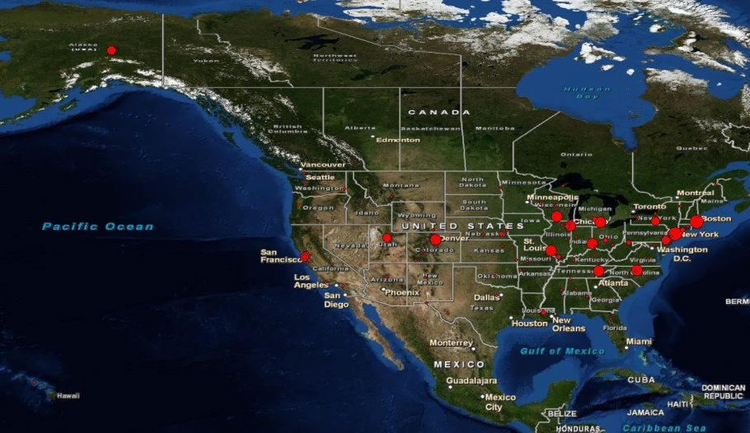
Lichens Bryophytes Climate Change
NSF ADBC funding 2011
~ 2.3 million specimen (90%)
900,000 lichens
1.4 million bryophytes
65 non-governmental US herbaria (95%)
16 digitization centers (collaborators)
Mobilizing existing
digital records
2 PEN proposals funded 2012
Add 120,000 specimen

Slide 6
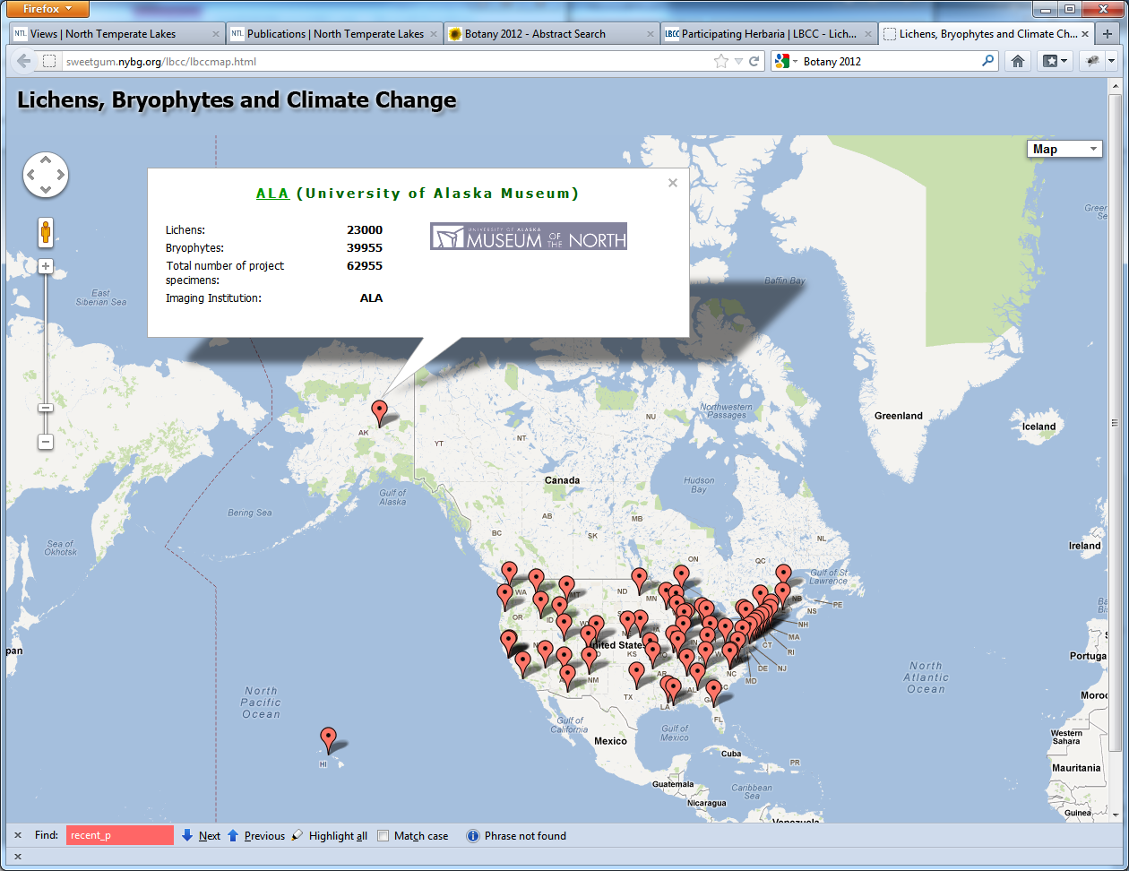
Participating Herbaria

Slide 7
Lichens Bryophytes Climate Change
Research Questions:
How are changes in distribution patterns of lichens and bryophytes over time correlated with man-made environmental changes?
How accurately can we predict where specific species can be found using existing herbarium data?

Slide 8
workflow

Slide 9
workflow
Central Processing
OCR
NLP
Bulk processing
Preliminary
geo-referencing
processed
Take Image
File name: barcode
Upload to folder on FTP server Florida
Image processing
+
Create/Merge Record in Portal
Link Image
unprocessed
Create Skeleton File
Darwin Core Fields: barcode, species name +
Upload to folder on FTP server Florida
Upload Record in Portal
Link Image
reviewed
Find Duplicates and Edit Record in Portal
Pending review
Existing Digitized Records
Darwin Core+
Manage Records in Portal
Approve Record in Portal
reviewed

Slide 10
Imaging stations
Great variety
Camera stands
Jewelry lighting boxes
Black coverings
Requirements
Resolution: small letter x needs to be 20 pixels high
Camera needs to connect to a computer
Battery life
Barcode reader

Slide 11
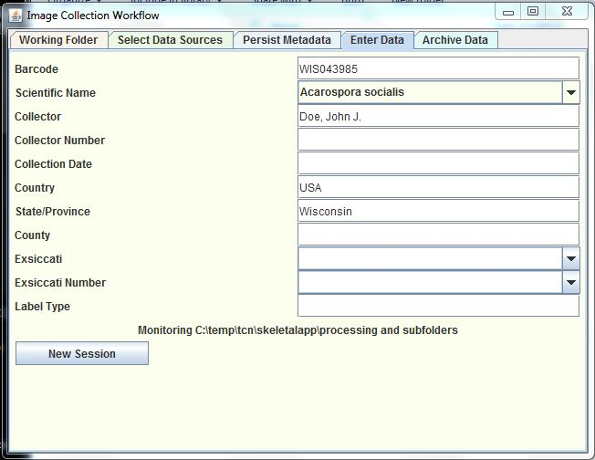
metadata
Barcode
Latest species name
Collector
Collection number

Slide 12
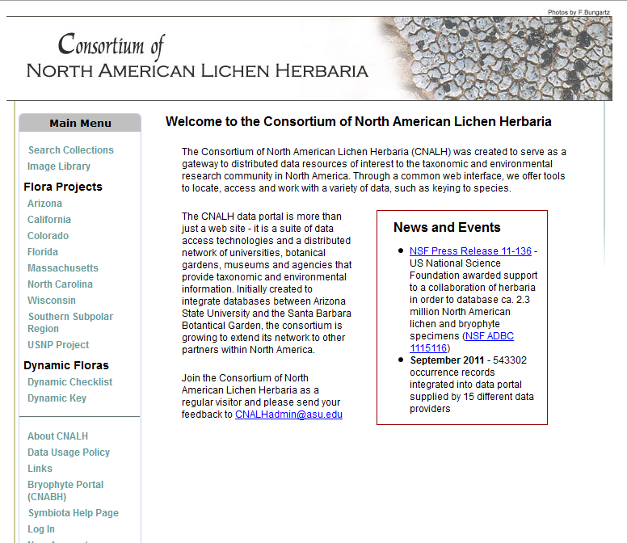
portals

Slide 13
Bryophyte Portal - bryophyteportal.org
Acronym | Name | Specimen Count
BING | State University of New York - Binghamton | 634
CMN | Canadian Museum of Nature Herbarium | 11,227
CNABH | General Observation and Personal Collections | 2
DUKE | Duke University Herbarium | 180,097
F | Field Museum of Natural History | 53,378
MICH | University of Michigan Herbarium | 23,295
MO | Missouri Botanical Garden | 228,835
MSC | Michigan State University | 100
NY | New York Botanical Garden | 344,041
PH | Academy of Natural Sciences of Drexel University | 12,463
TENN | University of Tennessee Herbarium | 15,057
UC | University of California - Berkeley | 95,191
UTC | Intermountain Herbarium (Utah State University) | 912
VSC | Valdosta State University | 4,069
VT | Pringle Herbarium | 12,791
WTU | University of Washington Herbarium | 76,971
 | Total: | 1,059,063

Slide 14
Lichen Portal - http://lichenportal.org
Acronym | Name | Specimen Count
ASU | Arizona State University Lichen Herbarium | 114,226
BRY | Brigham Young University | 9,063
CMN | Canadian Museum of Nature Herbarium | 31,102
CNALH | General Observation and Personal Collections | 8,577
DUKE | Duke University Herbarium | 3,801
F | Field Museum of Natural History | 35,020
ILLS | Illinois Natural History Survey | 10,453
ISC | Ada Hayden Herbarium at Iowa State University | 4,294
MICH | University of Michigan Herbarium | 21,512
MIN | University of Minnesota Lichen Herbarium | 144,182
MSC | Michigan State University | 105,476
NCU | University of North Carolina Herbarium | 3,445
NY | New York Botanical Garden | 105,476
OMA | University of Nebraska at Omaha Herbarium | 18,574
OSC | Oregon State University Herbarium | 5,198
PH | Academy of Natural Sciences of Drexel University | 583
SBBG | Santa Barbara Botanic Garden Lichen Herbarium | 31,294
SRP | Boise State University Lichen Herbarium | 16,055
TENN | University of Tennessee Herbarium | 8,061
UCR | University of California, Riverside Lichen Herbarium | 13,693
UPS | Uppsala University Exsiccati | 26,226
UTC | Intermountain Herbarium (Utah State University) | 267
WIS | University of Wisconsin - Madison | 53,922
WTU | University of Washington Herbarium | 25,930
 | Total: | 796,430

Slide 15
transcription

Slide 16
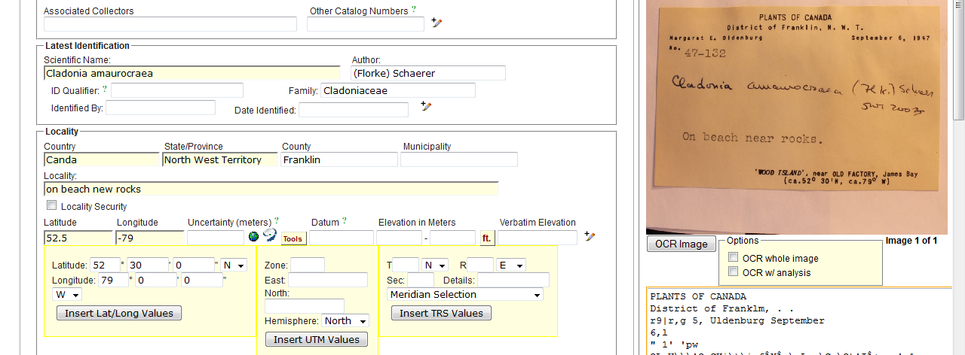
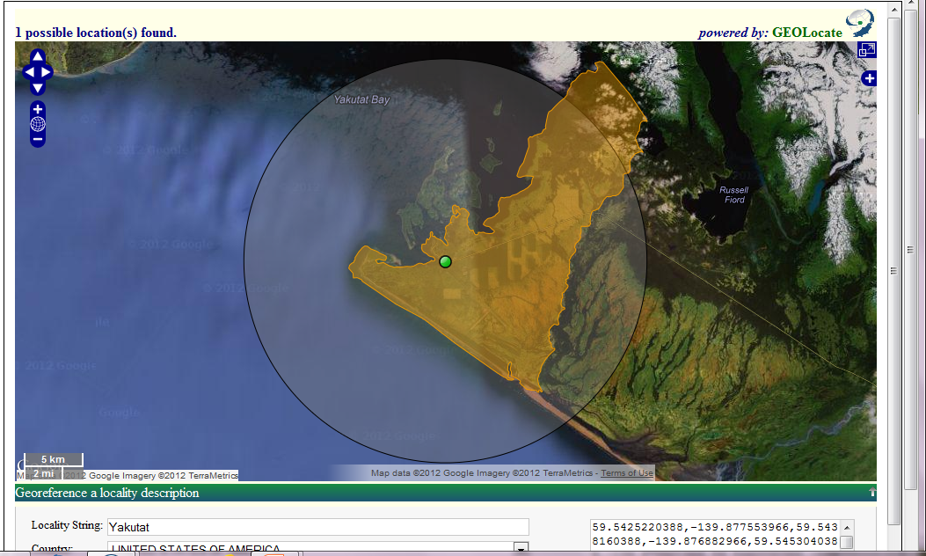
Geo-referencing
Supervised batch
geo-referencing

Slide 17
Crowd sourcing
John Brinda – Missouri Botanical Garden – national coordinator
Volunteer program within LBCC, such as California Academy of Science (Alison Young)
American Bryological & Lichenological Society members
Sophisticated User and Workflow Management System in SYMBIOTA
Transcription
Geo-referencing
Professional quality control

Slide 18
Thank you
Michael Adamo
Bruce Allen
Meredith Blackwell
Bill Buck
Alina Freire-Fierro
John Freudenstein
Alan Fryday
David Giblin
Karen Hughes
Steffi Ickert-Bond
Timothy James
Jennifer S. Kluse
Matt Von Konrat
Ben Legler
Tatyana Livshultz
Robert Lücking
Francois Lutzoni
Bob Magill
Andrew Miller
Brent Mishler
Donald Pfister
Richard Rabeler
Malcolm Sargent
Edward Schilling
Michaela Schmull
Blanka Shaw
Jon Shaw
Carol Shearer
Larry StClair
Barbara Thiers
Funded by the NSF ADBC program

Slide 19
technology
Metadata capture program
Custom System

Slide 20
numbers
Imaging speed | 300 – 500 per 8 hour day
Institutions currently uploading images | 9
Total number of images on server | ~ 130,000
Records available in the bryophyte portal | 960,000
Records available in the lichen portal | 703,000

Slide 21
portals
http://lichenportal.org
http://bryophyteportal.org
http://symbiota.org

Slide 22
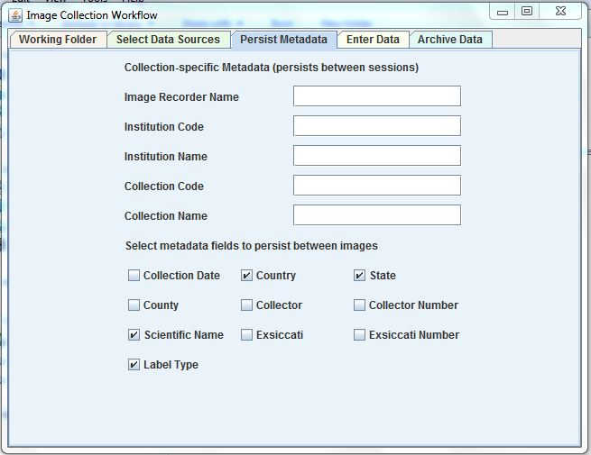
Persistent metadata

