Slide 1
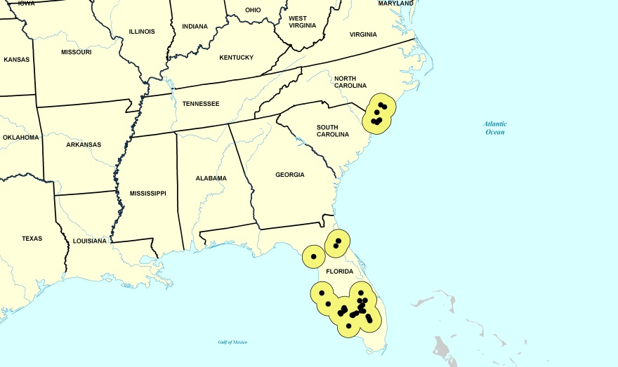
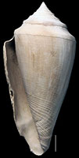
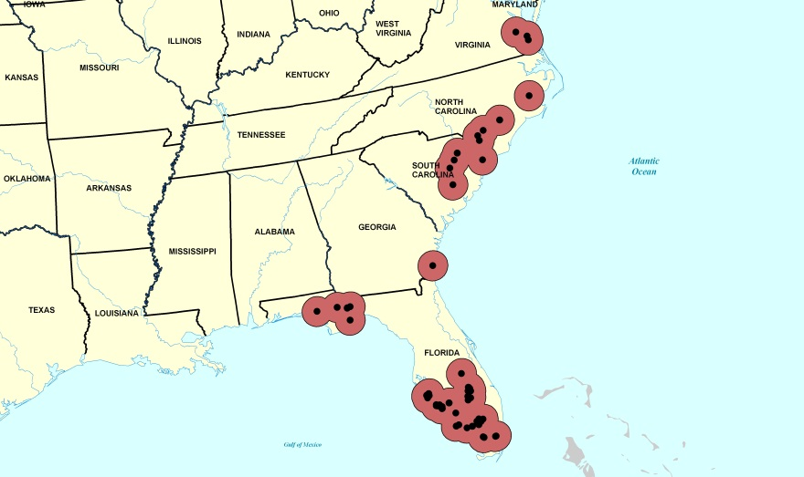
Digital Atlases of Fossil Collections: New Resources for the Public to Identify and Understand Ancient Biodiversity
Pleistocene
Pliocene
Jonathan R. Hendricks
Dept. of Geology, San Jose State University
Jonathan.hendricks@sjsu.edu

Slide 2
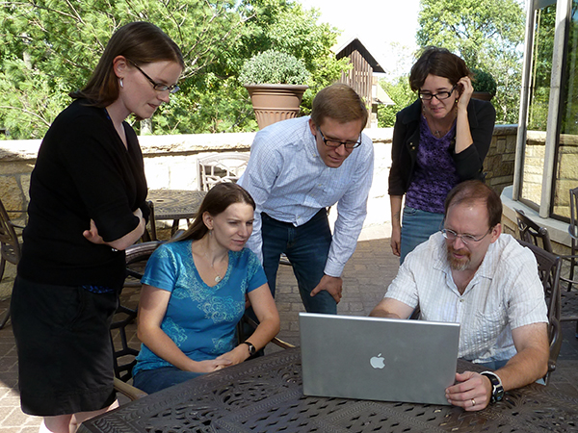
TCN Overview
“Digitization TCN: Collaborative Research: Digitizing Fossils to Enable New Syntheses in Biogeography – Creating a PALEONICHES-TCN”
Principal Investigators:
Bruce Lieberman (Univ. Kansas)
Alycia Stigall (Ohio Univ.)
Jonathan Hendricks (San Jose State Univ.)
Una Farrell, Alycia Stigall, Jonathan Hendricks, Hannah Brame, and Bruce Lieberman.

Slide 3
TCN: Goals
Database several major invertebrate fossil collections.
Georeference fossil collections to enable study of biogeographic patterns over time.
Generate digital atlases of fossil life for the general public and scientific community:
Digital images of ancient biodiversity.
Paleogeographic maps for individual species over multiple time intervals.

Slide 4
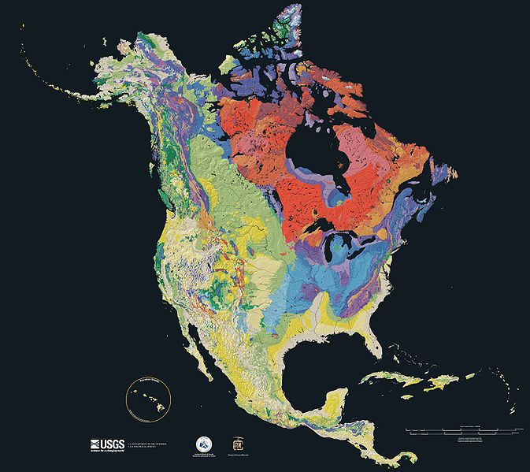
Project Coverage in Time and Space
Eon | Era | Period | Epoch
Phanerozoic | Cenozoic | Quaternary | Holocene
 |  |  | Pleistocene
 |  | Neogene | Pliocene
 |  |  | Miocene
 |  | Paleogene | Oligocene
 |  |  | Eocene
 |  |  | Paleocene
 | Mesozoic | Cretaceous | -
 |  | Jurassic | -
 |  | Triassic | -
 | Paleozoic | Permian | -
 |  | Pennsylvanian | -
 |  | Mississippian | -
 |  | Devonian | -
 |  | Silurian | -
 |  | Ordovician | -
 |  | Cambrian | -
Proterozoic | - | Ediacaran (630-542 Ma)- | -
Archean | - | - | -
Hadean | - | - | -
Younger
Slide shows the geological time scale.
Older

Slide 5
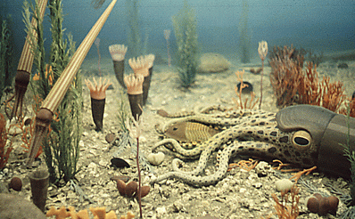
Ordovician (488-444 Ma) Collections
Region: Cincinnati area.
Collections:
Ohio University Zoological Collections (Alycia Stigall)
Department of Invertebrate Paleontology, Cincinnati Museum Center (Brenda Hunda)
Karl E. Limper Geology Museum, Miami University (Kendall Hauer)
Material to be digitized:
100,000 specimens
115 species
http://www.ucmp.berkeley.edu/ordovician/ordovician.php

Slide 6
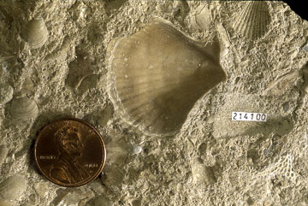
Pennsylvanian (318-299 Ma) Collections
Region: Mid-Continent.
Collection:
University of Kansas Biodiversity Institute, Division of Invertebrate Paleontology (Bruce Lieberman and Una Farrell)
Material to be digitized:
170,000 specimens
240 species
http://www.kgs.ku.edu/Extension/fossils/bivalve.html

Slide 7
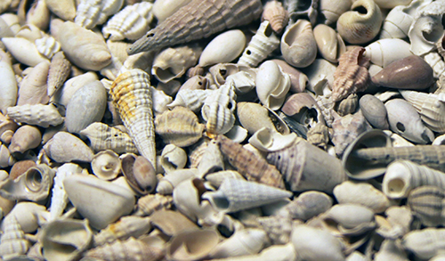
Neogene (23-2.6 Ma) Collections
Region: Southeastern USA.
Collection:
Division of Invertebrate Paleontology, Florida Museum of Natural History (Roger Portell)
Material digitized (focus will be on digital atlases):
176,615 specimens
500 species

Slide 8
Digital Atlases: Goals
Digital atlases:
“Field guides to the past” for three of the United States’ most fossil-rich regions
Online webpages
“App” for mobile devices
Intended audiences: scientists and advocational fossil collectors
Atlases will be generated for the following numbers of specimens from each time period:
Ordovician: 115 species
Pennsylvanian: 240 species
Neogene: 500 species

Slide 9
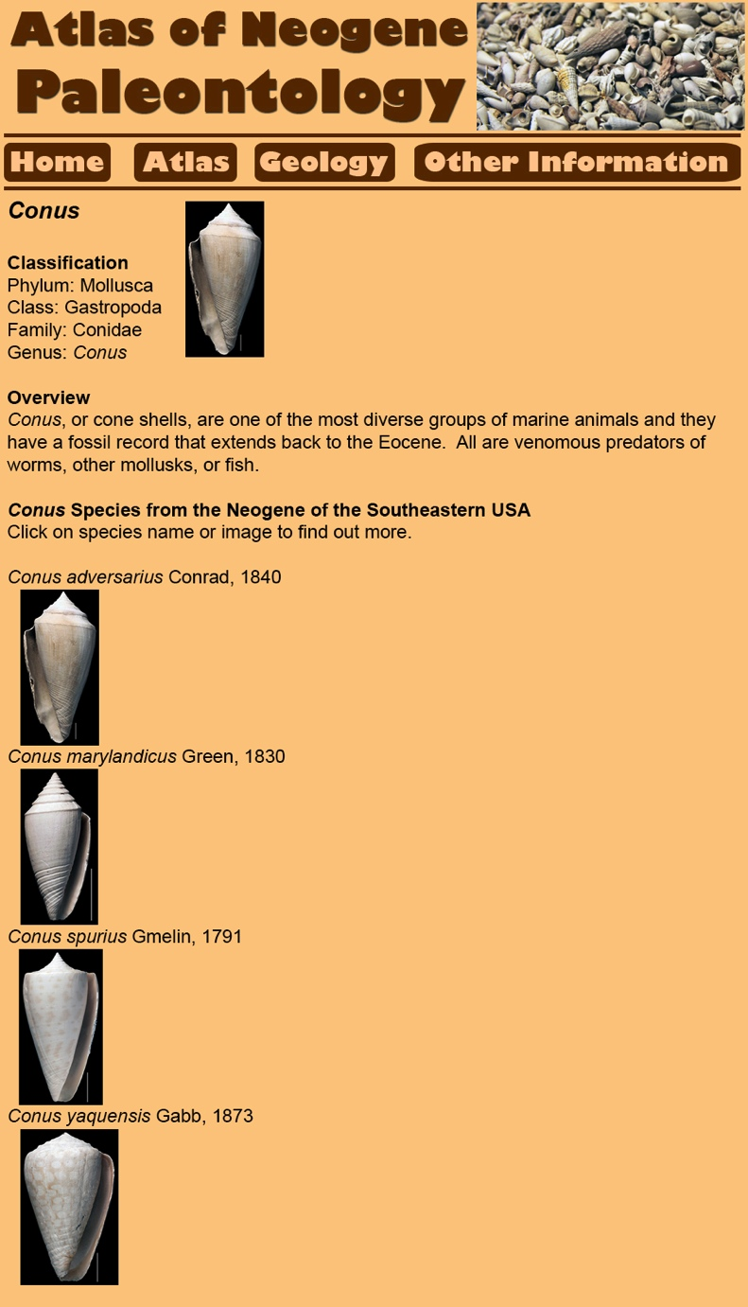
Genus Page
Classification (hyperlinks)
Overview of genus
Species list, with hyperlinked images to assist identifications
Slide shows figure of sample taxon webpage for Conus.

Slide 10
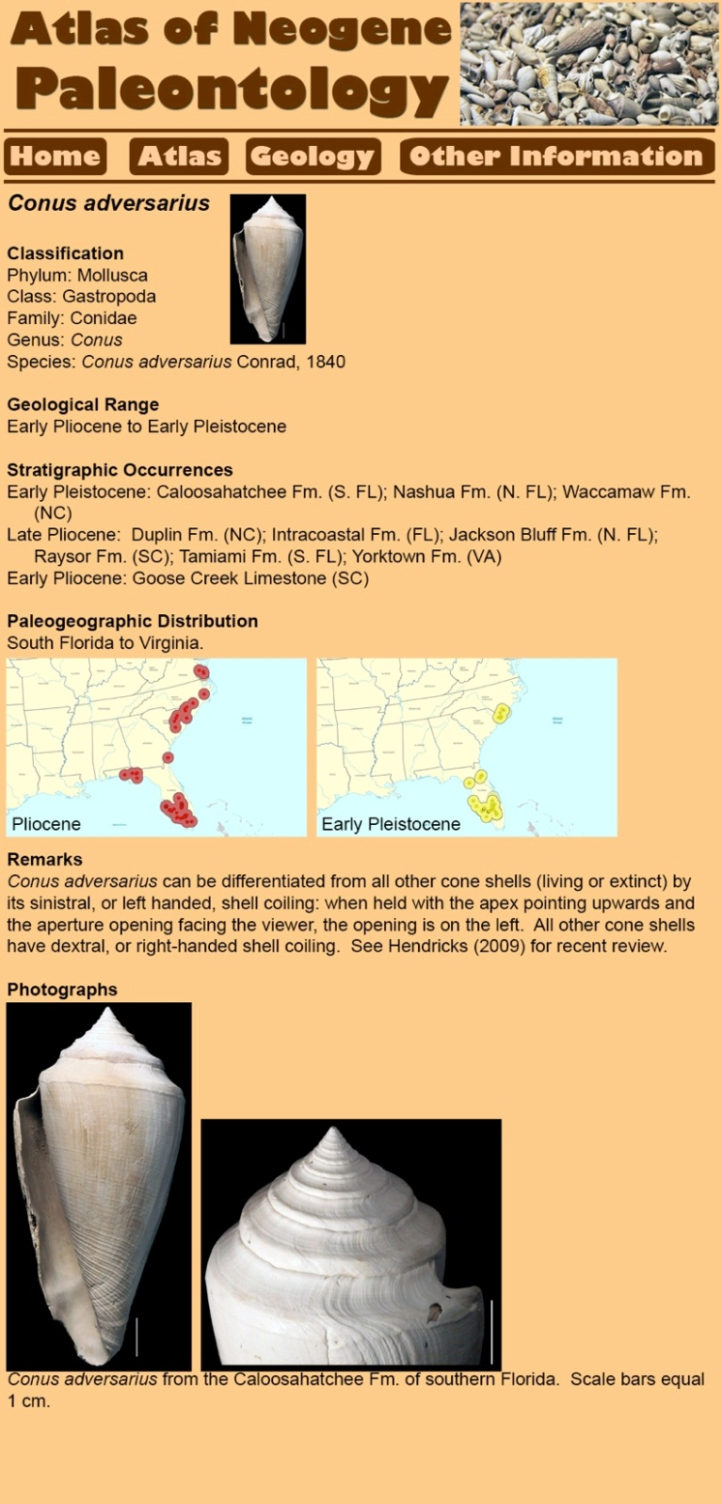
Species Page
Classification (hyperlinks)
Geological range
Stratigraphic occurrences (hyperlinks to taxon lists)
Paleogeographic distributions with “time-slice maps”
Remarks:
Features useful for identification
Important references
Photographs illustrating key features for identification
Slide shows figure of sample taxon webpage for Conus adversarius.

Slide 11
Range Changes Over Time

Slide 12
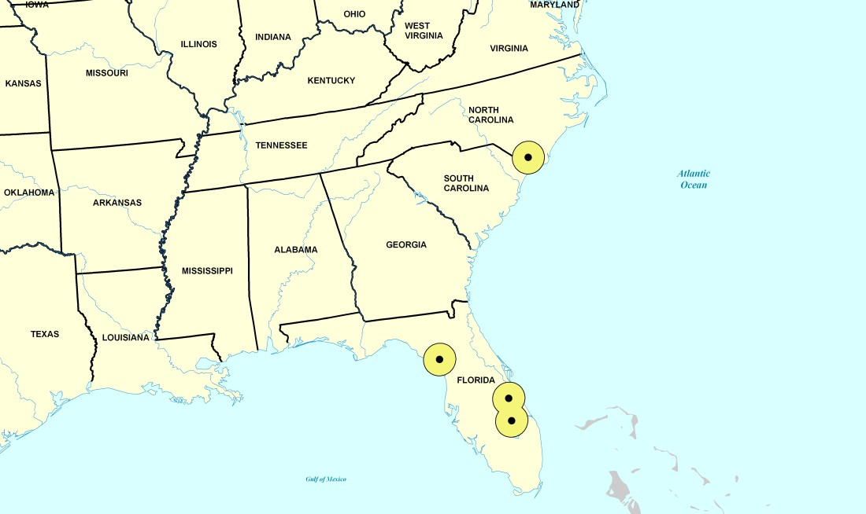
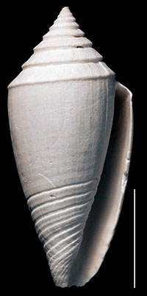
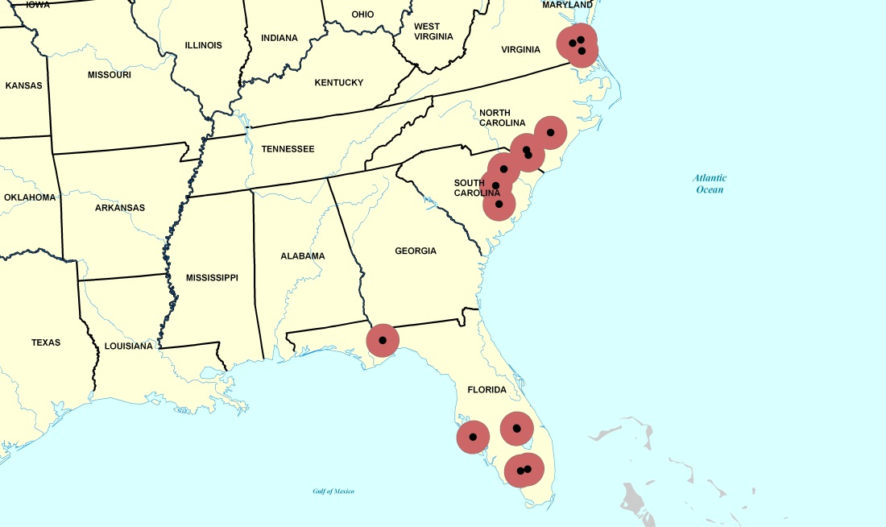
Conus marylandicus
Early Pleistocene
Range contraction prior to extinction.
Pliocene
Note: Dots are actual occurrence areas, surrounded by a 50km buffer.
All records

Slide 13
Varied Ranges Among Taxa During Individual Time Slices

Slide 14
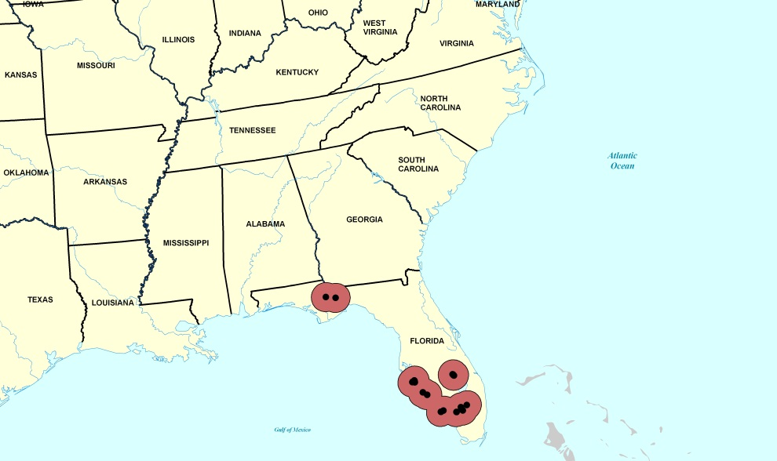
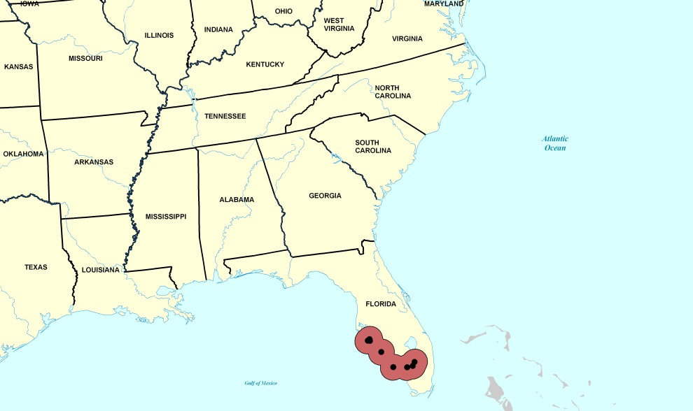
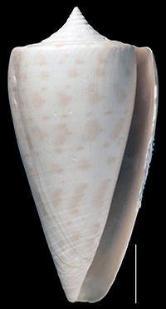
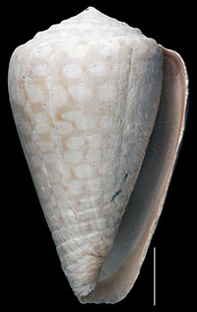
Different Ranges of Four Conus Species During the Pliocene
Conus adversarius
Conus marylandicus
Conus spurius
Conus yaquensis

Slide 15
Thank You
NSF EF 1206750, 1206757, and 1206769 for supporting this TCN.
The staff of iDigBio for organizing this workshop.

Slide 16
XXXX
XXXX
XXXX

