Slide 1
Biodiversity Information
Serving Our Nation (BISON):
A National Resource for
Species Occurrence Data
Elizabeth Martín
U.S. Geological Survey
Core Science Analytics and Synthesis
Core Science Systems

Slide 2
What is BISON?
Biodiversity Information Serving
Our Nation (BISON)
A national unified resource for discovery, linkage and reuse of species occurrence data

Slide 3
BISON Background & Goals
Developed by the U.S. Geological Survey
  Core Science Analytics and Synthesis (CSAS)
Goals
  Develop large integrated data store of fully indexed species occurrence records for the U.S.
  Incorporate federal and non-federal datasets of observations and specimens
  Develop resource capabilities tailored to U.S. needs

Slide 4
BISON and Federal Collections
BISON will serve as:
  Repository for digitized federal collections data
  Biodiversity hub of EcoINFORMA
BISON’s staff participate in IWGSC
Interagency Working Group on Scientific Collections (IWGSC) will develop:
  Clearinghouse of federal collections
  Policy recommendations for federal collections
  Budget guidance for federal collections
Notes:
IWGSC part of National Science and Technology Council

Slide 5
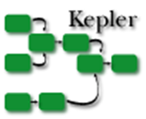

BISON Architecture
BISON Infrastructure
GBIF DB
GBIF
Users
US records
Normalized GBIF Occ. records
BISON Web portal
&
Web Services
Occurrence index
Spatial fields
County details
Occ. Records
Access via API
USGS member node
Data Publication Tool
US Data Providers
OGC Services
DataOne

Slide 6
BISON will include…
Powerful and flexible data search & filter capabilities
Easy download of data
GIS & data visualization component - access to high resolution base layers for the U.S.
Easily spun off web & map services, widgets, templates, stats for partners and users
Citizen science component - engage the public
Social science component - track societal relevance

Slide 7
Data in BISON
Over 106 million records as of Sept. 2012
Majority of records from GBIF
Initial new data input emphases:
  Federal datasets
  Invasive species data
New data from USGS to be added this year
  Amphibians, birds, fish and invasive species

Slide 8
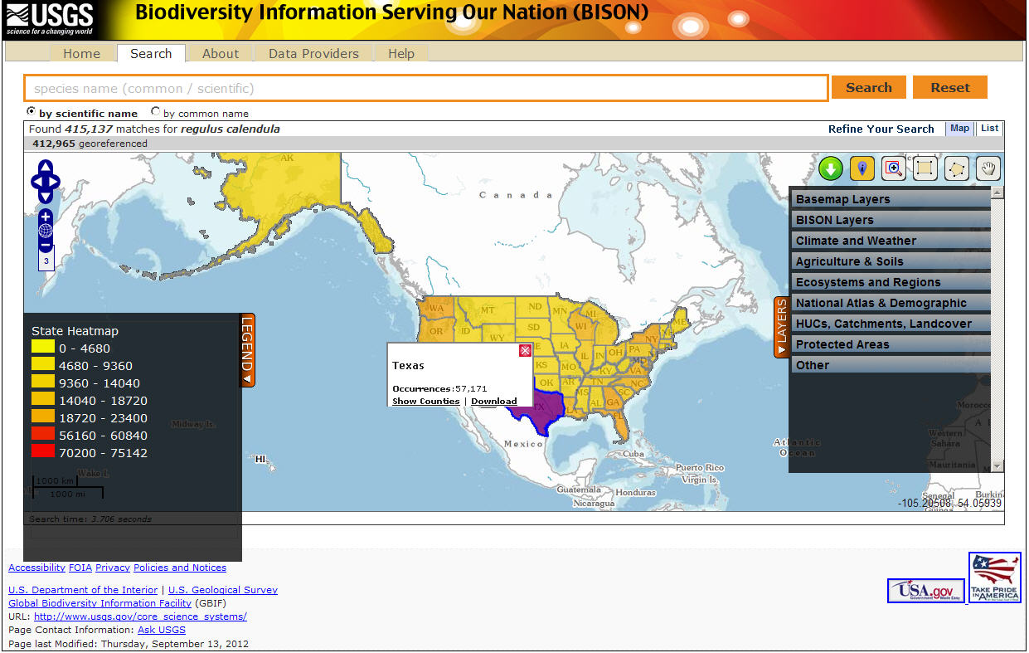
BISON Web Portal
Public release scheduled for early November

Slide 9
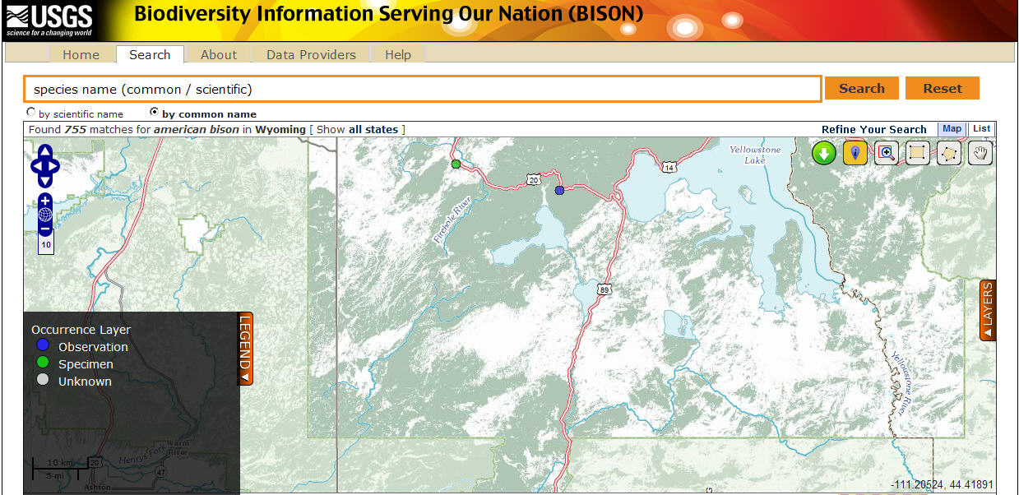
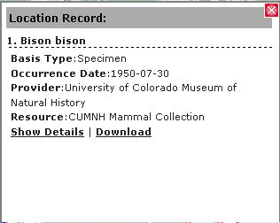
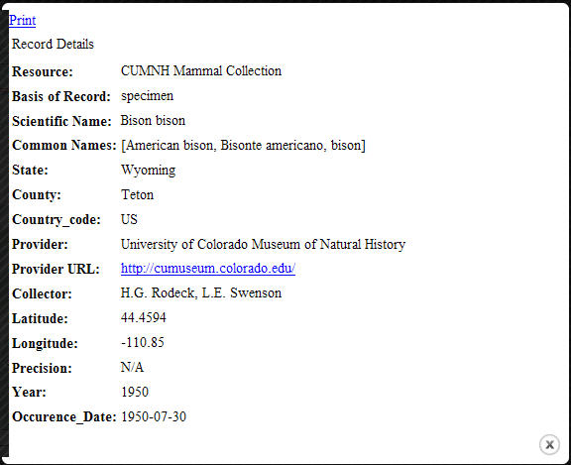
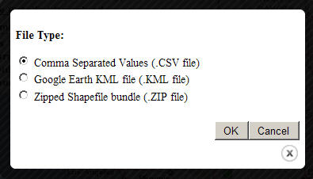
Data Documentation & Download

Slide 10
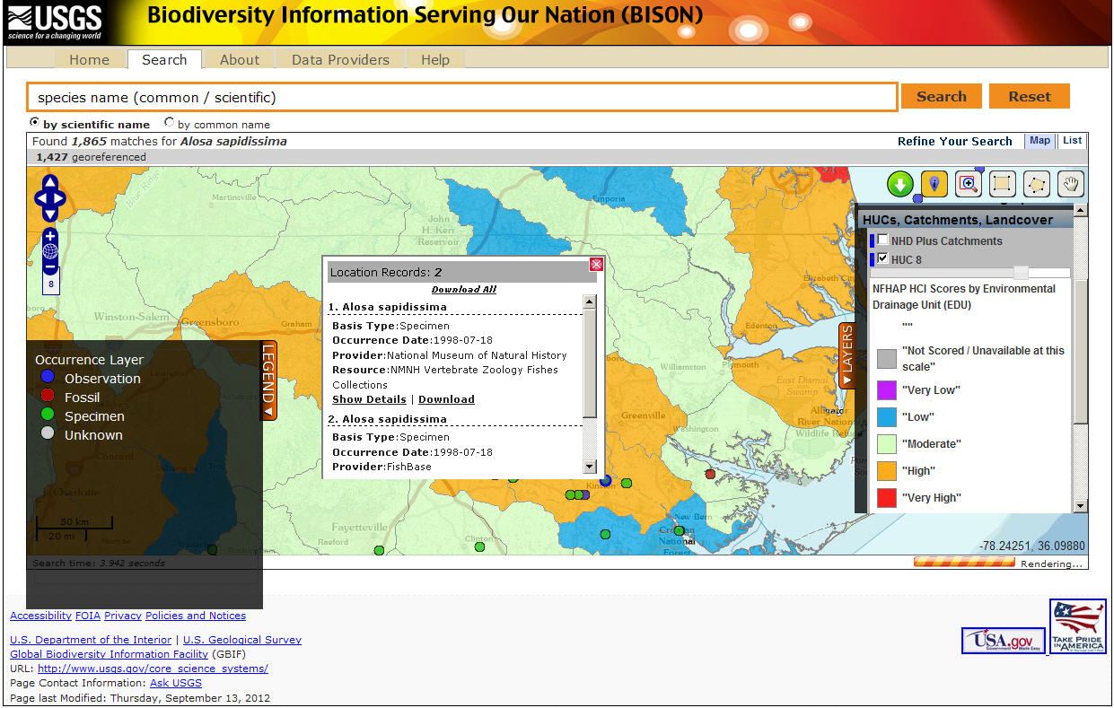
Data Visualization

Slide 11
Engaging Public Participation
Our initial approach
  Work with collaborators conducting citizen science programs / projects
  Collaborators aggregate data and contribute datasets to BISON
  BISON providing some assistance with use of technology to gather data
  Pilot projects support ecological monitoring and generation of new species occurrence records

Slide 12
Citizen Science Observation Platform
Use of mobile devices and social media for recording and delivery of data
Based on:
  Curated Twitter submissions
  Twitter data mining / stream API
Funded by USGS Community for Data Integration (CDI)

Slide 13
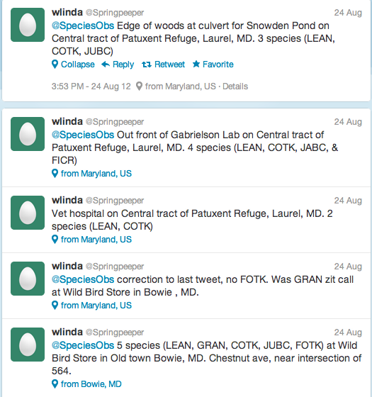
How it Works…
Tweets (@speciesobs) – Stream API
SMS, Email, Voice
MongoDB – Observations
Web Map
BISON Species Observations

Slide 14
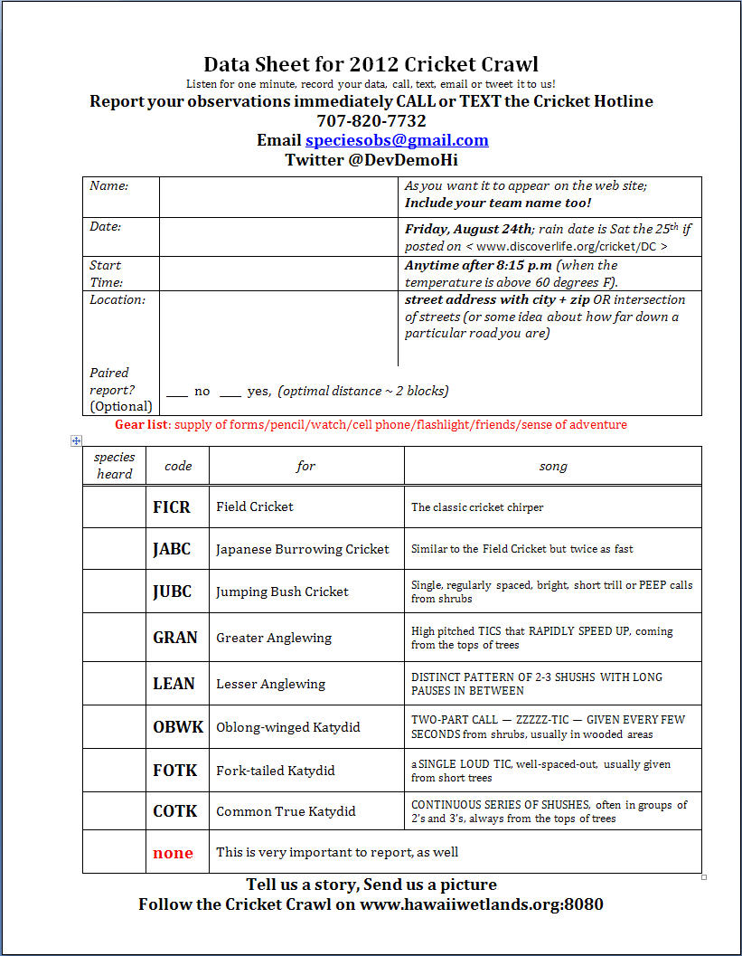
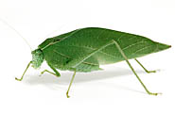
Twitter Submissions Demo Projects
Washington DC / Baltimore Cricket Crawl
http://www.discoverlife.org/cricket/DC/
Census of crickets
and katydids singing throughout Baltimore/DC metro areas
Conducted on August 24, 2012
hundreds of participants
2500 observations

Slide 15
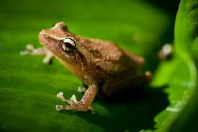
Twitter Submissions Demo Projects, cont’d.
Hawaii Critter Crawl
Students and general public participation
  Create awareness about biodiversity
  Identify locations of:
    Coqui frogs (invasive species)
    House geckos
    Native Hawaiian crickets
Fall 2012

Slide 16
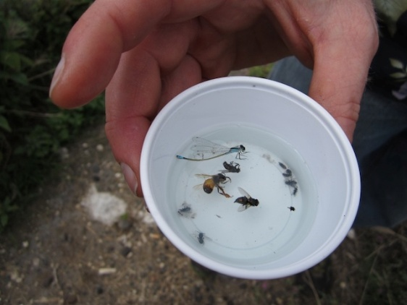
Hawaii Bee Bowl Surveys
Assessing feasibility of bee bowl surveys with K-12 students and teachers
  Bee collection follows defined protocol
  http://www.discoverlife.org/bee/bowl/
  Collected specimens sent to USGS Patuxent Wildlife Research Center for identification
  Some specimens donated to museums
Data
  USGS Native Bee Inventory DB
  To be incorporated into BISON

Slide 17
Thank You
For additional information
Elizabeth Martín - elizabeth_martin@usgs.gov
Derek Masaki - dmasaki@usgs.gov
Annie Simpson - asimpson@usgs.gov
Gerald (Stinger) Guala - gguala@usgs.gov
Director of BISON

