Slide 1
Notes from Nature: a scalable citizen science platform for transcribing records from natural history collections.
M.W. Denslow
S. Belonge, R. Gillespie, R. Guralnick,
J. Gross, A. Hill, Z. Murrell, P. Oboyski,
A. Sallans & A. Smith

Slide 2
Challenges
Natural history collections
Use of data to full potential
Volume
Total digitized ~33%
Heterogeneity

Slide 3
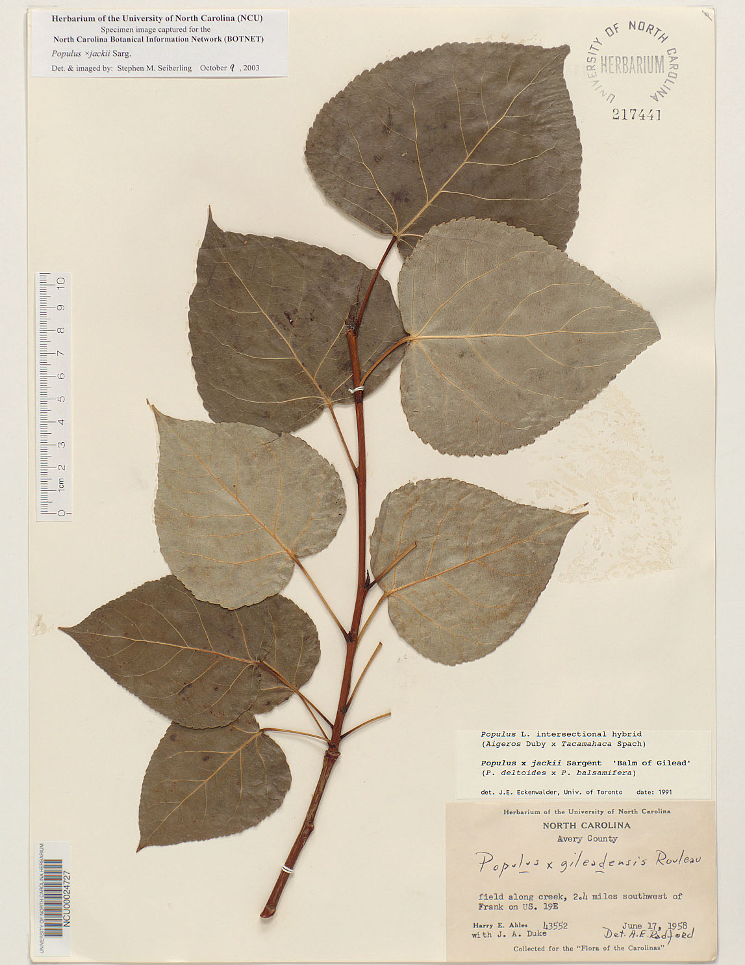
Challenges
Public engagement
Promote knowledge about
Organisms
Natural history collections
Use of specimens in research

Slide 4
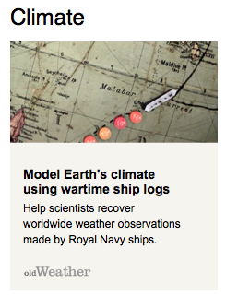
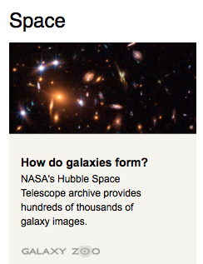
Solution
Citizen science transcription
Success in other domains
Old Weather
25,000 volunteers, 1.5 million records

Slide 5
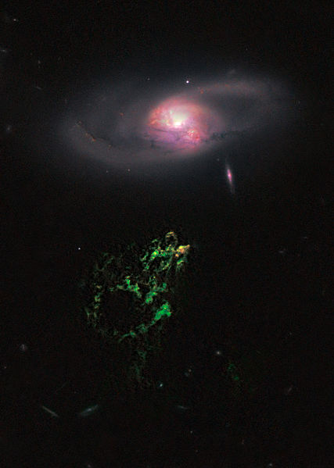
Hanny's Voorwerp ‘Hanny's object’
Discovered by a Dutch school
teacher named Hanny van Arkel

Slide 6
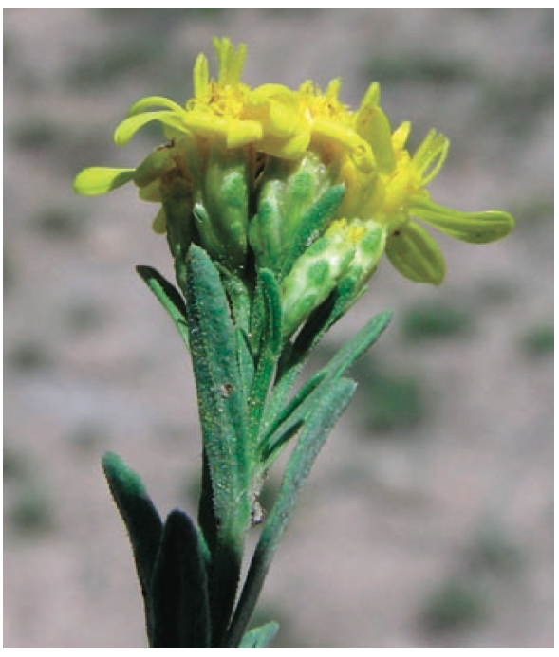
Citizen Science
Not just a way to gather data
Mutually beneficial partnership
Contribution of data, analyses or solutions toward scientific research by volunteers
Citizen scientists contributions to natural history are not new!

Slide 7
Citizen Science
Other efforts
Compare
Excellent models to build upon
Generalized solution
Volume, scalable

Slide 8
Notes From Nature: Phase 1
Citizen Science Alliance proposal
Limited resources
Software development
Vizzuality / Adler Planetarium
Phase 1 goals
Transcription interface prototype
Simple, direct interaction with specimens
Address complexities of multiple collections
Plan to recruit new pool of volunteers

Slide 9
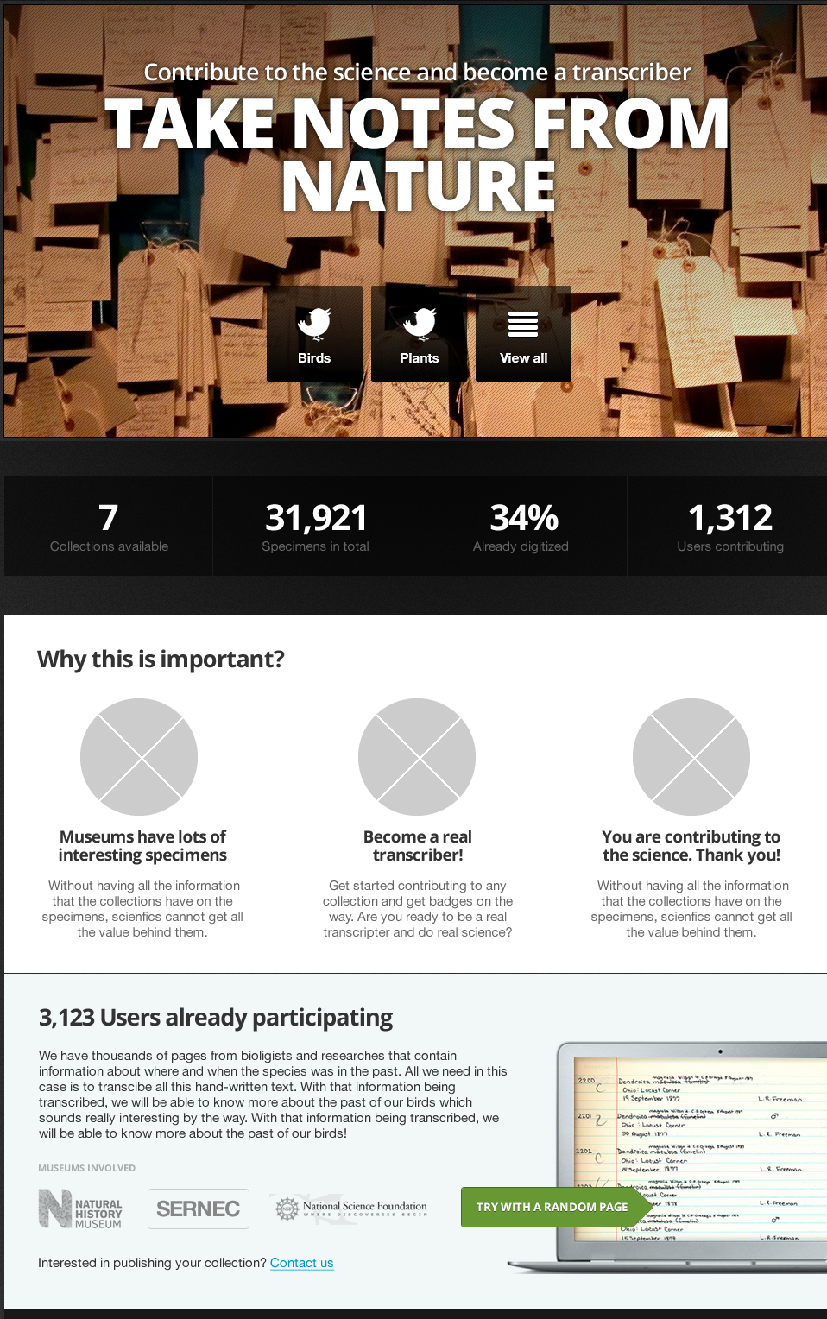
Notes From Nature: Phase 1
Progress
Private Beta
Public Beta prototype
November 2012
Focus on project needs
SERNEC, CalBug, Natural History Museum London

Slide 10
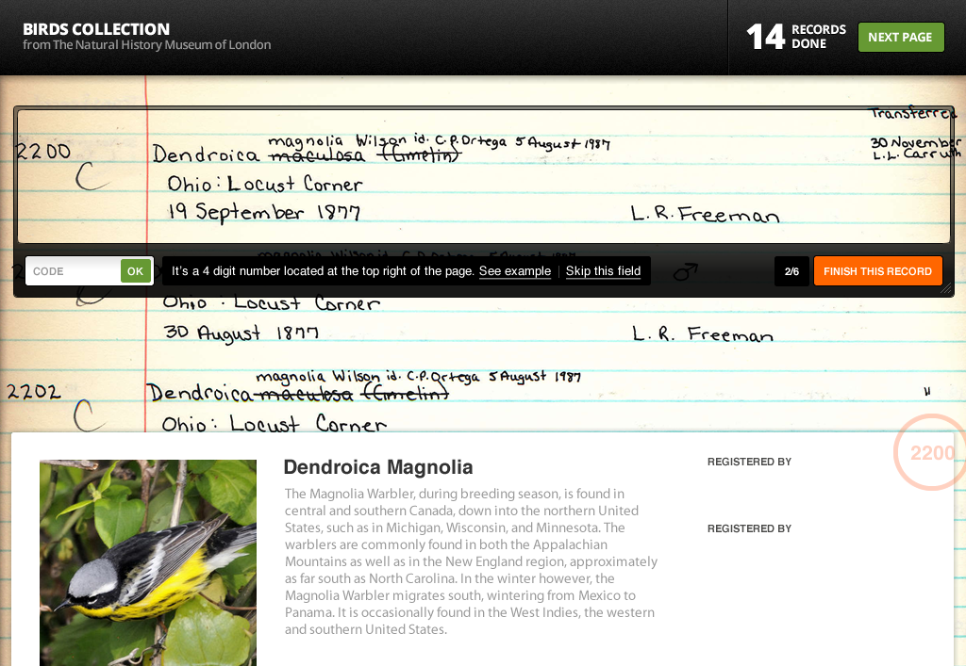
Notes From Nature: Phase 1
Projected outcomes
Improved transcription tool
Ways to engage with new volunteers

Slide 11
Notes From Nature: Phase 2
Proposed innovations
Accuracy assessment
User engagement
Optical Character Recognition (OCR) integration
Scalable solution

Slide 12
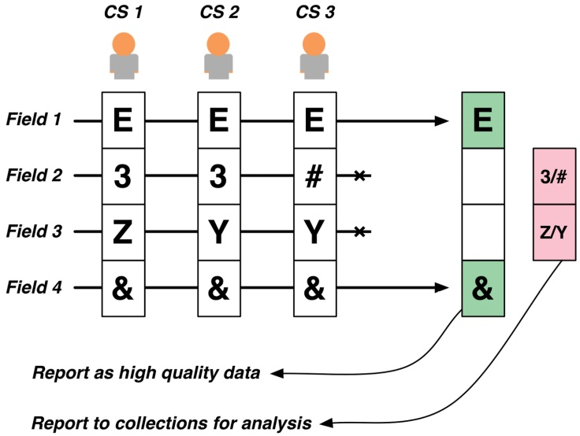
Text based fields pose greater challenges

Slide 13
Engagement
Interactive content
Inline tutorials
Advanced Interfaces

Slide 14
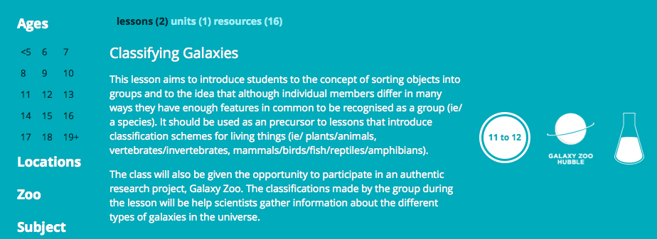
Engagement
Curriculum

Slide 15
Providing content from Encyclopedia of Life, etc.

Slide 16
OCR Integration
Two approaches
In the wild
Word spotting
Workflow
Machine readable parts
Human-in-the-loop
OCR Web API

Slide 18
Broader Interest
iDigBio
Research, evaluate digitization methods
Engaging citizen scientists
Thematic Collections Networks
Communicate scalable and effective digitization solution
Other OCR efforts (SALIX)
Improved OCR engine and Web API

