Slide 1
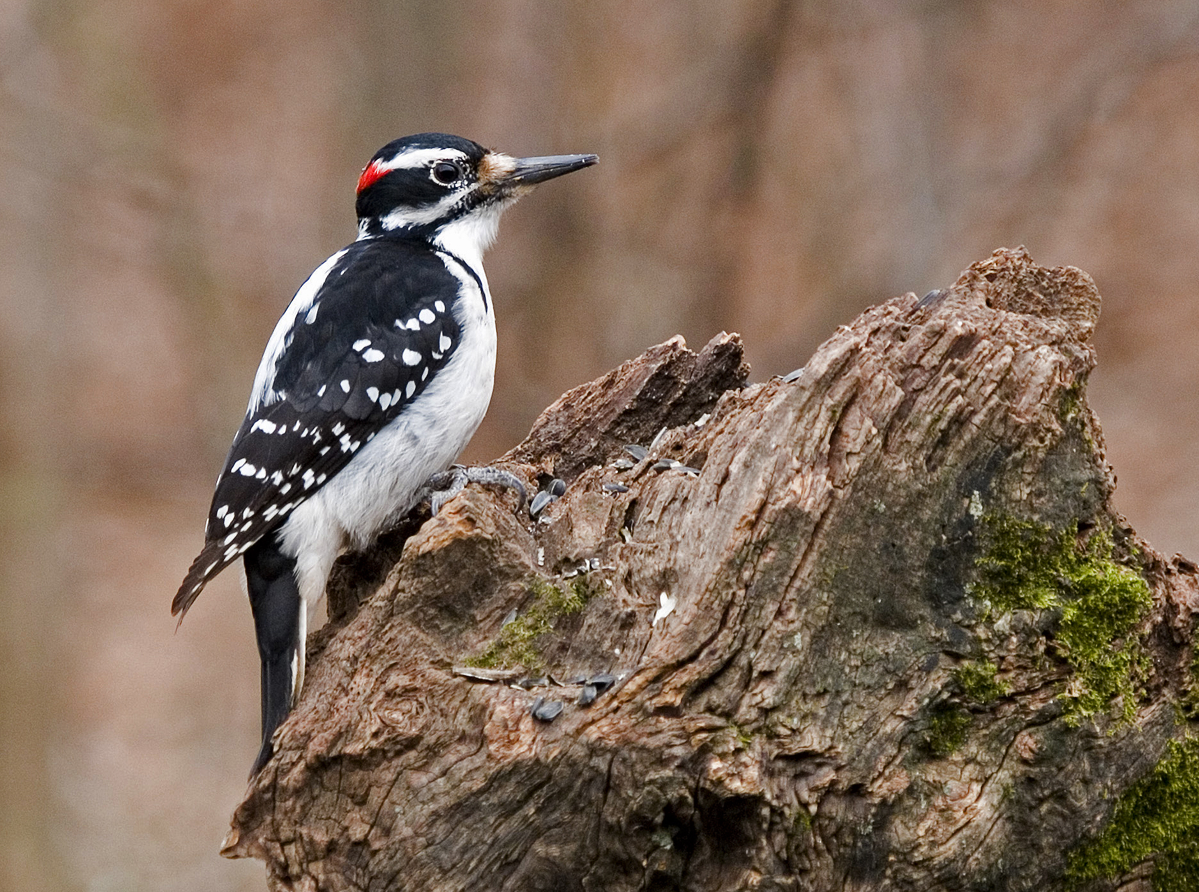
Engaging the public in ornithological research:
Lessons learned from 50 years of citizen science at Cornell
David Bonter, dnb23@cornell.edu

Slide 2
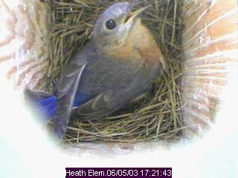
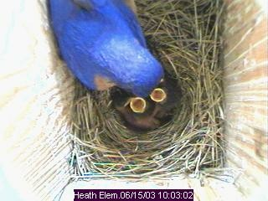
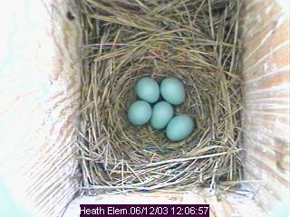
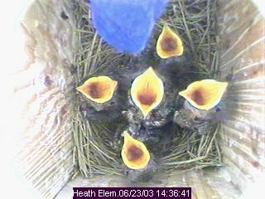
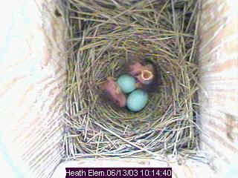
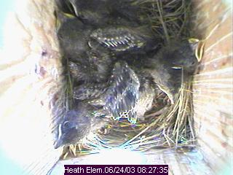
Citizen Science Projects
Nest Record Card Program (1965)
Project FeederWatch (1987)
Birds In Forested Landscapes (1991)
Project PigeonWatch (1991)
House Finch Disease Survey (1993)
The Birdhouse Network (1995)
Cerulean Warbler Atlas (1997)
Golden-Winged Warbler Atlas (1999)
Great Backyard Bird Count (1999)
eBird (2001)
Urban Bird Studies (2001)
NestWatch (2006)
YardMap (2011)
Notes:
Before we get to the grosbeak mystery, however, I’d like to provide a bit of background about the citizen science program at the Lab, in particular Project FeederWatch -- the program that I now manage.
The beginning of large-scale citizen science projects in North America can be traced to the beginnings of projects like the Christmas Bird Count, the Breeding Bird Survey, and early Lab programs such as the Nest Record Card Program. FeederWatch one of the older generation of projects and is a keystone of the Lab’s Citizen Science program.
In the last decade, the number of citizen science projects at the Lab and elsewhere has grown rapidly. (FrogWatch, WormWatch – name an organism and add the word “watch”.
For example, another citizen science project at the Lab is NestWatch, which enlists volunteers to record the reproductive activity of birds. The program also streams the immensely popular nest box cameras over the Internet. Here we see a bluebird nest in Kentucky at various stages. This site alone receives hundred of thousands of unique viewers/year– so it has tremendous reach and impact.

Slide 3
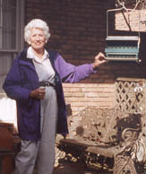
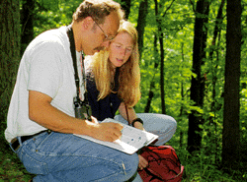
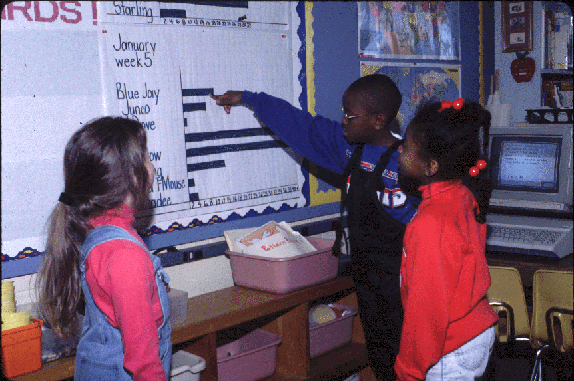
“Citizen Science”
Involves the public in professional research
Answers large-scale scientific questions
Promotes environmental awareness and scientific literacy
Notes:
Our model of citizen science seeks to form a link between individuals interested in birds and scientists interested in the biology and status of bird populations. Our programs generally cover vast spatial and temporal scales – most programs allowing participation from across the U.S. and Canada and increasingly, beyond North America.
Audiences targeted and audiences reached vary; do not necessarily overlap.
Although some of our programs require a relatively high skill level, we do have programs that encourage participation from all age groups and all levels of experience with birds and with science.
FeederWatch is a relatively simple program that can be successfully conquered by a beginning birder or an elementary school class, although approximately 35% of our participants do hold either Master’s or doctorate degrees.

Slide 4
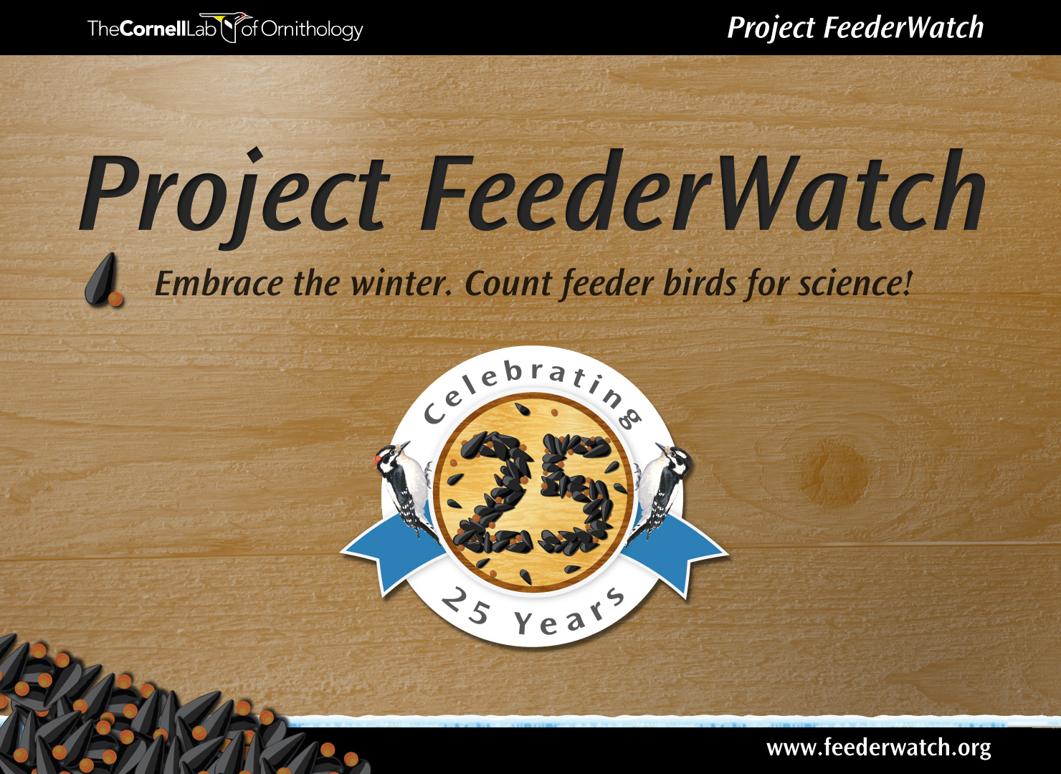
Notes:
In 1987 the Lab teamed up with our Canadian partners at Bird Studies Canada to launch Project FeederWatch, a continent-wide citizen science project designed to track changes in the abundance and distribution of birds in winter. Tomorrow marks the starting day of our 25th season of FeederWatch, and I wanted to take this opportunity to highlight some of what we have accomplished in the past, and to start the discussion about where we can take FeederWatch in the future.

Slide 5

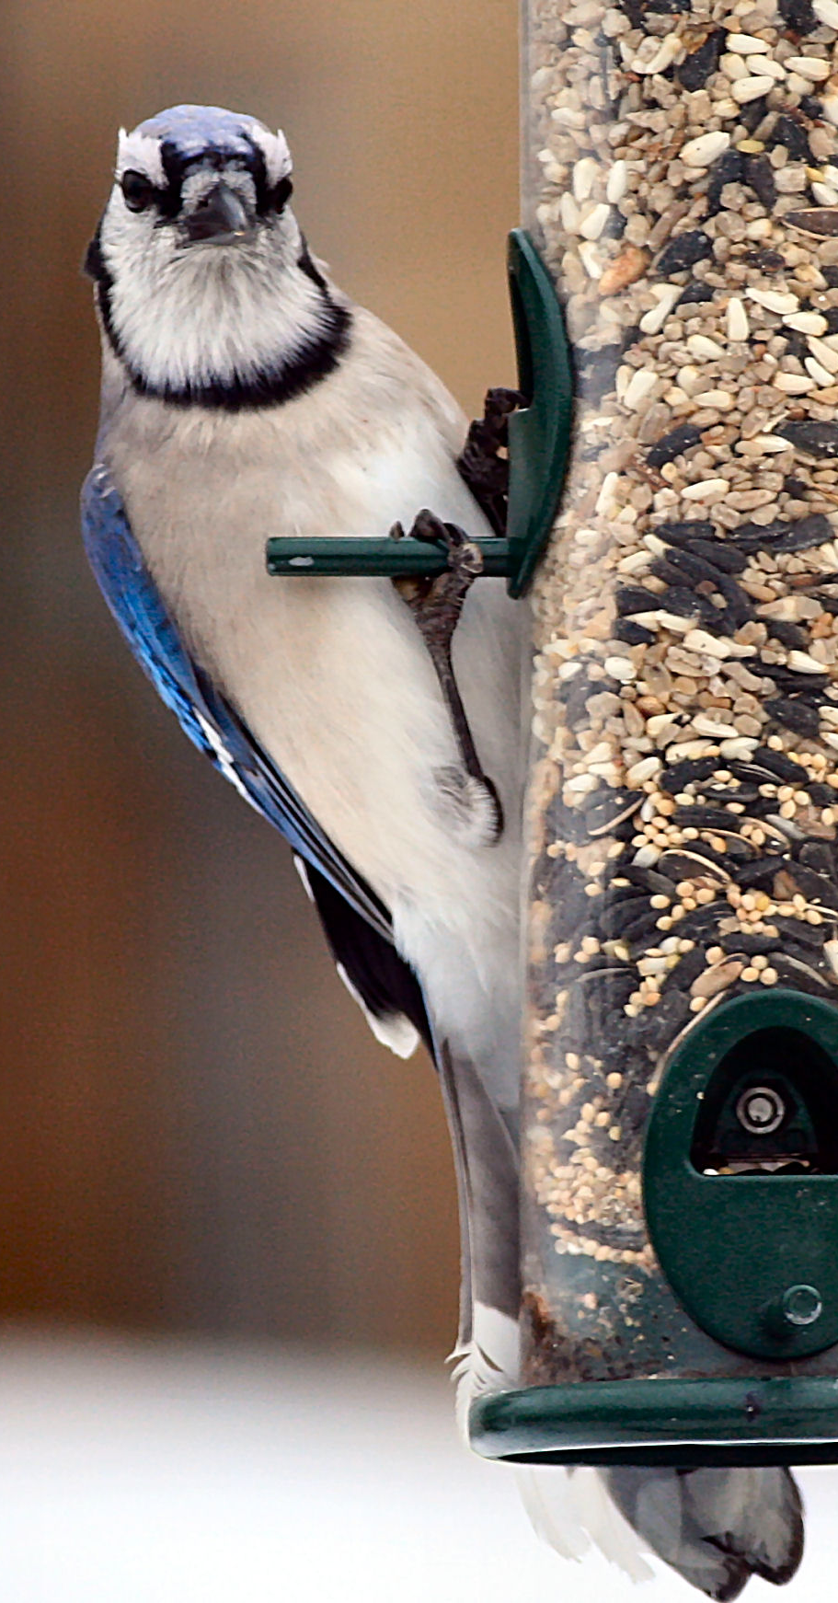
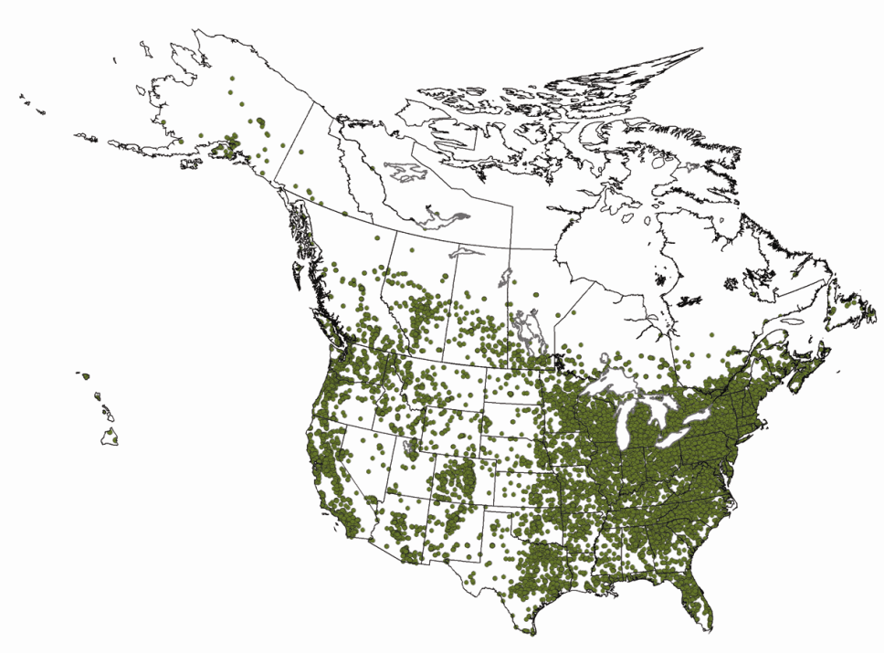
Project FeederWatch
16,969 participants in 2011-12
1.8 million checklists
> 52,000 count sites
> 110,000 checklists / year
4.2 million hours of volunteer time
2 books, 26 scientific papers
Notes:
So in FeederWatch we are paying close attention to all species that come to backyard bird feeders in the US and Canada, like the Blue Jay here.

Slide 6
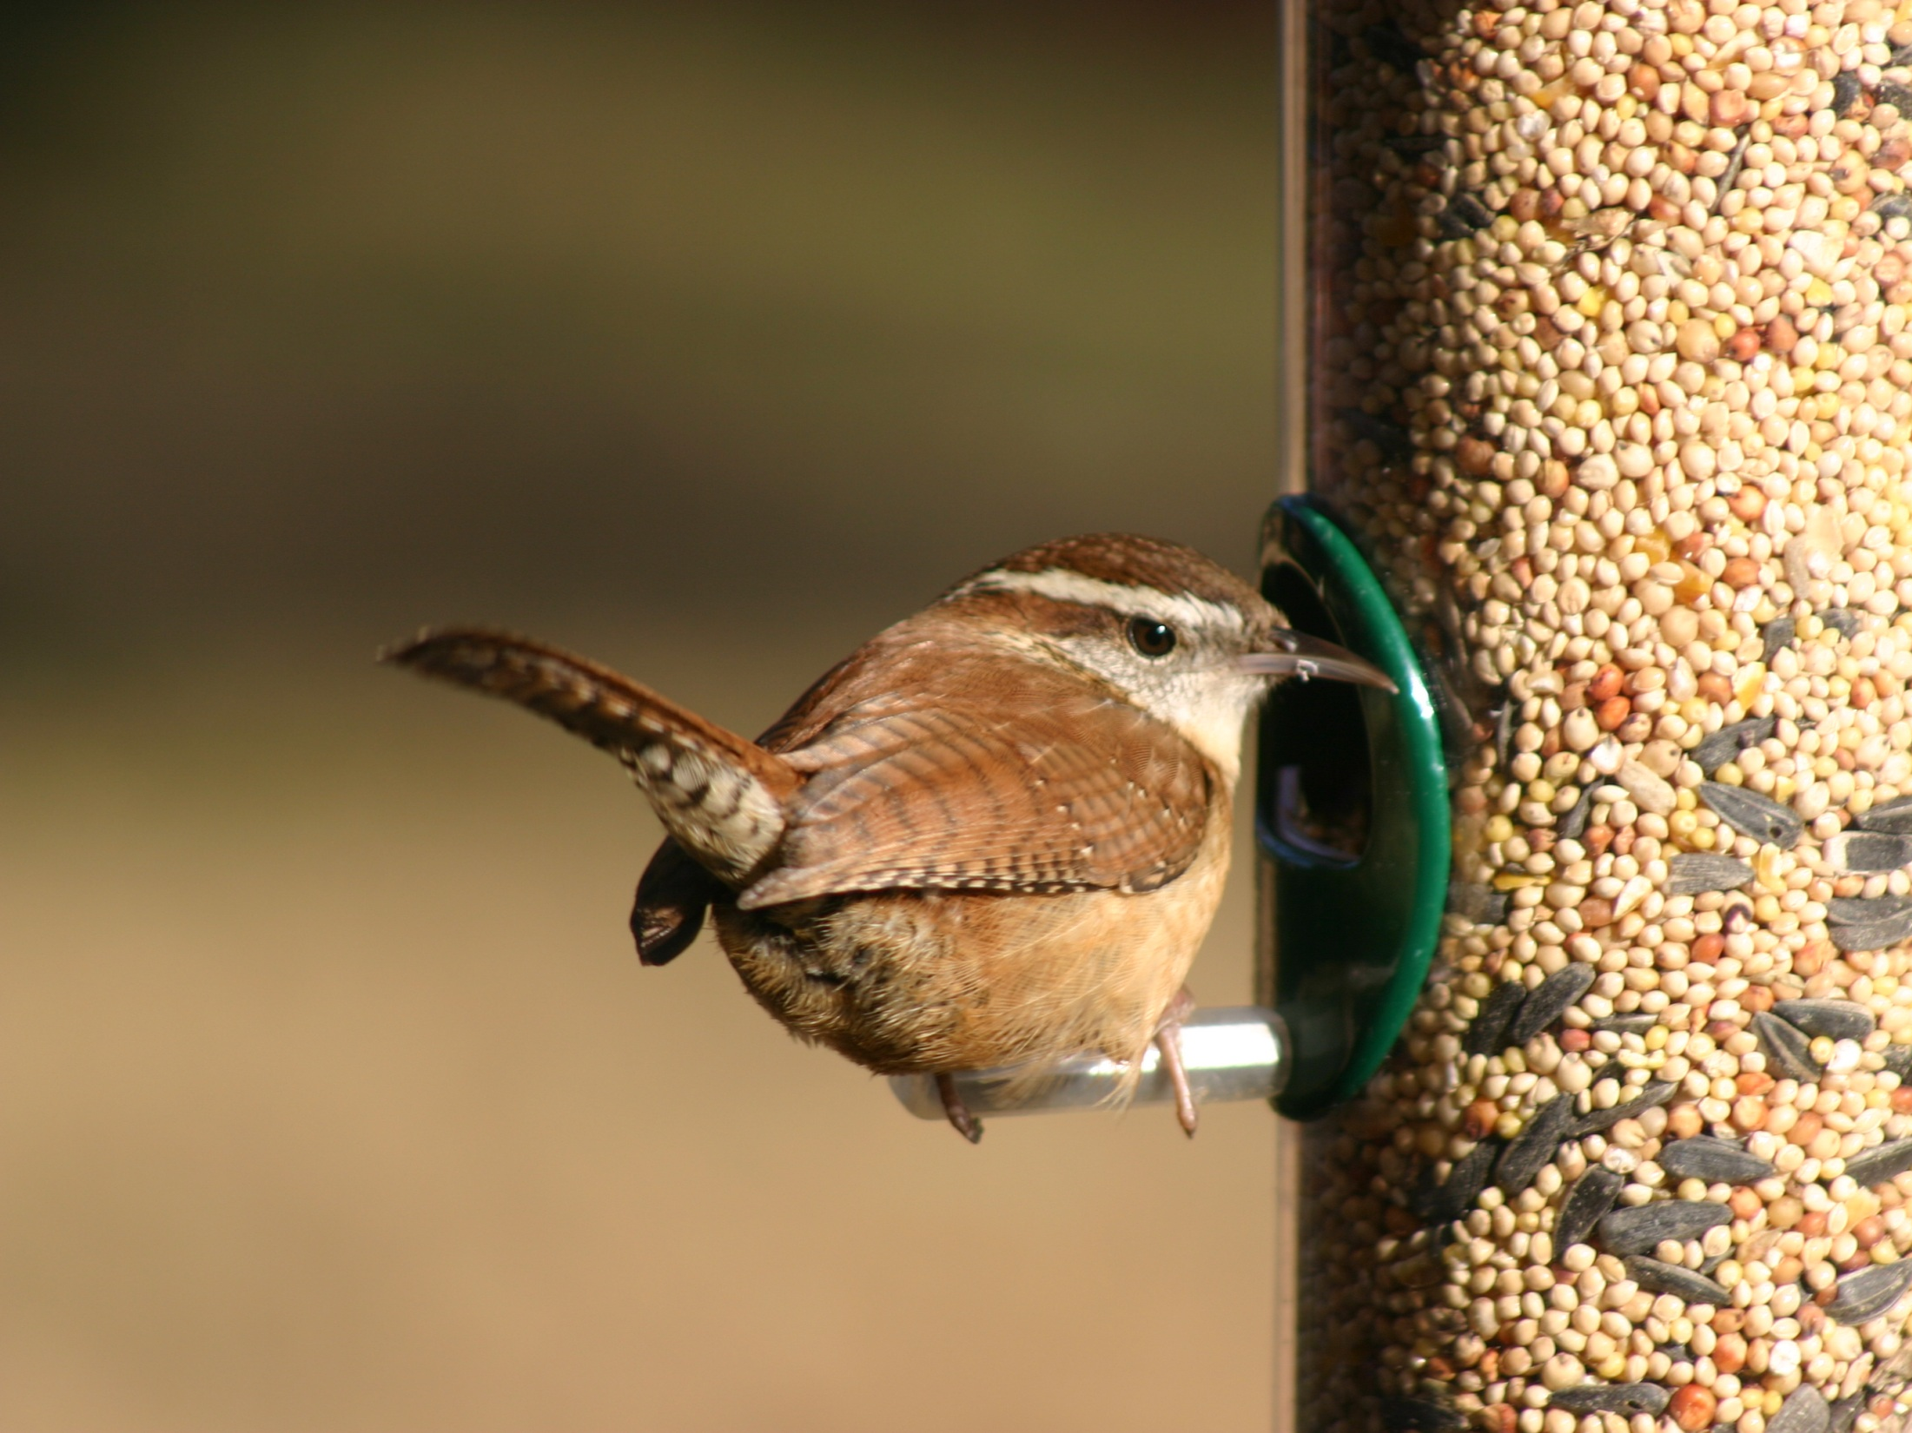
FeederWatch Protocol
Two-day counts
Maximum number of each species
Repeated counts
Weather & effort data
Provides presence and absence data
Notes:
FeederWatch participants periodically count the maximum number of each species seen in the proximity of a bird feeding station during two-day counts that are repeated as often as every week between November and April each winter. By requiring that participants only report the maximum number of each species in view at one time during the count, we are attempting to ensure that participants are not repeatedly counting the same individual birds.
Participants also record some basic weather data including temperature extremes, precipitation, and snow cover. And they record their effort – the amount of time they spent watching their bird feeding area during the two-day FeederWatch count.
People are reporting all of the species that they see, so we know where birds ARE as well as where birds ARE NOT, and we have an idea of relative abundance at a location based on the maximum flock size that was recorded.

Slide 7
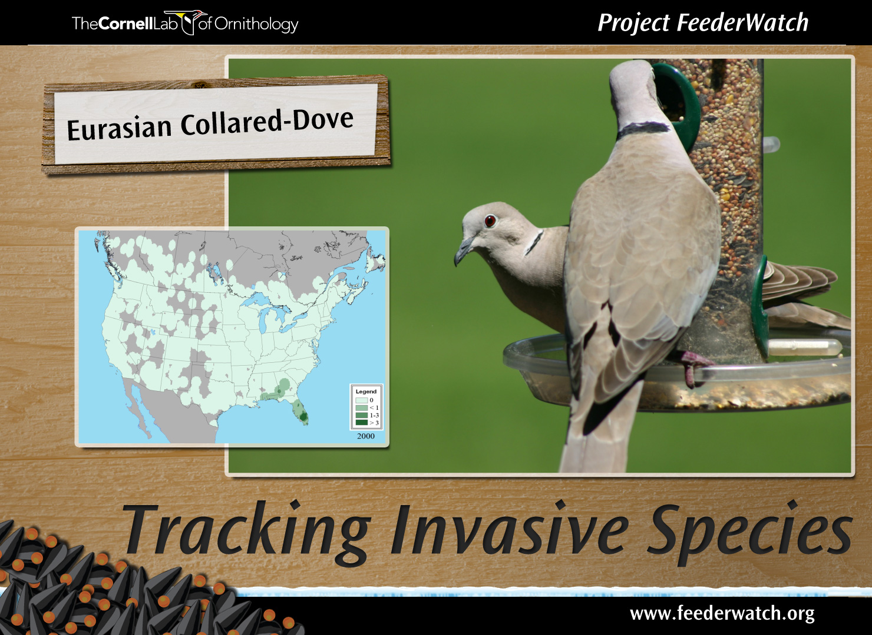
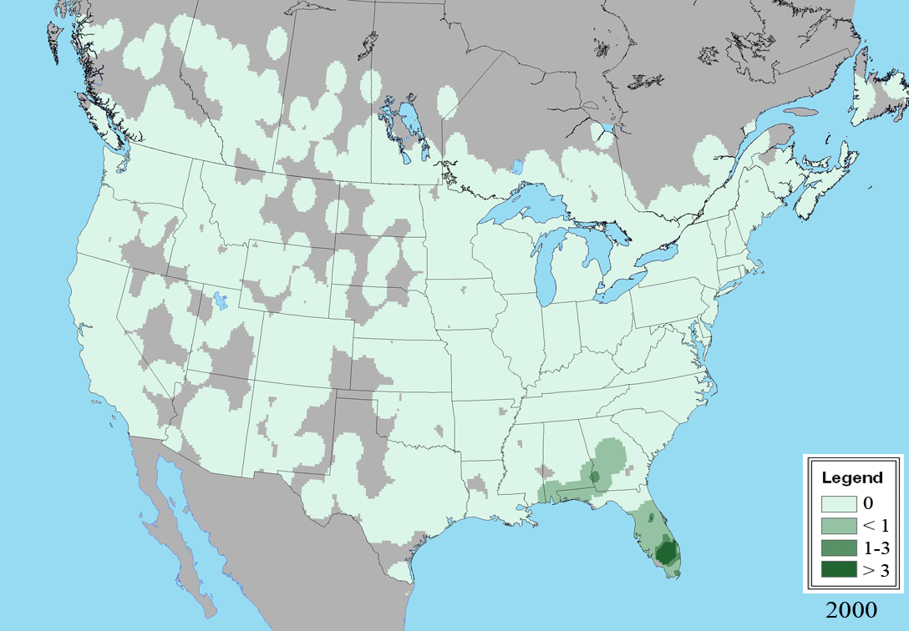
Notes:
When FeederWatch began, only a few hundred Eurasian Collared-Doves were found in North America. We’ve been able to track the remarkable conquest of the continent by this non-native species as it rapidly spread from Florida to Alaska in the last decade. A species that was unknown to most Americans when FeederWatch began is now one of the most common feeder birds in many parts of the country.

Slide 8
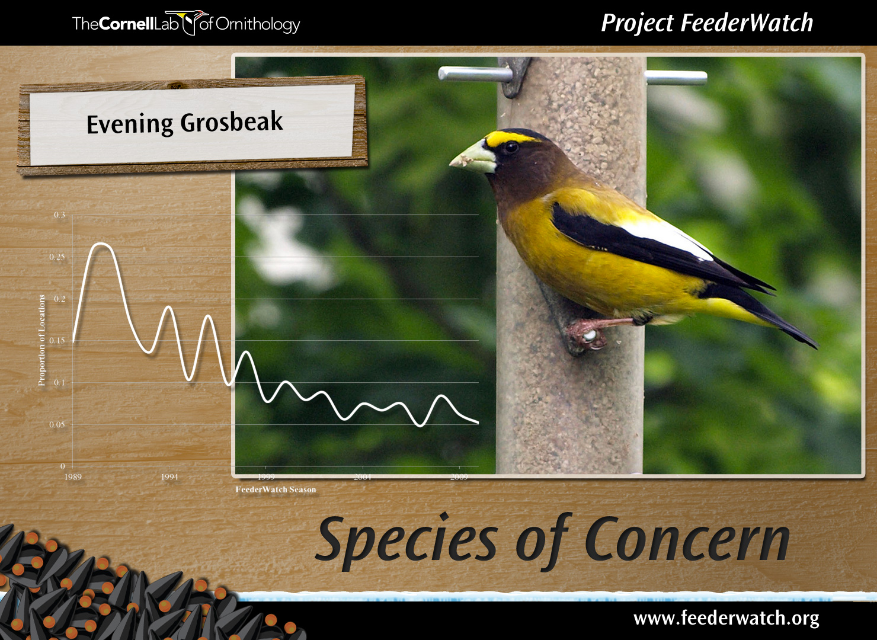
Notes:
Trending in the opposite direction is the Evening Grosbeak… In the early years of the project, this species was among the most familiar feeder birds, seen in large gregarious flocks throughout the northern US and throughout Canada. Populations have dramatically declined, and FeederWatch was there to quantify the extent and scope of changes in this species’ populations.

Slide 9
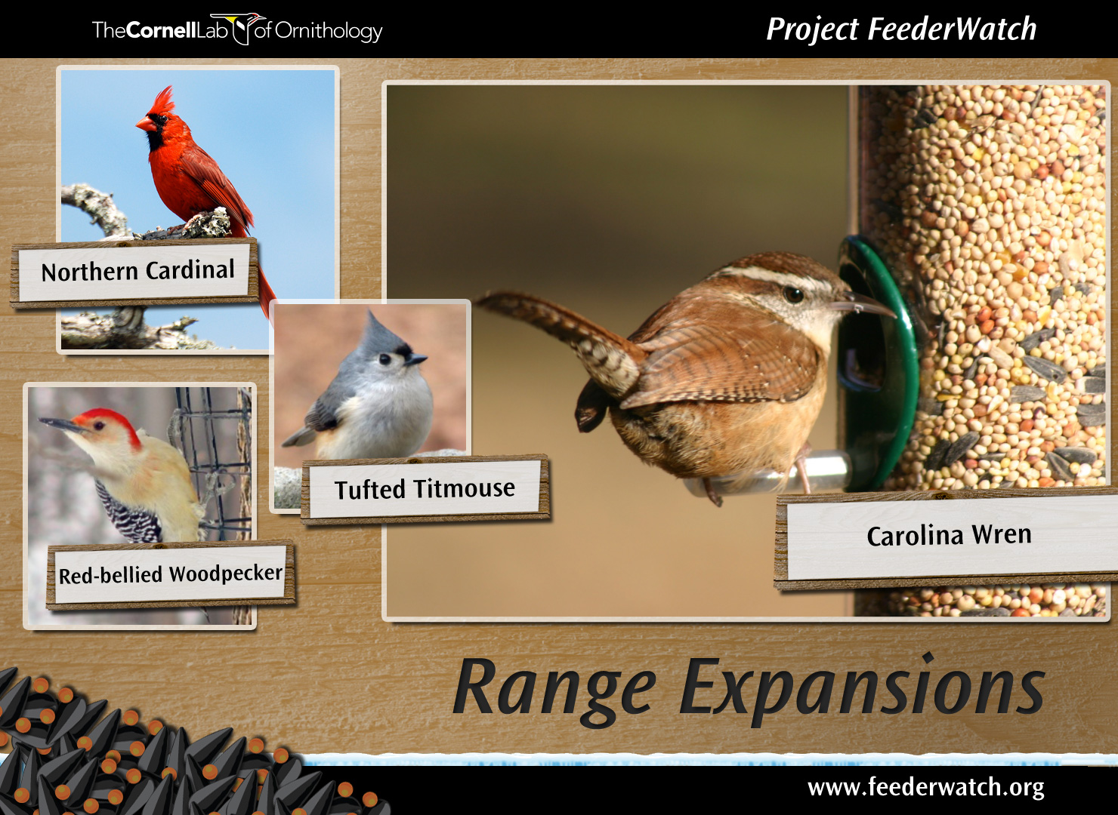
Notes:
While the grosbeaks range is contracting, most other common feeder species are doing quite well. Several, in fact, are expanding their ranges to the north.
NOCA, RBWO, TUTI, CARW, and Anna’s Hummingbirds are excellent examples of these expansions. And we are linking bird observations from FeederWatch with external datasets the study the influence of climate and habitat on the distributions and abundances of birds.

Slide 10
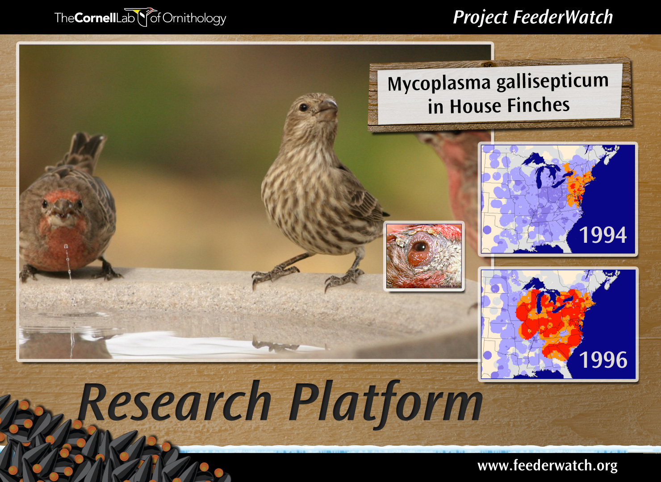
Notes:
FeederWatch has also proven to be a useful research platform from which to engage in more detailed studies. The prime example of this involves the development of the House Finch Disease Survey to explore the dynamics and impacts of a novel strain of MG – a disease that has had profound impacts on House Finch populations.
In order to assess the impact of any event, like a new disease, you need data gathered prior to the event as well as during and after the event. Now entering our 25th season, FeederWatch provides the temporal scale that is truly critical for placing events into context.

Slide 11
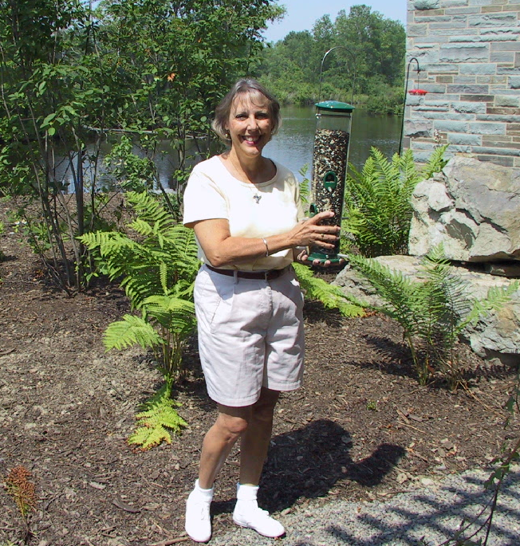
“FeederWatchers” are the key
All data collected by citizen scientists
Fully funded by participant fees
70% annual retention rate
Notes:
The participants really are the key to the project – they provide all of the data, they return year after year, and they completely support the program financially.
…. And, occasionally they even visit the Lab like this participant from Alabama to make sure that our feeders are filled and properly maintained.

Slide 12
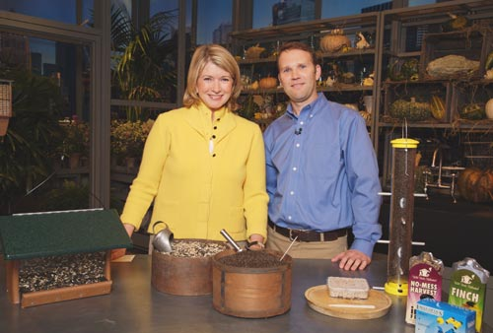
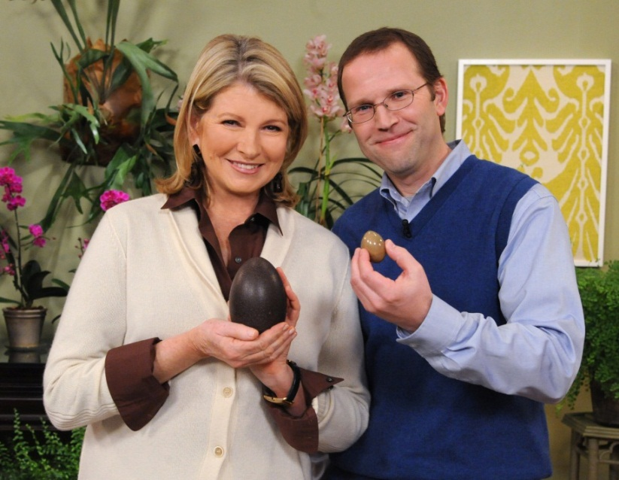
Recruitment – Try Everything
Demographics:
Women over 50
Highly educated

Slide 13
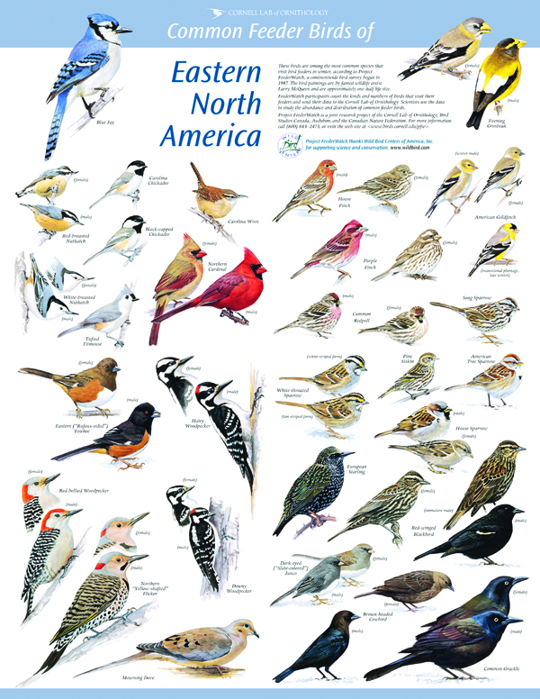
Resources for success
Educational resources
  Identification poster
Notes:
Validating data sets is time-consuming and expensive. Obviously, error prevention is far superior to error detection and cleaning, as it is cheaper and more efficient to
prevent errors than to try and find them and correct them later.
As the program develops, we continue to tweak how we gather the data in order to reduce errors, and we also invest in new resources in order to help participants succeed. One such resource that is remarkably simple is an identification poster depicting the common feeder birds that are likely to be seen in the participant’s region. If you can match…
/*
A process used to determine inaccurate, incomplete, or unreasonable data and then improving the
quality through correction of detected errors and omissions. The process may include format
checks, completeness checks, reasonableness checks, limit checks, review of the data to identify
outliers (geographic, statistical, temporal or environmental) or other errors, and assessment of data
by subject area experts (e.g. taxonomic specialists). These processes usually result in flagging,
documenting and subsequent checking and correction of suspect records. Validation checks may
also involve checking for compliance against applicable standards, rules, and conventions.
The general framework for data cleaning (after Maletic & Marcus 2000) is:
􀁹 Define and determine error types;
􀁹 Search and identify error instances;
􀁹 Correct the errors;
􀁹 Document error instances and error types; and
􀁹 Modify data entry procedures to reduce future errors.

Slide 14
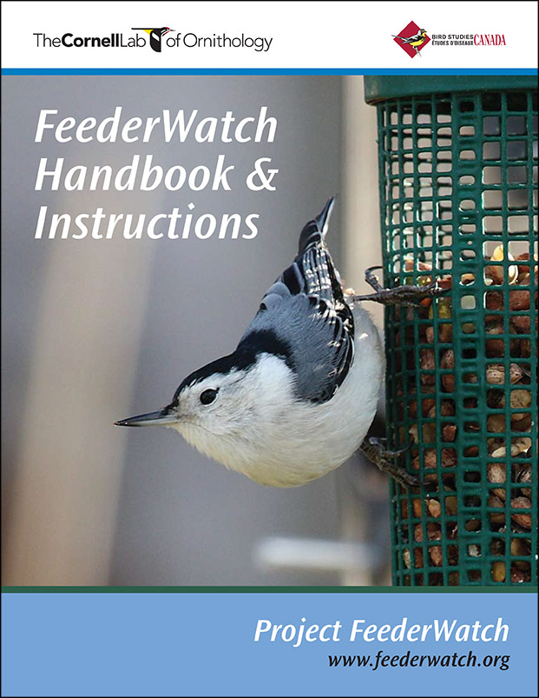
Resources for success
Educational resources
  Identification poster
  Online and print instructions
Notes:
Instructions—online and in print—are being constantly revised to clarify language and eliminate ambiguity. People generally do not like to read instructions, so brevity is key.

Slide 15
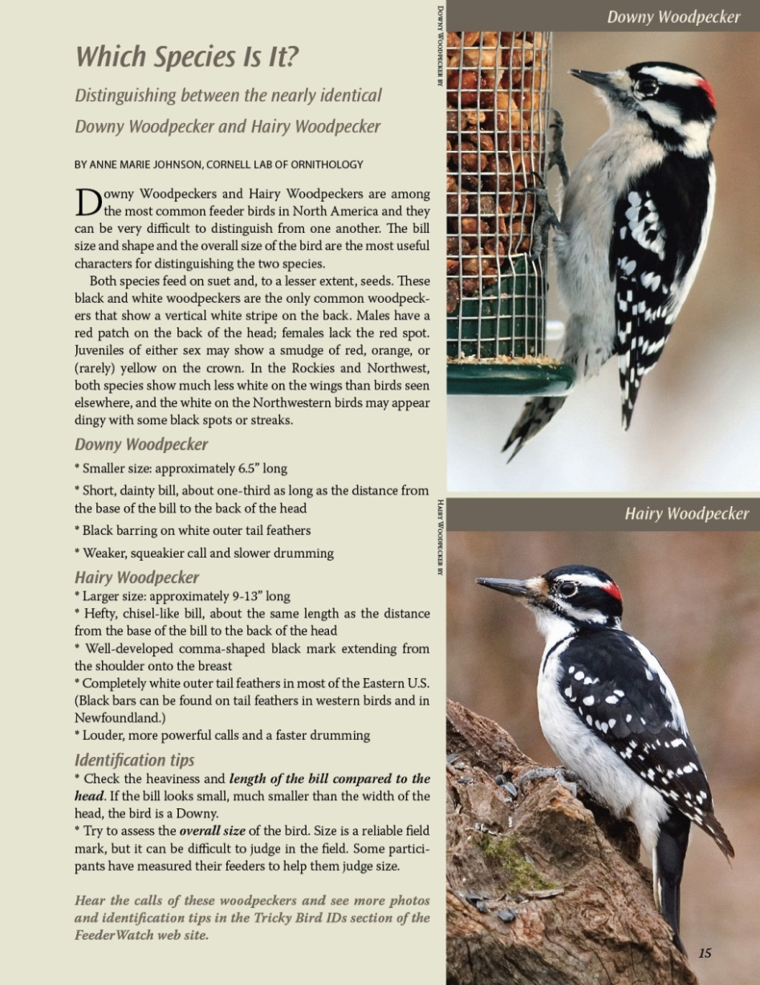
Resources for success
Educational resources
  Identification poster
  Online and print instructions
  “Tricky bird” identification
Notes:
We know that they are suites of species that are tricky to distinguish from one another regardless of your background knowledge or level of expertise. As such, we have developed a series of print and online materials to help participants determine which of these “tricky birds” are in their own backyard.

Slide 16
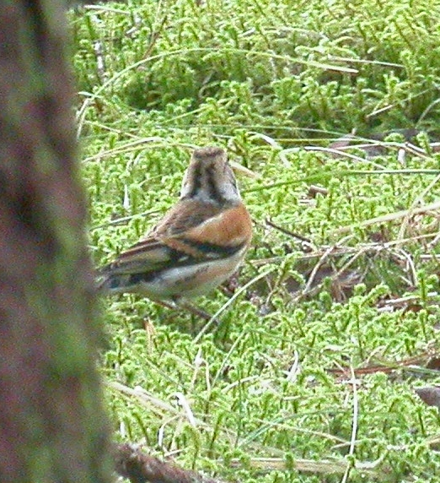
Resources for success
Educational resources
  Identification poster
  Online and print instructions
  “Tricky bird” identification
Participant support
  Online field guides
  Participant forum
  Photo ID
Notes:
We also answer thousands of emails and several hundred phone calls from participants each year. These one-on-one interactions are often necessary to help participants succeed in identifying a species or understanding the protocol.
A participant listserv allows participants to use one another as a resource.
Finally, digital photography has proven to be a wonderful thing for validating observations and educating the public. It is now easy and inexpensive for participants to snap a photo, send it to the Lab of Ornithology, and often receive identification assistance while the bird is still at their feeders. Even a lousy photo, like this one of a rare Brambling in Alaska, can be good enough for identification purposes.

Slide 17
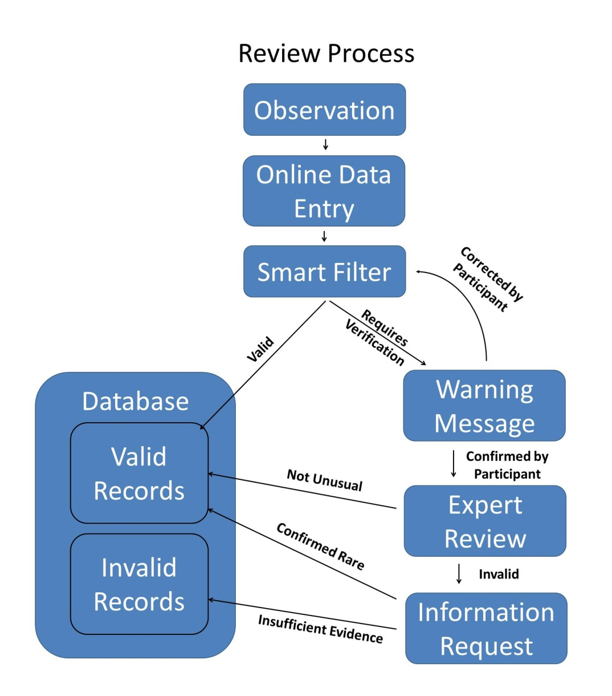
Data quality control
Research kit
Data filters & flagging system
Notes:
So how do we make sure that people are following our protocols and collecting useful data?
First, we send each participant a research kit that includes….
Also, behind the scenes, we maintain a series of filters that flag records that are unexpected for a certain location and a specific time of year. Those flagged records are reviewed by ornithologists at the Lab and at Bird Studies Canada. We often ask for confirmation of unusual reports, and, for the most part, adequate photos are provided as documentation to confirm unexpected reports. If sufficient evidence is not provided, the information remains flagged in the database and will not be used in analyses.

Slide 18
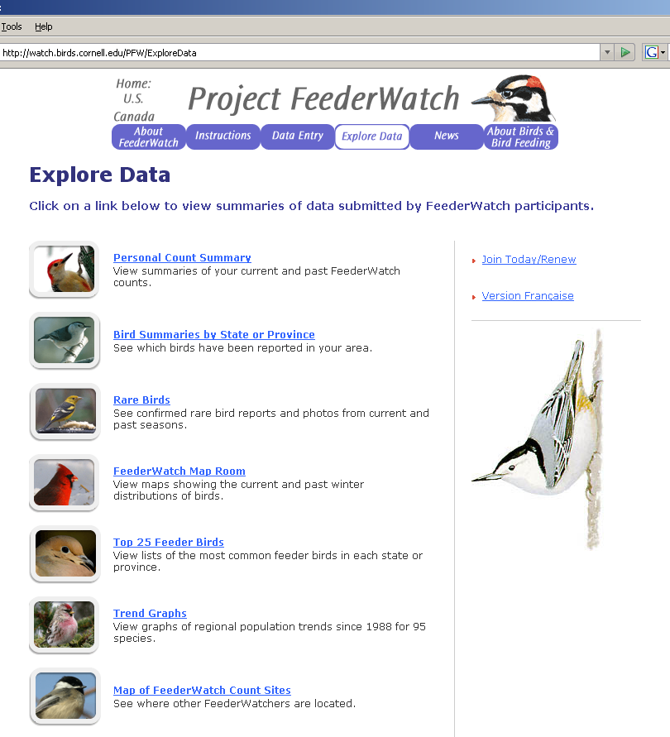
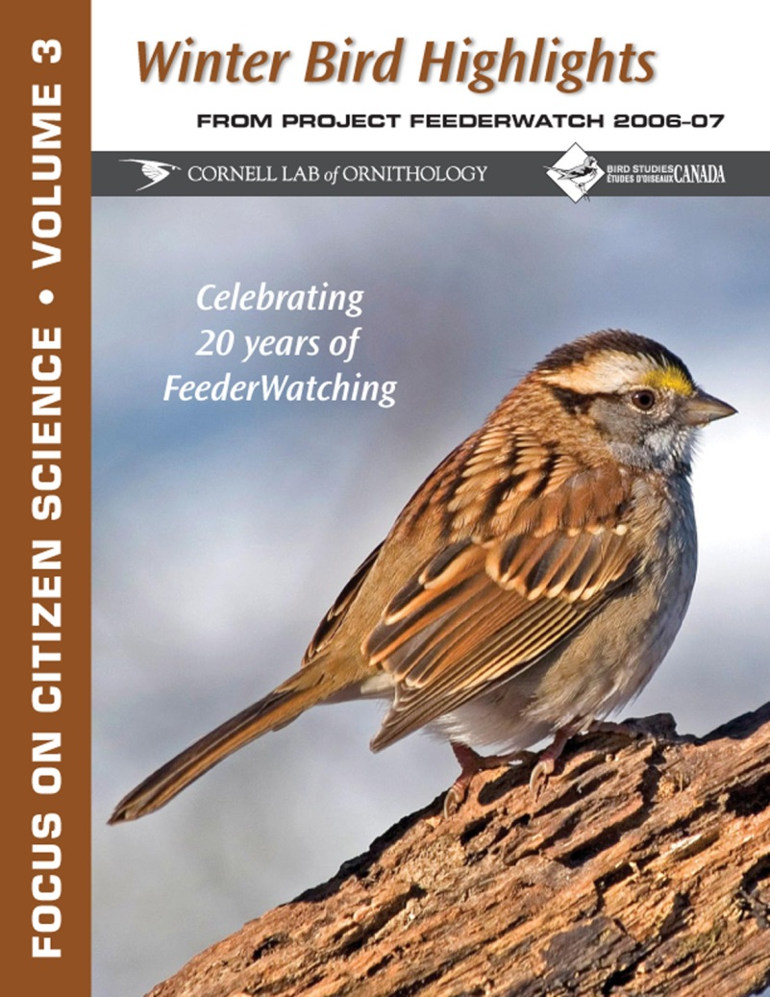
Feedback! Data output, education, outreach
Notes:
By asking the participants to contribute time, energy and money to the project, we need to provide feedback in multiple formats.
We publish Focus on Citizen Science magazine each fall that summarizes the major findings and trends from the previous FeederWatch season. This publication is sent to all project participants and all members of the Lab of Ornithology. We also publish popular articles in BirdScope, the newsletter of the Lab.
The Explore Data section of our web site contains a wealth of information that is accessible to anyone….
Participants can also login to the system and see the data that they have submitted.
And, of course, we also publish in scientific journals.

Slide 19


Slide 20
Get birders involved by giving them features they want.
Encourage birders to gather more meaningful data.
Use the data for science, education, and conservation.

Slide 21
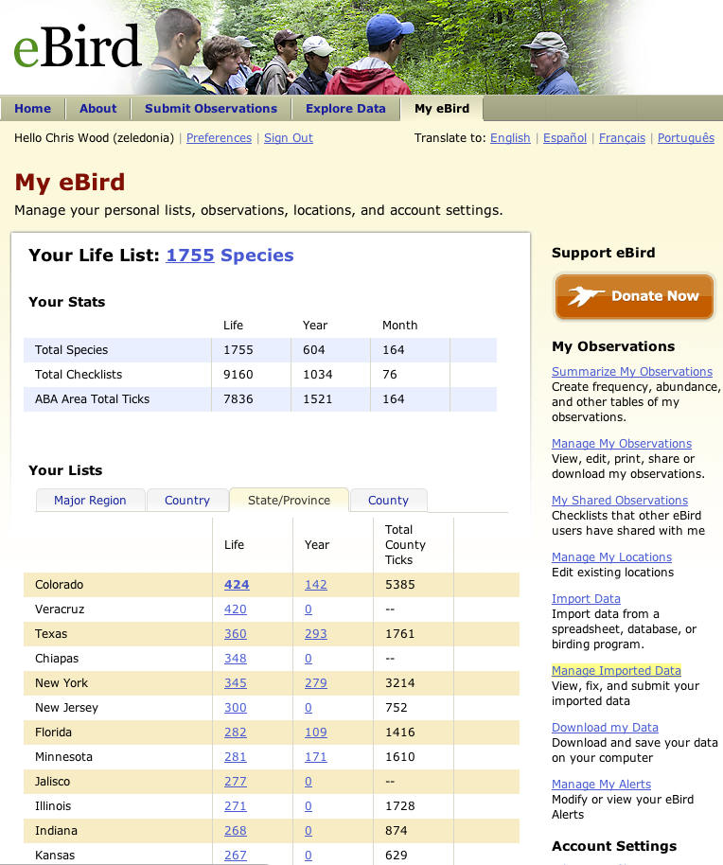
Personal Records

Slide 22
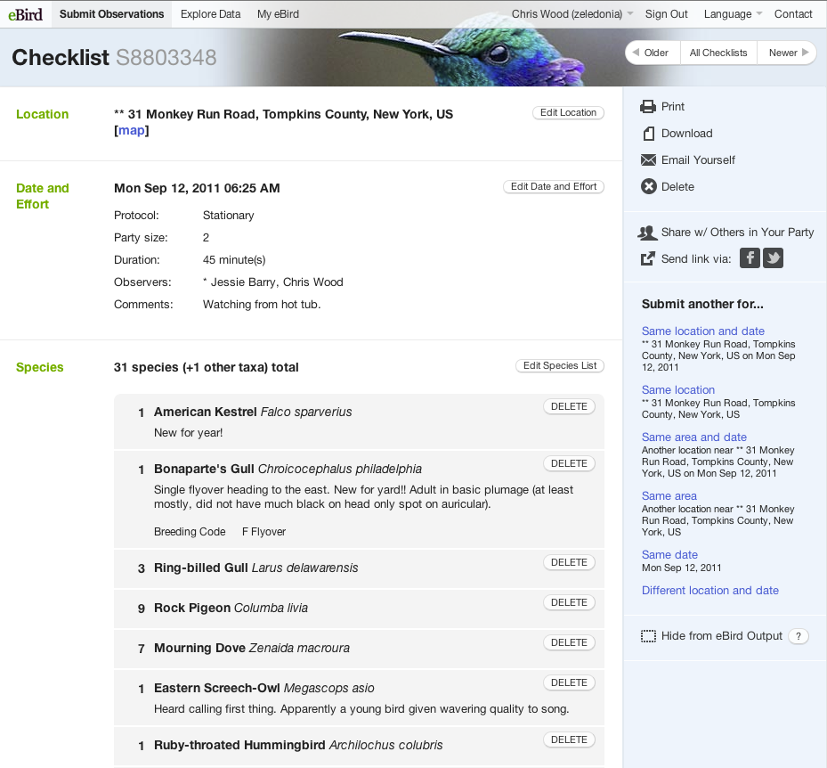
Personal
Records

Slide 23
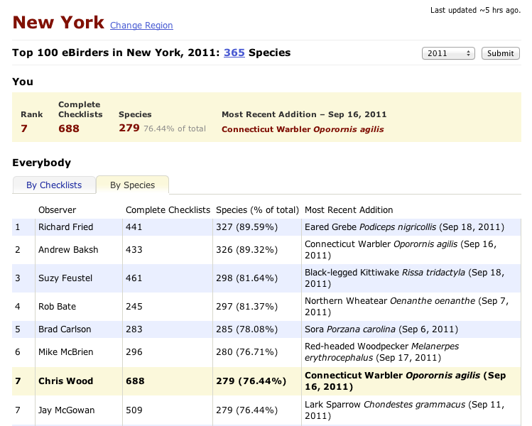
Friendly Competition

Slide 24
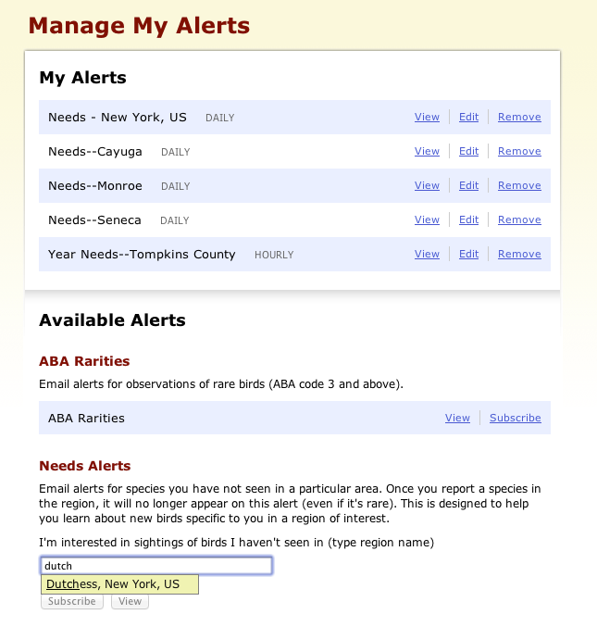
Alerts for “wanted” birds
Notes:
Mention Alerts functionality, google gadget,

Slide 25
What information is required?
Location
Date
Effort
Species
Notes:
What do we, the biologists and ecologists, want to get from the project?

Slide 26
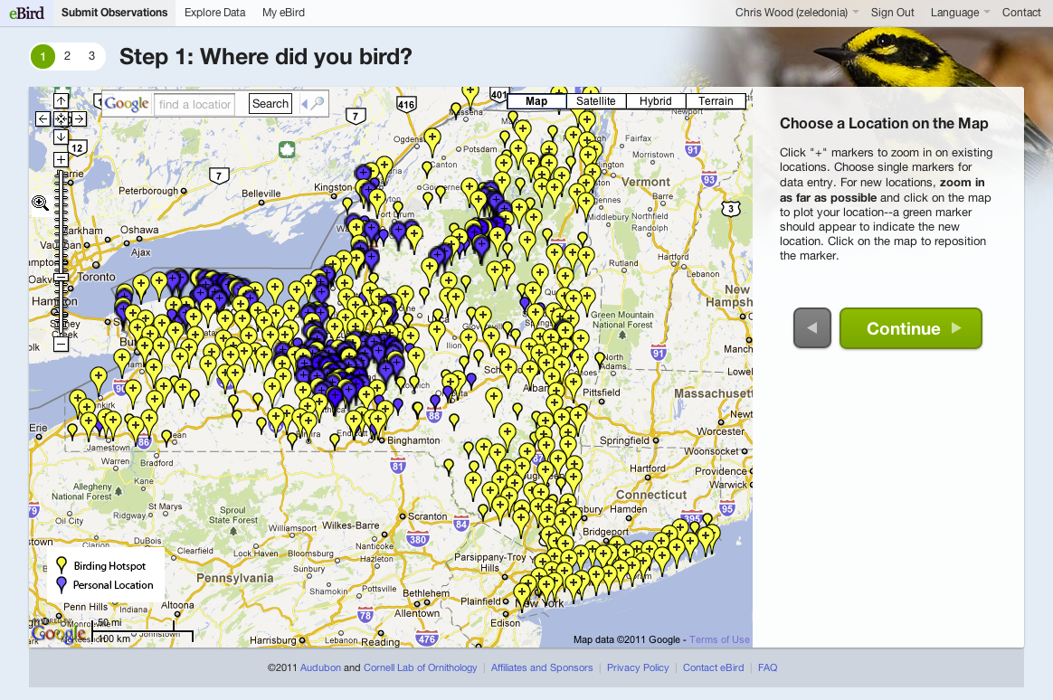
Streamlined data entry

Slide 27
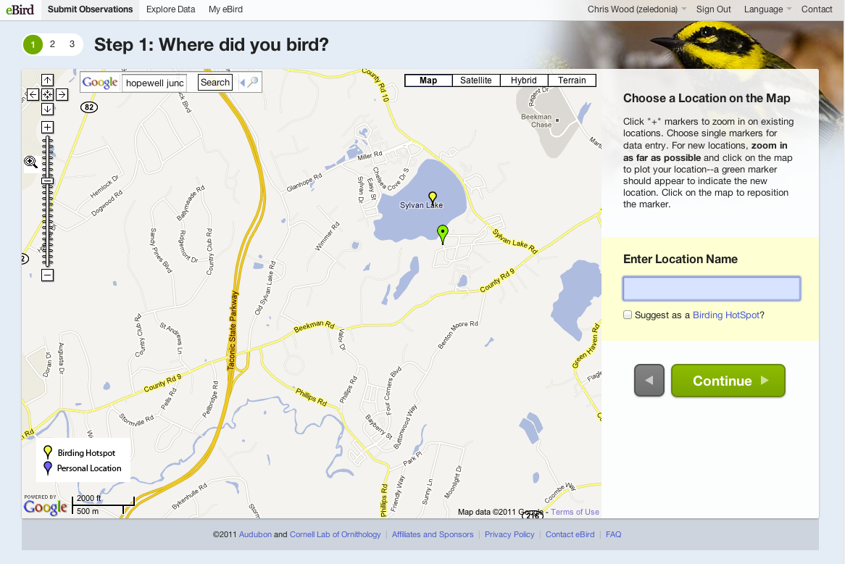
Streamlined data entry
Participants “get” Google Maps

Slide 28
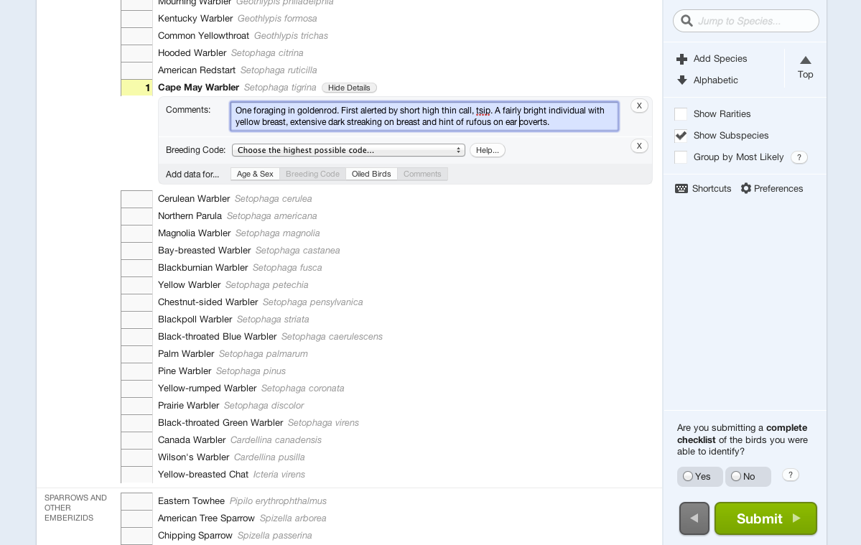
Streamlined data entry
Notes:
Fast and efficient system, 4-letter codes, ancillary info, most probable lists, upload data, mobile apps in development.

Slide 29
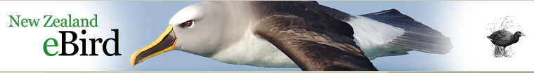
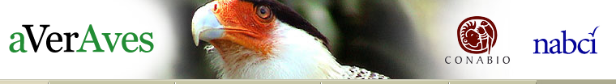
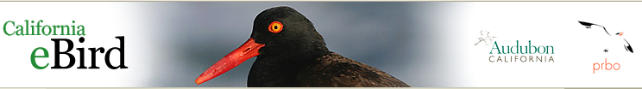
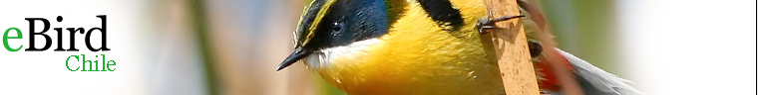
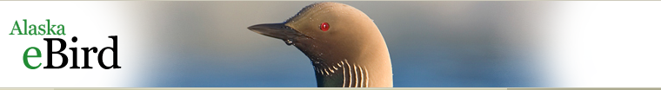
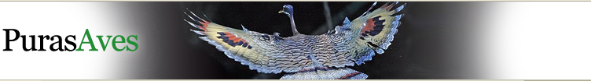
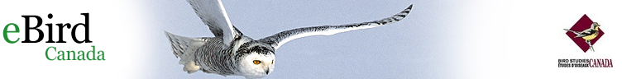
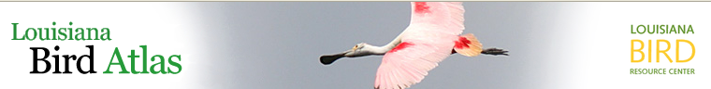
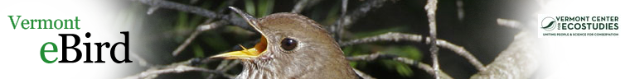
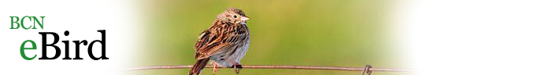
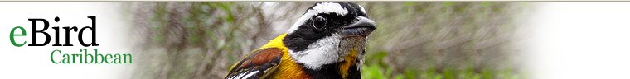
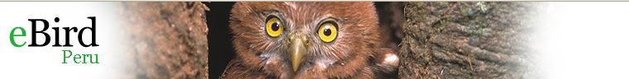
Notes:
People are inspired by a sense of place. More likely to engage if there is a local connection. Back-end technology is all the same – just a different “wrapper” and often locally-focused news items on the home page (maintained by local partner organization).

Slide 30
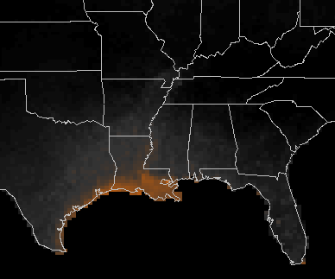
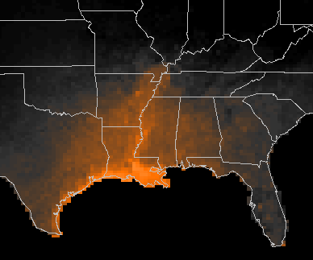



Indigo
Bunting
Spring
Migration
April 7
April 15
April 26
May 14

Slide 31

Chimney Swift | Full Year

Slide 32



Chimney Swift
Indigo Bunting

Slide 33


Slide 34

http://www.birds.cornell.edu/citscitoolkit/

Slide 35

Special thanks to the thousands of citizen scientists who make Project FeederWatch and eBird possible.
Janis Dickinson, Benjamin Zuckerberg, the Citizen Science staff, the Information Science staff
Team FeederWatch: Anne Marie Johnson, Susan Newman
Team eBird: Chris Wood, Brian Sullivan, Marshall Illiff

Slide 37


Data Filters
- Quantifiable
- Historic
- Geographically specific
- Temporally specific
Notes:
We currently have filters that review records at the level of state or province. Each filter first identifies a list of allowable species for that state. Then, based on historic counts, the filters create a limit on the number of each species that will be allowed in each month of the year. Reports that exceed these maximum values will be “flagged”.
For instance, here in Wisconsin, a participant can report as many as 66 Mourning Doves in January, but only 15 in April without triggering a flag. These limits are based on the biology of the species.

Slide 38


Flagged Reports
Step 1:
Request confirmation
Notes:
Fortunately, the vast majority of our participants now use our online data entry system. This allows for instantaneous feedback to the participant.
For instance, here I have attempted to report a Painted Redstart on one of my FeederWatch counts in New York. This would indeed be a rare sighting in my area, so they data entry system politely stops me, informs me that this report is highly unusual, and asks for confirmation. If I click yes, I really did see a Painted Restart, that report will then be forwarded to a review system to be evaluated by a scientist.

Slide 39

Flagged Reports Step 2:
Scientific review, request documentation
Notes:
Dickcissels winter primarily in Venezuela, so seeing one in Nova Scotia in January would indeed be unusual. Within the review system, we can click on the submission number to see the entire checklist submitted by this participant, we can click on their name to find out more details about the participant, we can click on the location to see a map pinpointing the location…

Slide 40

Notes:
… and we can click on a mail icon in order to automatically generate an email that requests additional information about the report…

Slide 41


Slide 42

$2,427,732
Fees & Donations Since 2001
Notes:
FeederWatchers are not only watching their feeders, counting birds, and sharing that information with us, they are also paying for the opportunity to work for us. Each FeederWatcher pays at least $12 per year… many make contributions well above the standard participant fees.
$2.4 is the amount of money that FeederWatchers have contributed in the last decade, and the program brings in more than $200,000 / year.

Slide 43

Streamlined data entry

Slide 44

Streamlined data entry
Notes:
Fast and efficient system, 4-letter codes, ancillary info, most probable lists, upload data, mobile apps in development.

