Slide 2
Specify Software Project – Quick Facts
Biological Collections Data Management Platform
Java, open source, thick clients: Win, Mac, Linux
Configurable and Customizable, Multidisciplinary
Modular designed to implant plug-ins
25 years, NSF, 2010-2014, $400K/yr funded by ABI and ADBC Programs at NSF.
Staff: 3 software engineers, 1 helpdesk manager, 2 student software testers, 1 trainer, 1 director

Slide 3
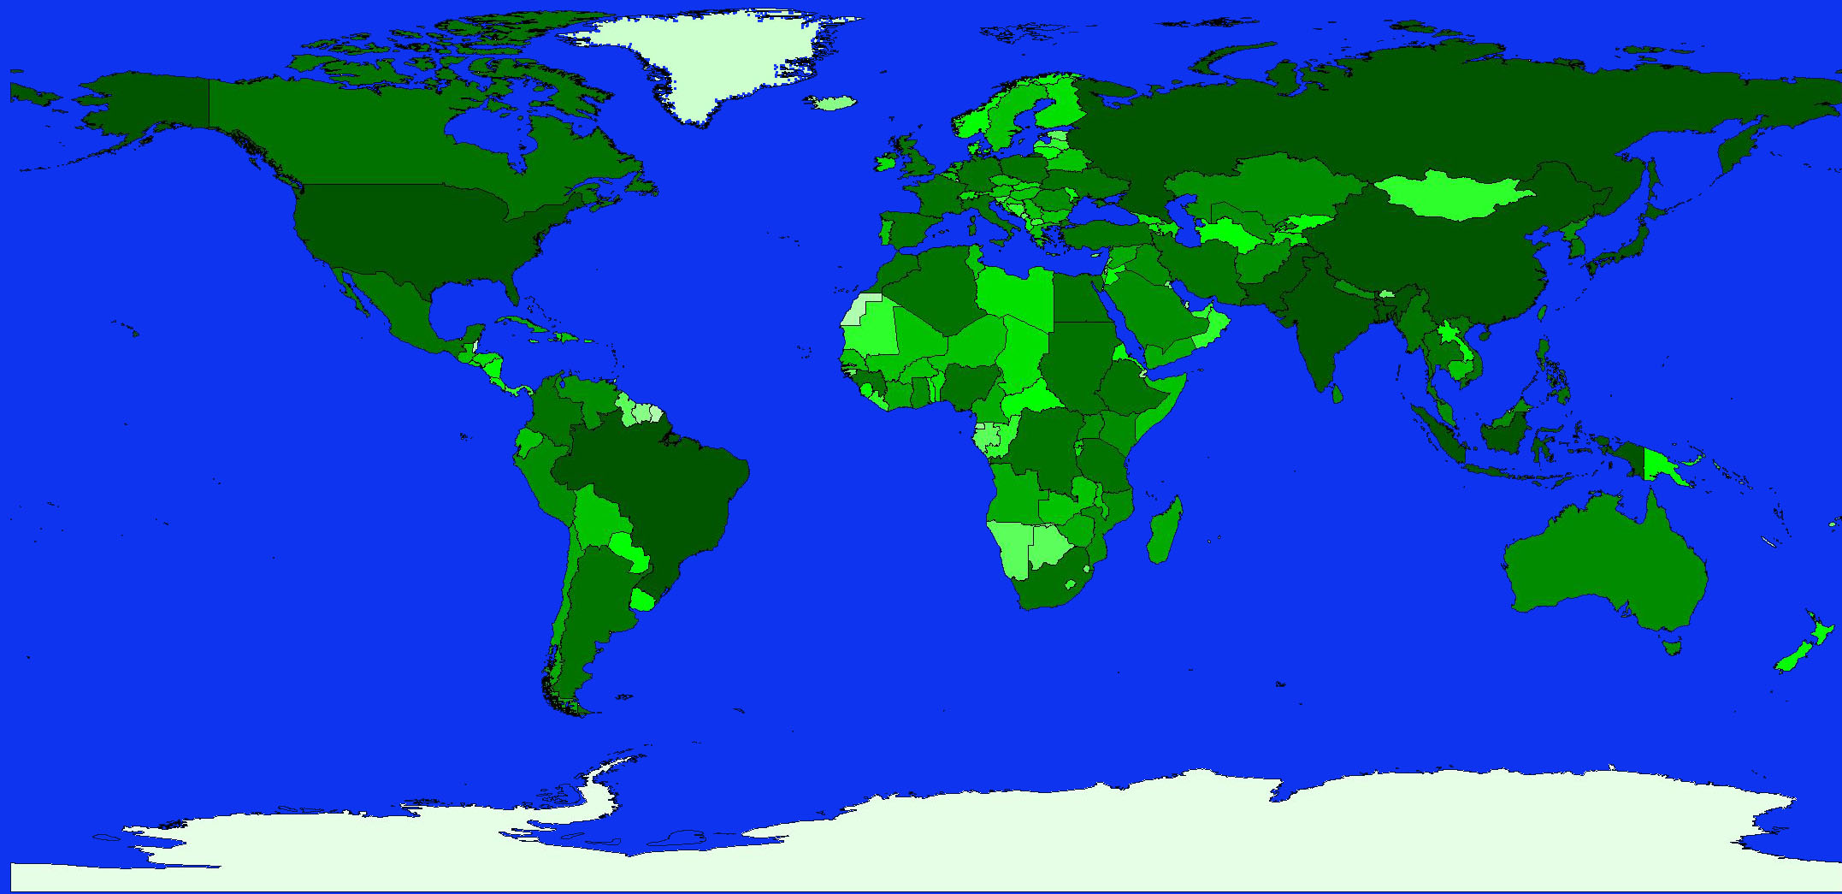
Norway
Finland
Denmark
Canada (2)
Sweden
Germany (6)
UK (2)
Poland
Hungary
Portugal (4)
Spain
Israel
Oman
Mexico
Guatemala (2)
Venezuela
India
Colombia (3)
Honduras
Malaysia
Ecuador
Kenya
Peru (2)
Brazil (9)
Chile (3)
New
Zealand
South Africa (3)
Australia (6)
Representation of all natural history disciplines
435 (296 U.S.) collections in 29 countries
247 (166 U.S.) institutions
15% annual adoption rate
Notes:
Representation of all Natural History disciplines
Over 375 collections in 26 countries
Over 140 US institutions in 43 states
Over 10 million specimens cataloged
Increasing all the time

Slide 4
Specify Applications
Specify 6 Platform – Clients for MacOS, Windows, Linux, uses MySQL data manager, extendible plug-ins
Specify EZDB – No MySQL installation needed
WorkBench – 2D data entry, and MobileWB
Schema Mapper – Graphical mapping of incoming or outgoing data
Collection Wizard – Defining a new Database
Backup and Restore
iReport – design labels, reports
Scatter Gather Reconcile – find duplicates in GBIF
GEOLocate – adding georeferences

Slide 5
Under Development
Specify 7 Thin Client and Server– Javascript with Java or Django, web browser, in collaboration with NRM, also Harvard, Ag Canada.
Specify 6 Portal – Public search portal, images, downloads, maps, export to IPT
Specify/Symbiota/FilteredPush Pipeline – move specimen records, updates, annotations between systems. In collaboration with iDigBio.
Image Management Plug-in – browse, search, sort, thumbnails, backend server, thick client, WorkBench, digitization workflows involving images.
Specify Insight – mobile platform for “consuming activities”

Slide 6
Lifemapper Project
Geospatial archive of GBIF distribution points and species distribution models, Postgres
Web services for geospatial data, computing niche models, creating presence-absence matrices PAMs for biodiversity pattern analysis.
Emphasis on researcher workflow, tools and metadata archives
Aimee Stewart, CJ Grady, Jeff Cavner
Funded by NSF EPSCoR 0919443, EHR/DRL 091859, BIO/ABI 0851290, OCI/CI-TEAM 0753336, NASA Access37, DEB/AVATOL 1208472, pending NIH (Trust)
Notes:
What is Lifemapper?
Simply, it is an archive of ecological data and a suite of tools to analyze that data.
Here we see an example of both data and the application of one of the analysis tools.
Each of the yellow “push pins” are observed occurrence points of Kirtland’s warbler retrieved from a local cache of the Global Biodiversity Information Facility’s specimen records database.
The red areas represent a probability map indicating areas where Kirtland’s warbler could potentially live where a greater color intensity indicates a higher probability.

Slide 7
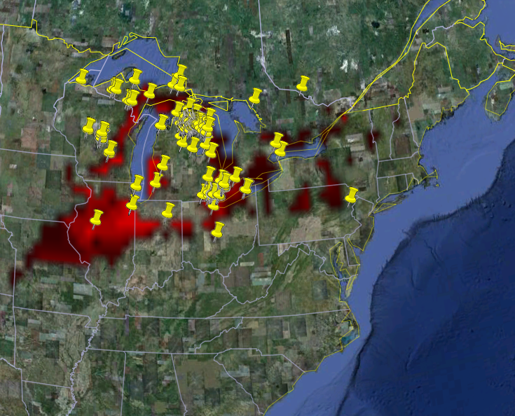
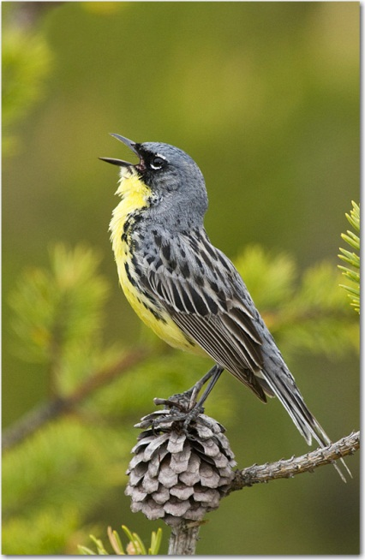
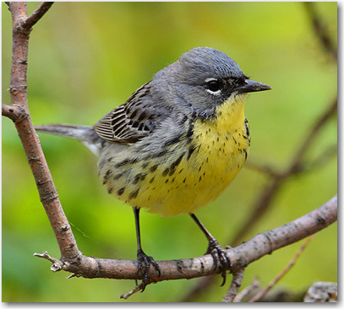
Lifemapper
Museum specimen (GBIF) occurrences for Dendroica kirtlandii
Notes:
What is Lifemapper?
Simply, it is an archive of ecological data and a suite of tools to analyze that data.
Here we see an example of both data and the application of one of the analysis tools.
Each of the yellow “push pins” are observed occurrence points of Kirtland’s warbler retrieved from a local cache of the Global Biodiversity Information Facility’s specimen records database.
The red areas represent a probability map indicating areas where Kirtland’s warbler could potentially live where a greater color intensity indicates a higher probability.

Slide 8
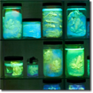
Species Distribution Modeling
Species Occurrence Data
SDM Modeling Algorithm
Predicted Habitat
Environmental Data
Notes:
We currently have 2 primary sets of tools – the first is Species Distribution Modeling or LmSDM
LmSDM calculates predicted habitat models using occurrence and environmental data and an OS software framework called openModeller, created by CRIA (Reference Center on Environmental Information) in Brazil
openModeller currently implements 11 algorithms for calculating SDM, each with multiple parameters to tune the calculations and can be extended to include new algorithms
Our primary data source for specimen occurrence data is GBIF. GBIF gives us a copy of their cache approximately once a month. These data are organized by scientific name and available through LM services for download and modeling. Alternatively researchers can upload their own datasets for LmSDM computation
Environmental layers are also served through LM services, including WorldClim elevation and bioclimatic variables and the same bioclimatic variables calculated from predicted future climate values from global climate models. Once again, researchers can upload their own environmental layers for use in LmSDM

Slide 9
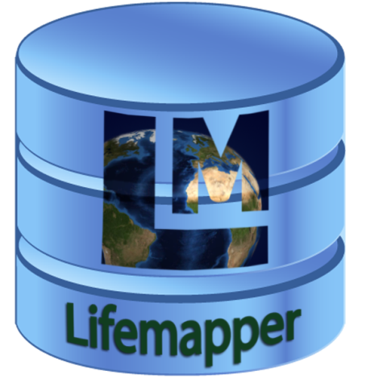
Web Services Architecture
Client Library
Compute
Resources
Pipeline
Data Archive
Notes:
I’d like to step back a bit now and describe the overall architecture and how it addresses the infrastructure goals of the project
The goals I want to emphasize are
Integration with other community projects, data and services
Collaboration and shared resources with other scientific communities and
Flexibility … in the sense of being able to interact with multiple data and metadata formats, and applications, but also code flexibility, and the ability to extend to different types of data and science
On the right of this slide, we see applications or projects that we can communicate with via WebServices.
We chose QGIS as our first client to the Range and Diversity, LmRAD, services because it is open-source, multi-platform, free, and a very powerful desktop Geographic Information System, or GIS. The nature of the LmRAD experiments is geospatial, tying biodiversity, ecology and species ranges together, so operating from a powerful, visual GIS platform allows the user to edit, analyze, visualize inputs and outputs using standard GIS operations.
VisTrails here is the workflow application that we created a plugin for as an easy interface to our other module, LmSDM
PRAGMA, EDAC, DataONE are just 3 of the many data sources, and in some cases data sinks, that we do or will interact with.
The Client library is a tiny, easy to use library that we wrote to simplify communications between our web services and both the VisTrails and QGIS plugins. We will release a new version soon, it can be used by other applications or even simple scripts.
As you can see in this diagram, everything to the left of the internet ‘cloud’, the bulk of our effort, goes towards data storage and processing.
All I really want to say about the backend is that the components were designed for re-use and extension, and that forethought is now paying off. While everything always takes longer than we want, we are increasingly speedy when adding new features, as the underlying building blocks are already solid.

Slide 10
ChangeThinking
Collaboration with School of Education, Animal Diversity Web, KUBI Informatics
Junior and senior high schools
Really research on how kids develop mental models about complex topics, e.g. climate change.
Schools in MI, KS, CA, MD, NC…
Video “SPECIES” Students Predicting the Effects of Climate In Ecological Systems
http://www.youtube.com/watch?v=VCFixtqlimg

Slide 11
Specify Insight
iPad II

Slide 12
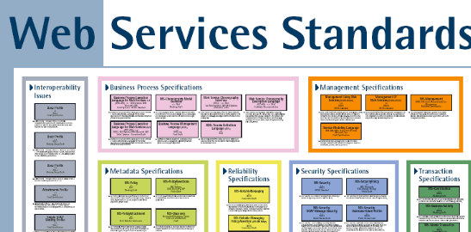
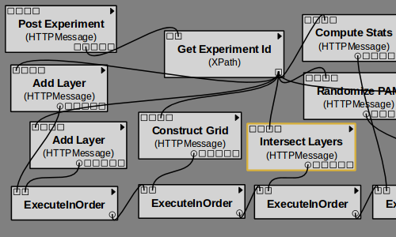
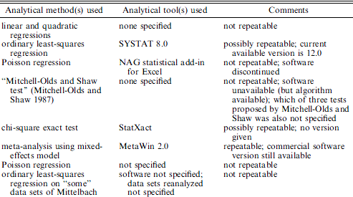
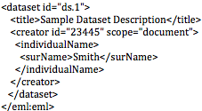
Lifemapper
Integration
Work Flow Tools
Repeatable Transparent Science
Archiving
Ellison, A. 2010. J. Ecology
EEML
Notes:
Our goal is to Develop a software architecture and tools that are modular, allow open access and enable innovative science by streamlining difficult and time-consuming tasks.
The architecture uses standard protocols and formats
To Integrate scientific data and analyses in clients, such as scientific workflow tools and GIS tools
To Archive and document data, tools, metadata, and entire research experiments in public repositories
To allow creative, transparent, repeatable science.

