Slide 1
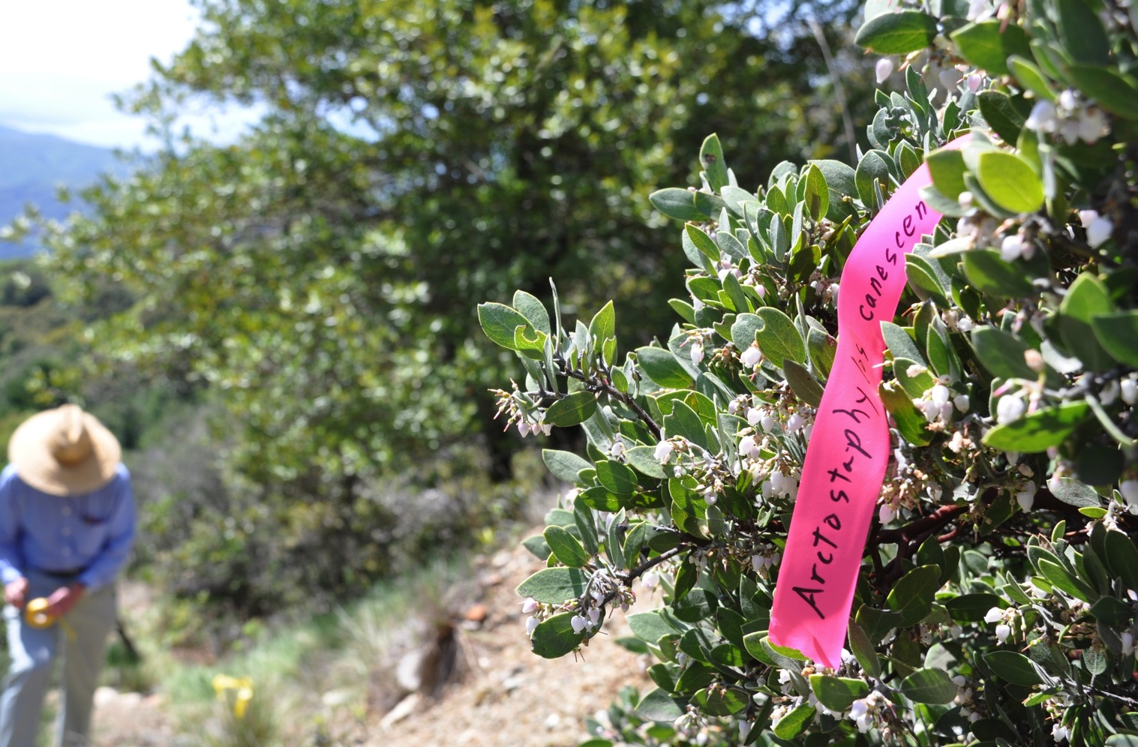
Documenting California biodiversity with citizen scientists: lessons learned through a year of planning
Alison Young
California Academy of Sciences
September 29, 2012

Slide 2
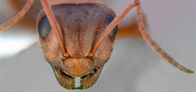
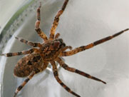
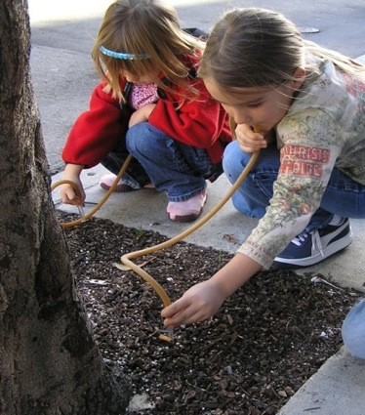
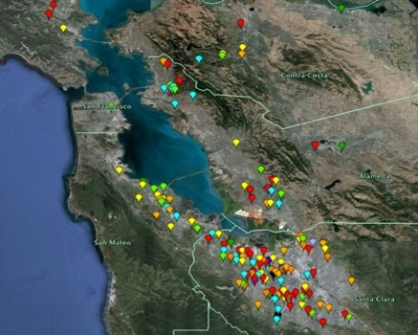
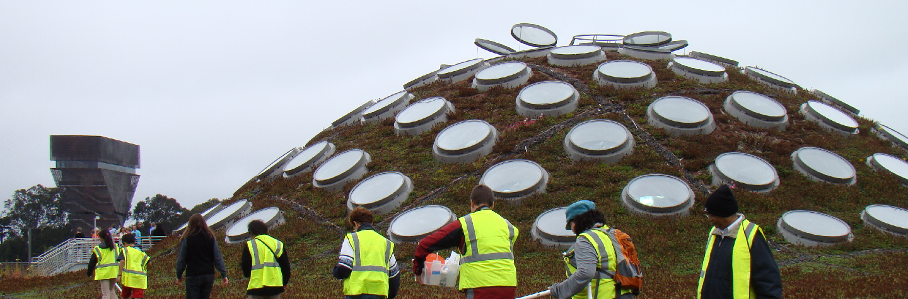
Living Roof Project
Previous citizen science projects at the Academy
Bay Area Ant Survey
Most Wanted Spider

Slide 3
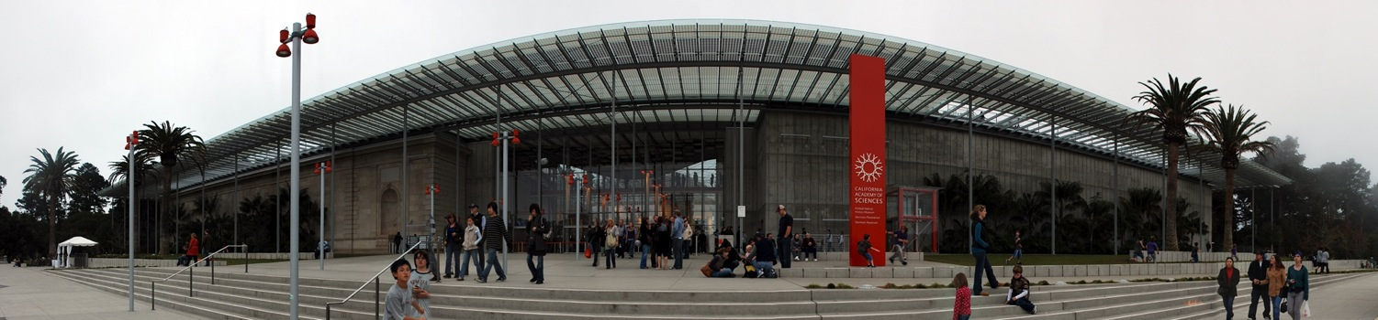
Lesson 1: Focus!
Academy Citizen Science, defined:
Engage the public in real, active scientific research connected to the Academy
Create projects with direct impact on biodiversity, science literacy, and/or conservation
Provide an opportunity for “tiered-involvement” by members of the public with varying expertise and time
Provide multiple entry points for participants at different stages of the scientific enterprise: defining the research, planning, data collection, analysis, and sharing outcomes
Engage scientists and participants in mutually beneficial work together
Innovate in the use of mobile and other digital media

Slide 4
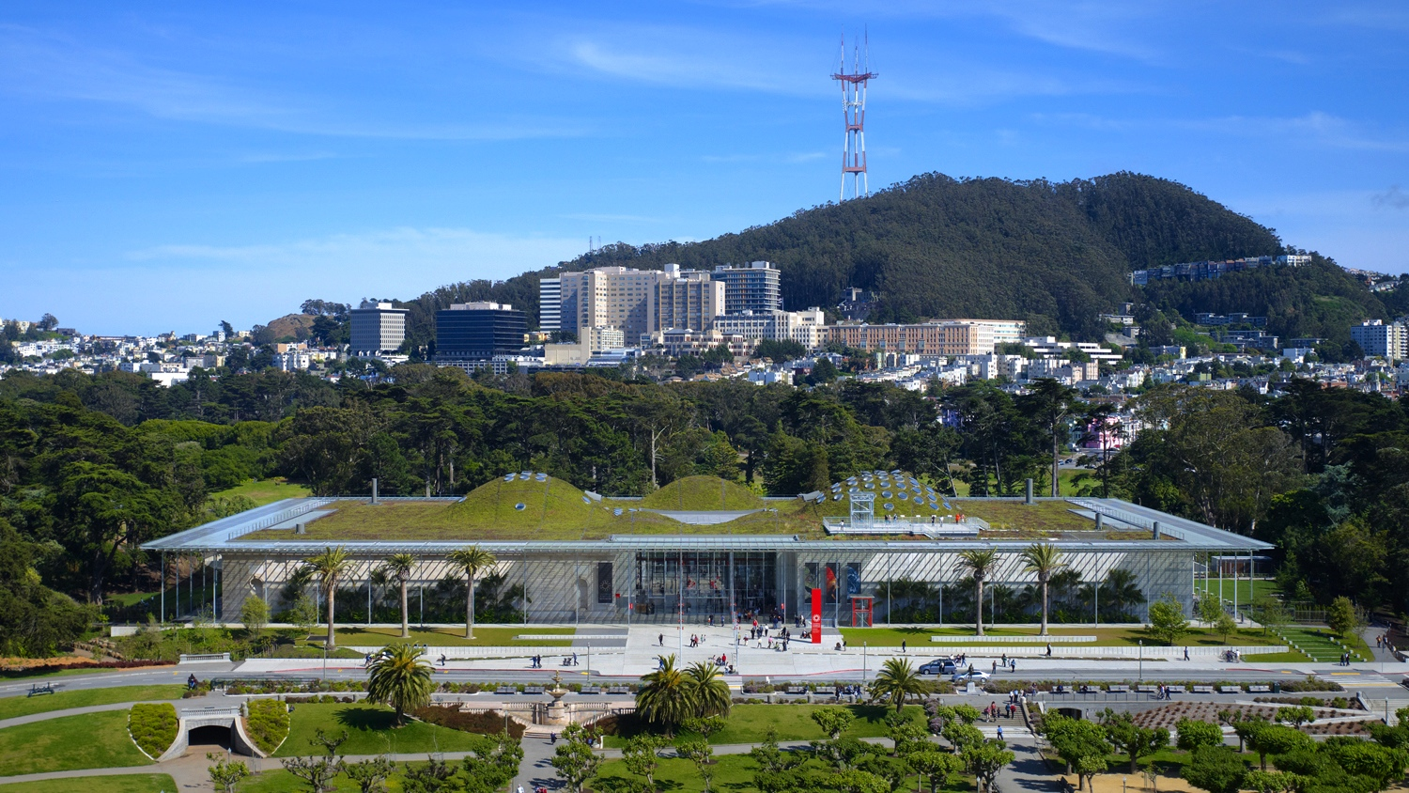
Lesson 2: Equal collaboration
Citizen Science is education AND research:
Collaboration between education division and research division
Coordinator on education side and research side
Core citizen science “team” with weekly meetings

Slide 5
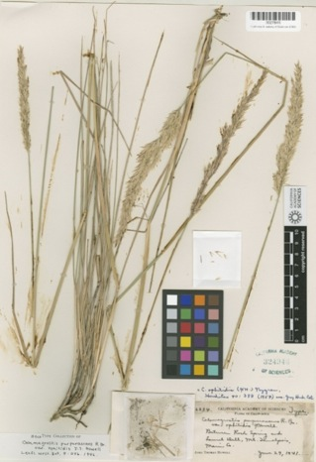
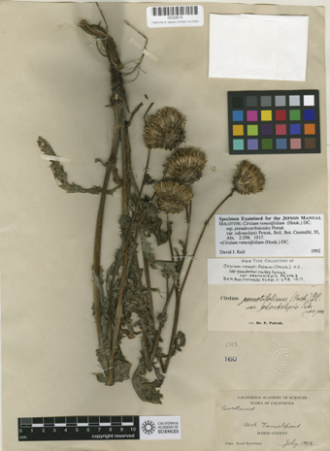
Lesson 3: Careful planning
If possible, don’t just launch a program:
Year-long planning grant: S.D. Bechtel, Jr. Foundation
Answer real research questions about California biodiversity
Use our historical collections as a baseline
Two test cases: terrestrial & intertidal
Series of citizen science meetings to learn from others

Slide 6

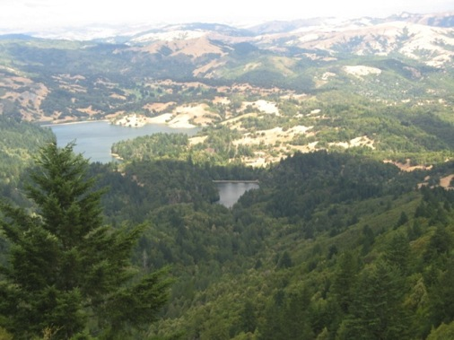
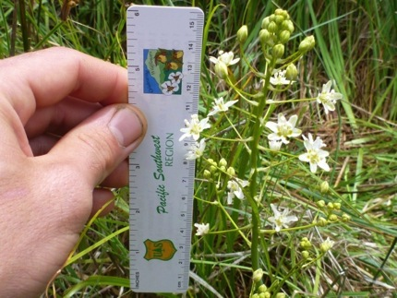
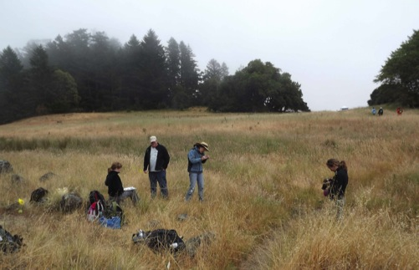
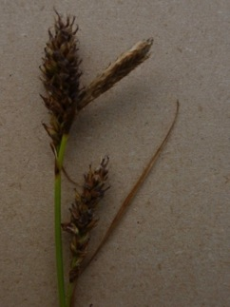
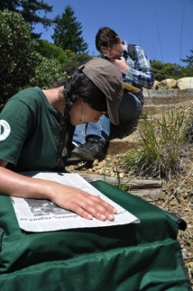
Test Case 1: Marin Municipal Water District
Key Goals:
Document current state of flora on Mt. Tamalpais.
Fill taxonomic gaps in our collections.
Distribution of invasives, fire-associated species.
Establish benchmark for exploring climate-related shifts in distribution.

Slide 7
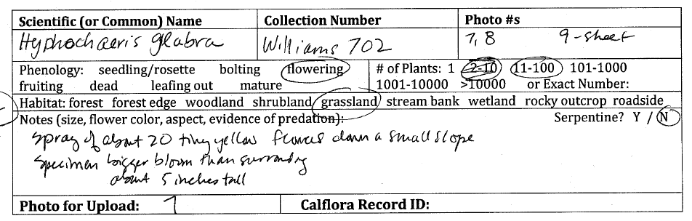
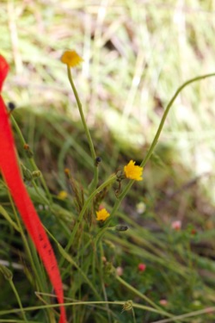
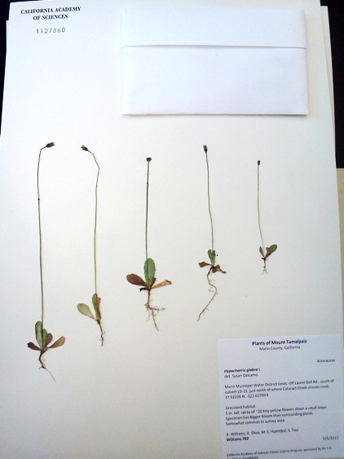
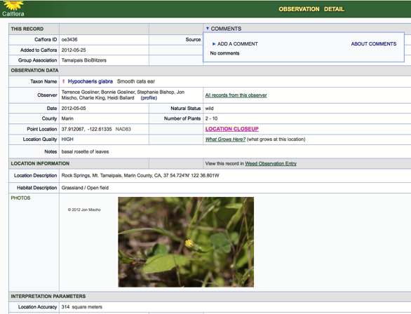
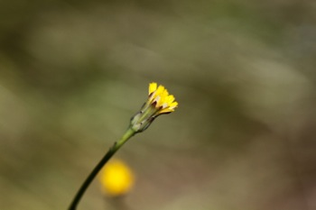
Test Case 1: Marin Municipal Water District

Slide 8
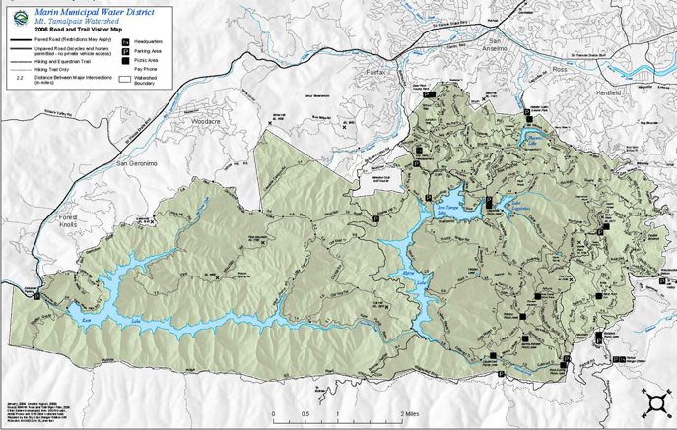
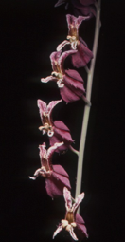
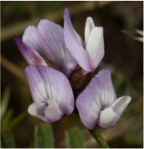
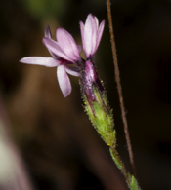
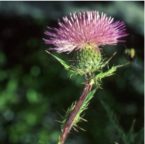
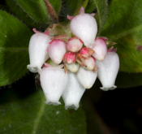
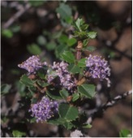
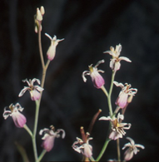
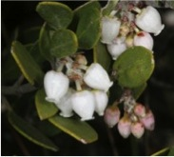
Test Case 1: Marin Municipal Water District
The Mt. Tamalpais watershed: a biodiversity paradise!
900+ species of plants and 400 (known) species of animals
More than 50% of Marin’s flora is found in the watershed (only 12% of Marin County)
15% of California’s flora is found in the watershed (0.01% of the area of the state)
17 species are known only from Marin and 8 of these are found in the watershed!

Slide 9

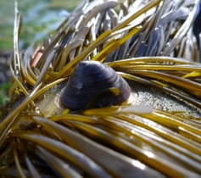
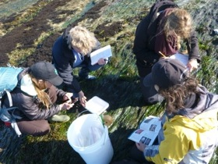
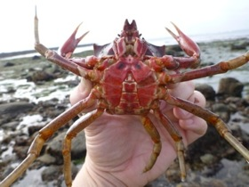
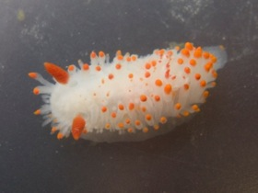
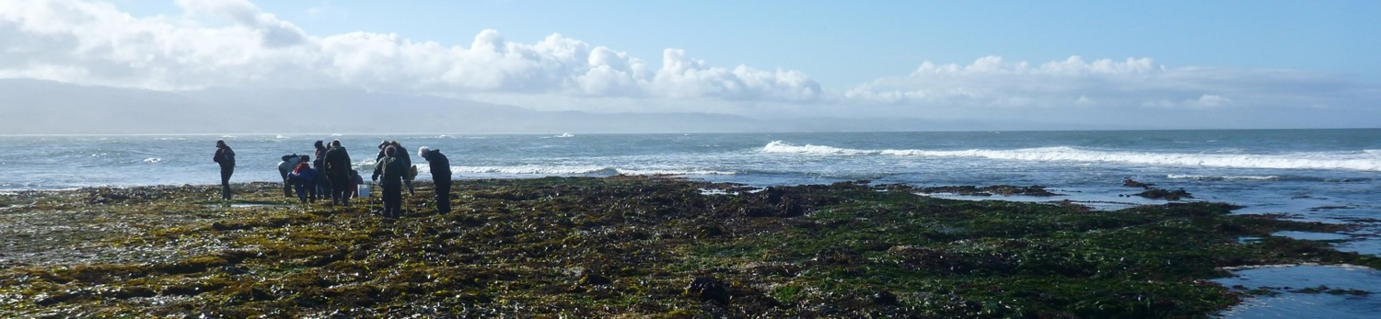
Test Case 2: Pillar Point reef
Key Goals:
Use Academy specimen data as baseline for comparing new data.
Deliver species list with GPS tagged images and habitat ranges.
Focus on influence of high visitorship and collecting.
Establish benchmark for exploring climate-related shifts in distribution.
Compare to adjacent marine protected area.

Slide 10
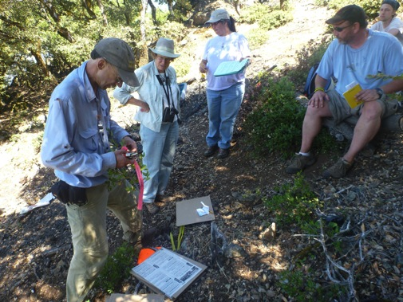
Volunteers
Recruited through:
  Volunteers who already worked with the Academy, MMWD, or GFNMS
Local organizations with similar interests:
  Chapters of the California Native Plant Society
  Friends groups
  Volunteers from local parks districts
Local colleges: botany/ecology/conservation biology classes
Meetup.com: Conservation Photography group
Word of mouth: friends of volunteers, Academy staff, etc.
Demographics:
~60% female / 40% male
25%: 50-59 years of age; 20%: 18-29; 20%: 30-39; 20%: 40-49; 15%: 60+
95% Caucasian
50% Graduate degree; 30% Bachelor’s degree; all with at least some college
70% had collected data in other scientific studies
80.5% volunteer in other capacities

Slide 11
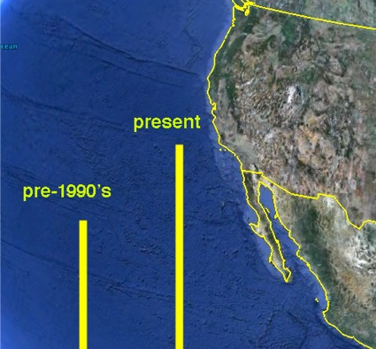
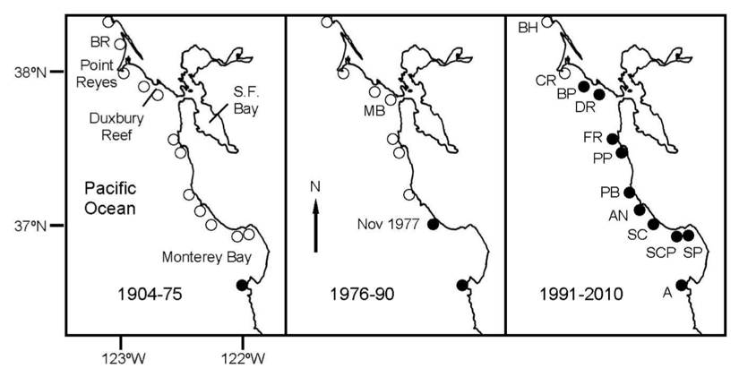
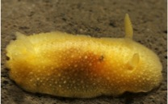
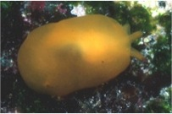
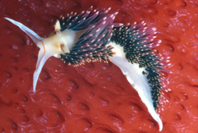
Test Case 2: Pillar Point reef
Rocky intertidal areas:
High biodiversity in a small area.
Intertidal species are bound within a small livable range = potential key indicators of climate change.
Pelagic larval stage allows for rapid range expansion and potentially permanent shift in distribution.

Slide 12
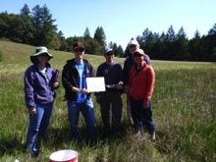
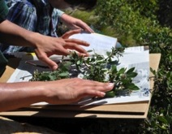
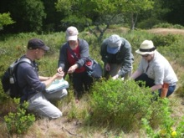

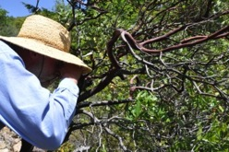
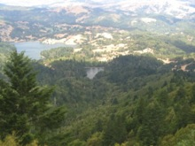
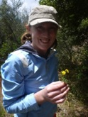

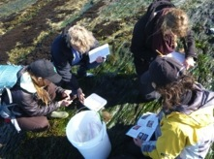
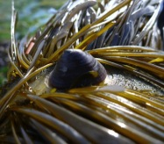
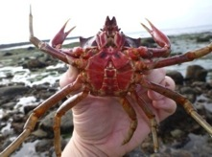
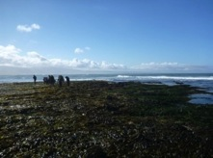




Progress to date
Test Case: Marin Municipal Water District
More than 650 observations made, comprising over 350 species of the known 920+ plant species on the watershed.
Distribution of species documented on 1/3 of the watershed.
More than 450 specimens collected.
Over 80 volunteer participants.
Test Case: Pillar Point Reef
More than 400 observations made, comprising close to 200 species.
22 specimens collected from select taxa, including samples for genetic work.
Over 50 volunteers engaged.

Slide 13





Lesson 4: Don’t be afraid to get it wrong
Listen to your volunteers and check your data:
Reworking protocols
Re-designing data sheets
Realistic timeline
Use of smartphones and other technology
Weather!
Data entry/upload
Different volunteers for different processes

Slide 14




Lesson 5: Feedback, reinforcement, & appreciation
Rapid feedback to your volunteers reinforces their role in the bigger picture:
Data visualization
Results
Emails
Photos
Appreciation:
Lots of gratitude
Swag
Unique opportunities
Appreciation events

Slide 15

Lesson 6: Evaluate!
Detailed feedback from your volunteers:
What did you hope to get out of participating in the surveys?
How would you describe the scientific purpose of the surveys?
In your words, how does your participation in the surveys contribute to this scientific purpose?
What was most challenging part of data collection and/or analysis for you?
In your view, why is scientific study of biodiversity, and this site in particular, important?
What aspects of the surveys do you think you learned the most from?
Did participating in the surveys introduce or raise any new questions for you that you would like to pursue?

Slide 16

Lesson 6: Evaluate!
We’re interested in knowing why you chose to participate in the surveys:
80.0% Contribute to scientific research
64.4% Curiosity about local environment, plants and animals
60.0% Spend time outside
53.3% Connect to / support colleagues
46.7% Meet others with similar interests
“Contribute to scientific research. Climate change may be expected to push certain plant species upslope; this project may prove that hypothesis (and the exceptions are bound to be interesting). Mostly, I'd just like to feel that I am making a contribution, however small, to our understanding of our world.”
How important is it to you to see the analysis or results of this data collection?
43.6% Very important
0.0% Not important

Slide 17






Lesson 7: Learn from others
Don’t re-invent the wheel: three days of citizen science meetings
Invited:
Citizen science practitioners
Biodiversity researchers
Conservation organizations
Data managers
Citizen scientists
Goals:
Benefit from the participants’ experience and their institutions’ research, programming, and resources to inform the design of the Academy’s new citizen science program.
Discuss best practices in citizen science biodiversity research.
Identify common goals, areas of need, and logical next steps.

Slide 18




Lesson 7: Learn from others
Topics:
Working with participants in citizen science projects
Setting research and conservation goals and aligning them with educational outcomes and needs of participants
The use of technology in citizen science and data management
Conference proceedings available for download at:
http://www.calacademy.org/science/citizen_science/

Slide 19





What’s next?
      2013+: Expand current projects, begin to create additional projects
      Add in goals not covered fully in test cases (tiered involvement, multiple entry points, mobile/digital media)
      Design a strategy for digitizing California specimens, especially those from survey locations (eventually for all specimens): for research and engagement
      San Francisco Specimens:
U.S. Marine Hospital
April 1886
Laurel Hill Cemetery
May 1895
Bay View Hills
May 1899
San Bruno Hills
June 1906
Near Cliff House
March 1902

Slide 20

What’s next?
Evaluation (on-going):
Are we meeting our goals?
Are we meeting the needs of our participants?
2014: Add a citizen science component to the public floor of the Academy
Future:
CA regional citizen science network (including network of science centers)
National/international eventually

Slide 21

Questions?
Alison Young
Citizen Science Educator
California Academy of Sciences
San Francisco, CA
ayoung@calacademy.org

