Slide 1
How to Break the Law and Annoy Your Friends and Colleagues: All in less than 20 minutes
Managing Natural History Collections Data for Global Discoverability
Sept. 2015, ASU
David Bloom, VertNet

Slide 2
Basic Terminology
Copyright: the legal claim to ownership of ideas and products that have been created.

Slide 3
Basic Terminology
License: a means to exercise copyright and to permit a user to perform a given activity or use an object or idea.

Slide 4
Basic Terminology
Waiver: a means to release some or all obligations of copyright, temporarily or permanently.

Slide 5
Basic Terminology
Terms of Use (ToS/ToU): a document defining the rules a user must follow or actions a user must take in order to use a given service.

Slide 6
Basic Terminology
Data Use Agreement (DUA): an agreement usually between a data source and a data user that specifies how and when a data set can be used.

Slide 7
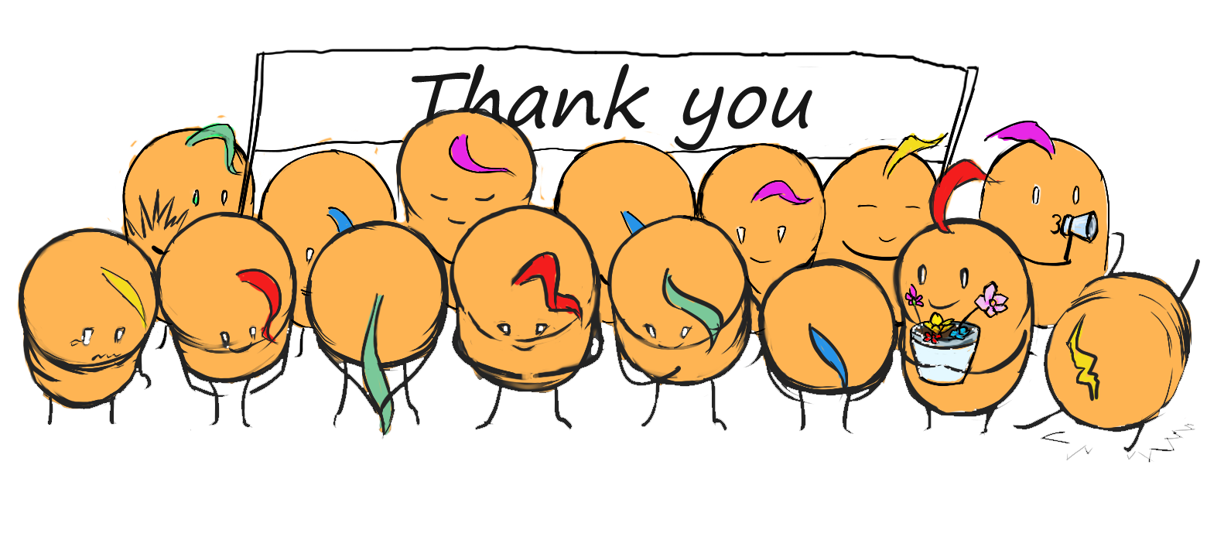
Why Copyright?
To receive appropriate recognition and attribution for providing content.
To protect any individual or institutional interests (financial or otherwise) that may arise from shared content.

Slide 8
What does this mean for biodiversity occurrence records, metadata, and associated media?

Slide 9
What can be protected?
Images
Media
Some textual descriptions that are clearly and demonstrably the creative work of the collector or observer, or other individual including, but not limited to, the unique expression of ideas, concepts or beliefs.

Slide 10
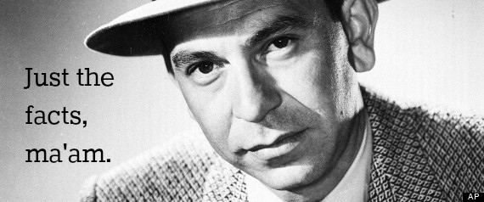
What cannot be protected?
(That’s most of the content collection databases.)

Slide 11
What are my options?
Creative Commons Designations
CC0 (CCZero)
CC-BY
CC-BY-NC
CC-SA – Beware!
CC-ND – Of little use
Non-Standard Terms of Use
(but, not for long)
Not portal or user-friendly
Data Use Agreements
Not portal-friendly

Slide 12
Pick One, please!

Slide 13
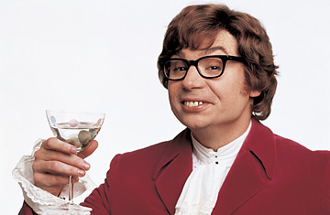
The Real Solution
Oh behave, baby!

Slide 14
Norms for Data Use
Give credit where credit is due
Be responsible with the data
Share what you’ve learned
Respect the Data License or Waiver
Understand and follow any restrictions or regulations
You’ll be glad you did
(and so will everyone else)

Slide 15
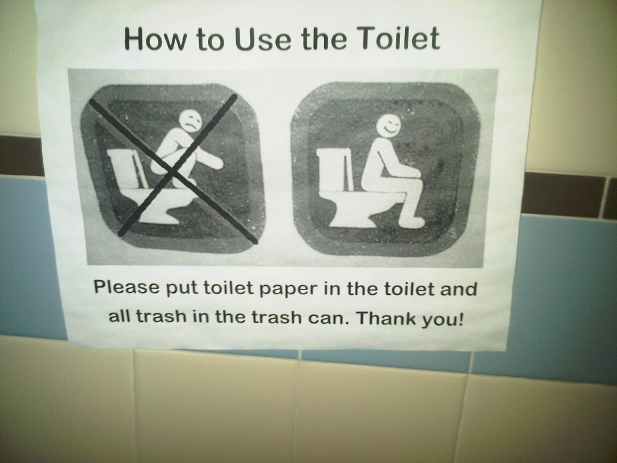
You can do it!
Yes, you can!

Slide 16
Recommended Citations
Single Dataset
Format:
[dataset name]. [data publisher]. [link to dataset] (accessed on [date])
Example:
Cowan Tetrapod Collection at the University of British Columbia Beaty Biodiversity Museum (UBCBBM). University of British Columbia. http://ipt.vertnet.org:8080/ipt/resource.do?r=ubc_bbm_ctc_birds (accessed on 2014-07-28)

Slide 17
Recommended Citations
Aggregated Dataset
Example:
Cowan Tetrapod Collection at the University of British Columbia Beaty Biodiversity Museum (UBCBBM). University of British Columbia. http://ipt.vertnet.org:8080/ipt/resource.do?r=ubc_bbm_ctc_birds (accessed on 2014-07-28) Field Museum of Natural History (Zoology) Bird Collection. Field Museum. http://fmipt.fieldmuseum.org:8080/ipt/resource.do?r=fm_birds (accessed on 2014-07-28) University of Kansas Bird Collection. University of Kansas Biodiversity Institute. http://ipt.nhm.ku.edu/ipt/resource.do?r=kubi_ornithology (accessed on 2014-07-28)

Slide 18
Some Resources
VertNet Guide to Copyright and Licenses
http://www.vertnet.org/resources/datalicensingguide.html
VertNet Norms for Data Use and Publication
http://www.vertnet.org/resources/norms.html
iDigBio Intellectual Property Policy
https://www.idigbio.org/content/idigbio-intellectual-property-policy
The Creative Commons
https://creativecommons.org/
Data Citations
http://vertnet.org/resources/help.html#t-tab4

Slide 19
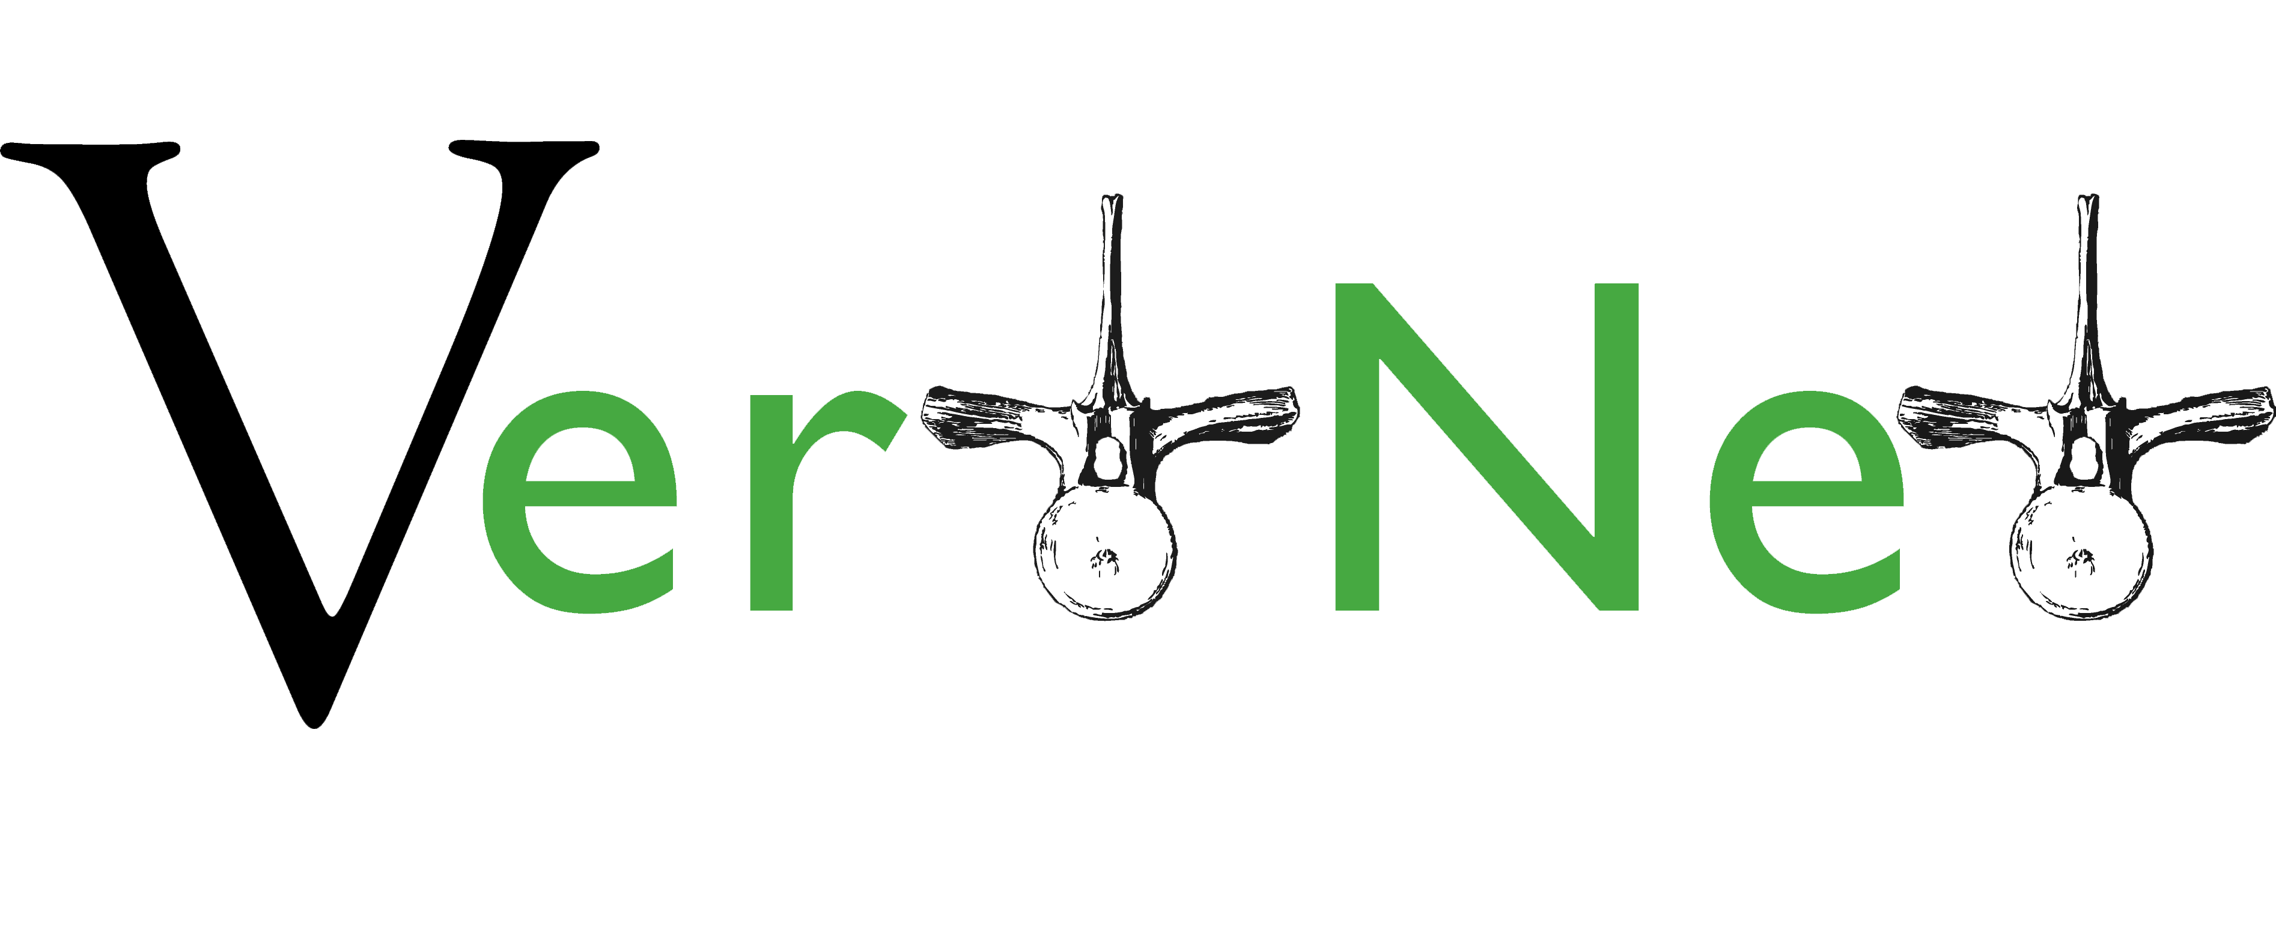
David Bloom
VertNet Coordinator
dbloom@vertnet.org
“Information is only of value if you give it to people with the ability to do something with it.”
- Gen. Stanley McChrystal

