Slide 1

Getting Your Data Published: Sending Data to iDigBio
Joanna McCaffrey, iDigBio Biodiversity Informatics Manager
Managing Natural History Collections Data for Global Discoverability
Arizona State University, September 15th, 2015
Thursday 17 September 2015, Tempe AZ
Notes:
Derived from several previous talks. Thank you, Molly Phillips, for the graphics
20 minutes
NOTE: one critical piece missing is about GUIDs – covered in another talk
Master iDigBio mobilization resource: https://www.idigbio.org/wiki/index.php/Data_Ingestion_Guidance

Slide 2

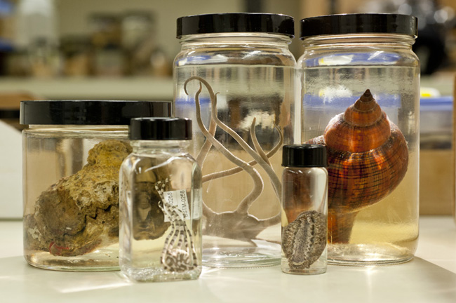
What do we mean by data publishing?
making biodiversity datasets publicly accessible & discoverable, in a standardized form, via a URL.

Slide 3
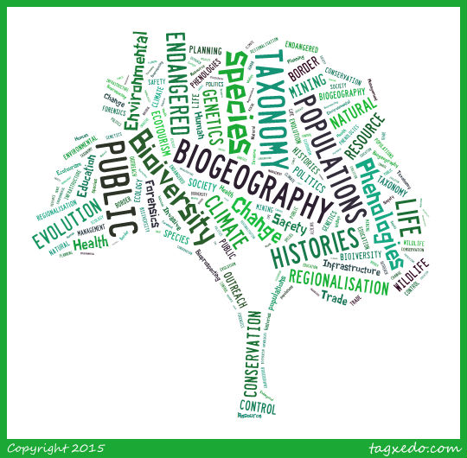
Why publish data? The 4 biggies for data aggregation
ACCESSIBILITY
Data Use
Data Quality
Attribution
Notes:
Why publish data?
Data publishing increases access to your data.
When your data are accessible
they can be used by others for research & education,
the data’s accuracy can be assessed by the community,
& researchers or institutions can receive credit when their data are used in projects & publications.

Slide 4
Data publishing: where to begin with iDigBio?
Email data@idigbio.org
There are four ways to share data:
Least Ideal
Most Ideal
Technical skill vs. time, updatability, data buy-back etc.

Slide 5

DATA Method #1 – BEST
What you already send to GBIF
  Using Darwin Core field names
  Packaged in a Darwin Core Archive (DwC-A)
  On an RSS feed (produced by IPT)
More on IPT this afternoon!
Notes:
You have two sets of assets to provide:
Specimen data
Images/media
With registration data (check entry at GRBio.org, use the same institution code and collection code in your exported data).
They can arrive together or separately
Let’s start with Specimen Data
Data: become familiar with Darwin Core, a metadata standard (recommendation) from TDWG and supported by GBIF and many other data aggregators
Best way to get data to iDigBio is to use IPT to help you generate the mapping of your database fields to Darwin Core, and to provide the resulting archive with an RSS feed for easy updates
GBIF provides this via their IPT so if you already send data to GBIF the work is already done!
IPT: Integrated Publishing Toolkit - a Java-based tool used to publish and share biodiversity datasets, https://code.google.com/p/gbif-providertoolkit/
RSS: Really Simple Syndication, uses a family of standard web feed formats^{[2]} to publish frequently updated information: blog entries, news headlines, audio, video, datasets. The reason you want your data on an RSS feed is because you would not have to tell us there are updates, everything is automatic. https://www.idigbio.org/wiki/index.php/CYWG_iDigBio_DwC-A_Pull_Ingestion

Slide 6
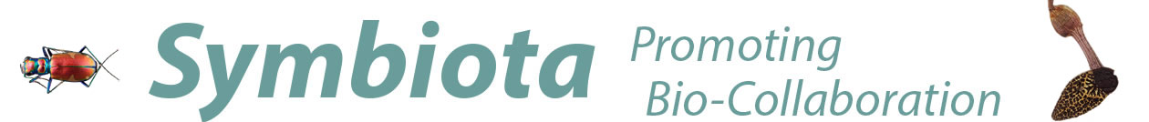
DATA Method #2 – BETTER+
When you mark your data to publish, all the necessary parts of the package are generated.
  Custom Darwin Core Archive (DwC-A) on an RSS feed produced by Symbiota
  automatic media
  http://symbiota.org
Notes:
Searching is not the same as publishing on a Symbiota node. You can be in the node, searchable, but not published. This is the strategy to use if you are also publishing thru your institution, it avoids duplicates.
The only possible downside to getting data via Symbiota is that it doesn’t support the full range of DwC, otherwise it is close to identical.

Slide 7

DATA #3 – GOOD ENOUGH
Export your data as CSV/TXT file with DwC fieldnames & let us host it on our IPT or VertNet’s
Create a custom CSV or TXT file, with XML style field names from Darwin Core,
  e.g., domain:fieldName
    dwc:catalogNumber
    ac:provider
⬇︎ personnel maintenance costs
Notes:
This method requires someone to have the time and skill to create a DwC file on their own. Using xml style field names from Darwin Core. See the example for what that would look like.
Another great option is setting up an IPT through VertNet.
They provide great support but there can be a waiting list.

Slide 8

DATA #4 - ADEQUATE
Throw the data over the wall and let us prepare it.
Has its challenges:
  data manipulations
  UUID, data cleansing
⬇︎buy-back
⬇︎updates
⬇︎backlog
Notes:
This method has its challenges:
:: We (me or you with my help) might need to perform some data manipulations (e.g., on dates, dec lat/lon, removing ‘0’ values, un-escaped quotes, escaped newlines)
:: Add a UUID, do significant data development (higher taxonomy, country code, split out dates = 20 hours worth of work that no one wants to do more than once)
If you are going to be submitting updates, it is important for the provider to ‘buy-back’ the improvements/fixes we make.

Slide 9
3 ways to get media to iDigBio:
Use Audubon Core extension in IPT
Via Symbiota
Media ingestion appliance
Linked to the specimen
Linked to the specimen
Can be linked to the specimen
Notes:
Create a file of Audubon Core metadata, include a URL to the media and camera info (EXIF), photographer, media description and the rights/rightsholder. PLUS a link to the specimen record via occurrenceID.
Media are linked automatically when using Symbiota to publish.
This method allows the provider to upload a collection of images for crowd sourcing. With the appliance, you can upload images before the records are available. To link to existing specimen records, you need to associate the uploaded images with iDigBio records in a CSV file that's produced by the appliance as part of the upload batch.

Slide 10
DATASET INFO: info about the provider
Send your dataset metadata with your provider information (eml.xml):
responsible parties (name, address, email, role)
institution name, institution code
URL to the data at your institution
descriptive paragraph about the collection
Notes:
Equivalent to the eml.xml file produced by IPT
<?xml version="1.0" encoding="utf-8"?>
<eml:eml xmlns:eml="eml://ecoinformatics.org/eml-2.1.1" xmlns:md="eml://ecoinformatics.org/methods-2.1.1" xmlns:proj="eml://ecoinformatics.org/project-2.1.1" xmlns:d="eml://ecoinformatics.org/dataset-2.1.1" xmlns:res="eml://ecoinformatics.org/resource-2.1.1" xmlns:dc="http://purl.org/dc/terms/" xmlns:xsi="http://www.w3.org/2001/XMLSchema-instance" xsi:schemaLocation="eml://ecoinformatics.org/eml-2.1.1 http://rs.gbif.org/schema/eml-gbif-profile/1.0.1/eml.xsd" xml:lang="eng">
<dataset>
<alternateIdentifier>4bfac3ea-8763-4f4b-a71a-76a6f5f243d3</alternateIdentifier>
<alternateIdentifier>http://digir.mcz.harvard.edu/ipt/resource.do?r=mczbase</alternateIdentifier>
<title xml:lang="eng">CUMV Amphibian Collection</title>
<creator>
<individualName>
<givenName>John</givenName>
<surName>Friel</surName>
</individualName>
<positionName>Curator</positionName>
<electronicMailAddress>john.friel@cornell.edu</electronicMailAddress>
</creator>
<metadataProvider>
<individualName>
<givenName>John</givenName>
<surName>Friel</surName>
</individualName>
<positionName>Curator</positionName>
<electronicMailAddress>john.friel@cornell.edu</electronicMailAddress>
</metadataProvider>
<associatedParty>
<individualName>
<givenName>John</givenName>
<surName>Friel</surName>
</individualName>
<electronicMailAddress>john.friel@cornell.edu</electronicMailAddress>
</associatedParty>
<language>eng</language>
<abstract>
<para>The CUMV Amphibian &amp; Reptile Collection became one of the leading university based herp collections in North America during the first half of this century, largely because of the efforts of Professor Albert Hazen Wright and his wife, Anna Allen Wright. The major strengths of the collection, amphibians from the southeastern United States and both reptiles and amphibians from the Northeast, reflects the intensive collection by the Wrights. Much of the material collected by the Wrights in New York and Georgia is not duplicated elsewhere. At present, the cataloged collection contains 44,300 alcoholic specimens, 238 dry skeletons, and 486 cleared and stained specimens. In all appoximately 300 species of amphibians and 500 species of reptiles are represented.
The last 15 years have been seen important acquisitions for the collection. To complement our traditional strength in North American taxa, we have made a concerted effort to obtain foreign material, especially synoptic series representing geographic areas. This material includes research specimens collected by Dr. F. Harvey Pough in Western and South Australia. The donation of his personal collection by Dr. Kraig Adler (Neurobiology and Behavior) has added more than 100 new species to the collection. Through collecting, exchanges and acquisition of other various collections we now have good representation of Costa Rican viperids, lizards from Western and South Australia, amphibians and reptiles from Puerto Rico, snakes and lizards from Mexico, and a more representative collection of African and European species.</para>
</abstract>
<distribution scope="document">
<online>
<url function="information">http://mczbase.mcz.harvard.edu/</url>
</online>
</distribution>
</dataset>
<additionalMetadata>
<metadata>
<gbif>
<resourceLogoUrl>http://ipt.vertnet.org:8080/ipt/logo.do?r=cumv_amph</resourceLogoUrl>
</gbif>
</metadata>
</additionalMetadata>
</eml:eml>

Slide 11


DATASET INFO: rights
Include data rights and rightsHolder information:
Use Creative Commons standards:
  CC0 for data (not copyrightable)
  CC BY for media (at least)

Slide 12
DATASET INFO: update collections lists
iDigBio Collections
https://www.idigbio.org/portal/collections
Index Herbariorum
http://sweetgum.nybg.org/ih/
GRBio.org Repositories:
http://grbio.org/find-biorepositories
Do you know what your institutionCode is?
Notes:
We work together with GRBio to make sure their repository and institutional collections data are up to date, and so before we accept data, we ask you to verify your data with them as well as with us. Critical to good data reporting is for the institution code and collections code in GRBio to be what is in your occurrence.txt file.

Slide 13
Data Quality: Consider searchability in the aggregate
Dates – dwc:eventDate, dwc:day, dwc:month, dwc:year:
this is not a month: Spring
this Is not a day: 10-18
this is not a year: 1989? Or [1989]
Taxonomy – fill in dwc:scientificName, parse out the elements, fill in higher taxonomy
this is not a species: shrimp
Tics: * [] {} ?
Use the verbatim and remarks fields for things that do not fit the definitions.

Slide 14
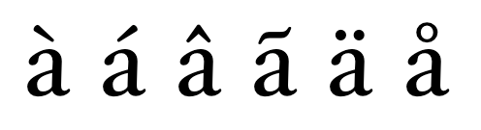
Data Quality: Grooming and tics
Your dataset is no longer just for making labels, there are other considerations for being digital, and out in the wild:
Put dates in ISO 8601 format, i.e., YYYY-MM-DD, e.g., 2015-09-17
Parse out scientific name
Conversely, put the piece parts into a scientific name
Provide as much higher taxonomy as your feel comfortable with, fill in tribe, sub+super family, kingdom, division, class, order) get out of ‘family’ land.
Make sure lat and lon coordinates are in decimal, and no N, S, E, W
Do not export '0' in fields to represent no value, e.g., lat or lon
put elevation in METERS units in the elevation field without the units (e.g., the fields dwc:minimumElevationInMeters and dwc:maximumElevationInMeters already assume the numeric values are in meters, so there no need to include the units with the data)
And not to get too esoteric, do not use un-escaped newline characters or embedded tabs
Watch out for diacritics, save in UTF-8
Notes:
These are best practices for recording data. If you have it right in the database, then you won’t have to do any manipulations to export it.

Slide 15
Thank you for your attention

