Slide 1
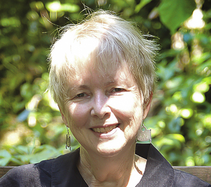
Photography 101: Tempe Edition
Joanna McCaffrey, iDigBio Biodiversity Informatics Manager
Managing Natural History Collections Data for Global Discoverability
Arizona State University, September 15th, 2015
Thursday 17 September 2015, Tempe AZ
Notes:
Derived from several previous talks.

Slide 2
Shopping List
Copy stand
Camera
Lens
Cables
  AC adapter
  Long USB cable
Computer & Monitor
Software
  Camera control software
  Image management software
Lights OR Photo-eBox Plus
Miscellaneous
Notes:
This is a high-level list of photography items needed to set up an imaging station. It is on the outset based on imaging herbarium sheets, but other collections will find it useful in their planning also.

Slide 3
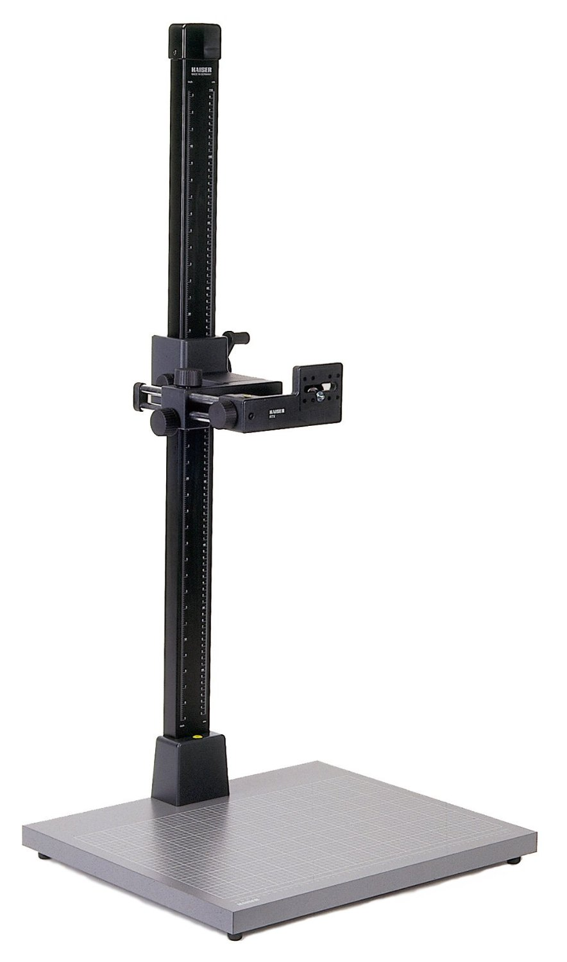
Copy Stand: Kaiser 205512 RSX
Notes:
A copy stand assures that the camera stays put.
It can be moved up or down, but once the right position is determined, it will save adjustment time from then on.
If you have things of different sizes, group them together to avoid having to move the camera on every shot.

Slide 4
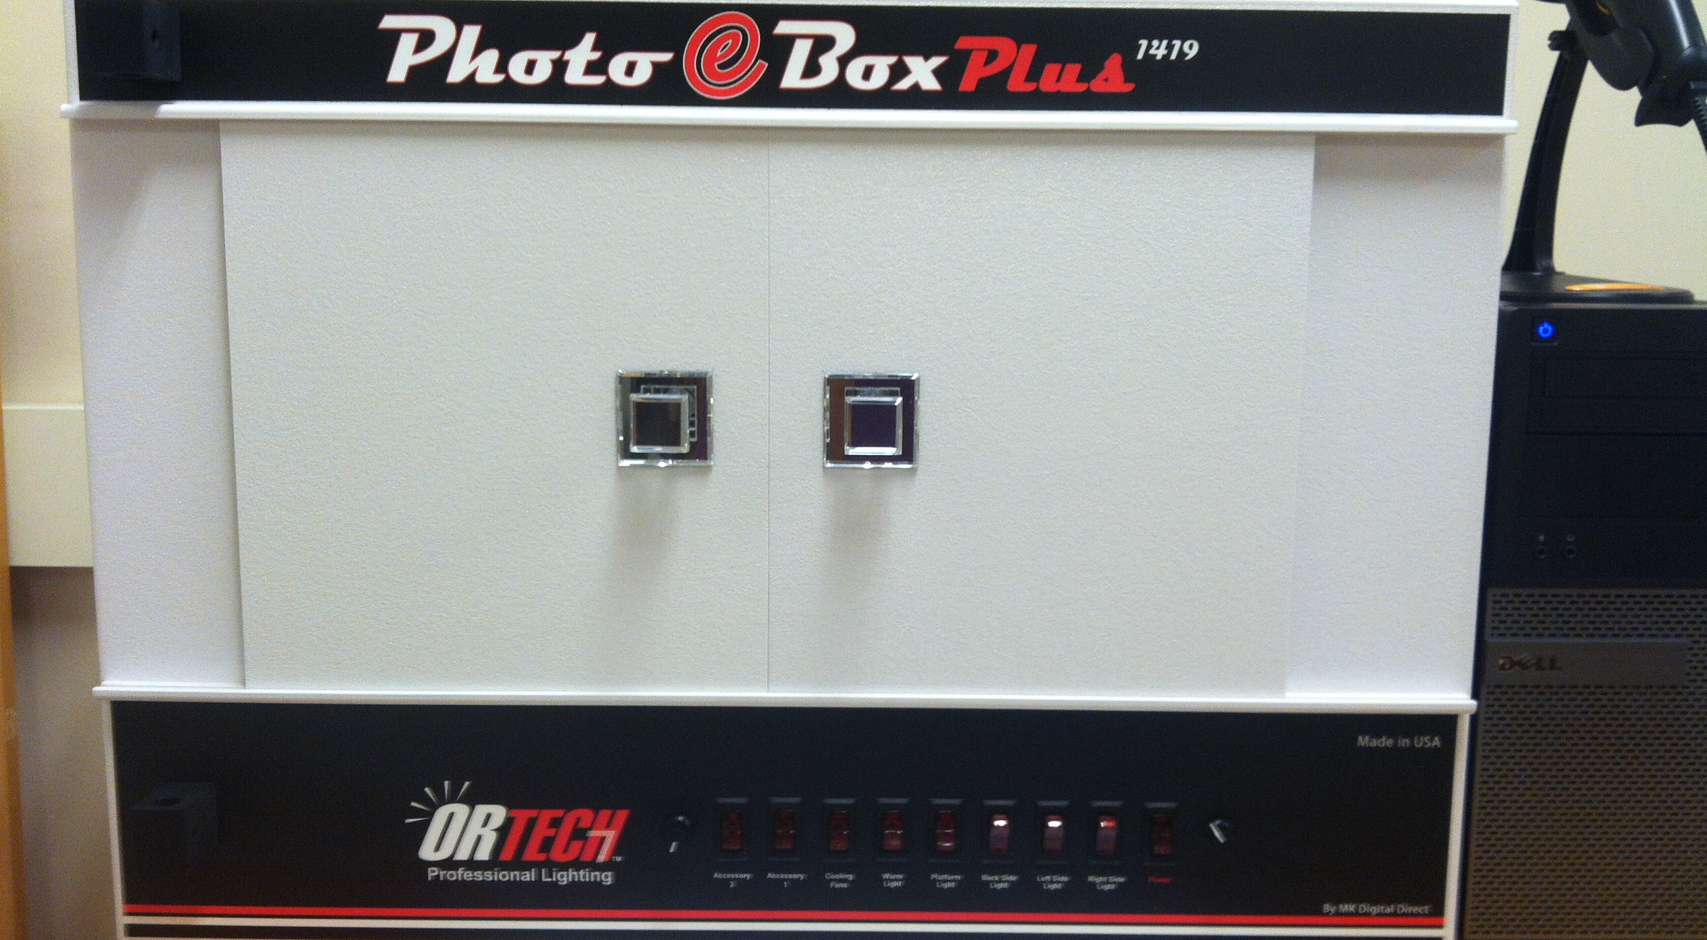
Photo eBox Plus
Notes:
OR Technologies makes custom-made boxes for the biological community. Their newest offering includes one for Fishes (bigger), contact Andy Bentley at KU to find out what he does.
The problem the botanists were trying to solve were the following:
Too much time taken to place the colour checker and ruler with every sheet = the box allowed them to place it once (at the top) and not have the placing/replacing time on every shot
Crop time – this is a delicate matter, in that the correct camera, in the right place on the copy stand, with the right lens, created a perfect ’fill the frame’ image that did not require cropping, thus saving post-processing time
Consistent lighting – depending on where an imaging station is placed and what kind of lights an imaging station uses, combined with the ambient light, can cause image anomalies – shadows and colour casts. The box removed all of those issues, it has self-contained lighting that are colour corrected, balanced and ready to make a perfect image, without shadows every time.
A small space consideration – if your space is limited and prone to imaging challenges – traffic, volunteer talent, the box will help to minimize those concerns. All a person has to do is turn on the lights, and put something in the right place in the box, the rest is ready.
Using the box for other kinds of collections, using other camera/lens combinations (recall that there is a whole in the top of the box that the camera setup has to compliment) can still work for you, even if you are not trying to solve all of the problems above.

Slide 5
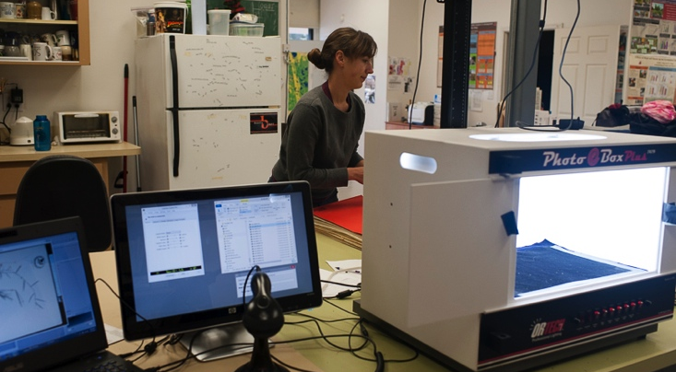
Photo eBox Plus in action

Slide 6
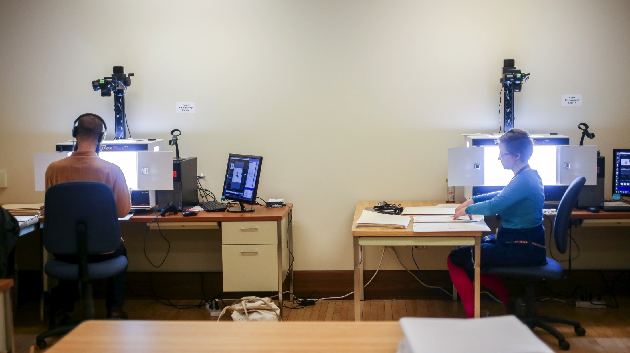
Work Environment

Slide 7
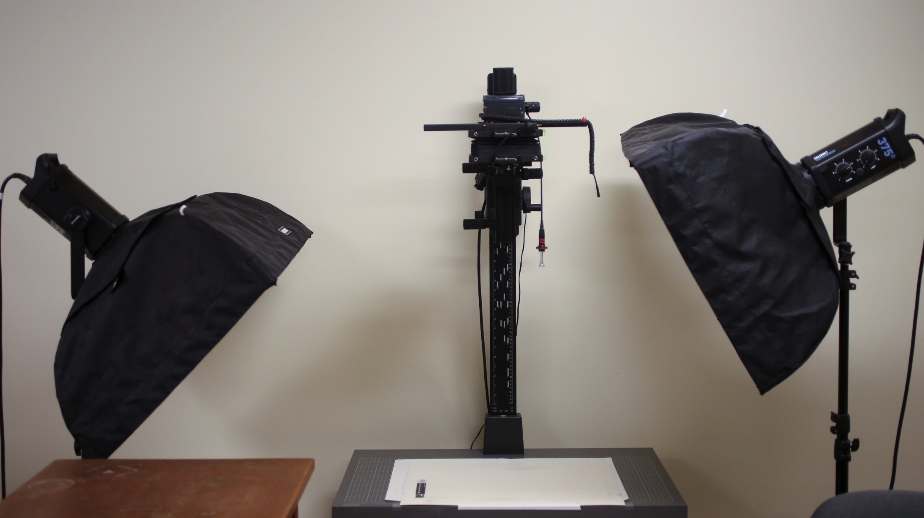
Copy Stand with 2 strobes

Slide 8
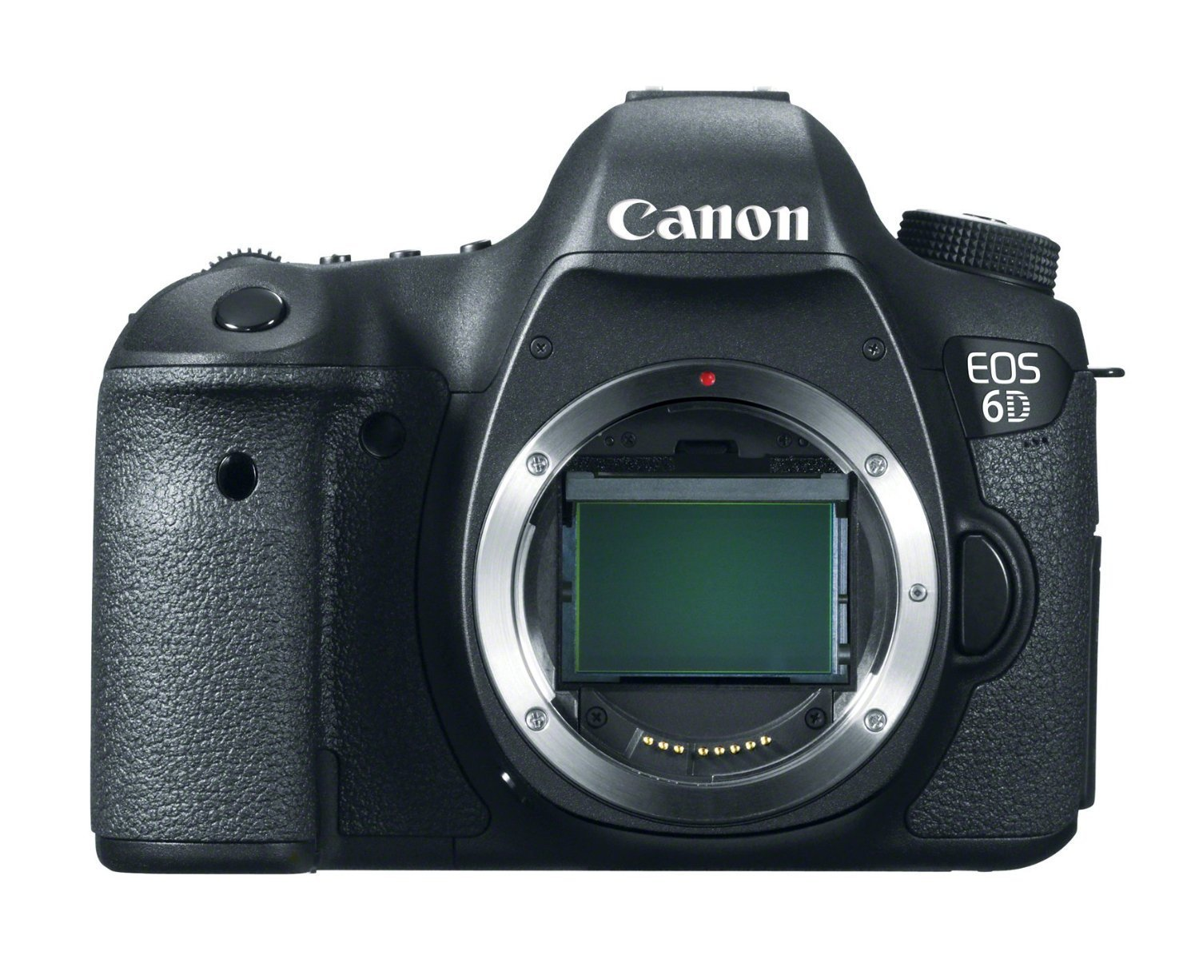
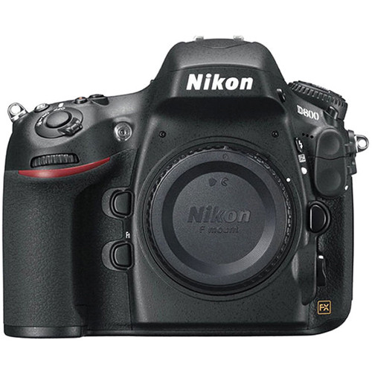
Camera – Canon or Nikon
Full Frame, at least 18 MP

Slide 9
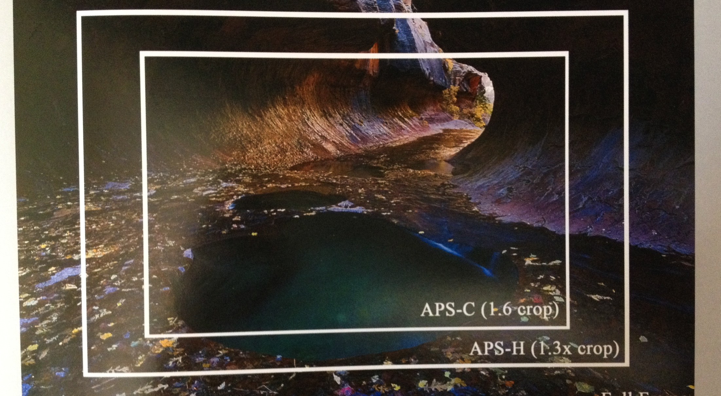
Full frame versus cropped frame
Notes:
Sensor size

Slide 10
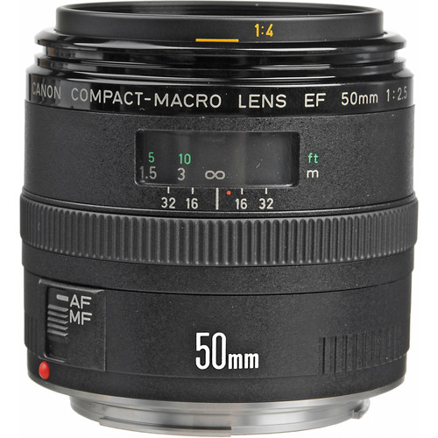
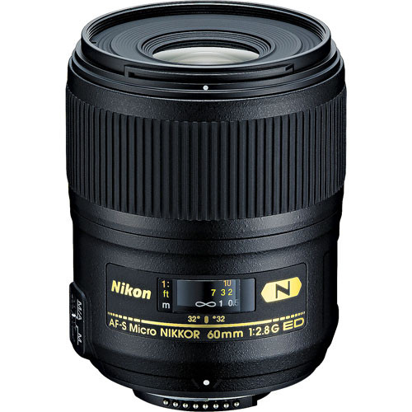
Lens 50 – 60 mm macro
Goal: Good 1:1 fidelity
Macrophotography lenses have extra close focusing ability
Notes:
Macrophotography lenses have extra close focusing ability and a different depth of field equation – 1/3 / 2/3 versus 2/3 / 1/3

Slide 11
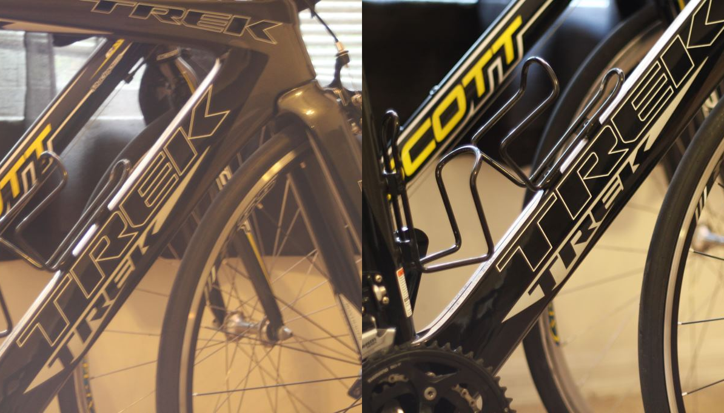
Good lens / bad lens
Notes:
All lens are not created equal – the optics, the range, the depth of focus (minimum focusing distance, f/stop)

Slide 12
Cables
AC adapter – replaces dependence on camera’s battery
Camera control – tethering camera to computer, using Live View
Notes:
Live View – seeing what you are photographing on the LCD on the back of the camera, instead of thru the lens, and when tethered, on the computer screen.
Remember that you cannot see thru the lens and you cannot look at the back of the camera at the Live View there because it is up on a copy stand.

Slide 13
Key Photography Terms
Image Goals
  Exposure – well balanced
  White balance – accurate light, no colour cast
  Focus - sharp

Slide 14
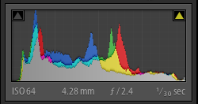
DO USE the histogram
Exposure: combination of ISO, f-stop and shutter speed
lean to the left – underexposed - DARK
lean to the right – overexposed – LIGHT
Notes:
ETTR – expose to the right

Slide 15
Camera Settings
Put the camera in manual mode (not program, shutter, speed, aperture, etc.)
Set matrix metering (not spot)
Place lens in auto focus
Exposure
  f/stop between f/9 and f/11
  ISO = 100
  Shutter speed = 1/60 sec.
White balance: auto, but depends on lights
Set image quality to Raw
Move camera up and down on the copy stand until in Live View the subject fills the frame and is in focus

Slide 16
Miscellaneous Equipment (1)
Spigots (spacers) and copy stand adapters
Barcode reader – for file naming
External hard drive – offloading images
Hot-shoe bubble – for leveling

Slide 17
Miscellaneous Equipment (2)
Extra bulbs
Ruler
Colour checker
Lens cleaning supplies
Roll of 1” gaffer tape
Monitor colour correction software

Slide 18
Image Management Software
Adobe Lightroom – convert to DNG in Lightroom
Notes:
There are lots of FREE classes online to learn how to use Lightroom (lynda.com is great too) – it is made for photography by Adobe, using the most common features in Adobe Photoshop, and built around a photographer’s workflow: take an image, move the image to a computer, process the image, store the image.

Slide 19
Camera Control Software
For tethered shooting and control of the camera
Canon
  EOS Utility
  Canon Digital Photo Professional - free
Nikon
  Nikon Capture NX2
  Nikon Camera Control Pro 2 – fee
Third party
Adobe Lightroom Tethered

Slide 20
References
Also see https://www.idigbio.org/wiki/index.php/Digitization_Template_3
Imaging equipment and guidelines for herbaria
And
iDigBio Imaging Equipment Recommendations (shopping list) (McCaffrey)

Slide 21
Thank you for your attention

