Slide 1
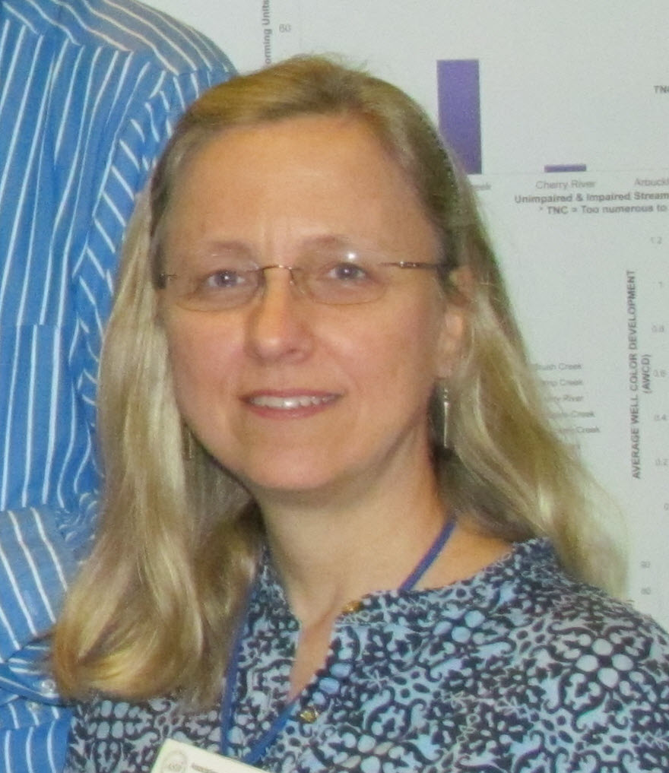
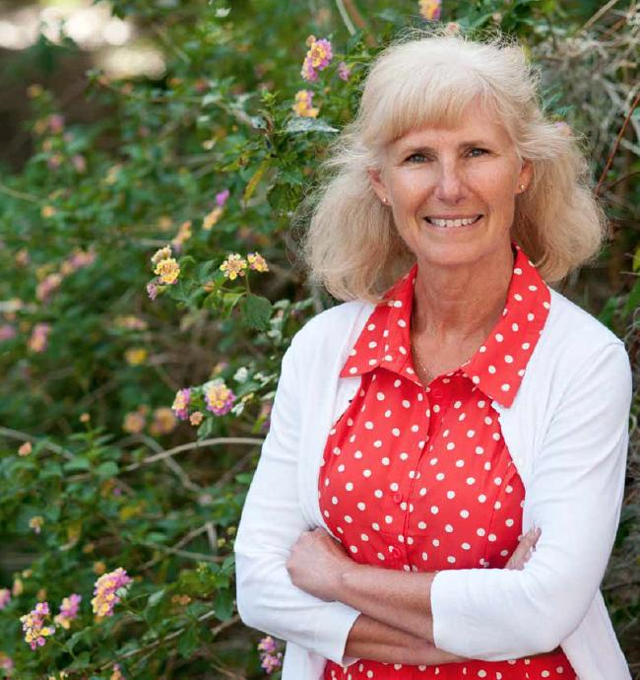
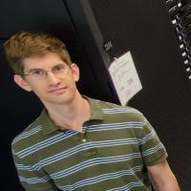
Biodiversity informatics skills for collections and research in the 21st Century
Authors: Deborah Paul, Pam Soltis, Matt Collins
@idbdeb @nottestuser @iDigBio #ICE2016
International Congress of Entomologists (ICE) 2016, Orlando, Florida, 30 September 2016
Session: Entomology in the Digital Age
Notes:
Symposium Section: Frontiers in Entomology
Symposium Title: Entomology in the Digital Age
Talk Title: Biodiversity informatics skills for collections and research in the 21st Century
Author: Deborah L. Paul, Pam Soltis, Matt Collins
At iDigBio, beyond mobilizing data, we’re working with our data providers and the informatics community to enhance museum specimen data and ensure the data and media are fit-for-use. We are engaging researchers and data providers to help them take advantage of ever-growing datasets, and the tools, methods, and apps that support robust data creation and research data use. For the last six years, through our collaborations with NSF bio-centers (NESCent, NEON, BEACON, SESYNC, DataONE, …), Data Carpentry, iDigBio workshops, symposia, surveys, and webinars we’re learning a lot about the computational and data literacy skills needs of our stakeholders. People in our collections data pipeline include: scientists and students collecting future specimens-to-be-accessioned, collection managers, data managers, data aggregators, downstream researchers, and the general public.
As museum collections mobilize to digitize their holdings, contributing more-and-richer data to our community portals -- students, museum staff, and researchers are often finding it’s not a small task to be good custodians of the data. While formal science programs are teaching bioinformatics skills for genomic and metagenomics research, few are strategically teaching the pre-requisite skills to current researchers, students and staff that are necessary to manage data effectively over a lifetime. These skills help insure data is discoverable, and in a standardized format that supports research analysis reproducibility.
This talk provides an overview of the current landscape for biodiversity informatics skills from our experiences at iDigBio. You are invited to share your experiences and insights about what it will take to address these needs into the future.

Slide 2
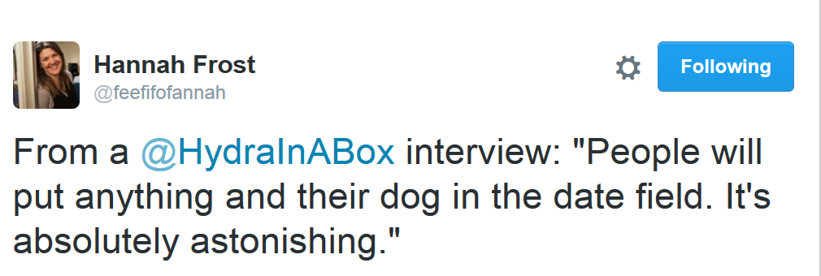
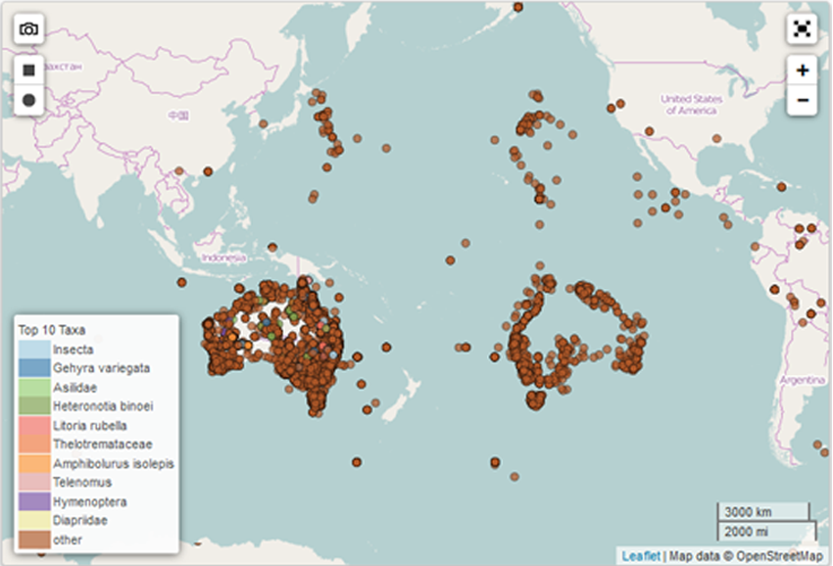
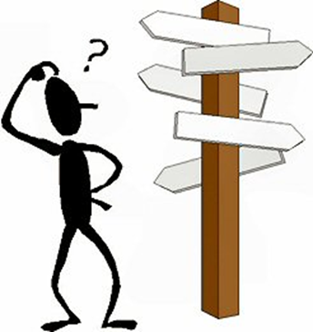
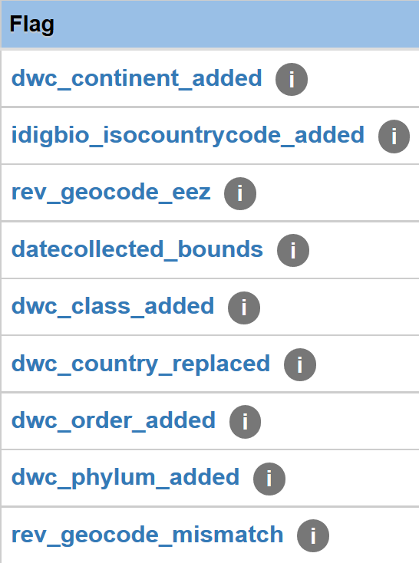
Notes:
What are some of the challenges faced when using this data? How are folks addressing these?
Access - where is this data?
Formatting - do you know how to transform it, use it to enhance your data?
Spotty coverage (gaps)
Possible duplication
Needs georeferencing or validation
Taxonomic challenges - need verification
non-standard Country values
How can you, the entomologist, taxonomist, systematist, ecologist, genomicists, enhance our data?
Voucher
Add your expertise and insights to the research questions and approaches
Add your locality knowledge
Fill in the gaps (taxonomic, geographic, associations, traits, ...)
What about your future research projects? How about incorporating voucher specimens in your research efforts (NEON example) - supporting reproducible research. Use our data to enhance your research

Slide 3
A framework for this talk
iDigBio data and data uses
Biodiversity informatics
Who needs natural history biodiversity informatics skills?
What skills are needed?
What’s been done? (some examples)
What are some lessons learned so far?
Who else is looking at these issues? What other communities?
What about you?
Notes:
At iDigBio, beyond mobilizing data, we’re working with our data providers and the informatics community to enhance museum specimen data and ensure the data and media are fit-for-use. We are engaging researchers and data providers to help them take advantage of ever-growing datasets, and the tools, methods, and apps that support robust data creation and research data use. For the last six years, through our collaborations with NSF bio-centers (NESCent, NEON, BEACON, SESYNC, DataONE, …), Data Carpentry, iDigBio workshops, symposia, surveys, and webinars we’re learning a lot about the computational and data literacy skills needs of our stakeholders.

Slide 4
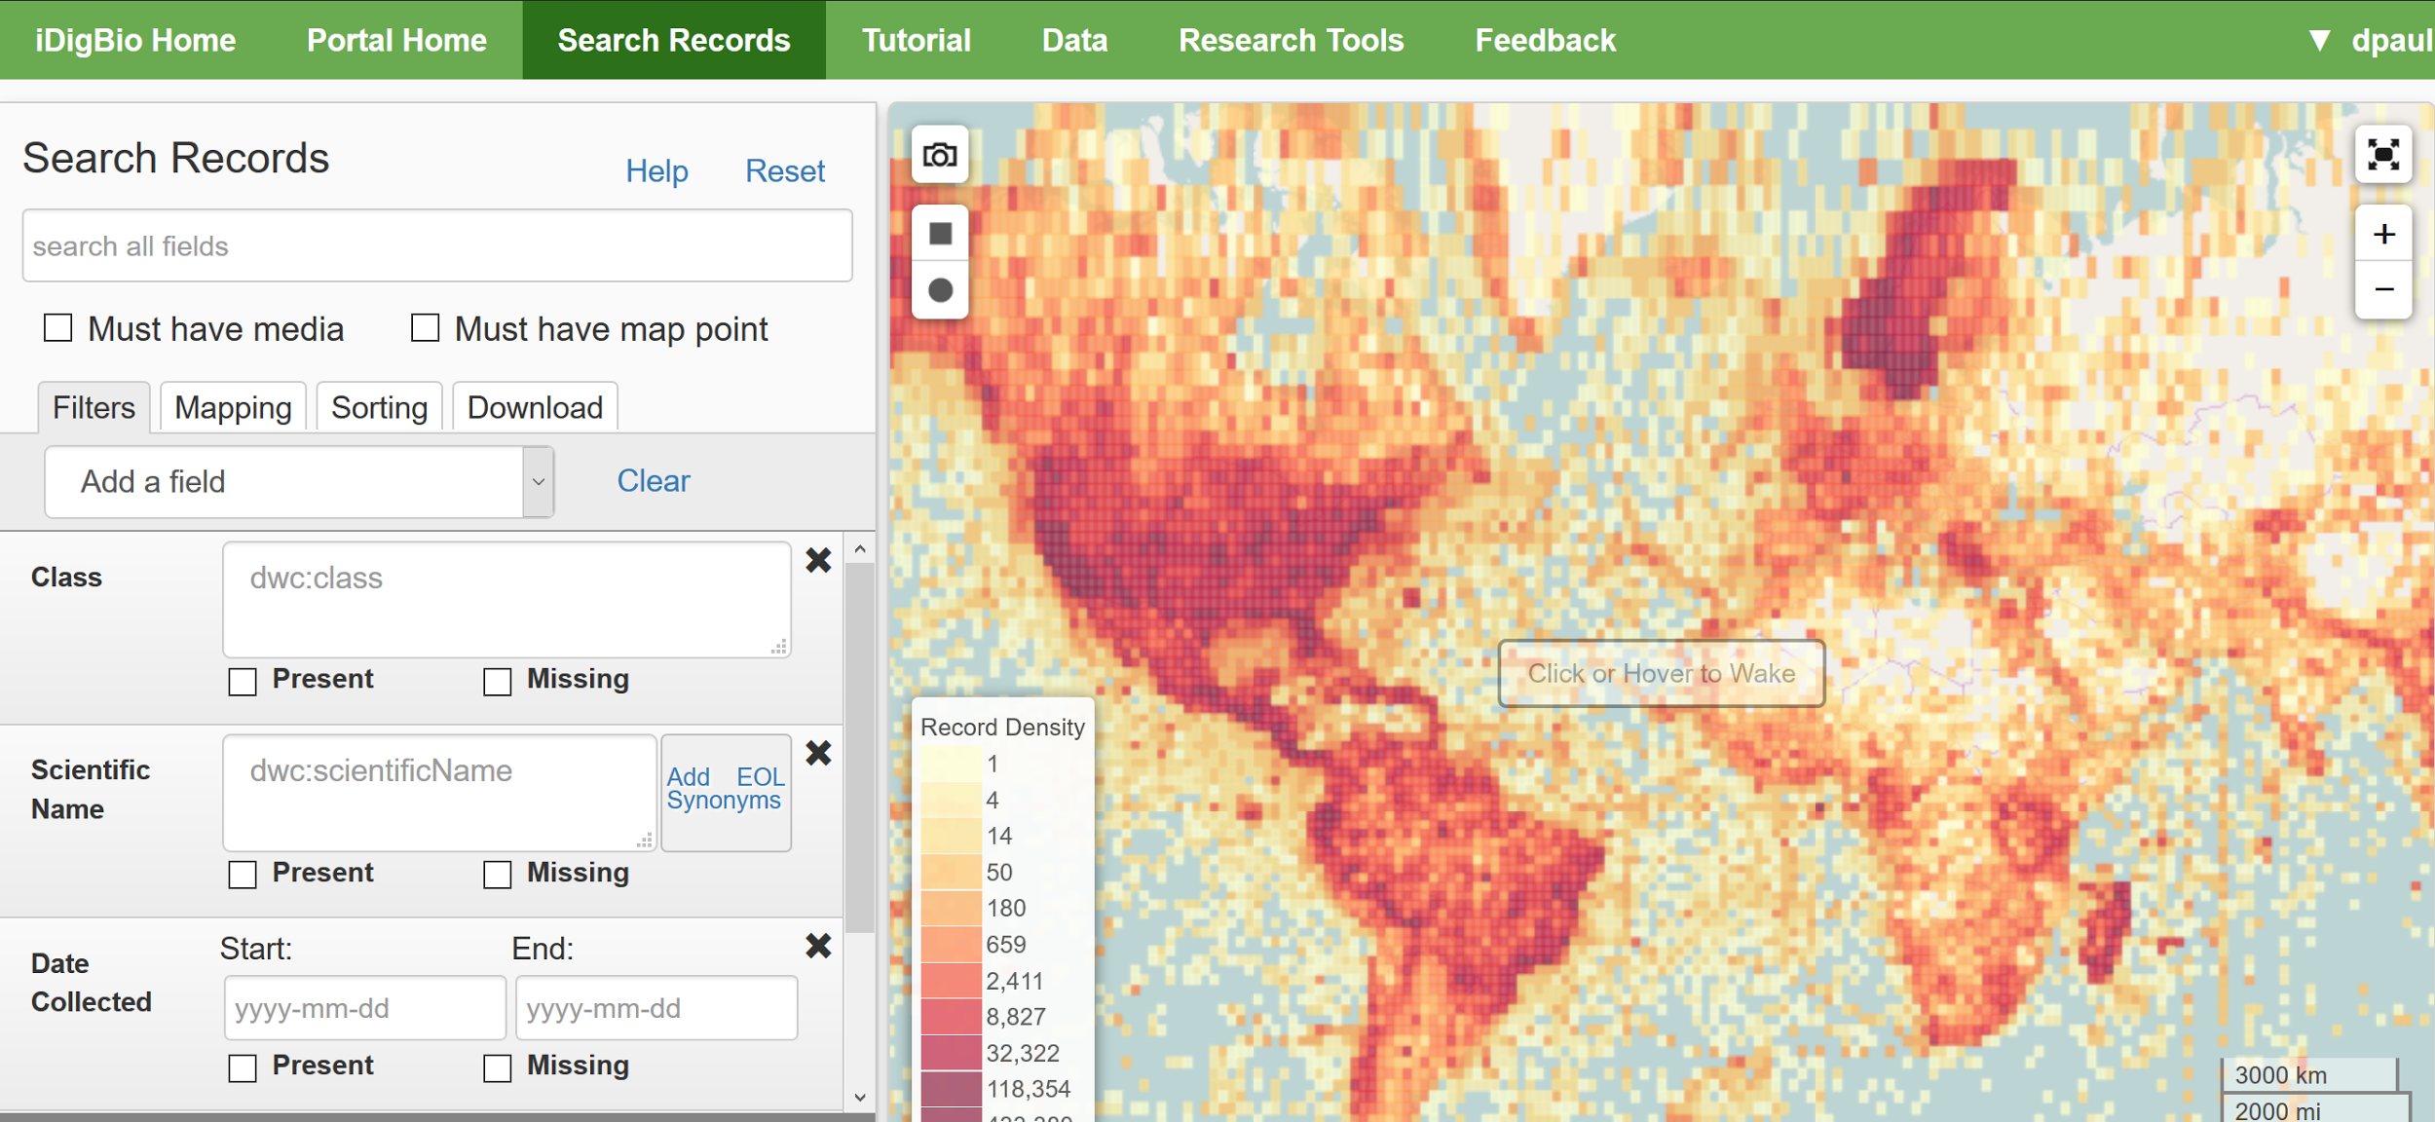
www.idigbio.org
Notes:
iDigBio is a 10 year project, currently in year 6, funded by the National Science Foundation to foster (inculcate?!) a culture of digital transformation in natural history collections. Our database currently contains over 65 Million records and 15 Million images - all about vouchered museum specimens (no observations).
For the first 5 years, we focused our efforts on figuring out how to think about collections’ digitization in a systematic way. With collections staff, curators, collection managers, researchers, and technical staff, we used workshops, webinars, symposia, and publications to foster discovery and dissemination of digitization best practices.
Along with mentoring the digitization of collections, our mandate includes: providing robust access to the data in our online database, working with researchers and collections staff on skills needed to work with our data, and tightening integration between key software products to speed up access to and research use of this rich data resource.

Slide 5
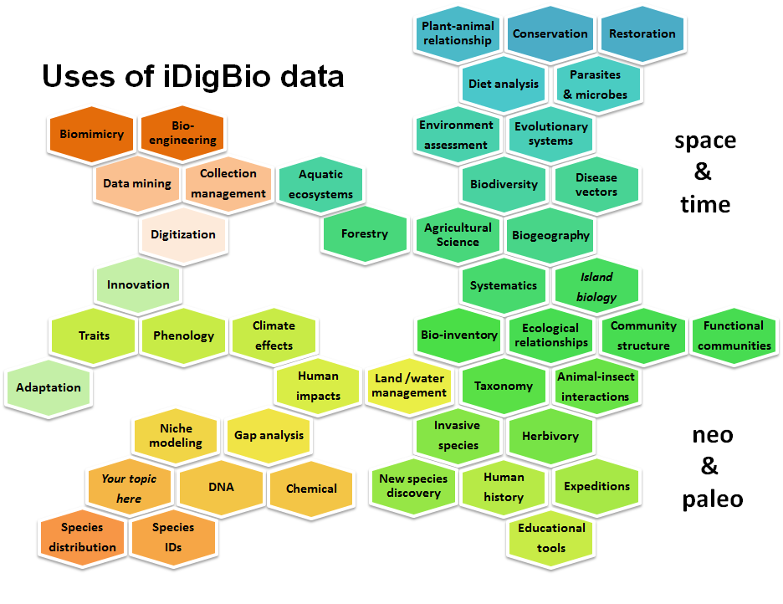
Shelley James, iDigBio 2016
Notes:
How can these data be used (Shelley’s slide on uses so far)? What kind of skills and literacy do you need for these research examples?
Note potential industrial, agricultural, and bio-engineering uses.
What about novel uses? ecotourism? sentiment or attitude shifting? apps that encourage interaction and engagement with nature
Using data to plan expeditions, discover new species, reveal cryptic species, clarify areas of endemism, climate change, phenology, species declines, ecological restoration, back-casting, ENM, conservation status (Seltmann, 2014), …
Advantages (1 slide)
using gaps to inform future work, testing models, engaging / reaching more people, opportunity to learn new skills / concepts, ...

Slide 6
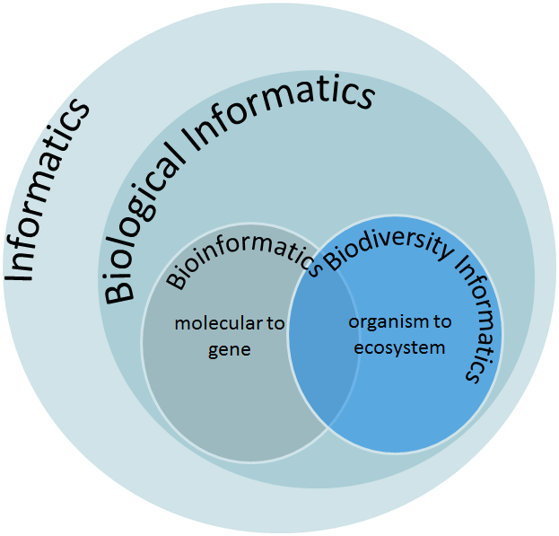
Biodiversity Informatics
human skills
data literacy
computational literacy
software tools
collect
manage
research
share and publish
infrastructure
hardware and software
data standards

Slide 7
Why biodiversity informatics skills?
Facilitate collaboration
Important for employment
Prevent and reduce errors
Facilitate data sharing, reproducibility
Speed up scientific research productivity
Necessary for synthetic and analytical research
Prevent loss of data, wasted effort & funds
Improve communication between IT and so-called “non-IT” staff
Notes:
you need to understand the nature of the data, in order to integrate it to do synthetic research.

Slide 8
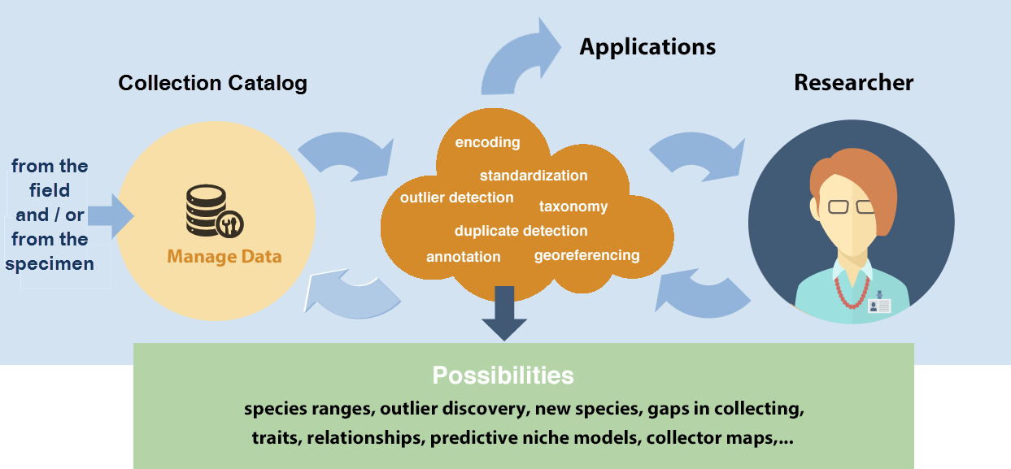
The research data pipeline | your institution & career needs
Data > Knowledge > Application
Notes:
Researcher collects data (in a museum, and / or in the field), Researcher to publication, submit data to museum to a data repository, tell museum about the paper. Collection Mgr, Data Mgr, Curator, Technical Assistant, Student, Volunteer, may provide data, or take researcher’s data for the in-house collection’s database. What skills do these people need? Where’s the overlap? Which skills are critical? Which skills are (probably) more timeless? [with the understanding of today].
Challenges for Data Collectors: using standards, software integration, annotations, data gaps, collector bias, need to learn new skills, grasp new concepts

Slide 9
What skills and knowledge are needed?
What level of skills are needed? an IT point-of-view
Conversational awareness
or mastery?
command-line manual pages
automated file naming / renaming
OpenRefine (http://openrefine.org)
large text files
concatenate files
computer directory structure
write a text file not in Word
the idea that you can parse a file
the shell commands, piping, grepping
which tool do we need to use to do an analysis
csv files (delimited) files
formulate questions for your data and have them answered by your computer
preparing data for analysis (such as formatting, trimming, masking, deduplication, mapping to a standard, etc)
awareness of data and metadata standards, ...
and how to map data to them or make them compliant
(BEACON, SESYNC, NEON, NESCent, iPlant, iDigBio)
Notes:
What biodiversity informatics skills and knowledge are needed - from IT staff across major NSF projects.
better spreadsheet skills data cleaning / standardization skills import and export of (text) data encoding (UTF-8) formatting (dates, for example) using suggested / required field formats

Slide 10
Sentiments about data from researchers and graduate students
manage data in Excel and it's terrible.
organizing GIS data and it's becoming a nightmare.
having a hard time analyzing microarray, SNP or multivariate data with Excel and Access.
I want to use public data.
I work with faculty at undergrad institutions and want to teach data practices, but I need to learn it myself first.
companies are asking for data analysis experience.
trying to reboot my lab's workflow to manage data and analysis in a more sustainable way.
re-entering data over and over again by hand; there must be a better way.
overwhelming amounts of data.
out of my depth on computation and want to increase my confidence.
(BEACON, SESYNC, NEON, NESCent, iPlant, iDigBio)
Notes:
What are some skills that researchers ask for, or tech staff realize researchers need for working with this, and all data - to support reproducible research and long-lived data?
Where / how are you acquiring these data skills?

Slide 11
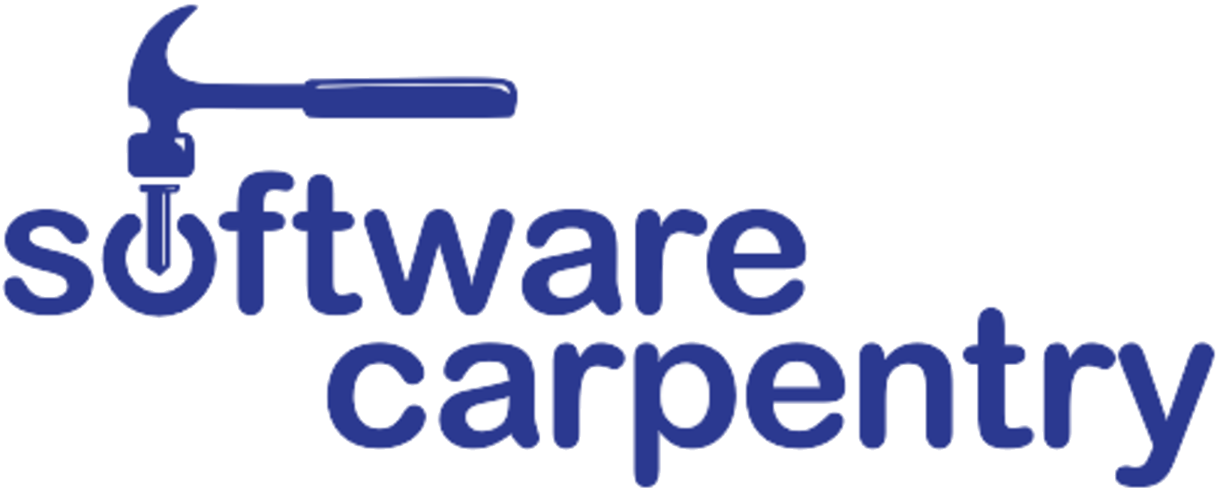
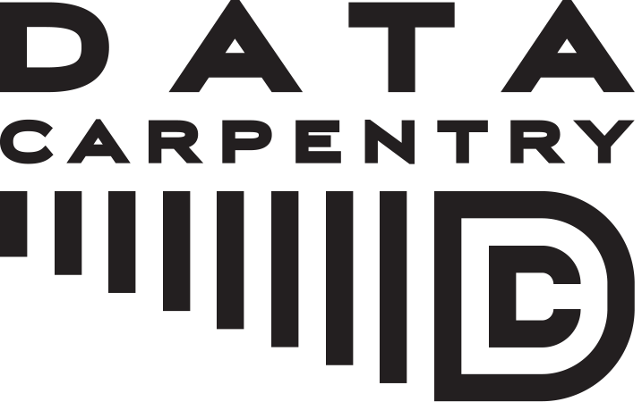
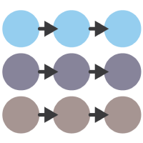
Seeking skills and scaling up efforts to meet needs
Reproducible Science Curriculum
@GitHub
Notes:
Data Carpentry – discipline specific
Better spreadsheet skills
Open Refine
Intro to SQL Intro to R
// Need to mention NEON Geospatial Data Carpentry (see ESA 2016 talk)
Worldwide, people are seeking workforce training for data science and data management skills. Software Carpentry (SwC), Data Carpentry (DC), Library Carpentry, and Reproducible Science Curriculum, provide short courses around the world, using materials aimed at novice and intermediate-level students.
This community also trains instructors - in an attempt to scale efforts. Mentoring is working (85% example!). Hurdles - the technical challenge of finding communication tools (Skype, Google Hangouts), that work for everyone across the world’s time zones, and the time zones themselves.
GitHub (for example)
not teaching same skills to all (rather tailored, and designed to meet need)

Slide 12
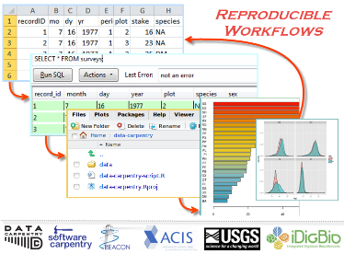
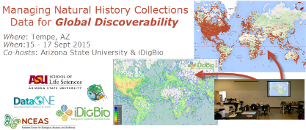
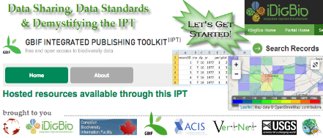
Some Biodiversity Informatics Courses at iDigBio
Notes:
//FIX Screen shots if I use this slide - Google Slides reduced the pixel number and now they are fuzzy.
Biodiversity informatics workshops at iDigBio incorporate some of their materials.
Future? Field to Database (ASU course) UIUC Course for Museum Studies: Data Cleaning .... KU Course from Andy Short for Entomology Students AMNH 2 week long course (Katja Seltmann)

Slide 13
Using Digitized Herbarium Data in Research: A Crash Course
3rd in a Series of Workshops
The Annual Botany Meetings
Botanical Society of America & Affiliated Societies

Slide 14
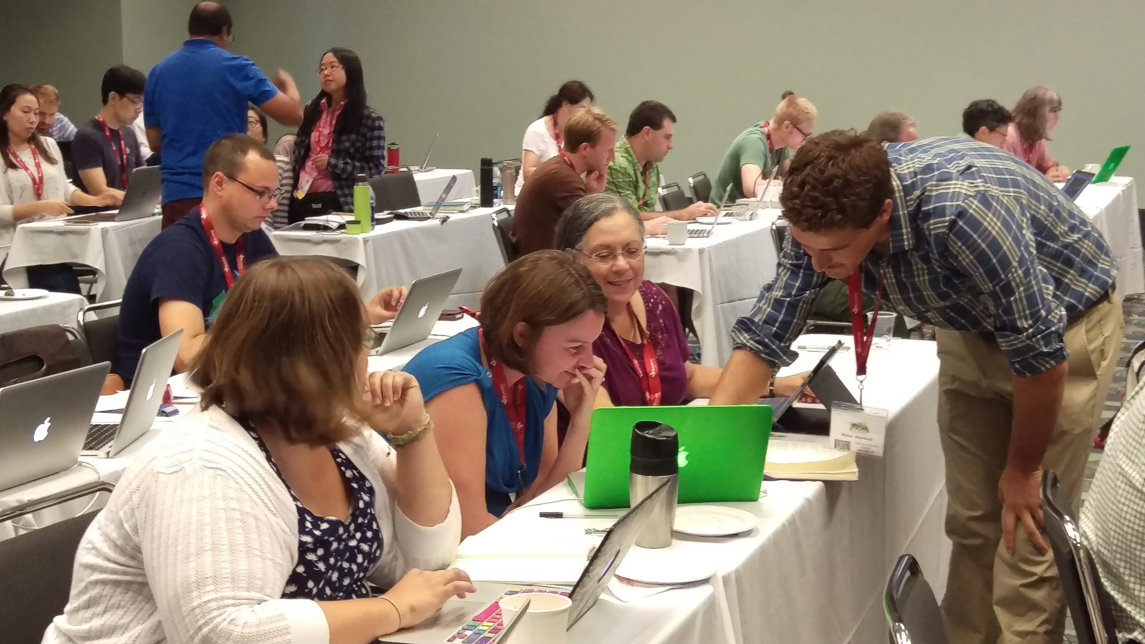
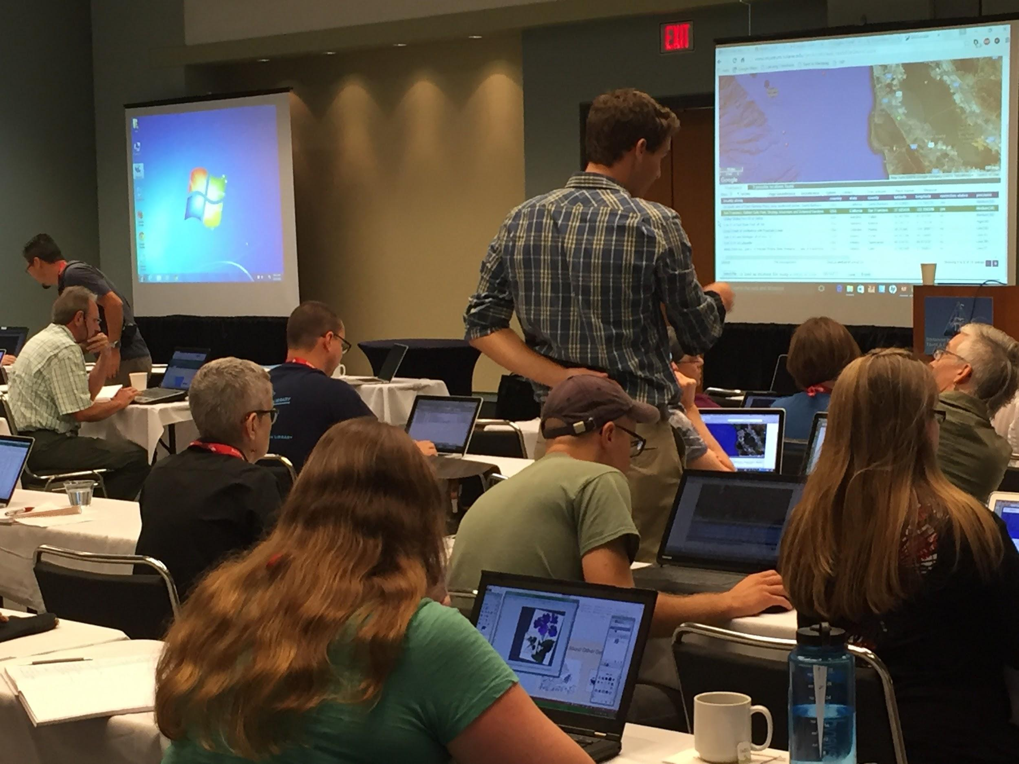
Using Digitized Herbarium Data in Research: A Crash Course
Data downloads
Georeferencing
GEOLocate
Ecological Niche Modeling (ENM)
Maxent
Data reproducibility
Paleo and future ENM
Ancestral niche reconstruction
Geospatial analysis (beyond ENM)
Linking to phylogeny

Slide 15
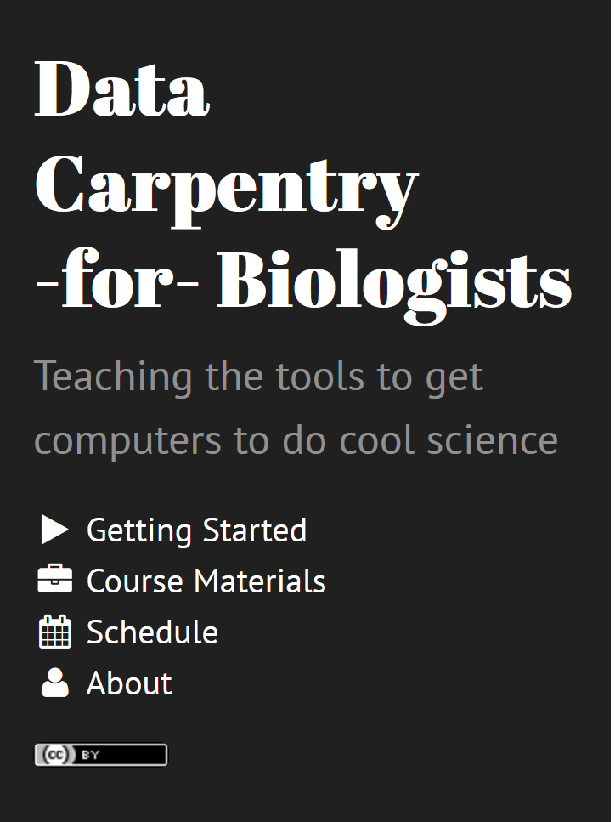
On scaling up Data Carpentry:
2 days to a semester
Insights from Ethan White
Students highly motivated - recognize need for skills
relevance to student research problems
explaining why can be very important in cases where it isn't immediately obvious.
most students view computers as a tool that they need, but don't love.
Ethan White, Ph D.
Notes:
http://www.datacarpentry.org/semester-biology/
Other communities: DSI | Ecologists - Ethan White
Who is the community?
How are their skills being addressed? Lessons learned?
1. Students know they need these skills and are therefore highly motivated
2. They want to understand how what you're teaching them will solve their day to day research problems. If you fail to make that connection it can be frustrating because of (1). As a result explaining why can be very important in cases where it isn't immediately obvious.
2b. Most students view computers as a tool that they need, but don't love.
3. Doing this well, in my experience, requires low student to teacher ratios (~20/1). At these levels most students can learn to think of computing as logical and understandable. Above these levels a decent fraction of students will feel like computing is about getting the incantations right.
4. Semester long classes with lots of exercises result in the majority of the students being able to do the things they are taught vs. workshops which result in most of the students knowing what they should learn and how to start learning it.

Slide 16
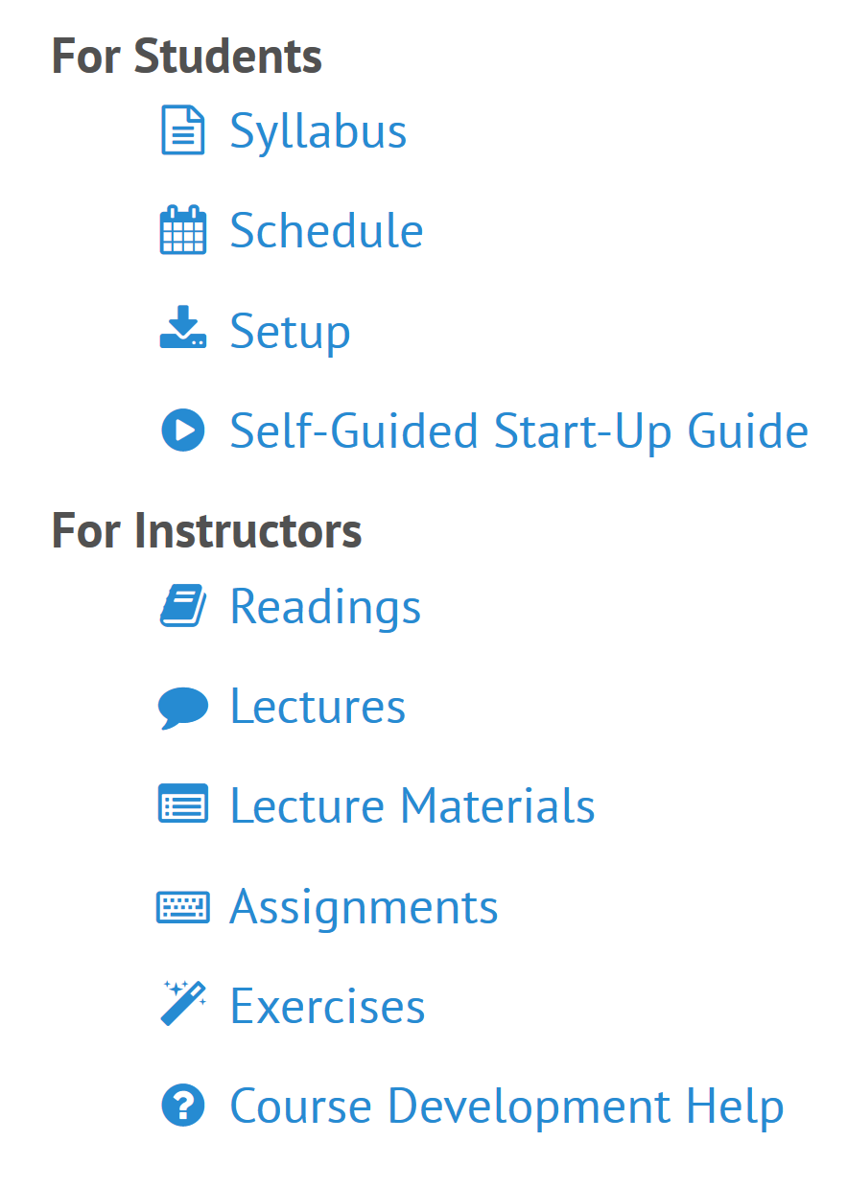
On scaling up Data Carpentry:
2 days to a semester
Insights from Ethan White
Low student to teacher ratios (~20/1). else “students will feel like computing is about getting the incantations right.”
Semester long classes with lots of exercises result in the majority of the students being able to do the things they are taught vs.
Workshops which result in most of the students knowing what they should learn and how to start learning it.

Slide 17
Building the capacity to build capacity, at home and abroad
Software / Data Carpentry instructor training at University of Florida - 3 attendees from previous Data Carpentry workshop at the University of Miami
Software / Data Carpentry instructor training in South Africa - 2 attendees from the Data Carpentry workshop at TDWG 2016 in Kenya conducted by iDigBio
Mentorship of African instructors to host their first workshops
University of Venda, South Africa - 10/16/2016
Communication has challenges - voice, video, internet costs
Without seed funding for an experienced instructor, the first workshop is difficult to get started
But, eagerness is there!

Slide 18
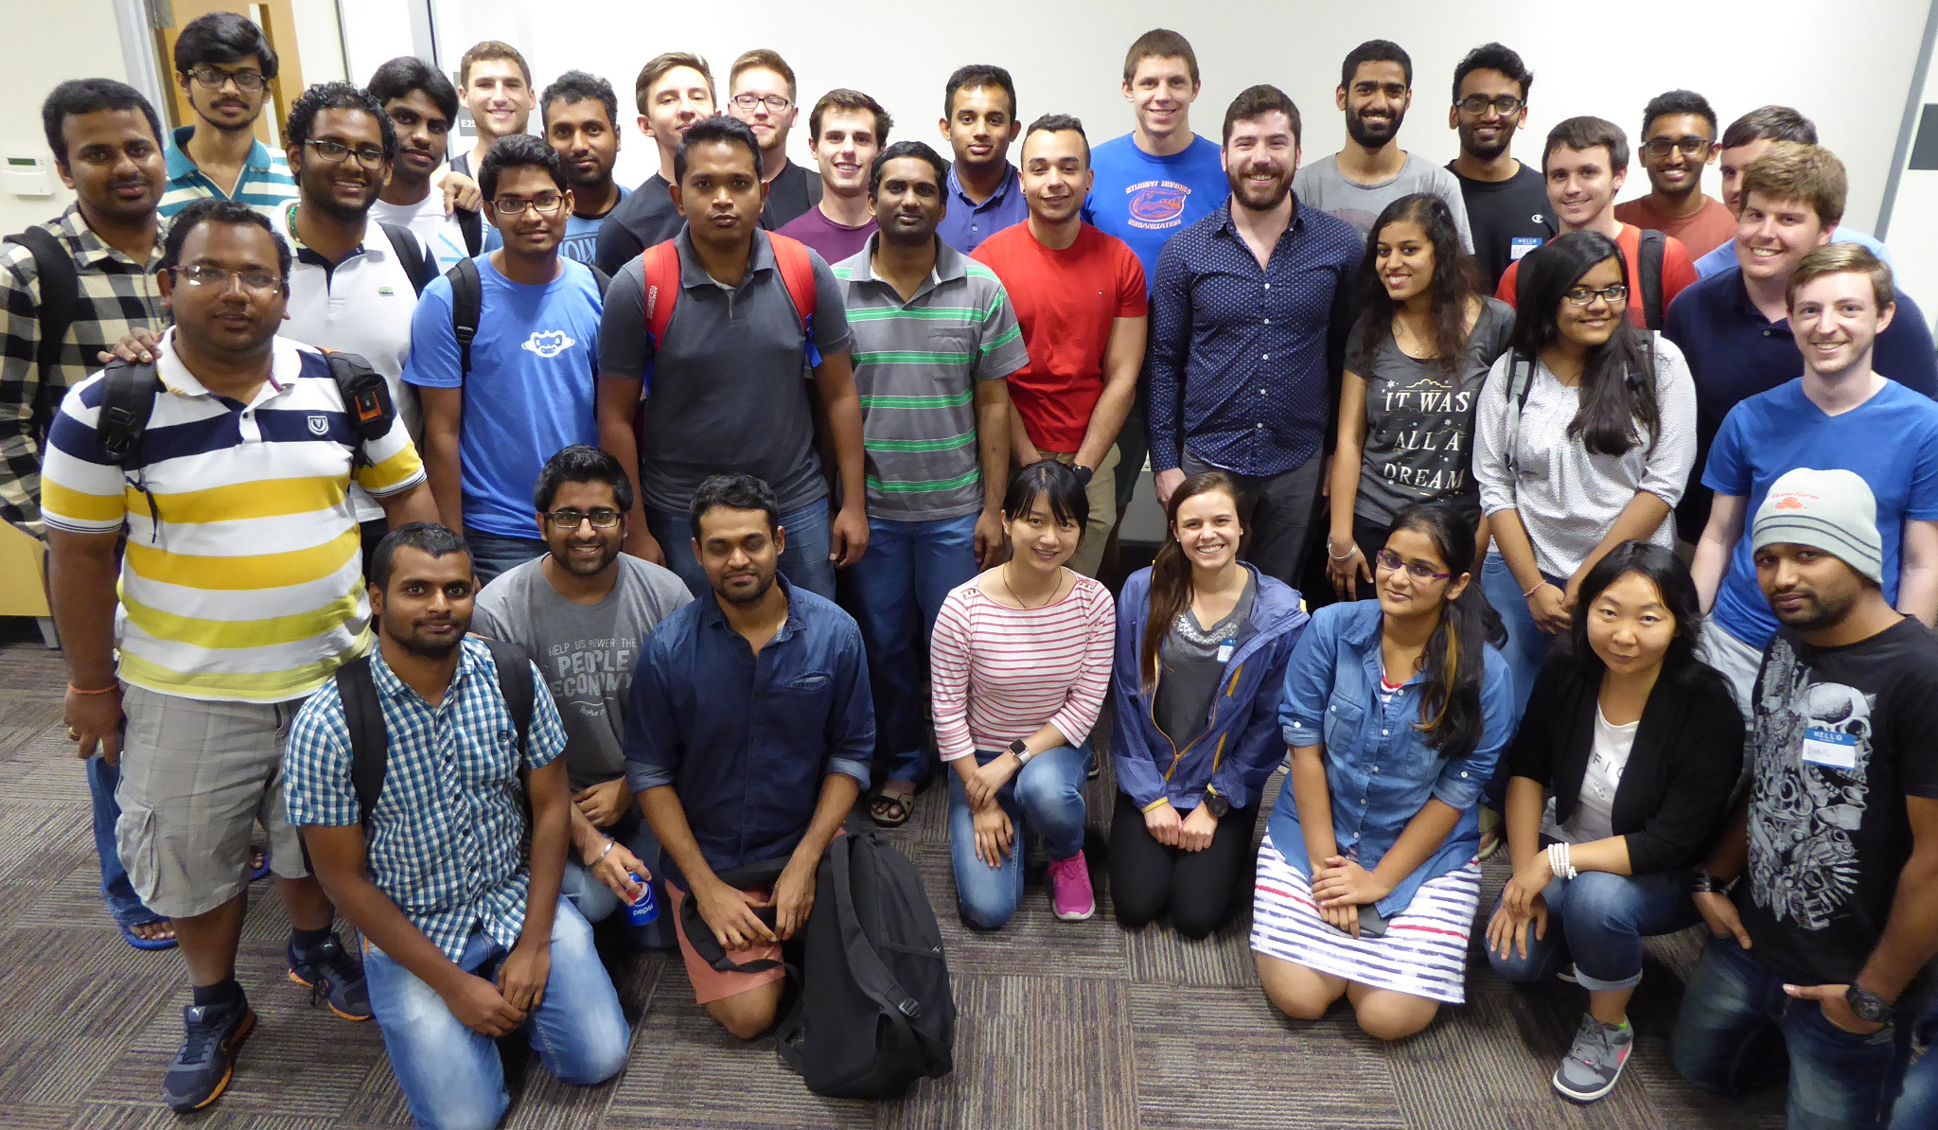
DSI - Data Science and Informatics Student Organization
Founded in 2014 at the University of Florida by students who want to teach themselves data science tools and skills - Not satisfied with curriculum!
A multi- and inter-disciplinary student organization dedicated to celebrating and promoting Data Science at the University of Florida.
Partnered with the UF Informatics Institute, whose aim is to foster informatics research and education at UF across all disciplines
700 members over 2 years
>25 evening workshops
>300 unique survey responders
3 joint projects
4 social events
K-12 outreach events
http://www.dsiufl.org
Notes:
Other communities: DSI | Ecologists - Ethan White
Who is the community?
How are their skills being addressed? Lessons learned?

Slide 19
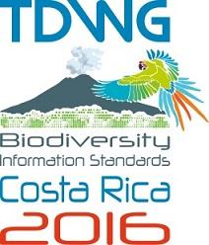
Biodiversity Information Standards (TDWG):
capacity building efforts
2014
2015
2016
Biodiversity informatics curriculum/teaching Interest Group (Koivula, H.)
Effective Biodiversity Data Management Training (König-Ries, B. et al)
Professional and formal biodiversity informatics training as a key for capacity building: state-of-play, challenges (Koureas, D).
Training and Collaboration for sustained African Engagement in Biodiversity Informatics (Bart, H. et al)
Pre-TDWG 2015 week-long training
Biodiversity Informatics Curriculum Interest Group (Koivula, H. et al)
Notes:
Biodiversity Information Standards, TDWG continues to have conversations (workshops, symposia, working groups) about capacity building for the scientific community.
[SAMPLE TDWG TITLES of SYMPOSIA from Last Three Years]
We need to harmonize the development of museum biodiversity informatics training and implementation. This includes collating needed biodiversity informatics skills and literacy and finding or developing courses. Also, we need a way to track and offer ongoing education credits. What role does SPNHC play, with collections and other organizations such as Biodiversity Information Standards (TDWG), the Global Biodiversity Information Facility (GBIF), and iDigBio, to develop these training standards to sustain and support current and future workforce training? Where and how best to manage such a program?

Slide 20
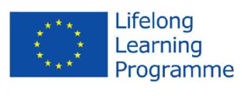
Where do we go from here?
Entomological Collections Network
Entomological Society of America / ICE 2016
Society for the Preservation of Natural History Collections SPNHC
iDigBio
Synthesys3
DataONE
Biodiversity Information Standards, TDWG
Global Biodiversity Information Facility (GBIF)
EU Collections Competencies Project
Environmental Data Initiative (EDI)
North America, South America, EU, Africa, Asia, Oceania, ...
Some Questions for You...
What’s you experience with data skills? How do you scale up your work as datasets get bigger? What skills and literacy needs will be addressed with infrastructure enhancements? Where do you get your skills?
Notes:
We need to harmonize the development of museum biodiversity informatics training and implementation. This includes collating needed biodiversity informatics skills and literacy and finding or developing courses. Also, we need a way to track and offer ongoing education credits. What role does the Entomological Society of America play? and other organizations such as SPNHC, Biodiversity Information Standards (TDWG), the Global Biodiversity Information Facility (GBIF), and iDigBio, to develop these training standards to sustain and support current and future workforce training? Where and how best to manage such a program?
BCON, NSF, AIBS, ...

Slide 21
Enhancing 21st century biodiversity informatics skills and supporting infrastructure - everyone’s got a role to play.
Contact: dpaul@fsu.edu

