Slide 1
Georeferencing Natural History Collections Data: The GEOLocate Project
Nelson E. Rios
iDigBio Train the Trainers Georeferencing Workshop Gainesville, FL 8-12, Oct 2012

Slide 2
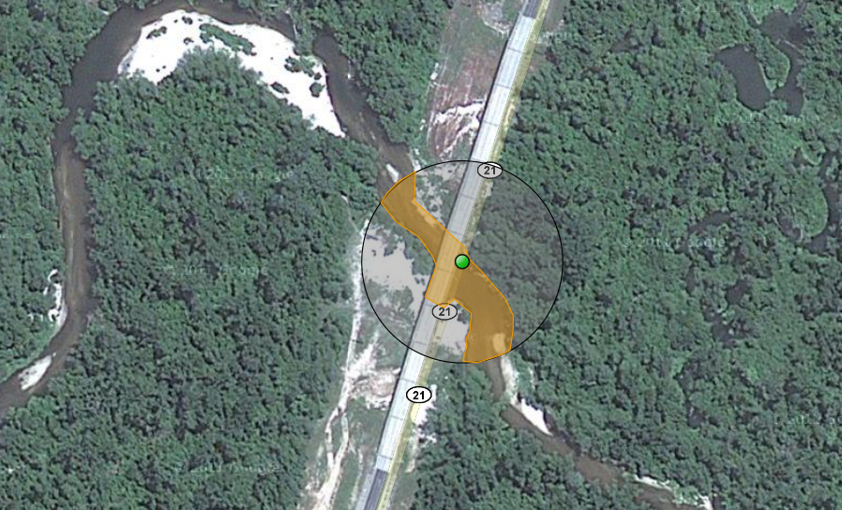
What is Georeferencing
pushepatapa creek, trib. to pearl river, 7.8 miles north of bogalusa at hwy 21; Washington; LA; USA
latitude: 30.88797 longitude: -89.83601 uncertainty radius: 48m uncertainty polygon: 30.88823,-89.83641, 30.88815,-89.83634, 30.88808,-89.83622…

Slide 3
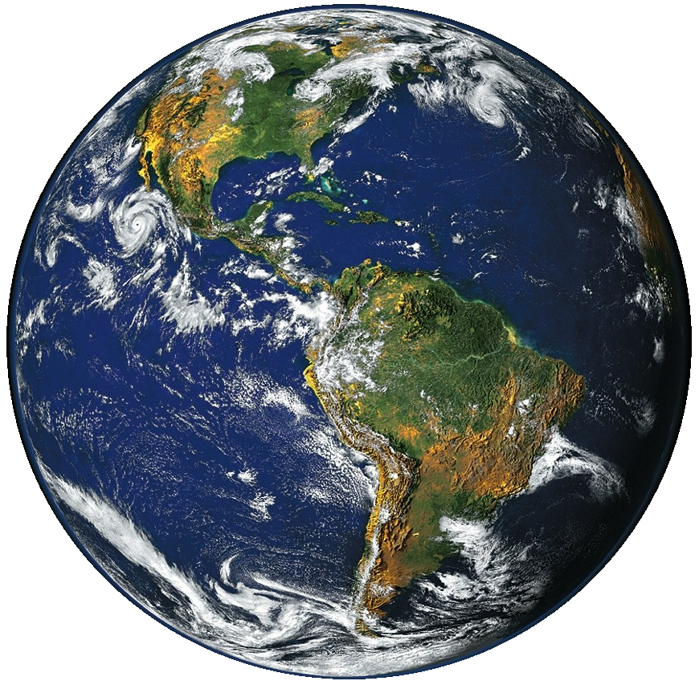
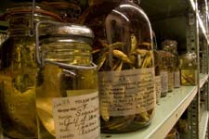
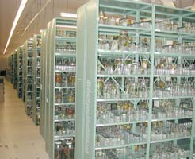
3 billion specimens with ½ billion collecting events

Slide 4
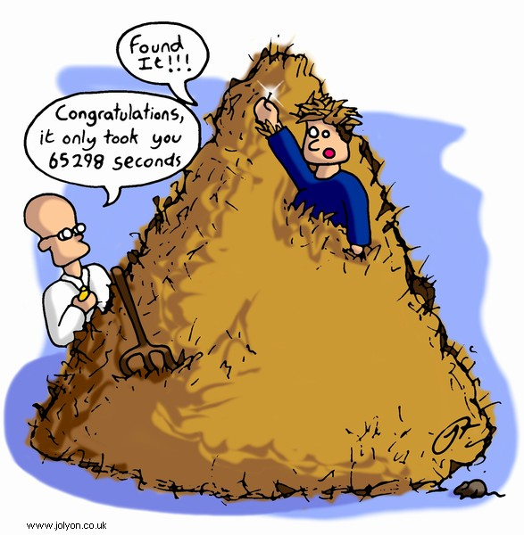
Traditional Methods

Slide 5
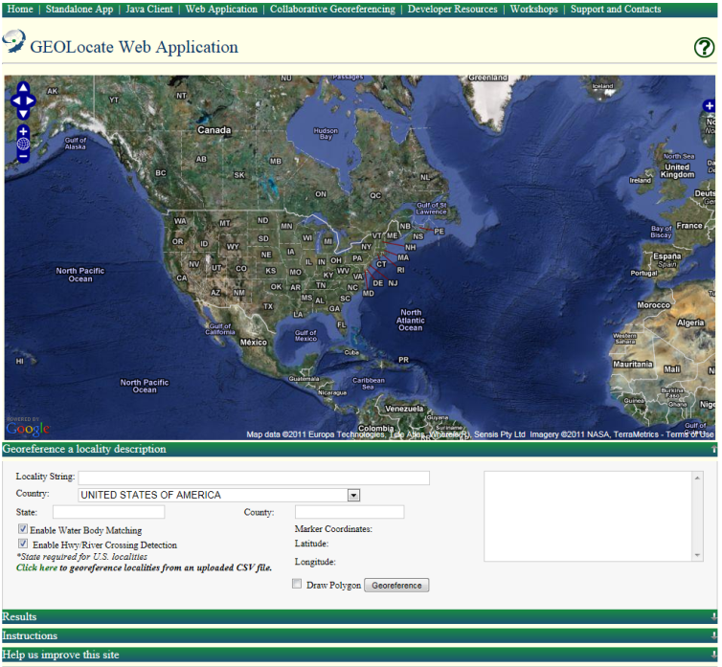
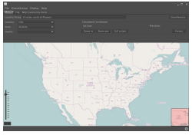
Software & services for georeferencing of natural history collections data
automated georeferencing
verification & correction
multi-lingual
kml export
interoperability
soap & rest api
batch processing
training
geographic visualization
google, bing, openstreet, wms
uncertainty determination
collaborative georeferencing

Slide 6
Typical GEOLocate Workflow
pushepatapa creek, trib. to pearl river, 7.8 miles north of bogalusa at hwy 21; Washington; LA; USA
Data Entry & Preparation
1
Automated Processing
Georeferencing Algorithm
2
Manual
Verification
Visualize, verify & adjust output coordinates & uncertainties
3
latitude: 30.88797 longitude: -89.83601 uncertainty radius: 48m uncertainty polygon: 30.88823,-89.83641, 30.88815,-89.83634, 30.88808,-89.83622…

Slide 7
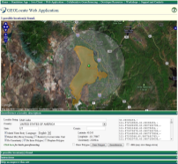
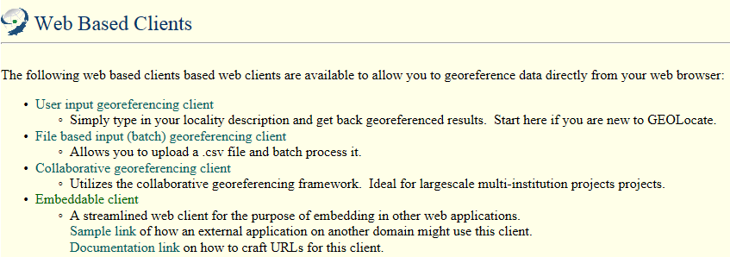
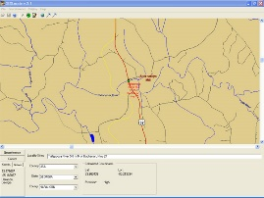
Options: Web vs. Desktop?

Slide 8
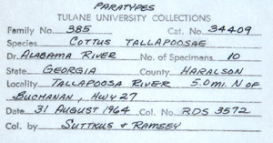
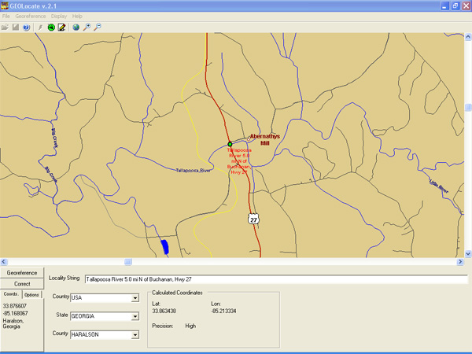
Georeferencing Example: Desktop App

Slide 9
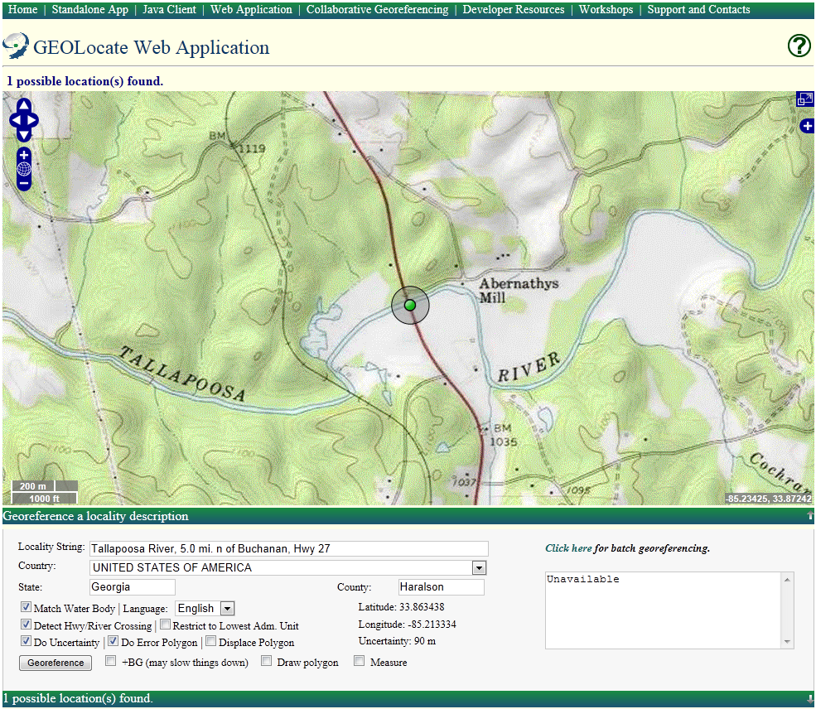

Slide 10
Algorithm Performance
Versus Known U. S. Localities
 | % Found | Mean Dist. Off | Standard Error
GEOLocate | 95% | 6.1 km | 2.1 km
6 km

Slide 11
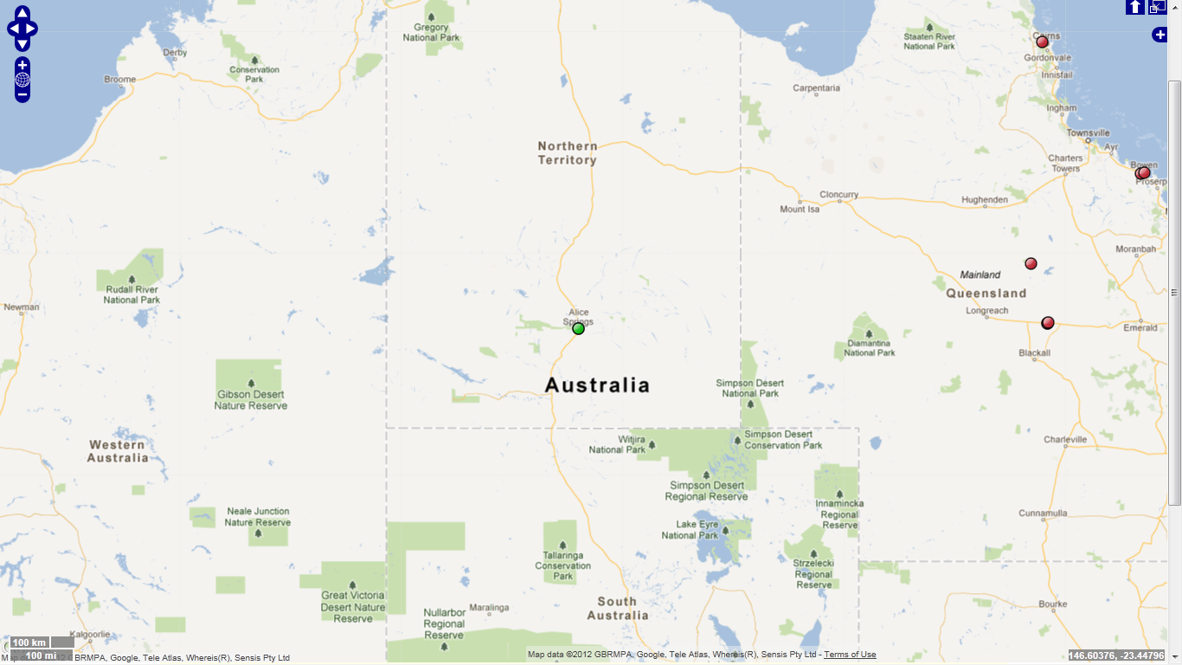
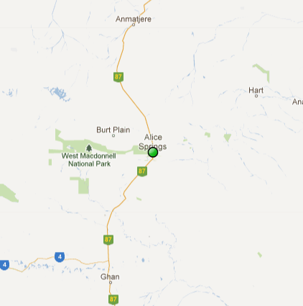
Algorithm Performance
Versus Known Australian Localities
 | % Found | Mean Dist. Off | Standard Error
GEOLocate | 86 97% | 796 218 km | 154 48 km
796 km
218 km

Slide 12
Verification & Correction of Outputs
Computed coordinates are displayed on digital maps
Manual verification of each record
Drag and drop correction of records

Slide 13
Multiple Result Handling
Caused by duplicate names, multiple names & multiple displacements
Beaver Creek; Louisiana; USA
Results are scored and most “accurate” result assigned to active marker (green)
All results are recorded and displayed as static markers (red)
Working on using specimen data to limit spread of results

Slide 14
Representation of Uncertainty
Eagle Lake, Warren County, Mississippi,
USA

Slide 15
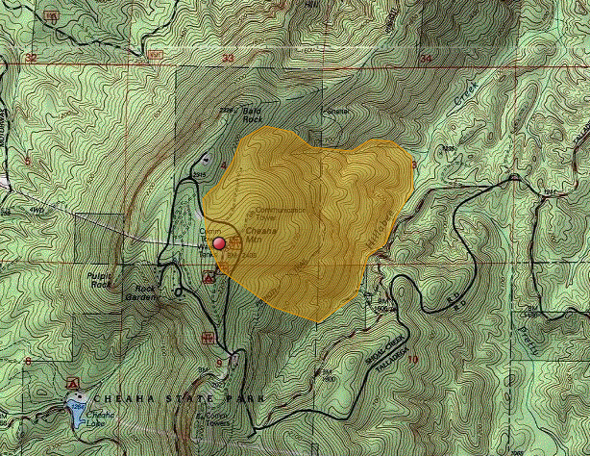
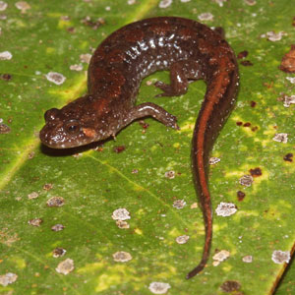
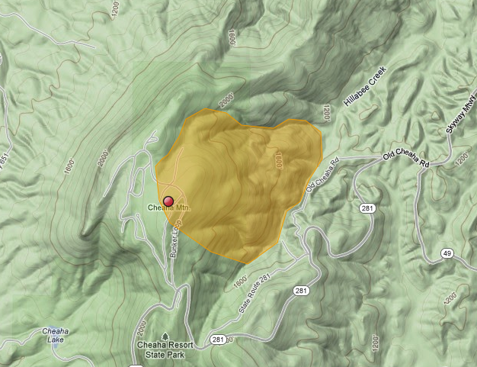
East side Cheaha of Mountain Cleburne County; Alabama; USA
Desmognathus conanti
Spotted Dusky Salamander

Slide 16
Uncertainties within GEOLocate
Point radius (web app) and polygonal uncertainties (both)
Utah Lake,
UT, USA
Point radius represented as a distance in meters from georeferenced point
Polygons represented as a comma delimited array of vertices using latitude and longitude
Supports auto-detection and generation of polygons for selected places (web app only, in development for desktop app)

Slide 17
Georeferencing Options:
My Creek at Hwy 1
My Creek
7 miles North of
7 miles North of
Mythical Place
Mythical Place
Detect Hwy/ River Crossing
Match Water Body

Slide 18
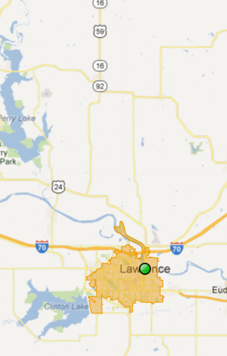
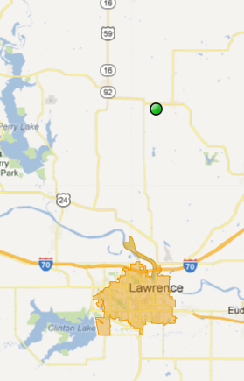
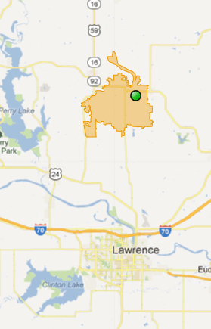
Generating Polygons:
Lawrence, KS
15 mi N of Lawrence, KS
no displacement
15 mi N of Lawrence, KS
displaced polygon

Slide 19
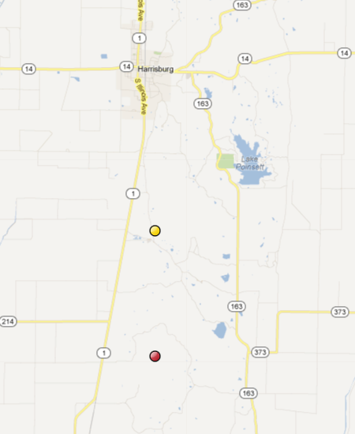
+BG Integrating Results from Biogeomancer
7 miles South of Harrisburg;
Poinsett; Arkansas;
USA;
Biogeomancer
Active Marker
GEOLocate

Slide 20
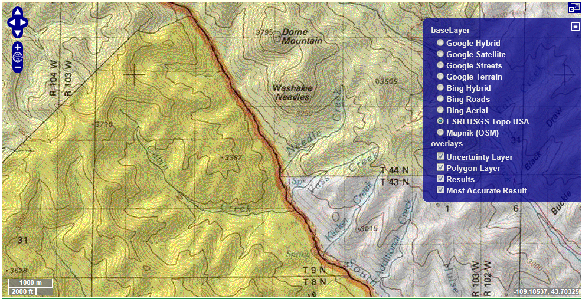
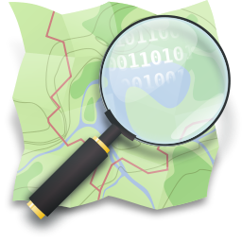
Visualization: Base Layers

Slide 21
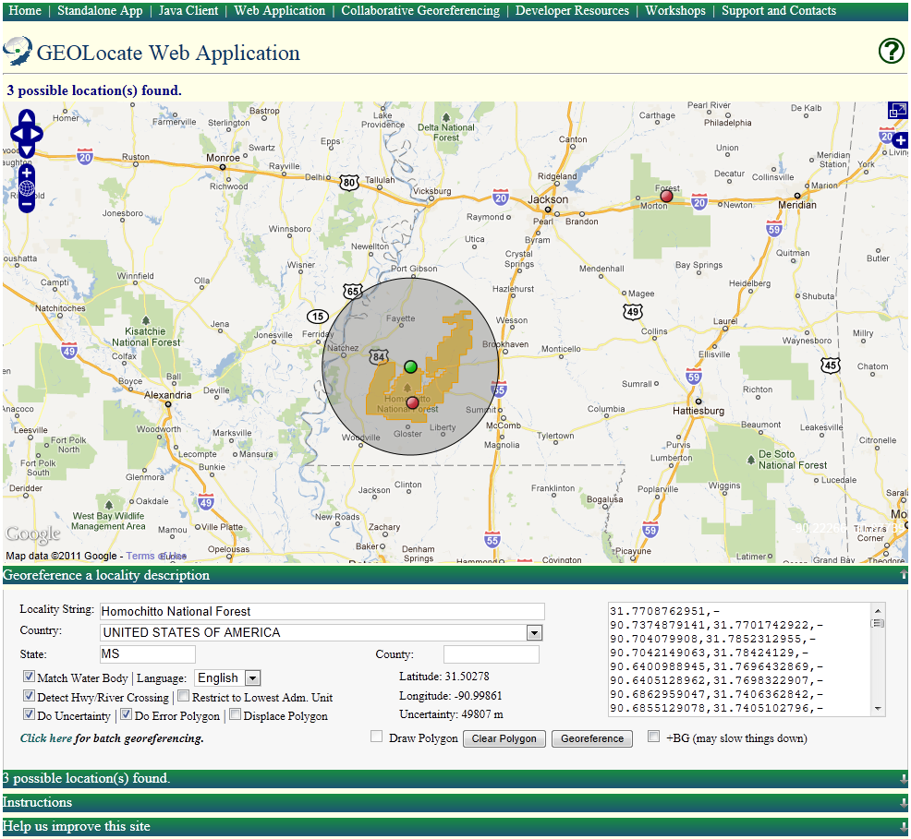
Web Client Walkthrough

Slide 22
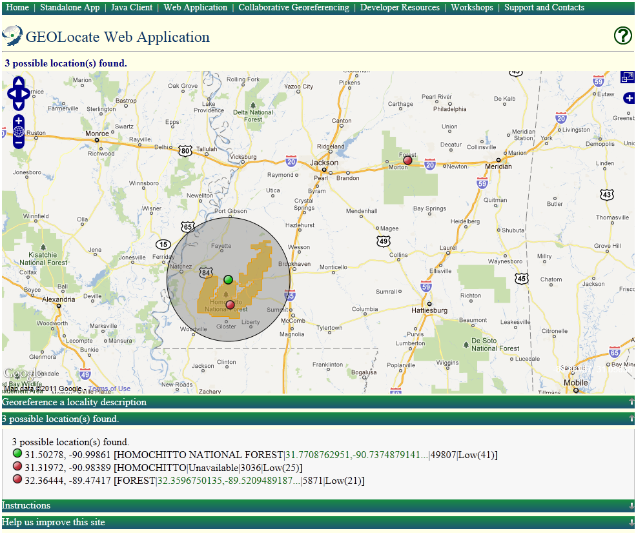

Slide 23
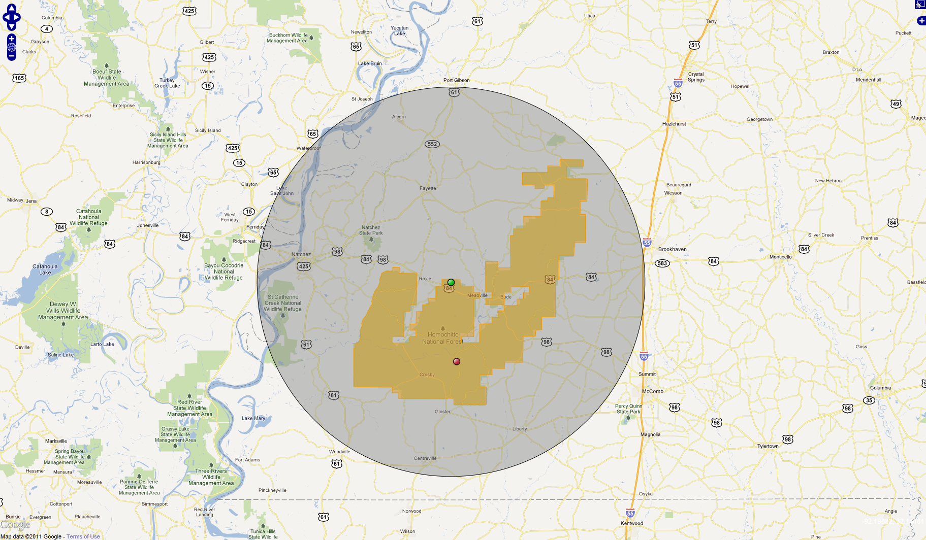
Homochitto National Forest; MS; USA
Full Screen Mode

Slide 24
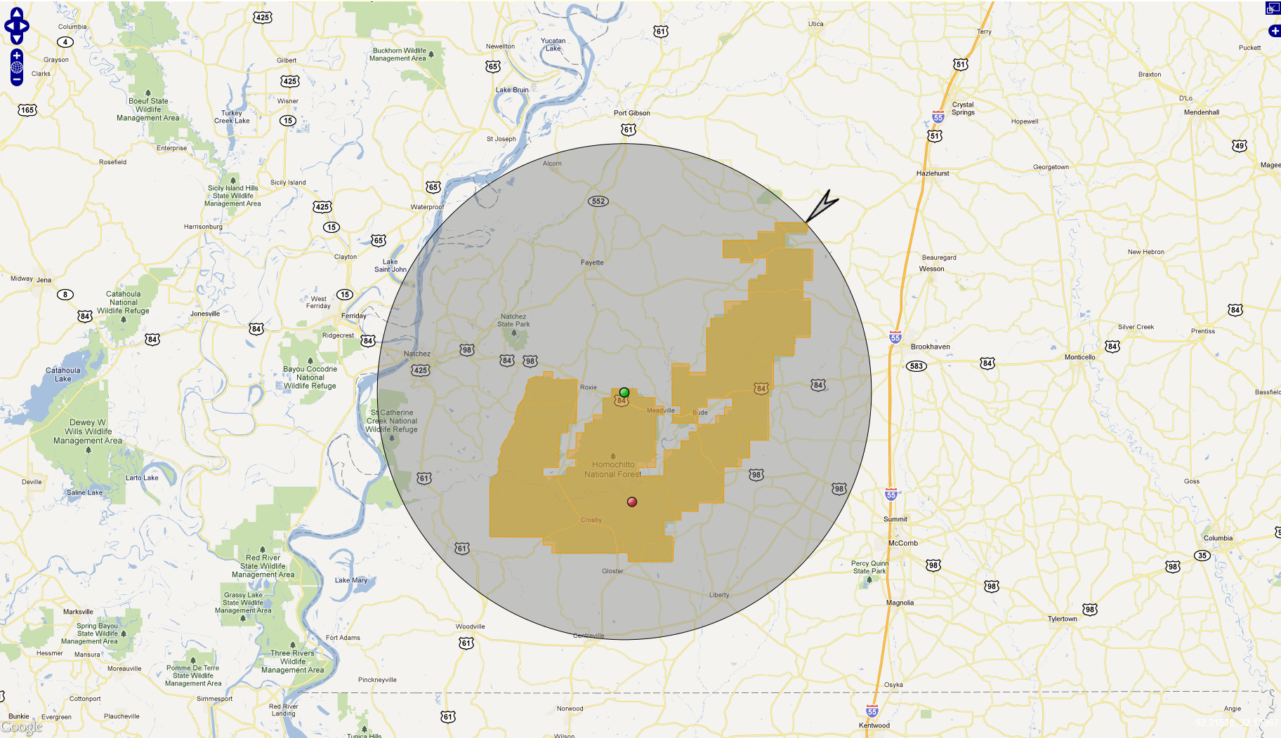
Homochitto National Forest; MS; USA
Resizing Uncertainty

Slide 25
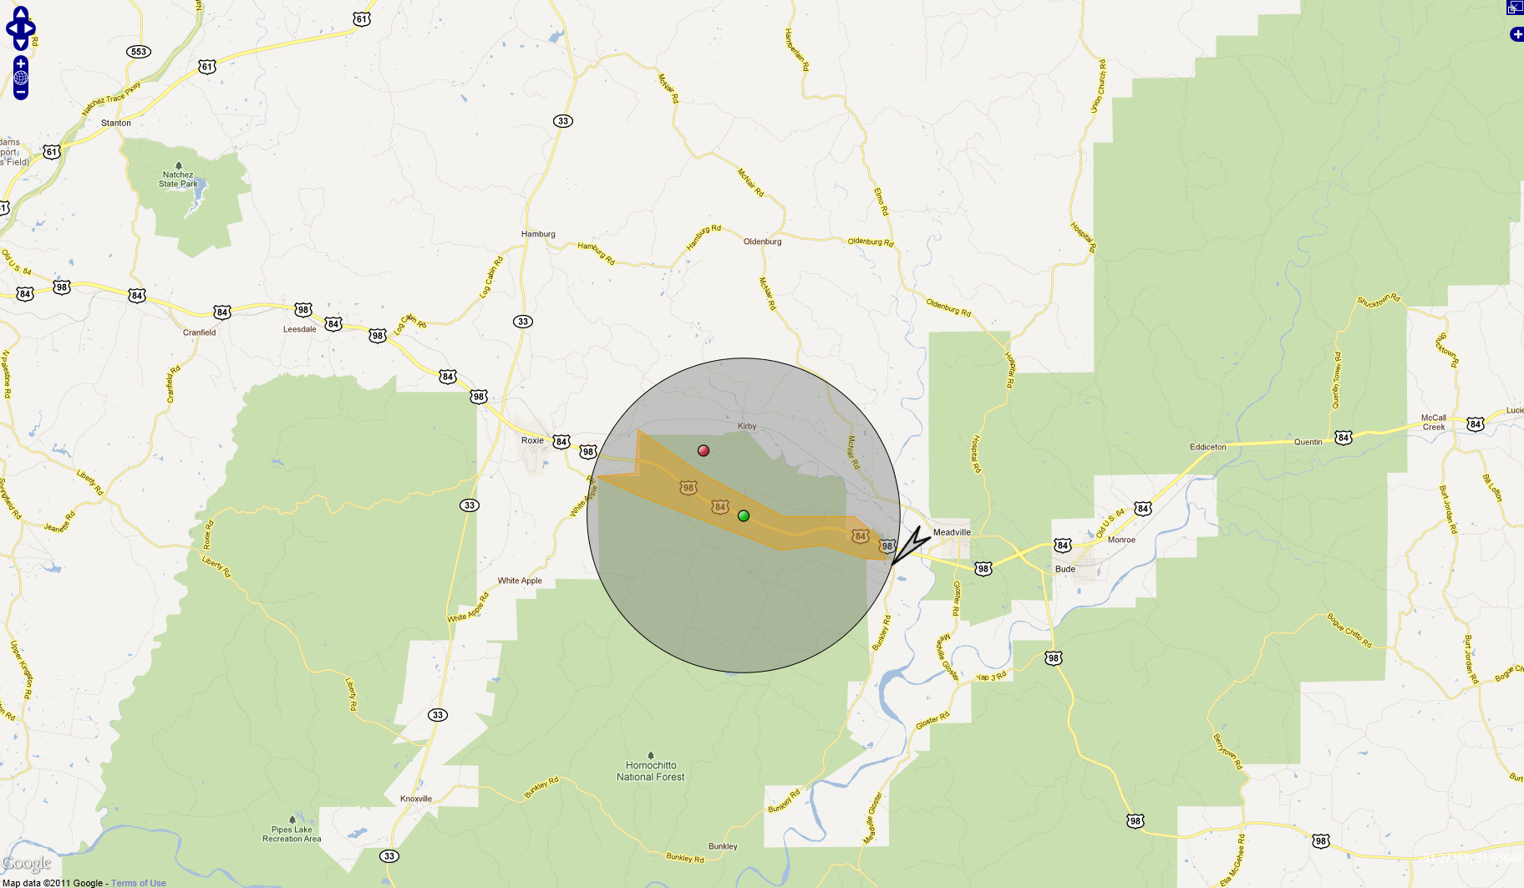
Homochitto National Forest; MS; USA
Along Highway 84
Drawing a polygon

Slide 26
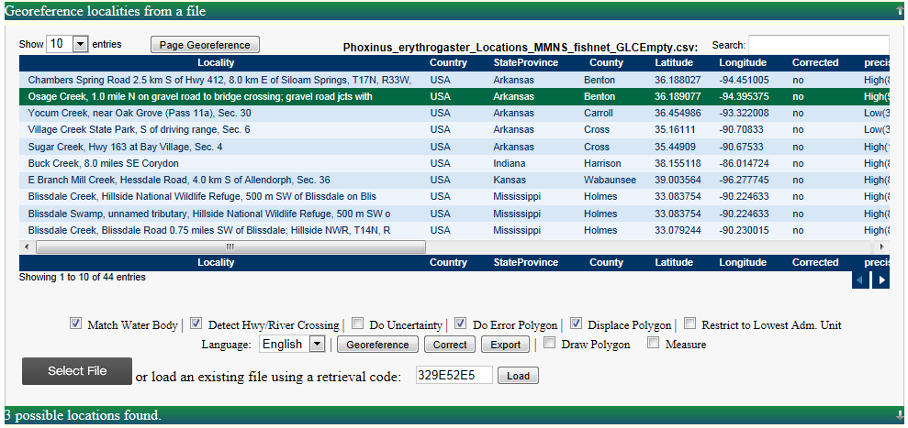
Batch Georeferencing

Slide 27
Collaborative georeferencing
Increased output by take advantages similarities across collections
Distribution of workloads to appropriate expertise

Slide 28
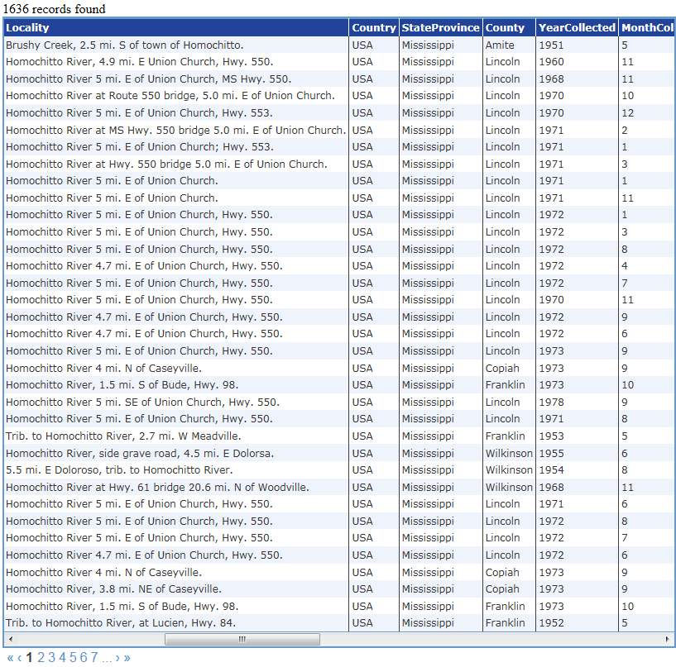
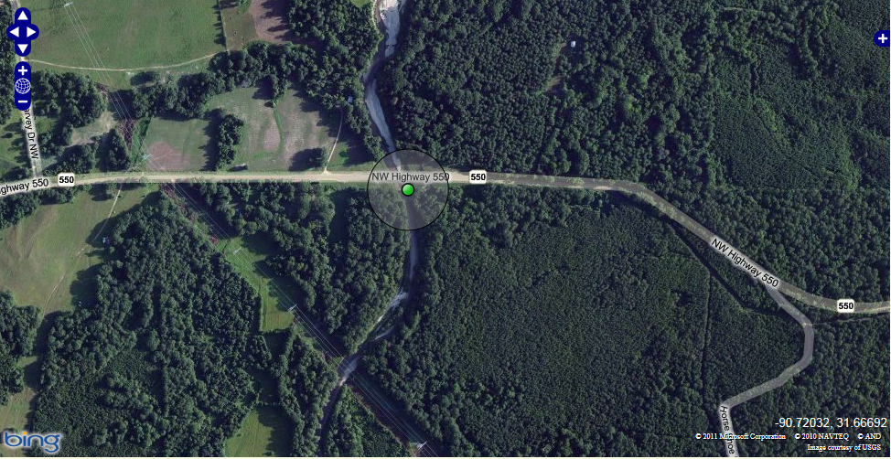
Collaborative Georeferencing: Sharing Data
Corrected 22 collecting events,
approx. 200 specimen records

Slide 29
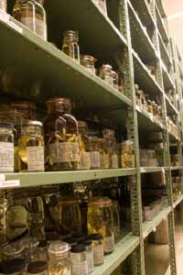
Collaborative Georeferencing Performance
2100 randomly selected collecting events from the Tulane University fish collection were imported and georeferenced using the collaborative georeferencing framework
33% were duplicates
30% more related by similarity index
2100
782
63% reduction in effort overall

Slide 30
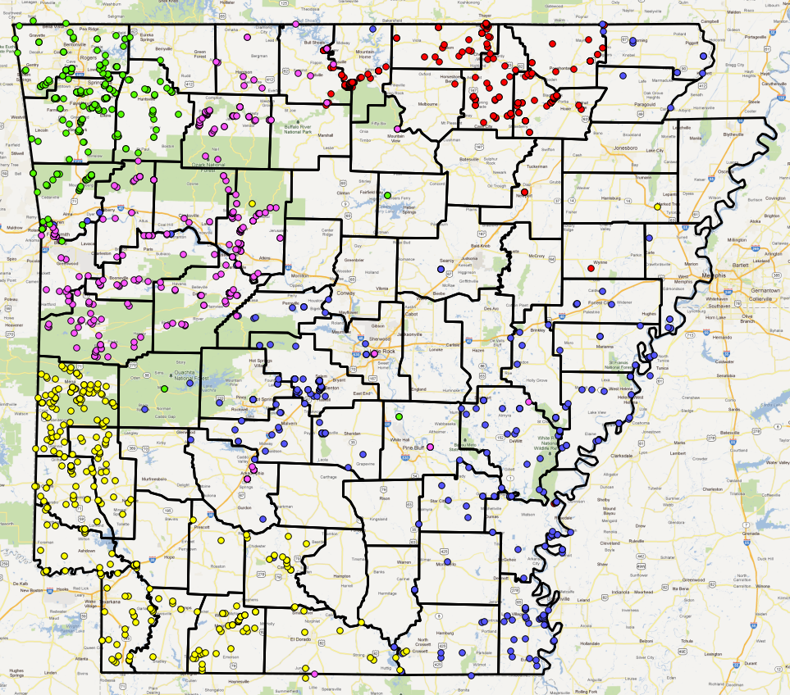
Distributing Workloads

Slide 31
Organizational Units
Community
Community
Data sources
Data sources
Users
Data sources
Data sources
Community
Community

Slide 32
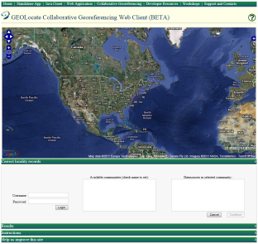
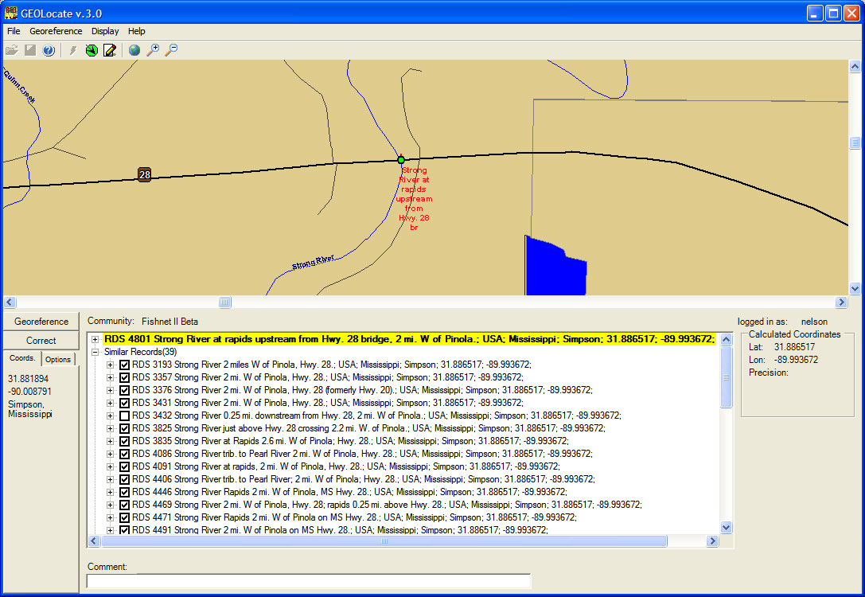
Collaborative Georeferencing within GEOLocate
DiGIR Service
Remote
Data Source
CSV Upload
Community
&
Data Management
Cache Update Web
Service
CoGe Web Portal Application
Data Retrieval Web
Service
Data Store
Correction
&
Verification
Insert Correction Web
Record Processor
Service
CoGe Client Application (Desktop or Web)
Georeferencing Web
Service

Slide 33
Collaborative Georeferencing Management Portal

Slide 34
Georeferencing Communities
Create Communities
Data Sources
Add New Users & Link Out

Slide 35
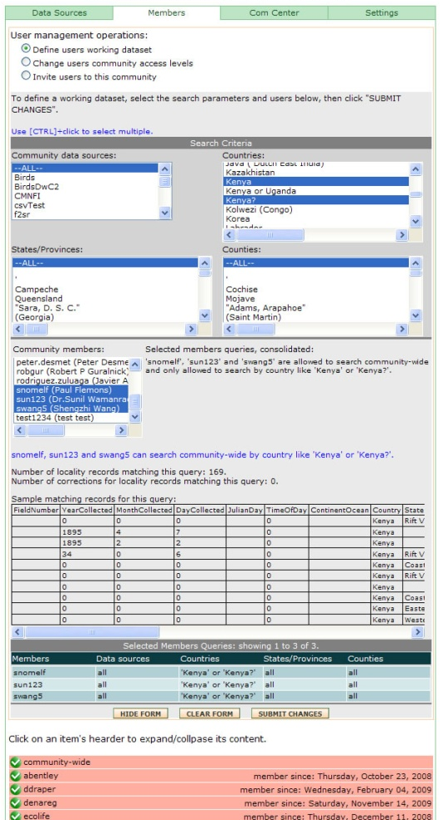
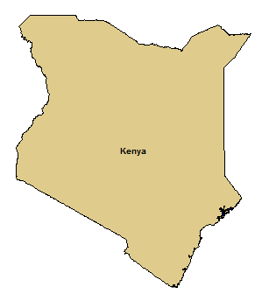
User Management:
Task Assignment
Assign all records from Kenya to
experts on East African regions

Slide 36
Monitoring & Managing Progress

Slide 37
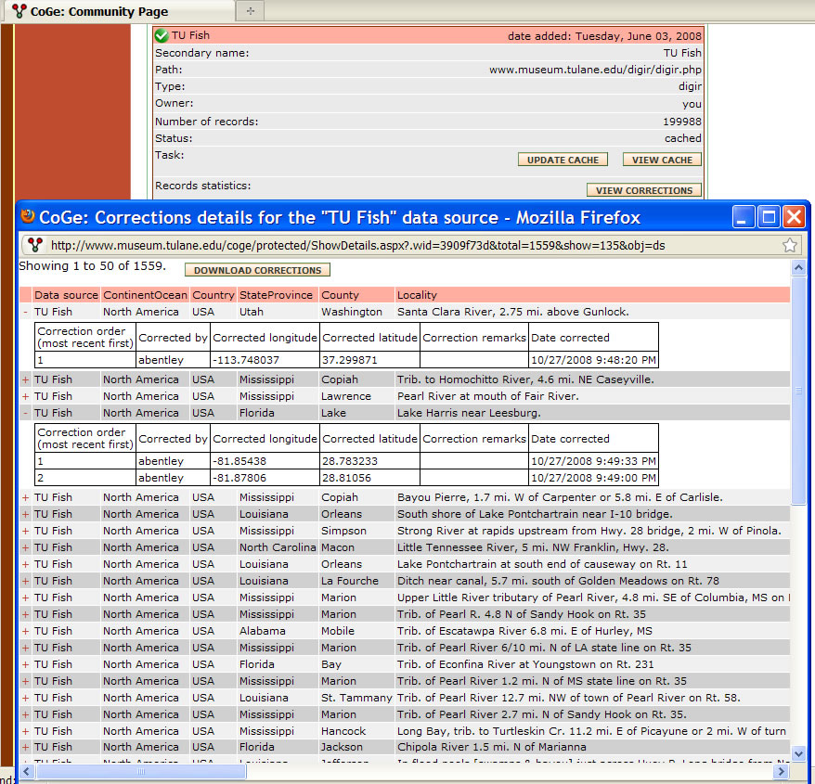
Data Repatriation

Slide 38
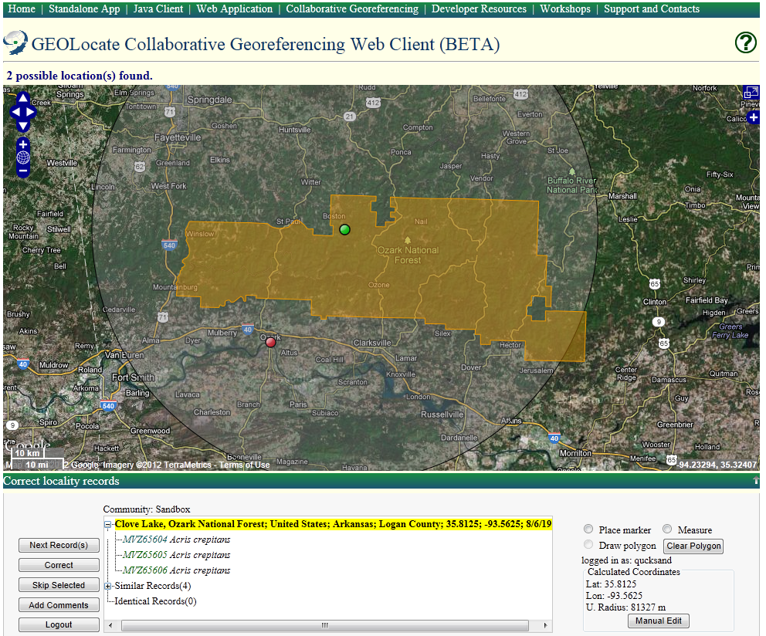
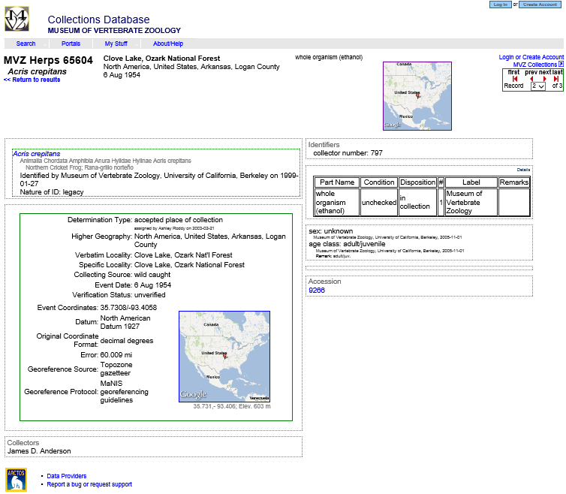
Collaborative Web Client

Slide 39
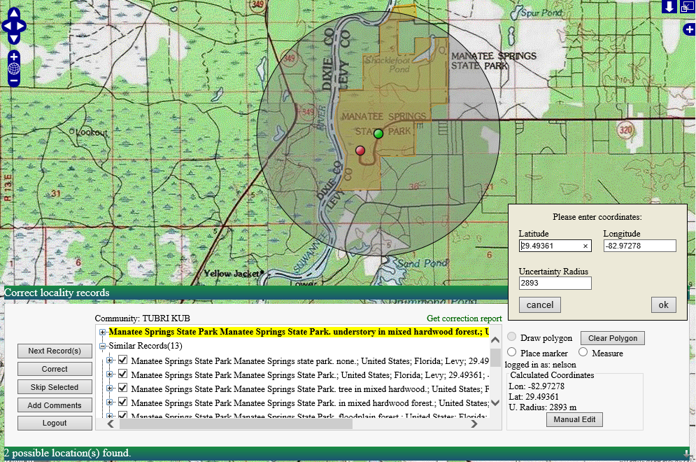
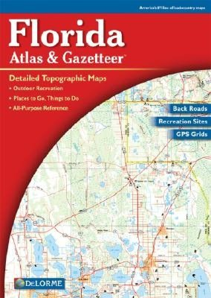

Slide 40
Interoperability:
Georeferencing Web Services
&
Embeddable Web Client

Slide 41
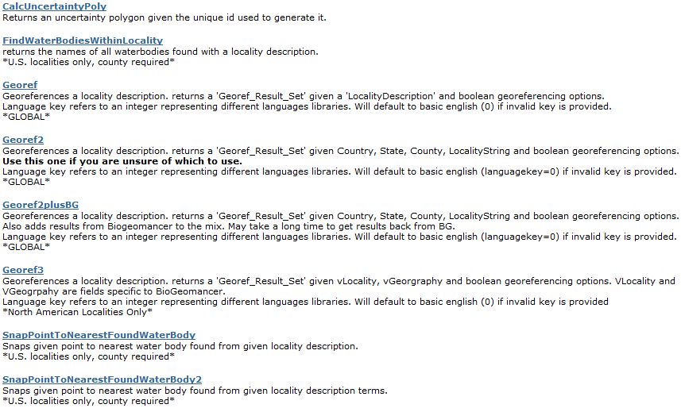
Georeferencing Services: GEOLocate v2
SOAP & HTTP Get/Post
http://www.museum.tulane.edu/webservices/geolocatesvcv2/geolocatesvc.asmx

Slide 42
HTTP/1.1 200 OK
Content-Type: text/xml; charset=utf-8
Content-Length: length
<?xml version="1.0" encoding="utf-8"?>
<Georef_Result_Set xmlns="http://www.museum.tulane.edu/webservices/">
<EngineVersion>string</EngineVersion>
<NumResults>int</NumResults>
<ExecutionTimems>double</ExecutionTimems>
<ResultSet>
<WGS84Coordinate>
<Latitude>double</Latitude>
<Longitude>double</Longitude>
</WGS84Coordinate>
<ParsePattern>string</ParsePattern>
<Precision>string</Precision>
<Score>int</Score>
<UncertaintyRadiusMeters>string</UncertaintyRadiusMeters>
<UncertaintyPolygon>string</UncertaintyPolygon>
<ReferenceLocation>string</ReferenceLocation>
<DisplacedDistanceMiles>double</DisplacedDistanceMiles>
<DisplacedHeadingDegrees>double</DisplacedHeadingDegrees>
<Debug>string</Debug>
</ResultSet>
<ResultSet>
.
.
.
</ResultSet>
</Georef_Result_Set>
Version 2 Get Response
georef2()

Slide 43
SOAP to … Wrapper
url: http://www.museum.tulane.edu/webservices/geolocatesvcv2/glcwrap.aspx?
locality | required | the locality description
country | required
state | optional | will return zero results if country is USA and state is not provided
county | optional
hwyX | optional | enable looking for intersections between roads and water bodies. values: [true], false
enableH2O | optional | snap points to water bodies if found in locality. values: [true], false
doUncert | optional | calculate uncertainty radius. values: [true], false
doPoly | optional | generate polygons for known places. values: true, [false]
displacePoly | optional | displaces polygons in line with locality description. doPoly must be enabled, otherwise ignored. values: true, [false]
languageKey | optional | selected language. 0=English. values: [0],1,2,3,4
fmt | optional | output format. values: [json], geojson
callback | optional | wraps response in a callback
Examples:
http://www.museum.tulane.edu/webservices/geolocatesvcv2/glcwrap.aspx?Country= USA&Locality=bogalusa&state=la
http://www.museum.tulane.edu/webservices/geolocatesvcv2/glcwrap.aspx?Country=USA&Locality=bogalusa&state=la&dopoly=true&fmt=geojson
Comments:
Currently errors are returned as plain text without any JSON formatting. This will be updated in a future update. For example (when not enough data provided): http://www.museum.tulane.edu/webservices/geolocatesvcv2/glcwrap.aspx?Country=USA

Slide 44
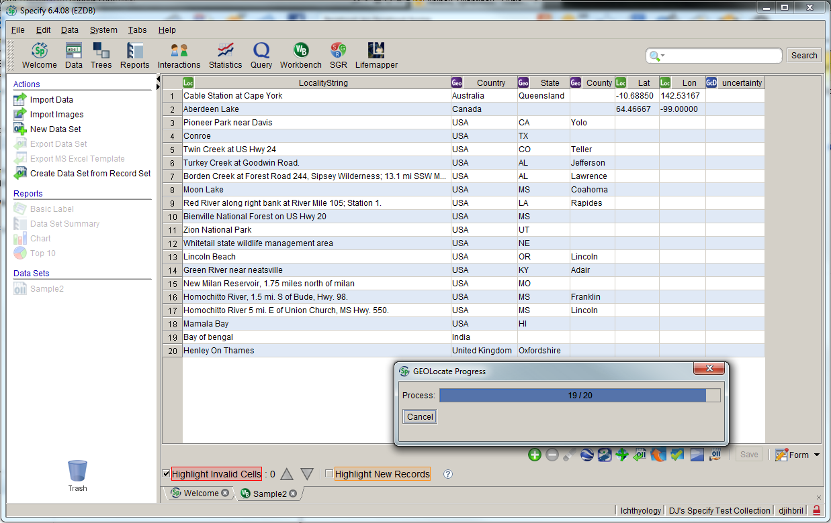

Slide 45
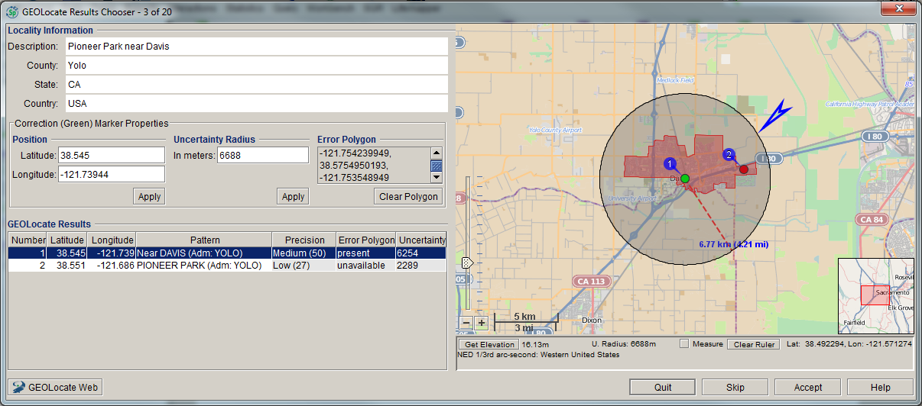

Slide 46
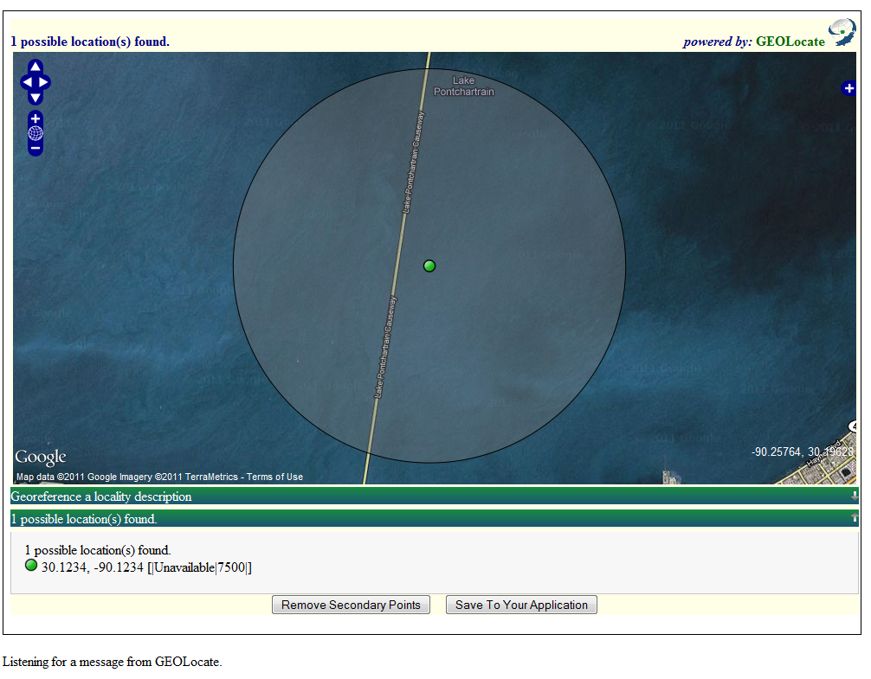
Application Services: Web Client APIs
URL API for user input & lightweight web clients
Lightweight client, specifically designed for embedding into other web applications.
Two way communication between web sites uses JavaScript postMessage()
Compatible with all modern browsers:
IE 8.0+
Firefox 3.0+
Safari 4.0+
Chrome 1.0+
Opera 9.5+

Slide 47
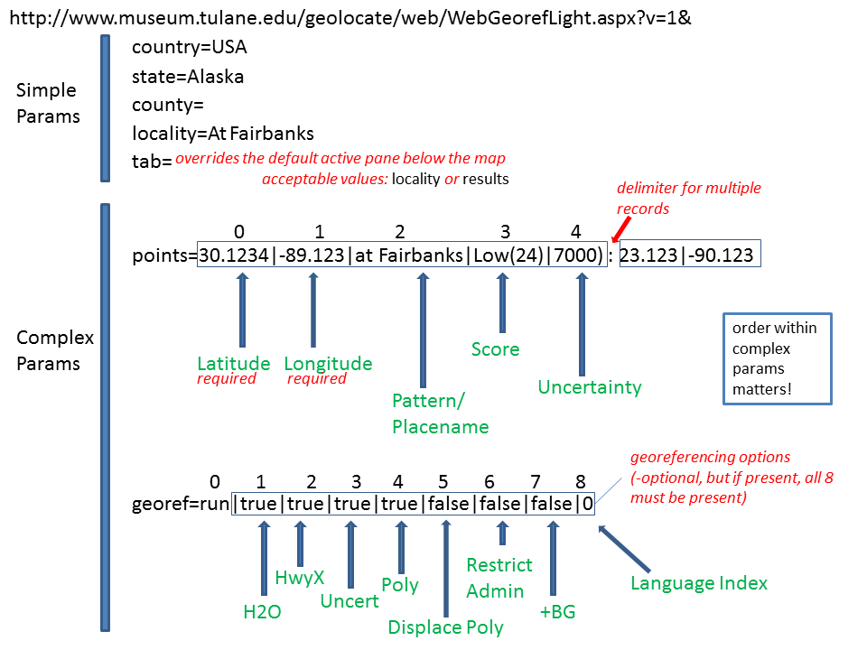

Slide 48
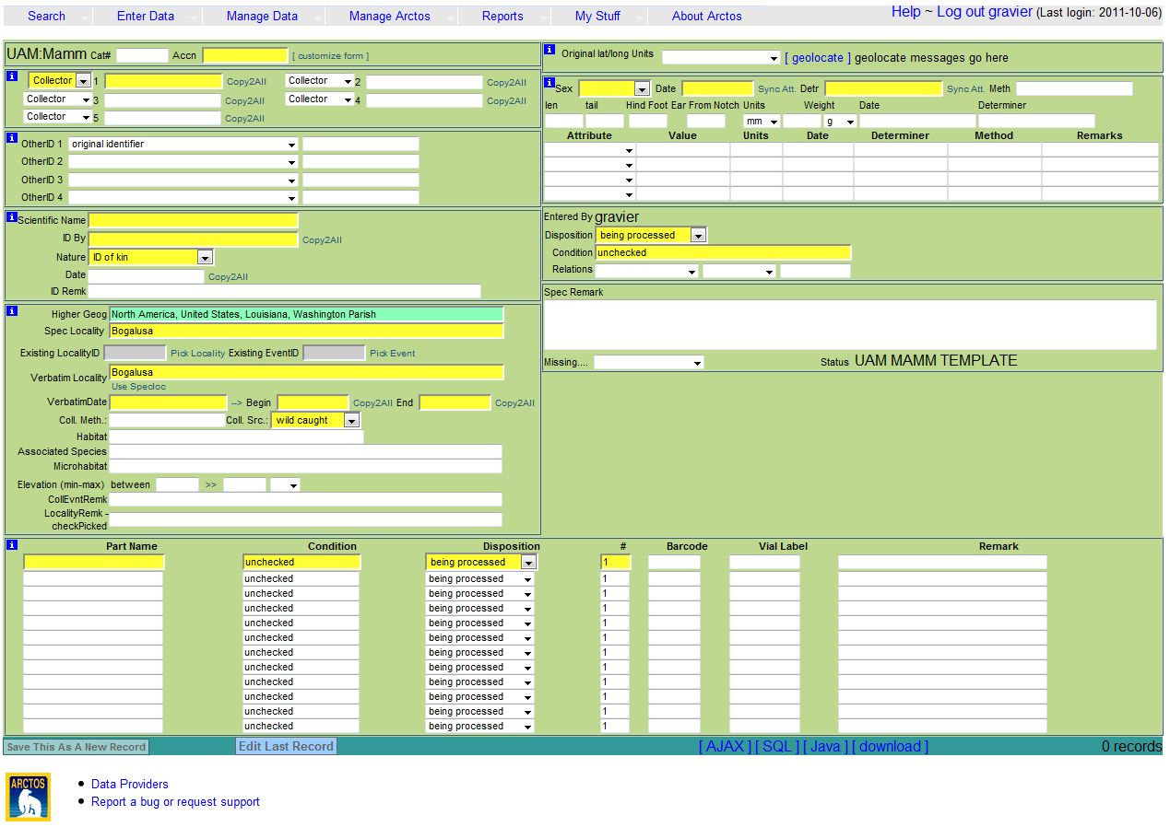
Arctos

Slide 49
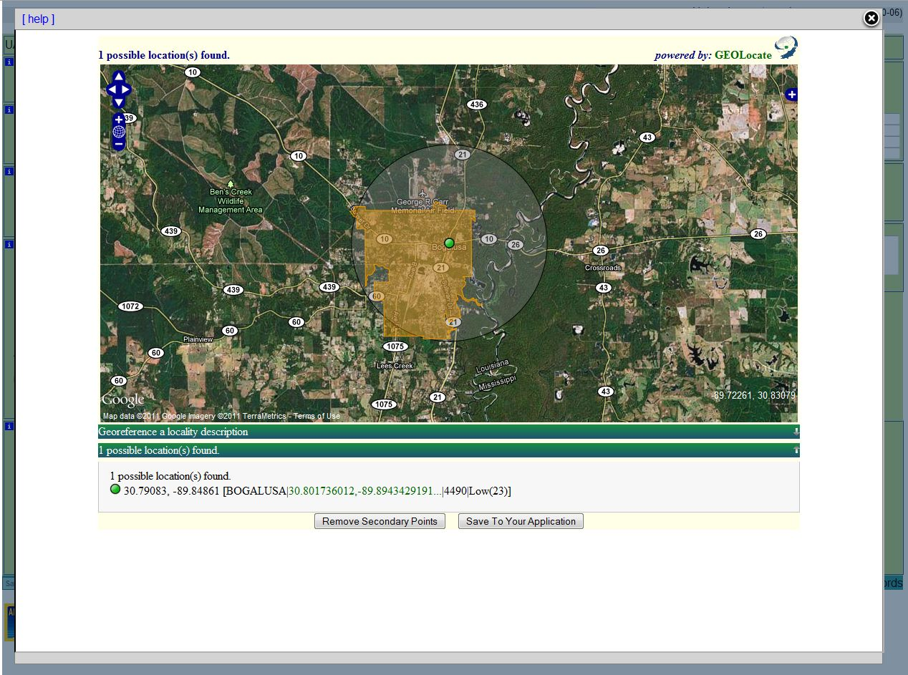

Slide 52
Excel
http://www.museum.tulane.edu/geolocate/web/WebGeoref.aspx? v=1&Country=USA&State=LA&County=Washington&Locality=Bogalusa&georef=run

Slide 53
Future Work: K-18 Crowdsourcing
Paynes Prairie Preserve State Park, near Gainesville. Alachua; FL; USA
Clustering based upon spatial variance, uncertainties & user skill level.

