Slide 1
Geographical Concepts
IDigBio Train the Trainers Georeferencing Workshop Gainesville, Fl 8-12, Oct 2012

Slide 2
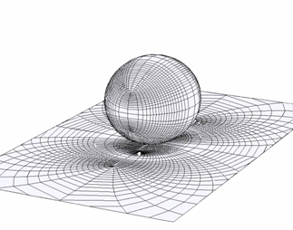
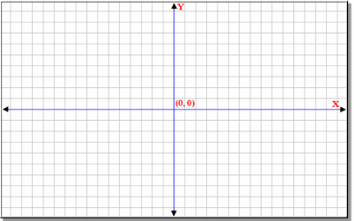
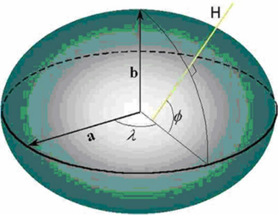
Geographical Concepts
3 main concepts
Projection
Datum
Coordinate system

Slide 3
Geographical Concepts: Projections

Slide 4
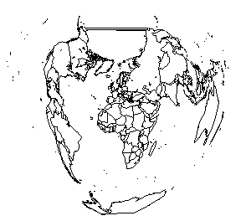
Geographical Concepts: Projections
Bonne equal-area projection

Slide 5
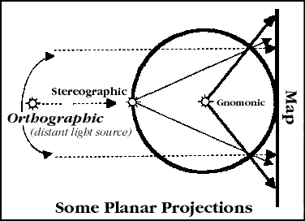
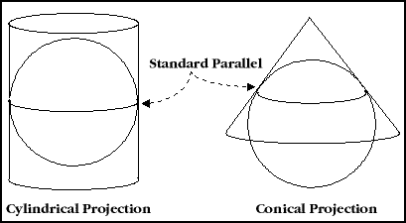
Geographical Concepts: Projections

Slide 6
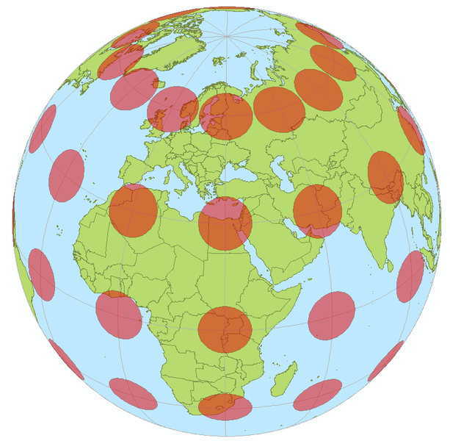
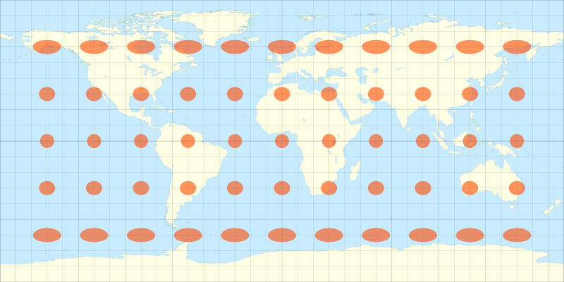
What projections do
Rectangular projection
Tissot’s Indicatrix of distortion

Slide 7
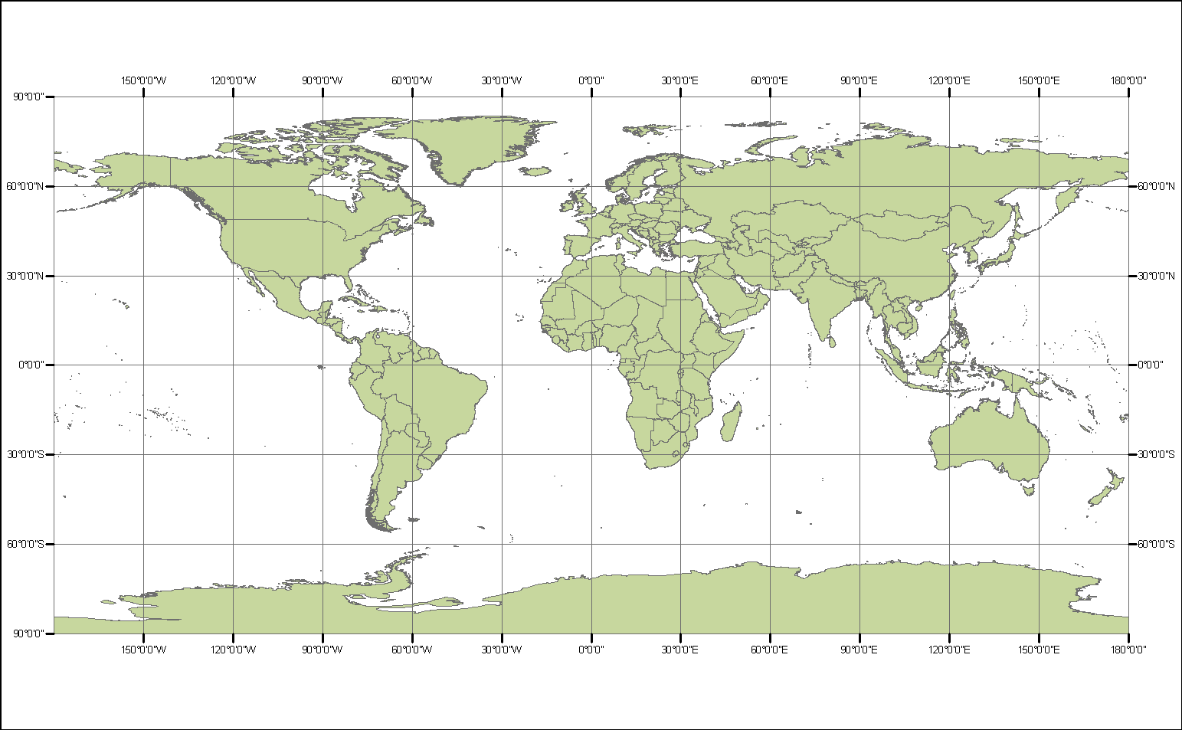
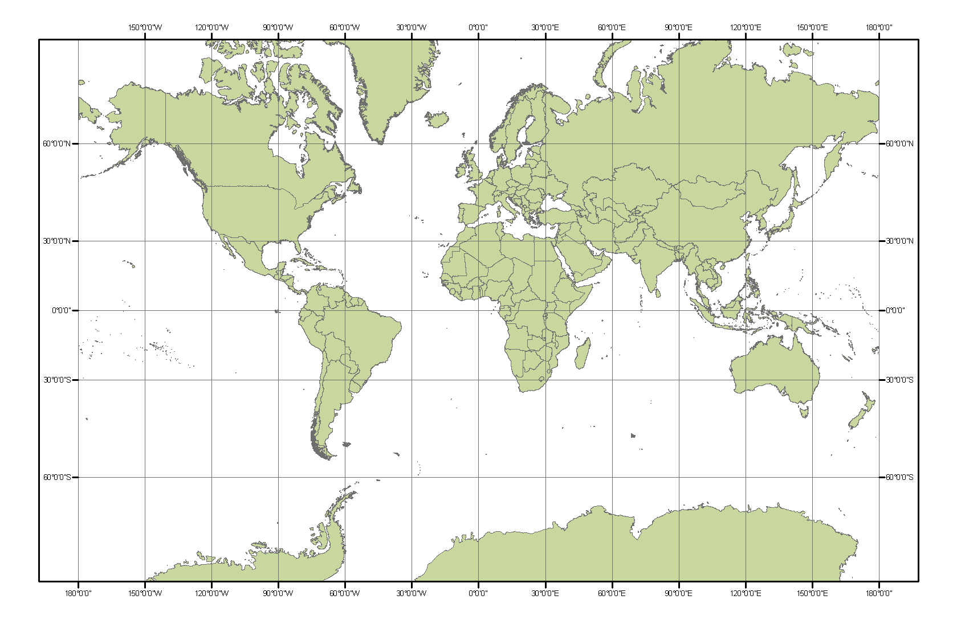
Projections Examples
Geographic
preserves NS distance
Mercator
preserves shape (terrible for poles, distorts area)

Slide 8
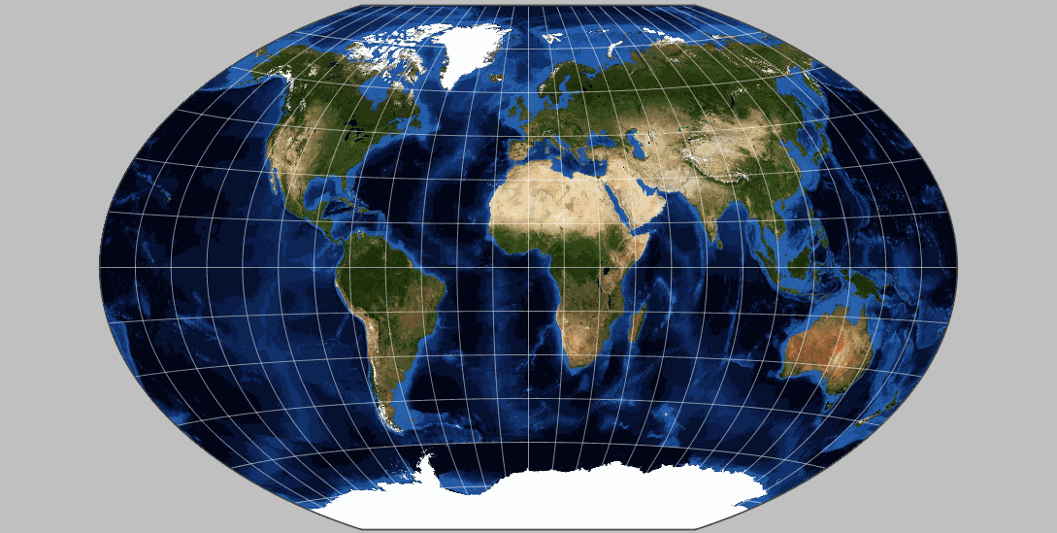
Projections: Take Home Message
Projections compromises…
Equal-area
True shape
True scale
True direction
Select projection to fit your needs

Slide 9
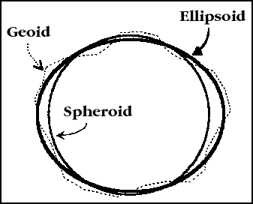
Geographical Concepts: Datum

Slide 10
Geographical Concepts: Datums
Common Datums
NAD27 (North American Datum): system derived from land-based surveys, using Clarke 1886 ellipsoid
NAD83: satellite-based system using the Earth’s center as a reference point; eventually adopted as GRS80 (Geodetic Ref. System 1980)
WGS84 (World Geodetic System 1984): mathematically refined GRS80 used by the US military and default for GPS
For most uses, NAD83, GRS80, WGS84 are equivalent

Slide 11
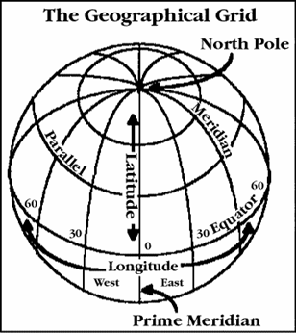
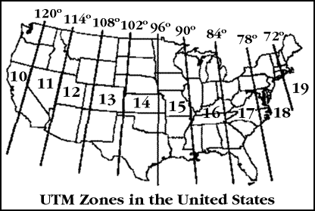
Geographical Concepts: Coordinate Systems

