Slide 1
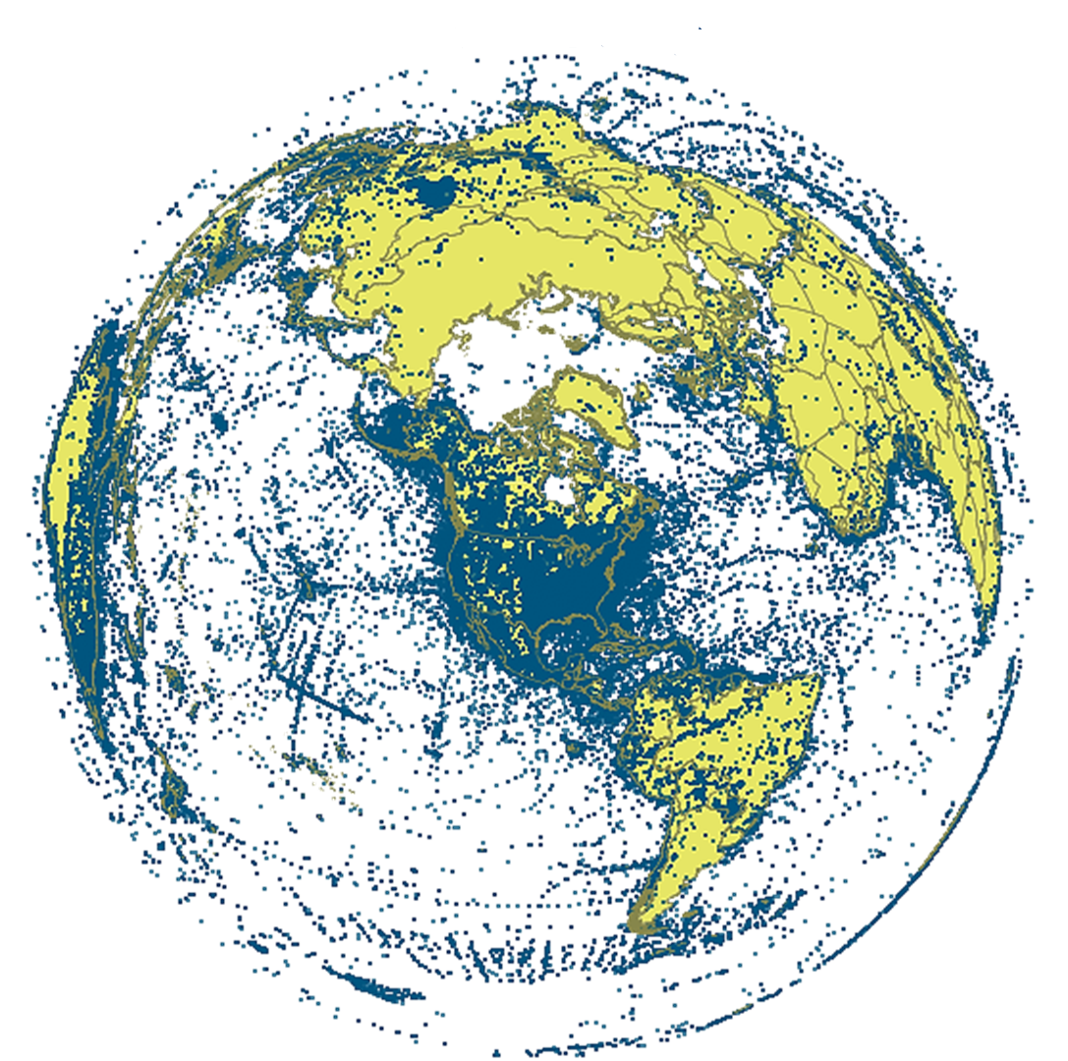
Large Scale Collaborative Georeferencing A FishNet Perspective
Nelson E. Rios
nrios@tulane.edu
iDigBio Train the Trainers Georeferencing Workshop Gainesville, FL 8-12, Oct 2012

Slide 2
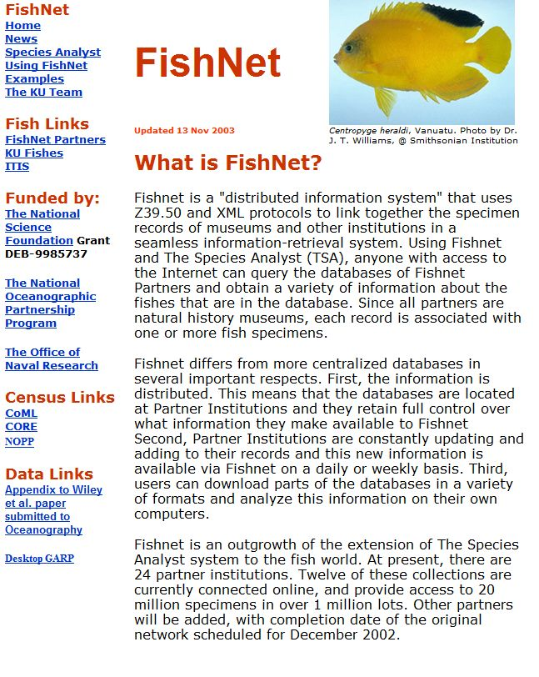
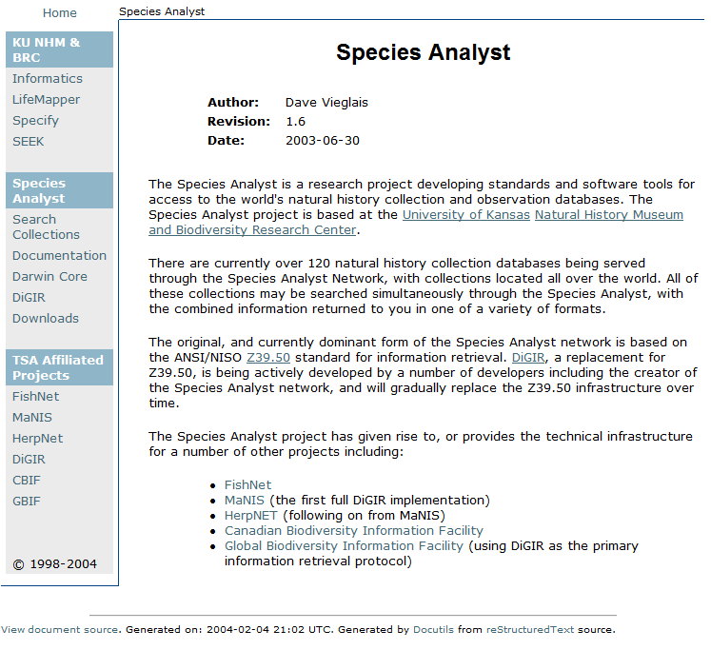
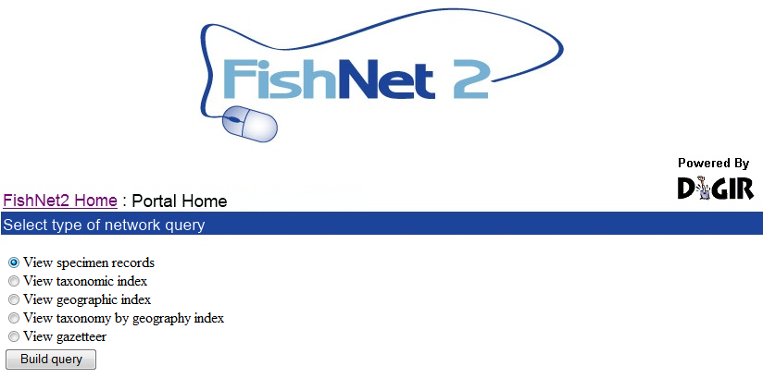
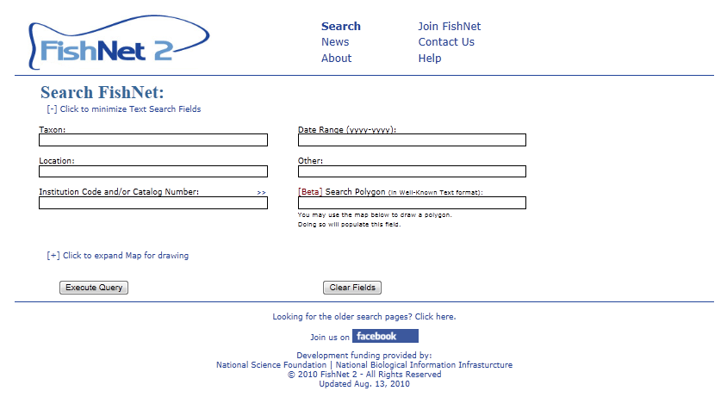
History of FishNet
1999: Creation of original FishNet Network
Z39.50 protocol for sharing data
Search via Species Analyst (distributed query model)
2005: FishNet 2 created
Transition to DiGIR Protocol
Search via DiGIR Portal (distributed query model)
2010: FishNet 2 (centralized query model)
Harvesting of DiGIR, DwCA, Static Spreadsheets
Search via FishNet 2 Portal (centralized query model)

Slide 3
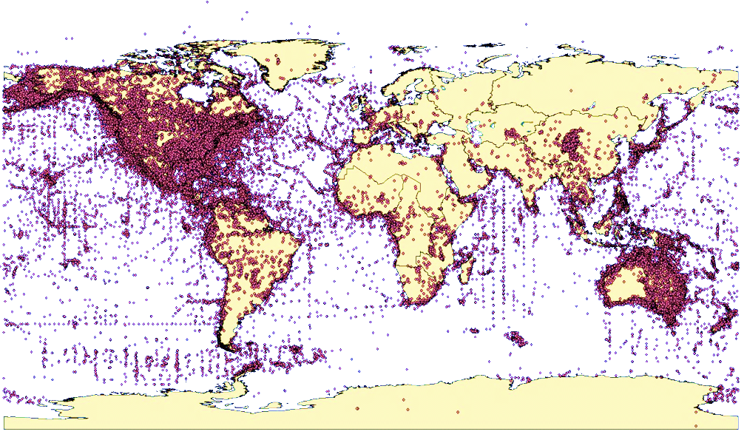
Global network of fish collections
52 data providers
3.3 million lots
30+ million specimens
57% georeferenced
4+ million lots 100% georeferenced

Slide 4
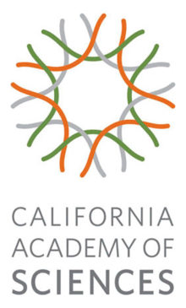
Georeferencing Collaborators

Slide 5
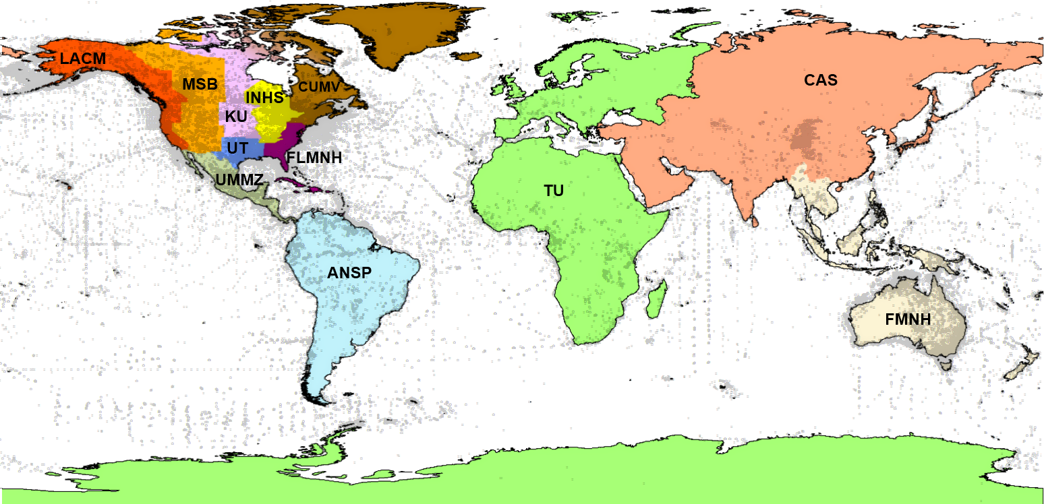
Preliminary Assignments
2 out of 4 million records in
need of georeferencing ~250,000 locality records

Slide 6
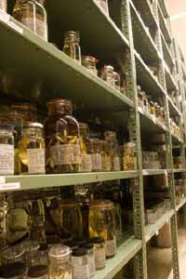
Collaborative Georeferencing Performance
2100 randomly selected collecting events from the Tulane University fish collection were imported and georeferenced using the collaborative georeferencing framework
33% were duplicates
30% more related by similarity index
2100
782
63% reduction in effort overall

Slide 7
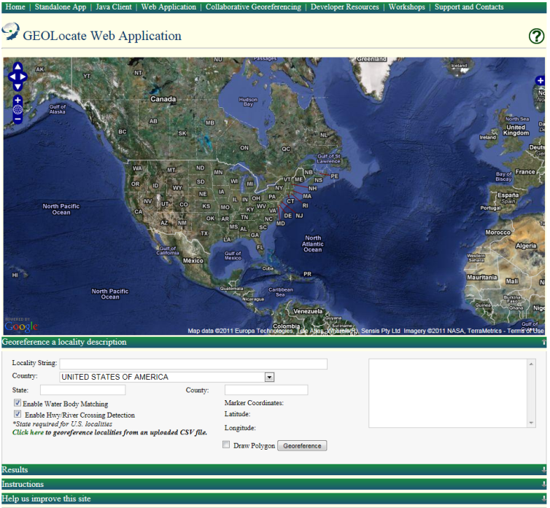
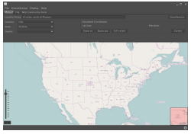
Software & services for georeferencing of natural history collections data
automated georeferencing
verification & correction
multi-lingual
kml export
interoperability
soap & rest api
batch processing
training
geographic visualization
google, bing, openstreet, wms
uncertainty determination
collaborative georeferencing

Slide 8
Uncertainty
Point (legacy)
Point + Radius
Point + Radius + Polygon

Slide 9
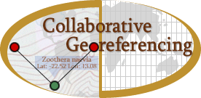
Leveraging Existing Technology and Expertise

Slide 10
Workflow: Integrating API’s
clean data, add to locality gazetteer & match against locality gazetteer
pre-georeference, assess verification difficulty, identify problematic records
produce datasets for CoGe based on institution and anticipated difficulty of verification
Assign workloads by institution, difficulty & region
repatriate
final review of results
verify, correct & annotate
data providers
http://geolocate.fishnet2.net/workflow.html

