Slide 1
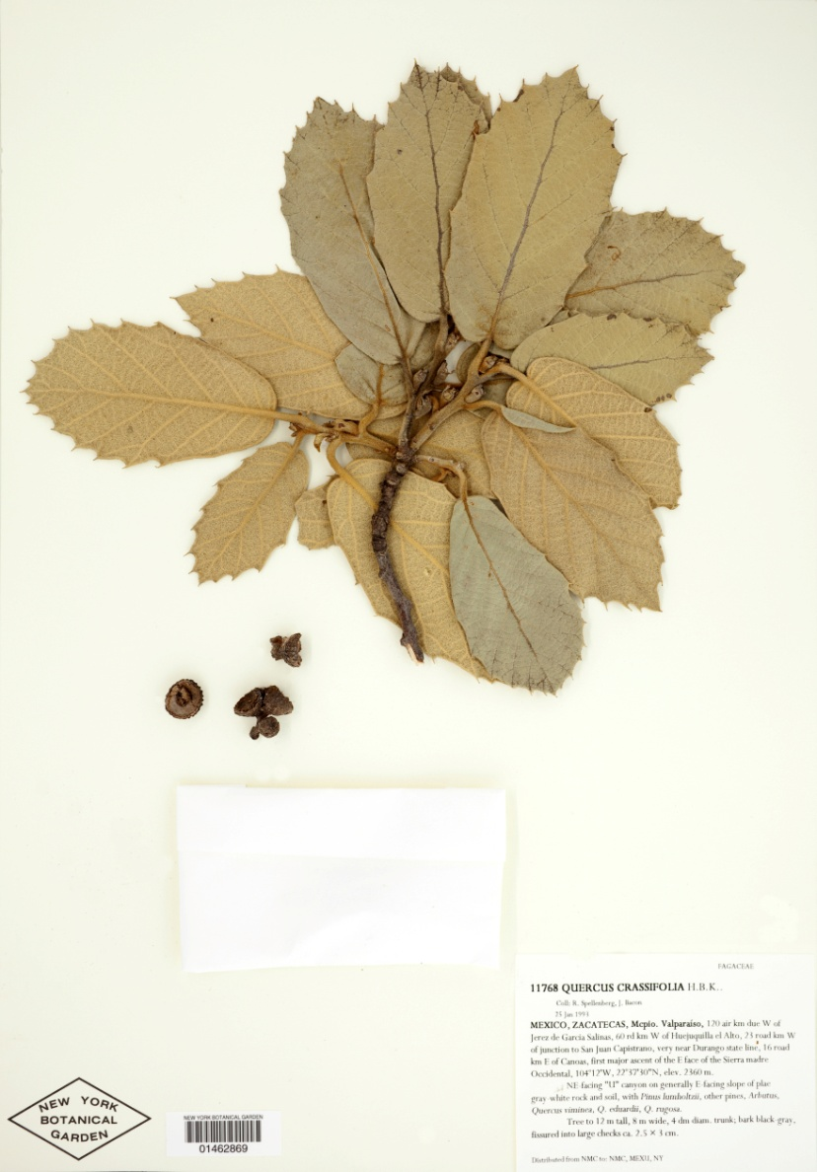
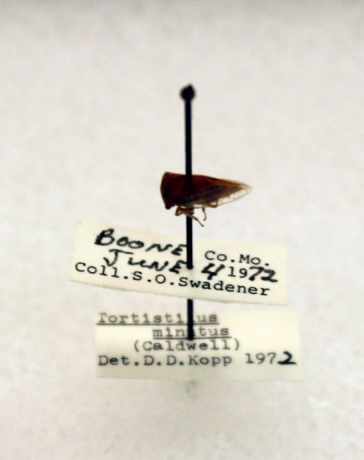
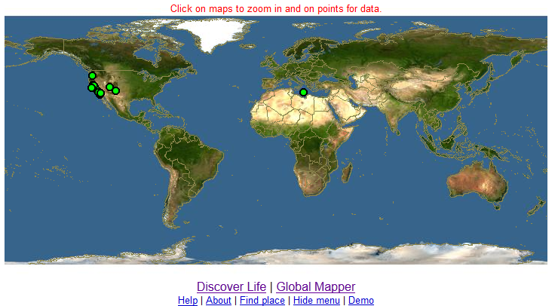
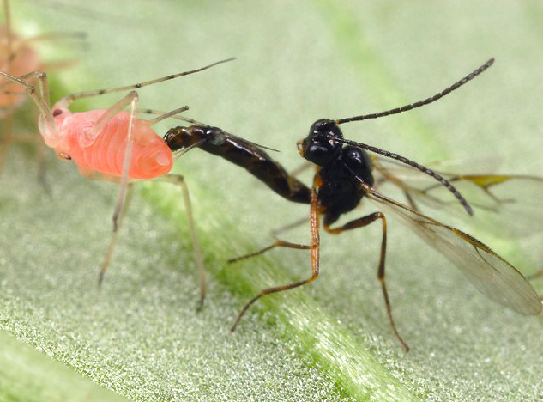
Tri-Trophic Digitization TCN
Plants, Herbivores, and Parasitoids
North American Biota
Plants: 20 families, 8,066 species
Hemiptera: 11,150 species
Hymenoptera: 1,039 species
Collaborators | Specimens databased | % Georef | Specimens to database
Botanical (14) | 1,341,000 | 23 | 1,224,000
Entomological (18) | 126,000 | 90 | 1,206,000
Total | 1,467,000 | 29 | 2,430,000
Photo: www.alexanderwild.com

