Slide 1
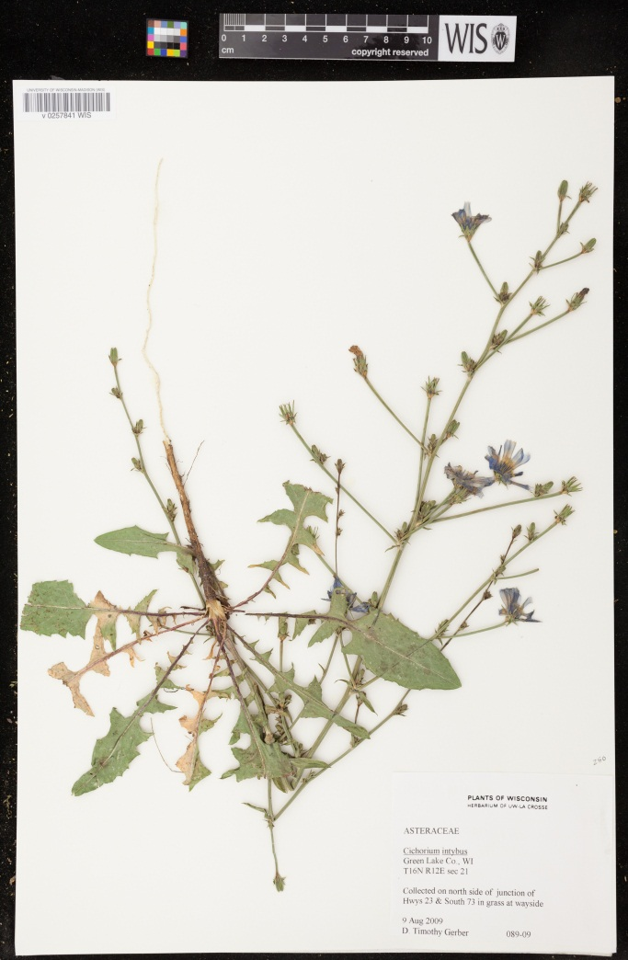
Wisconsin State Herbarium (WIS) – University of Wisconsin Madison’s
Tri-trophic Digitization project
Family | WIS specimens
Apiaceae | 3899
Asteracae | 33068
Chenopodiaceae | 1439
Cupressaceae | 691
Cyperaceae | 23676
Fabaceae (s.l.) | 7712
Fagaceae | 2094
Grossulariaceae | 1804
Juglandaceae | 688
Lamiaceae | 6571
Oleaceae | 763
Pinaceae | 1261
Poaceae | 20353
Polygonaceae | 4943
Rhamnaceae | 692
Rosaceae | 14283
Salicaceae | 4640
Scrophulariaceae | 5590
Solanaceae | 1379
Zygophyllaceae | 6
TOTAL | 135552
In addition to needing to georeference these 135,000+ specimen WIS is also the host institution for the WBIS (Wisconsin Botanical Information System) database.
This database has a total of 370,514 vascular plant specimen records from 26 participating institutions, most from Wisconsin, although the geographical diversity is expanding as WIS enters more of their non-Wisconsin specimen records. Of this total only approximately 3.98% have long./lat.

