Slide 1
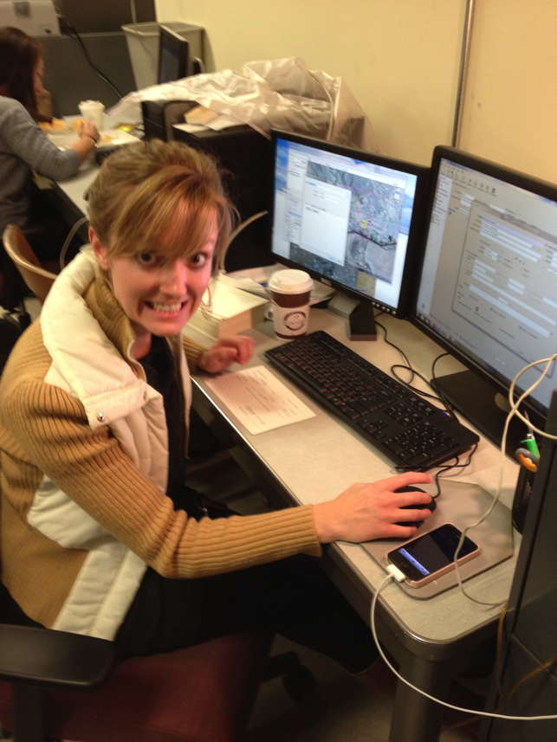
Anatomy of a fossil collection

Slide 2
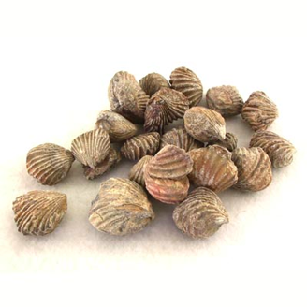
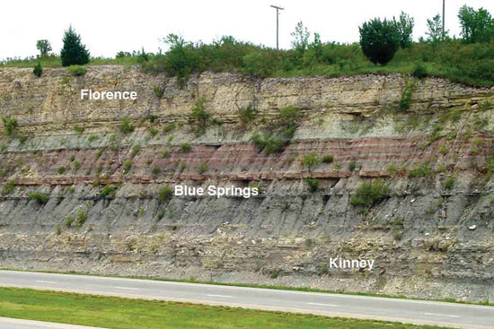
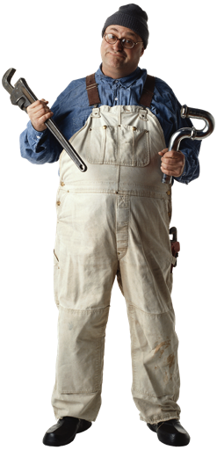
Exposure of the upper Matfield Shale (Kinney and Blue Springs) and lower Barneston Limestone (Florence) along the south side of I-70 just east of exit 299; near NW corner, sec. 8, T. 12 S., R. 6 E., Geary County, Kansas.

Slide 3
Existing Collection Records

Slide 4
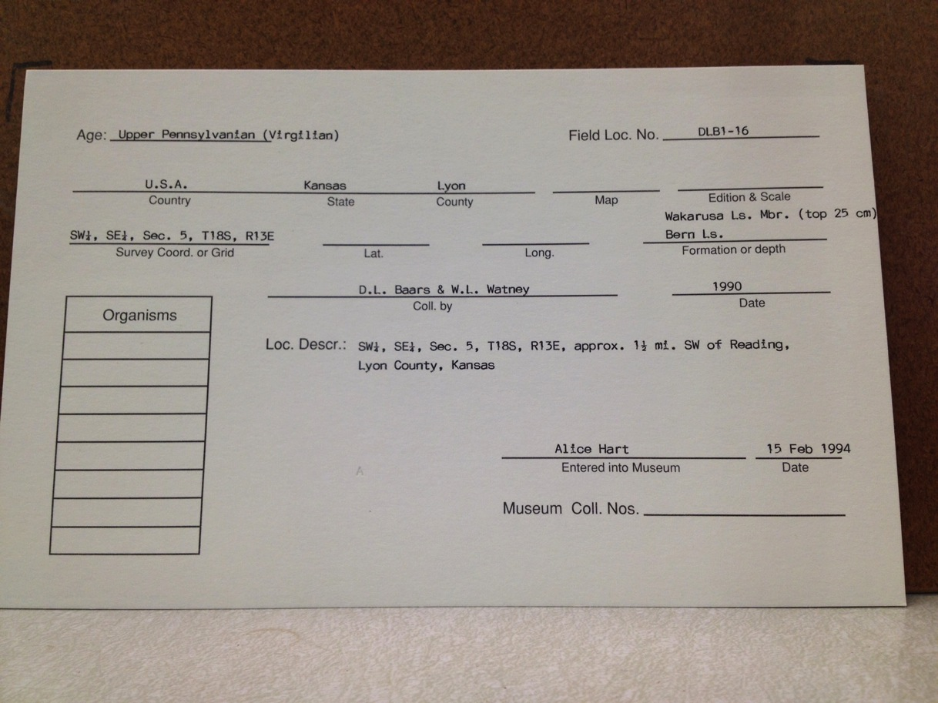
Geologic Age
Locality Number
Higher Geography
TRS
Lithostratigraphy
Collector(s)
Collection Date
Locality

Slide 5
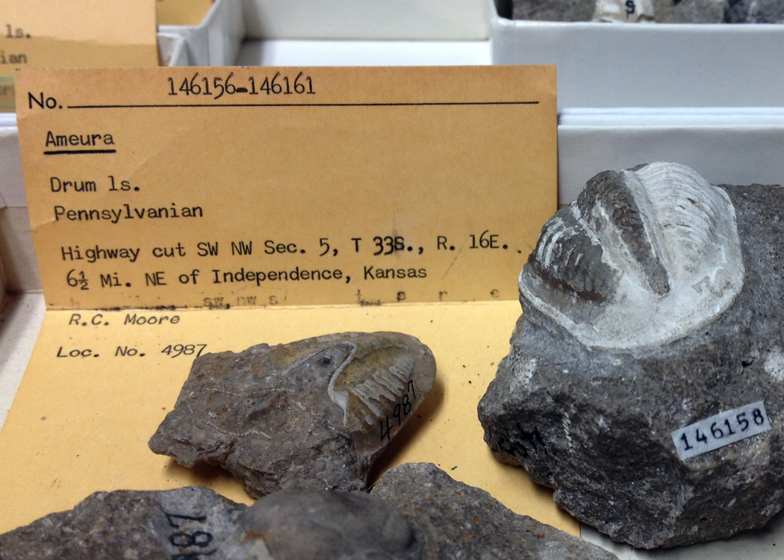
Specimen number(s)
Taxon
Lithostratigraphy
Geologic Age
Locality
Collector
Locality number

Slide 6
Specify
Stratigraphy and Age are associated with the collection object and Collecting Event is separate, such that multiple objects of different ages and formations can be collected from the same locality.

Slide 7
Exposure of the upper Matfield Shale (Kinney and Blue Springs) and lower Barneston Limestone (Florence) along the south side of I-70 just east of exit 299; near NW corner, sec. 8, T. 12 S., R. 6 E., Geary County, Kansas.

Slide 8
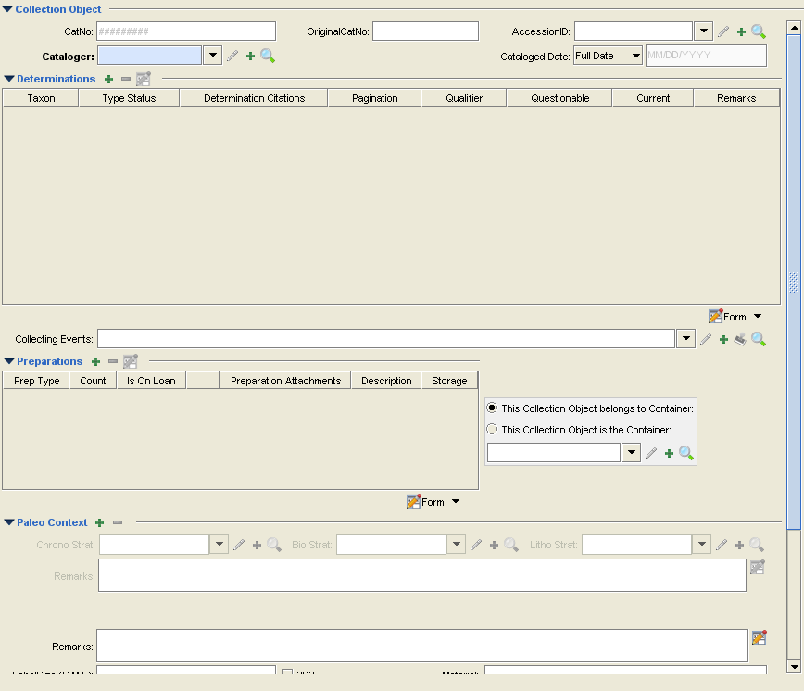

Slide 9
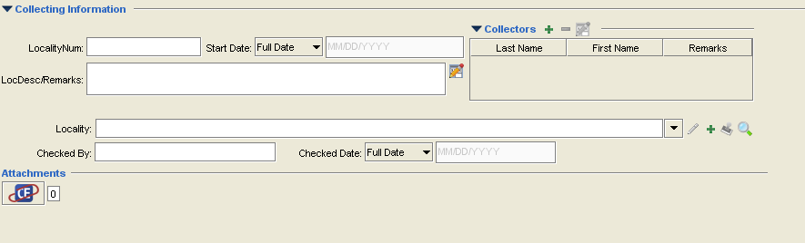

Slide 10
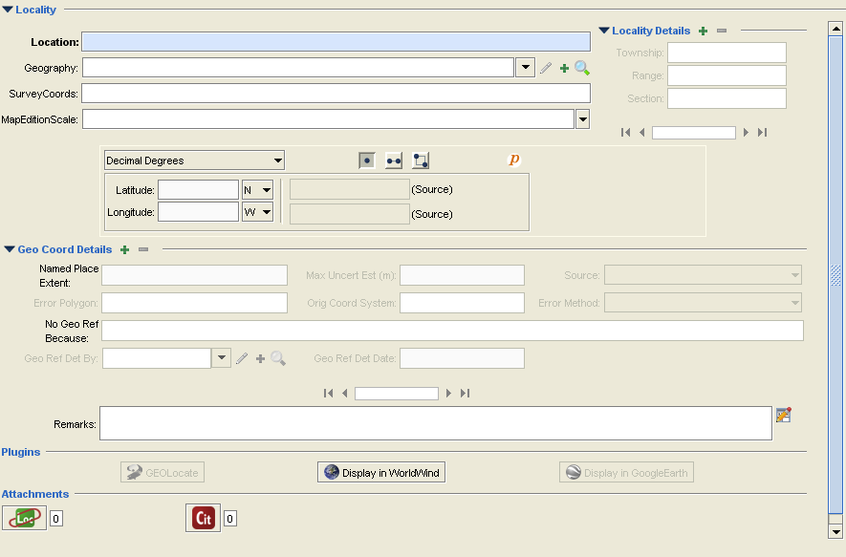

Slide 11
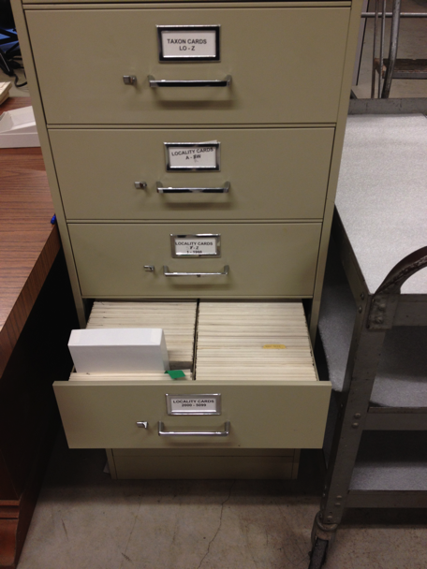
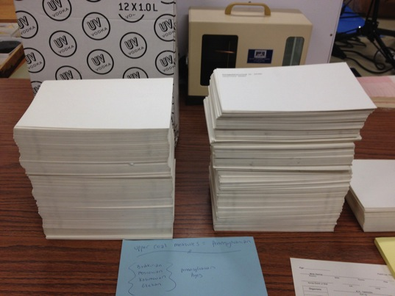
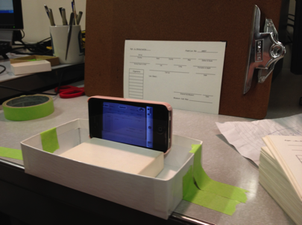

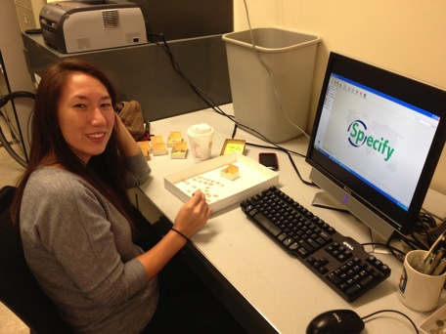


Slide 12
