Slide 1
Using the TRS system in the midcontinent of the US

Slide 2
Areas of the United States covered by the TRS system
http://www.blm.gov/wo/st/en/prog/more/cadastralsurvey/meridians.-WidePar-51114-DownloadFile.tmp/pmmap2.jpg

Slide 3
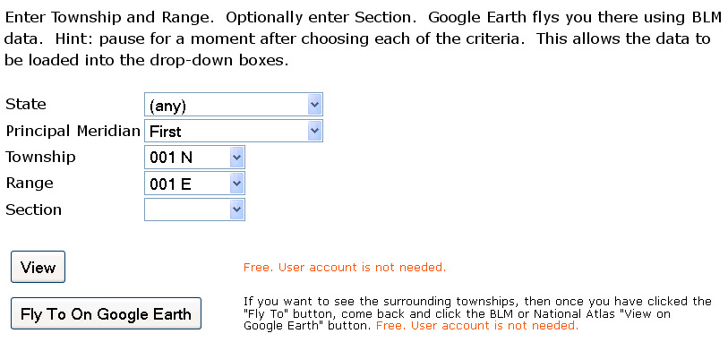
Using Earthpoint to convert TRS
http://www.earthpoint.us/TownshipsSearchByDescription.aspx

Slide 4
KE EMu record of a collecting locality

Slide 5
Earthpoint continued

Slide 6
