Slide 1
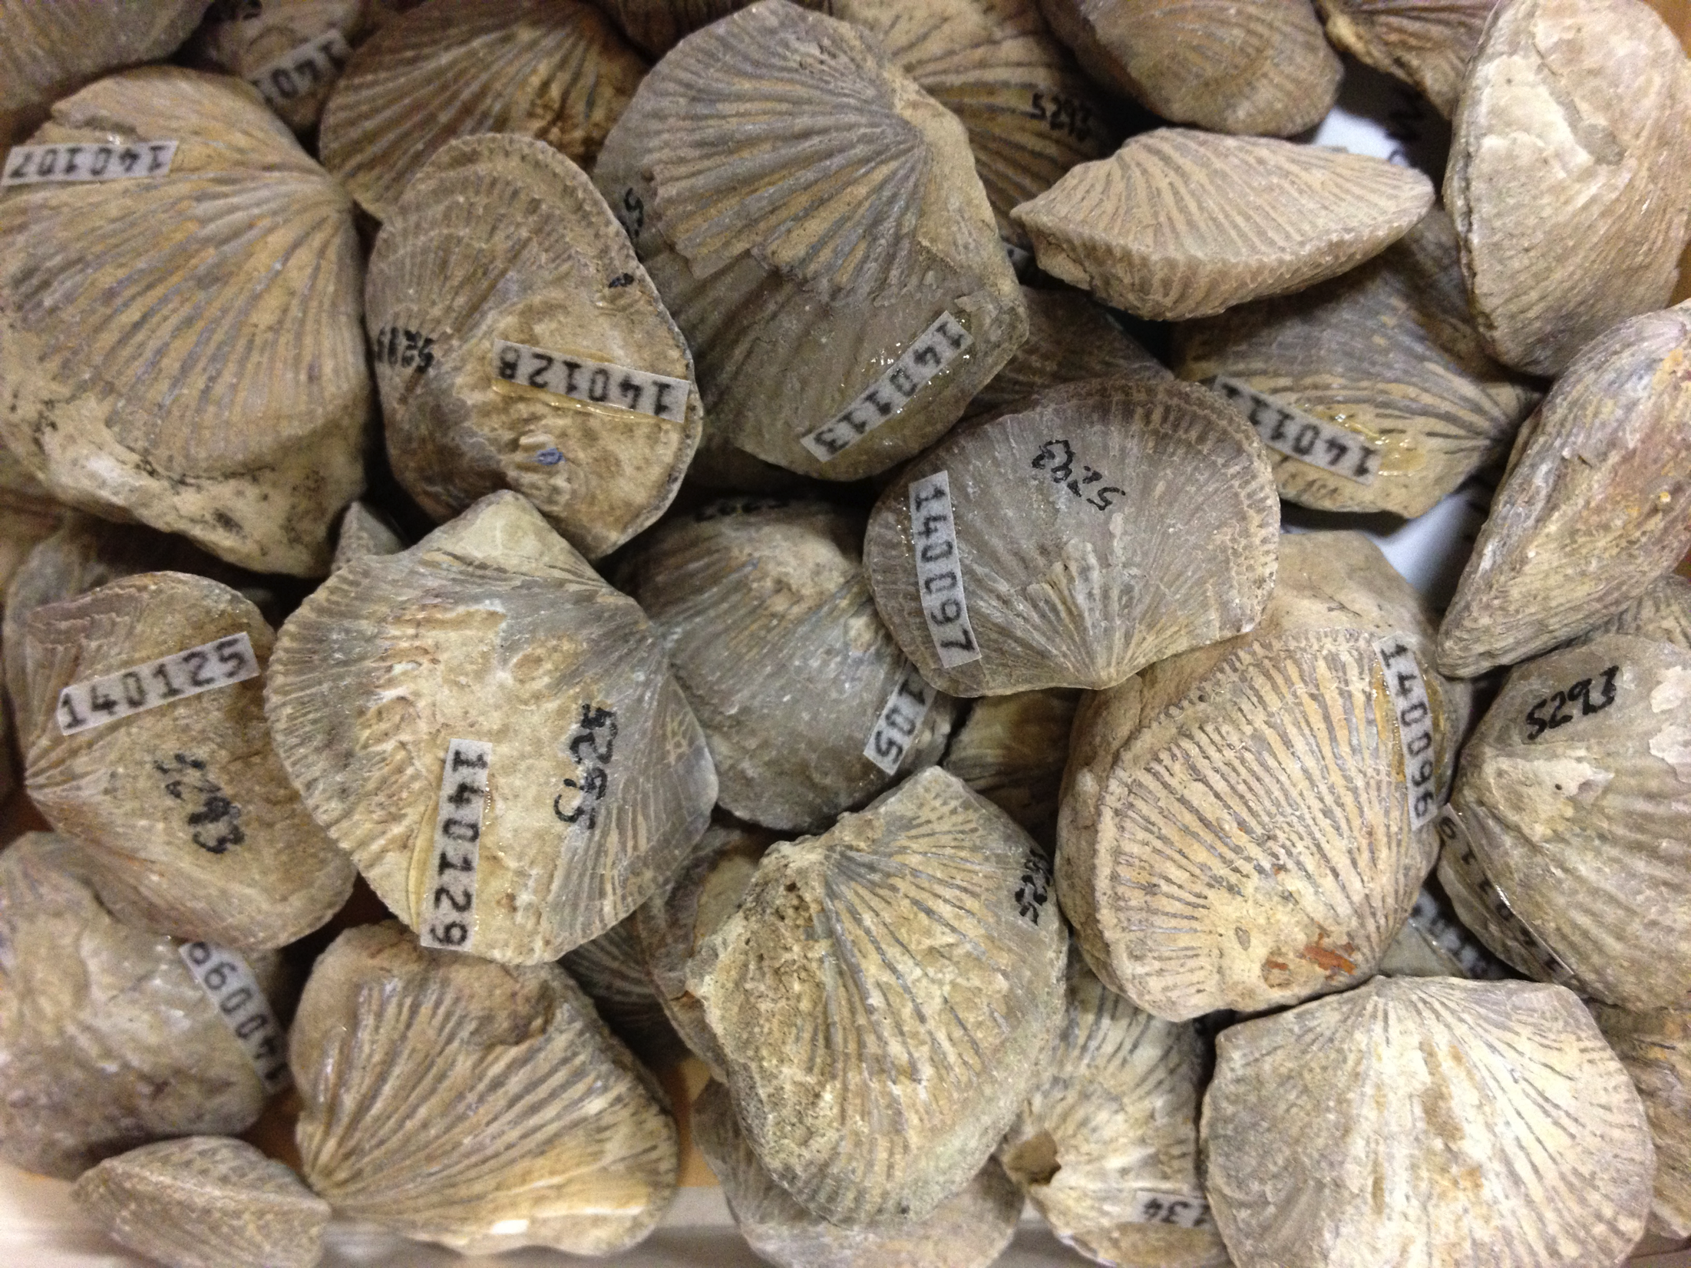
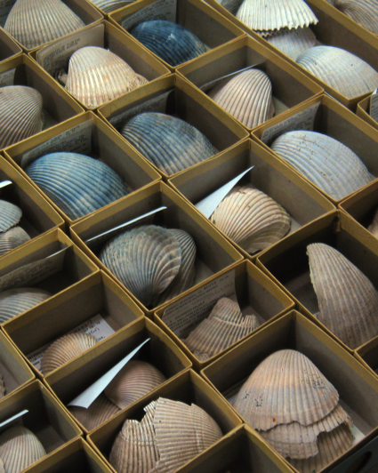
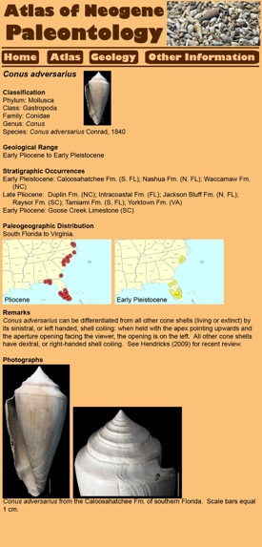
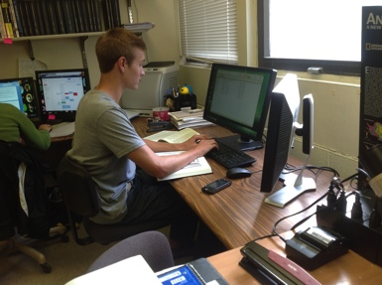
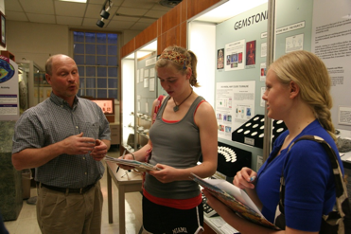
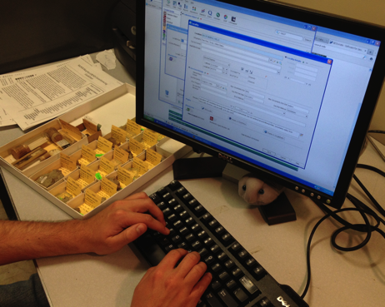
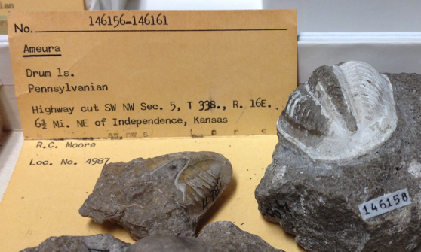
Paleoniches TCN
Ordovician (488-444Ma)
Ohio University Zoological Collections, Cincinnati Museum Center and the Karl E. Limper Geology Museum (MUGM)
>1,500 localities
>100,000 specimens
~115 species
Neogene (23-2.6Ma)
Florida Museum of Natural History
>3000 localities
176,615 specimens
~500 species
Aims
Georeference and database ~450,000 invertebrate fossil specimens
~11,500 localities
Data use: Ecological Niche Modeling, Digital Atlases
To be trained: Grad students, post-doc, and potentially undergraduates
Method: Mostly Specify+Geolocate. Possibly automation. Open to suggestions!
Pennsylvanian (318-299Ma)
University of Kansas
~7,000 localities
>170,000 specimens
~240 species

