Slide 1
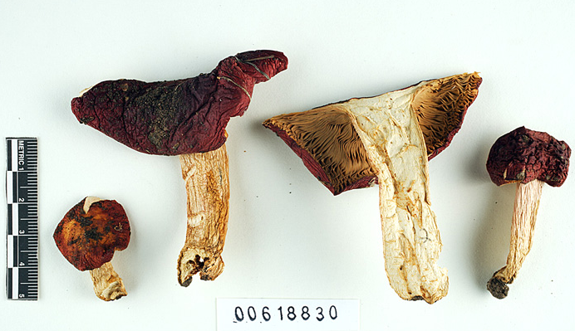
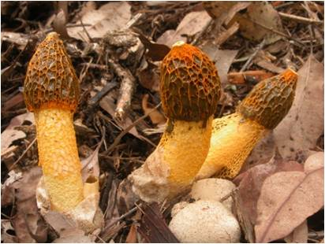
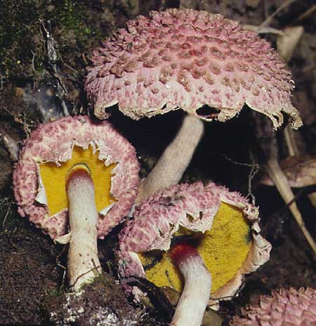
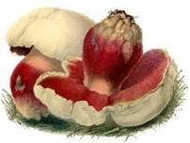
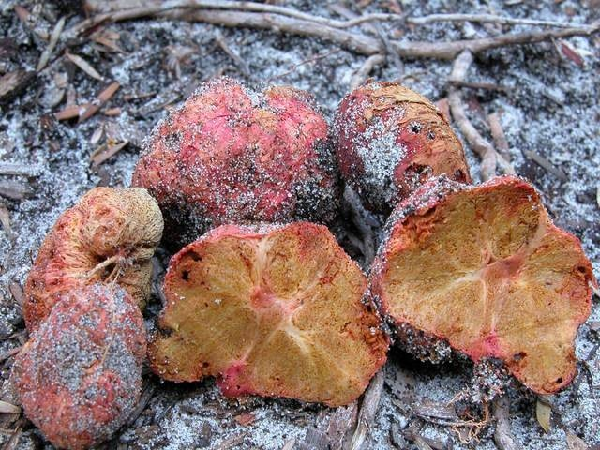
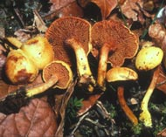
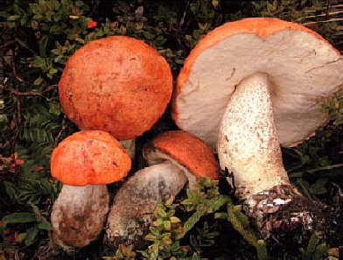
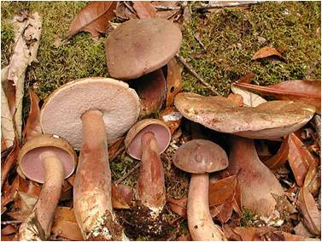
Macrofungi Collections Consortium

Slide 2
Project Overview
Digitization goals: specimen data, field book collection information
700,000 new specimen records + 600,000 previously digitized specimens = 1.3 million
Some collection labels and field book entries contain geographic coordinates → more rapid georeferencing
Training: staff, students and volunteers from 35 institutions; citizen scientists (e.g. members of local and national mycology clubs)
Institutional labor, automation and crowd-sourcing

