Slide 1

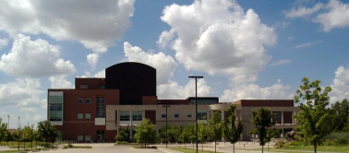
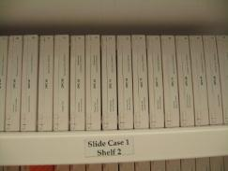
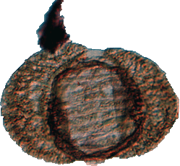
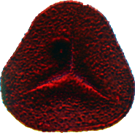
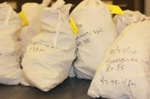
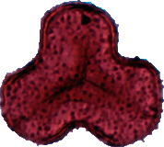
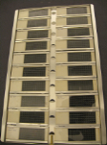


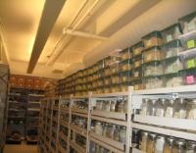
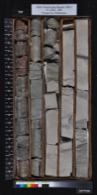
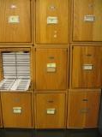
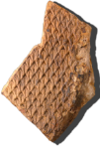
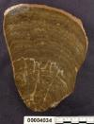
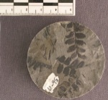


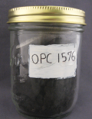
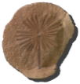
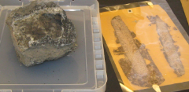


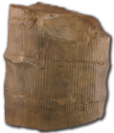
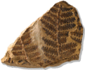
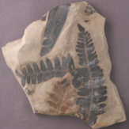
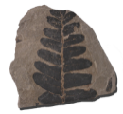



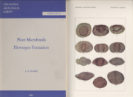
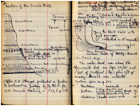
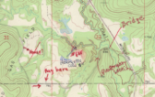
Leonard R. Wilson Collection of Micropaleontology & Paleobotany at
Sam Noble Oklahoma Museum of Natural History
What types of specimens are being georeferenced?
Pollen
Spores
Microfossils
Reserves/Bulk
Residues
Thin Sections/Coal ball Peels
Macrofossils
Who will be georeferencing?
Supporting Documentation
Collection
Staff
How many specimens to georeference?
Uh…Depends How You Count
Students
Localities = ~10,000
Individual Slabs/Slides = ~ 60,000+
Volunteers
Individuals on Slabs/Slides = ???
Notes:
Leonard R. Wilson Collection of Micropaleontology & Paleobotany at Sam Noble Oklahoma Museum of Natural History

Slide 2
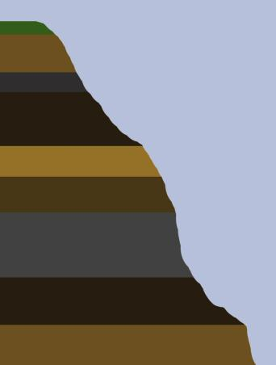
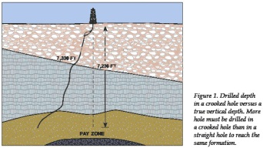


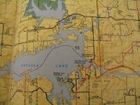
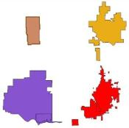
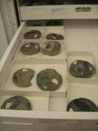
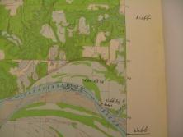
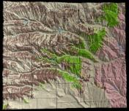

Leonard R. Wilson Collection of Micropaleontology & Paleobotany at
Sam Noble Oklahoma Museum of Natural History
What methods we are planning for georeferencing?
Still in Development but…
GPS 1
Surface
GPS 5
Locality 5
Locality 5
Formation H
Have not determined how to handle well core drift from drilling
Formation G
GPS 4
Locality 4
Formation F
Locality 4
GPS 3
Locality 3
Formation E
Locality 3
Formation D
GPS 2
Locality 2
Formation C
Locality 2
GPS 1
Locality 1
Formation B
Locality 1
© University of Texas @ Austin, 2000 [Color added]
Formation A
Have not determined how to handle verifying plotting correctly
Using city boundaries/outlines
at time when collected
Using geology to limit
Using ArcGIS to rectify & digitize
from maps marked
by collectors
Using measurements from city’s perceived measuring point
at time of collection
(e.g. from post office, from courthouse)
© Landis, 2005
© Landis, 2005
Notes:
Some of Our Georeferencing “Challenges”:
A point in space (includes depth) not just a point on a map
Geology can help constrain
Some localities are wells and wells experience drift when drilling
Many of our localities are potentially along rivers or creeks that were flooded to produce reservoirs
Some localities drawn as diagram of map
Some localities marked/circled “broadly” on maps

