Slide 1
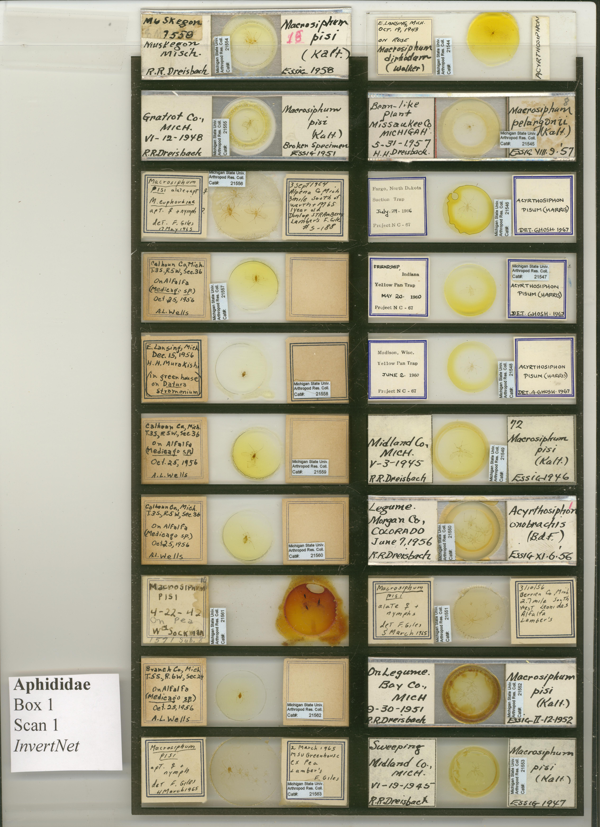
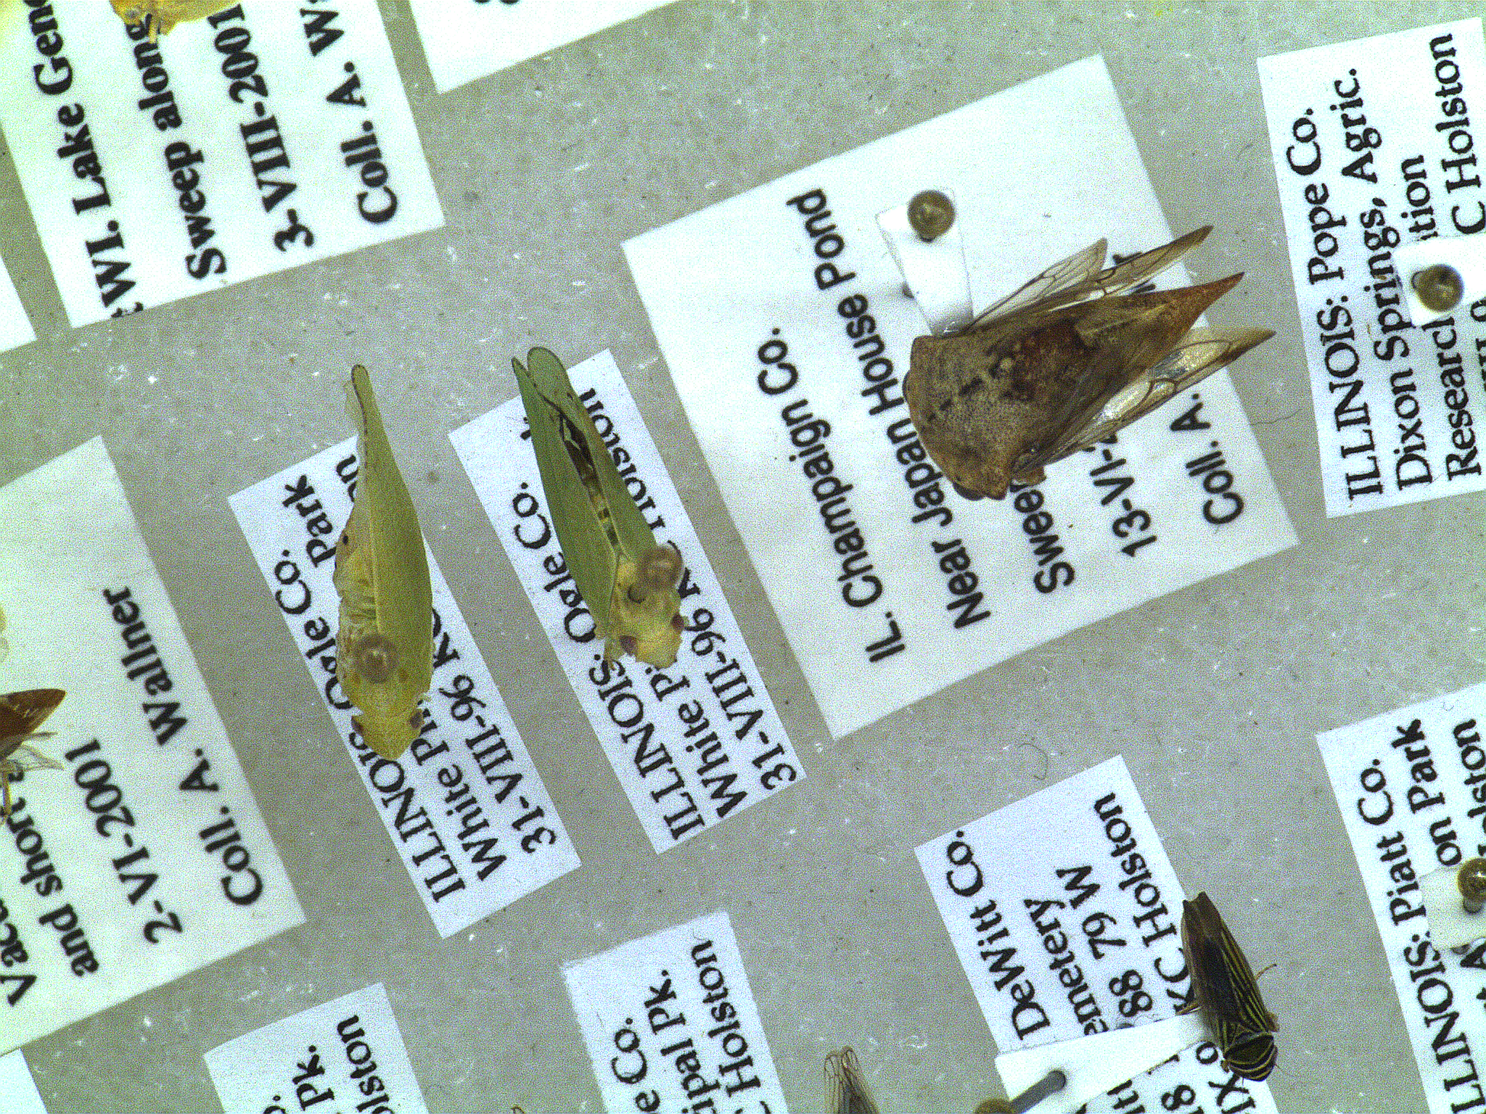
Digitize ~55 million pinned, alcohol, and slide mounted arthropod specimens
Semi-automated georeferencing workflows integrating rapid label data capture as OCR capabilities improve
Crowdsourcing programs?
Notes:
We will capture high-resolution, pan-tilt images of whole drawers including locality label data producing label images suitable for downstream parsing and text capture. Incorporate efficient, reliable and affordable georeferencing workflows that maximize value the images being produced.

