Slide 1
GPS usage and GeoReferencing
A crash course to the eTrex Venture and Georeferencing your field data.

Slide 2
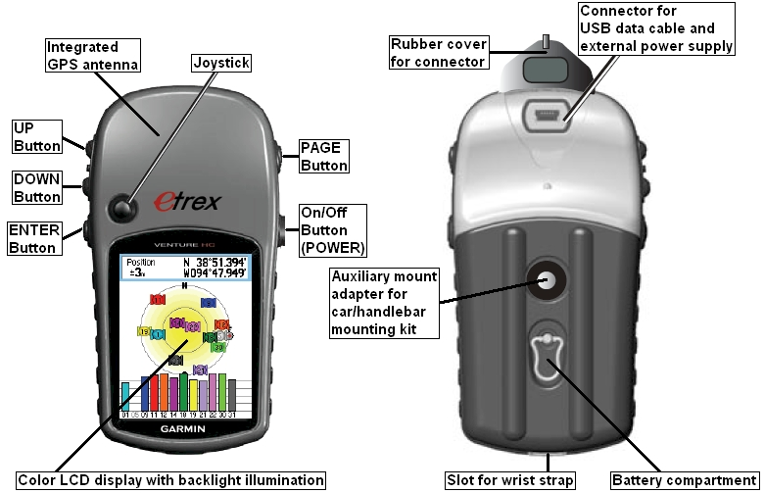

Slide 3
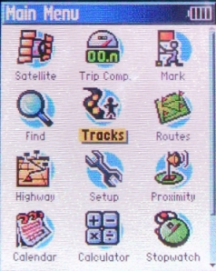
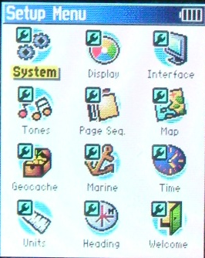
Working with a Garmin
Checking your Datum
The Page button scrolls through the Satellite, Map, Compass and Menu Screens.
Be sure to first check your Datum to see that it matches your institution’s standard or that of your points to be found.
You can set Units and Coordinate Types from this menu as well
Merriam Powell uses the WGS84 datum as standard.

Slide 4
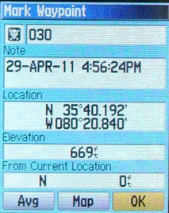
Working with a Garmin
The Page button scrolls through the Satellite, Map, Compass and Menu Screens.
Set a Waypoint from the Menu Screen with the joystick.
You can adjust the name, notes, and coordinates from this screen. To find the point again just select Find and enter the name.
A descriptive name now will save you trouble finding it later!
You can also use this method to enter points from a spreadsheet or paper file.

Slide 5
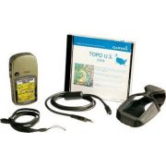
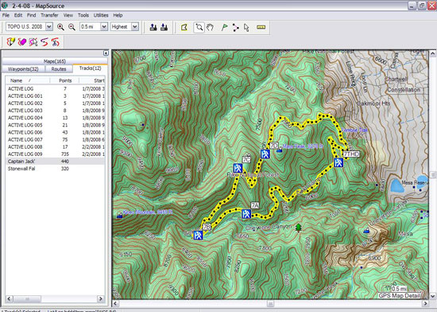
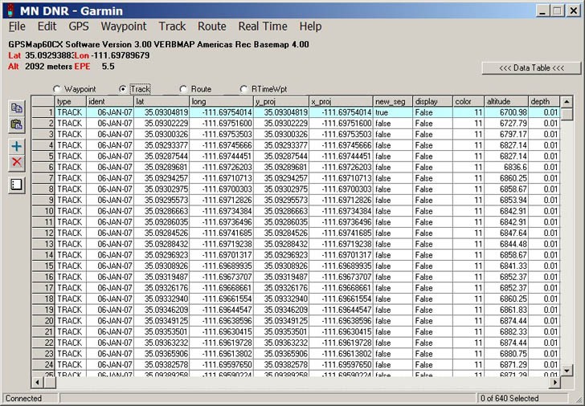
Home from the field
The Garmin Venture HC uses a MicroUSB cable to connect to a computer!
MapSource software can install background maps on your GPS unit.
MapSource software can also be used to download field point information. An alternative is DNRGPS (formerly DNRGarmin) which can export the spreadsheet of points to a variety of formats including .kml, .csv, .xls, and .shp!
Make sure your software datum matches your Garmin datum!

Slide 6
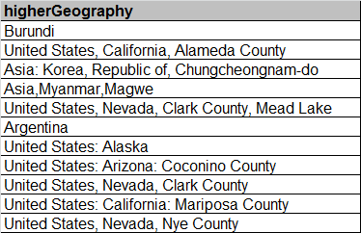
Georeferencing Your Points
Do you know where you were?
More important, does anyone else?
The first step is to fill in your Geographic Data
Mark the name of the Country, State/Province, County, and City (if applicable) in the appropriate field.
The more you can put in here, the easier it will be for future users to use or georeference your data.

Slide 7
Georeferencing Your Points
Your GPS can’t set a locality for you.
Locality is important to future users of your points.
Be as descriptive as possible of the area at which you took a point.
Be specific – tell compass directions, give measurements
Be accurate – describe only your area
Be precise – include plenty of information
Be succinct – this is not a report!
Remember, you’ve already taken Latitude and Longitude, but a future user might not be able to reproduce your point without a good description. Use common-sense words that anyone can understand.

Slide 8
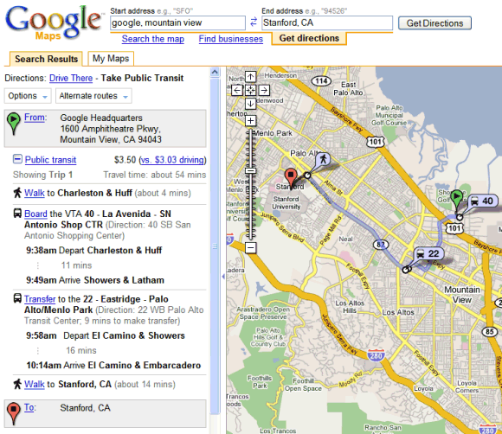
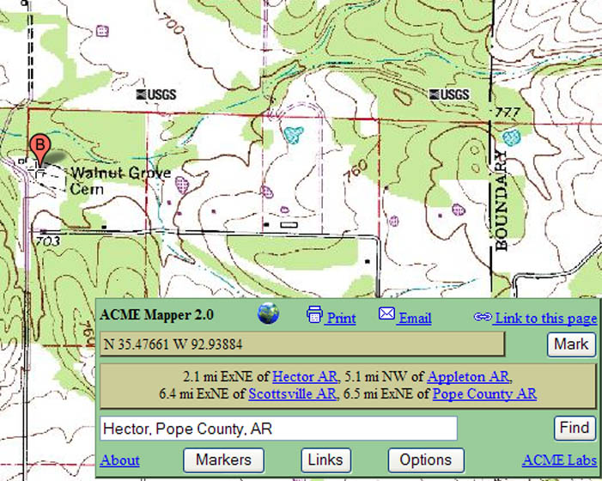
Georeferencing Your Points
Always double-check your points.
Google Maps, Google Earth, ACME Mapper, or any other gazetteer, paper map, or atlas can be used to visualize your collected point(s). This can avoid mistakes in georeferencing and help you eliminate errors in your data.

Slide 9
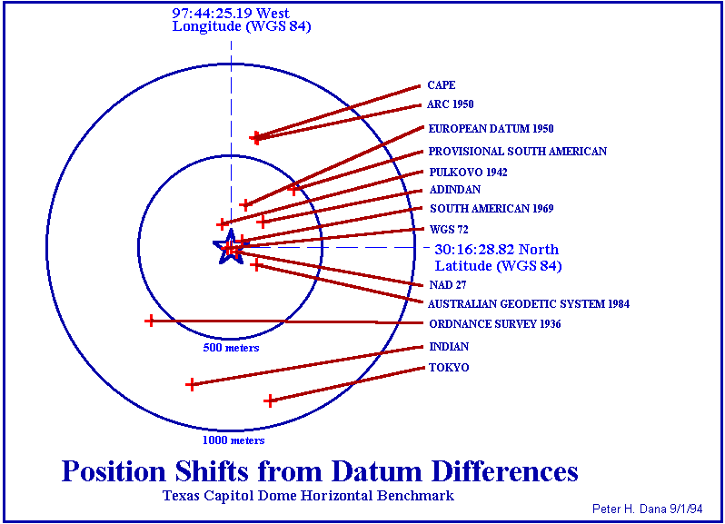
Common Georeferencing Errors
Wrong Datum

Slide 10
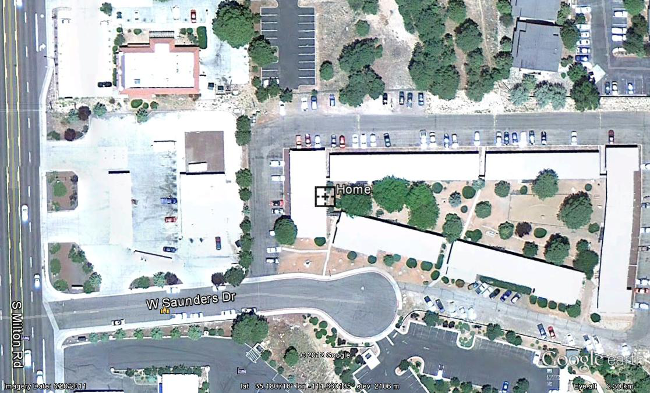
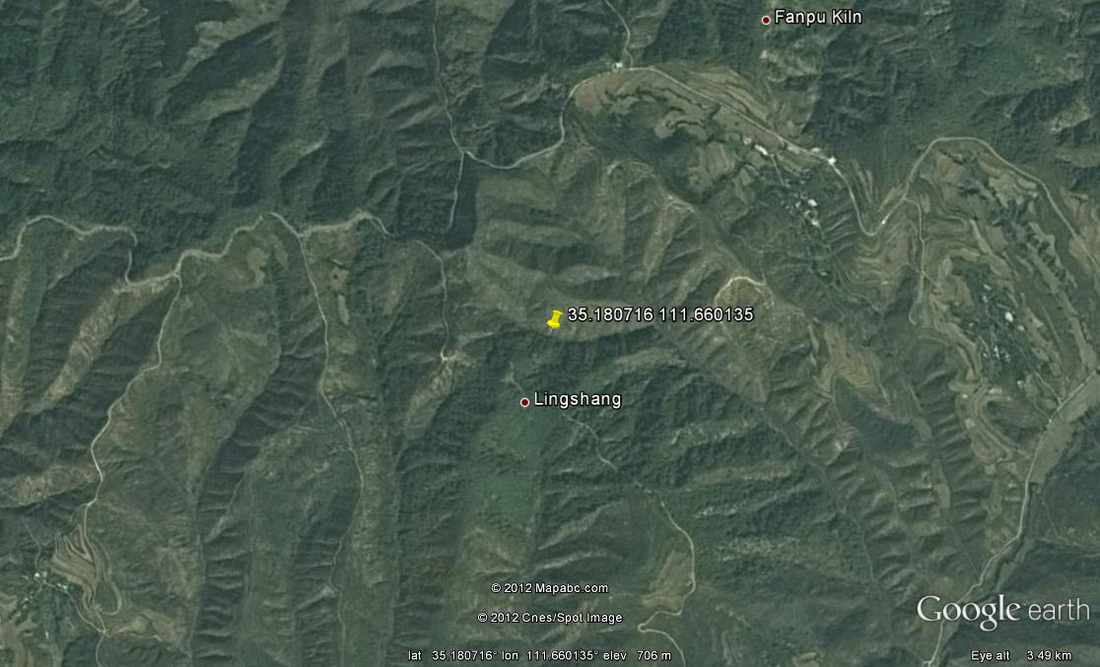
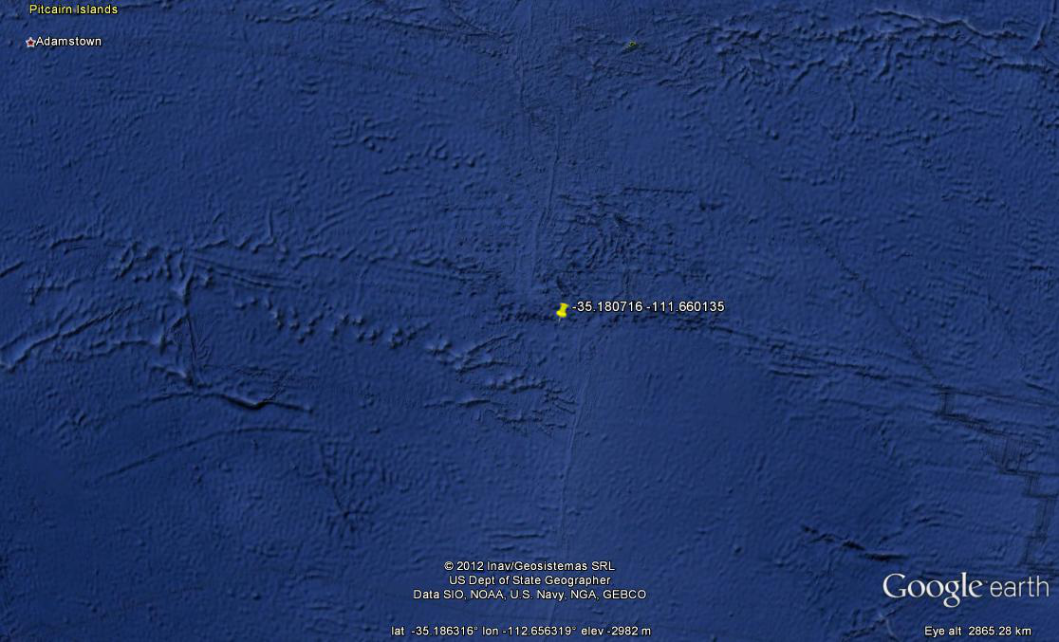
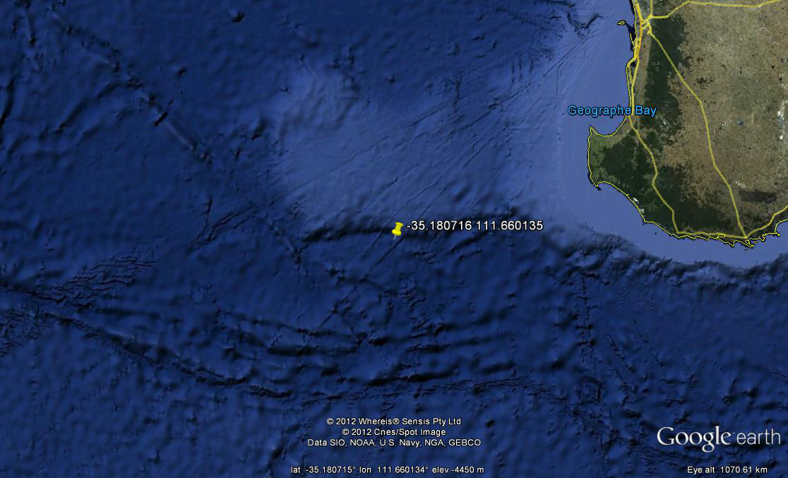
Common Georeferencing Errors
Wrong Hemisphere

