Slide 1
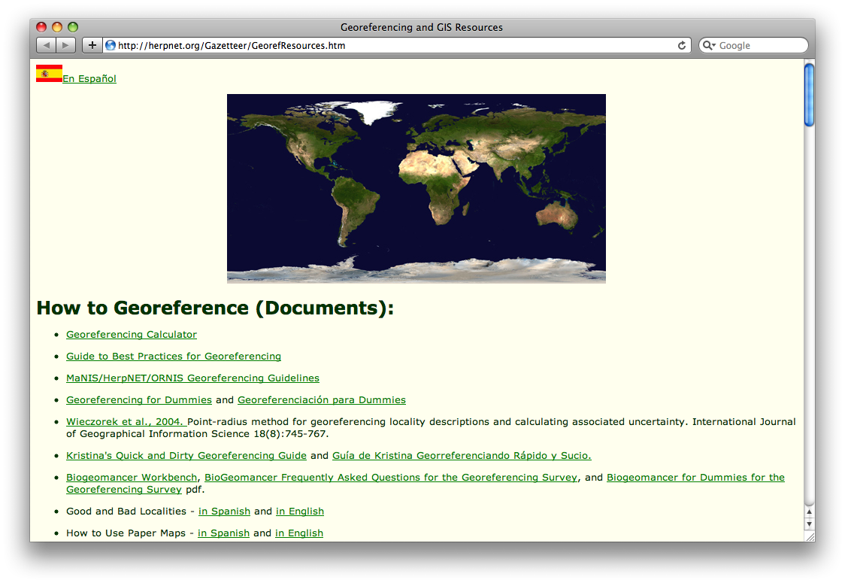
Online resources for georeferencing
http://herpnet.org/Gazetteer/GeorefResources.htm
Notes:
What about unknown datum for UTM?
Online exercises: renewed file
Extent for MTM exercise (datum unknown)?

Slide 2
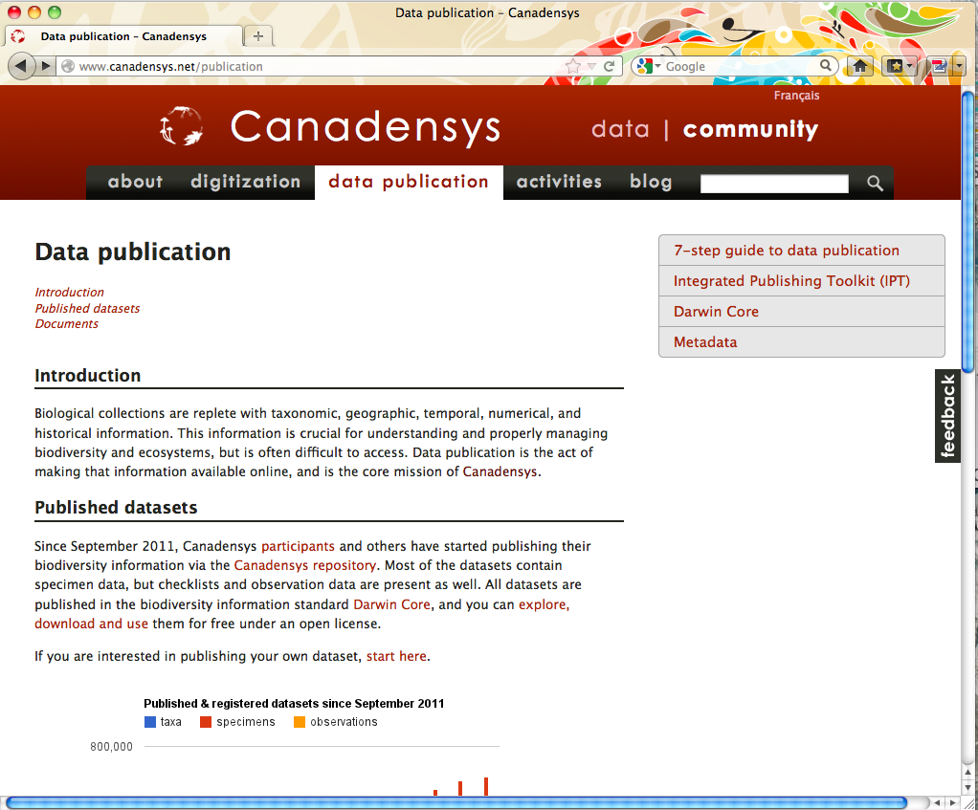
Other georeferencing resources
http://www.canadensys.net/georeferencing

Slide 3
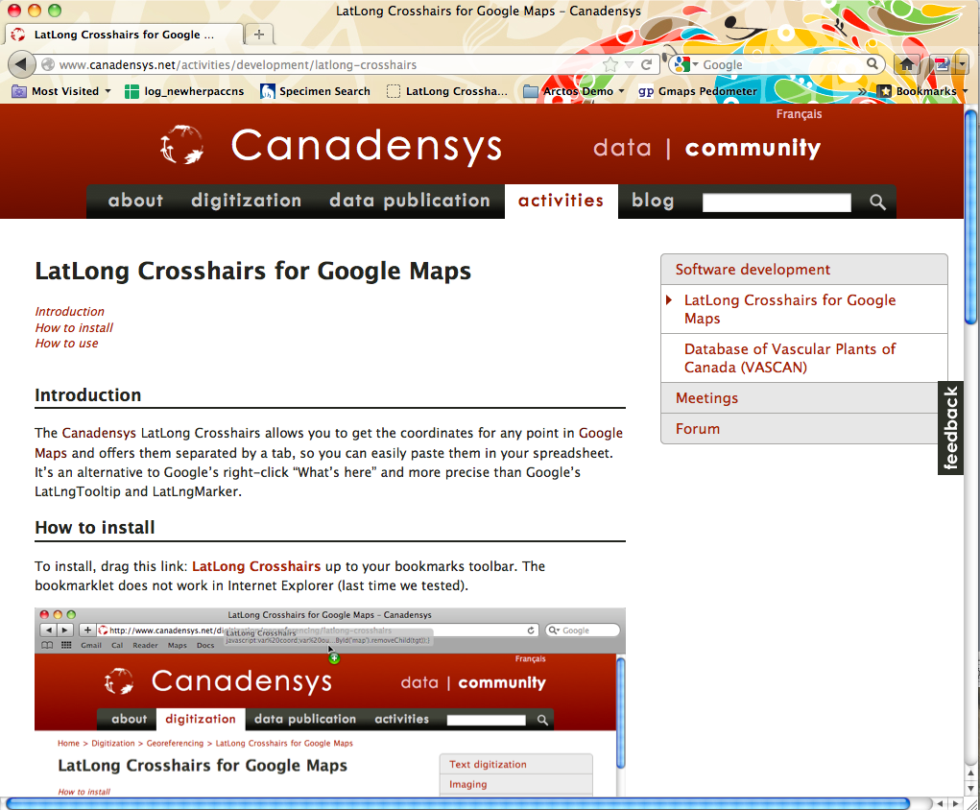
LatLong Crosshairs for Google Maps
http://www.canadensys.net/activities/development/latlong-crosshairs

Slide 4
Google Maps
http://maps.google.com
Web mapping service application by Google
Search & directions
  Free text search, depends on zoom level
  Directions for travelling by car, bike, public transport and foot
  Data compiled from different sources
Maps
  Datum: WGS84
  Views: map, satellite (= aerial photography), terrain, Google Street View + various layers of information
  Data compiled from different sources (indicated at the bottom of each map)

Slide 5
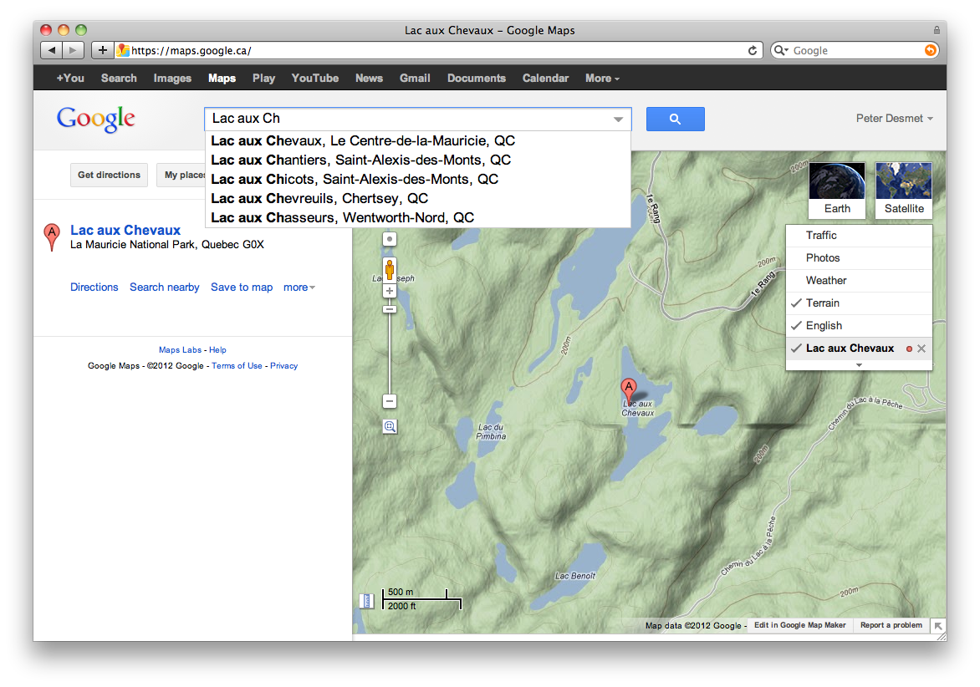
Google Maps – Search
Search with suggestions
Previous searches
Report a problem

Slide 6
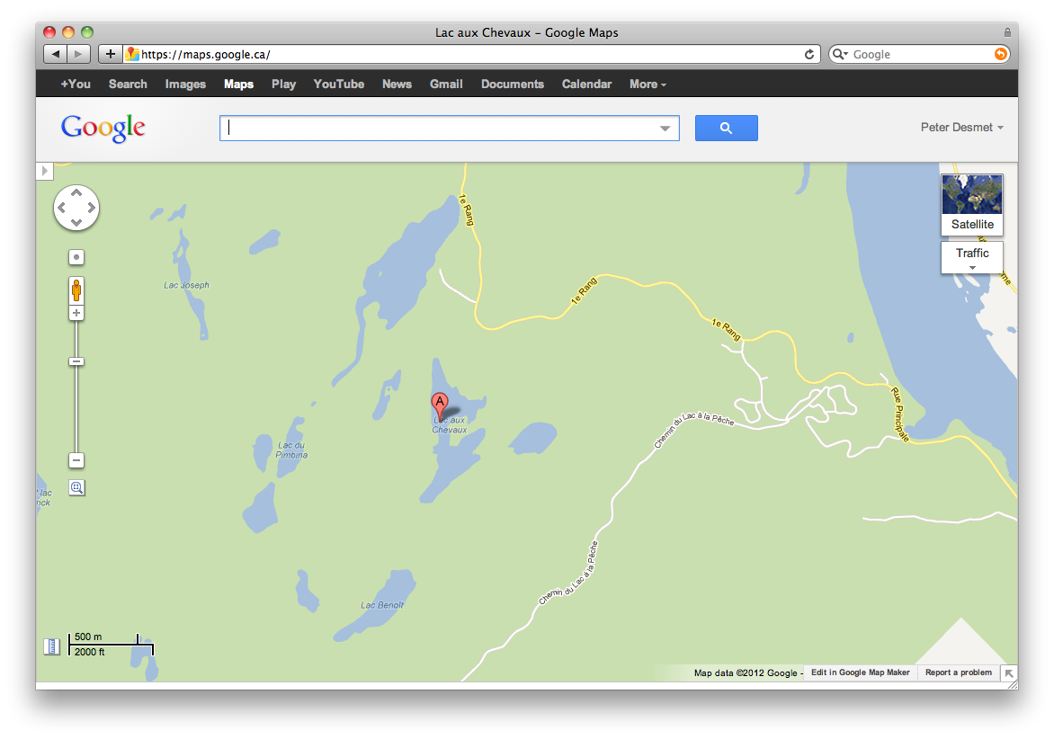
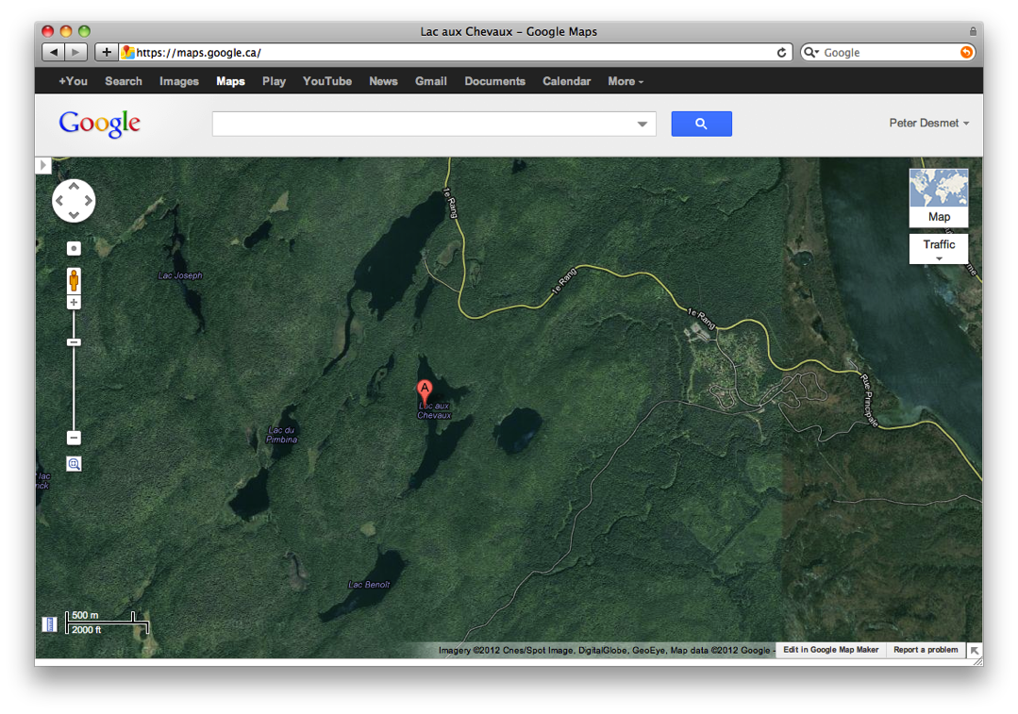
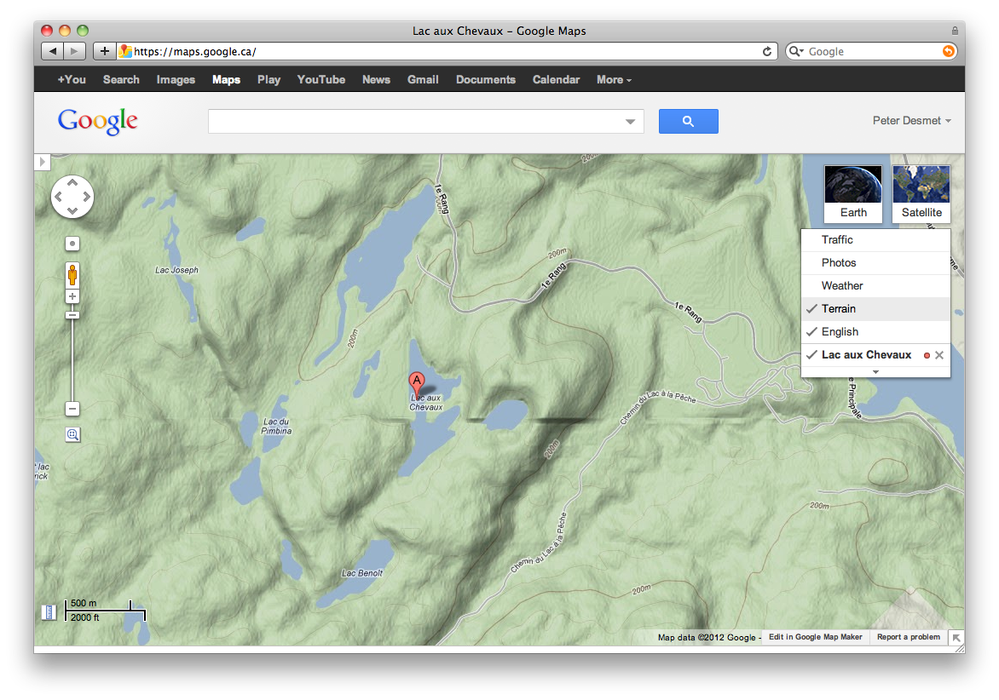
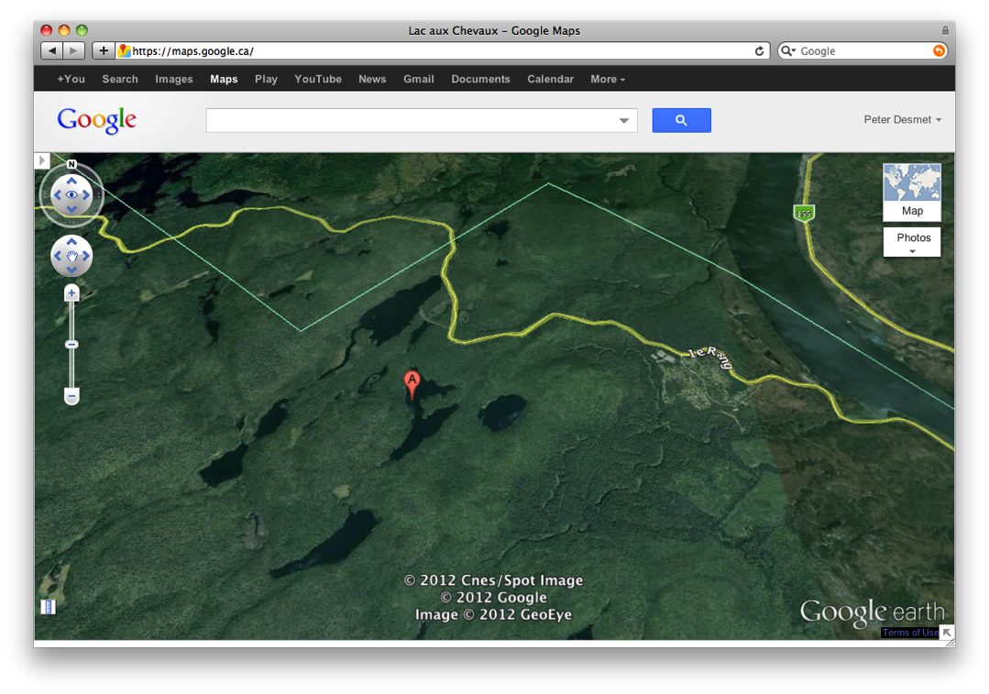
Google Maps – Views
Maps
Satellite
Terrain (under ‘Map’)
Earth (plugin required)

Slide 7
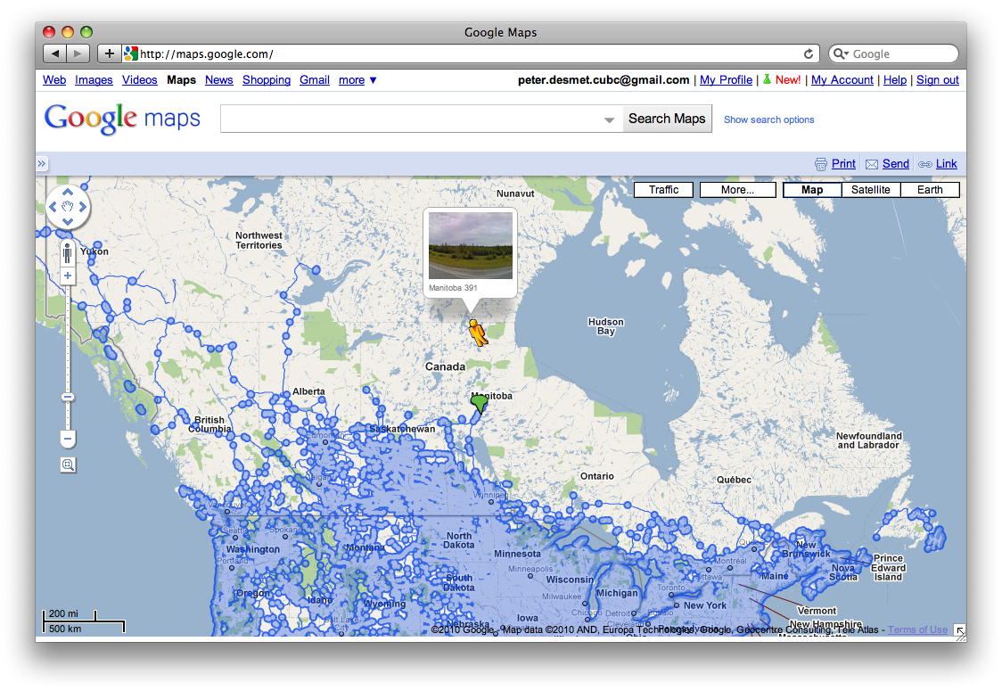
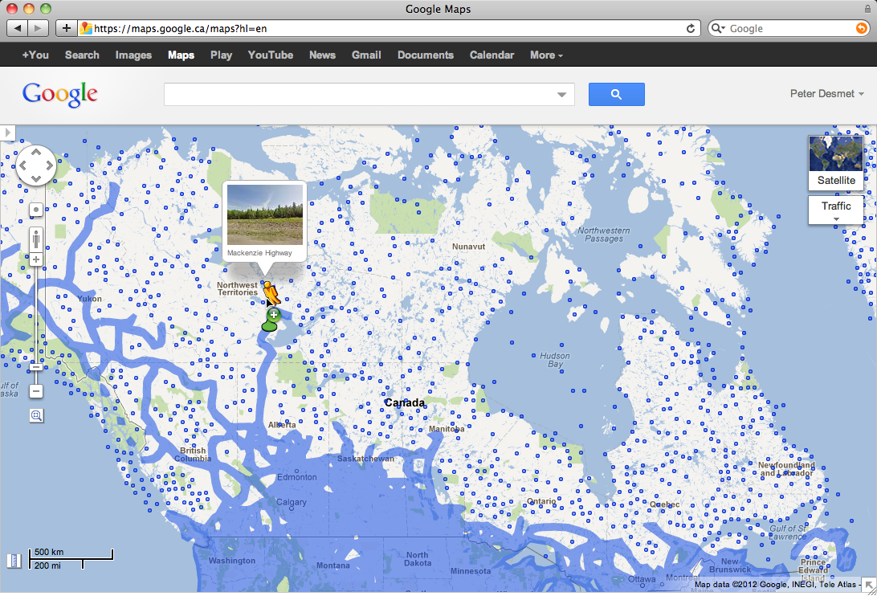
Google Maps – Street View
Street View

Slide 8
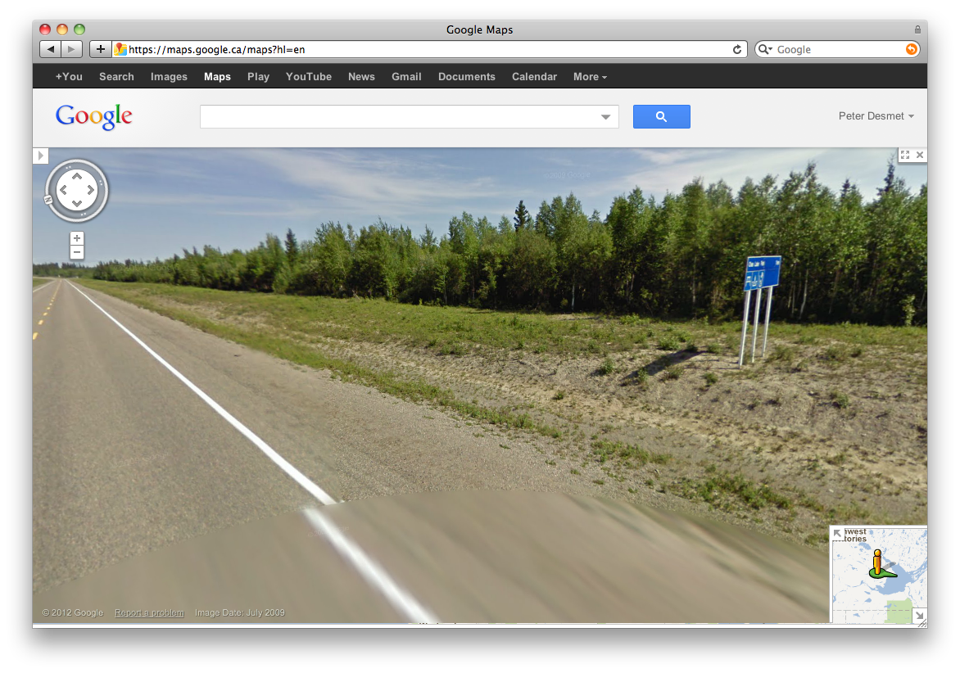
Google Maps – Street View
I collected here

Slide 9
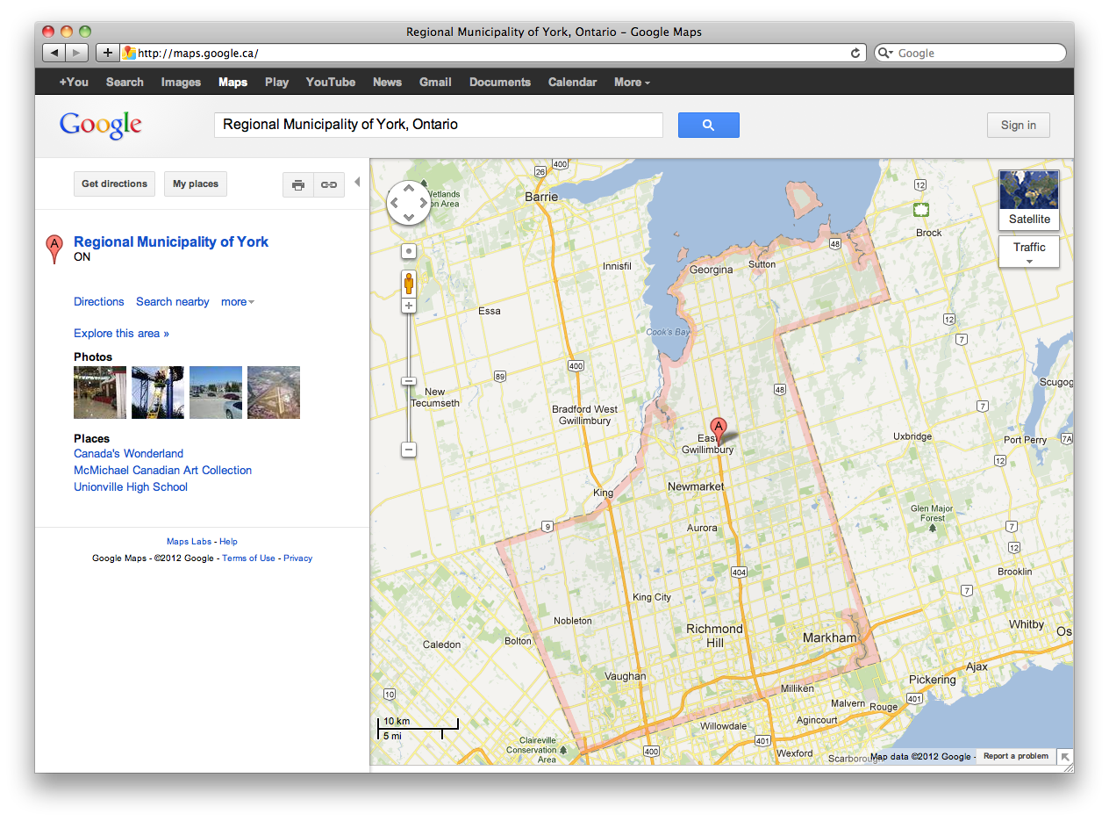
Google Maps – Shapes

Slide 10
Google Maps – Get coordinates
Requires widgets or additional plugins:
  Activate LatLng Marker in Google Maps Labs
  Use this page (French/English): http://bit.ly/universimmedia
  Use the Canadensys LatLong Crosshairs bookmarklet (does not work in Internet Explorer): http://www.canadensys.net/latlong-crosshairs
Use Distance Measurement Tool to measure extent
Use My places to save markers, create maps and share with others (including kml import)

Slide 11
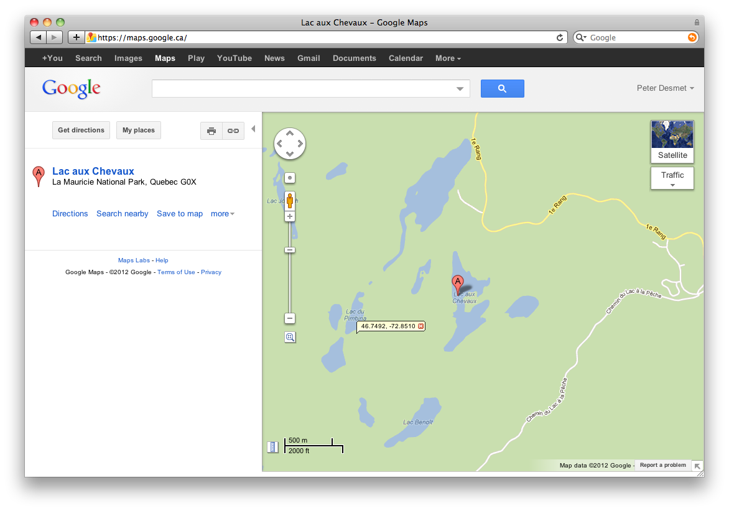
Google Maps – Get coordinates
My places
Google Maps Labs
LatLng Marker
Right-click and‘Drop LatLng Marker’
(activate in ‘Labs’ first)

Slide 12
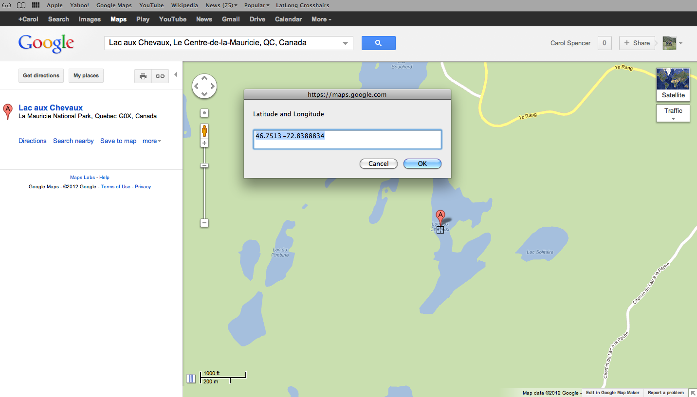
Google Maps – Get coordinates
Canadensys bookmarklet
Click to toggle
Crosshairs
Pan map to change position
Click to get coordinates

Slide 13
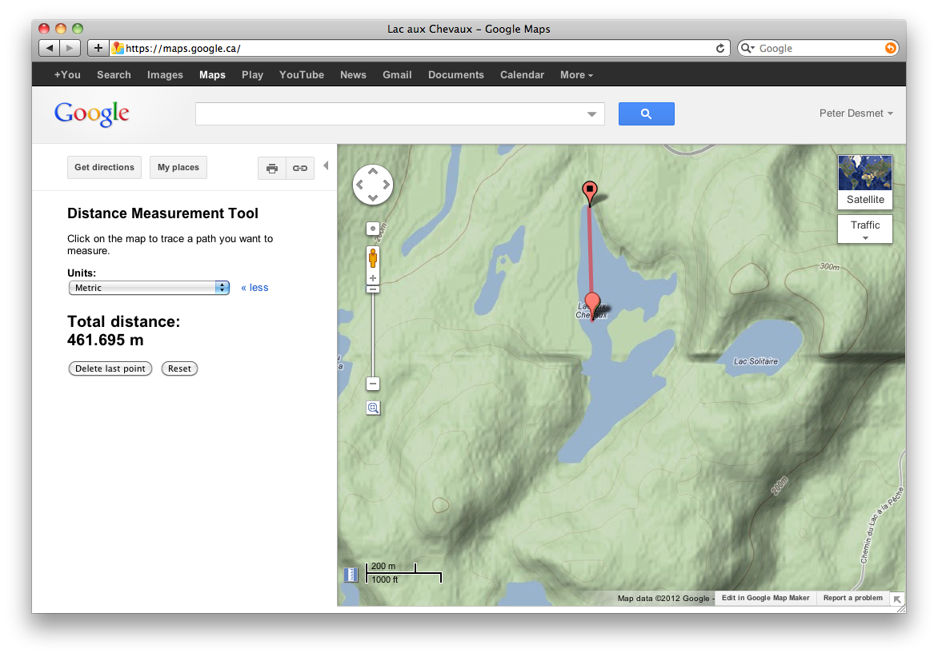
Google Maps – Measure extent
Distance Measurement Tool
(activate in ‘Labs’ first)

Slide 14
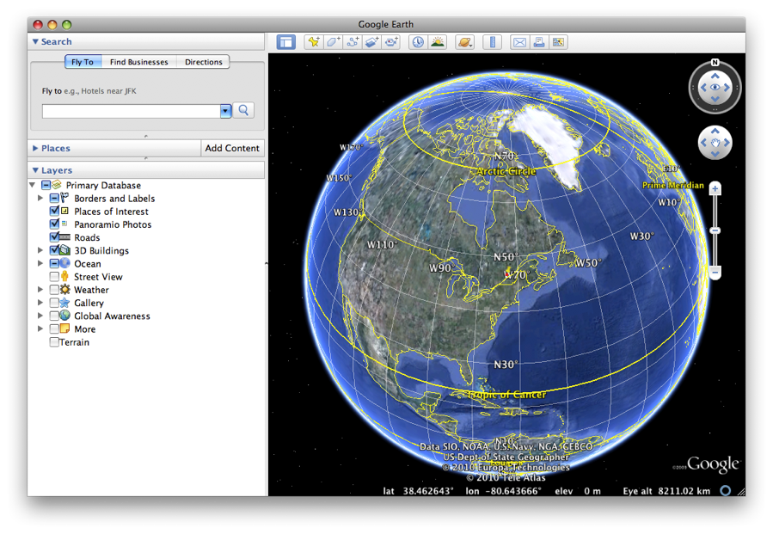
Google Earth
http://earth.google.com
3D globe desktop application
Same data as Google Maps
  Datum: WGS84
  No map or terrain view
Similar functionalities as Google Maps
  Search more limited than Google Maps (no suggestions)
  Right-click and choose ‘Get Info’ for coordinates
  Use ruler to measure extent
  Several coordinate formats
  Numerous information layers (format: kml)

Slide 15
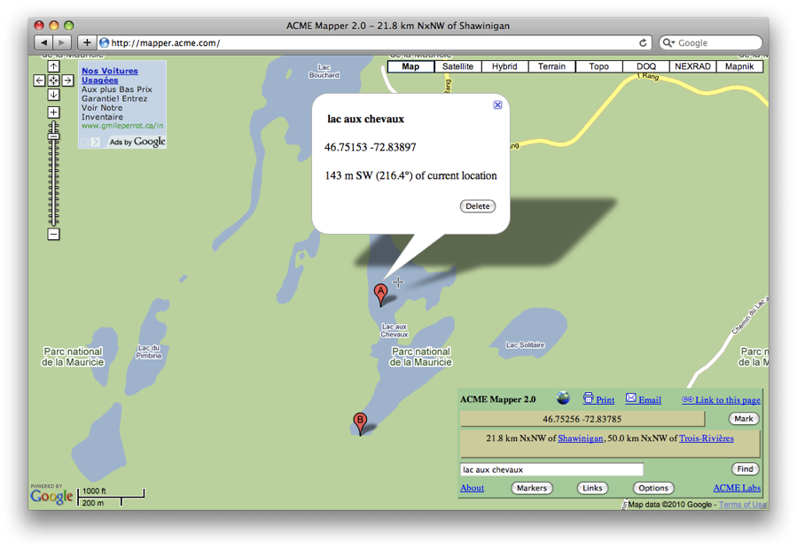
ACME Mapper
http://mapper.acme.com/
Google Maps interface
  Datum: WGS84 (& NAD27)
  Map, satellite, hybrid and terrain
  Topo, DOQ, NEXRAD and Mapnik
  Free text search not dependent on zoom level
  Markers cannot be moved, but new markers can be placed at crosshairs (click ‘Mark’)
  Several coordinate formats for each marker + heading and distance from crosshairs
  Saves all markers automatically

Slide 16
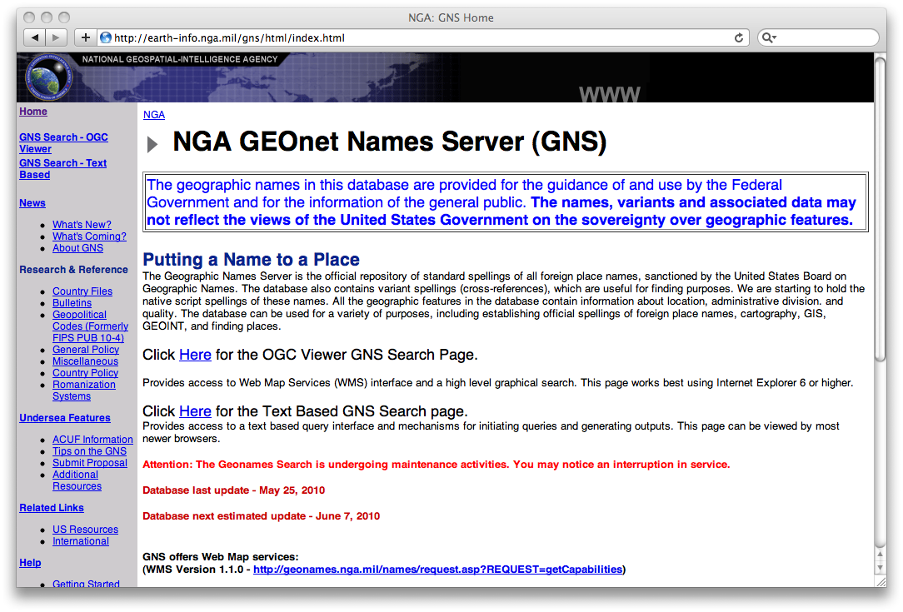
GEOnet Names Server (GNS)
http://earth-info.nga.mil/gns/html/
Worldwide data from NGA and
US BGN
  NIMA = National Imagery and
  Mapping Agency
  Datum: WGS84
  Degrees minutes seconds,
  precision to nearest minute
  Feature type
  Used as a source for many gazetteers
For US data, use Geographic Names Information System (GNIS): http://geonames.usgs.gov/pls/gnispublic/
Notes:
GNS: GeoNet Names Server
NGA: National Geospatial-Intelligence Agency
US BGN: US Board on Geographic Names

Slide 17
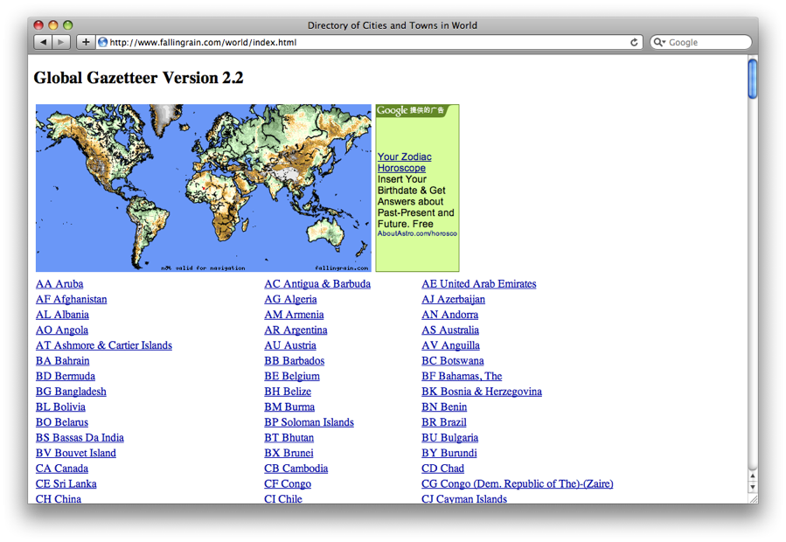
Falling Rain
http://www.fallingrain.com
Worldwide gazetteer for cities
and towns
Great for hard to find localities,
especially outside US
  Datum: WGS84
  Degrees minutes (seconds), based on NIMA
  Browse to find locality (no search)
  Provides hierarchy, alternative names, topo maps, altitude, weather information and location of nearby towns in nautical miles (nm). Use Georef. Calc. to translate nm into kilometers.
Example: Qaryeh-ye Gol`alam, Velayat-e Lowgar, AF

Slide 18
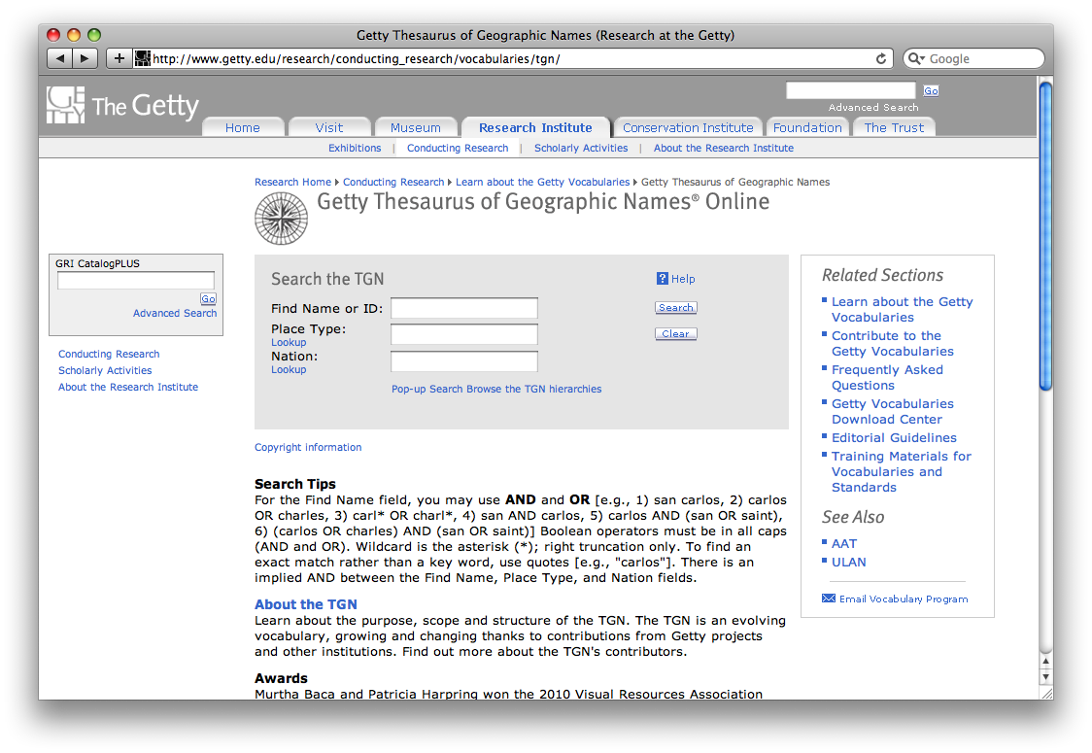
Getty Thesaurus of Geographic Names (TGN)
http://bit.ly/Getty-TGN
Worldwide gazetteer by
The Getty
Useful for finding alternative
and old names
  Feature types
  Geographical hierarchy
  Degrees minutes or no coordinates! Use recent name and search in Google Maps
Example: New Amsterdam, US

Slide 19
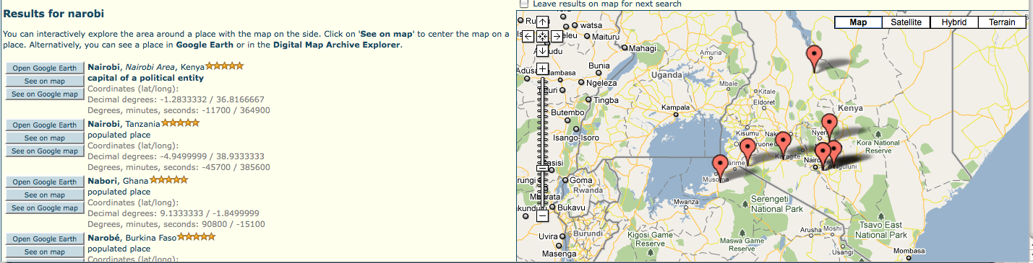
FuzzyG – JRC Fuzzy Gazetteer
http://dma.jrc.it/services/fuzzyg/
Worldwide gazetteer designed for bad spelling.
Useful for finding alternative, doubtful spelling and old names
  Feature types, by continent
  Degrees minutes or no coordinates
  Use recent name and then search in Google Maps
Example: Narobi instead of Nairobi, Africa

Slide 20
UTM & MTM
UTM = Universal Tranverse Mercator
  Divides earth in 60 UTM zones = 6 degrees per zone
  Datum: WGS84 and others
  Notation: Zone Easting Northing = 17N 630084 4833438
  Zone includes hemisphere (17N) or latitude band (17T): MGRS
  Default extent: 30m (if recorded with GPS receiver)
  http://www.dmap.co.uk/utmworld.htm
  UTM Calculator: http://bit.ly/bdxn37
MTM = Modified Tranverse Mercator
  Used in Canada: zones are 3 degrees, different codes, false easting and scale, etc.
  UTM/MTM Calculator: http://bit.ly/utmmtm

Slide 21
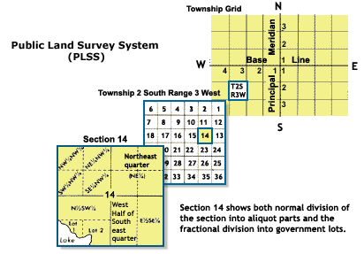
Public Land Survey System (PLSS)
Mainly used in the West, Midwest and some Southern states in the US
Uses Township-Range-Section (TRS):
T13N-R14E-S15, Arizona, Coconino County
Graphical Locator: http://www.esg.montana.edu/gl/
  Translates TRS in decimal degrees
  Datum: NAD27
Determine state and meridian:
http://bit.ly/bSouTw
For extents: http://manisnet.org/
GeorefGuide.html

Slide 22
Other tools
Wikimedia Commons Atlas of the World –
  An organized and commented collection of geographical, political, and historical maps
Statoids: http://www.statoids.com/
  Information about administrative divisions (provinces, counties) and their history, area, population, codes, etc.
  No coordinates!
  Similar: CIA World Factbook http://bit.ly/dDtT1i
GPS Visualizer: http://www.gpsvisualizer.com/
  Use to translate a file with coordinates into kml or a picture
  Similar: http://www.simplemappr.net/ for publications
See http://bit.ly/herpnet-georef-resources for more…

Slide 23
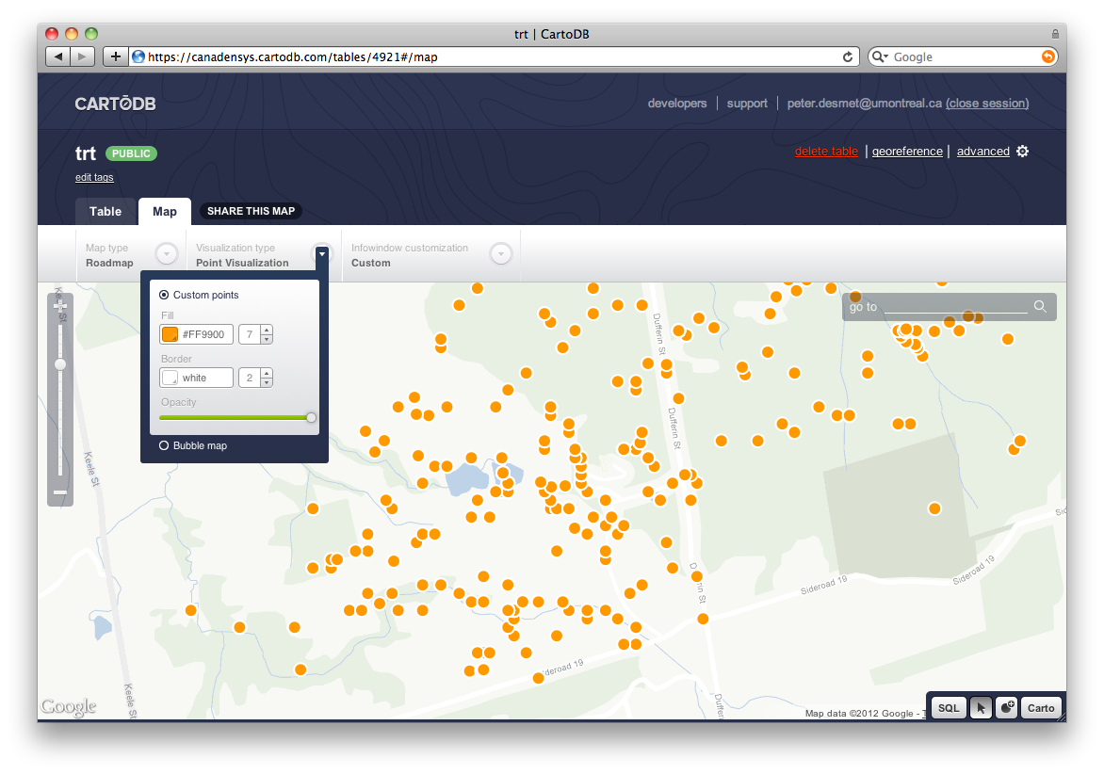
Other tools: CartoDB
http://cartodb.com
Online geospatial database
by Vizzuality
Useful for visualizing your data
  Drag and drop CSV upload
  Easy customization of your map
  Share and embed your map
  Powerful development tools
Free account = 5 tables / 5MB of data

Slide 24
Links
Google Maps: maps.google.com
LatLong crosshairs: www.canadensys.net/latlong-crosshairs
Hard to find localities: www.fallingrain.com
Old & alt. names: bit.ly/Getty-TGN
  UTM map: www.dmap.co.uk/utmworld.htm
UTM calculator: bit.ly/bdxn37
Other tools: bit.ly/herpnet-georef-resources

